Slide 1
Digital Signature
Instructor: Dr. Wei (Lisa) Li
Department of Computer Science, GSU

Slide 2
Motivation
Alice orders a pink car from the car salesmen Bob
After seeing the pink car, Alice states that she has never ordered it:
How can Bob prove towards a judge that Alice has ordered a pink car? (And that he did not fabricate the order himself)
Symmetric cryptography fails because both Alice and Bob can be malicious
Can be achieved with public-key cryptography

Slide 3
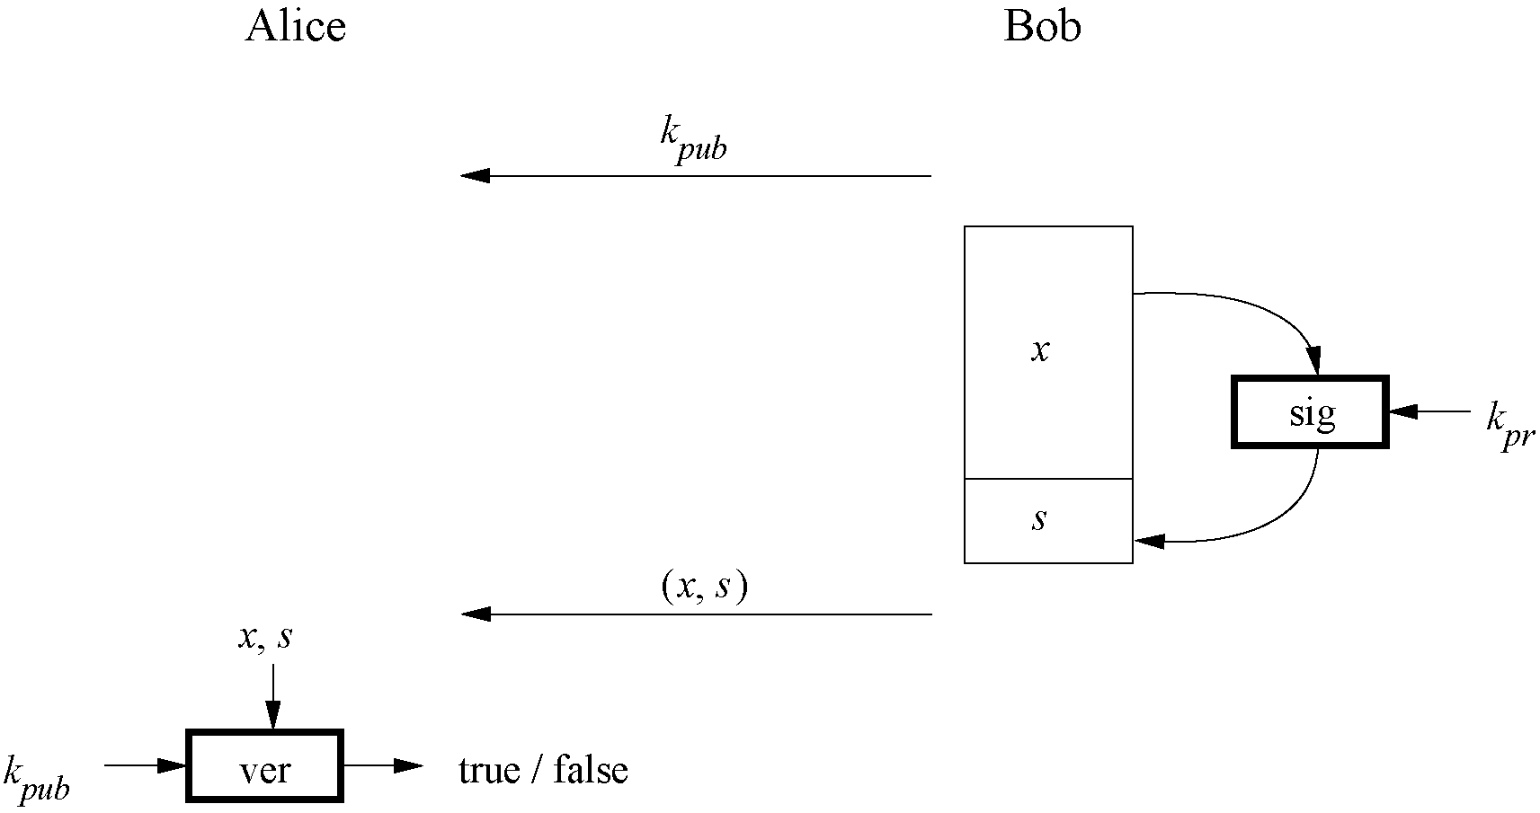
Principle of Digital Signatures

Slide 4
Main Idea
For a given message x, a digital signature is appended to the message (just like a conventional signature).
Only the person with the private key should be able to generate the signature.
The signature must change for every document.
The signature is realized as a function with the message x and the private key as input.
The public key and the message x are the inputs to the verification function.

Slide 5
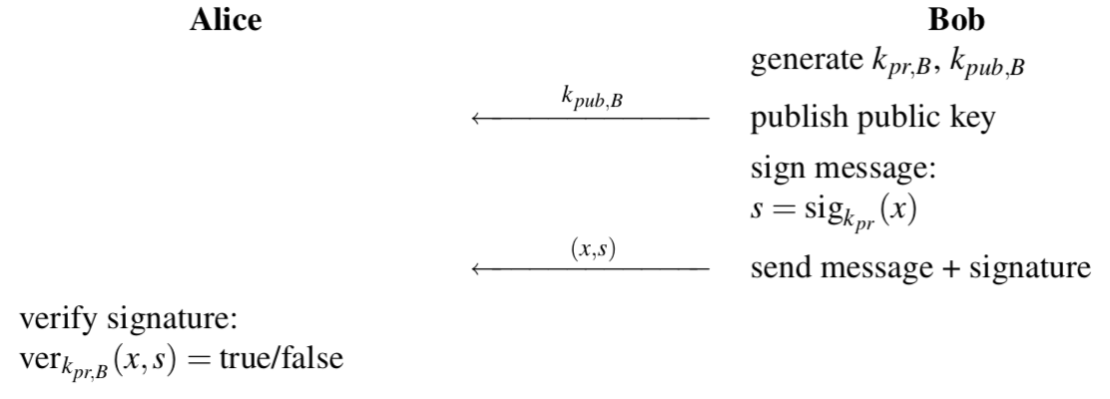
Basic Digital Signature Protocol

Slide 6
Core Security Services
The objectives of a security systems are called security services.
Confidentiality: Information is kept secret from all but authorized parties.
Integrity: Ensures that a message has not been modified in transit.
Message Authentication: Ensures that the sender of a message is authentic. An alternative term is data origin authentication.
Non-repudiation: Ensures that the sender of a message can not deny the creation of the message. (c.f. order of a pink car)

Slide 7
Additional Security Services
Identification/entity authentication: Establishing and verification of the identity of an entity, e.g. a person, a computer, or a credit card.
Access control: Restricting access to the resources to privileged entities.
Availability: The electronic system is reliably available.
Auditing: Provides evidences about security relevant activities, e.g., by keeping logs about certain events.
Physical security: Providing protection against physical tampering and/or responses to physical tampering attempts
Anonymity: Providing protection against discovery and misuse of identity.

Slide 8
RSA digital signature scheme

Slide 9
Main Idea of RSA Signature Scheme
To generate the private and public key: Use the same key generation as RSA encryption.
To generate the signature: “encrypt” the message x with the private key
Append s to message x
To verify the signature: “decrypt” the signature with the public key
If x=x’, the signature is valid
s = sig_{Kpriv}(x) = x^{d} mod n
x’=ver_{Kpub}(s)=s^{e} mod n

Slide 10
RSA Signature Protocol
Alice
Bob
K_{pub}
K_{pr} = d
K_{pub} = (n, e)
Compute signature:
s = sig_{kpr}(x) ≡ x^{d} mod n
(x,s)
Verify signature:
x‘ ≡ s^{e} mod n
If x‘ ≡ x mod n → valid signature
If x‘ ≡ x mod n → invalid signature

Slide 11
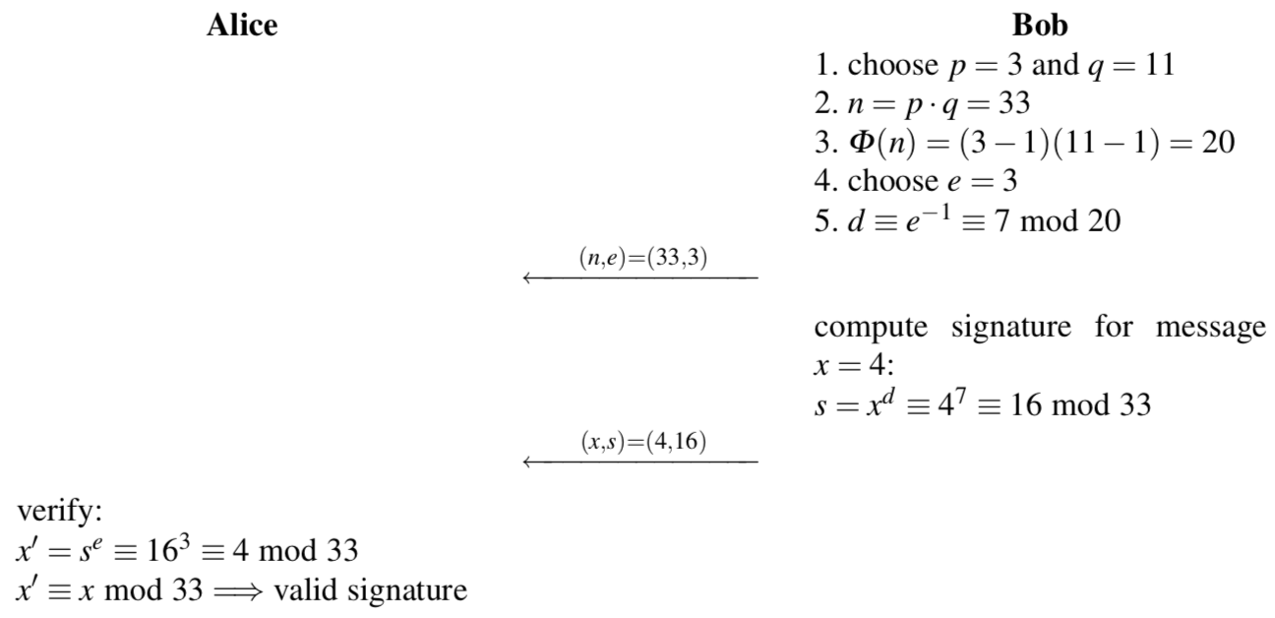
RSA Signature Example

Slide 12
Security and Performance of the RSA Signature Scheme
Security:
The same constrains as RSA encryption: n needs to be at least 1024 bits to provide a security level of 80-bit.
The signature, consisting of s, needs to be at least 1024 bits long
Performance:
The signing process is an exponentiation with the private key and the verification process an exponentiation with the public key.
Signature verification is very efficient as a small number can be chosen for the public key.

Slide 13
Existential Forgery Attack against RSA Digital Signature
Alice
Oscar (generates a valid signature for a random message)
Bob
(n,e)
(n,e)
1. Choose signature:
s in Z_{n}
2. Compute message:
x ≡ s^{e} mod n
(x,s)
Verification:
s^{e} ≡ x‘ mod n
since s^{e} = (x^{d})^{e} ≡ x mod n
→ Signature is valid

Slide 14
Existential Forgery and Padding
An attacker can generate valid message-signature pairs (x,s)
But an attack can only choose the signature s and NOT the message x
Attacker cannot generate messages like „Transfer $1000 into Oscar‘s account“
Formatting the message x according to a padding scheme can be used to make sure that an attacker cannot generate valid (x,s) pairs.
Key Idea: adding a random value prior to the hashed version of x
→ Different signatures are obtained if a message is signed twice

Slide 15
Facts about the Digital Signature Algorithm (DSA)
Federal US Government standard for digital signatures (DSS)
Proposed by the National Institute of Standards and Technology (NIST)
DSA is based on the Elgamal signature scheme
Signature is only 320 bits long
Signature verification is slower compared to RSA

Slide 16
Digital Signature Algorithm (1)
Key generation of DSA:
Generate a prime p with 2¹⁰²³ < p < 2¹⁰²⁴
Find a prime divisor q of p-1 with 2¹⁵⁹ < q < 2¹⁶⁰
Find an integer α with ord(α)=q
Choose a random integer d with 0<d<q
Compute β ≡ α^{d} mod p
The keys are:
k_{pub} = (p,q,α,β)
k_{pr} = (d)

Slide 17
Digital Signature Algorithm (2)
DSA signature generation : Given message x, signature s, private key d and public key (p,q,α,β)
Choose an integer as random ephemeral key k_{E} with 0<k_{E}<q
Compute r ≡ (α^{kE} mod p) mod q
Computes s ≡ (SHA(x)+d ∙ r) k_{E}⁻¹ mod q
The signature consists of (r,s)
SHA denotes the hash function SHA-1 which computes a 160-bit fingerprint of message x, which will be introduce later.

Slide 18
Digital Signature Algorithm (3)
DSA signature verification: Given message x, signature s and public key (p,q,α,β)
Compute auxiliary value w ≡ s⁻¹ mod q
Compute auxiliary value u₁ ≡ w ∙ SHA(x) mod q
Compute auxiliary value u₂ ≡ w ∙ r mod q
Compute v ≡ (α^{u1} ∙ β ^{u2} mod p) mod q
If v ≡ r mod q → signature is valid
If v ≡ r mod q → signature is invalid

Slide 19
DSA: Example
Alice
Bob
Key generation:
choose p = 59 and q = 29
choose α = 3
choose private key d = 7
β = α^{β} = 3⁷ ≡ 4 mod 59
Sign:
Compute has of message H(x)=26
Choose ephermal key k_{E}=10
r = (3¹⁰ mod 59) ≡ 20 mod 29
s = (26 + 7 ∙ 20) ∙ 3) ≡ 5 mod 29
(p, q, α, β)=(59, 29, 3, 4)
(x,(r, s))=(x,20, 5)
Verify:
w ≡ 5⁻¹ ≡ 6 mod 29
u₁ ≡ 6 ∙ 26 ≡ 11 mod 29
u₂ ≡ 6 ∙ 20 ≡ 4 mod 29
v = (3¹¹ ∙ 4⁴ mod 59) mod 29 = 20
v ≡ r mod 29 → valid signature

Slide 20
Security of DSA
To solve the discrete logarithm problem in p the powerful index calculus method can be applied. But this method cannot be applied to the discrete logarithm problem of the subgroup q. Therefore q can be smaller than p.
p | q | hash output (min) | security levels
1024 | 160 | 160 | 80
2048 | 224 | 224 | 112
3072 | 256 | 256 | 128
Standardized parameter bit lengths and security levels for the DSA

Slide 21
Lessons Learned
Digital signatures provide message integrity, message authentication and non-repudiation.
RSA is currently the most widely used digital signature algorithm.
Competitor is the Digital Signature Standard (DSA).
RSA verification can be done with short public keys e. Hence, in practice, RSA verification is usually faster than signing.
DSA has shorter signatures than RSA
In order to prevent certain attacks, RSA should be used with padding.
The modulus of DSA and the RSA signature schemes should be at least 1024-bits long. For true long-term security, a modulus of length 3072 bits should be chosen.

