Slide 1
Hash Function_02
Instructor: Dr. Wei (Lisa) Li
Department of Computer Science, GSU

Slide 2
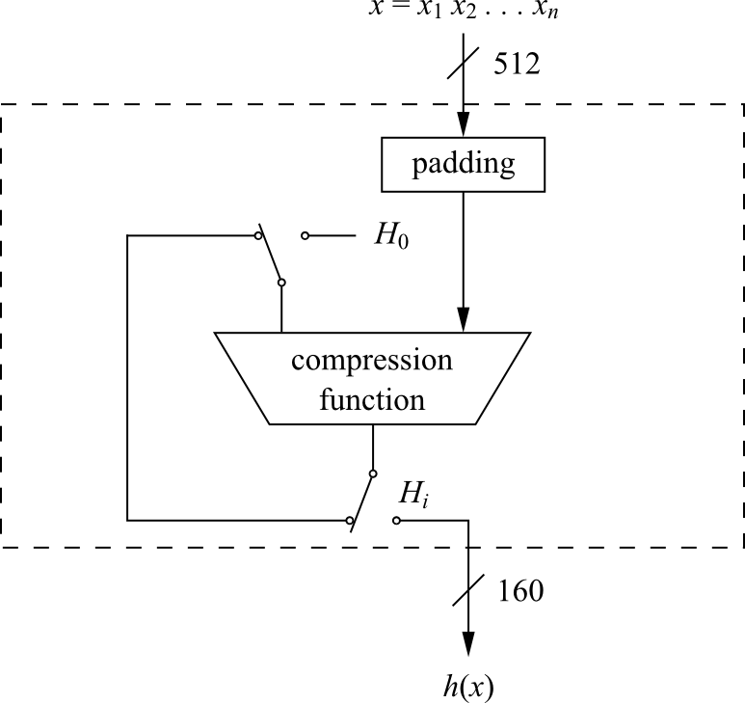
SHA-1: High Level Diagramm
Compression Function consists of 80 rounds which are divided into four stages of 20 rounds each

Slide 3
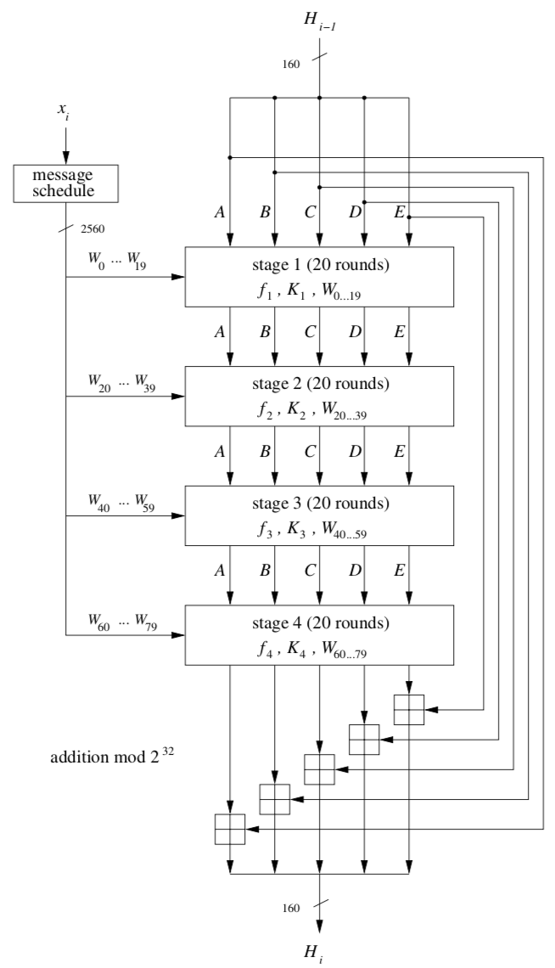
SHA-1: Four Stages
Each stage is composed of 20 rounds, where parts of the message block are processed by the function f_{t} together with some stage-dependent constant K_{t}
The output after 80 rounds is added to the input value H_{i−1} modulo 2³² in word-wise fashion

Slide 4
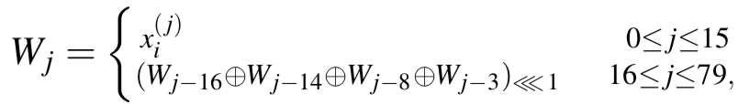
SHA-1: Internal of a round (1)
A message schedule computes a 32-bit word W₀,W₁,...,W₇₉ for each of the 80 rounds
Note: <<<n indicates a circular left shift by n bit positions

Slide 5
SHA-1: Internal of a round (2)
Five working registers of size of 32 bits A, B, C, D, E
A hash value H_{i} consisting of ﬁve 32-bit words H_{i}⁽⁰⁾, H_{i}⁽¹⁾, H_{i}⁽²⁾ , H_{i}⁽³⁾, H_{i}⁽⁴⁾
The hash value holds the initial value H₀, which is replaced by a new hash value after the processing of each single message block.
The ﬁnal hash value H_{n} is equal to the output h(x) of SHA-1.

Slide 6
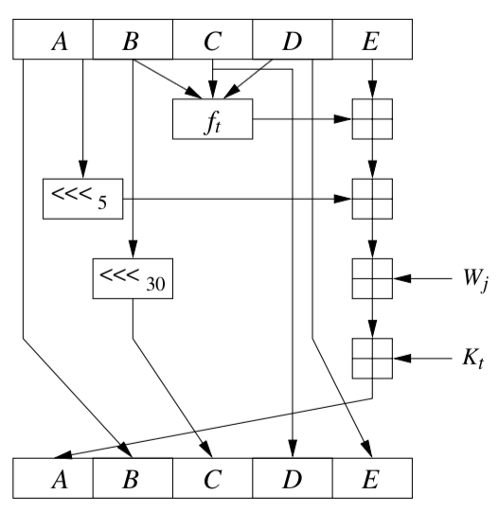
SHA-1: Internal of a round (3)
The operation within round j in stage t is given by

Slide 7
SHA-1: Internal of a round (4)
Every 20 rounds a new function and a new constant are being used
The f_{t} function only uses bitwise Boolean opera- tions, namely logical AND (∧), OR (∨), NOT (top bar) and XOR
These operation are applied to 32-bit variables and are very fast to implement on modern PCs
Stage t | Round j | Constant K_{t} | Function f_{t}
1 | 00…19 | K=5A827999 | f(B,C,D)=(B∧C)∨(¯B∧D)
2 | 20…39 | K=6ED9EBA1 | f(B,C,D)=B⊕C⊕D
3 | 40…59 | K=8F1BBCDC | f(B,C,D)=(B⊕C)∨(B⊕D)∨(C⊕D)
4 | 60…79 | K=CA62C1D6 | f(B,C,D)=B⊕C⊕D

