Slide 1
Course Introduction
Instructor: Dr. Wei (Lisa) Li
Department of Computer Science, GSU

Slide 2
Course Information
CSC 8980: Cryptography
Instructor: Dr. Wei (Lisa) Li
Office Hours: MW 3:30 pm -- 4:30 pm
Office Room: Room 733, 25 Park Place
Email: wli28@gsu.edu
Phone: (404) 413-6658
TA: Suganya Gunanathan
Email: sgunanathan1@student.gsu.edu
Office Hours: TR 3:15 pm – 5:15 pm
Office Room: TBA

Slide 3

Textbook (required)
“Understanding Cryptography”
by Dr.-Ing. Christof Paar
and Dr.-Ing. Jan Pelzl,
Springer, 2010.

Slide 4
Further Reading (optional)
Addition to Understanding Cryptography
A.Menezes, P. van Oorschot, S. Vanstone, Handbook of Applied Cryptography. CRC Press, October 1996.
History of Cryptography (great bedtime reading)
S. Singh, The Code Book: The Science of Secrecy from Ancient Egypt to Quantum Cryptography, Anchor, 2000.
D. Kahn, The Codebreakers: The Comprehensive History of Secret Communication from Ancient Times to the Internet. 2nd edition, Scribner, 1996.

Slide 5
Course Policy
Grading Policy:
Attendance 10%
Homework Assignment 30%
Quiz (TBA) 30%
Final Project (TBA) 30%
Late-Submission Policy
For each late submission, 10% will be deducted from your score.
Assignments will NOT be accepted after one week

Slide 6
Course Policy (cont.)
Make-Up Quiz
Make up quiz will be given only for absences discussed with the instructor prior to the exam. If no arrangements are made, your grade will be a ZERO.

Slide 7
What is security?
What should be considered to ensure security?

Slide 8
Security vs. Privacy
Security
Privacy
Confidentiality: data is safely
stored without unauthorized
access and use
Collection of personal information
Access to personal information
Integrity: data is reliable and accurate
Protect personal information
Availability: data is available for use when it is needed
Using and disclosing personal information in unauthorized manner
Accountability: malicious behavior can be traced and detected
Data quality

Slide 9
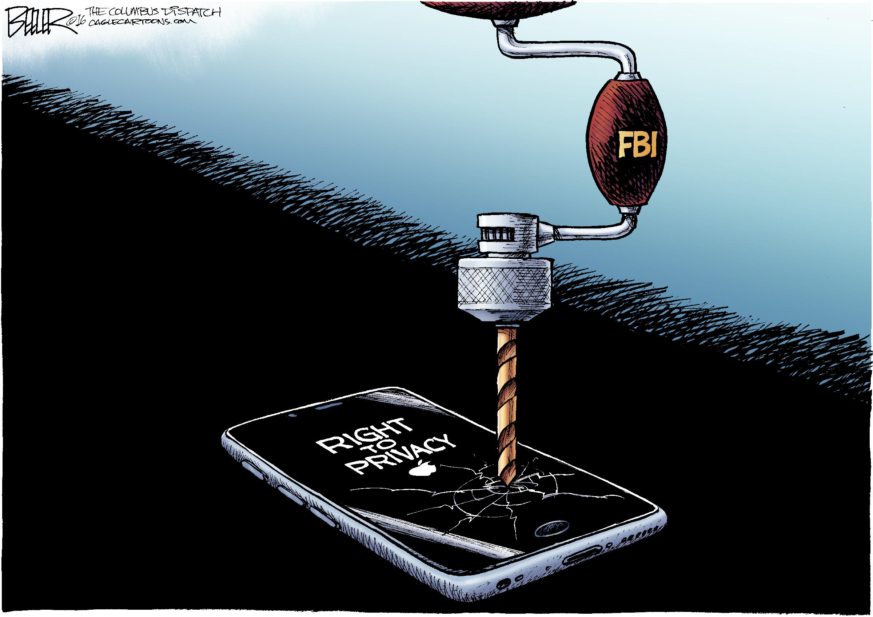
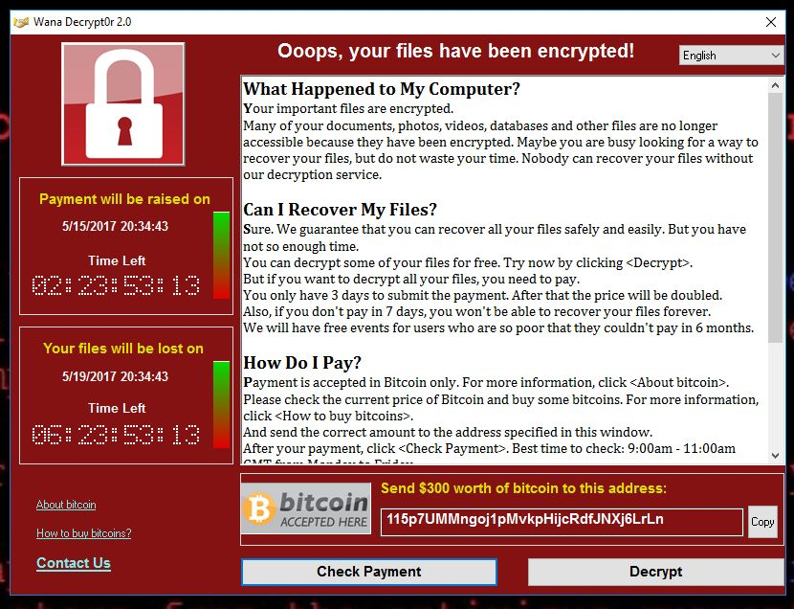
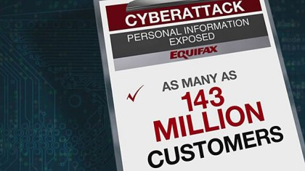
Security & Privacy in Practice
Notes:
The legal tussle between Apple and the U.S. Federal Bureau of Investigation (FBI) over access to the iPhone used by a shooter in last year's San Bernardino attacks
Hospitals, schools, companies and governments around the world were assessing the damage Saturday after a massive cyberattack hit almost 100 countries, infecting computers with malware that demanded ransom payments.
One of the largest security breaches ever has come to light today as Equifax revealed attackers used an exploit on its website to access records for 143 million US citizens (for reference, the US has a population for 323 million or so, that's about 44 percent).

Slide 10
Security & Privacy Issues
What to happen?
unauthorized access, malicious code, data breach…
Where to happen?
email communication, internet/networks, could/edge/fog computing, big data, computer/system…
What result?
privacy leakage, system collapse, economic loss…

Slide 11
What can we do?
How can we do?

Slide 12
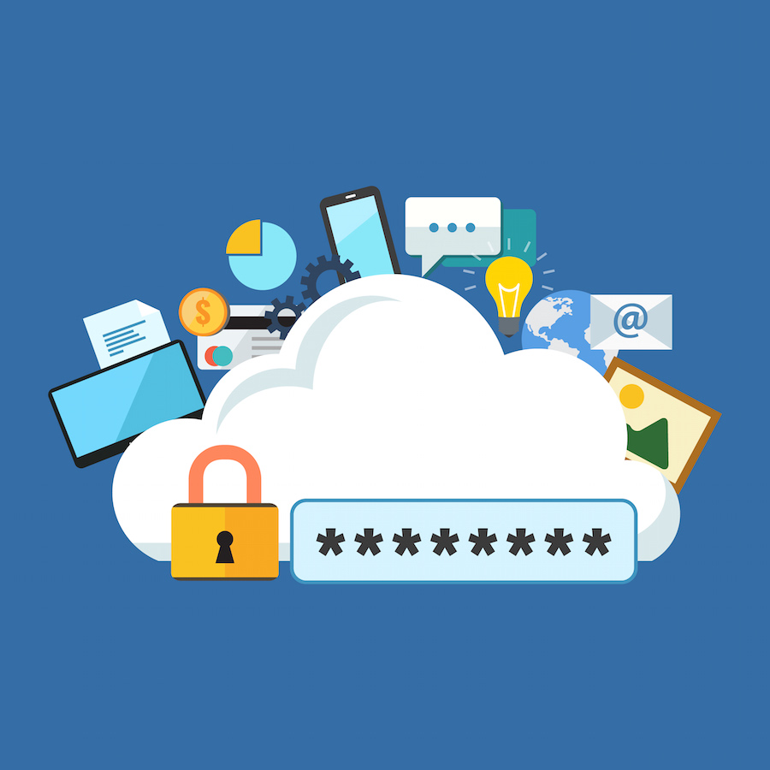
What & Why Cryptography?
“Science of secret writing with the goal of hiding the meaning of a message”
“Art of writing and solving codes”

Slide 13
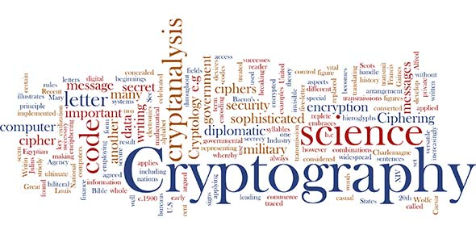
What to Cover in This Course?
What are the basics of cryptography?
How to encrypt and decrypt data, i.e., crypto algorithm?
How secure a crypto algorithm is?

Slide 14
Overview
Cryptology
Cryptography
Cryptanalysis
Symmetric Ciphers
Asymmetric Ciphers
Protocols
Block Ciphers
Stream Ciphers

Slide 15
Course Outline
This course is intended to provide a general introduction to cryptography. This introductory course will cover a number of fundamental concepts and schemes in cryptography, including:
Symmetric cryptography
Stream ciphers
Block ciphers,
Data encryption standard (DES)
Advanced encryption standard (AES)

Slide 16
Course Outline (cont.)
Public-key cryptography
RSA cryptosystem
Digital signatures
Hash functions
Message authentication codes (MACs)
Key establishment
Other selected topics…

Slide 17
Objectives & Outcomes
Upon successful completion of this course, students should have the knowledge to:
Understand the basic concepts of cryptography.
Understand the main ideas, advantages, and disadvantages of various cryptosystems.
Understand various cryptosystems implementations and applications.

