Slide 1
Data Encryption Standard_02
Instructor: Dr. Wei (Lisa) Li
Department of Computer Science, GSU

Slide 2
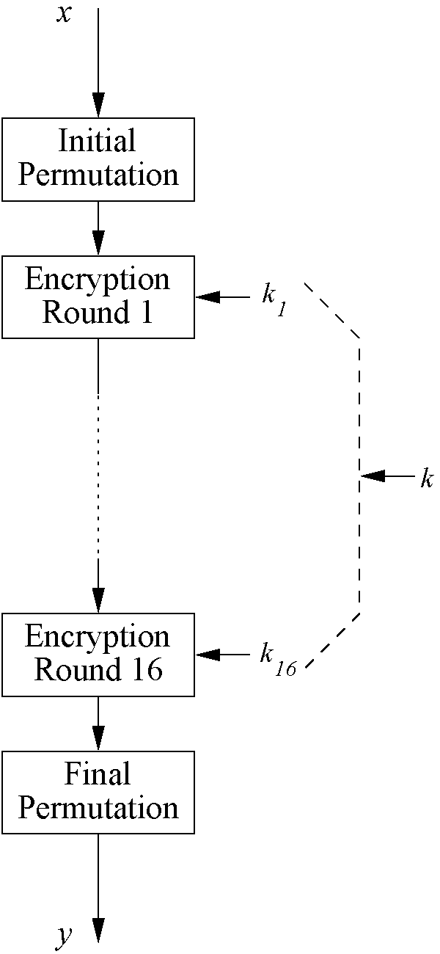
Overview of DES
Encrypts blocks of size 64 bits
Uses a key of size 56 bits
Symmetric cipher: uses same key for encryption and decryption
Uses 16 rounds which all perform the identical operation
Different subkey in each round derived from main key

Slide 3
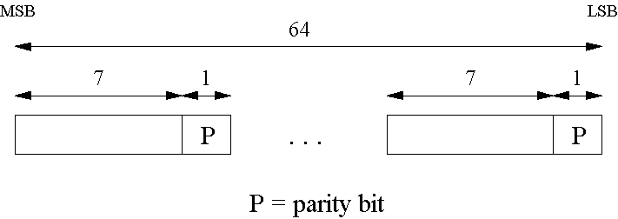
Key Schedule (1)
Derives 16 round keys (or subkeys) k_{i} of 48 bits each from the original 56 bit key.
The input key size of the DES is 64 bit: 56 bit key and 8 bit parity:
Notes:
For applications with long term security needs, 128 bit keys should be considered. For thwarting against attacks with to-be-developed quantum computers, 256 bits are believed to be appropriate. Since a longer key usually does no carry a performance penality for symmetric algorithms, it is a prudent choice to use ciphers with a key lengths of around 128 bits.

Slide 4
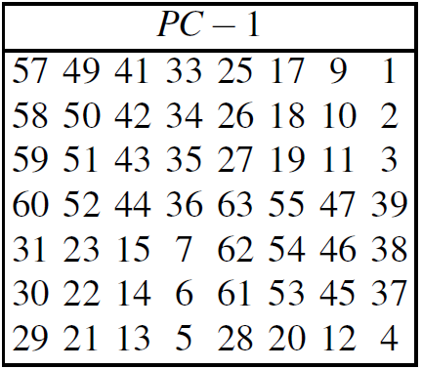
Key Schedule (2)
Parity bits are removed in a first permuted choice PC-1 (note that the bits 8, 16, 24, 32, 40, 48, 56 and 64 are not used at all)
Notes:
For applications with long term security needs, 128 bit keys should be considered. For thwarting against attacks with to-be-developed quantum computers, 256 bits are believed to be appropriate. Since a longer key usually does no carry a performance penality for symmetric algorithms, it is a prudent choice to use ciphers with a key lengths of around 128 bits.

Slide 5
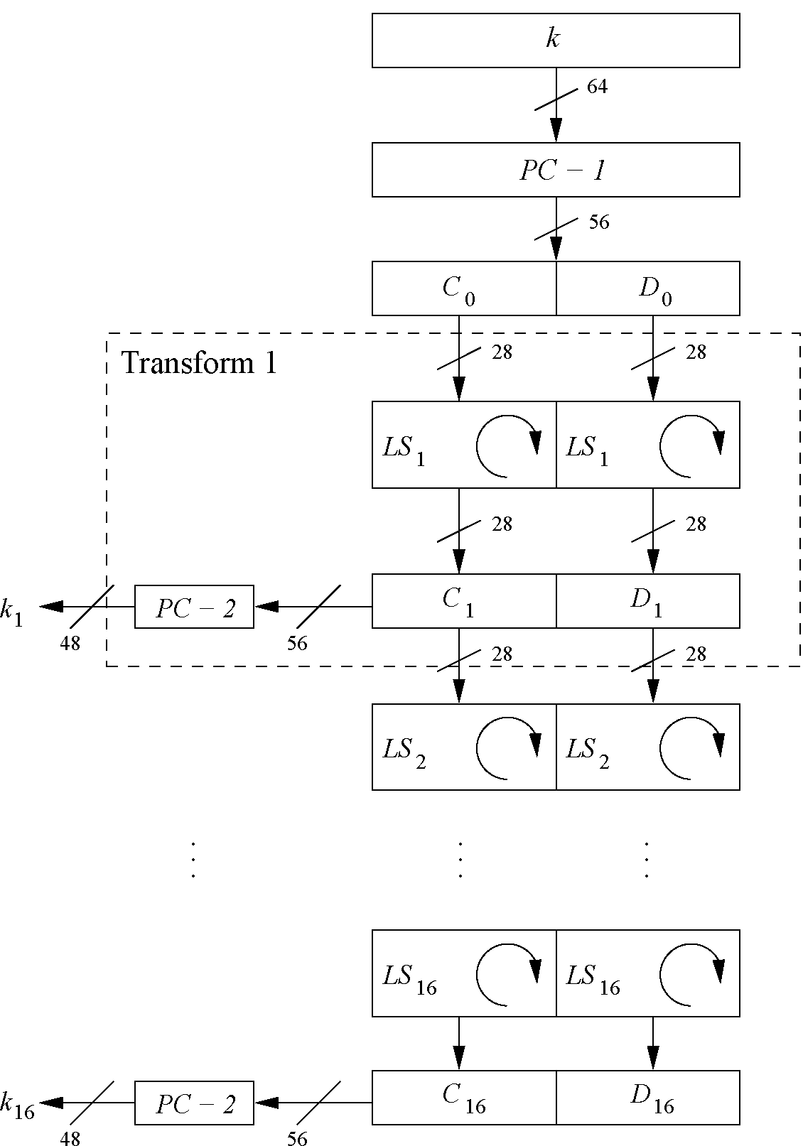
Key Schedule (3)
Split key into two 28-bit halves C₀ and D₀
In rounds i = 1, 2, 9 ,16, the two halves are each rotated left by one bit.
In all other rounds where the two halves are each rotated left by two bits.
Notes:
For applications with long term security needs, 128 bit keys should be considered. For thwarting against attacks with to-be-developed quantum computers, 256 bits are believed to be appropriate. Since a longer key usually does no carry a performance penality for symmetric algorithms, it is a prudent choice to use ciphers with a key lengths of around 128 bits.

Slide 6
Key Schedule (4)
In each round i permuted choice PC-2 selects a permuted subset of 48 bits of C_{i} and D_{i} as round key k_{i}, i.e. each k_{i} is a permutation of k
Select 24 bits from left half and 24 bits from right
Notes:
For applications with long term security needs, 128 bit keys should be considered. For thwarting against attacks with to-be-developed quantum computers, 256 bits are believed to be appropriate. Since a longer key usually does no carry a performance penality for symmetric algorithms, it is a prudent choice to use ciphers with a key lengths of around 128 bits.

Slide 7
Key Schedule (5)
Each round key is a selection of 48 permuted bits of the input key k
Key schedule realizes 16 permutations systematically
Each of the 56 key bits is used in different round
Each bit is used in approximately 14 of the 16 round keys
Note: The total number of rotations: 4 x 1 + 12 x 2 = 28
→ D₀ = D₁₆ and C₀ = C₁₆

Slide 8
Rerview of DES
Encrypts blocks of size 64 bits
Uses a key of size 56 bits
Symmetric cipher: uses same key for encryption and decryption
Uses 16 rounds which all perform the identical operation
Different subkey in each round derived from main key

Slide 9
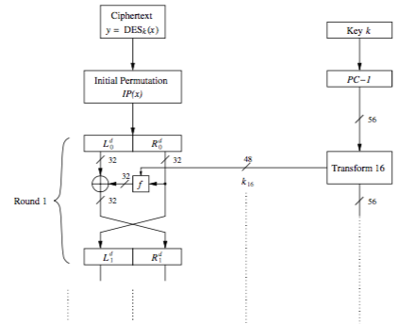
Decryption: Feistel Networks (1)
In DES, decryption function reverses encryption function in a round-by-round manner

Slide 10
Decryption: Feistel Networks (2)
Generate the same 16 round keys in reverse order, e.g.,
in round 1, subkey 16 is used
in round 2, subkey 15 is used

Slide 11
Decryption: Feistel Networks (3)
At initial stage:

Slide 12
Decryption: Feistel Networks (4)
In round 1, we have

Slide 13
Decryption: Feistel Networks (5)
Similarly, in each round i, we have:

Slide 14
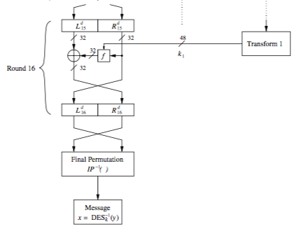
Decryption: Feistel Networks (6)
At the end of decryption, the initial permutation is reversed:

Slide 15
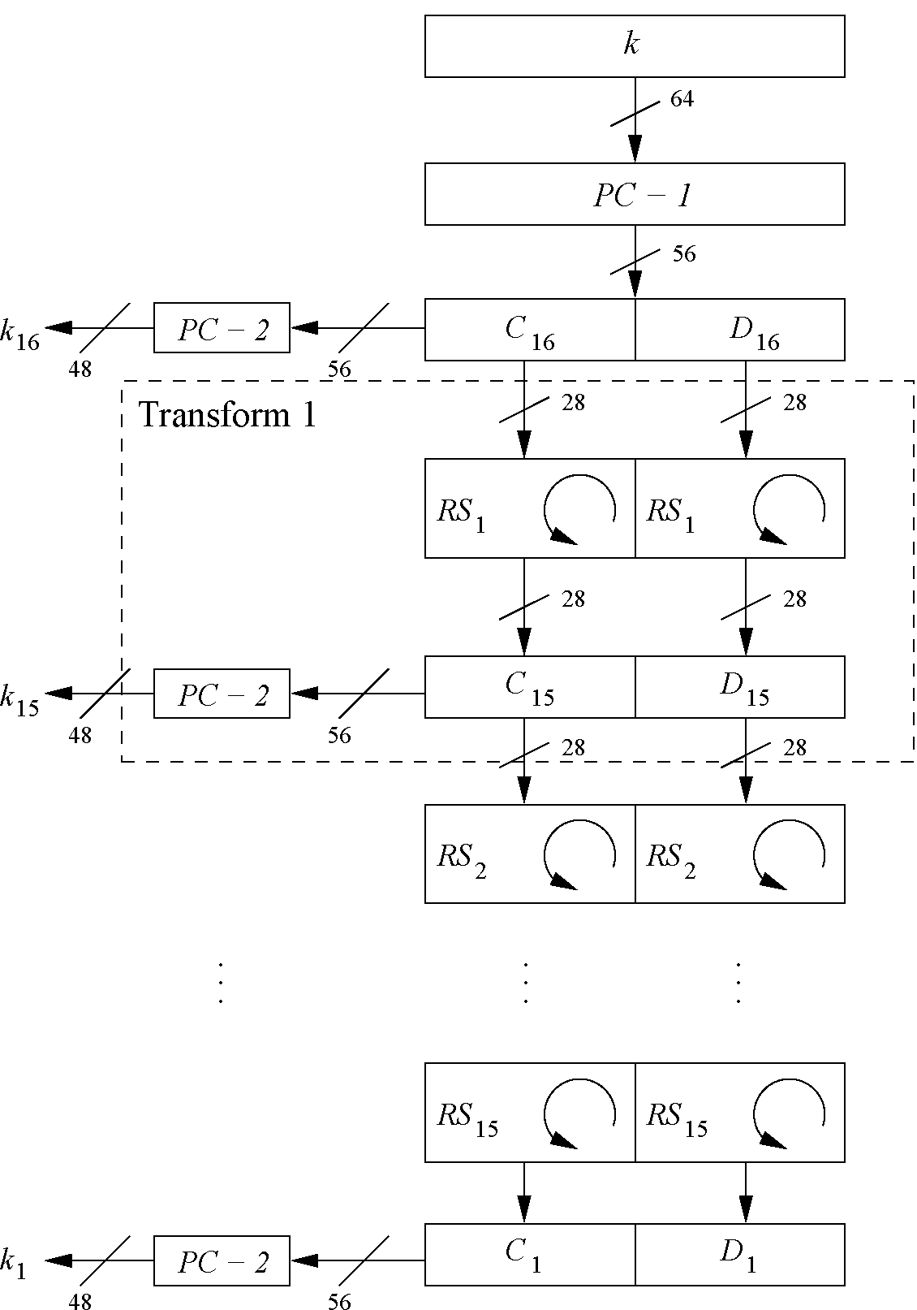
Reversed Key Schedule
As D₀=D₁₆ and C₀=C₁₆, round 1 key can be generated by applying PC-2 right after PC-1 (no rotation here!)
All other rotations of C and D can be reversed to reproduce the other round keys resulting in:
No rotation in round 1.
One bit rotation to the right in rounds 2, 9 and 16
Two bit rotations to the right in all other rounds

Slide 16
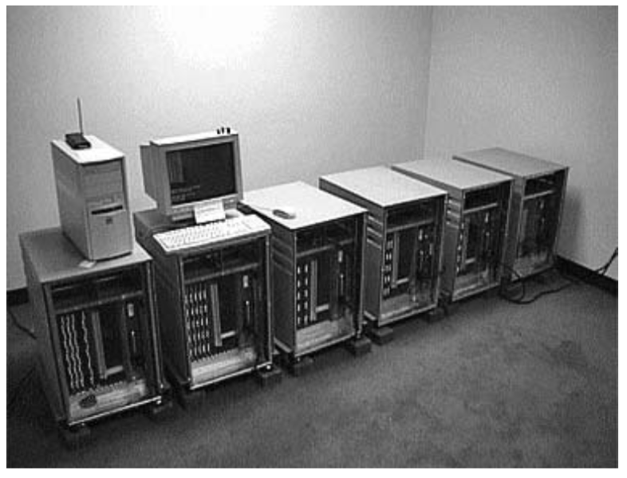
Security of DES (1)
After proposal of DES two major criticisms arose:
Key space is too small (2⁵⁶ keys)
S-box design criteria have been kept secret: Are there any hidden analytical attacks (backdoors), only known to the NSA?
Exhaustive key search:
For a given pair of plaintext-ciphertext
(x, y) test all 2⁵⁶ keys until the condition
DES_{k}⁻¹(x)=y is fulfilled. ⇒ Relatively easy given today’s
computer technology!
Notes:
The major weakness of the method is that each plaintext symbol always maps to the same ciphertext symbol. That means that the statistical properties of the plaintext are preserved in the ciphertext. For practical attacks, the following properties of language can be exploited:
Determine the frequencies of every ciphertext letter. The frequency distribution (even of relatively short pieces of encrypted text) will be close to that of the given language in general. In particular, the most frequent letters (for instance, in English: „e“ is the most frequent one with about 13%, „t“ is the second most frequent one with about 9%, „a“ is the third most frequent one with about 8%, ...) can often easily be spotted in ciphertext.
The method above can be generalized by looking at pairs (or triples, or quadruples, or ...) of ciphertext symbols. For instance, in English (and German and other European languages), the letter „q“ is almost always followed by a „u“. This behavior can be exploited for detecting the substitution of the letter „q“ and the letter „u“.
If we assume that word separators (blanks) have been found (which is often an easy task), one can often detect frequent short words such as „the“, „and“, ... , which leaks all the letters in the words involved in those words

Slide 17
Security of DES (2)
Analytical Attacks:
Confusion introduced by XOR operation (substitution)
Nonlinear relationship between outputs and inputs through S-boxes
Diffusion caused by expansion, S-boxes, and permutation P in each round
→
DES is highly resistent to both differential and linear cryptanalysis, which have been published years later than the DES. This means IBM and NSA had been aware of these attacks for 15 years! So far there is no known analytical attack which breaks DES in realistic scenarios.
Notes:
The major weakness of the method is that each plaintext symbol always maps to the same ciphertext symbol. That means that the statistical properties of the plaintext are preserved in the ciphertext. For practical attacks, the following properties of language can be exploited:
Determine the frequencies of every ciphertext letter. The frequency distribution (even of relatively short pieces of encrypted text) will be close to that of the given language in general. In particular, the most frequent letters (for instance, in English: „e“ is the most frequent one with about 13%, „t“ is the second most frequent one with about 9%, „a“ is the third most frequent one with about 8%, ...) can often easily be spotted in ciphertext.
The method above can be generalized by looking at pairs (or triples, or quadruples, or ...) of ciphertext symbols. For instance, in English (and German and other European languages), the letter „q“ is almost always followed by a „u“. This behavior can be exploited for detecting the substitution of the letter „q“ and the letter „u“.
If we assume that word separators (blanks) have been found (which is often an easy task), one can often detect frequent short words such as „the“, „and“, ... , which leaks all the letters in the words involved in those words

Slide 18
History of Attacks on DES
Year | Proposed/ implemented DES Attack
1977 | Diffie & Hellman, (under-)estimate the costs of a key search machine
1990 | Biham & Shamir propose differential cryptanalysis (2⁴⁷ chosen ciphertexts)
1993 | Mike Wiener proposes design of a very efficient key search machine: Average search requires 36h. Costs: $1.000.000
1993 | Matsui proposes linear cryptanalysis (2⁴³ chosen ciphertexts)
Jun. 1997 | DES Challenge I broken, 4.5 months of distributed search
Feb. 1998 | DES Challenge II--1 broken, 39 days (distributed search)
Jul. 1998 | DES Challenge II--2 broken, key search machine Deep Crack built by the Electronic Frontier Foundation (EFF): 1800 ASICs with 24 search engines each, Costs: $250 000, 15 days average search time (required 56h for the Challenge)
Jan. 1999 | DES Challenge III broken in 22h 15min (distributed search assisted by Deep Crack)
2006-2008 | Reconfigurable key search machine COPACOBANA developed at the Universities in Bochum and Kiel (Germany), uses 120 FPGAs to break DES in 6.4 days (avg.) at a cost of $10 000.

Slide 19

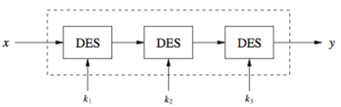

Triple DES – 3DES
Triple encryption using DES is often used in practice to extend the effective key length of DES to 168, 112, or 56 bits.
Alternative version of 3DES:
Advantage:
k₁=k₂=k₃ performs single DES encryption
k₁ and k₂ are independent, and k₁=k₃ , i.e., 2DES
No practical attack known today.
Used in many legacy applications, i.e., in banking systems.

Slide 20
Alternatives to DES
Algorithm | I/O Bit | key lengths | remarks
AES / Rijndael | 128 | 128/192/256 | DES ''replacement'', worldwide used standard
Triple DES | 64 | 112 (effective) | conservative choice
Mars | 128 | 128/192/256 | AES finalist
RC6 | 128 | 128/192/256 | AES finalist
Serpent | 128 | 128/192/256 | AES finalist
Twofish | 128 | 128/192/256 | AES finalist
IDEA | 64 | 128 | (Patented till 2011)

Slide 21
Lessons Learned
DES was the dominant symmetric encryption algorithm from the mid-1970s to the mid-1990s. Since 56-bit keys are no longer secure, the Advanced Encryption Standard (AES) was created.
Standard DES with 56-bit key length can be broken relatively easily nowadays through an exhaustive key search.
DES is quite robust against known analytical attacks: In practice it is very difficult to break the cipher with differential or linear cryptanalysis.
By encrypting with DES three times in a row, triple DES (3DES) is created, against which no practical attack is currently known.
The “default” symmetric cipher is nowadays often AES. In addition, the other four AES finalist ciphers all seem very secure and efficient.

