Slide 1
Block Ciphers_01
Instructor: Dr. Wei (Lisa) Li
Department of Computer Science, GSU

Slide 2
What we have learnt about block cipher by now?
DES, 3DES, and AES encrypt a block of data
How to utilize a block cipher?
How to encrypt long plaintexts with a block cipher?

Slide 3
Block Ciphers
A block cipher is much more than just an encryption algorithm, it can be used ...
to build different types of block-based encryption schemes
to realize stream ciphers
to construct hash functions
to make message authentication codes
to build key establishment protocols
to make a pseudo-random number generator
...
The security of block ciphers also can be increased by
key whitening
multiple encryption

Slide 4
Encryption with Block Ciphers
There are several ways of encrypting long plaintexts, e.g., an e-mail or a computer file, with a block cipher (“modes of operation”)
Electronic Code Book mode (ECB)
Cipher Block Chaining mode (CBC)
Output Feedback mode (OFB)
Cipher Feedback mode (CFB)
Counter mode (CTR)
Galois Counter Mode (GCM)
Goal: in addition to confidentiality, they provide authenticity and integrity:
Is the message really coming from the original sender? (authenticity)
Was the ciphertext altered during transmission? (integrity)

Slide 5
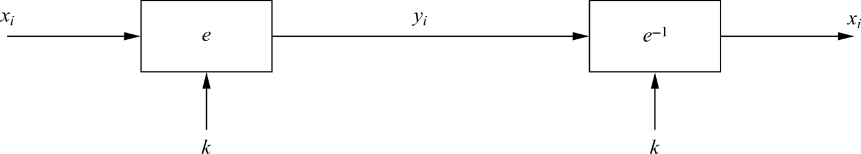
Electronic Code Book Mode (ECB)
e_{k}(x_{i}): the encryption of a b-bit plaintext block x_{i} with key k
e_{k}⁻¹(y_{i}): the decryption of b-bit ciphertext block y_{i} with key k
Messages which exceed b bits are partitioned into b-bit blocks
Each Block is encrypted separately
Encryption: y_{i} = e_{k} (x_{i}), i ≥ 1
Decryption: x_{i} = e_{k}⁻¹ (y_{i}) = e_{k}⁻¹ (e_{k} (x_{i})), i ≥ 1

Slide 6
ECB: Advantages/Disadvantages
Advantages
No block synchronization between sender and receiver is required
Bit errors caused by noisy channels only affect the corresponding block but not succeeding blocks
Block cipher operating can be parallelized (advantage for high-speed implementations)
Disadvantages: ECB encrypts highly deterministically
Identical plaintexts result in identical ciphertexts
An attacker recognizes if the same message has been sent twice (traffic analysis)
Plaintext blocks are encrypted independently of previous block
an attacker may reorder ciphertext blocks which results in valid plaintext

Slide 7

Substitution Attack on ECB
Once a particular plaintext to ciphertext block mapping x_{i} → y_{i} is known, a sequence of ciphertext blocks can easily be manipulated
Suppose an electronic bank transfer
the encryption key between the two banks does not change too frequently
The attacker sends $1.00 transfers from his account at bank A to his account at bank B repeatedly
He can check for ciphertext blocks that repeat, and he stores blocks 1,3 and 4 of these transfers
He now simply replaces block 4 of other transfers with the block 4 that he stored before
all transfers from some account of bank A to some account of bank B are redirected to go into the attacker’s B account!

Slide 8

Example: encrypting bitmaps in ECB mode
Identical plaintexts are mapped to identical ciphertexts
Statistical properties in the plaintext are preserved in the ciphertext

Slide 9
Deterministic encryption schemes are vulnerable to statistic analysis on ciphertexts
The same plaintext should result in different ciphertexts every time, i.e., probabilistic encryption
This can be achieved by introducing some form of randomness, e.g. initiation vector (IV)

Slide 10
Cipher Block Chaining Mode (CBC)
There are two main ideas behind the CBC mode:
The encryption of all blocks are “chained together”
ciphertext y_{i} depends not only on block x_{i} but on all previous plaintext blocks as well
The encryption is randomized by using an initialization vector (IV)
Do not have to keep IV secret
IV usually is a nonce, i.e., a number used only once

Slide 11
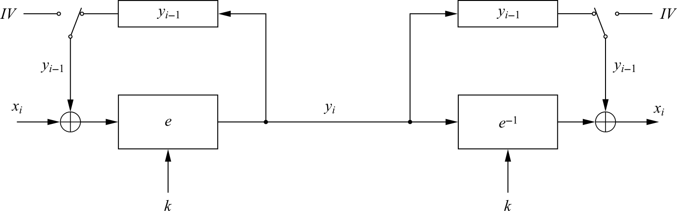
Cipher Block Chaining Mode (CBC)
For the first plaintext block x₁ there is no previous ciphertext
An IV is added to the first plaintext to make each CBC encryption nondeterministic
The first ciphertext y₁ depends on plaintext x₁ and the IV
The second ciphertext y₂ depends on the IV, x₁ and x₂
The third ciphertext y₃ depends on the IV and x₁, x₂ and x₃, etc.

Slide 12
Cipher Block Chaining Mode (CBC)
Encryption (first block): y₁ = e_{k} (x₁ ⊕ IV)
Encryption (general block): y_{i} = e_{k} (x_{i} ⊕ y_{i−1}), i ≥ 2
Decryption (first block): x₁ = e_{k}⁻¹ (y₁) ⊕ IV
Decryption (general block) : x_{i} = e_{k}⁻¹ (y_{i}) ⊕ y_{i−1}, i ≥ 2

Slide 13
Substitution Attack on CBC
Suppose the last example (electronic bank transfer)
If the IV is properly chosen for every wire transfer, the attack will not work at all
If the IV is kept the same for several transfers, the attacker would recognize the transfers from his account at bank A to back B
If we choose a new IV every time we encrypt, the CBC mode becomes a probabilistic encryption scheme, i.e., two encryptions of the same plaintext look entirely different
It is not needed to keep the IV secret!
Typically, the IV should be a non-secret nonce (value used only once)

Slide 14
More about CBC
In the example of bank transfer, the attacker cannot make a specific manipulation, but can cause random changes to the plaintexts, redirecting transfer to some other random bank accounts.
→ Encryption itself is not sufficient, and we also have to protect message integrity

Slide 15
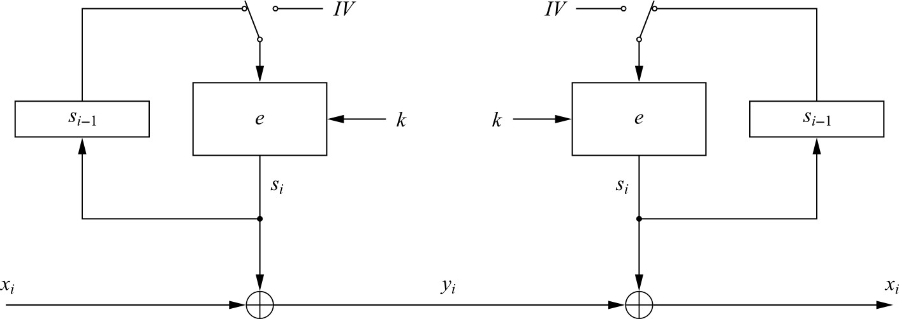
Output Feedback Mode (OFB)
It is used to build a synchronous stream cipher from a block cipher
Key stream is not generated bitwise but instead in a blockwise fashion
Output of the cipher gives us key stream bits S_{i} with which we can encrypt plaintext bits using the XOR operation

Slide 16
Output Feedback Mode (OFB)
It is used to build a synchronous stream cipher from a block cipher
Key stream is not generated bitwise but instead in a blockwise fashion
Output of the cipher gives us key stream bits S_{i} with which we can encrypt plaintext bits using the XOR operation
Encryption (first block): s₁ = e_{k} (IV) and y₁ = s₁ ⊕ x₁
Encryption (general block): s_{i} = e_{k} (s_{i−1}) and y_{i} = s_{i} ⊕ x_{i} , i ≥ 2
Decryption (first block): s₁ = e_{k} (IV) and x₁ = s₁ ⊕ y₁
Decryption (general block) : s_{i} = e_{k} (s_{i−1}) and x_{i} = s_{i} ⊕ y_{i} , i ≥ 2

Slide 17
OFB: Advantages/Disadvantages
Advantages
Nondeterministic (probabilistic) encryption by using different IV values
Block cipher computation is independent of the plaintext, so one or more blocks S_{i} can be precomputed
No block synchronization between sender and receiver is required
Disadvantage
Once one block S_{i} is computed incorrectly, the following blocks will be wrong (similar to CBC)

Slide 18
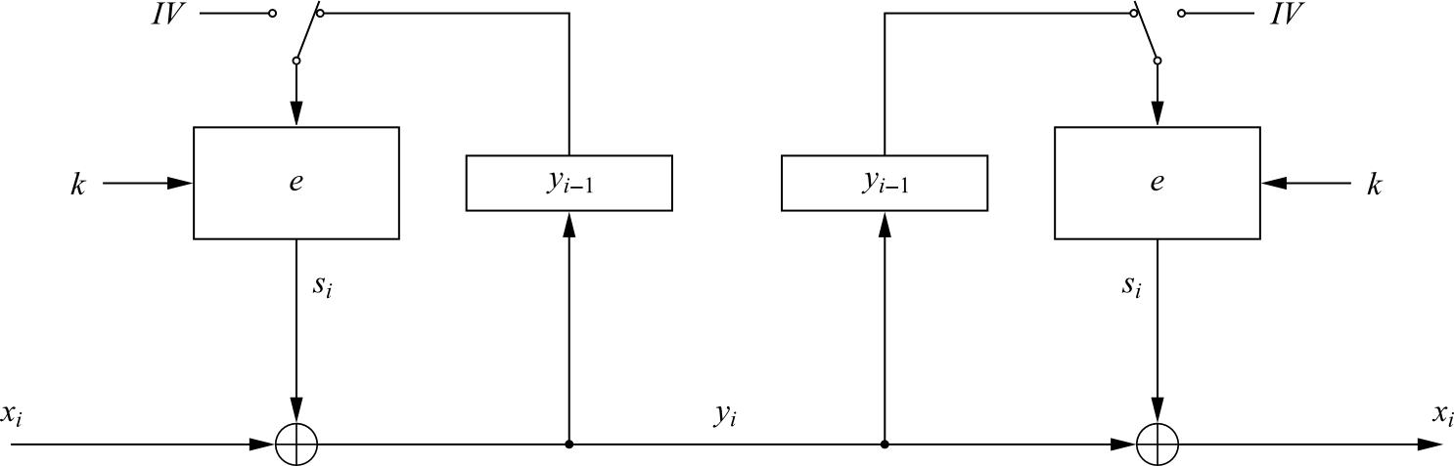
Cipher Feedback Mode (CFB)
It uses a block cipher as a building block for an asynchronous stream cipher (similar to the OFB mode), more accurate name: “Ciphertext Feedback Mode”
Key stream S_{i} is generated in a blockwise fashion and is also a function of ciphertext
As a result of the use of an IV, the CFB encryption is also nondeterministic
Encryption (first block): y₁ = e_{k} (IV) ⊕ x₁
Encryption (general block): y_{i} = e_{k} (y_{i−1}) ⊕ x_{i} , i ≥ 2
Decryption (first block): x₁ = e_{k} (IV) ⊕ y₁
Decryption (general block) : x_{i} = e_{k} (y_{i−1}) ⊕ y_{i} , i ≥ 2

Slide 19
Schedule of Quiz 1
Time: Wednesday, 02/28/2018, from 1:00 pm to 2:45pm
Location: Classroom
Quiz 1:
Opened book (only paper materials and calculator are allowed, no electronic device)
Exam range: contents of Lectures 2-10 (including preliminary, stream cipher, DES, AES, and block cipher)

