Slide 1
Quiz Review_01
Instructor: Dr. Wei (Lisa) Li
Department of Computer Science, GSU

Slide 2
What we have learnt by now?
Modular Arithmetic
Steam Cipher
DES
AES
Block Cipher Modes
Some Classic Types of Attacks

Slide 3
Modular Arithmetic
Definition: Modulus Operation
Let a, r, m be integers and m > 0. We write
a ≡ r mod m
if (r-a) is divisable by m.
“m” is called the modulus
“r” is called the remainder
Properties:
Remainder is not unique → choose the smallest positive integer
Modular division → prefer to multiply by the inverse value (definition, existence)
Modular reduction can be performed to facilitate calculation

Slide 4
Important Concepts
Group
Field
Ring
→ Their definitions and properties

Slide 5
Symmetric Cryptography
Solution: Encryption with symmetric cipher. ⇒ Oscar obtains only ciphertext y, that looks like random bits
Oscar (bad guy)
Unsecure channel (e.g. Internet)
y
Alice (good)
Encryption e( )
Decryption d( )
Bob (good)
x
y
x
K
K
Key Generator
Secure Channel
x is the plaintext
y is the ciphertext
K is the key
Set of all keys {K1, K2, ...,Kn} is the key space

Slide 6
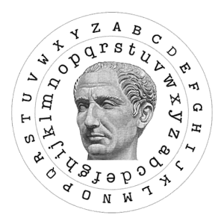
Steam Ciphers
Substitution Cipher: replace each plaintext letter by a fixed other letter
Shift (or Casare) Cipher: take letter that follows after k positions in the alphabet
Affine Cipher (extension of the shift cipher): rather than just adding the key to the plaintext, we also multiply by the key

Slide 7
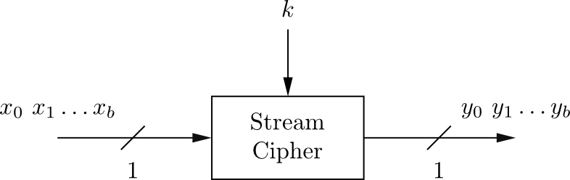
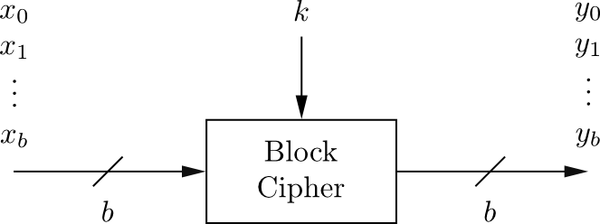
Block Cipher vs. Stream Cipher
Stream Ciphers
Encrypt bits individually
Usually small and fast → common in embedded devices
Block Ciphers:
Always encrypt a full block (several bits)
Are common for Internet applications

Slide 8
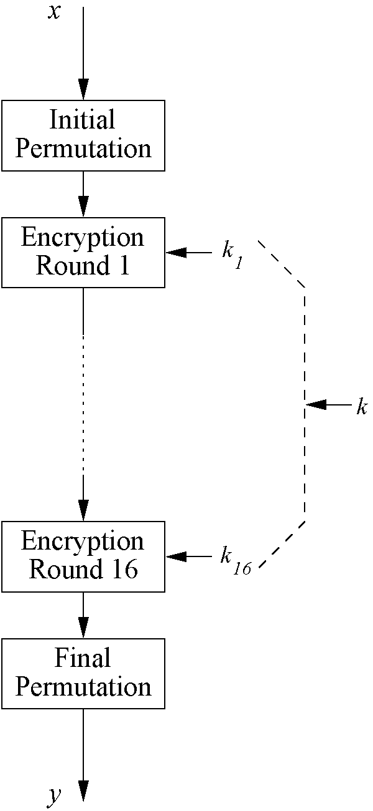
Overview of DES
Encrypts blocks of size 64 bits
Uses a key of size 56 bits
Symmetric cipher: uses same key for encryption and decryption
Uses 16 rounds which all perform the identical operation
Different subkey in each round derived from main key

Slide 9
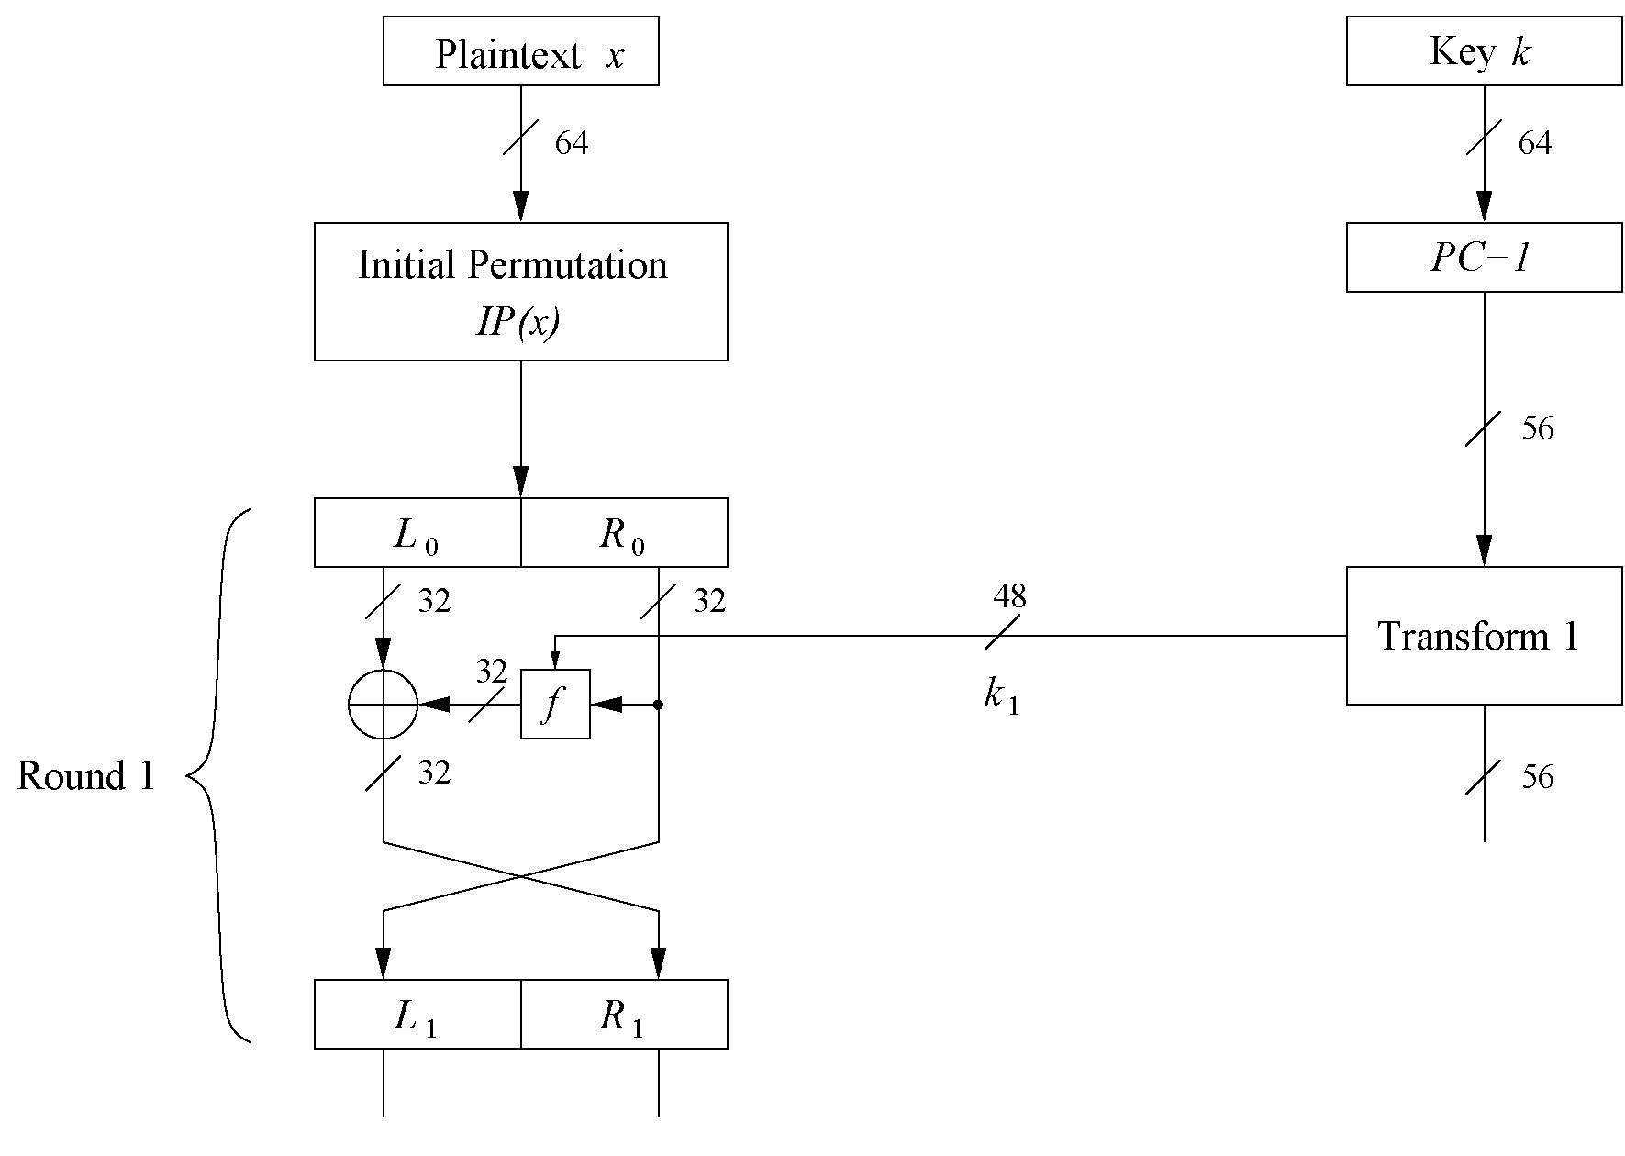
DES Feistel Network
DES structure is a Feistel network
Advantage: encryption and decryption differ only in keyschedule

Slide 10
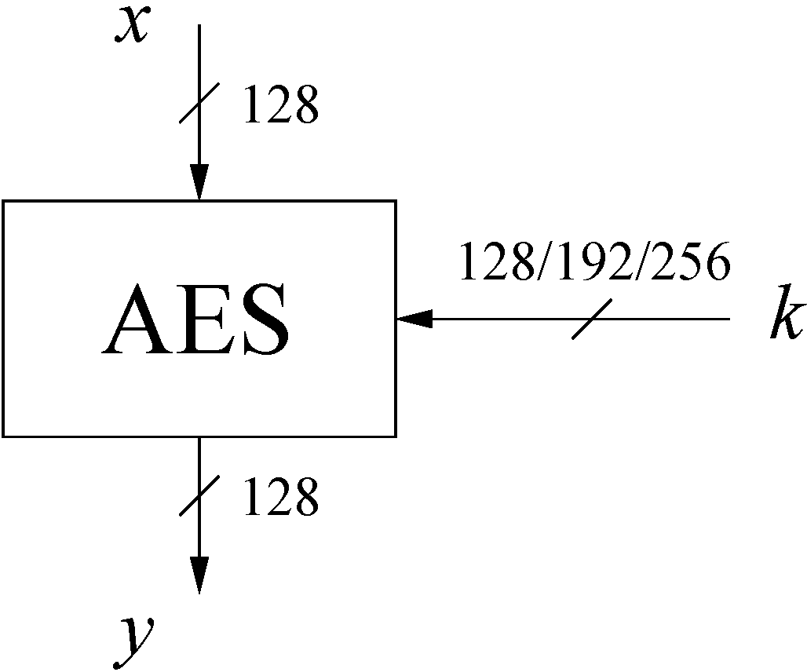
AES: Overview (1)
The number of rounds depends on the chosen key length:
Key length (bits) | Number of rounds
128 | 10
192 | 12
256 | 14

Slide 11
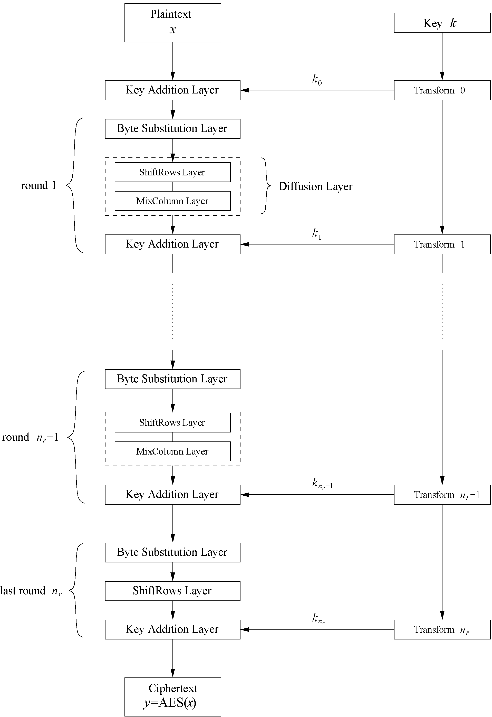
AES: Overview (2)
Iterated cipher with 10/12/14 rounds
The whole block is encrpted in each round
Each round consists of “Layers”

Slide 12
Mode of Block Cipher
Electronic Code Book mode (ECB)
Cipher Block Chaining mode (CBC)
Output Feedback mode (OFB)
Cipher Feedback mode (CFB)
Counter mode (CTR)
Galois Counter Mode (GCM)

Slide 13
Classic Types of Attacks
Brute-force attack (or exhaustive key search)
Letter frequency analysis attack
Linear analysis attack
Substitution attack
Meet-in-the-Middle attack
Note: all introduce attacks have been illustrated via examples in lectures.

Slide 14
Schedule of Quiz 1
Time: Wednesday, 02/28/2018, from 1:00 pm to 2:45pm
Location: Classroom
Quiz 1:
Opened book (only paper materials and calculator are allowed, no electronic device)
Exam range: contents of Lectures 2-10 (including preliminary, stream cipher, DES, AES, and block cipher)

