Slide 1
RSA_01
Instructor: Dr. Wei (Lisa) Li
Department of Computer Science, GSU

Slide 2
Preliminary Review

Slide 3
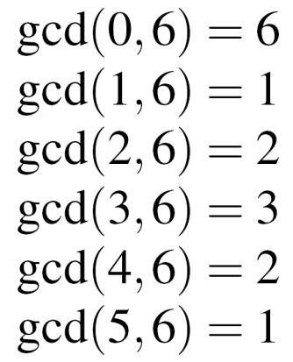
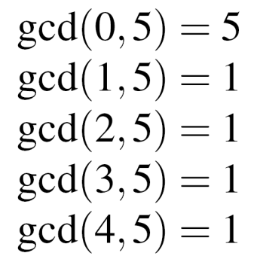
Euler's Phi Function (1)
New problem, important for public-key systems, e.g., RSA: Given the set of the m integers {0, 1, 2, …, m -1}, How many numbers in the set are relatively prime to m ?
Answer: Euler‘s Phi function Φ(m)
Example for the sets {0,1,2,3,4,5} (m=6) and {0,1,2,3,4} (m=5)
→ 1 and 5 relatively prime to m=6, → Φ(5) = 4 hence Φ(6) = 2
Testing one gcd per number in the set is extremely slow for large m.

Slide 4
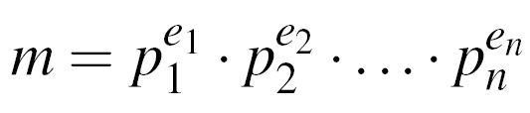
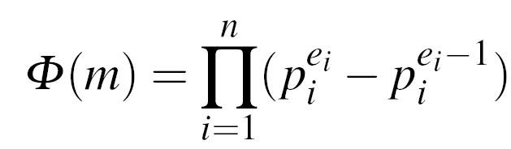
Euler‘s Phi Function (2)
If canonical factorization of m known: (where p_{i} primes and e_{i} positive integers)
then calculate Phi according to the relation:
Phi especially easy for e_{i} = 1, e.g., m = p . q → Φ(m) = (p-1) . (q-1)
Example m = 899 = 29 . 31: Φ(899) = (29-1) . (31-1) = 28 . 30 = 840
Note: Finding Φ(m) is computationally easy if factorization of m is known (otherwise the calculation of Φ(m) becomes computationally infeasible for large numbers)

Slide 5
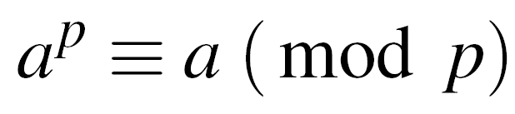
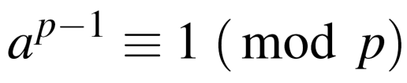

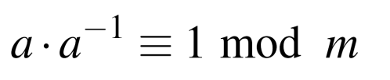
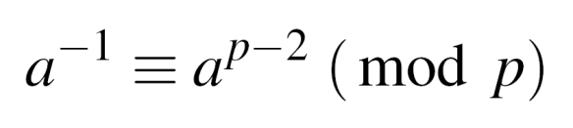


Fermat‘s Little Theorem
Given a prime p and an integer a:
Can be rewritten as:
Use: Find modular inverse, if p is prime. Rewrite to
Comparing with definition of the modular inverse:
→ is the modular inverse modulo a prime p
Example: a = 2, p = 7
Fermat‘s Little Theorem works only modulo a prime p
✓

Slide 6
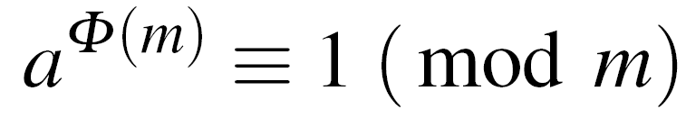

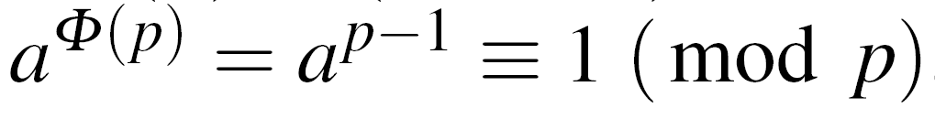
Euler‘s Theorem
Generalization of Fermat‘s little theorem to any integer modulus
Given two relatively prime integers a and m :
Example: m=12, a=5
1. Calculate Euler‘s Phi Function
2. Verify Euler‘s Theorem
Fermat‘s little theorem = special case of Euler‘s Theorem
For a prime p:
→ Fermat:

Slide 7
RSA Cryptosystem
Martin Hellman and Whitfield Diffie published their landmark public-key paper in 1976
Ronald Rivest, Adi Shamir and Leonard Adleman proposed the asymmetric RSA cryptosystem in1977
Until now, RSA is the most widely use asymmetric cryptosystem although elliptic curve cryptography (ECC) becomes increasingly popular
RSA is mainly used for two applications
Transport of (i.e., symmetric) keys (Ch. 13 of Understanding Cryptography)
Digital signatures (Ch. 10 of Understanding Cryptography)

Slide 8
Encryption and Decryption
RSA operations are done over the integer ring Z_{n} (i.e., arithmetic modulo n), where n = p * q, with p, q being large primes
Encryption and decryption are simply exponentiations in the ring
In practice x, y, n and d are very long integer numbers (≥ 1024 bits)
The security of the scheme relies on the fact that it is hard to derive the „private exponent“ d given the public-key (n, e)
Definition
Given the public key (n,e) = k_{pub} and the private key d = k_{pr} we write
y = e_{kpub}(x) ≡ x^{e} mod n
x = d_{kpr}(y) ≡ y^{d} mod n
where x, y in Z_{n.}
We call e_{kpub}() the encryption and d_{kpr}() the decryption operation.

Slide 9
Key Generation (1)
Like all asymmetric schemes, RSA has set-up phase during which the private and public keys are computed
Algorithm: RSA Key Generation
Output: public key: k_{pub} = (n, e) and private key k_{pr} = d
Choose two large primes p, q
Compute n = p * q
Compute Φ(n) = (p-1) * (q-1)
Select the public exponent e in {1, 2, …, Φ(n)-1} such that gcd(e, Φ(n) ) = 1
Compute the private key d such that d * e ≡ 1 mod Φ(n)
RETURN k_{pub} = (n, e), k_{pr} = d

Slide 10
Key Generation (2)
Algorithm: RSA Key Generation
Output: public key: k_{pub} = (n, e) and private key k_{pr} = d
Choose two large primes p, q
Compute n = p * q
Compute Φ(n) = (p-1) * (q-1)
Select the public exponent e ε {1, 2, …, Φ(n)-1} such that gcd(e, Φ(n) ) = 1
Compute the private key d such that d * e ≡ 1 mod Φ(n)
RETURN k_{pub} = (n, e), k_{pr} = d
Remarks:
Choosing two large, distinct primes p, q (in Step 1) is non-trivial
gcd(e, Φ(n)) = 1 ensures that e has an inverse and, thus, that there is always a private key d

Slide 11
Example: RSA with small numbers
ALICE
Message x = 4
y = x^{e} ≡ 4³ ≡ 31 mod 33
BOB
Choose p = 3 and q = 11
Compute n = p * q = 33
Φ(n) = (3-1) * (11-1) = 20
Choose e = 3
d ≡ e⁻¹ ≡7 mod 20
y^{d} = 31⁷ ≡ 4 = x mod 33
K_{pub} = (33,3)
y = 31

Slide 12
RSA Implementation
The RSA cryptosystem uses only one arithmetic operation (modular exponentiation) which makes it conceptually a simple asymmetric scheme
Even though conceptually simple, due to the use of very long numbers, RSA is orders of magnitude slower than symmetric schemes, e.g., DES, AES
When implementing RSA (esp. on a constrained device such as smartcards or cell phones) close attention has to be paid to the correct choice of arithmetic algorithms
The square-and-multiply algorithm allows fast exponentiation, even with very long numbers…

Slide 13
Square-and-Multiply
Basic principle: Scan exponent bits from left to right and square/multiply operand accordingly
Rule: Square in every iteration (Step 3) and multiply current result by x if the exponent bit h_{i} = 1 (Step 5)
Modulo reduction after each step keeps the operand y small
Algorithm: Square-and-Multiply for x^{H} mod n
Input: Exponent H, base element x, Modulus n
Output: y = x^{H} mod n
Determine binary representation H = (h_{t}, h_{t-1}, ..., h₀)₂
FOR i = t-1 TO 0
y = y² mod n
IF h_{i} = 1 THEN
y = y * x mod n
RETURN y

Slide 14
Example: Square-and-Multiply
Computes x²⁶ without modulo reduction
Binary representation of exponent: 26 =(1,1,0,1,0)₂=(h₄,h₃,h₂,h₁,h₀)₂
Step |  | Binary exponent | Op | Comment
1 | x = x¹ | (1)₂ |  | Initial setting, h₄ processed
1a | (x¹)² = x² | (10)₂ | SQ | Processing h₃
1b | x² * x = x³ | (11)₂ | MUL | h₃ = 1
2a | (x³)² = x⁶ | (110)₂ | SQ | Processing h₂
2b | - | (110)₂ | - | h₂ = 0
3a | (x⁶)² = x¹² | (1100)₂ | SQ | Processing h₁
3b | x¹² * x = x¹³ | (1101)₂ | MUL | h₁=1
4a | (x¹³)² = x²⁶ | (11010)₂ | SQ | Processing h₀
4b | - | (11010)₂ | - | h₀ = 0

Slide 15
Complexity of Square-and-Multiply
The square-and-multiply algorithm has a logarithmic complexity, i.e., its run time is proportional to the bit length (rather than the absolute value) of the exponent
Given an exponent with t+1 bits: H = (h_{t},h_{t-1}, ..., h₀)₂ with h_{t} = 1, we need the following operations
# Squarings = t
Average # multiplications = 0.5 t
Total complexity: #SQ + #MUL = 1.5 t
Exponents are often randomly chosen, so 1.5 t is a good estimate for the average number of operations
Note that each squaring and each multiplication is an operation with very long numbers, e.g., 2048 bit integers.

Slide 16
Speed-Up Techniques
Modular exponentiation is computationally intensive
Even with the square-and-multiply algorithm, RSA can be quite slow on constrained devices such as smart cards
Some important tricks:
Short public exponent e
Chinese Remainder Theorem (CRT)
Exponentiation with pre-computation (not covered here)

Slide 17
Fast encryption with small public exponent
Choosing a small public exponent e does not weaken the security of RSA
A small public exponent improves the speed of the RSA encryption significantly
This is a commonly used trick (e.g., SSL/TLS, etc.) and makes RSA the fastest asymmetric scheme with regard to encryption!
Public Key | e as binary string | #SQ + #MUL
2¹+1 = 3 | (11)₂ | 1 + 1 = 2
2⁴+1 = 17 | (1 0001)₂ | 4 + 1 = 5
2¹⁶ + 1 | (1 0000 0000 0000 0001)₂ | 16 + 1 = 17

Slide 18
Fast decryption with CRT
Choosing a small private key d results in security weaknesses!
In fact, d must have at least 0.3t bits, where t is the bit length of the modulus n
However, the Chinese Remainder Theorem (CRT) can be used to (somewhat) accelerate exponentiation with the private key d
Based on the CRT we can replace the computation of
x^{d mod Φ(n)} mod n
by two computations
x^{d} ^{mod (p-1)} mod p and x^{d mod (q-1)} mod q
where q and p are „small“ compared to n

