Slide 1
Discrete Logarithm
Instructor: Dr. Wei (Lisa) Li
Department of Computer Science, GSU

Slide 2
Discrete Logarithm Problem

Slide 3
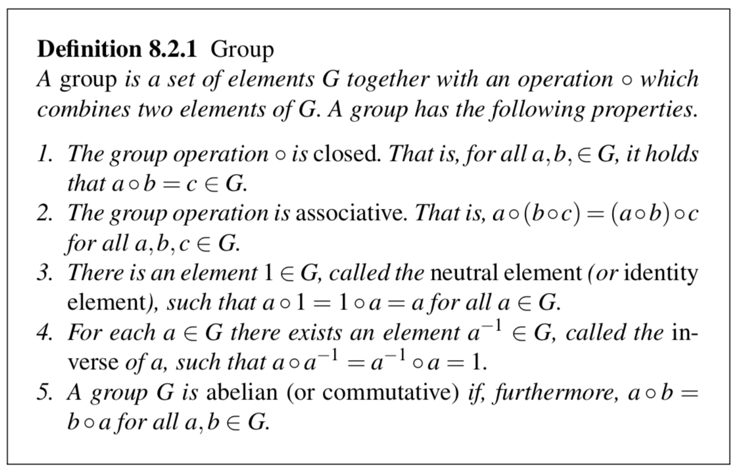
Preliminary (1)
Z_{p}*: the set of positive integers smaller than p which are relatively prime to p

Slide 4
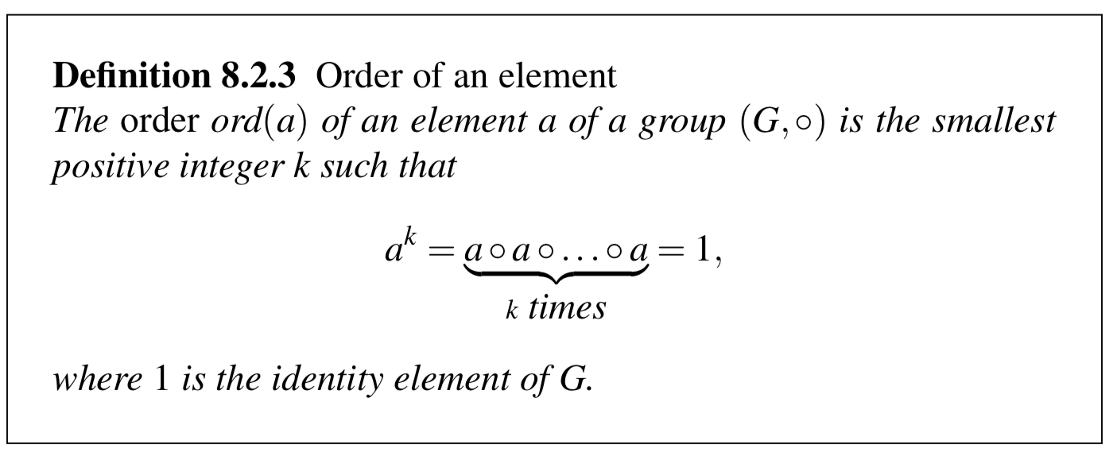
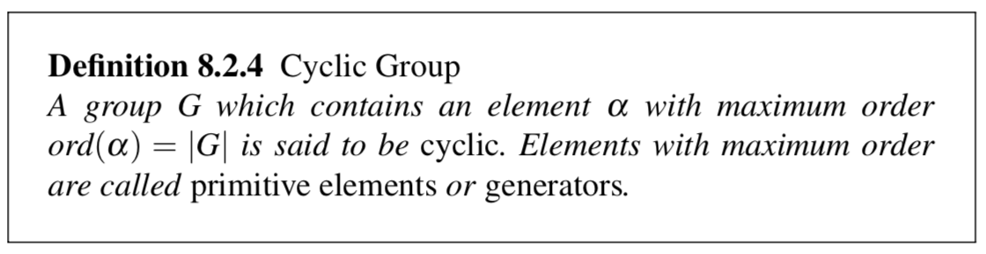
Preliminary (2)

Slide 5
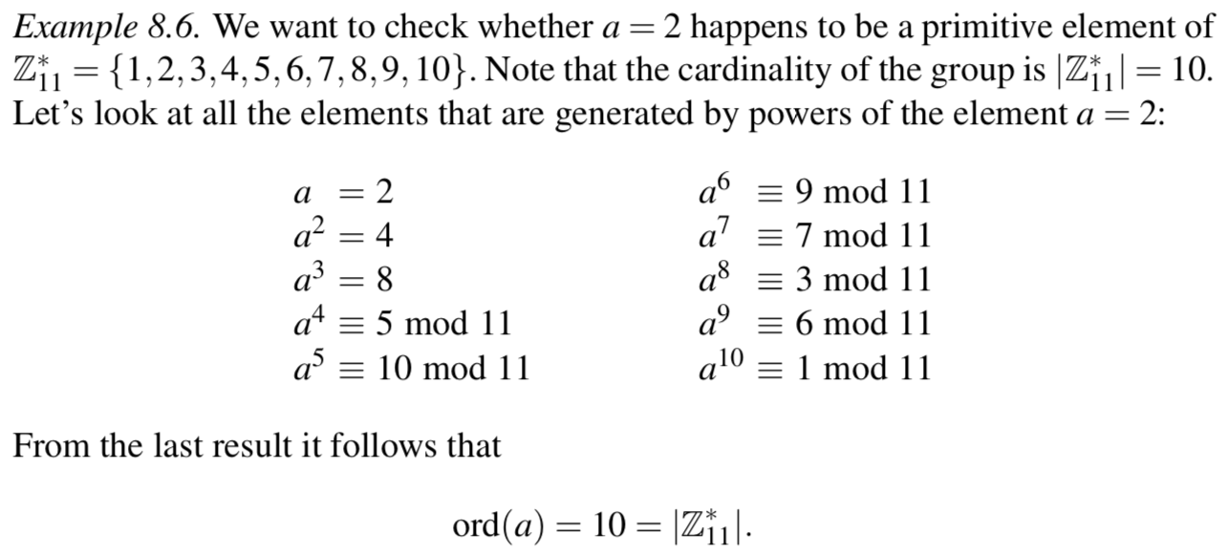
Cyclic Group: Example

Slide 6
Discrete Logarithm Problem
Discrete Logarithm Problem (DLP) in Z_{p}*
Given is the finite cyclic group Z_{p}* of order p−1 and a primitive element α ∈ Z_{p}* and another element β ∈ Z_{p}*.
The DLP is the problem of determining the integer 1 ≤ x ≤ p−1 such that α^{x} ≡ β mod p
This computation is called the discrete logarithm problem (DLP)
x = log_{α} β mod p
Example: Compute x for 5^{x} ≡ 41 mod 47
Remark: For the coverage of groups and cylcic groups, we refer to Chapter 8 of Understanding Cryptography

Slide 7
Generalized Discrete Logarithm Problem
Given is a finite cyclic group G with the group operation ◦ and cardinality n.
We consider a primitive element α ∈ G and another element β ∈ G.
The discrete logarithm problem is finding the integer x, where 1 ≤ x ≤ n, such that:
β = α ◦ α ◦ α ◦. . .◦ α = α^{x}
x times

Slide 8
Diffie–Hellman Key Exchange: Overview
Proposed in 1976 by Whitfield Diffie and Martin Hellman
Widely used, e.g. in Secure Shell (SSH), Transport Layer Security (TLS), and Internet Protocol Security (IPSec)
The Diffie–Hellman Key Exchange (DHKE) is a key exchange protocol and not used for encryption (For the purpose of encryption based on the DHKE, ElGamal can be used.)

Slide 9
Diffie–Hellman Key Exchange: Set-up
Set-up Steps:
Choose a large prime p.
Choose an integer α ∈ {2,3, . . . , p−2}.
Publish p and α.

Slide 10
Diffie–Hellman Key Exchange: Process
Alice
Bob
Choose random private key k_{prA}=a ∈{1,2,…,p-1}
Choose random private key k_{prB}=b ∈ {1,2,…,p-1}
Compute corresponding public key k_{pubA}= A = αª mod p
A
Compute correspondig public key k_{pubB}= B = α^{b} mod p
B
Compute common secret k_{AB} = Bª = (αª)^{b} mod p
Compute common secret k_{AB} = A^{b} = (α^{b})ª mod p
We can now use the joint key k_{AB} for encryption, e.g., with AES
y
y = AES_{kAB}(x)
x = AES⁻¹_{kAB}(y)

Slide 11
Diffie–Hellman Key Exchange: Example
Domain parameters p=29, α=2
Alice
Bob
Choose random private key k_{prA}= a = 5
Choose random private key k_{prB}=b = 12
Compute corresponding public key k_{pubA}= A = 2⁵ = 3 mod 29
A
Compute correspondig public key k_{pubB}= B = 2¹² = 7 mod 29
B
Compute common secret k_{AB} = Bª = 7⁵ = 16 mod 29
Compute common secret k_{AB} = A^{b} = 3¹² = 16 mod 29
Proof of correctness:
Alice computes: Bª = (α^{b})ª mod p Bob computes: A^{b} = (αª)^{b} mod p
i.e., Alice and Bob compute the same key k_{AB} !

Slide 12
Attacks against DLP
Summary of records for computing discrete logarithms in Z_{p}*
Decimal digits | Bit length | Date
58 | 193 | 1991
68 | 216 | 1996
85 | 282 | 1998
100 | 332 | 1999
120 | 399 | 2001
135 | 448 | 2006
160 | 532 | 2007
In order to prevent attacks that compute the DLP, it is recommended to use primes with a length of at least 1024 bits for schemes such as Diffie-Hellman in Z_{p}*

Slide 13
Security of Classical Diffie–Hellman Key Exchange (1)
Which information does Oscar have?
α, p
k_{pubA} = A = αª mod p
k_{pubB} = B = α^{b} mod p
Which information does Oscar want to have?
k_{AB} = α^{ba} = α^{ab} = mod p
This is kown as Diffie-Hellman Problem (DHP)

Slide 14
Security of Classical Diffie–Hellman Key Exchange (2)
The only known way to solve the DHP is to solve the DLP, i.e.
Compute a = log_{α} A mod p
Compute k_{AB} = Bª = α^{ba} = mod p
It is conjectured that the DHP and the DLP are equivalent, i.e., solving the DHP implies solving the DLP.
To prevent attacks, i.e., to prevent that the DLP can be solved, choose p > 2¹⁰²⁴

Slide 15
Elgamal Encryption Scheme: Overview
Proposed by Taher Elgamal in 1985
Can be viewed as an extension of the DHKE protocol
Based on the intractability of the discrete logarithm problem and the Diffie–Hellman problem

Slide 16
Elgamal Encryption Scheme: Principle
Alice
Bob
choose d = k_{prB} ∈ {2,…,p-2}
compute β = k_{pubB}= α^{d} mod p
β
choose i = k_{prA} ∈ {2,…,p-2}
compute ephemeral key k_{E} = k_{pubA}= α^{i} mod p
k_{E}
compute k_{M} = k_{E}^{d} mod p
compute k_{M} = β^{i} mod p
encrypt message x ∈ Z_{p}*: y = x·k_{M} mod p
y
decrypt x = y·k_{M}⁻¹ mod p
This looks very similar to the DHKE! The actual Elgamal protocol re-orders the computations which helps to save one communication (cf. next slide)

Slide 17
Elgamal Encryption Scheme: Protocol
Alice
Bob
choose large prime p
choose primitive element α ∈ Z_{p}* or in a subgroup of Z_{p}*
choose d = k_{prB} ∈ {2,…,p-2}
compute β = k_{pubB}= α^{d} mod p
choose i = k_{prA} ∈ {2,…,p-2}
compute k_{E} = k_{pubA}= α^{i} mod p
compute masking key k_{M} = β^{i} mod p
k_{pubB} = (p, α, β)
encrypt message x ∈ Z_{p}*: y = x·k_{M} mod p
(k_{E}, y)
compute masking key k_{M} = k_{E}^{d} mod p
decrypt x = y·k_{M}⁻¹ mod p

Slide 18
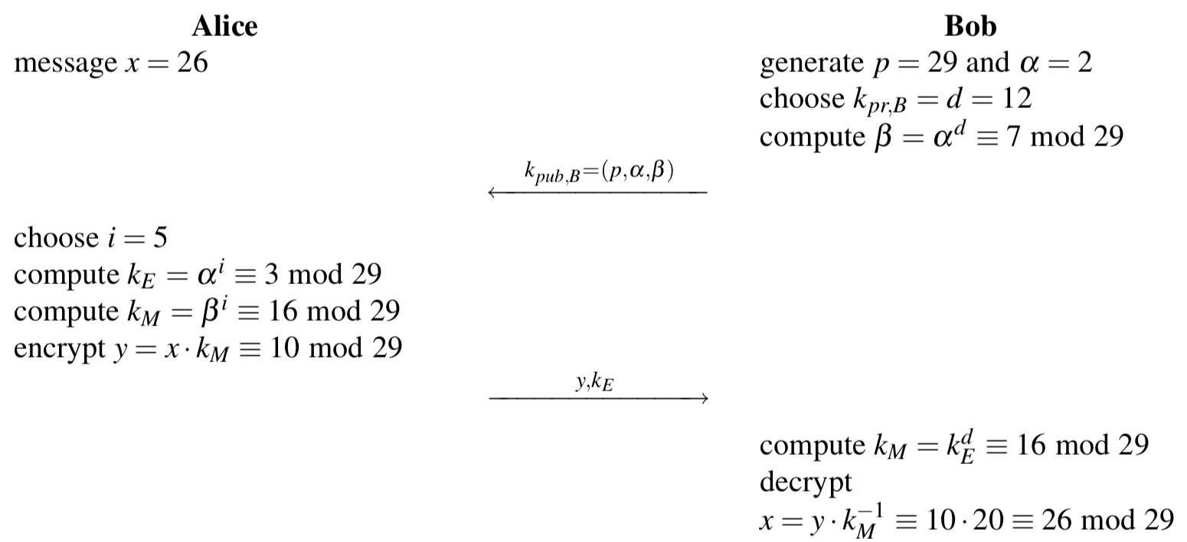
Elgamal Encryption Scheme: Example

Slide 19
Computational Aspects
Key Generation
Generation of prime p
p has to of size of at least 1024 bits
Prime-finding algorithms
Encryption
Requires two modular exponentiations and a modular multiplictation
All operands have a bitlength of log₂ p
Efficient execution requires methods such as the square-and-multiply algorithm
Decryption
Requires one modular exponentiation and one modulare inversion

Slide 20
Security
Passive attacks
Attacker eavesdrops p, α, β = α^{d} , k_{E} = α^{i}, y = x· β^{i} and wants to recover x
Problem relies on the DLP
Active attacks
If the public keys are not authentic, an attacker could send an incorrect public key
An attack is also possible if the secret exponent i is being used more than once

Slide 21
Lessons Learned
The Diffie–Hellman protocol is a widely used method for key exchange. It is based on cyclic groups.
The discrete logarithm problem is one of the most important one-way functions in modern asymmetric cryptography. Many public-key algorithms are based on it.
For the Diffie–Hellman protocol in Z_{p}*, the prime p should be at least 1024 bits long. This provides a security roughly equivalent to an 80-bit symmetric cipher.
For a better long-term security, a prime of length 2048 bits should be chosen.
The Elgamal scheme is an extension of the DHKE where the derived session key is used as a multiplicative masked to encrypt a message.
Elgamal is a probabilistic encryption scheme, i.e., encrypting two identical messages does not yield two identical ciphertexts.

