Slide 1
Hash Function_01
Instructor: Dr. Wei (Lisa) Li
Department of Computer Science, GSU

Slide 2
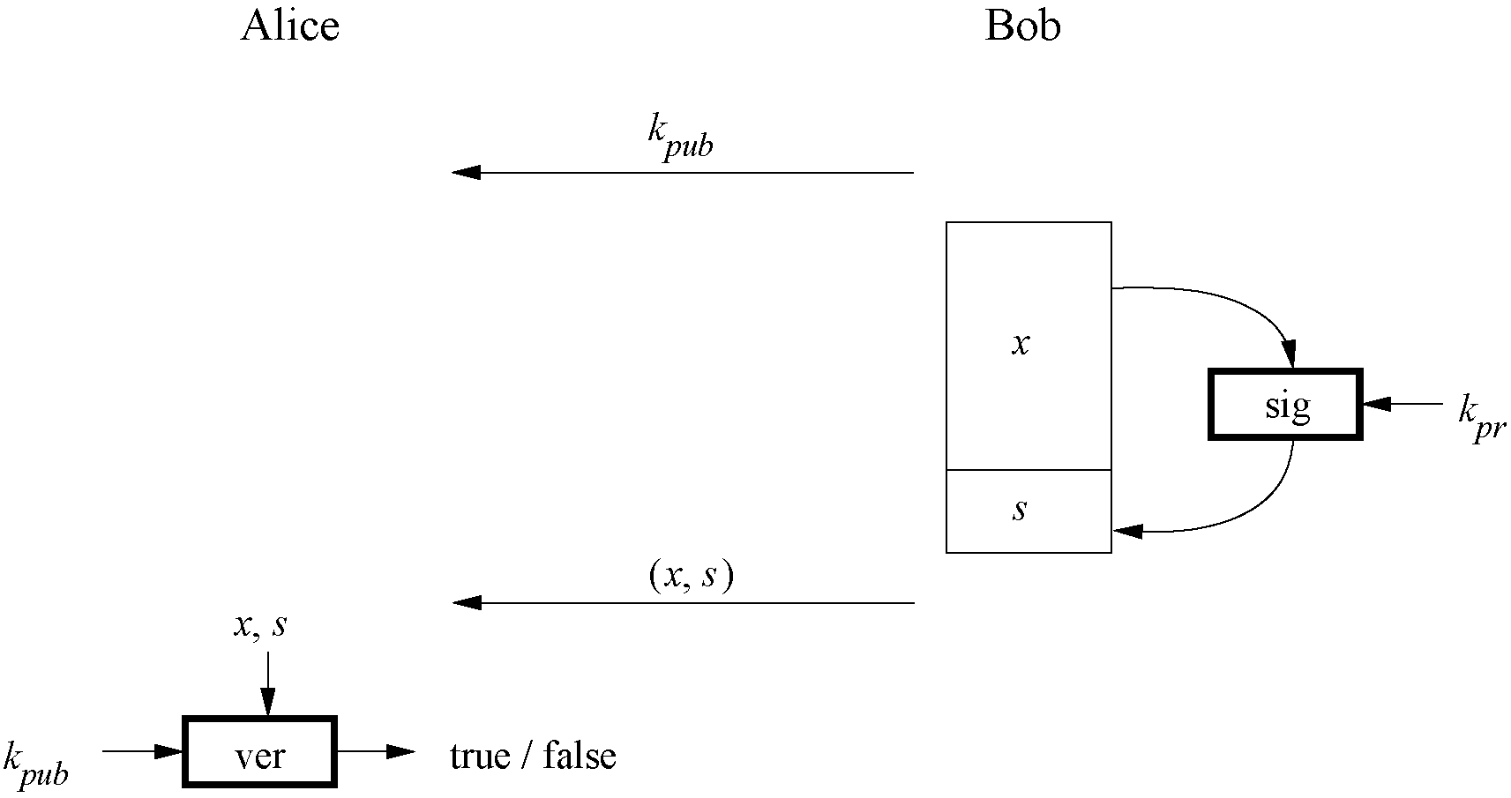
Review of Digital Signature

Slide 3
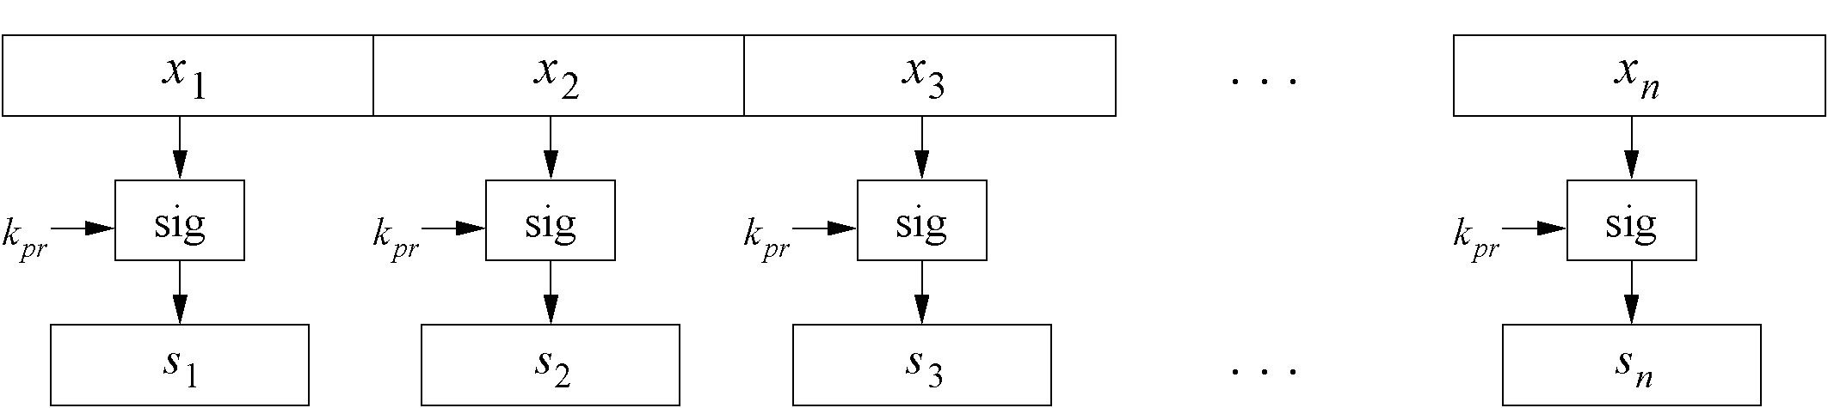
Why we need hash functions
Problem: Naive signing of long messages generates a signature of same length.
Three Problems: Computational overhead, Message overhead, Security limitations
Solution: Instead of signing the whole message, sign only a digest (=hash)
Also secure, but much faster
Needed: Hash Functions

Slide 4
Digital Signature with a Hash Function
Notes:
x has fixed length
z, y have fixed length
z, x do not have equal length in general
h(x) does not require a key
h(x) is public
x
x_{i}
z_{i} = h( x_{i} || z_{i-1} )
z
Sig_{kpr}(z)
y = sig_{kpr}(z)

Slide 5
Basic Protocol for Digital Signatures with a Hash Function
Alice
Bob
K_{pub}
z = h(x)
s = sig_{Kpr}(z)
(x, s)
z' = h(x)
ver_{Kpub}(s,z')=true/false

Slide 6
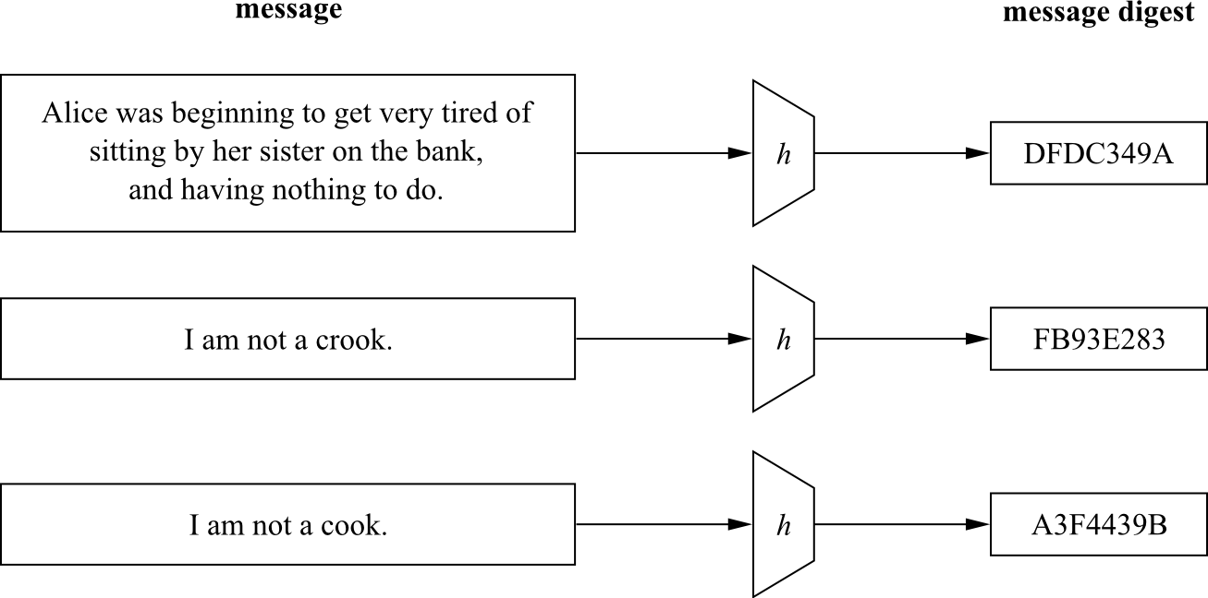
Principal Input-Output Behavior of Hash Functions

Slide 7
Hash Function: Security Properties (1)
Preimage resistance: For a given output z, it is impossible to ﬁnd any input x such that h(x) = z, i.e., h(x) is one-way.
Second preimage resistance: Given x₁, and thus h(x₁), it is computationally infeasible to ﬁnd any x₂ such that h(x₁) = h(x₂).
Collision resistance: It is computationally infeasible to ﬁnd any pairs x₁ ≠ x₂ such that h(x₁) = h(x₂).

Slide 8
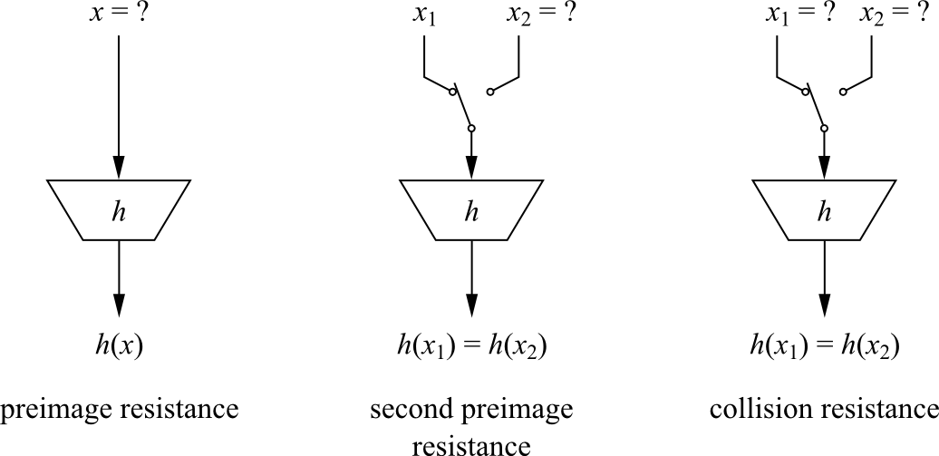
Hash Function: Security Properties (2)

Slide 9
Hash Function: Security
It turns out that collision resistance causes most problems
How hard is it to find a collision with a probability of 0.5?
Related Problem: How many people are needed such that two of them have the same birthday with a probability of 0.5?
No! Not 365/2=183. 23 are enough ! This is called the birthday paradoxon (Search takes ≈√2^{n} steps).
To deal with this paradox, hash functions need a output size of at least 160 bits.

Slide 10
Hash Function: Algorithms
Hash Algorithms
Special Algorithms, e.g. MD5 - family
based on block ciphers
MD5 – family
SHA-1: output - 160 bit; input - 512 bit chunks of message x; operations - bitwise AND, OR, XOR, complement cyclic shifts.
RIPE-MD 160: output - 160 bit; input - 512 bit chunks of message x; operations – like in SHA-1, but two in parallel and combinations of them after each round.

Slide 11
Example: Secure Hash Algorithm SHA-1
Part of the MD-4 family.
Based on a Merkle-Dåmgard construction.
160-bit output from a message of maximum length 2⁶⁴ bit.
Widely used (even tough some weaknesses are known)

Slide 12
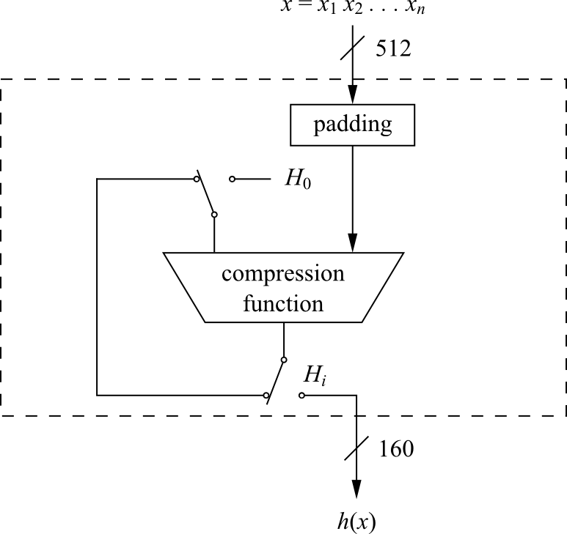
SHA-1: High Level Diagramm
Compression Function consists of 80 rounds which are divided into four stages of 20 rounds each

Slide 13
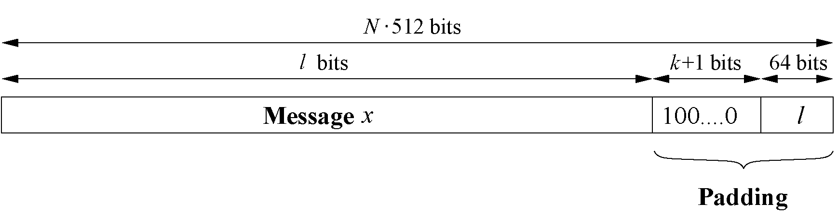
SHA-1: Padding
Message x has to be padded to fit a size of a multiple of 512 bit.
Padding: 1 followed by k zero bits + 64-bit representation
k ≡ 512 − 64 − 1 − l = 448 − (l + 1) mod 512

Slide 14
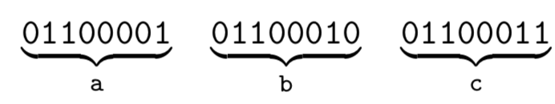
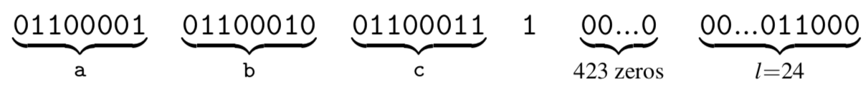
SHA-1: Example
Given is the message “abc ” consisting of three 8-bit ASCII characters with a total length of l = 24 bits:
We append a “1” followed by k = 423 zero bits, where k is determined by
Finally, we append the 64-bit value which contains the binary representation of the length l = 24₁₀ = 11000₂. The padded message is then given by

Slide 15
SHA-1: Hash Computation
Each message block x_{i} is processed in four stages with 20 rounds each
SHA-1 uses:
A message schedule which computes a 32-bit word W₀,W₁,...,W₇₉ for each of the 80 rounds
Five working registers of size of 32 bits A,B,C,D,E
A hash value H_{i} consisting of ﬁve 32-bit words H_{i}⁽⁰⁾, H_{i}⁽¹⁾, H_{i}⁽²⁾ , H_{i}⁽³⁾, H_{i}⁽⁴⁾
In the beginning, the hash value holds the initial value H₀, which is replaced by a new hash value after the processing of each single message block.
The ﬁnal hash value H_{n} is equal to the output h(x) of SHA-1.

Slide 16
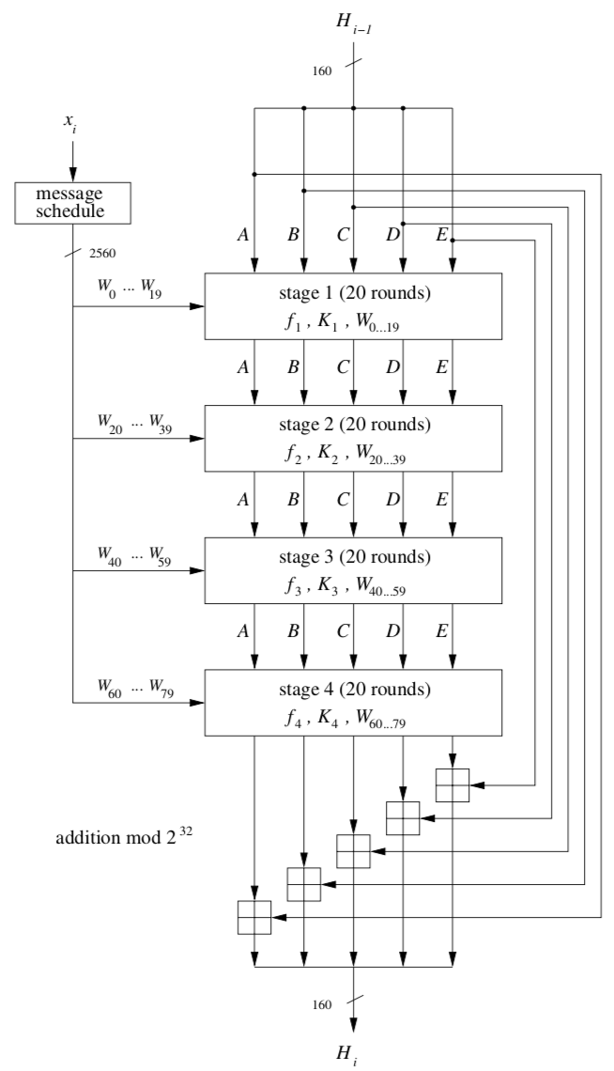
SHA-1: Four Atages
Each stage is composed of 20 rounds, where parts of the message block are processed by the function f_{t} together with some stage-dependent constant K_{t}
The output after 80 rounds is added to the input value H_{i−1} modulo 2³² in word-wise fashion

Slide 17
SHA-1: SHA Rounds
Every 20 rounds a new function and a new constant are being used
The f_{t} function only uses bitwise Boolean opera- tions, namely logical AND (∧), OR (∨), NOT (top bar) and XOR
These operation are applied to 32-bit variables and are very fast to implement on modern PCs
Stage t | Round j | Constant K_{t} | Function f_{t}
1 | 00…19 | K=5A827999 | f(B,C,D)=(B∧C)∨(¯B∧D)
2 | 20…39 | K=6ED9EBA1 | f(B,C,D)=B⊕C⊕D
3 | 40…59 | K=8F1BBCDC | f(B,C,D)=(B⊕C)∨(B⊕D)∨(C⊕D)
4 | 60…79 | K=CA62C1D6 | f(B,C,D)=B⊕C⊕D

Slide 18
Lessons Learned
Hash functions are keyless. The two most important applications of hash functions are their use in digital signatures and in message authentication codes such as HMAC.
The three security requirements for hash functions are one-wayness, second preimage resistance and collision resistance.
Hash functions should have at least 160-bit output length in order to withstand collision attacks; 256 bit or more is desirable for long-term security.
Serious security weaknesses have been found in SHA-1, and the hash function should be phased out.

