Slide 1


Permit Planning Project (C3PO)

Slide 2
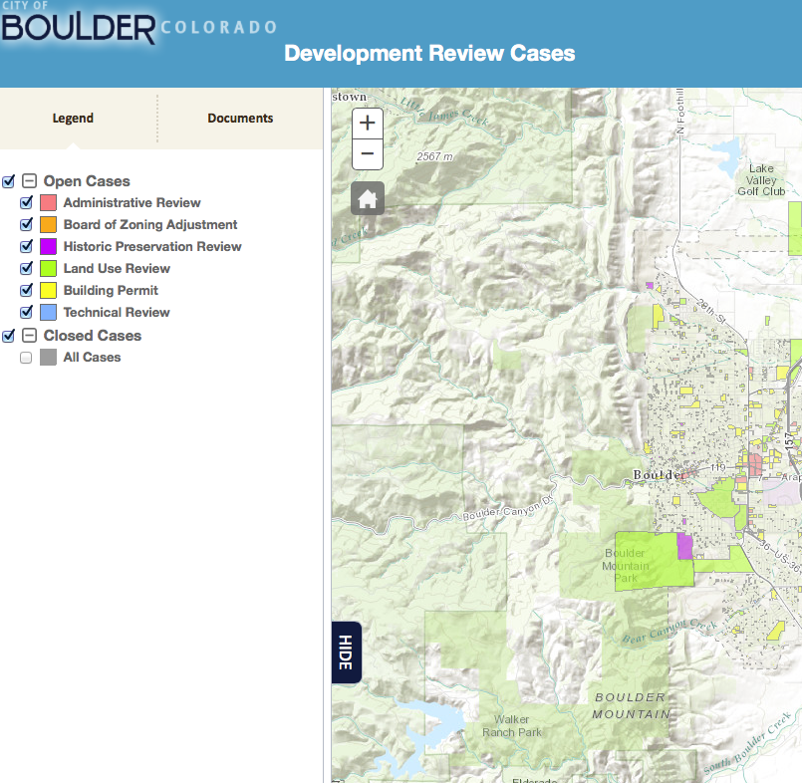
Screen 1 - Discovery

Slide 3
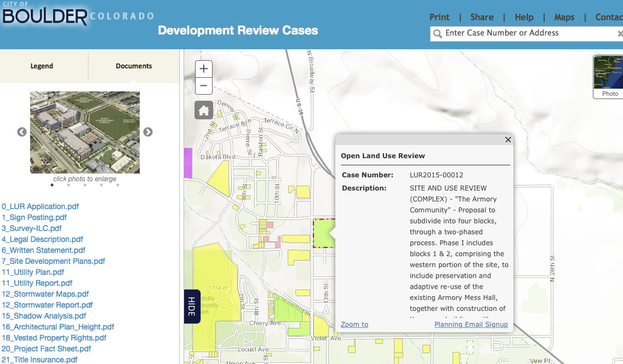
Screen 2 – Select Project
Thumbnail Description
Selected Documents
Map of Site
Non-jargon Description
Link to All Formal Submissions
Link to User Generated Info
Link to Read-only Comments
Annotated List of Documents
Status of Project
Get Involved !!

Slide 4
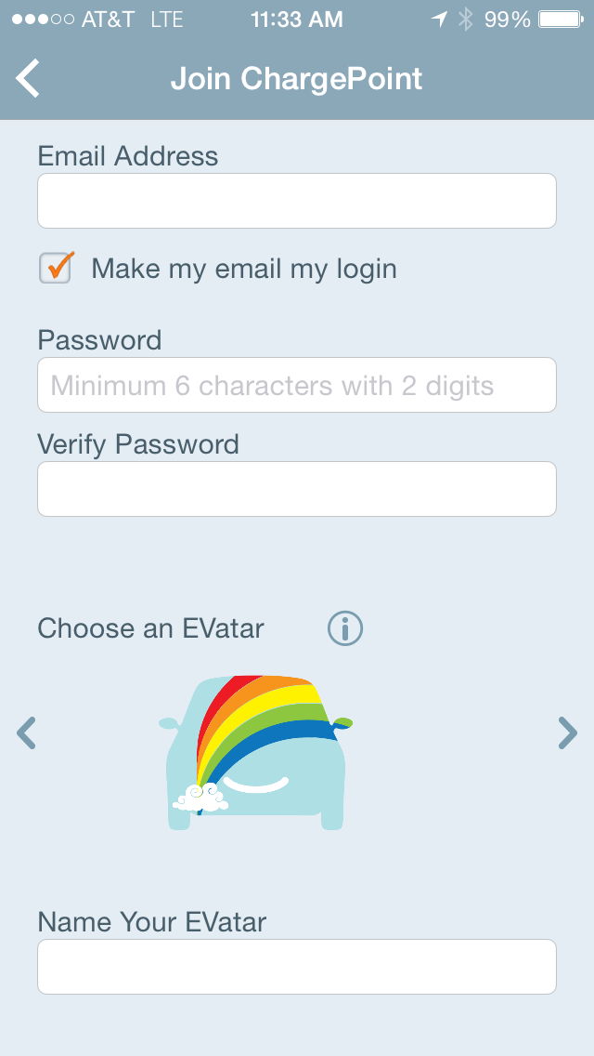
Screen 3 Create User Profile
C3PO xxxxx

Slide 5
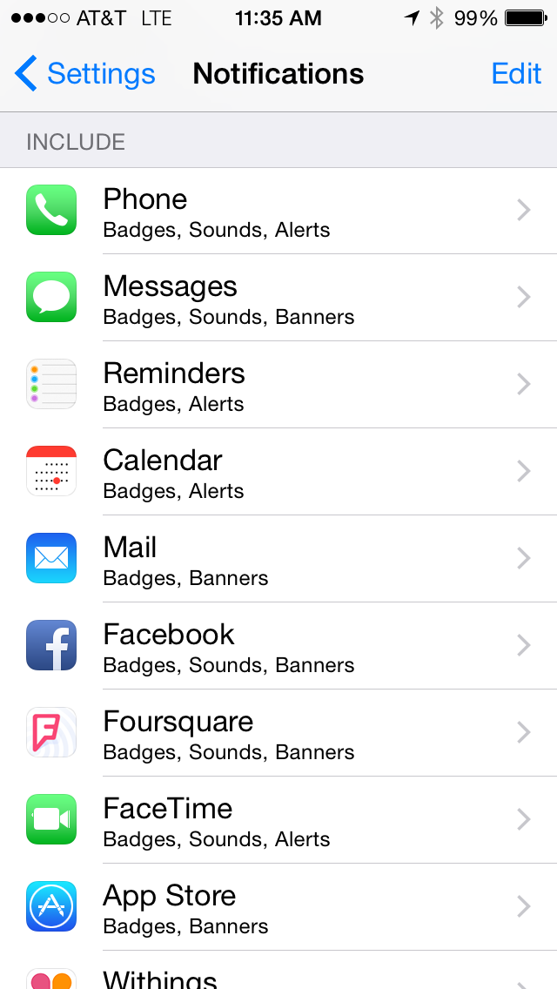
Screen 4 Notifications Module
Armory Project
✓
Boulder Junction
Comment Period Open
✓
City Council Hearing
✓
…………………………

Slide 6
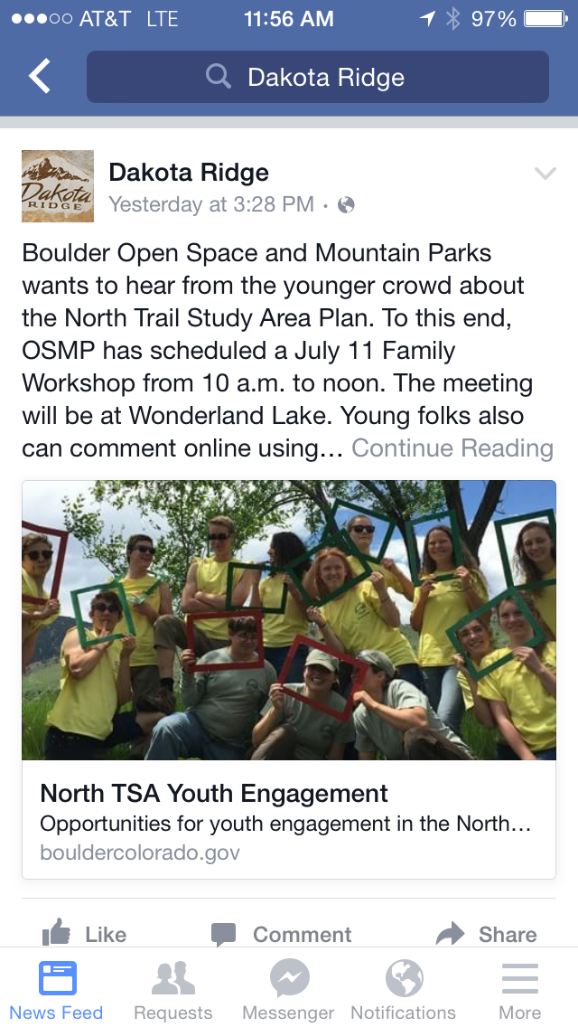
Screen 5 Participation Module

