Slide 1


Slide 2
Visualizing the Inside Journey of Recovery from Opioid Use Disorder
11
Pete Arriaza
Silvia Canelon
Vince Giorno
Alyssa Hernandez
Spriha Jha
Adnette Kamugisha
Selah Lynch
Ben Miller
Laura Mullin
Jessica Streeter
Catherine Weiss
Notes:
Hello Everyone, my name is Pete Arriaza and I will be presenting on behalf of team 11.
We have been working on, to visualizing the inside journey of recovery from Opioid Use Disorder.
During the presentation, I'll provide you with some background on the project & how we approached it.
At the end of the presentation, I hope to increase the empathy you have toward this long recovery process our community is facing.
I will start with:
Our Motivation
Our Approach to the problem
Collection of Qualitative and Quantitative data
Findings
Demo of our final product
Technical Details
What's Next
Q & A

Slide 3
Motivation
Highlight the process and the barriers
Focus on the individual
Help explain what recovery looks like and build empathy
First recovery story: Ramon Cruz
Notes:
a visualization of recovery process was requested by the DataHack partners
they asked us to highlight both the recovery process and the barriers within the process (“pain points”)
Every recovery path is unique
inspired by first recovery story we heard: Ramon Cruz.
A formerly incarcerated individual.
Circular relationship between mental illness and addiction.
Stigma of both mental illness and addiction.
Problems of access to medically assisted treatment.

Slide 4
1. Get a basic understanding
Opioid Use Disorder
What is withdrawal like? How long does it last?
Recovery
What is the referral process?
Who are the treatment providers?
How and when can a person begin treatment?
Notes:
Performed online research to get this basic understanding
Created a graphic that illustrated the referral process and the relationships between payers (insurance companies), assessment centers, and treatment centers
Began to appreciate some of the hurdles that individuals regularly encounter (these were discussed at kickoff event: lack of access to M.A.T., stigma, homelessness, … )

Slide 5
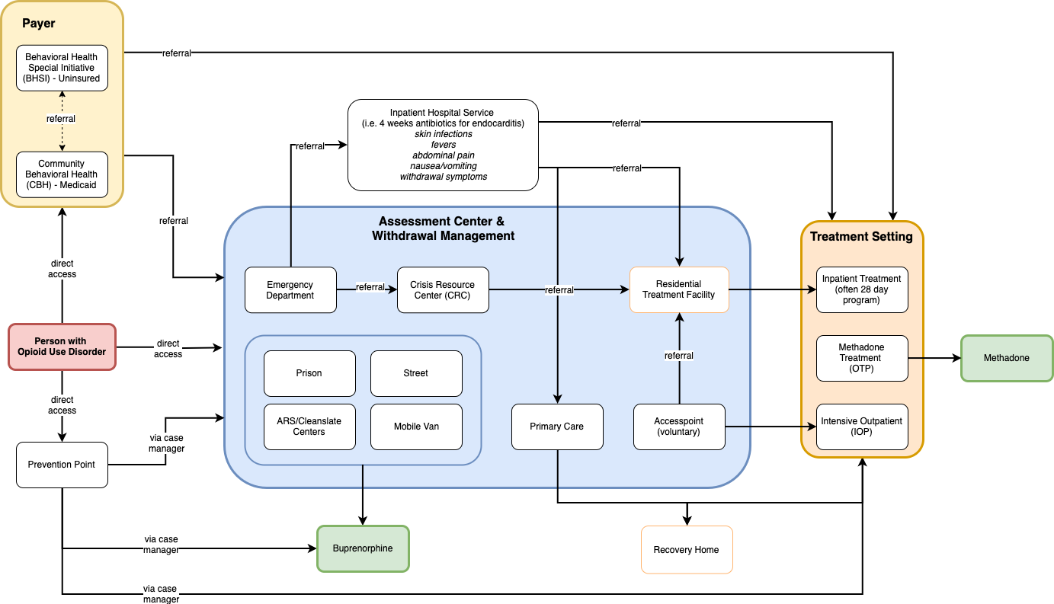
Notes:
we’ll include this graphic in our report.
we know this is to small to read
useful to highlight how complex the recovery system is
communicate that it took us a relatively long period of time to make sense of how to approach our assignment

Slide 6
2. Collect qualitative data
Interviewed partners at Health Federation of Philadelphia
Interviewed case managers at Prevention Point and recovery specialists at Penn Medicine
Found specific recovery stories online
Notes:
To understand the problem in-depth it was important for us to do additional research.
Qualitative research gave us a personal view of the problem the city of Philadelphia has been facing. Having a chance to talk to people from Prevention Point, the Health Federation of Philadelphia and reading blogs helped us understand more about what recovery looks on an individual level.
The personal stories were touching and guided us through more research and the creation of the individual narratives that we will present in the coming slides.

Slide 7
3. Collect quantitative data to support narratives
SAMHSA TEDS-A databases 2015-2017
National Institute on Drug Abuse (NIDA)
Opioid Misuse and Overdose Report February 2020 (Department of Public Health, Philadelphia)
Data from the Open Data Pennsylvania website
Notes:
“Data are just summaries of thousands of stories – tell a few of those stories to help make the data meaningful.” — Chip & Dan Heath
2. Quantitative data gave us information in a numeric form that can explain the amplitude of the stories we heard, read and researched. We collected data from the System Abuse and Mental Health Services Administration database (SAMHSA), the National Institute on Drug abuse, the Department of Public Health and the Open Data Pennsylvania Website.

Slide 8
Recurring Themes in Recovery Stories
Every recovery path is unique
Role of relapse in recovery
Importance of “mindset for recovery”
Role of long-term relationship between individuals with OUD and agencies like Prevention Point
Stigma and the role that it plays
Benefit of “lived experience”
Vulnerable populations
Notes:
every recovery path is unique and is often non-linear and without a clear end point
Recovery can include relapse. Can relapse, but it doesn’t mean that recovery is over.
Recovery can only begin when a person is ready. Until that point, their access to harm reduction education / harm reduction services is extremely important
long-term relationship with case managers: people know who to turn to when they’re ready
Stigma
if an individual was treated poorly in the past by an ER, s/he may refuse treatment in the future
some abstinence based programs don’t allow for MAT
Vivitrol programs can be manifestation of stigma because doses cannot be diverted
When case managers can share that they have “lived experience” and are in recovery themselves, it often makes individuals more comfortable. These case managers are able to offer compassion because they have been through withdrawal and some of same challenges themselves.
Vulnerable populations:
homeless
uninsured
mothers
formerly incarcerated
people with dual diagnosis of OUD and mental illness

Slide 9
Technical Details
Website is a “scrolly”
Graphics remain in place and change as reader scrolls through story
HTML can be imported as iframe and embedded in partner’s websites
Notes:
uses “scrollama” library for scrolling based events
css - position: sticky
vanilla javascript to reduce dependency size
mobile-friendly version... coming soon!

Slide 10
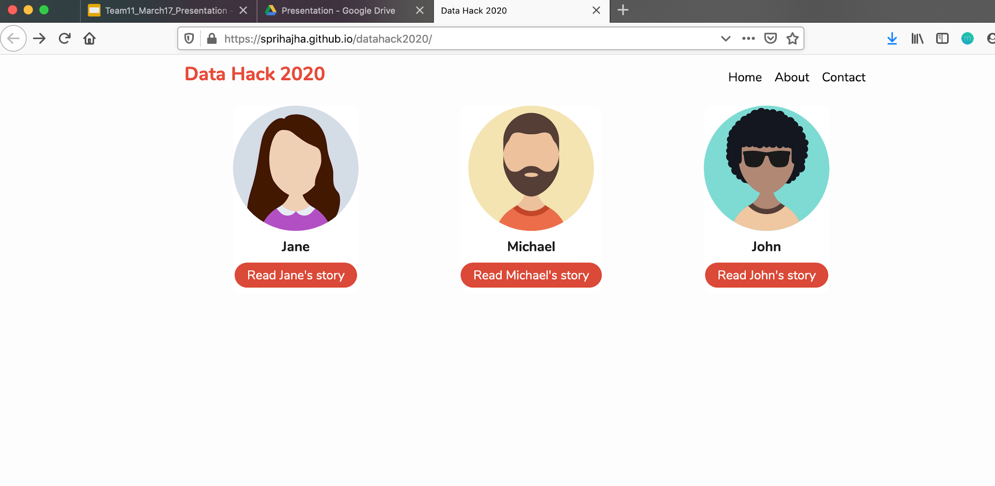
Demo
https://sprihajha.github.io/datahack2020/
Notes:
We present three narratives of individuals in recovery in the form of a storytelling web application.
Deliberately chose to focus on recovery, rather than how a person formed their addiction
Points along the timeline of each narrative are explored and explained through supporting data

Slide 11
With special thanks to:
Catherine Abrams, Anya Slizik, Health Federation of Philadelphia
Nicole O’Donnell, Bryant Rivera, Dr. Utsha Khatri, Penn Medicine
Devin Kloss, person in recovery
Megan, Stefani, Dolores, Marilyn, Andrew, and Susanna, Prevention Point
Nathaniel Lash, Philadelphia Inquirer
Notes:
Lessons learned:
came into project expecting that there would be lots of quantitative data.
however, we needed to gather our own (qualitative) data
We’ve attempted to blend the qualitative and quantitative data in a meaningful, storytelling way

Slide 12
Future Projects
Incorporate this web app into the partners’ web pages
Amend personas or create additional personas
Replace personas with actual first-person stories and include photography
Add supporting data from other Data Hack teams

Slide 13
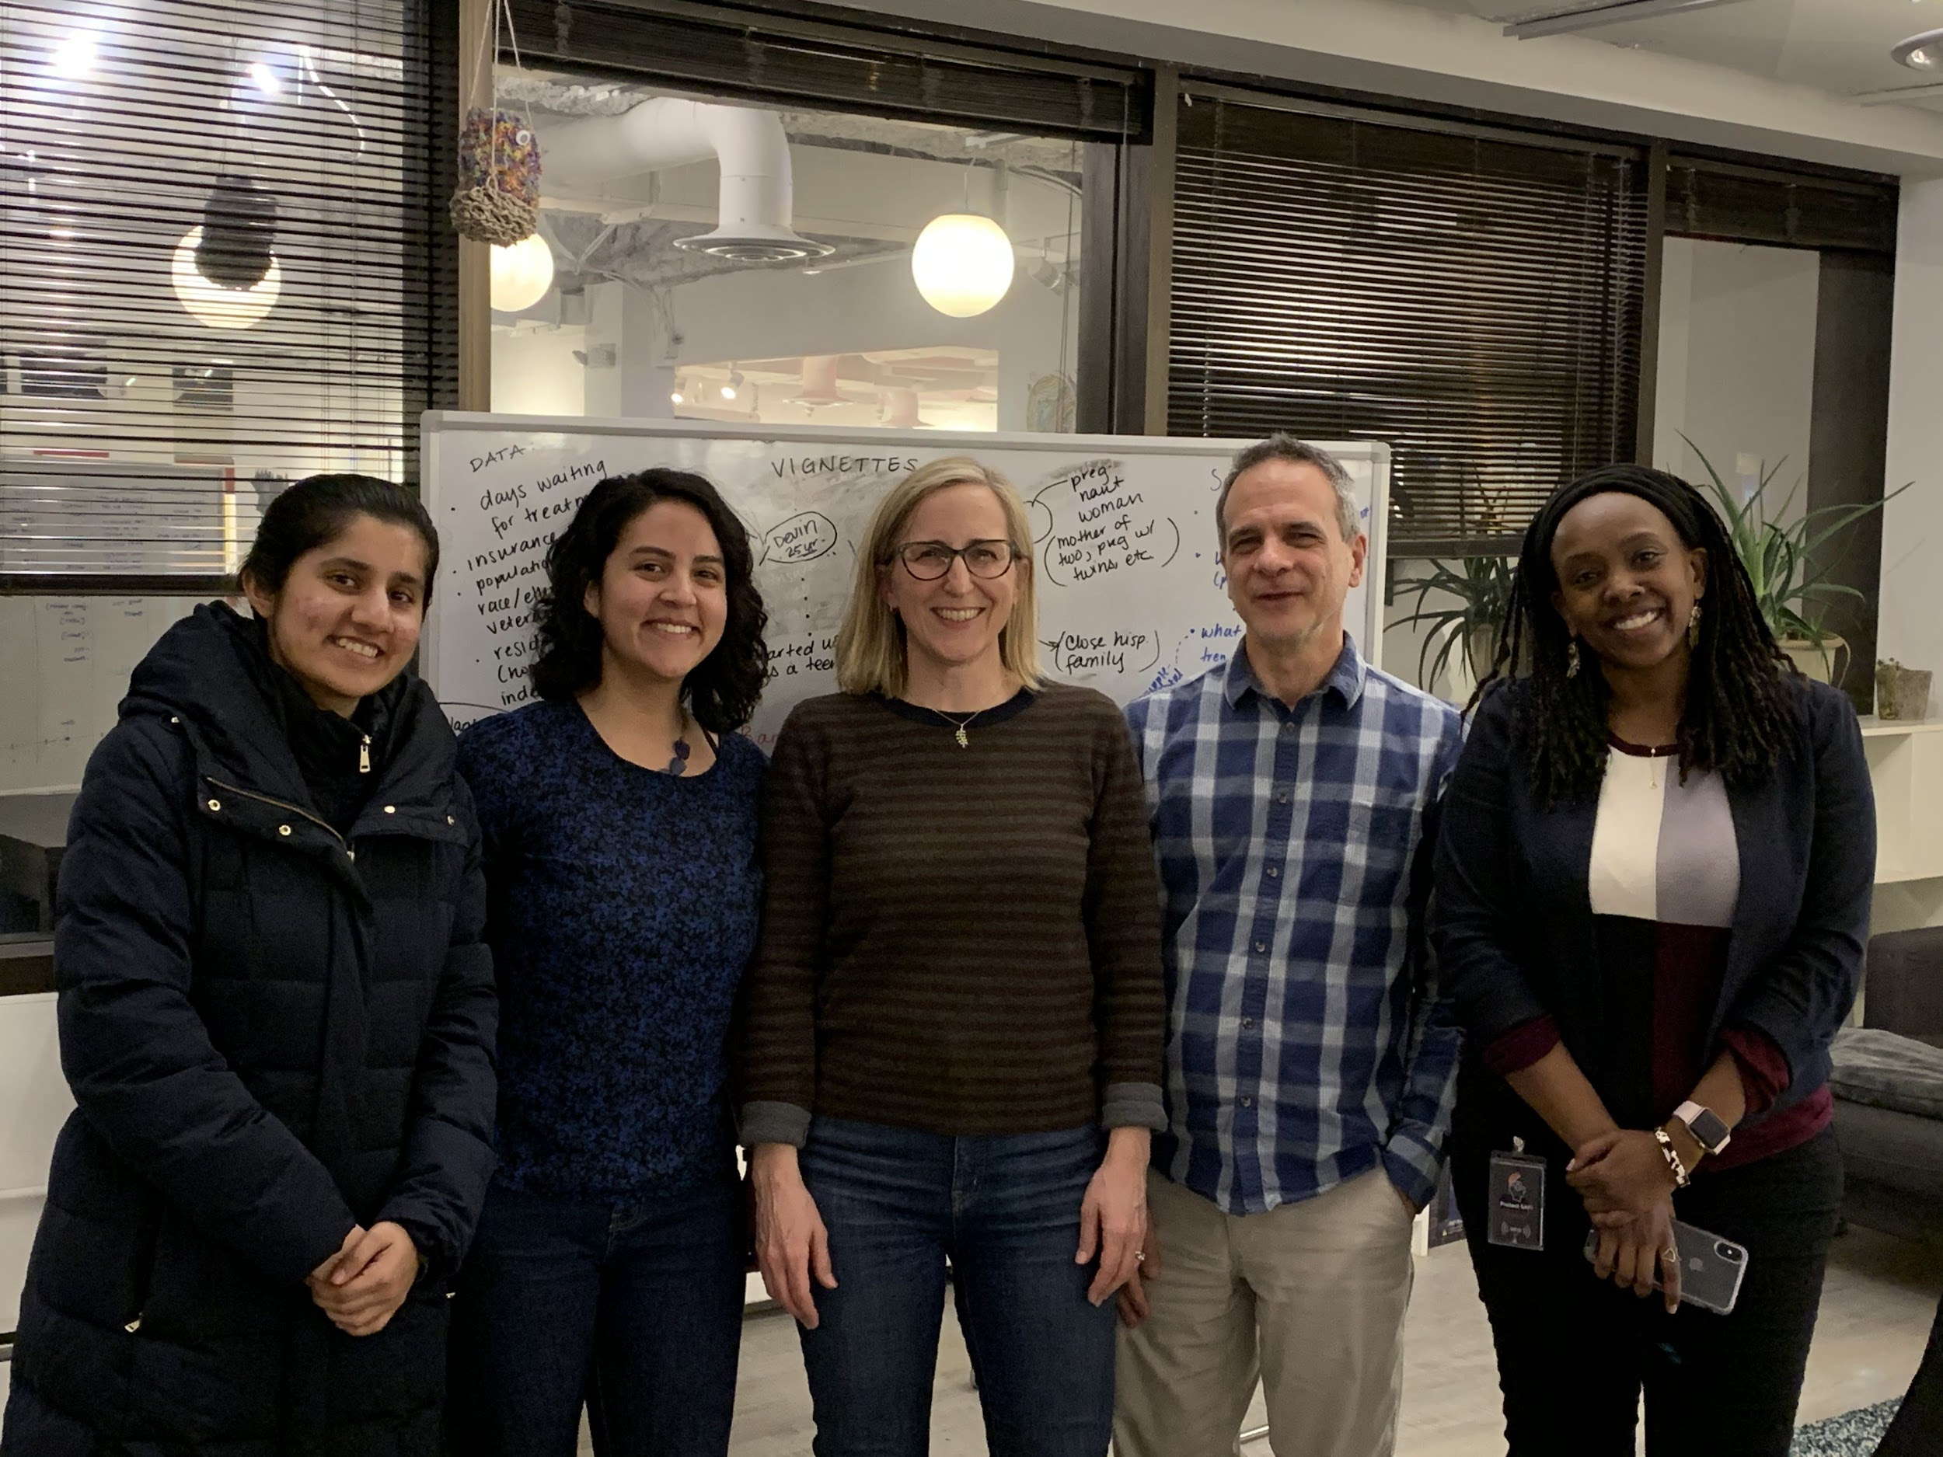




Q&A
Alyssa
Ben
Spriha
Silvia
Catherine
Vince
Adnette
Laura
Pete
Not pictured: Selah Lynch Jessica Streeter

