Slide 1
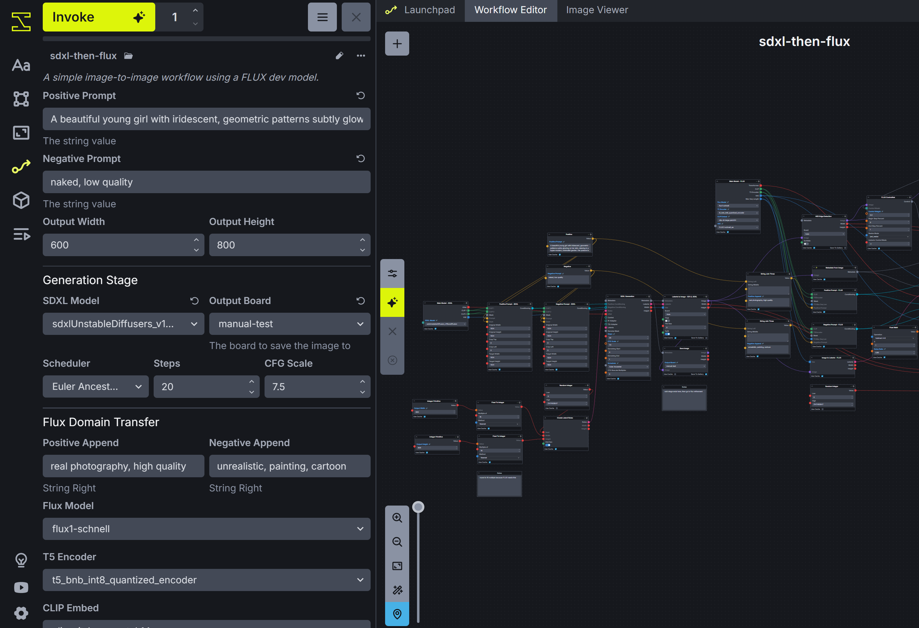
[0] IvkStringField
[1] IvkStringField
[2] IvkIntegerField
[3] IvkIntegerField
[4] IvkModelIdentifierField
[5] IvkBoardField
[6] IvkIntegerField
[5] IvkStringField
[7] IvkFloatField
[8] IvkStringField
[9] IvkStringField
[10] IvkModelIdentifierField
[11] IvkModelIdentifierField

