Slide 1
Presentation on Search Engine Optimization (SEO) at Ombryo Lab Pvt. Ltd
Student Name: | Bijay Chaudhary
TU Roll no: | 8449/17
College: | Nepal Commerce Campus
Internal Supervisor: | Mr. Nipun Thapa

Slide 2
Organization details
Name : Ombryo Lab Pvt. Ltd
Location : New Baneshwor, Kathmandu, Nepal
Website : https://ombryo.com.np/
Phone : 9860336392
Email : hr@ombryo.com.np, vacancy@ombryo.com.np
Fb : https://www.facebook.com/Ombryo-Lab-Pvt-Ltd-103216612065097

Slide 3
Introduction to organization
Ombryo Lab Pvt. Ltd. is a Startup Incubator Company registered under Company Act 2063 of Nepal.
Which aims in changing the IT Landscape of Nepal with the adoption of silicon valley culture.
It’s specialties are JavaScript & Python consulting, Software Development and Start-ups incubator among startups and mid-sized businesses(involves functions like: SEO of Website, SEO optimized content writing, Link Building & Digital Marketing of SaaS product) around the world.

Slide 4
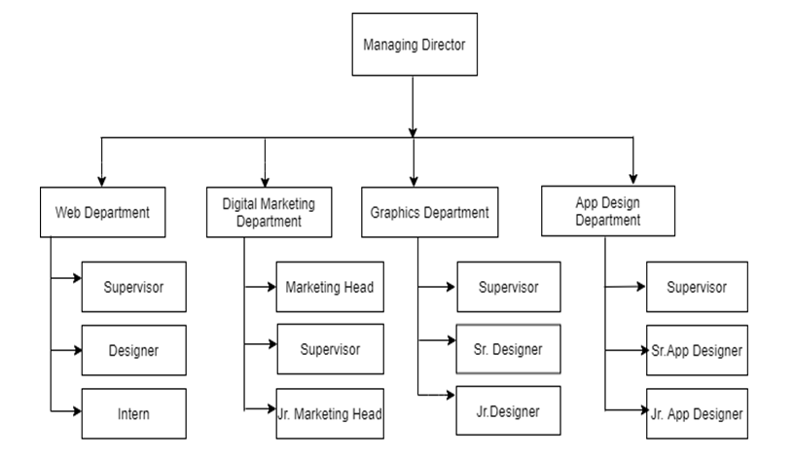
Organization Structure

Slide 5
Role in the Organization
Position | SEO(Search Engine Optimization) Intern
Roles and Responsibilities | Study and complete assigned task Assist Product SEO heads/supervisor
Duration | 90 Working Days
Start Date | 25th March, 2022
End Date | 7th July, 2022
Working Hour | 07:00 AM to 03:00 PM
Organization Supervisor | Mr. Arun Chaudhary (SEO head of krispCall.com)

Slide 6
Objective of the internship
To expose students to a particular job and a profession or industry.
To provide students with opportunity to develop skills in the field of interest.
To assist students in gaining vital work related experience and building strong résumé for bright career.
To help students in developing business contacts i.e. creating network contacts.
To help students potentially land permanent or contractual jobs from host company.

Slide 7
Methodologies
Organization Selection
Apply for vacancies
Reference by supervisor
Placement
First an interview was taken then I was placed as an SEO Trainee (Intern).

Slide 8
Activities Performed
Study about Technical, On-page & Off-page SEO.
Study krispCall.com & TimeTracko (company’s own SaaS products) and list out the Competitors & analyze their Tactics(also called SWOT Analysis).
Assist the Supervisor for the Task assigned by SEO head of the Company.
SEO Analysis(like, Website Analysis & Competitor Analysis)
Keyword Research (Google Adwords Keyword Planner)
Content Research (Buzzsumo)
Content Creation & Optimization (WordPress)
Title and Meta Description Optimization(WordPress Plugin: Yoast SEO)
Image Optimization
Off-page Optimization (Email outreach, Blog Commenting, FAQ & Social Media)
Case Study (Virtual Cloud Telephony System)
Social Media Optimization (Facebook, Twitter, Google+)
Monitoring and Reporting (Google Analytics & Google Search Console)
Customer Communication (Emails & Skype)

Slide 9
SEO Tools and Software Used
SEMrush for SEO site audit, keyword research, backlink analysis, competitor analysis and many more.
SERPfox for Search Engine Position Tracking.
Screaming Frog for manual crawling, analyzing & auditing website like a Web Spider.
Ahrefs for Link Building, Keyword Research, Competitor analysis, Rank Tracking & Site Audits.
Google Search Console for Webmasters and SEO.
Google Analytics & GSC (Google Search Console) for Testing & Verification Methods.
Facebook, Emails and Skype for communication with clients.
AnyDesk for remote computer access.
TimeTracko for attendance and leave.
WordPress for publishing Blog Contents.
Slack for task assignment & internal communication within Organization.
Google Meet & Zoom for Video Conferencing, Webinar Sessions & Meetings.

Slide 10
Conclusion and lessons learnt
Importance of time
Work in a Corporate Environment(workplace culture & tradition)
Team Work & Collaboration
Working Mechanism of Search engines
Finding Keywords for SEO Campaign
Create SEO Optimized Contents
Use different SEO Tools
Monitor, Analyze & Test SEO Results
Importance of good communication skills

Slide 11
Challenges:
A new routine
Identity
Not Enough Work
Not Enough Direction
Not Enough Feedback

Slide 12
Recommendations:
Rise in the Paid Internship
Team of SEO Experts
SEO Friendly Website
Regular Contents
Weekly Meeting Session

Slide 13
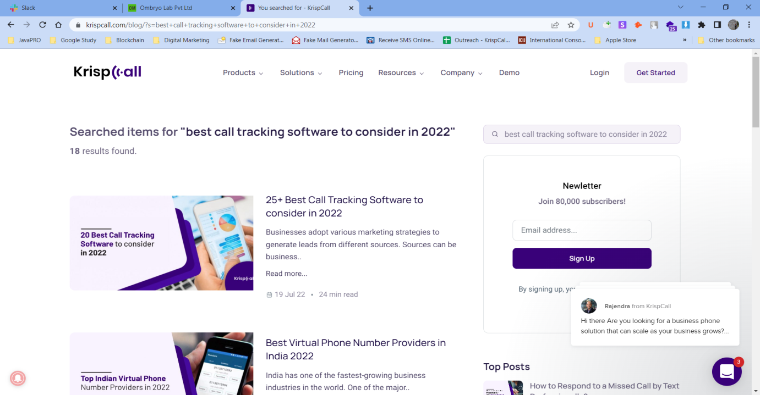
Appendices
Front-end view of krispCall.com

Slide 14
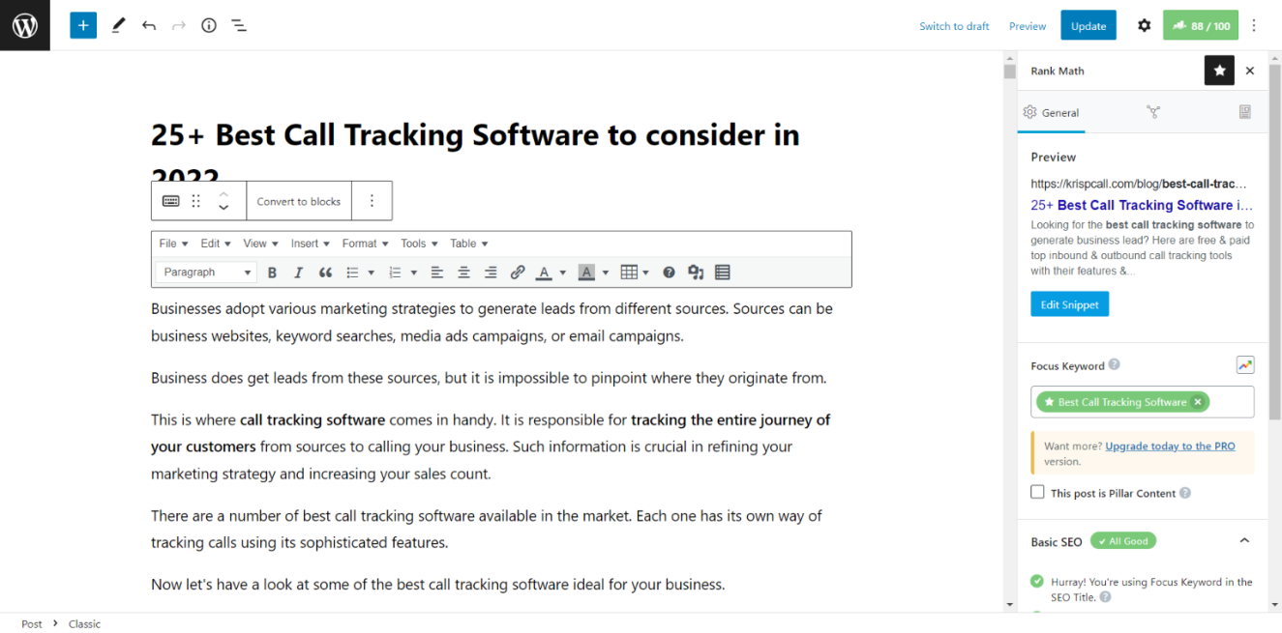
Appendices
Content Backend view- krispCall.com

Slide 15
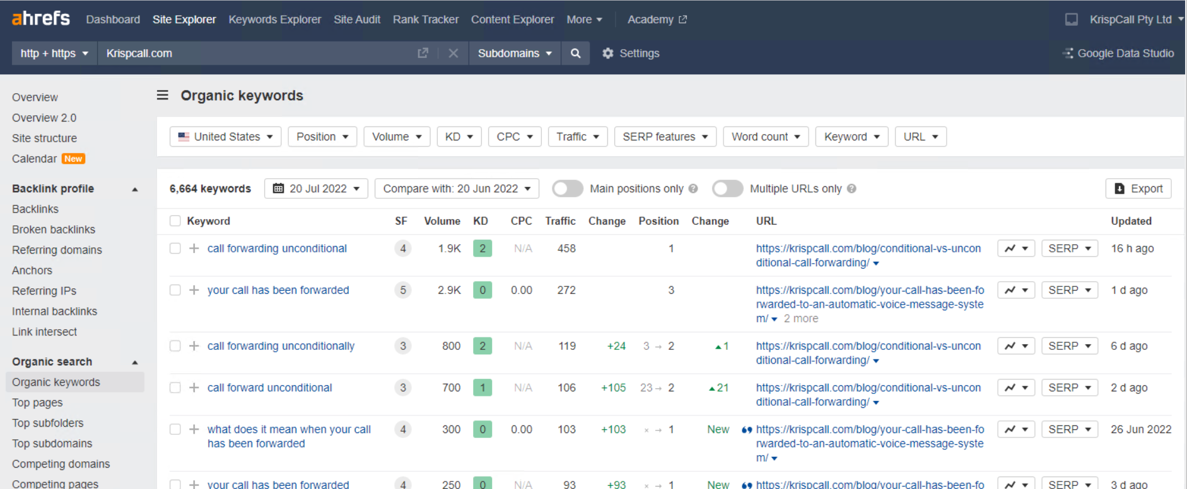
Appendices
krispCall organic Keywords

Slide 16
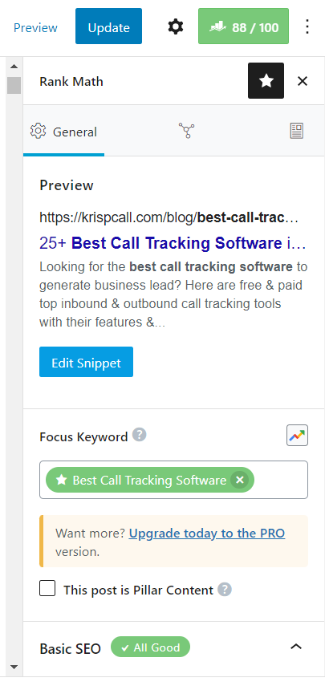
Appendices
Meta tag (focused keywords)

Slide 17
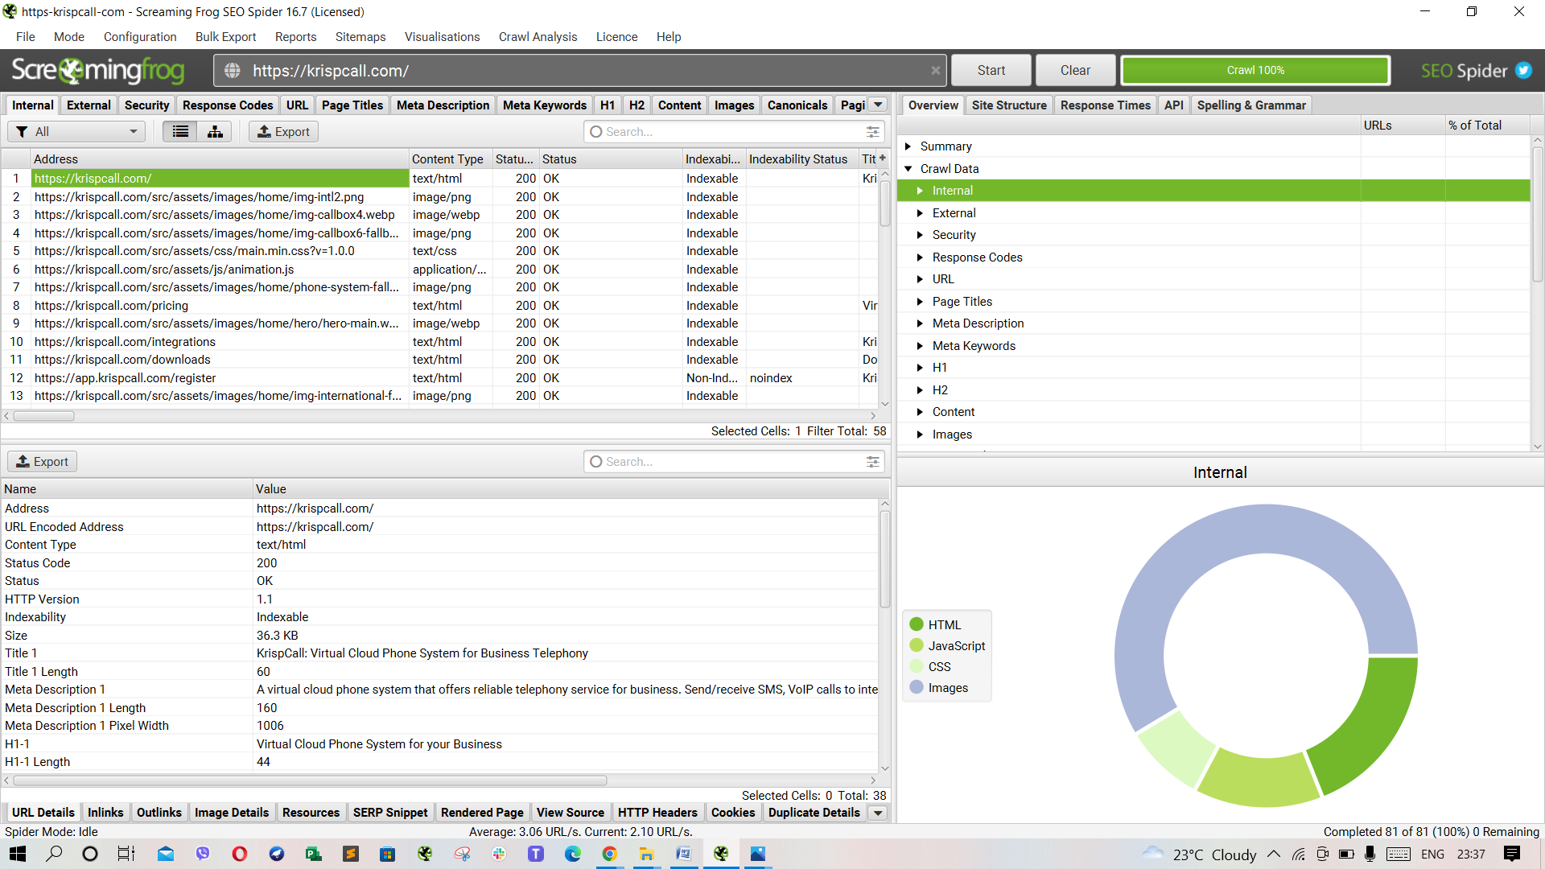
Appendices
Screaming Frog SEO Spider

Slide 18
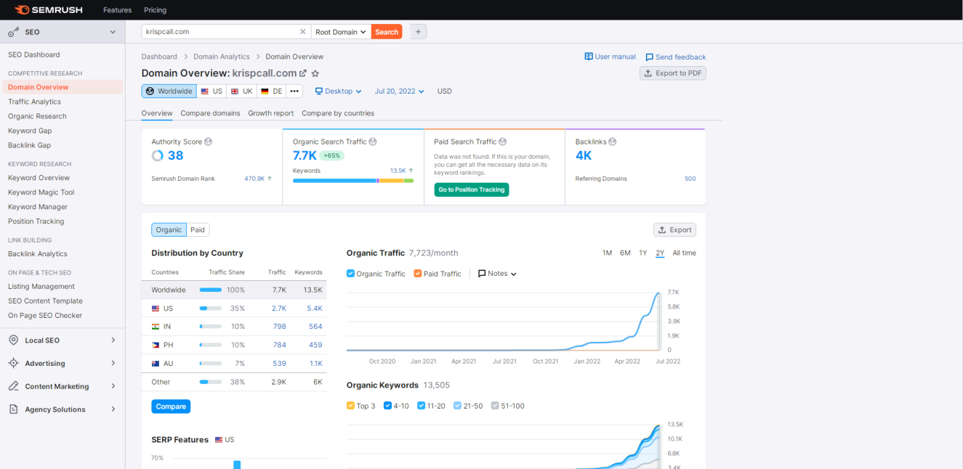
Appendices
SEMrush Dashboard

Slide 19
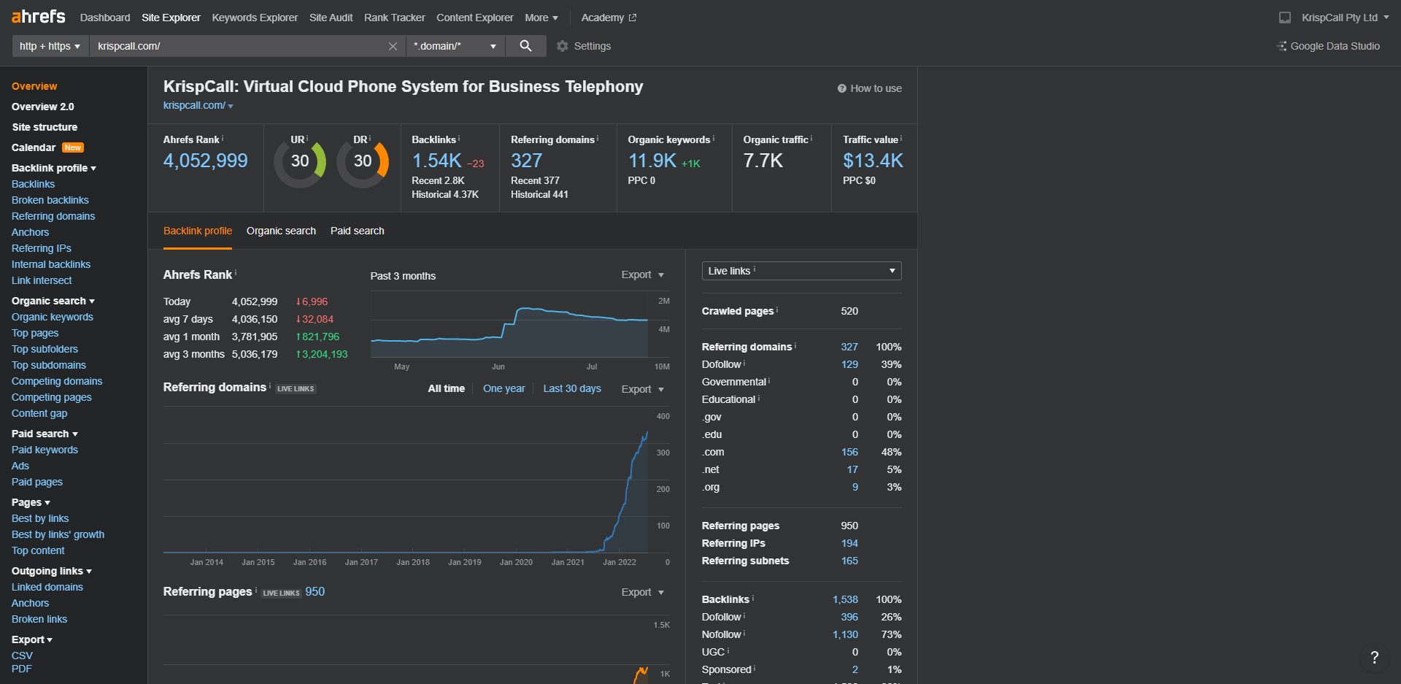
Appendices
Ahrefs Dashboard- krispCall.com

Slide 20
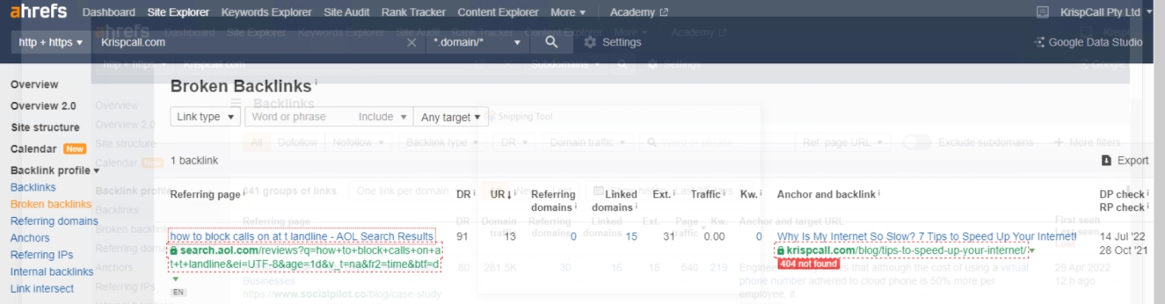
Appendices
Analysis of broken links using Ahrefs- krispCall.com

Slide 21
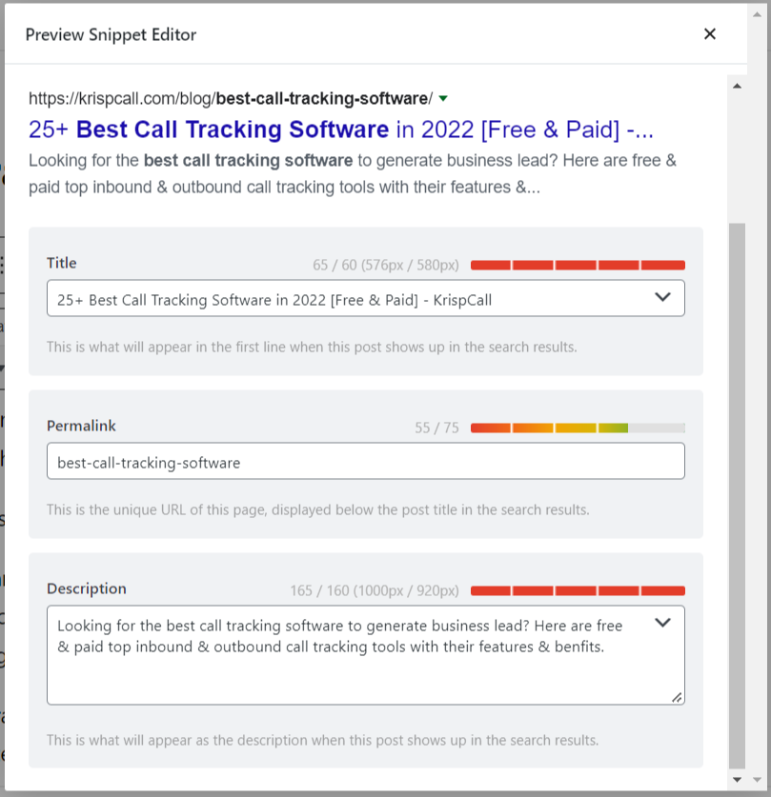
Appendices
Title and Meta Description Optimization

Slide 22
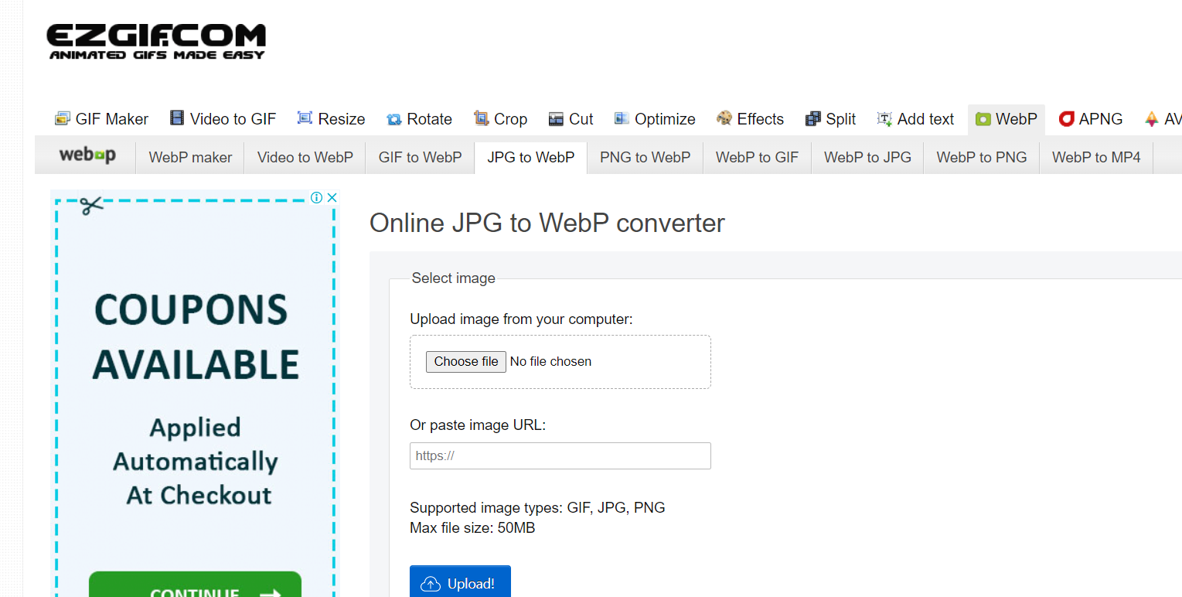
Appendices
Image Optimization- krispCall.com

Slide 23
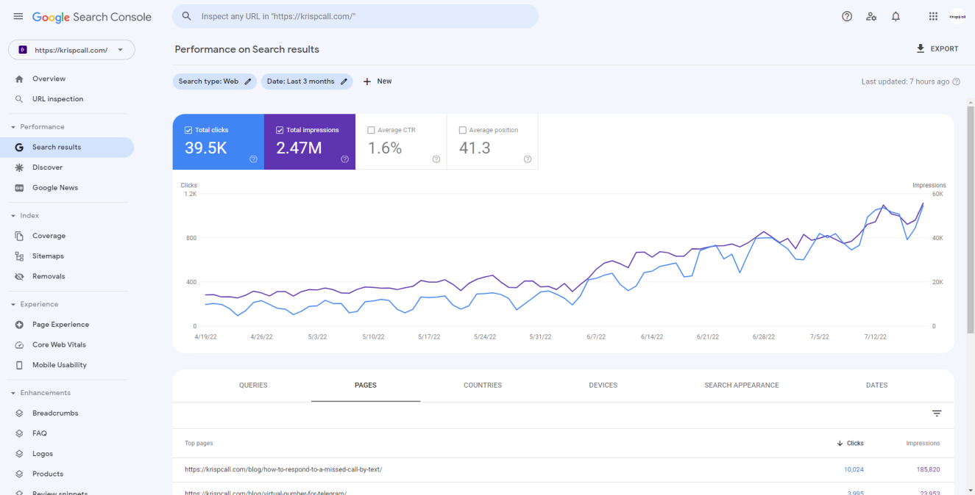
Appendices
Google Search Console

Slide 24
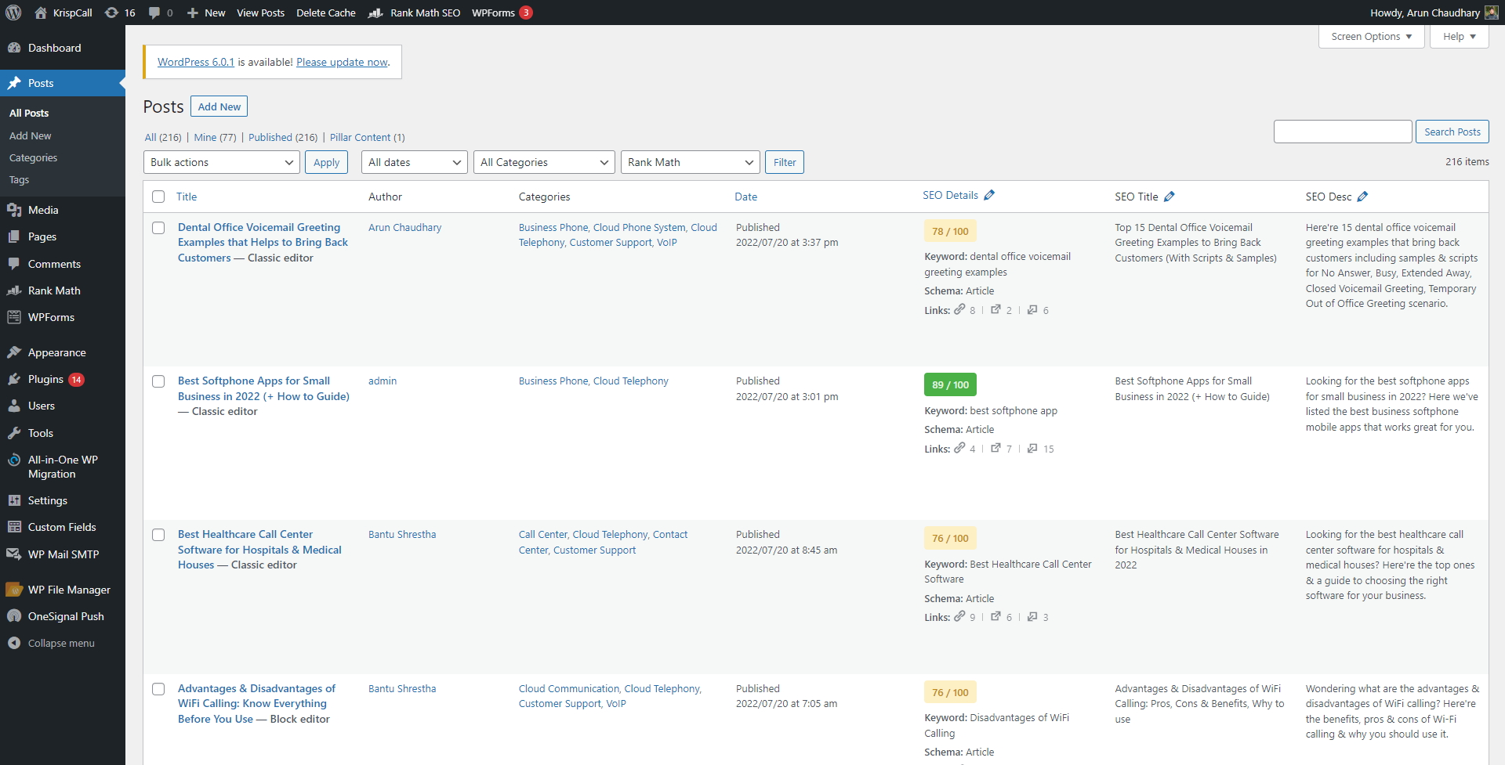
Appendices
WordPress Dashboard- krispCall.com

Slide 25
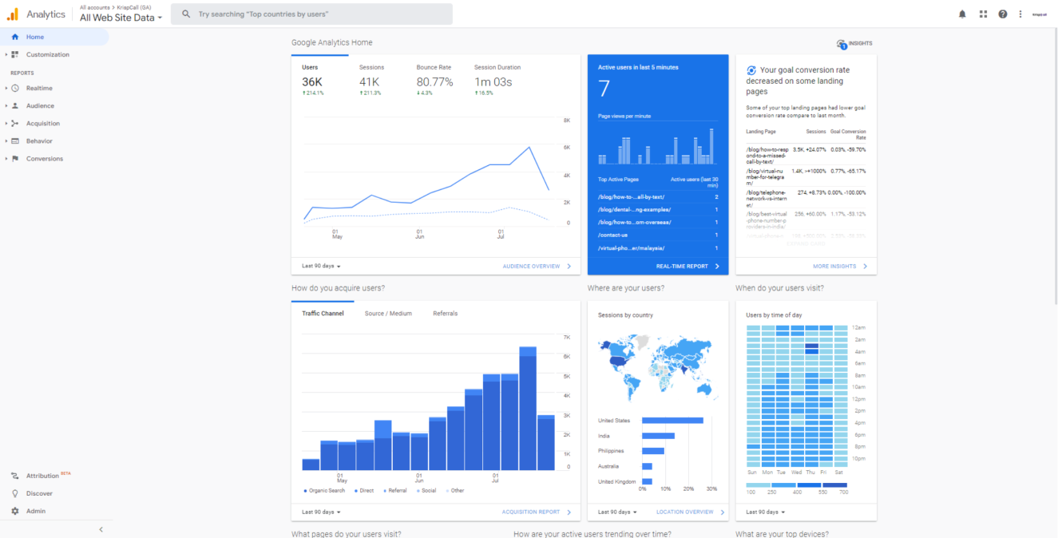
Appendices
Audience Growth using Google Analytics- krispCall.com

Slide 26
Thank you !!!
Any Questions?

