Slide 1
FACE EXPRESSION RECOGNITION
Cindy
Deep Learning Project

Slide 2


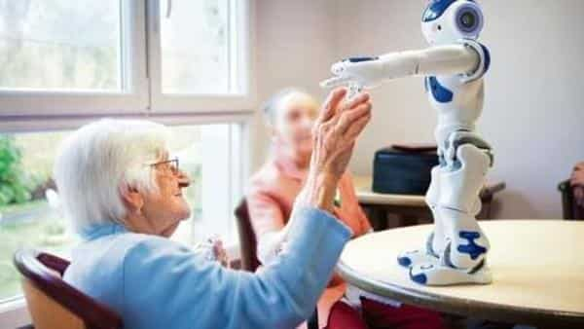
MOTIVATION

Slide 3
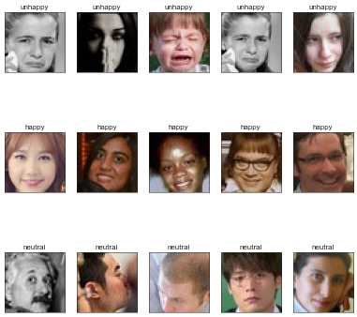
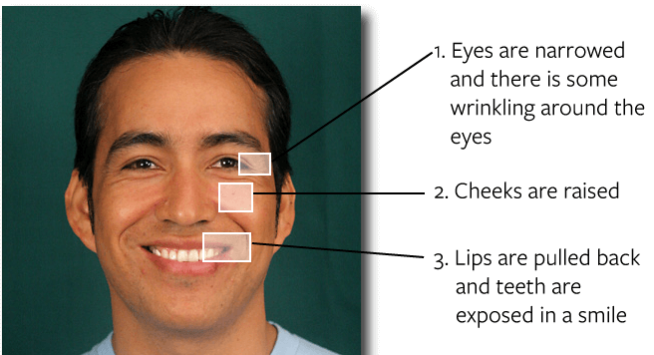
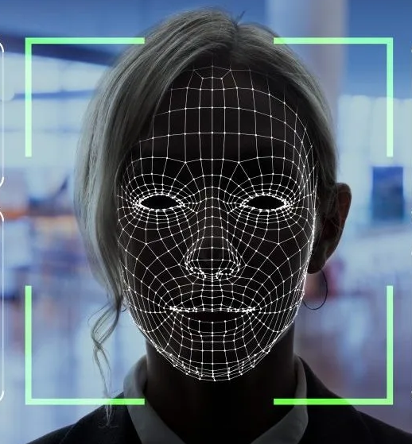
MOTIVATION

Slide 4
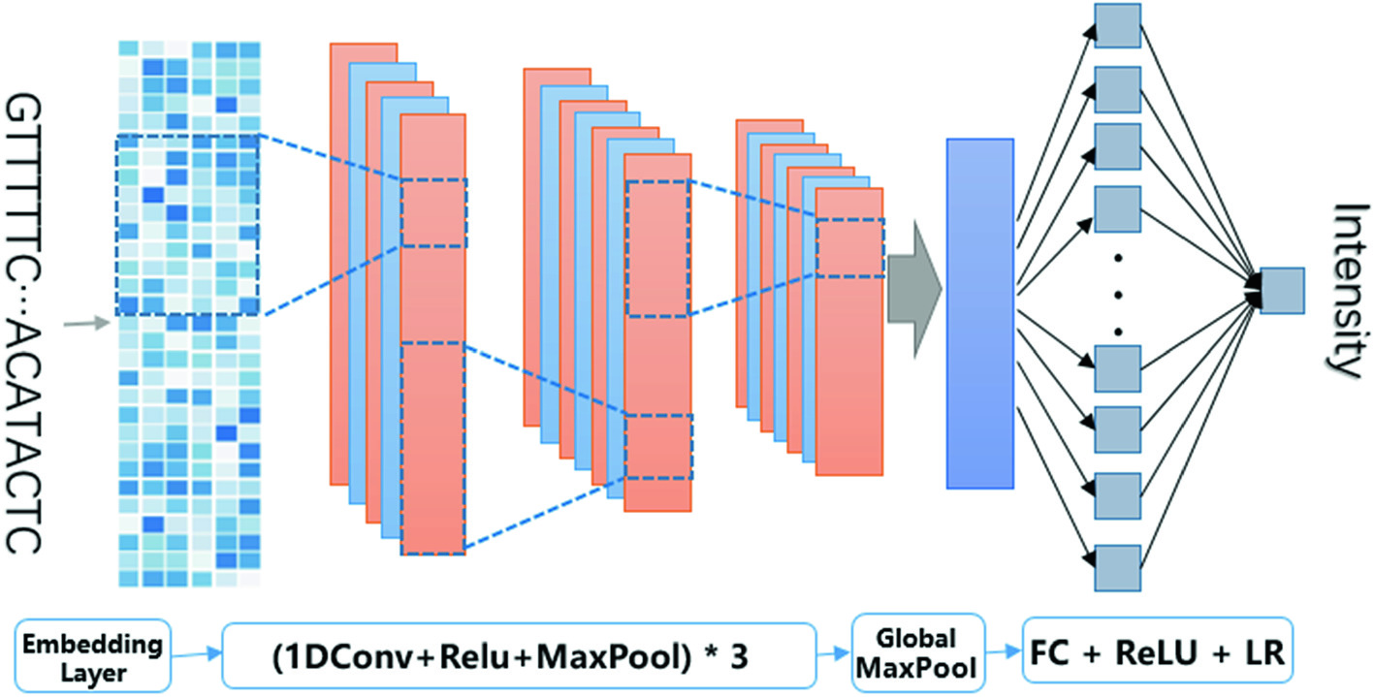
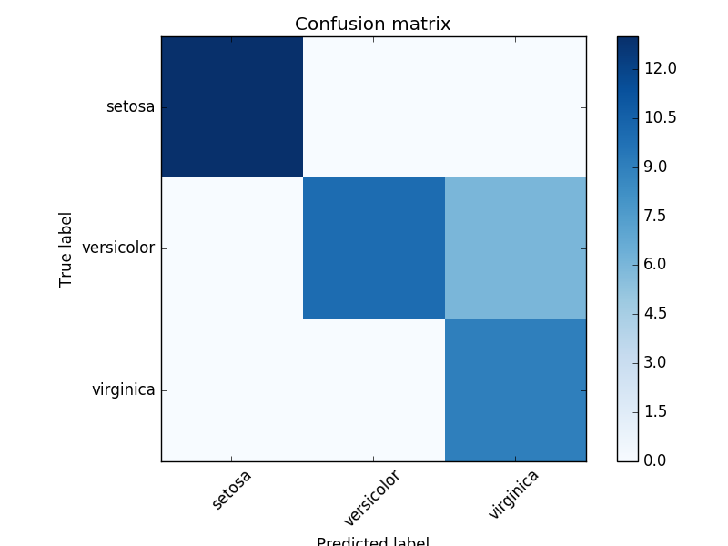
Workflow
3 Category Prediction
- Happy
- Not Happy
- Neutral
Conv2D + ReakyReLU + MaxPooling
Dense Leaky ReLU + SoftMax
Confusion Matrix/
Prediction Result
Image Dataset (Kaggle)
35886 images

Slide 5
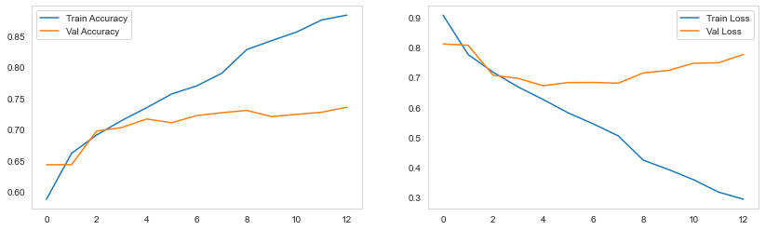
Result
Accuracy:
0.71

Slide 6
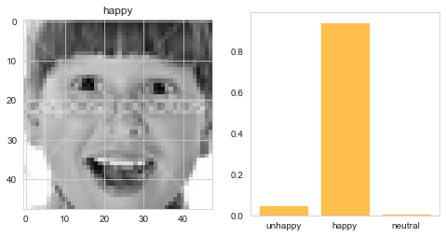
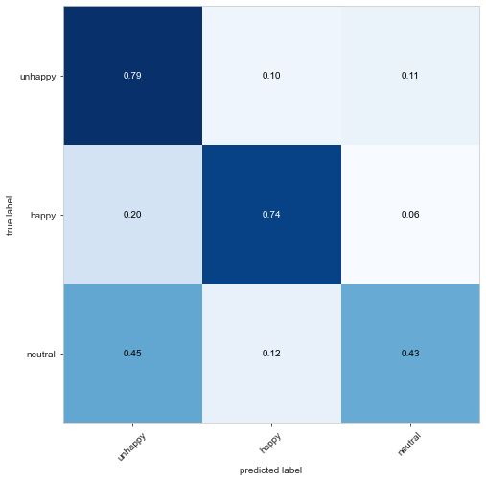
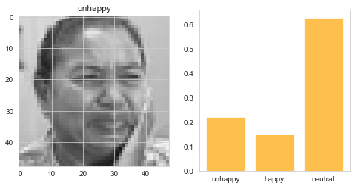
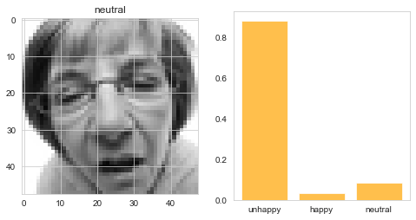
Result

Slide 7
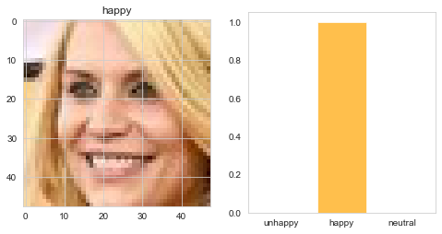
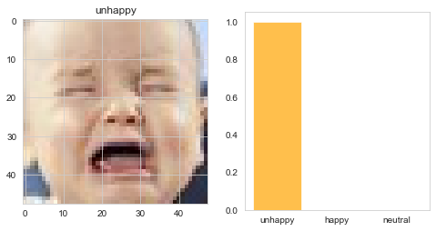
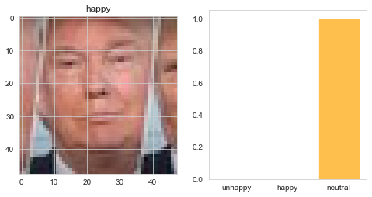
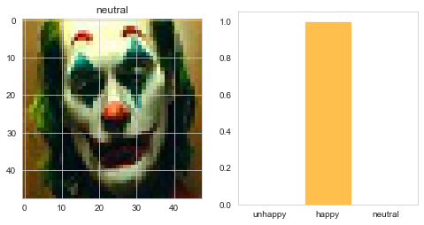
Weak in identifying fake expression

Slide 8
Future work
Build a more robust model to solve overfitting
Identify more expressions – Angry, Sad, Disgust, Fear
Build Face detection model to work with more face images data
Data Augmentation

Slide 9

Thank you

