Slide 1
Welcome!

Slide 2

About Me
Full-time software engineer in the field of cybersecurity
Part-time Computer Science lecturer with CodeIT
Our aim is to help students learn the fundamentals of Computer Science, and be able to apply what they learn to solve problems and pick up new software skills

Slide 3
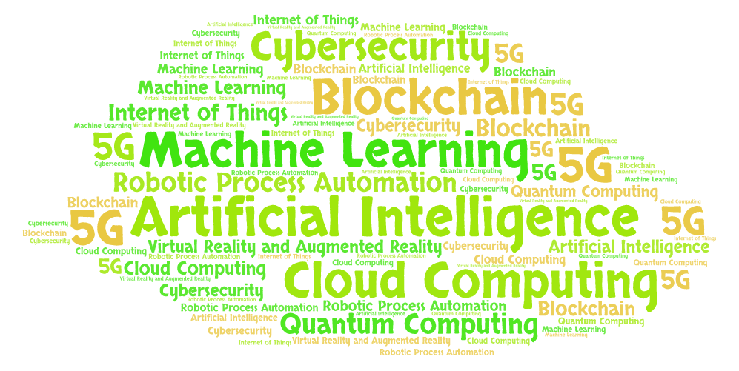
Top trends in tech
Notes:
Generated by https://wordart.com/

Slide 4
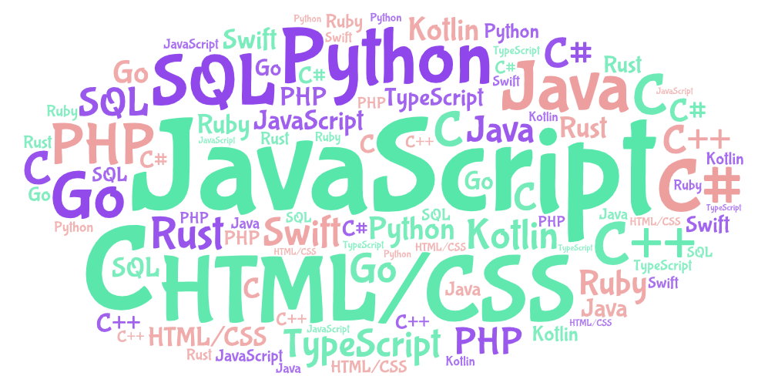
Top programming languages

Slide 5
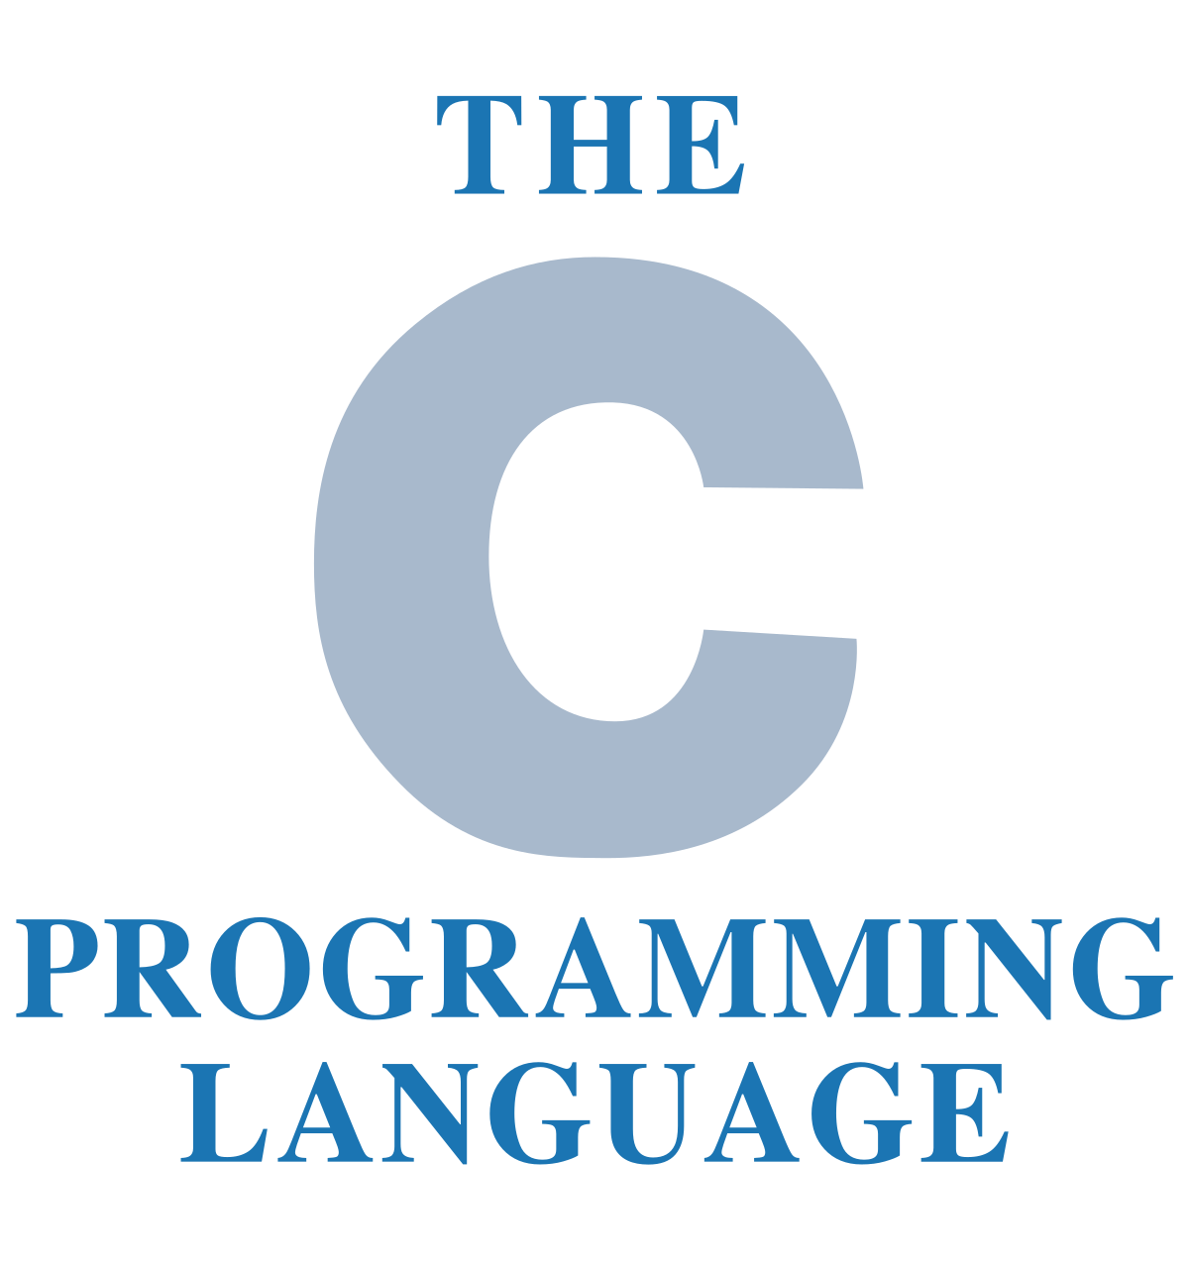

What you’ll learn in this course
Fundamentals of the C programming language
Fundamentals of the Python programming language
How to think and solve problems

Slide 6
What is a program?
Computers are machines. They don’t think for themselves. They need us to tell them what to do.
We need a way to tell our computers to do what we want them to, but computers don’t understand English.
Writing code is a way for us to talk to our computers by giving them instructions.
A special program, called a compiler, translates our code into a special language called machine language which computers can understand. Machine language is written in binary.

Slide 7
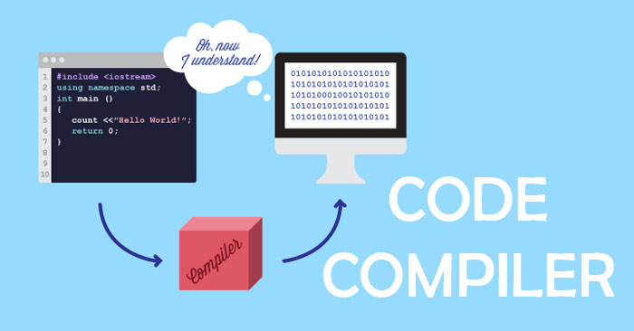

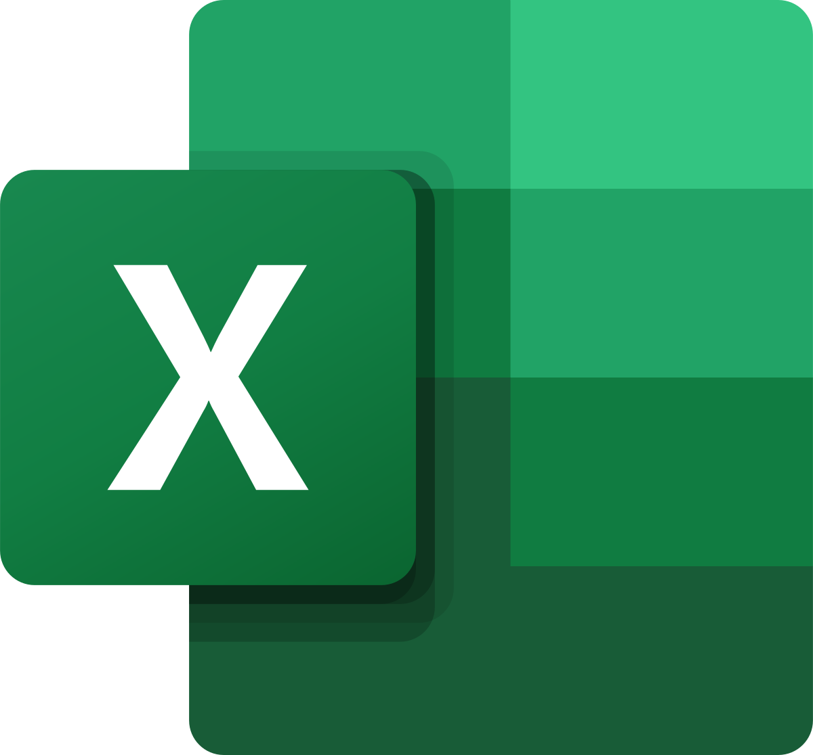

Source code
Machine language

Slide 8
The C programming language
Levels of abstraction – a higher level language describes instructions in a more abstract form
For example, machine language is the lowest level language. It is the least abstract. Machine language consists of precise instructions that only a computer can understand
C is a higher level language. It combines the precise instructions from machine language into abstract instructions that we as humans can understand
C can be a high or low level programming language, depending on how you look at it. It is of a higher level than machine language, but of a lower level than Python. Higher level languages are much easier to learn and understand!

Slide 9
The C programming language
C programming helps you to understand better how computers work
A foundation in C makes it easier to learn other programming languages
C programming is very widely used. Here are some of them:
To program operating systems, like Windows and Linux – this is the software that powers your desktops, laptops, and mobile phones!
To program embedded systems – these include microcontrollers and processors that are used to power robots, IoT devices, automobiles, and many more!
To develop powerful applications, such as Microsoft Office programs, graphic design tools, computer games, and many more!

Slide 10
Steps of writing a program
Define the program objectives
Design the program
Write the code
Compile
Run the program
Test and debug the program

Slide 11
Your first Hello World program
This is your first step to being a programmer
In any new programming language we learn, the first thing we do is to learn how to show “Hello World” on our screen
If you see the words “Hello World” appear on your screen, it means you have written your code correctly, and you are able to run your program!

Slide 12
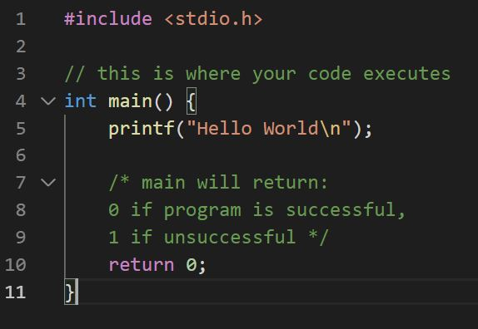
Your first Hello World program
This is a comment. Comments should start with 2 forward slashes, or /* */. Comments are ignored and do not run like the rest of the code. They are only for people to read. Always make it a habit to write comments.
Every program must have a main() function. This is where the computer starts running the program. If you don’t have a main function, your compiler cannot compile your code and you cannot run your code.
All functions should have an opening and closing curly braces
This is a built-in C function that lets your print (show) output onto screen
All statements should end with a semicolon.
Spaces, newlines, tabs, extra semicolons are ignored by the C compiler, but they are good for readability
The main() function must have a return statement. This returns the number 0 or 1 based on whether the program was run successfully or not
1
2
1
2
3
4
5
6
3
4
1
5
7
6
7

Slide 13
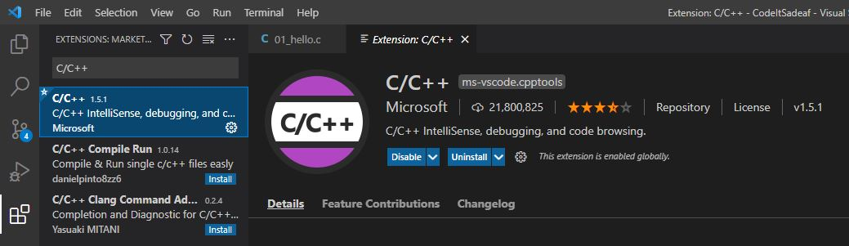
Install C/C++ extension

Slide 14
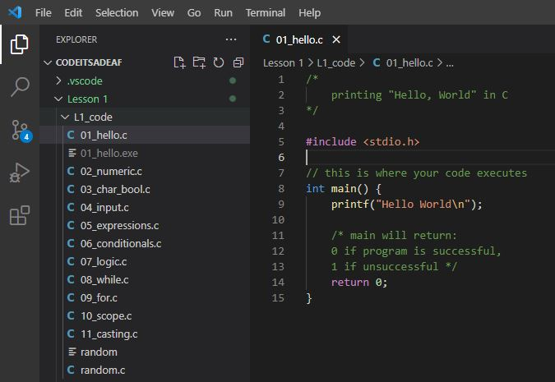
Open 01_hello.c

Slide 15
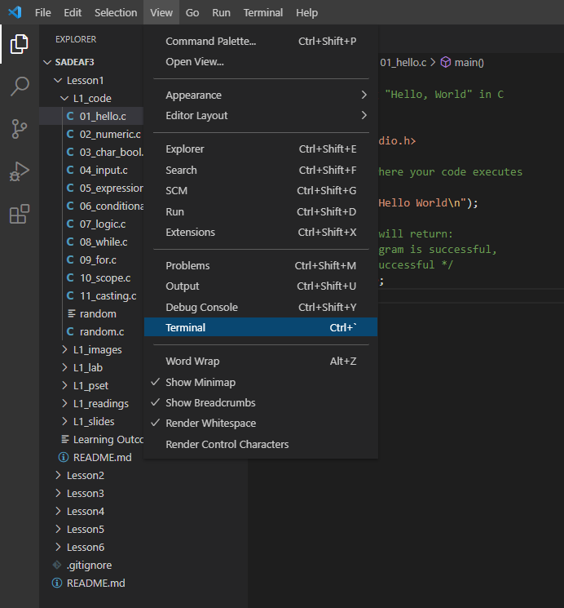
Click View -> Terminal.

Slide 16
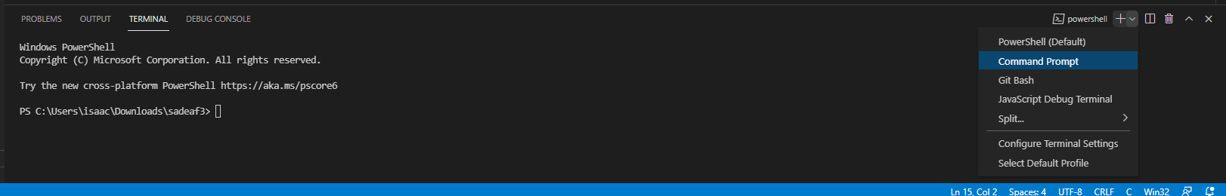
The Terminal window appears at bottom of editor. Click on the top right and change to Command Prompt.

Slide 17
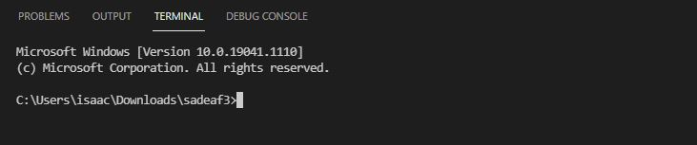
You are now using Command Prompt in the Visual Studio Code terminal.
By default, you will be in the directory where you opened your project.

Slide 18
Running our first program
We now have to run through steps 3-5 of writing a program:
Write the code
Compile
Run the program
We have already written the code.
Now let’s compile our code. We will use a program called gcc to compile our code.

Slide 19
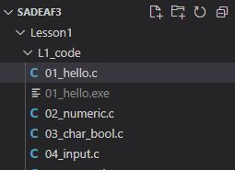
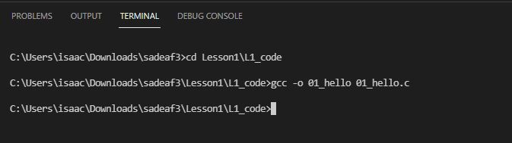
Using gcc to compile code
We need to first change directories to the folder L1_code where our code resides.
Type in the following and press Enter. This will compile our code and create a binary file called 01_hello.exe. This is the file that contains the machine language!

Slide 20
Using gcc to compile code
Let’s take a closer look at what we typed into the command prompt
Output binary file
File containing source code
gcc program

Slide 21
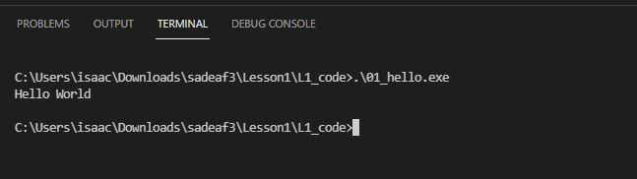
Hello World Output
Now we need to run the program. Type the following to run the program, and we see our “Hello World” output.
Output

Slide 22
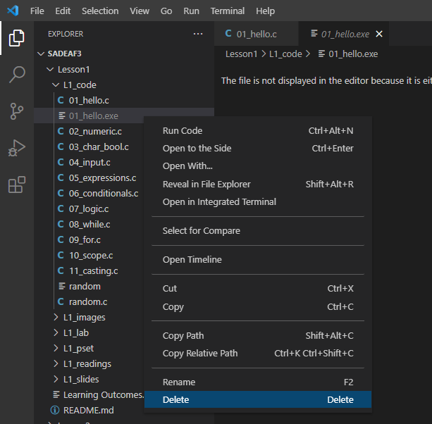
Using Run Build Task to compile code
Now let’s look at a shortcut in Visual Studio Code to compile your code.
Let’s first delete our binary file so we can see that the shortcut actually works.

Slide 23
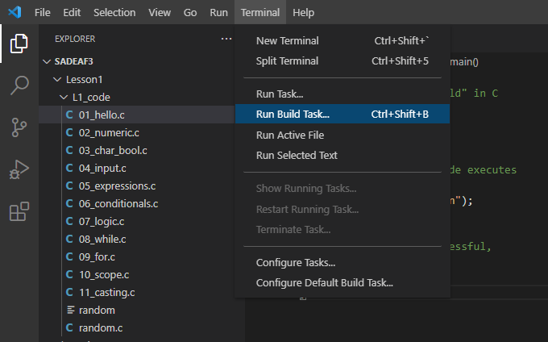
Using Run Build Task to compile code
Next, with our file 01_hello.c open, click on Terminal -> Run Build Task

Slide 24
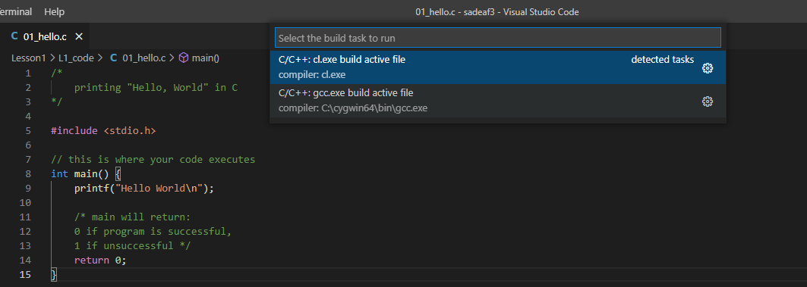
Using Run Build Task to compile code
My gcc compiler path
A window should pop up asking you to choose your compiler. Choose your gcc compiler path

Slide 25
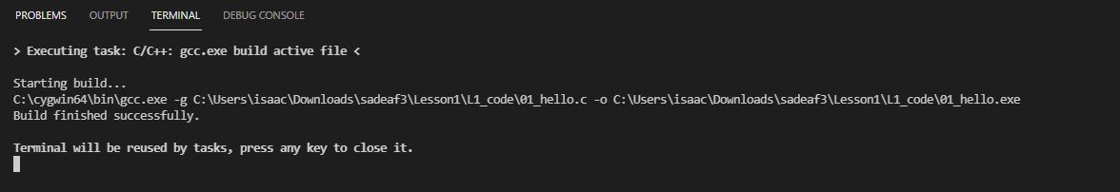
gcc compiling your code
Your code will now be compiled by gcc. A binary file called 01_hello.exe is once again created. Press Enter to go back to Command Prompt.

Slide 26
Hello World Output
Now run the program again. Type the following to run the program, and we see our “Hello World” output.
Output

Slide 27
Variables
To allow our programs to do more powerful things, they need to store and manipulate data. Variables are used to store our data types and save them for further use in the program. They are essentially names that we can use to access a specific data. You can also think of them as boxes in your computer’s memory that hold the data.
Variables of a certain data type can only hold data of that type
x
4
Variable name
Data

Slide 28
Naming variables
There are rules to naming variables:
Variable names should only contain letters, numbers, or underscores
Variable names must begin with a letter
You can’t have two variables in the same program with the same name
Valid variable names:
myData
pay94,
age_limit
Amount
Qt1yIncome
Invalid variable names:
94Pay
my Age
lastname, firstname

Slide 29
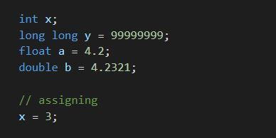
Declare, initialize, assign variables
1
Declare/define variables – state the variable’s type and name. This lets your computer know to allocate memory space for your variable
Initialize variables – sets an initial value for the variable when you declare it
Assign a value to a variable. The variable must have already been declared. Assigning a value uses the assignment operator (=) to put a value into the variable
2
1
3
2
3

Slide 30
Data types
Examples of data types:
numbers, decimals, characters, strings etc.

Slide 31
Data types – numeric data types
Integers
Whole numbers (can be signed or unsigned)
Range of signed integers: -2,147,483,648 to 2,147,483,647
Range of unsigned integers: 0 to 4,294,967,295
Long long
Whole numbers like integers, but with bigger range
Range of signed long long: -9,223,372,036,854,775,808 to 9,223,372,036,854,775,807
Range of unsigned long long: 0 to 18,446,744,073,709,551,615
Floats
Decimals (signed), range indicates the precision
Range: 3.4 × 10⁻³⁸ to 3.4 × 10³⁸
Doubles
Decimals (signed), higher precision than float
Range: 1.7 × 10⁻³⁰⁸ to 1.7 × 10³⁰⁸

Slide 32
Data types – numeric data types
Data type | Examples
int | 1 -10,000 2,147,483,000
long long | 1 -10,000 -36,854,775,808
Float | 1.00 -3.1415 3762891.56743
Double | 1.00 0.0000001423 1.4 × 10⁻³⁰⁸

Slide 33
Data types – char data type
A character is any single character your computer can represent.
Since computers can only understand numbers, an ASCII code is used as the numerical representation of a character. The ASCII table contains the mappings between ASCII codes and the characters they represent
Your computer can understand 256 different characters, some printable, some non-printable.
To specify printable characters, enclose them in single quotes - ‘’

Slide 34
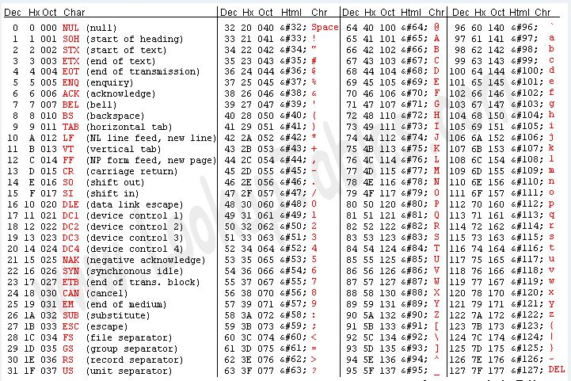
Data types – char data type

Slide 35
Data types – char data type
Some examples of characters:
‘a’, ‘B’, ‘ ‘, ‘!’, ‘1’, ‘9’, ‘\n’
Things to note:
‘ ‘ indicates a space character
Characters such as ‘1’ and ‘9’ are characters and not integers
‘\n’ is called the newline character

Slide 36
Data types – bool data type
The Boolean data type only contains 2 possible values – true or false.
Booleans are also represented by numbers. 1 represents true, and 0 represents false
Booleans are often used in conditional expressions, which we will learn later
Examples of Booleans:
true, false

Slide 37
Any questions?
Notes:
Zoom poll (name the data type):
- List various data types in quick succession

Slide 38
Input and output
For your program to interact with users, it needs to be able to read input and print output.
printf() function prints formatted data onto the output screen
scanf() function reads formatted data from standard input (stdin), which is usually the keyboard
These 2 functions are built-in C functions that are part of the stdio.h library, the standard input/output library. A library is just a file containing code which other programmers can use. We call such files header files. To use the library, you need to include the header file in your program

Slide 39


Input and output – printf
The simplest use of the function printf() – takes in a C string as its only argument.
More complex use of the function printf() with more arguments – the C string can include format specifiers (sequences of characters beginning with %). The additional arguments are formatted and inserted into the string replacing their respective specifiers
21

Slide 40


Input and output – scanf
Data is read from standard input according to the format specified and stored in the variables pointed to by the additional arguments
21
User input

Slide 41
Input and output – format specifiers
Format specifiers lets your program know what is the data type of the data you want to print, so your program can print it correctly
Data type | Format specifier
int | %d
long long | %lld
float | %f
double | %lf
char | %c
Notes:
Run through 04_input.c

Slide 42
Arithmetic expressions
One of the most fundamental things a computer needs to do is arithmetic!
Operators (symbols used to perform a calculation or other task):
+ (addition)
- (subtraction)
* (multiplication)
/ (division)
% (modulus – calculates the remainder after a division)
= (assignment operator – assigns a value to a variable)
Operands:
Variables or values on either side of the operators, which the operators work on
Expressions:
A combination of operands and operators that results in a numeric value

Slide 43
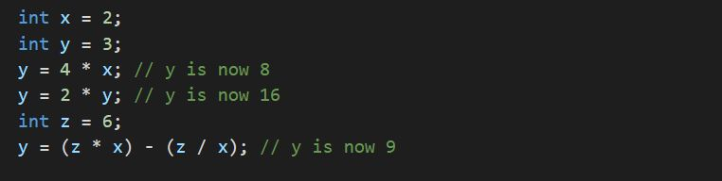
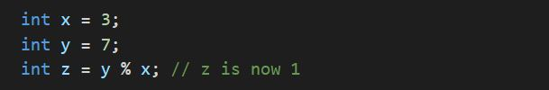
Arithmetic expressions - examples

Slide 44
Arithmetic expressions - examples
operands
expressions
operator

Slide 45
Arithmetic expressions – operator precedence
Operator precedence – The order of precedence determines which operators act upon a value first.
For operators with equal precedence, their associativity determines which operators act first (usually left to right)
Expressions in opening and close parentheses will be computed first
Order of precedence | Operator
Higher | * / %
Lower | + -

Slide 46
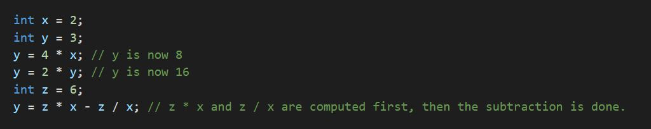
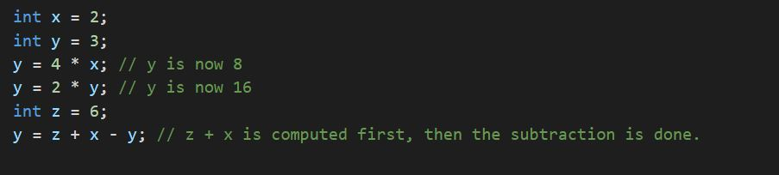
Arithmetic expressions – operator precedence

Slide 47
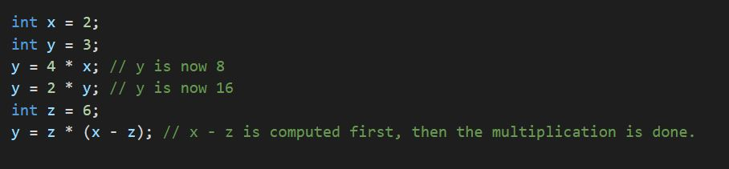
Arithmetic expressions – operator precedence

Slide 48
Arithmetic expressions - division
Regular division vs integer division
Regular division results in decimal numbers (floating-point types)
Integer division results in whole numbers, and will be automatically rounded down if the first integer is not divisible by the second integer

Slide 49
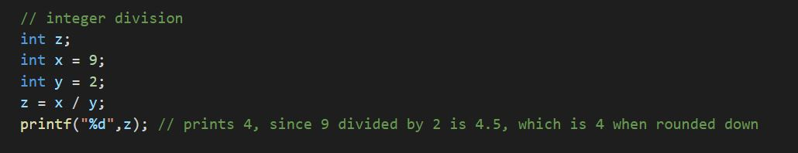
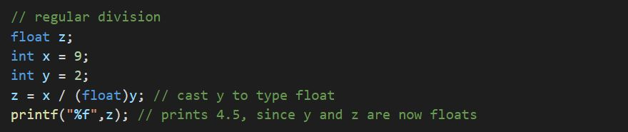
Arithmetic expressions - division

Slide 50

Arithmetic expressions – updating variables
To update the value of a variable, we can use an arithmetic expression to compute a new value, and store it back into the variable

Slide 51
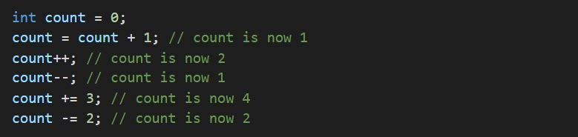
Arithmetic expressions – updating variables
Postfix expressions are shortcuts to update the value of a variable. Examples include:
++ (eg: x++, equivalent to x = x + 1)
-- (eg: x--, equivalent to x = x – 1)
+= (eg: x += 1, equivalent to x = x + 1)
-= (eg: x -= 1, equivalent to x = x – 1)

Slide 52
Conditional expressions
Conditional statements help you to make a decision based on certain conditions.
Examples of conditional statements:
If I make enough money, then we’ll go to Italy.
If the weather is hot, then wear shorts, else wear pants.
In C, these conditions are specified by boolean expressions which evaluate to true or false

Slide 53
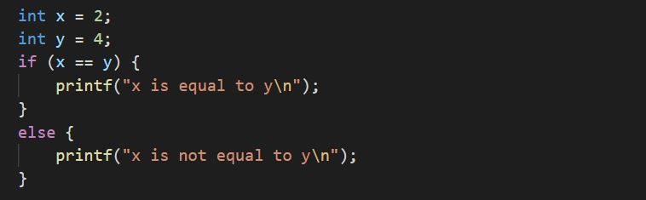
Conditional expressions - syntax
Note:
Curly braces are not required if there is only one statement in the if-else block’s body. However, it is required if you have more than one statement. Hence, it is always good practice to put curly braces
if (condition)
{ body }
else
{ body}
Evaluates to true
Output:
x is not equal to y

Slide 54
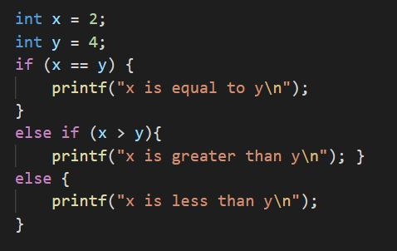
Conditional expressions - syntax
if (condition)
{ body }
else if (condition)
{ body }
else if (condition)
{ body }
else
{ body }
Evaluates to false
Evaluates to true
Output:
x is less than y

Slide 55
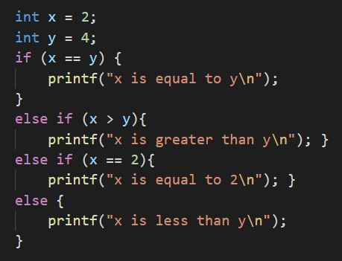
Conditional expressions - syntax
if (condition)
{ body }
else if (condition)
{ body }
else if (condition)
{ body }
else
{ body }
Note: If any condition evaluates to true, your program will run only the block of statements that correspond to that condition. It will skip the rest even if those conditions evaluate to true.
Output:
x is less than y

Slide 56
Comparison operators
Comparison operators – operators that compare values and return true or false.
Comparison | Operator | Result
Less than | < | returns true if the value on the left is less than the value on the right, otherwise it returns false
Greater than | > | returns true if the value on the left is greater than the value on the right, otherwise it returns false.
Less than or equal to | <= | returns true if the value on the left is less than or equal to the value on the right, otherwise it returns false.
Greater than or equal to | >= | returns true if the value on the left is greater than or equal to the value on the right, otherwise it returns false.
Equal to | == | returns true if the value on the left is equal to the value on the right, otherwise it returns false.
Not equal to | != | returns true if the value on the left is not equal to the value on the right, otherwise it returns false.
Notes:
https://www.codecademy.com/articles/fwd-js-comparison-logical

Slide 57
Logical (Boolean) operators
Logical operators – operators that combine multiple boolean expressions or values and return true or false.
Examples:
I weigh at least 100kg AND I am at least 2 meters tall
I have a degree in Computer Science OR I have a degree in Electrical Engineering
I am NOT (American OR British)
x is divisible by 2 AND x is divisible by 3

Slide 58
Logical (Boolean) operators
Logical operation | Operator | Result
AND | && | Returns true if and only if the expressions on both sides of it are true. Otherwise, returns false
OR | || | Returns true if the expression on either side of it is true. Otherwise, returns false.
NOT | ! | Reverses the logical value of its expression. If a condition is true, the NOT operator will make it false. If a condition is false, the NOT operator will make it true

Slide 59
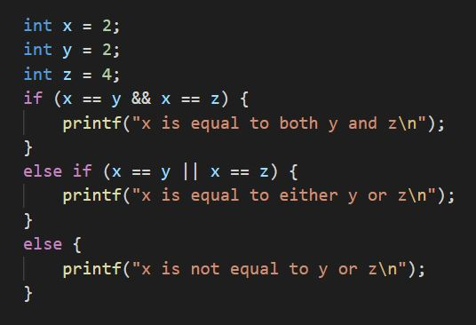
Logical (Boolean) operators
Output:
x is equal to either y or z

Slide 60
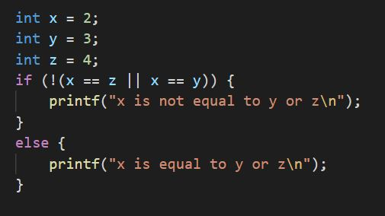
Logical (Boolean) operators
Output:
x is not equal to y or z

Slide 61
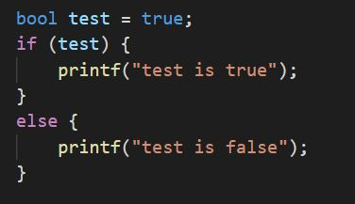
Conditional expressions - syntax
Boolean expressions evaluate to true or false, so you can just put a true or false value in the condition without making any comparison
Output:
test is true
Notes:
https://www.cs.uic.edu/~jbell/CourseNotes/C_Programming/Decisions.html

Slide 62
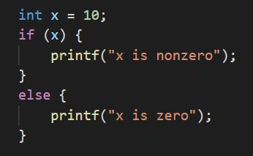
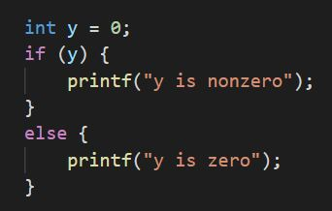
Conditional expressions - syntax
When interpreting Boolean expressions, zero is interpreted as false, and anything non-zero is interpreted as true
Output:
x is nonzero
Output:
y is zero

Slide 63
Conditional expressions - opposites
Expression | Opposite
NOT (A > B) | A <= B
NOT (A < B) | A >= B
NOT (A <= B) | A > B
NOT (A >= B) | A < B
NOT (A == B) | A != B
NOT (A != B) | A == B

Slide 64
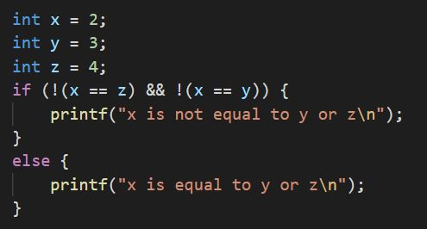
Conditional expressions – De Morgan’s Laws
Expression | Equivalent expression
NOT (A OR B) | (NOT A) AND (NOT B)
NOT (A AND B) | (NOT A) OR (NOT B)

Slide 65
Conditional expressions – De Morgan’s Laws
Expression | Equivalent expression
NOT (A OR B) | (NOT A) AND (NOT B)
NOT (A AND B) | (NOT A) OR (NOT B)
A
NOT A
B
NOT B

Slide 66
Loops
A loop is a section of code that repeats a number of times. This is known as iteration. You don’t want a loop to repeat forever – that’s called an infinite loop. Loops should eventually come to a stop once they finish doing the job.
2 types of loops – while and for loop
The block of code inside a loop is repeated as long as the looping condition is met

Slide 67
Loops – while loop
while (condition)
{ body }
The block of code within the curly braces repeats as long as (while) the condition is true.
The possible conditions for a while loop are exactly the same as conditions used for if-else statements

Slide 68
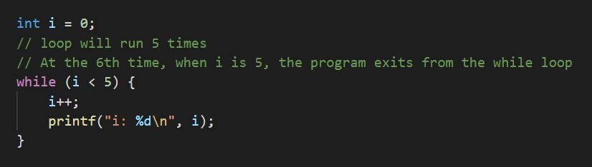
Loops – while loop
Program goes back up here and repeats as long as i < 5
When i is 5, program exits from while loop, and continues with the rest of the code
Note:
You must always remember to update the variable inside the while loop’s condition, or else your loop will repeat forever!

Slide 69
Loops – do-while loop
A do-while loop behaves almost exactly like a while loop, except that the body of the loop executes at least one time.
do
{ body }
while (condition)

Slide 70
Loops – for loop
for (declare and initialize variable; condition; update variable)
{ body }
A variable is first declared and initialized.
The variable is tested in the condition
The block of code within the curly braces repeats as long as the condition is true.
After each repetition of the for loop, the variable is updated, and then tested again in the condition

Slide 71
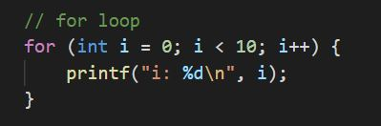
Loops – for loop
1
2
4
Sequence of operations:
1, 2, 3, 4, 2, 3, 4, 2, 3, 4, …
Loop will run 10 times.
3
Declare and initialize variable
Update variable
Condition

Slide 72
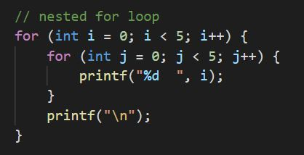
Loops – nested for loops
1
For each repetition of loop 1 (outer loop), loop 2 (inner loop) repeats 5 times.
Output:
0 0 0 0 0
1 1 1 1 1
2 2 2 2 2
3 3 3 3 3
4 4 4 4 4
1
2
2

Slide 73
Loops – break and continue statements
The break statement causes the program to exit the loop early
The continue statement causes the program to immediately go to the next repetition of the loop
These statements can be used in both for and while loops

Slide 74
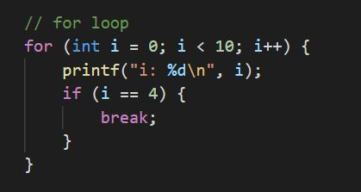
Loops – break and continue statements
Program goes back up here and repeats as long as i < 10
When i is 4, program exits from for loop, and continues with the rest of the code
Loop will run only 5 times instead of 10 times

Slide 75
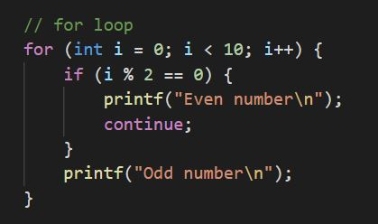
Loops – break and continue statements
1
At 1, ,Program immediately goes to the next repetition of the loop and doesn’t go to statement 2 when i is even
1
2
2

Slide 76
Variable scope
A variable’s scope refers to the block of code in a program in which it is available in.
When you create a variable within a block, it’s scope consists of the block it was created in, as well as any nested blocks within.
Within a block, you can only access variables that have been initialized within that block and outer scoped blocks, but not vice versa.

Slide 77
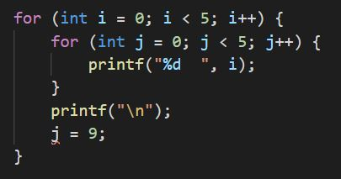
Variable scope
The inner loop can access the variable i because it was initialized in the outer loop. The scope of variable i includes both the outer and inner loops
The outer loop cannot access the variable j because it was initialized in the inner loop. The scope of variable j only includes the inner loop
1
1
2
2
Scope of variable j
Scope of variable i

Slide 78
Any questions?
Notes:
Zoom poll (name the data type):
- List various data types in quick succession

