Slide 1
Welcome!

Slide 2

About Me
Full-time software engineer in the field of cybersecurity
Part-time Computer Science lecturer with CodeIT
Our aim is to help students learn the fundamentals of Computer Science, and be able to apply what they learn to solve problems and pick up new software skills

Slide 3
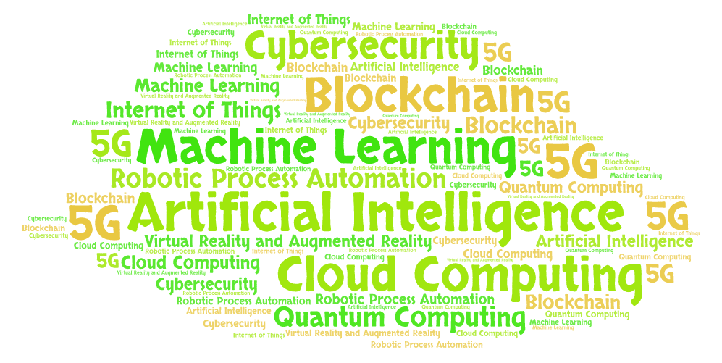
Top trends in tech
Notes:
Generated by https://wordart.com/

Slide 4
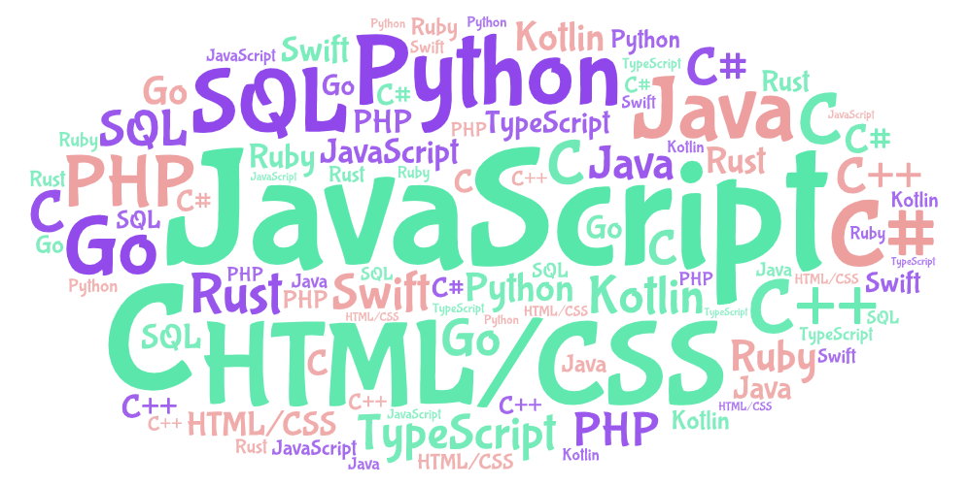
Top programming languages

Slide 5
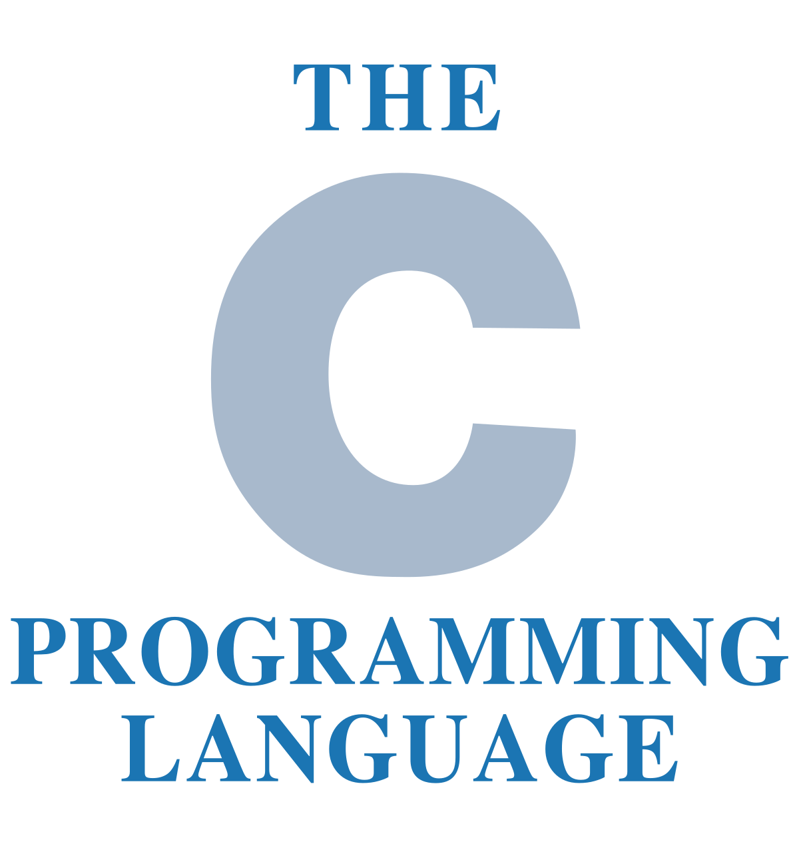

What you’ll learn in this course
Fundamentals of the C programming language
Fundamentals of the Python programming language
How to think and solve problems

Slide 6
What is a program?
Computers are machines. They don’t think for themselves. They need us to tell them what to do.
We need a way to tell our computers to do what we want them to, but computers don’t understand English.
Writing code is a way for us to talk to our computers by giving them instructions.
A special program, called a compiler, translates our code into a special language called machine code which computers can understand. Machine code is written in binary.

Slide 7
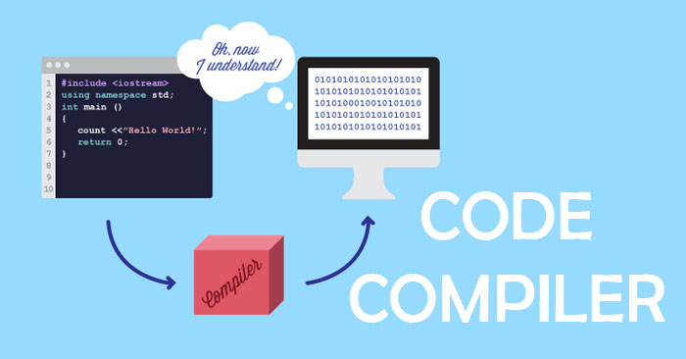

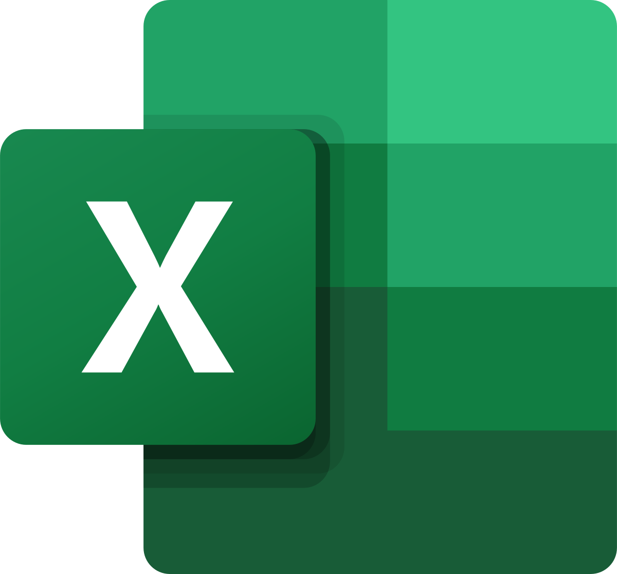

Source code
Machine code

Slide 8
Abstraction
Abstraction is the process of hiding implementation details and only showing the functionality to the user.
For example, when you wash your laundry in a laundry machine, you put your laundry and detergent inside the machine, press a button, and wait for the machine to perform its task. But how does the machine wash your clothes? What mechanism does it use? A user is not required to know the engineering behind its workings. This allows the user to efficiently use the laundry machine just with a click of the button.

Slide 9
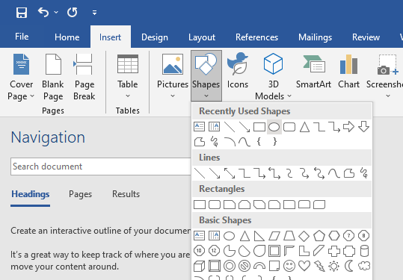
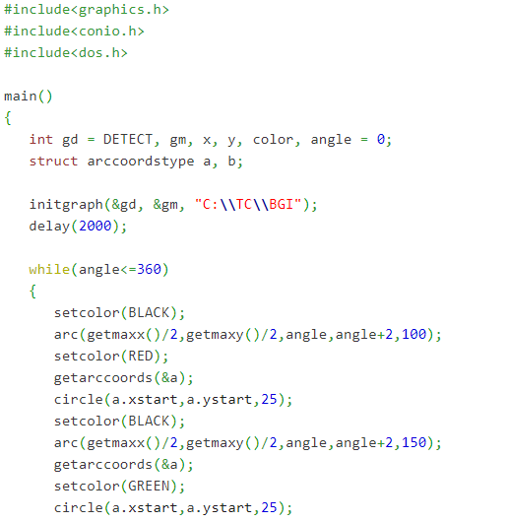
Less abstract
Click a button to create a circle shape in Microsoft Word. But how is this implemented?
C code for creating a circle. But how is this implemented?

Slide 10

Less abstract
Machine code for creating the C code. But how is the machine code implemented? How does it get read by computers?
C code for creating a circle. But how is this implemented?

Slide 11
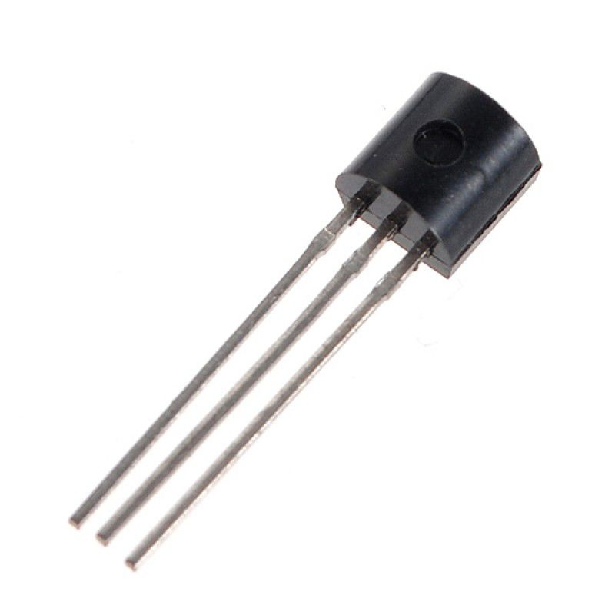
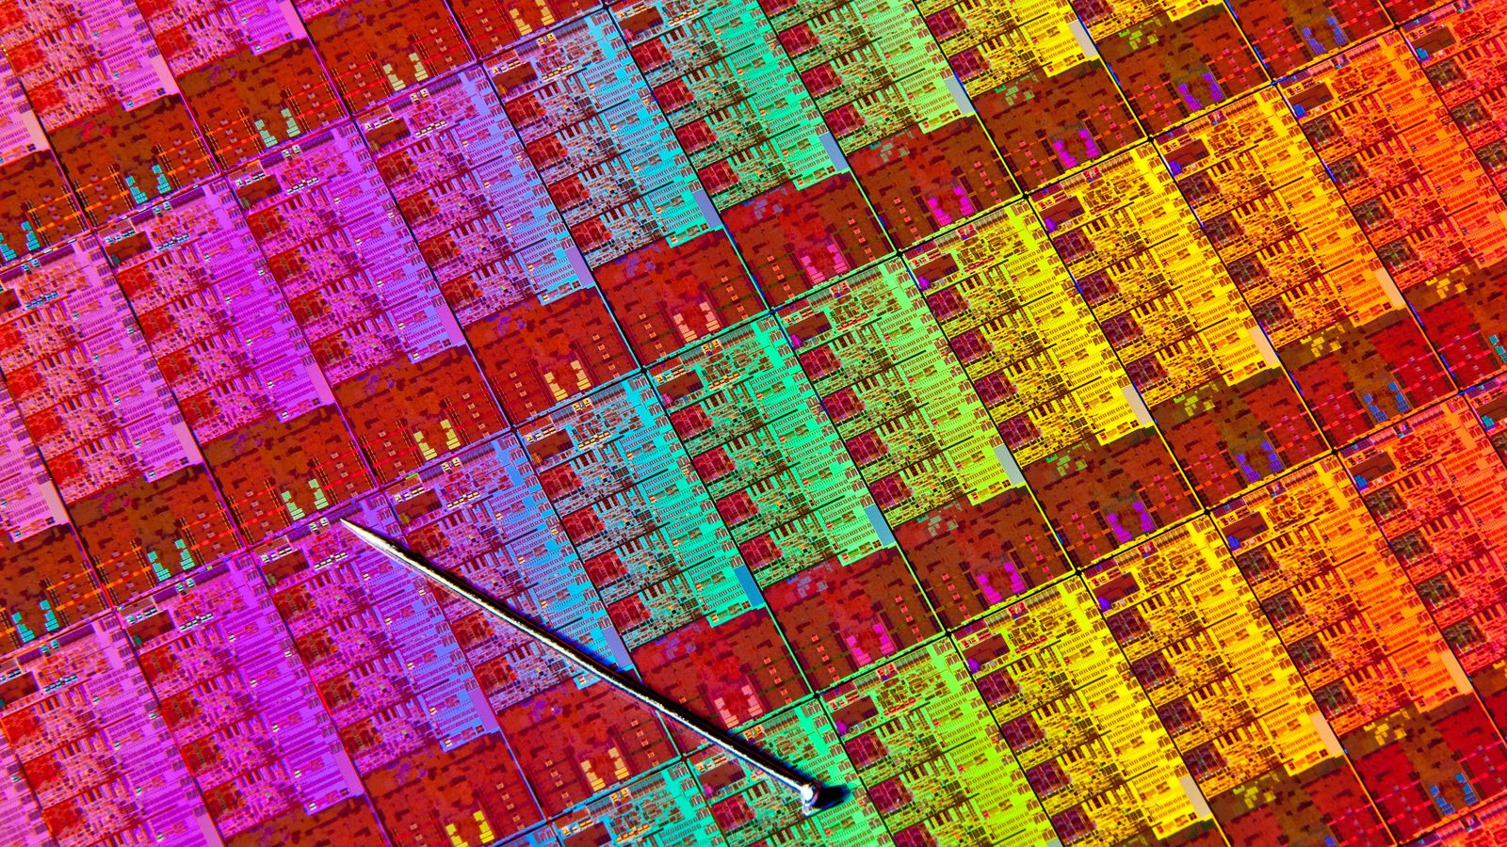
Less abstract
Machine code for creating the C code. But how is the machine code implemented? How does it get read by computers? At this stage, we are still working with software
At the lowest, most basic level, computers are made up of tiny transistors that work like switches that can be turned on or off. These switches are flipped on or off by an electrical charge. To tell a computer what to do, we send electric charges to flip different switches on or off. A one in machine code flips a switch on, while a zero flips the switch off. This is how computers understand machine code! At this point, we are working with hardware.

Slide 12
The C programming language
Levels of abstraction – a lower level (less abstract) programming language is a lot closer to what machines understand, but more difficult for us humans to understand. A higher level (more abstract) programming language is closer to what we humans can understand, but needs to be converted more times in order to obtain machine code
Machines can only understand one language – machine code. This is also the lowest level (least abstract) programming language. Sometimes you will hear about assembly language. This is a higher level language than machine code, but lower level than C
The C language is lower-level than most other languages, including Python.
However, sometimes you will hear that C is a high level language because it is still higher level than assembly language and machine code

Slide 13
The C programming language
C programming helps you to understand better how computers work
A foundation in C makes it easier to learn other programming languages
C programming is very widely used. Here are some of them:
To program operating systems, like Windows and Linux – this is the software that powers your desktops, laptops, and mobile phones!
To program embedded systems – these include microcontrollers and processors that are used to power robots, IoT devices, automobiles, and many more!
To develop powerful applications, such as Microsoft Office programs, graphic design tools, computer games, and many more!

Slide 14
Steps of writing a program
Define the program objectives
Design the program
Write the code
Compile
Run the program
Test and debug the program

Slide 15
Your first Hello World program
This is your first step to being a programmer
In any new programming language we learn, the first thing we do is to learn how to show “Hello World” on our screen
If you see the words “Hello World” appear on your screen, it means you have written your code correctly, and you are able to run your program!

Slide 16
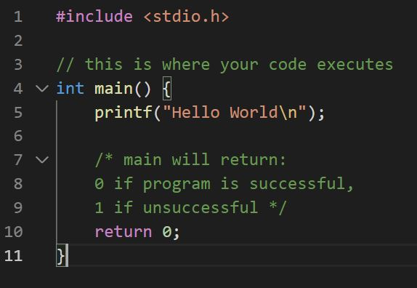
Your first Hello World program
This is a comment. Comments should start with 2 forward slashes, or /* */. Comments are ignored and do not run like the rest of the code. They are only for people to read. Always make it a habit to write comments.
Every program must have a main() function. This is where the computer starts running the program. If you don’t have a main function, your compiler cannot compile your code and you cannot run your code.
All functions should have an opening and closing curly braces
This is a built-in C function that lets you print (show) output onto screen
All statements should end with a semicolon.
Spaces, newlines, tabs, extra semicolons are ignored by the C compiler, but they are good for readability
The main() function must have a return statement. This returns the number 0 or 1 based on whether the program was run successfully or not
1
2
1
2
3
4
5
6
3
4
1
5
7
6
7

Slide 17
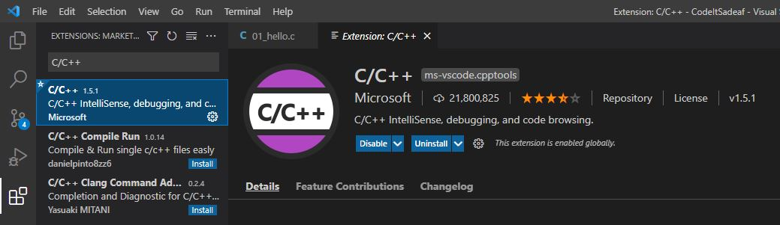
Install C/C++ extension

Slide 18
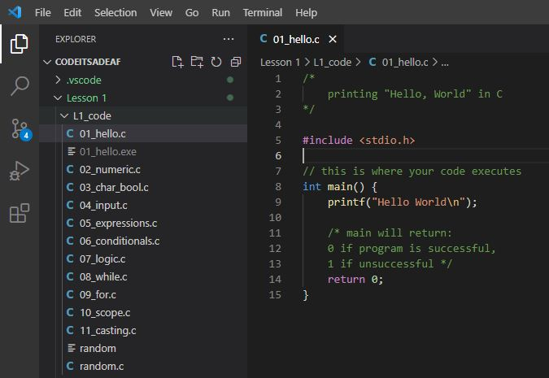
Open 01_hello.c

Slide 19
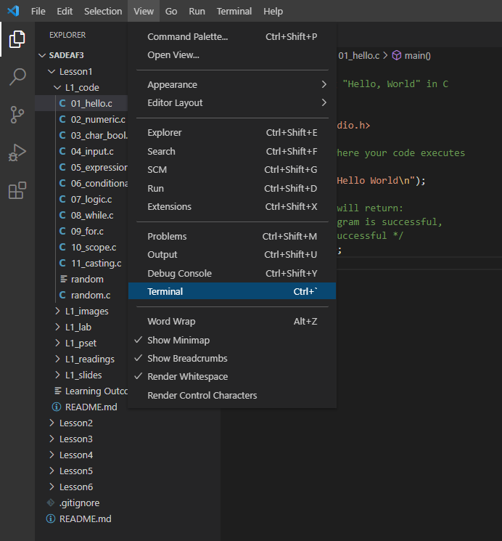
Click View -> Terminal.

Slide 20
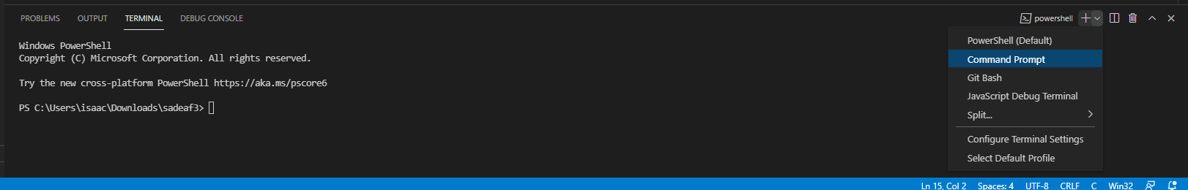
The Terminal window appears at bottom of editor. Click on the top right and change to Command Prompt.

Slide 21
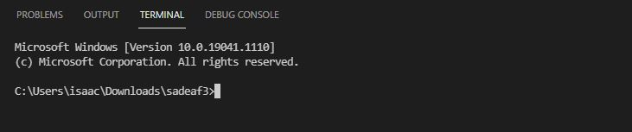
You are now using Command Prompt in the Visual Studio Code terminal.
By default, you will be in the directory where you opened your project.

Slide 22
Running our first program
We now have to run through steps 3-5 of writing a program:
Write the code
Compile code
Run the program
We have already written the code.
Now let’s compile our code. We will use a program called gcc to compile our code.

Slide 23
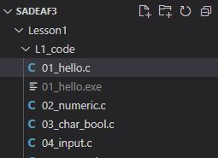
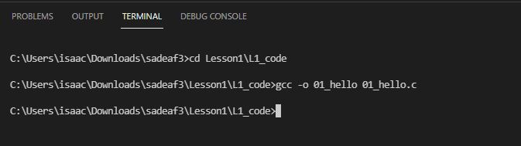
Using gcc to compile code
We need to first change directories to the folder L1_code where our code resides.
Type in the following and press Enter. This will compile our code and create a binary file called 01_hello.exe. This is the file that contains the machine language!

Slide 24
Using gcc to compile code
Let’s take a closer look at what we typed into the command prompt
Output binary file
File containing source code
gcc program

Slide 25
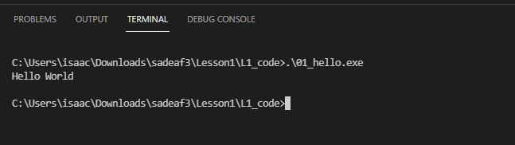
Hello World Output
Now we need to run the program. Type the following to run the program, and we see our “Hello World” output.
Output

Slide 26
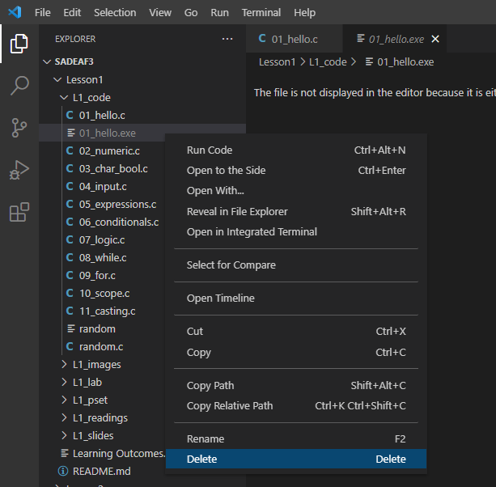
Using Run Build Task to compile code
Now let’s look at a shortcut in Visual Studio Code to compile your code.
Let’s first delete our binary file so we can see that the shortcut actually works.

Slide 27
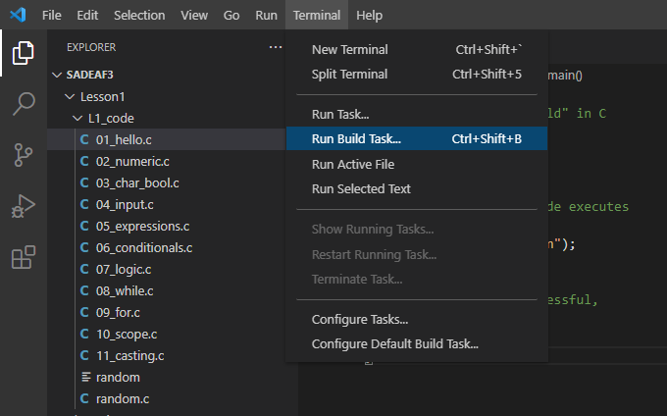
Using Run Build Task to compile code
Next, with our file 01_hello.c open, click on Terminal -> Run Build Task

Slide 28
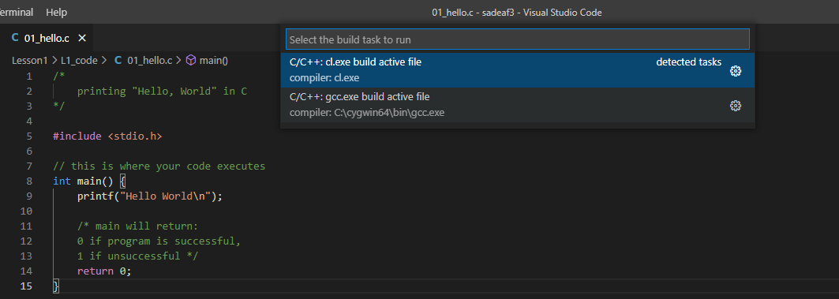
Using Run Build Task to compile code
My gcc compiler path
A window should pop up asking you to choose your compiler. Choose your gcc compiler path

Slide 29
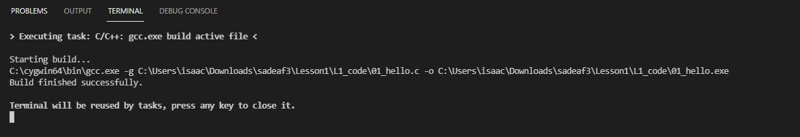
gcc compiling your code
Your code will now be compiled by gcc. A binary file called 01_hello.exe is once again created. Press Enter to go back to Command Prompt.

Slide 30
Hello World Output
Now run the program again. Type the following to run the program, and we see our “Hello World” output.
Output

Slide 31
Variables
To allow our programs to do more powerful things, they need to store and manipulate data. Variables are used to store our data types and save them for further use in the program. They are essentially names that we can use to access a specific data. You can also think of them as boxes in your computer’s memory that hold the data.
Variables of a certain data type can only hold data of that type
x
4
Variable name
Data

Slide 32
Naming variables
There are rules to naming variables:
Variable names should only contain letters, numbers, or underscores
Variable names must begin with a letter
You can’t have two variables in the same program with the same name
Valid variable names:
myData
pay94,
age_limit
Amount
Qt1yIncome
Invalid variable names:
94Pay
my Age
lastname, firstname

Slide 33
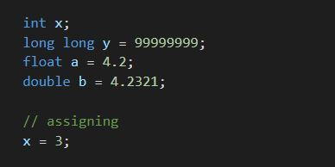
Declare, initialize, assign variables
1
Declare/define variables – state the variable’s type and name. This lets your computer know to allocate memory space for your variable
Initialize variables – sets an initial value for the variable when you declare it
Assign a value to a variable. The variable must have already been declared. Assigning a value uses the assignment operator (=) to put a value into the variable
2
1
3
2
x
1
3
y
99999999
2
x
4
3

Slide 34
Data types
Examples of data types:
numbers, decimals, characters, strings etc.

Slide 35
Data types – numeric data types
Integers
Whole numbers (can be signed or unsigned)
Range of signed integers: -2,147,483,648 to 2,147,483,647
Range of unsigned integers: 0 to 4,294,967,295
Long long
Whole numbers like integers, but with bigger range
Range of signed long long: -9,223,372,036,854,775,808 to 9,223,372,036,854,775,807
Range of unsigned long long: 0 to 18,446,744,073,709,551,615
Floats
Decimals (signed), range indicates the precision
Range: 3.4 × 10⁻³⁸ to 3.4 × 10³⁸
Doubles
Decimals (signed), higher precision than float
Range: 1.7 × 10⁻³⁰⁸ to 1.7 × 10³⁰⁸

Slide 36
Data types – numeric data types
Data type | Examples
int | 1 -10,000 2,147,483,000
long long | 1 -10,000 -36,854,775,808
float | 1.00 -3.1415 3762891.56743
double | 1.00 0.0000001423 1.4 × 10⁻³⁰⁸

Slide 37
Data types – char data type
A character is any single character your computer can represent.
Since computers can only understand numbers, an ASCII code is used as the numerical representation of a character. The ASCII table contains the mappings between ASCII codes and the characters they represent
Your computer can understand 256 different characters, some printable, some non-printable.
To specify printable characters, enclose them in single quotes - ‘’

Slide 38
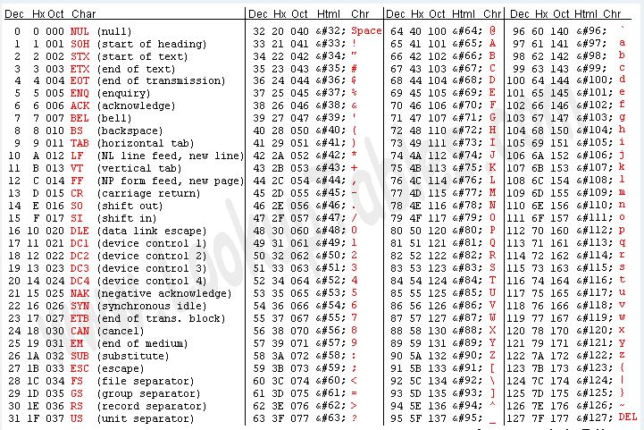
Data types – char data type

Slide 39
Data types – char data type
Some examples of characters:
‘a’, ‘B’, ‘ ‘, ‘!’, ‘1’, ‘9’, ‘\n’
Things to note:
‘ ‘ indicates a space character
Characters such as ‘1’ and ‘9’ are characters and not integers
‘\n’ is called the newline character

Slide 40
Data types – bool data type
The Boolean data type only contains 2 possible values – true or false.
Booleans are also represented by numbers. 1 represents true, and 0 represents false
Booleans are often used in conditional expressions, which we will learn later
Examples of Booleans:
true, false

Slide 41
Any questions?
Notes:
Zoom poll (name the data type):
- List various data types in quick succession

Slide 42
Input and output
For your program to interact with users, it needs to be able to read input and print output.
printf() function prints formatted data onto the output screen
scanf() function reads formatted data from standard input (stdin), which is usually the keyboard
These 2 functions are built-in C functions that are part of the stdio.h library, the standard input/output library. A library is just a file containing code which other programmers can use. We call such files header files. To use the library, you need to include the header file in your program

Slide 43


Input and output – printf
The simplest use of the function printf() – takes in a C string as its only argument.
More complex use of the function printf() with more arguments – the C string can include format specifiers (sequences of characters beginning with %). The additional arguments are formatted and inserted into the string replacing their respective specifiers
21

Slide 44


Input and output – scanf
Data is read from standard input according to the format specified and stored in the variables pointed to by the additional arguments
21
User input

Slide 45
Input and output – format specifiers
Format specifiers lets your program know what is the data type of the data you want to print, so your program can print it correctly
Data type | Format specifier
int | %d
long long | %lld
float | %f
double | %lf
char | %c
Notes:
Run through 04_input.c

Slide 46
Arithmetic expressions
One of the most fundamental things a computer needs to do is arithmetic!
Operators (symbols used to perform a calculation or other task):
+ (addition)
- (subtraction)
* (multiplication)
/ (division)
% (modulus – calculates the remainder after a division)
= (assignment operator – assigns a value to a variable)
Operands:
Variables or values on either side of the operators, which the operators work on
Expressions:
A combination of operands and operators that results in a numeric value

Slide 47
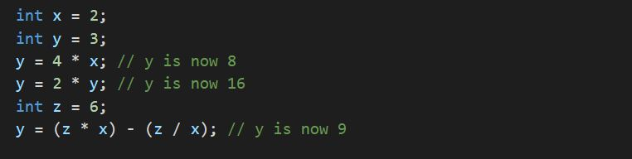
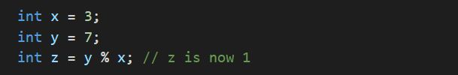
Arithmetic expressions - examples

Slide 48
Arithmetic expressions - examples
operands
expressions
operator

Slide 49
Arithmetic expressions – operator precedence
Operator precedence – The order of precedence determines which operators act upon a value first.
For operators with equal precedence, their associativity determines which operators act first (usually left to right)
Expressions in opening and closing parentheses will be computed first
Order of precedence | Operator
Higher | * / %
Lower | + -

Slide 50
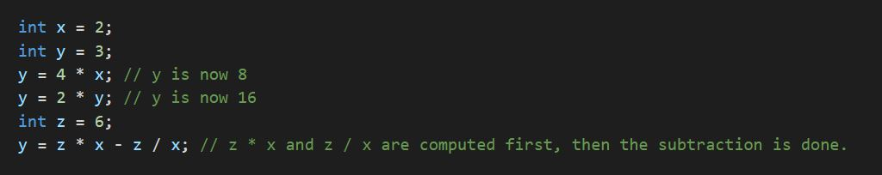
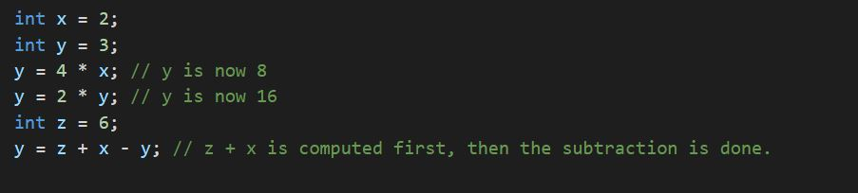
Arithmetic expressions – operator precedence

Slide 51
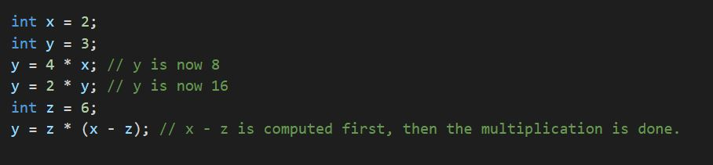
Arithmetic expressions – operator precedence

Slide 52
Arithmetic expressions - division
Regular division vs integer division
Regular division results in decimal numbers (floating-point types)
Integer division results in whole numbers, and will be automatically rounded down if the first integer is not divisible by the second integer

Slide 53
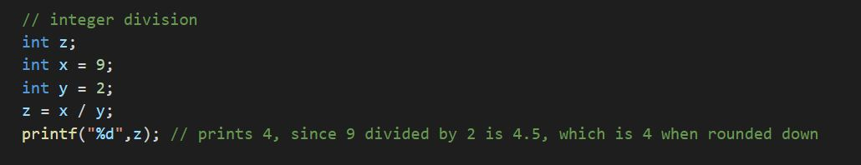
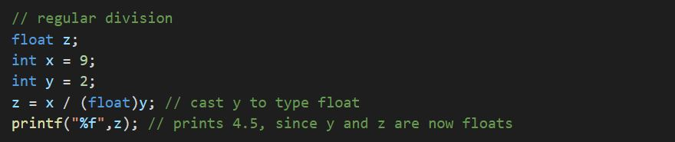
Arithmetic expressions - division

Slide 54

Arithmetic expressions – updating variables
To update the value of a variable, we can use an arithmetic expression to compute a new value, and store it back into the variable

Slide 55
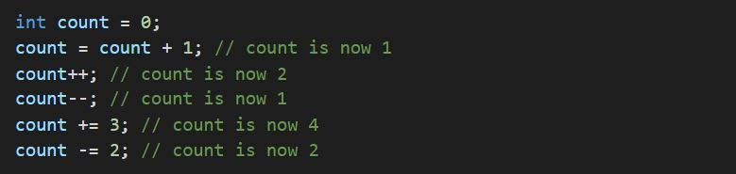
Arithmetic expressions – updating variables
Postfix expressions are shortcuts to update the value of a variable. Examples include:
++ (eg: x++, equivalent to x = x + 1)
-- (eg: x--, equivalent to x = x – 1)
+= (eg: x += 1, equivalent to x = x + 1)
-= (eg: x -= 1, equivalent to x = x – 1)

Slide 56
Conditional expressions
Conditional statements help you to make a decision based on certain conditions.
Examples of conditional statements:
If I earn more than $1000 this month, then we’ll go to Italy.
If the weather is more than 25 degrees Celsius, then wear shorts, else wear pants.
In C, these conditions are specified by boolean expressions which evaluate to true or false

Slide 57
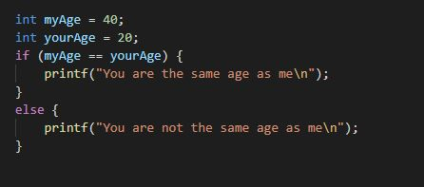
Conditional expressions - syntax
Note:
Curly braces are not required if there is only one statement in the if-else block’s body. However, it is required if you have more than one statement. Hence, it is always good practice to put curly braces
if (condition)
{ body }
else
{ body}
Evaluates to false
Output:
You are not the same age as me

Slide 58
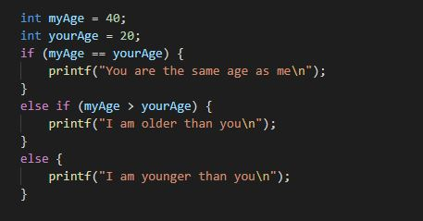
Conditional expressions - syntax
if (condition)
{ body }
else if (condition)
{ body }
else if (condition)
{ body }
else
{ body }
Evaluates to false
Evaluates to true
Output:
I am older than you

Slide 59
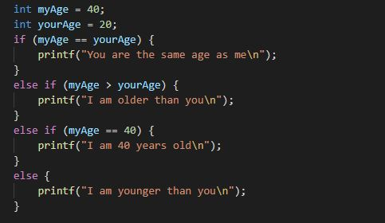
Conditional expressions - syntax
if (condition)
{ body }
else if (condition)
{ body }
else if (condition)
{ body }
else
{ body }
Evaluates to false
Evaluates to true
Evaluates to true but is skipped
Note: If any condition evaluates to true, your program will run only the block of statements that correspond to that condition. It will skip the rest even if those conditions evaluate to true.
Output:
I am older than you

Slide 60
Comparison operators
Comparison operators – operators that compare values and return true or false.
Comparison | Operator | Result
Less than | < | returns true if the value on the left is less than the value on the right, otherwise it returns false
Greater than | > | returns true if the value on the left is greater than the value on the right, otherwise it returns false.
Less than or equal to | <= | returns true if the value on the left is less than or equal to the value on the right, otherwise it returns false.
Greater than or equal to | >= | returns true if the value on the left is greater than or equal to the value on the right, otherwise it returns false.
Equal to | == | returns true if the value on the left is equal to the value on the right, otherwise it returns false.
Not equal to | != | returns true if the value on the left is not equal to the value on the right, otherwise it returns false.
Notes:
https://www.codecademy.com/articles/fwd-js-comparison-logical

Slide 61
Logical (Boolean) operators
Logical operators – operators that combine multiple boolean expressions or values and return true or false.
Examples:
I weigh at least 100kg AND I am at least 2 meters tall
I have a degree in Computer Science OR I have a degree in Electrical Engineering
I am NOT (American OR British)
x is divisible by 2 AND x is divisible by 3

Slide 62
Logical (Boolean) operators
Logical operation | Operator | Result
AND | && | Returns true if and only if the expressions on both sides of it are true. Otherwise, returns false
OR | || | Returns true if the expression on either side of it is true. Otherwise, returns false.
NOT | ! | Reverses the logical value of its expression. If a condition is true, the NOT operator will make it false. If a condition is false, the NOT operator will make it true

Slide 63
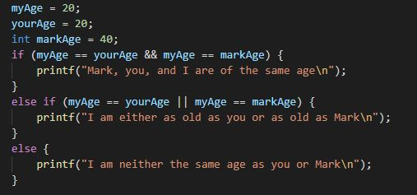
Logical (Boolean) operators
Output:
I am either as old as you or as old as Mark

Slide 64
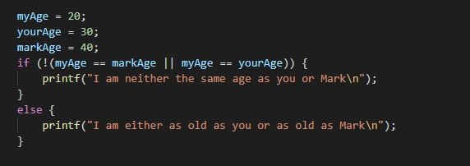
Logical (Boolean) operators
Output:
I am neither the same age as you or Mark

Slide 65
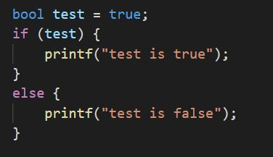
Conditional expressions - syntax
Boolean expressions evaluate to true or false, so you can just put a true or false value in the condition without making any comparison
Output:
test is true
Notes:
https://www.cs.uic.edu/~jbell/CourseNotes/C_Programming/Decisions.html

Slide 66
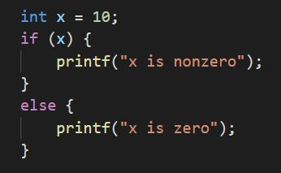
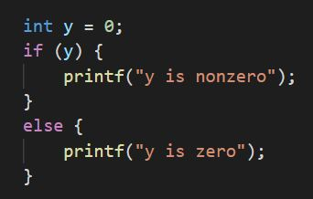
Conditional expressions - syntax
When interpreting Boolean expressions, zero is interpreted as false, and anything non-zero is interpreted as true
Output:
x is nonzero
Output:
y is zero

Slide 67
Conditional expressions - opposites
Expression | Opposite
NOT (A > B) | A <= B
NOT (A < B) | A >= B
NOT (A <= B) | A > B
NOT (A >= B) | A < B
NOT (A == B) | A != B
NOT (A != B) | A == B

Slide 68
Switch statements
The if-else statement is great for simple testing of data, like if your data has only 2 or 3 possible values. However if your data can take on many possible values, you will need many else-if blocks, and this can make your code messy.
The switch statement is a better way of testing many different possible values.

Slide 69
Switch statements - syntax
switch (variable)
{
case value1:
{ body }
case value2:
{ body }
case value1:
{ body }
case value2:
{ body }
default:
{ body }
}
if (condition)
{ body }
else if (condition)
{ body }
else if (condition)
{ body }
else if (condition)
{ body }
else
{ body }
similar

Slide 70
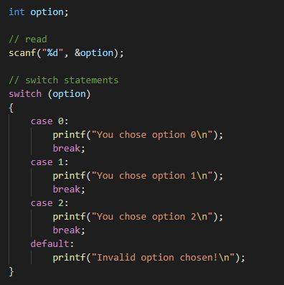
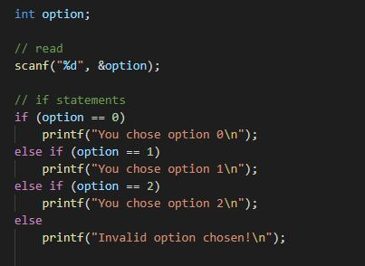
similar
Note that this break statement is necessary for each switch case, or else your program will flow through to the next switch case

Slide 71
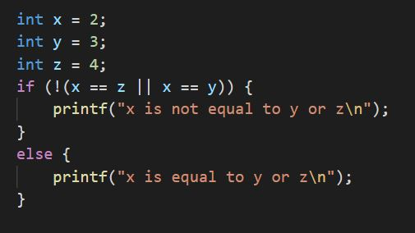
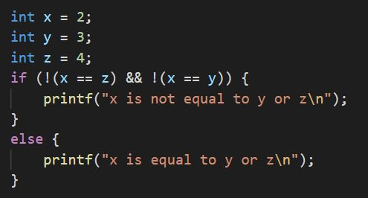
Conditional expressions – De Morgan’s Laws
Expression | Equivalent expression
NOT (A OR B) | (NOT A) AND (NOT B)
NOT (A AND B) | (NOT A) OR (NOT B)

Slide 72
Conditional expressions – De Morgan’s Laws
Expression | Equivalent expression
NOT (A OR B) | (NOT A) AND (NOT B)
NOT (A AND B) | (NOT A) OR (NOT B)
A
NOT A
B
NOT B

Slide 73
Loops
A loop is a section of code that repeats a number of times. This is known as iteration. You don’t want a loop to repeat forever – that’s called an infinite loop. Loops should eventually come to a stop once they finish doing the job.
2 types of loops – while and for loop
The block of code inside a loop is repeated as long as the looping condition is met

Slide 74
Loops – while loop
while (condition)
{ body }
The block of code within the curly braces repeats as long as (while) the condition is true.
The possible conditions for a while loop are exactly the same as conditions used for if-else statements

Slide 75
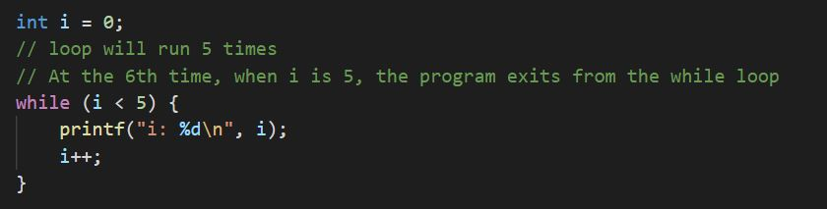
Loops – while loop
Program goes back up here and repeats as long as i < 5
When i is 5, program exits from while loop, and continues with the rest of the code
Note:
You must always remember to update the variable inside the while loop’s condition, or else your loop will repeat forever!

Slide 76
Loops – do-while loop
A do-while loop behaves almost exactly like a while loop, except that the body of the loop executes at least one time.
do
{ body }
while (condition)

Slide 77
Loops – for loop
for (declare and initialize variable; condition; update variable)
{ body }
A variable is first declared and initialized.
The variable is tested in the condition
The block of code within the curly braces repeats as long as the condition is true.
After each repetition of the for loop, the variable is updated, and then tested again in the condition

Slide 78
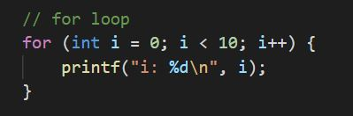
Loops – for loop
1
2
4
Sequence of operations:
1, 2, 3, 4, 2, 3, 4, 2, 3, 4, …
Loop will run 10 times.
3
Declare and initialize variable
Update variable
Condition

Slide 79
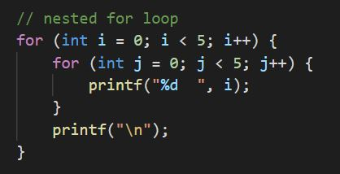
Loops – nested for loops
1
For each repetition of loop 1 (outer loop), loop 2 (inner loop) repeats 5 times.
Output:
0 0 0 0 0
1 1 1 1 1
2 2 2 2 2
3 3 3 3 3
4 4 4 4 4
1
2
2

Slide 80
Loops – break and continue statements
The break statement causes the program to exit the loop early
The continue statement causes the program to immediately go to the next repetition of the loop
These statements can be used in both for and while loops

Slide 81
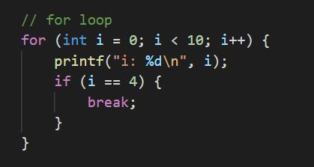
Loops – break and continue statements
Program goes back up here and repeats as long as i < 10
When i is 4, program exits from for loop, and continues with the rest of the code
Loop will run only 5 times instead of 10 times

Slide 82
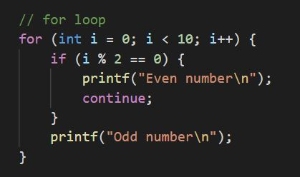
Loops – break and continue statements
1
At 1, ,Program immediately goes to the next repetition of the loop and doesn’t go to statement 2 when i is even
1
2
2

Slide 83
Variable scope
A variable’s scope refers to the block of code in a program in which it is available in.
When you create a variable within a block, it’s scope consists of the block it was created in, as well as any nested blocks within.
Within a block, you can only access variables that have been initialized within that block and outer scoped blocks, but not vice versa.

Slide 84
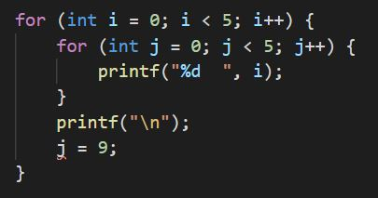
Variable scope
The inner loop can access the variable i because it was initialized in the outer loop. The scope of variable i includes both the outer and inner loops
The outer loop cannot access the variable j because it was initialized in the inner loop. The scope of variable j only includes the inner loop
1
1
2
2
Scope of variable j
Scope of variable i

Slide 85
Any questions?
Notes:
Zoom poll (name the data type):
- List various data types in quick succession

