Slide 1

Quantum Approximate optimization algorithm
A cookbook inspired guide for culinary quantum experiences
by jckcj

Slide 2
Ingridients
Motivation
Overview
Theory
Adiabatic theorem and Trotterization
QAOA
Hamiltonian and gate creation
Circuit
Recall
Potential and outlook
Link hier
Open Jupyter notebook
Follow the lecture (please, we put so much effort in it)

Slide 3
Motivation
Solution to :
the max (k) cut problem
travelling sales-man problem
generalized adiabatic functions
general solution to boolean value problems
finding ground state of a Hamiltonian

Slide 4
Overview
Hybrid problem solver
Classic optimization to create new parameters
Use quantum computer to evaluate a cost function with classical parameters
Optimize new parameters with quantum result
Repeat
Classic optimization
Quantum evaluation

Slide 5
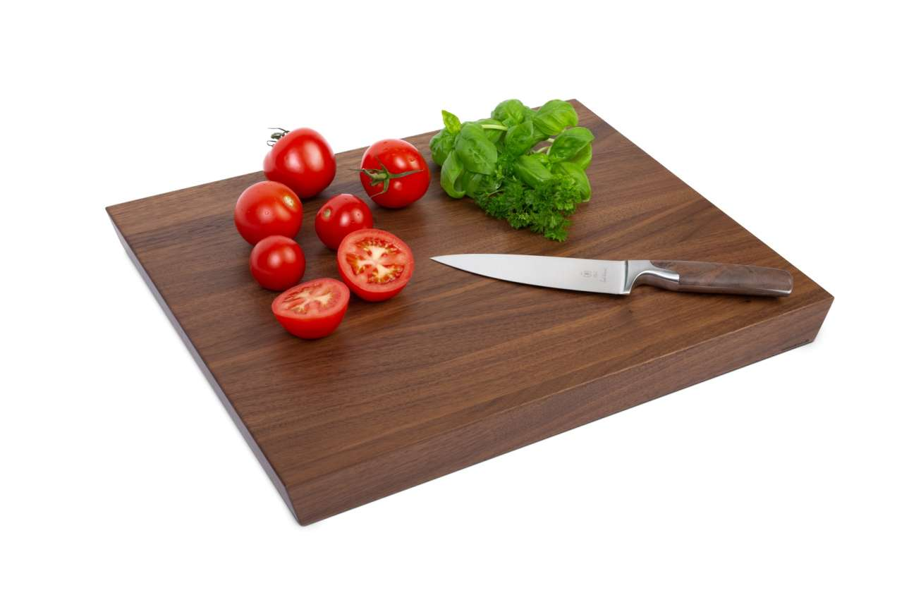
Theory – but before
Annealing
Trotterization
Closely related to QAOA

Slide 6
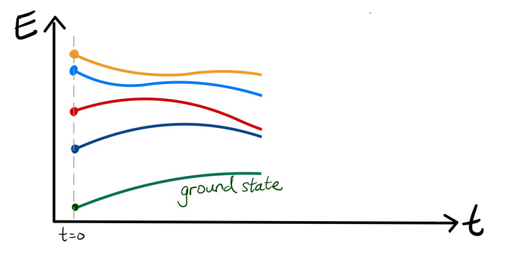
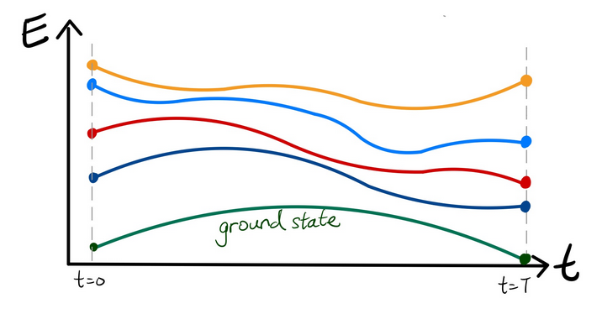
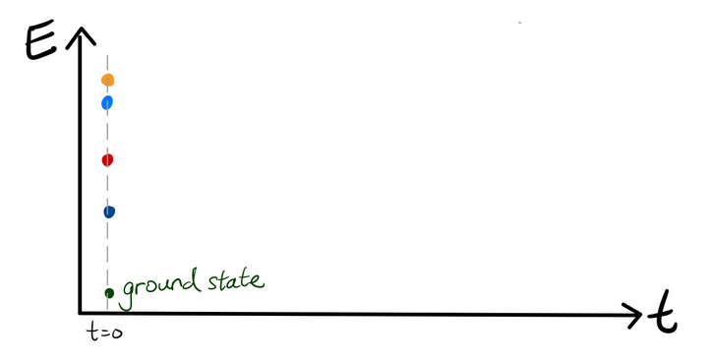
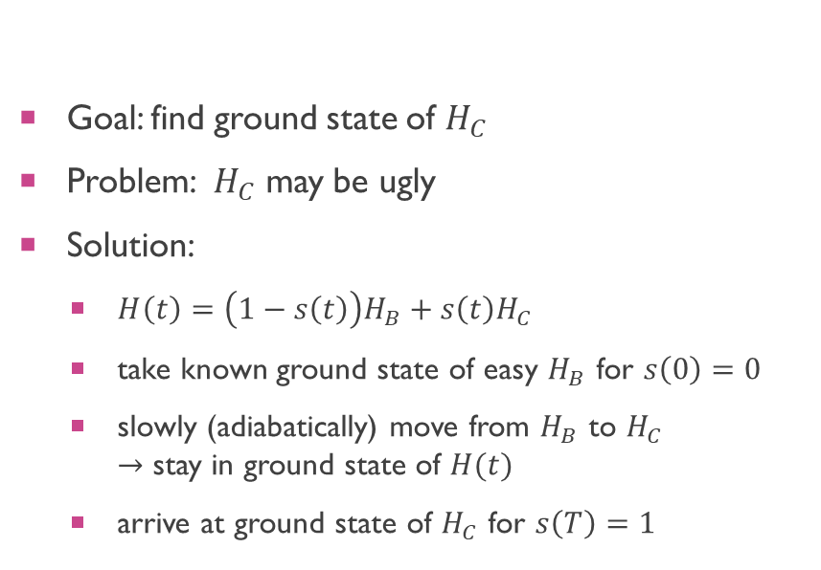
theory – adiabatic theorem
Goal: find ground state of $H_{C}$
Problem: $H_{C}$ may be ugly
Solution:
$H\left(t\right)=\left(1−s\left(t\right)\right)H_{B}+s\left(t\right)H_{C}$
take known ground state of easy $H_{B}$ for $s\left(0\right)=0$
slowly (adiabatically) move from $H_{B}$ to $H_{C}$ $→$ stay in ground state of $H(t)$
arrive at ground state of $H_{C}$ for $s\left(T\right)=1$

Slide 7
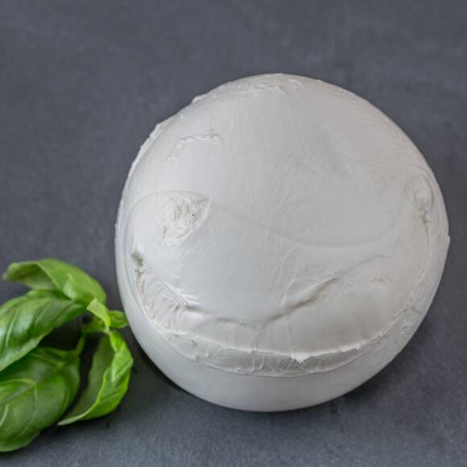

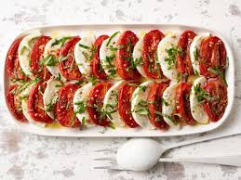
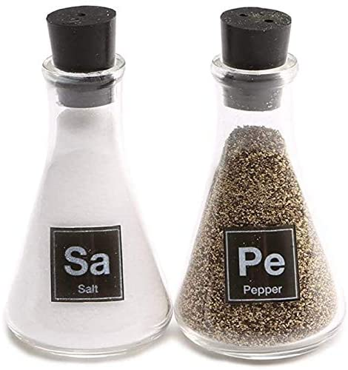


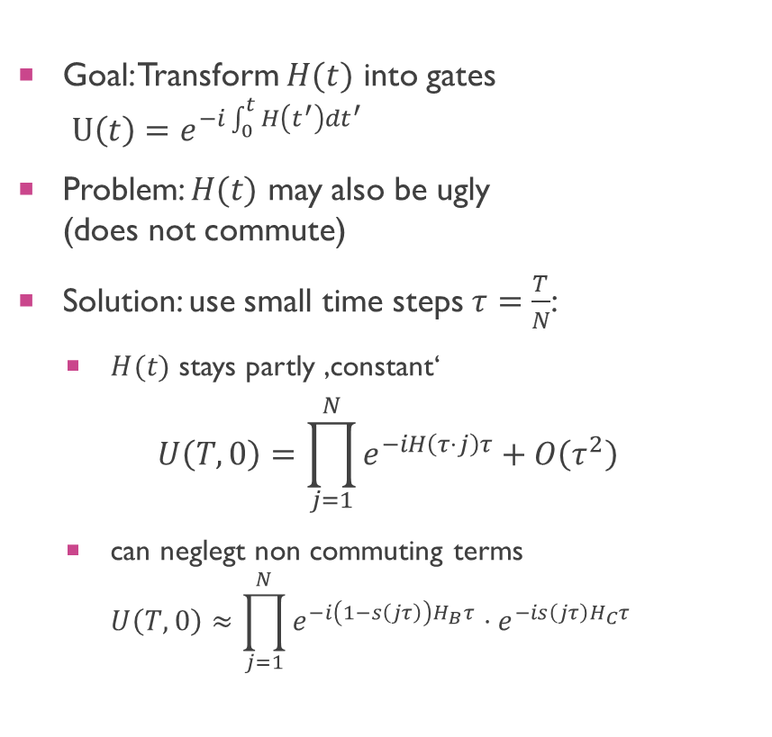
Theory – trotterization
$$H_{B}$$
$$H_{C}$$
Goal: Transform $H(t)$ into gates $U\left(t\right)=e^{−i\int_{0}^{t}{H\left(t^{′}\right)dt^{′}}}$
Problem: $H(t)$ may also be ugly (does not commute)
Solution: use small time steps $τ=\frac{T}{N}$:
$H(t)$ stays partly ‚constant‘
$$U\left(T,0\right)=\prod_{j=1}^{N}{e^{−iH\left(τ⋅j\right)τ}}+O\left(τ^{2}\right)$$
can neglegt non commuting terms $U\left(T,0\right)≈\prod_{j=1}^{N}{e^{−i\left(1−s\left(jτ\right)\right)H_{B}τ}}⋅e^{−is\left(jτ\right)H_{C}τ}$

Slide 8
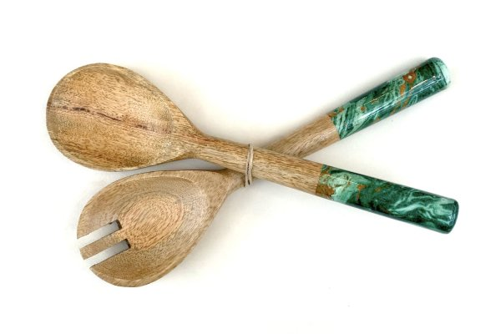
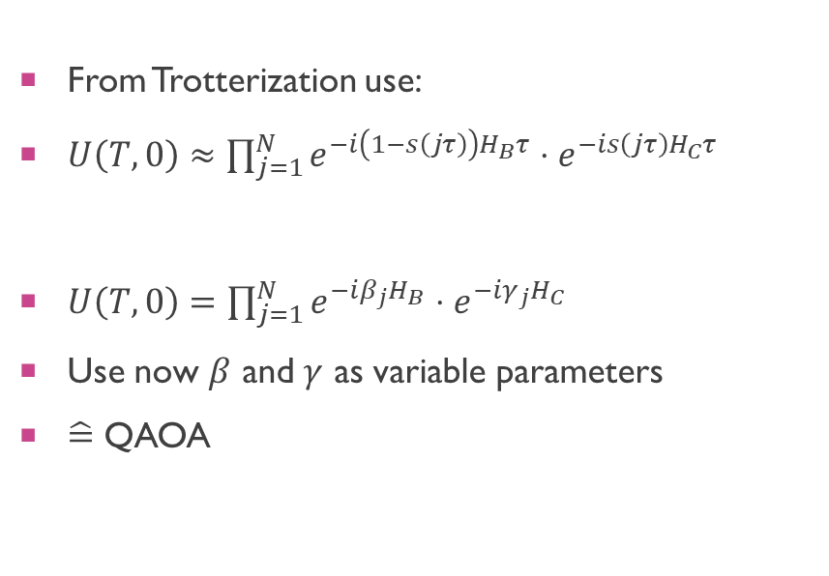
QAOa
From Trotterization use:
$U\left(T,0\right)≈\prod_{j=1}^{N}{e^{−i\left(1−s\left(jτ\right)\right)H_{B}τ}}⋅e^{−is\left(jτ\right)H_{C}τ}$
$β_{j}=\left(1−s\left(jτ\right)\right)τ, γ_{j}=s\left(jτ\right)τ$
$U\left(T,0\right)=\prod_{j=1}^{N}{e^{−iβ_{j}H_{B}}⋅e^{−iγ_{j}H_{C}}}$
Use now $β$ and $γ$ as variable parameters
$\hat{=}$ QAOA

Slide 9
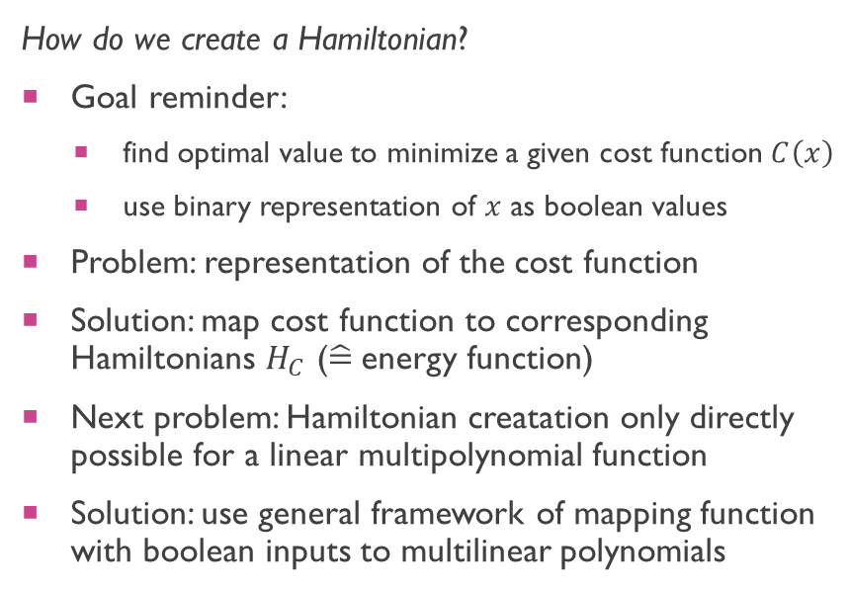
Theory – Hamiltonian creation
How do we create a Hamiltonian?
Goal reminder:
find optimal value to minimize a given cost function $C\left(x\right)$
use binary representation of $x$ as boolean values
Problem: representation of the cost function
Solution: map cost function to corresponding Hamiltonians $H_{C}$ ($\hat{=}$energy function)
Next problem: Hamiltonian creatation only directly possible for a linear multipolynomial function
Solution: use general framework of mapping function with boolean inputs to multilinear polynomials

Slide 10
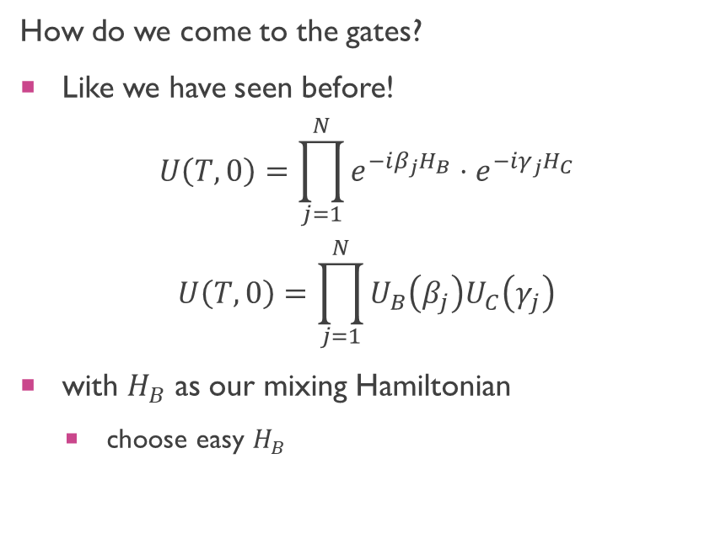
Theory – Gate creation
How do we come to the gates?
Like we have seen before!
$$U\left(T,0\right)=\prod_{j=1}^{N}{e^{−iβ_{j}H_{B}}⋅e^{−iγ_{j}H_{C}}}$$
$$U\left(T,0\right)=\prod_{j=1}^{N}{U_{B}\left(β_{j}\right)U_{C}\left(γ_{j}\right)}$$
with $H_{B}$ as our mixing Hamiltonian
choose easy $H_{B}$
Hamiltonian with I-ZZ from notebook

Slide 11
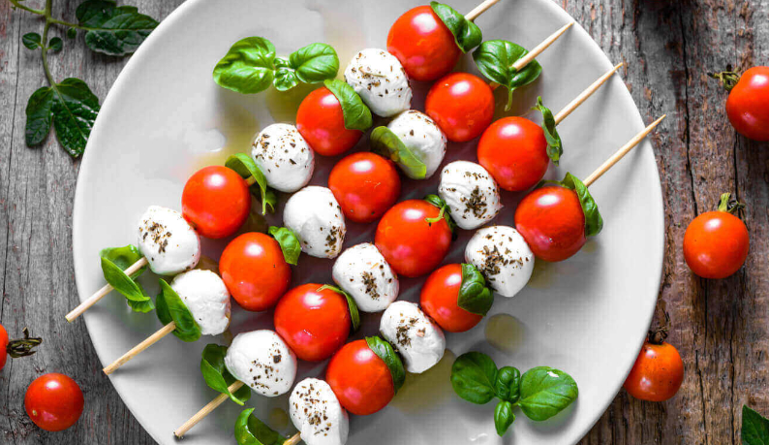
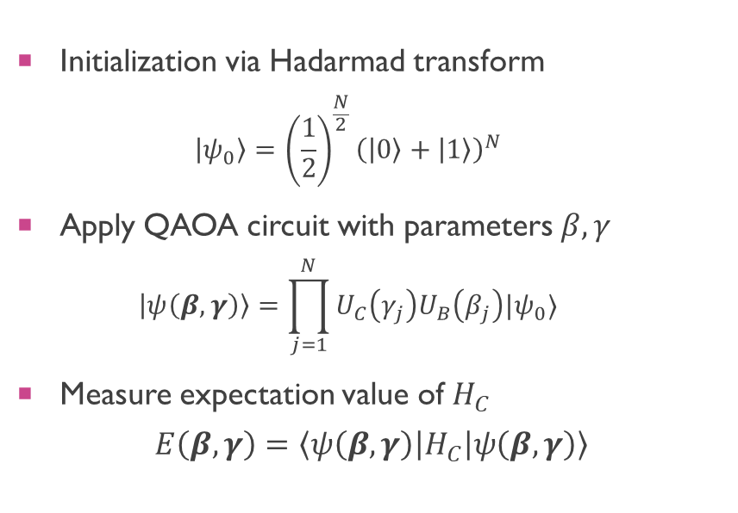
Circuit
N
Initialization
U_{B} Mixing
U_{C} Cost
Measurement
Initialization via Hadarmad transform
$$\left|ψ_{0}\right\rangle ={\left(\frac{1}{2}\right)}^{\frac{N}{2}}{\left(\left|0\right\rangle +\left|1\right\rangle \right)}^{N}$$
Apply QAOA circuit with parameters $β, γ$
$$\left|ψ\left(β, γ\right)\right\rangle =\prod_{j=1}^{N}{U_{C}\left(γ_{j}\right)U_{B}\left(β_{j}\right)|ψ_{0}⟩}$$
Measure expectation value of $H_{C}$
$$E\left(β,γ\right)=\left\langle ψ\left(β, γ\right)\left|H_{C}\right|ψ\left(β,γ\right)\right\rangle$$

Slide 12
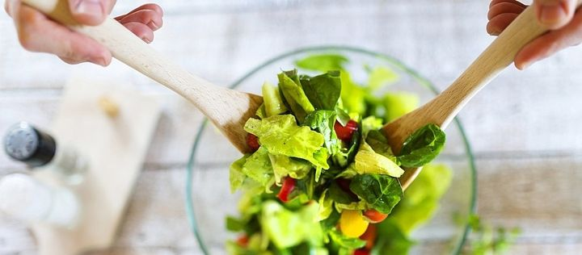

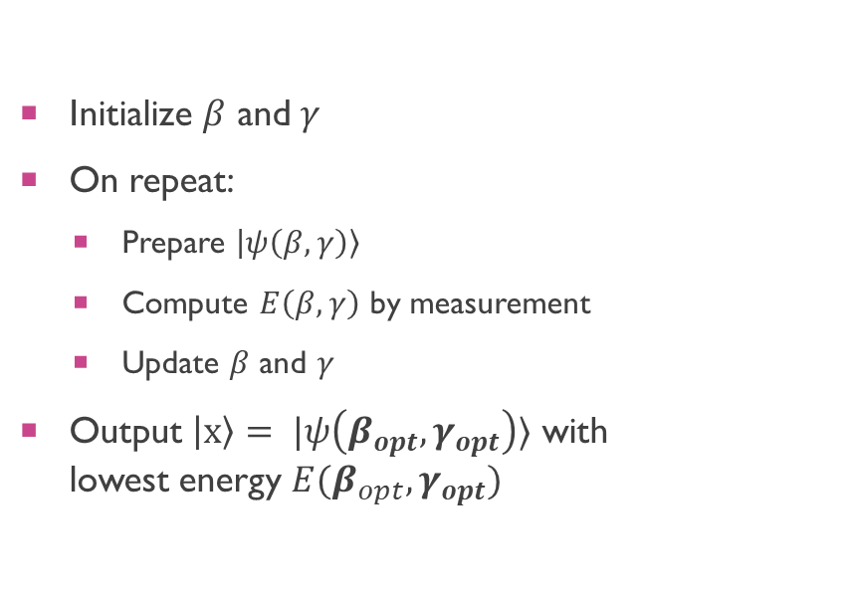

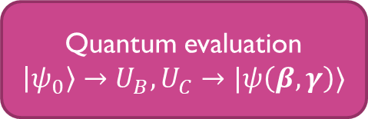

Recall
$$β, γ$$
Initialize $β$ and $γ$
On repeat:
Prepare $\left|ψ\left(β,γ\right)\right\rangle$
Compute $E\left(β, γ\right)$ by measurement
Update $β$ and $γ$
Output $\left|x\right\rangle = |ψ\left(β_{opt},γ_{opt}\right)⟩$ with lowest energy $E(β_{opt}, γ_{opt})$
Classic optimization
Update $β, γ$
Quantum evaluation
$\left|ψ_{0}\right\rangle →U_{B},U_{C}→|ψ\left(β, γ\right)⟩$
$$E\left(β,γ\right)$$

Slide 13
potential and outlook
Solution to many problems
Possible use of a quantum speedup
More real life applications needed to proof speedup

