Slide 1

Quantum Approximate optimization algorithm
A cookbook inspired guide for culinary quantum experiences
by jckcj

Slide 2
IngrEdients
Motivation
Overview
Theory
Adiabatic theorem and Trotterization
QAOA
Hamiltonian and gate creation
Circuit
Recall
Potential and outlook
https://github.com/CodeJP97/QHT-2022-WoQ/blob/main/LectureProblem.ipynb
Open Jupyter notebook

Slide 3
Motivation
Solution to :
the max (k) cut problem
travelling sales-man problem
generalized adiabatic functions
general solution to boolean value problems
finding ground state of a Hamiltonian
Jupyter notebook (Part 1)

Slide 4
Overview
Hybrid problem solver
Classic optimization to create new parameters
Use quantum computer to evaluate a cost function with classical parameters
Optimize new parameters with quantum result
Repeat
Classic optimization
Quantum evaluation

Slide 5
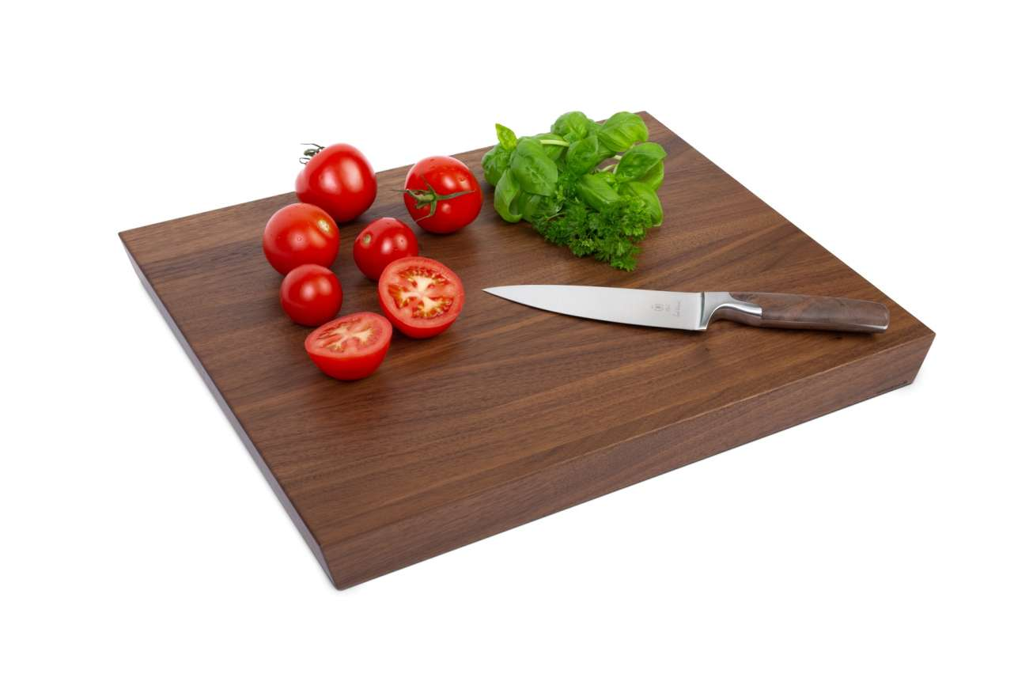
Theory – but before
Annealing
Trotterization
needed for QAOA

Slide 6
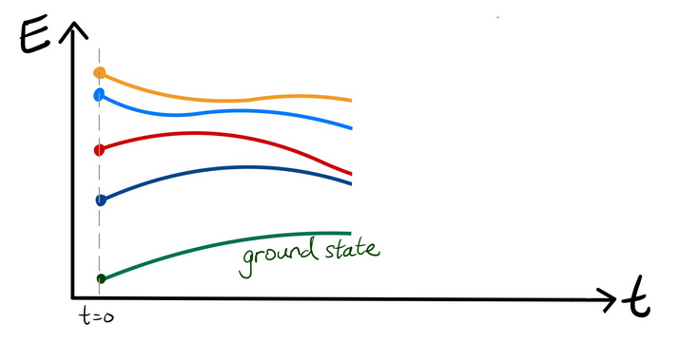
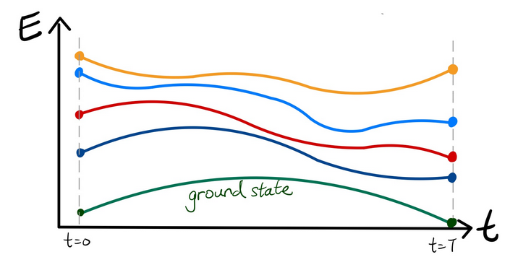
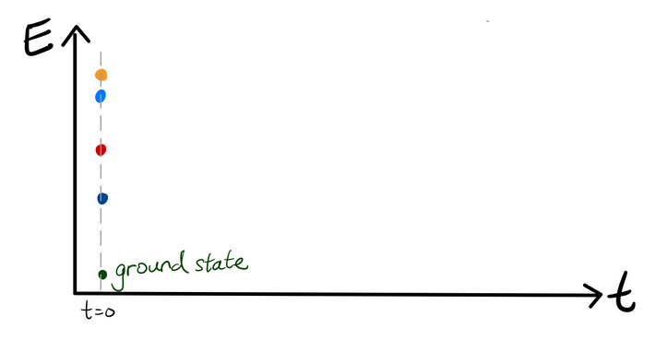
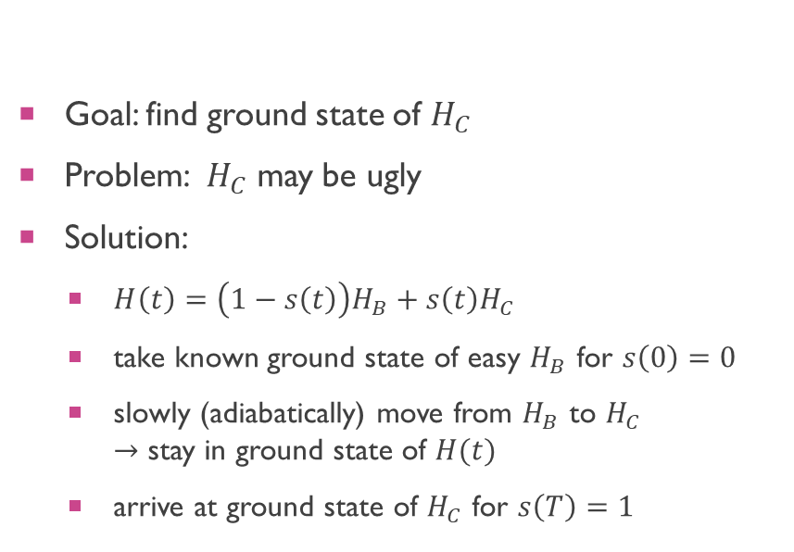
theory – adiabatic theorem
Goal: find ground state of $H_{C}$
Problem: $H_{C}$ may be ugly
Solution:
$H\left(t\right)=\left(1−s\left(t\right)\right)H_{B}+s\left(t\right)H_{C}$
take known ground state of easy $H_{B}$ for $s\left(0\right)=0$
slowly (adiabatically) move from $H_{B}$ to $H_{C}$ $→$ stay in ground state of $H(t)$
arrive at ground state of $H_{C}$ for $s\left(T\right)=1$

Slide 7
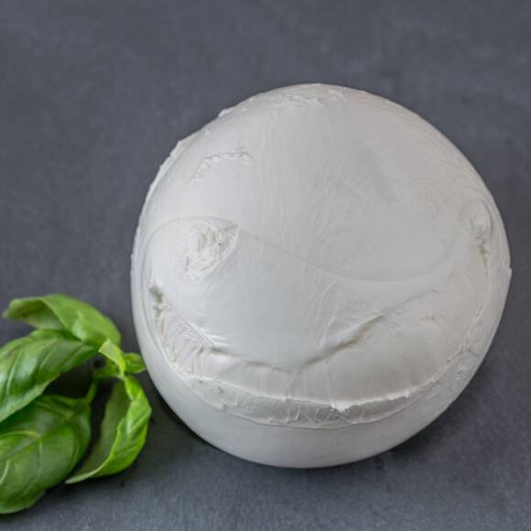
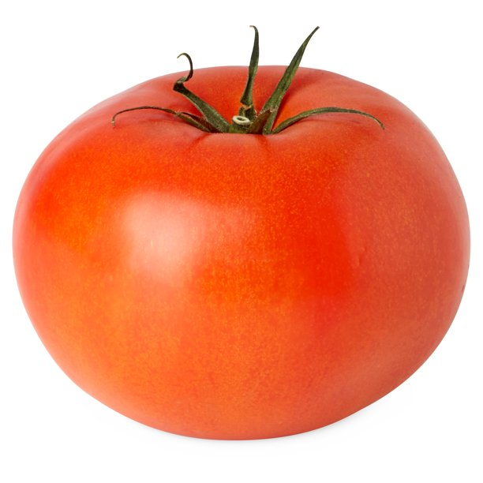
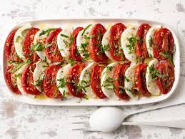
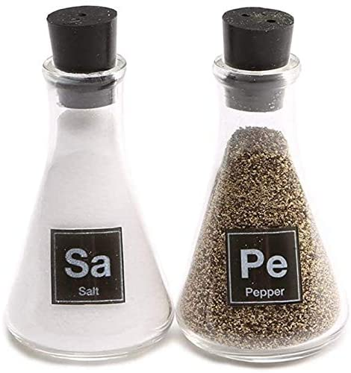


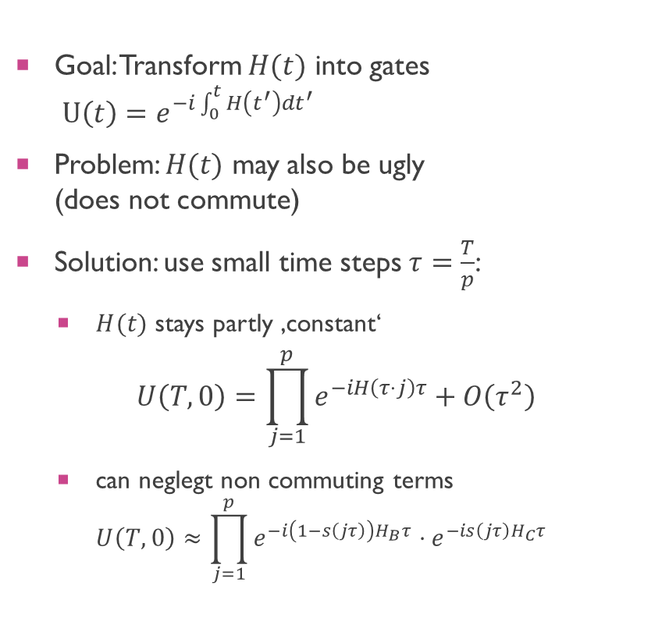
Theory – trotterization
$$H_{B}$$
$$H_{C}$$
Goal: Transform $H(t)$ into gates $U\left(t\right)=e^{−i\int_{0}^{t}{H\left(t^{′}\right)dt^{′}}}$
Problem: $H(t)$ may also be ugly (does not commute)
Solution: use small time steps $τ=\frac{T}{p}$:
$H(t)$ stays partly ‚constant‘
$$U\left(T,0\right)=\prod_{j=1}^{p}{e^{−iH\left(τ⋅j\right)τ}}+O\left(τ^{2}\right)$$
can neglegt non commuting terms $U\left(T,0\right)≈\prod_{j=1}^{p}{e^{−i\left(1−s\left(jτ\right)\right)H_{B}τ}}⋅e^{−is\left(jτ\right)H_{C}τ}$

Slide 8
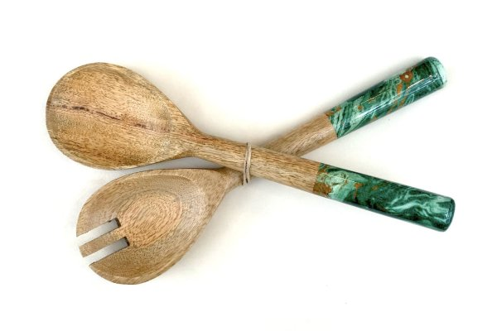
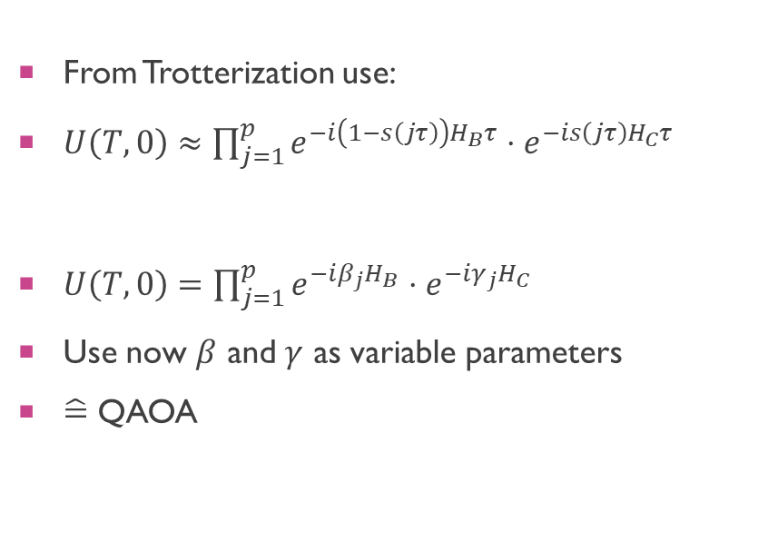
QAOa
From Trotterization use:
$U\left(T,0\right)≈\prod_{j=1}^{p}{e^{−i\left(1−s\left(jτ\right)\right)H_{B}τ}}⋅e^{−is\left(jτ\right)H_{C}τ}$
$β_{j}=\left(1−s\left(jτ\right)\right)τ, γ_{j}=s\left(jτ\right)τ$
$U\left(T,0\right)=\prod_{j=1}^{p}{e^{−iβ_{j}H_{B}}⋅e^{−iγ_{j}H_{C}}}$
Use now $β$ and $γ$ as variable parameters
$\hat{=}$ QAOA

Slide 9
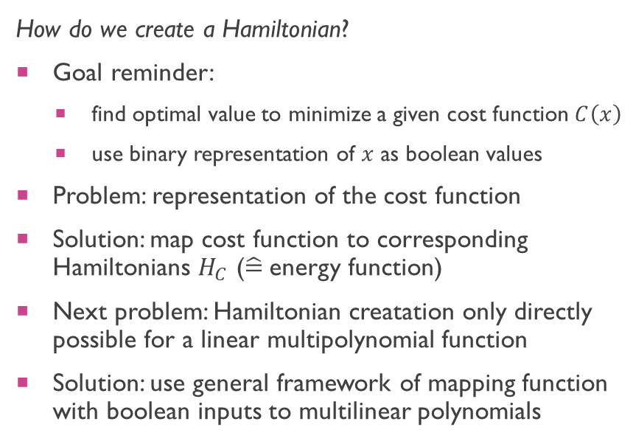
Theory – Hamiltonian creation
How do we create a Hamiltonian?
Goal reminder:
find optimal value to minimize a given cost function $C\left(x\right)$
use binary representation of $x$ as boolean values
Problem: representation of the cost function
Solution: map cost function to corresponding Hamiltonians $H_{C}$ ($\hat{=}$energy function)
Next problem: Hamiltonian creatation only directly possible for a linear multipolynomial function
Solution: use general framework of mapping function with boolean inputs to multilinear polynomials

Slide 10
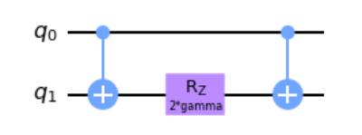
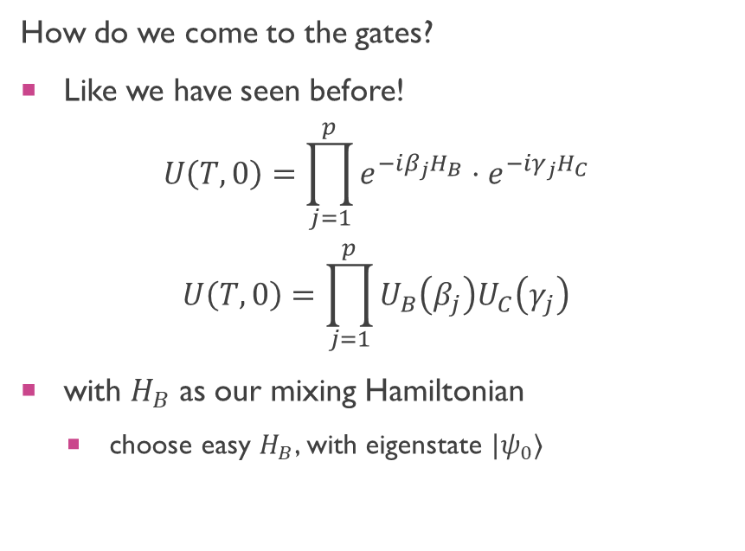
Theory – Gate creation
How do we come to the gates?
Like we have seen before!
$$U\left(T,0\right)=\prod_{j=1}^{p}{e^{−iβ_{j}H_{B}}⋅e^{−iγ_{j}H_{C}}}$$
$$U\left(T,0\right)=\prod_{j=1}^{p}{U_{B}\left(β_{j}\right)U_{C}\left(γ_{j}\right)}$$
with $H_{B}$ as our mixing Hamiltonian
choose easy $H_{B}$, with eigenstate $|ψ_{0}⟩$
Jupyter notebook (Part 2)

Slide 11
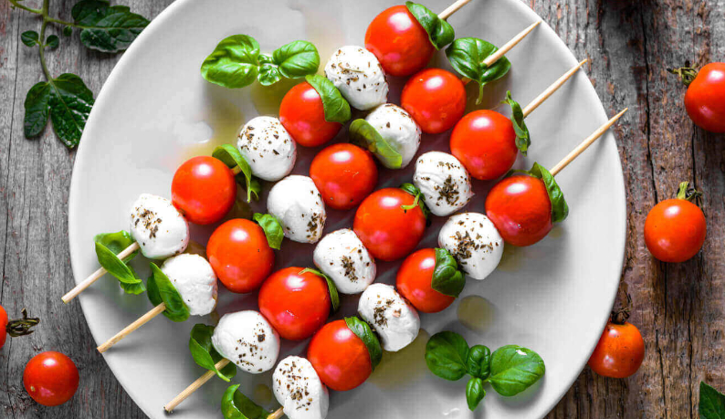
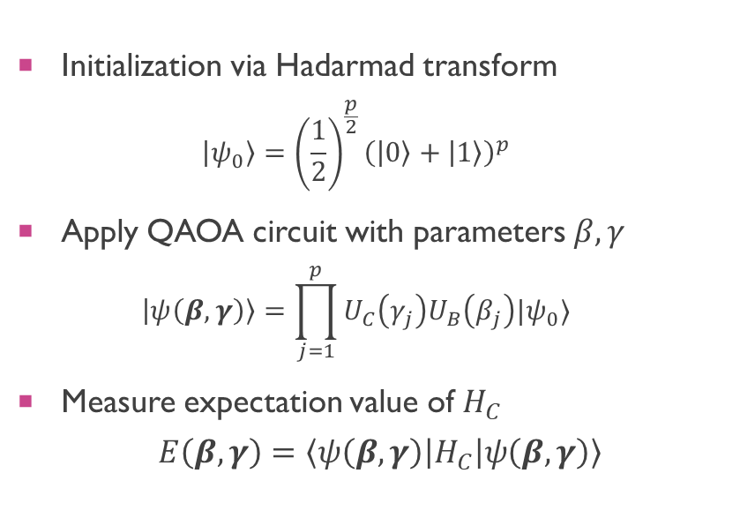
Circuit
p
Initialization
U_{B} Mixing
U_{C} Cost
Measurement
Initialization via Hadarmad transform
$$\left|ψ_{0}\right\rangle ={\left(\frac{1}{2}\right)}^{\frac{p}{2}}{\left(\left|0\right\rangle +\left|1\right\rangle \right)}^{p}$$
Apply QAOA circuit with parameters $β, γ$
$$\left|ψ\left(β, γ\right)\right\rangle =\prod_{j=1}^{p}{U_{C}\left(γ_{j}\right)U_{B}\left(β_{j}\right)|ψ_{0}⟩}$$
Measure expectation value of $H_{C}$
$$E\left(β,γ\right)=\left\langle ψ\left(β, γ\right)\left|H_{C}\right|ψ\left(β,γ\right)\right\rangle$$
Jupyter notebook (Part 3)

Slide 12
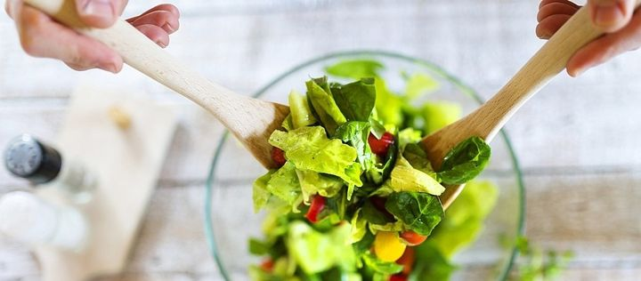

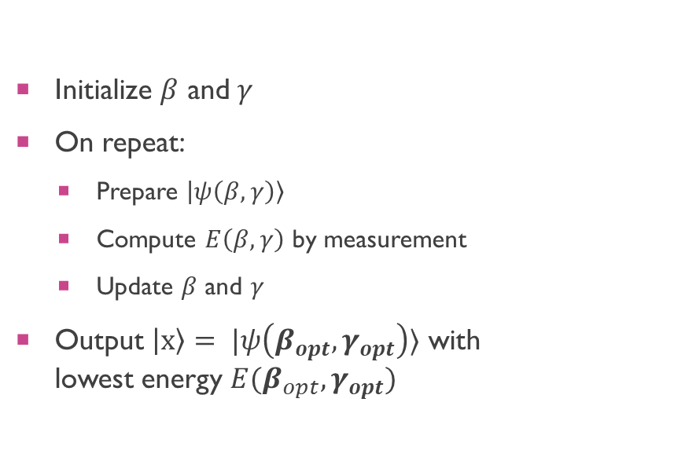

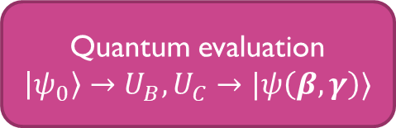

Recall
$$β, γ$$
Initialize $β$ and $γ$
On repeat:
Prepare $\left|ψ\left(β,γ\right)\right\rangle$
Compute $E\left(β, γ\right)$ by measurement
Update $β$ and $γ$
Output $\left|x\right\rangle = |ψ\left(β_{opt},γ_{opt}\right)⟩$ with lowest energy $E(β_{opt}, γ_{opt})$
Classic optimization
Update $β, γ$
Quantum evaluation
$\left|ψ_{0}\right\rangle →U_{B},U_{C}→|ψ\left(β, γ\right)⟩$
$$E\left(β,γ\right)$$

Slide 13
potential and outlook
Solution to many problems
Outlook homework: max cut (right)
Possible use of a quantum speedup
More real life applications needed to proof speedup

