Slide 1

TEAM: CHAMCHAMATE CODERS
PROJECT: CODEKAKSHA

Slide 2

Problem Statement
Coding is becoming an essential skill for engineering students, but it is often difficult to understand the concepts of data structures and algorithms without any real interaction with the teacher. The ongoing pandemic has confined everyone to their homes and regular classroom teaching & learning has come to a halt. This has created the need for a virtual space where programmers can come together and learn, teach, collaborate with each other.
Also, people who are skilled at programming concepts and can potentially be good teachers, sometimes lack in facilities (like writing pad, stylus etc) which can help them teach virtually.
Our primary aim is to make a virtual platform where people can learn, teach, and have fun with code. The platform must provide functionality to host interactive code sessions.

Slide 3


Track: Education

Slide 4
Solution
CODEKAKSHA
CodeKaksha is a virtual platform where people can learn, teach, collaborate and have fun with code. The platform provides the functionality to host interactive code sessions, called ‘coderences’.
It provides features such as a collaborative white-board, compiler and video conferencing, to facilitate easy teaching-learning and collaboration.
Users can also save their code sessions (‘coderences’) in their account, and resume any session from where they left it.
1

Slide 5

CODEKAKSHA
FEATURES

Slide 6

CODEKAKSHA
HOW WOULD IT HELP?

Slide 7
Github Link
Link to your github repo

Slide 8
Demo Link
Link to your demo

Slide 9
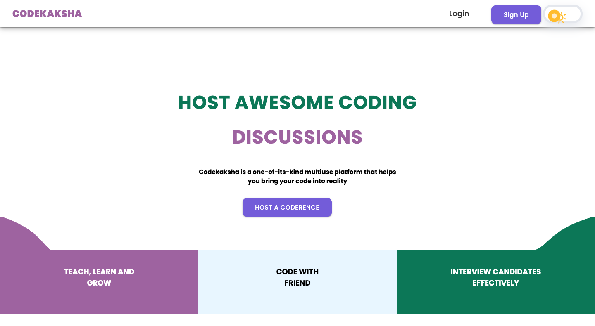
UI / UX Screenshots

Slide 10
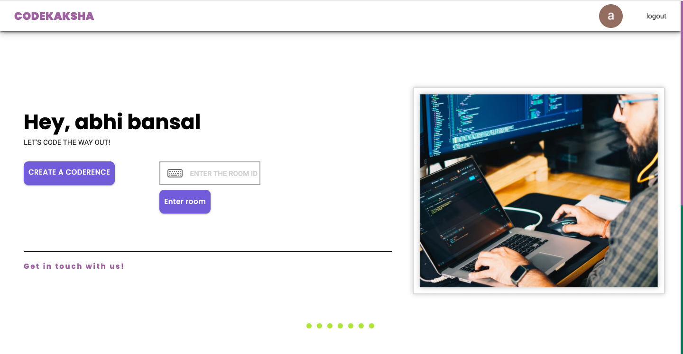
UI / UX Screenshots

Slide 11
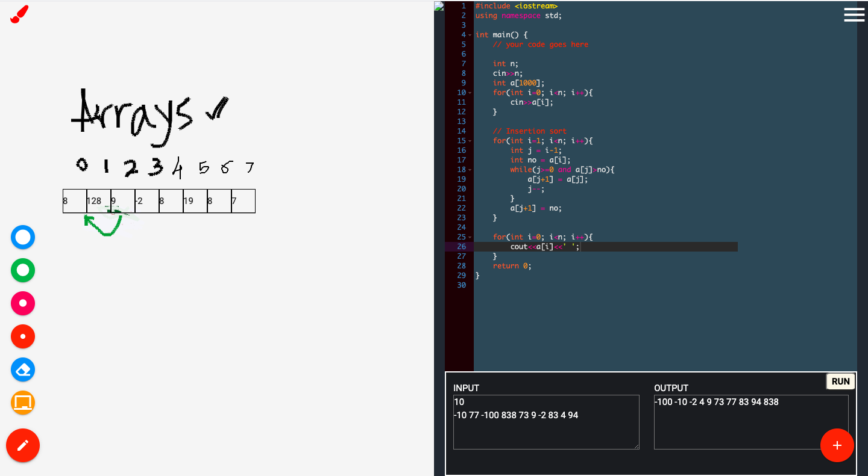
UI / UX Screenshots

Slide 12

Technologies Used

Slide 13
Technologies Used
We have used HTML5, CSS & JavaScript to create the frontend.
We have used NodeJS on the backend, and Firebase as a database, to store details of saved ‘coderences’ and for user authentication.
We have also used ‘socket.io’ and ‘peer.js’ to enable users to create live sessions, and enable video conferencing.

Slide 14

Future Scope

Slide 15
Future Scope
•In the future, we plan on building more functionality such as:
Support for larger live sessions
Support for other programming languages
More writing features in the collaborative whiteboard
A more secure and stable backend for saving user’s previous sessions

Slide 16
Team Members
Abhinandan Sharma
Shubhang
Vikash
Abhilasha Bansal

Slide 17
Video Link
Upload your Video link.
You can directly upload your video through your Google Drive or upload them on youTube and embed the link.

Slide 18
Thank You;

