Slide 1




Team BPSU

Slide 2
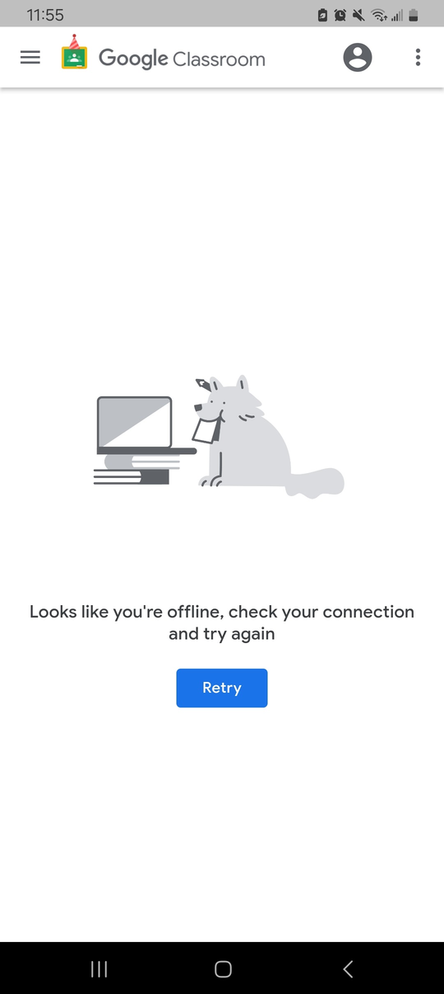
Food for Thought
Imagine, trying your best to cram for an assignment you weren’t even aware was handed out due to your unstable internet connection
Only for you to not be able to pass on time because before you submit, you lose internet connection

Slide 3

Food for Thought
That could’ve been avoided if you were aware of the assignment especially its due date!

Slide 4

Food for Thought
A survey found that about two-thirds of students in their population reported how poor internet connectivity hinders their ability to submit their deliverables on time.
The Link Between Internet Connectivity and Missed Assessments in the Online Class Modality - the International Academic Forum (IAFOR), 2022

Slide 5

What if...
  We are able to store class activities in an offline calendar?
  We are able to manage our time by being able to visualize our schedules?
  We are being reminded and held acountable by a cute little starfish?

Slide 6

Introducing

Slide 7
Clingy

Slide 8
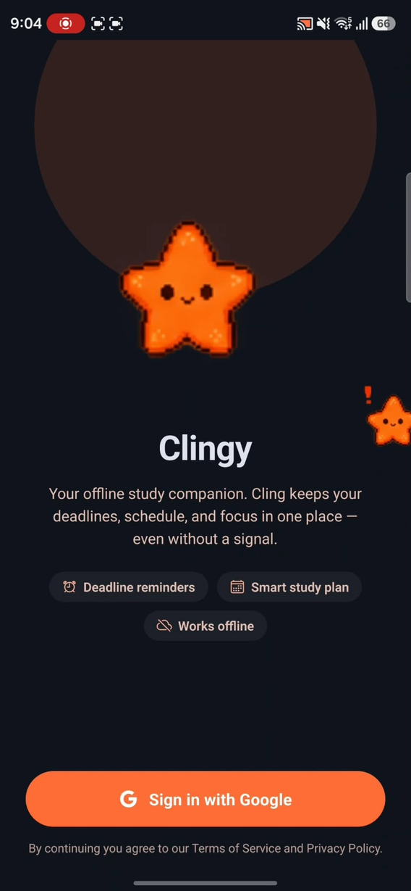
What Is it?
Lightweight, offline-first personalized academic companion

Slide 9
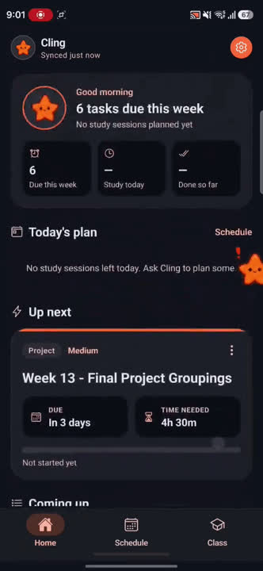
Set up on the go
Clingy connects to your Google Classroom and instantly imports your assignments and deadlines. No manual entry needed.

Slide 10
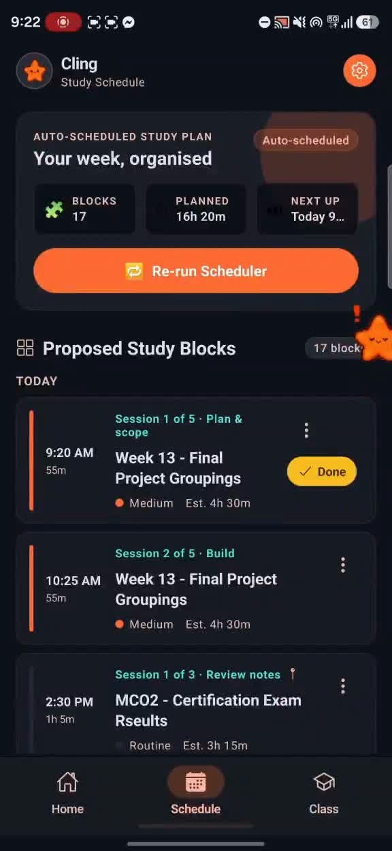
Cling keeps your plan in sight.
Cling combines your assignments and calendar into one prioritized plan, then sticks with you while you work.

Slide 11
Cling
Who are they?
They are a floating mascot that stays nearby, keeps your study plan in view, and gives you a friendly nudge to stay focused and accountable.

Slide 12
Schedule Your way!
If you won’t make it to your study session, that’s ok! reschedule with Cling seamlessly

Slide 13
study anytime, anywhere
No internet? No problem! Cling is so clingy it still works even without internet connection!
The only times requiring internet is when you sync to google services

Slide 14
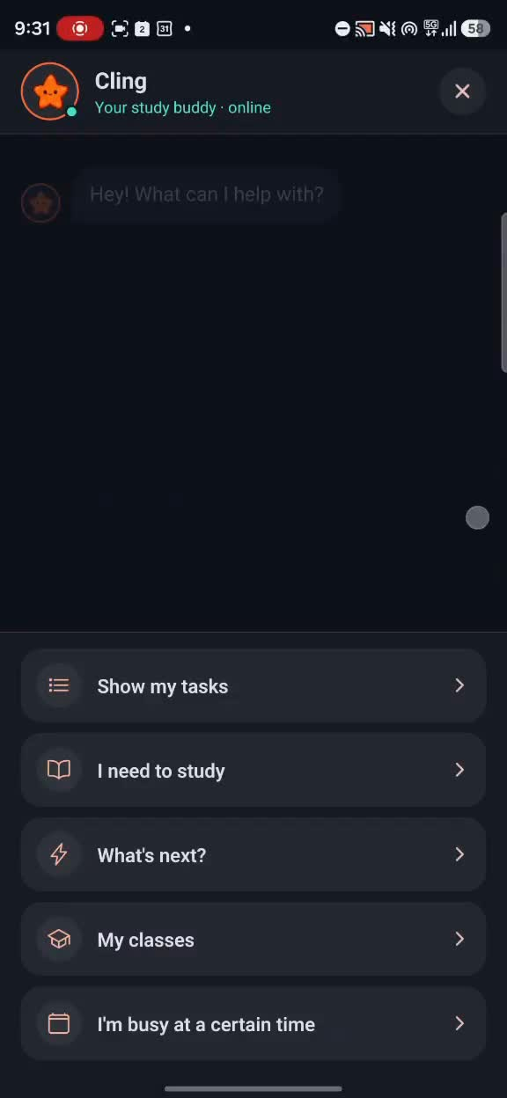
Ask your personal assistant
Want to add a task? Ask Cling. Need an overview? Ask Cling. Your companion is there anywhere, anytime, even offline.

Slide 15
Finally...

Slide 16
Turn on the internet

Slide 17
But There’s one more thing...

Slide 18
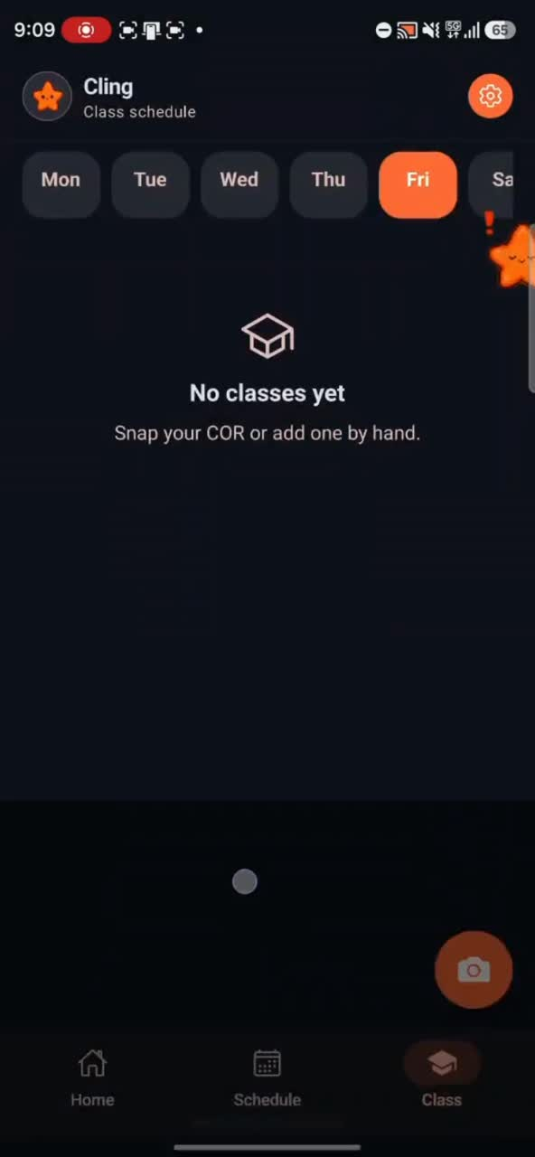

Slide 19
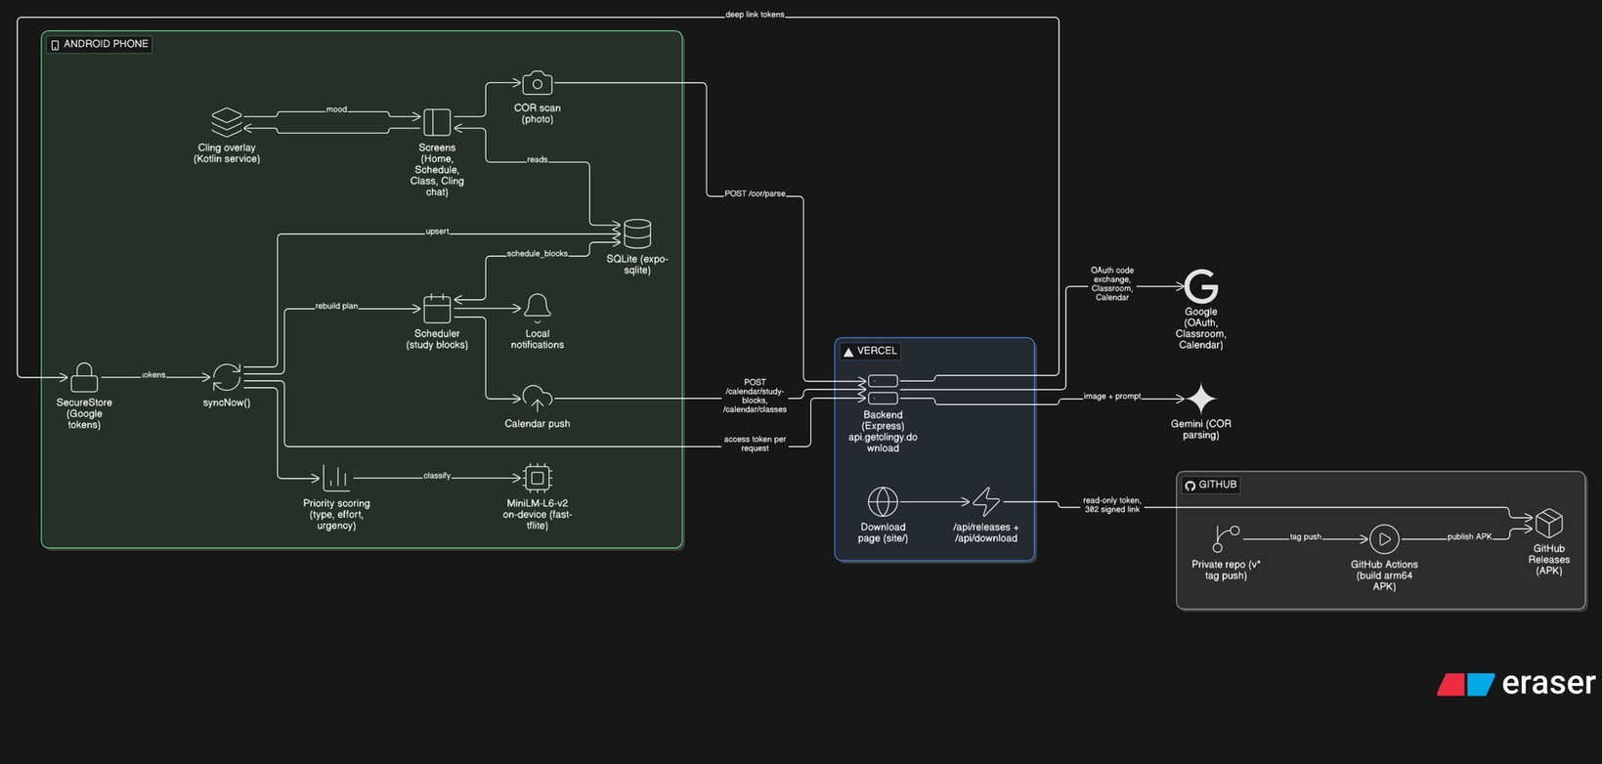
System Architecture

Slide 20

<getclingy.download>

