Slide 1
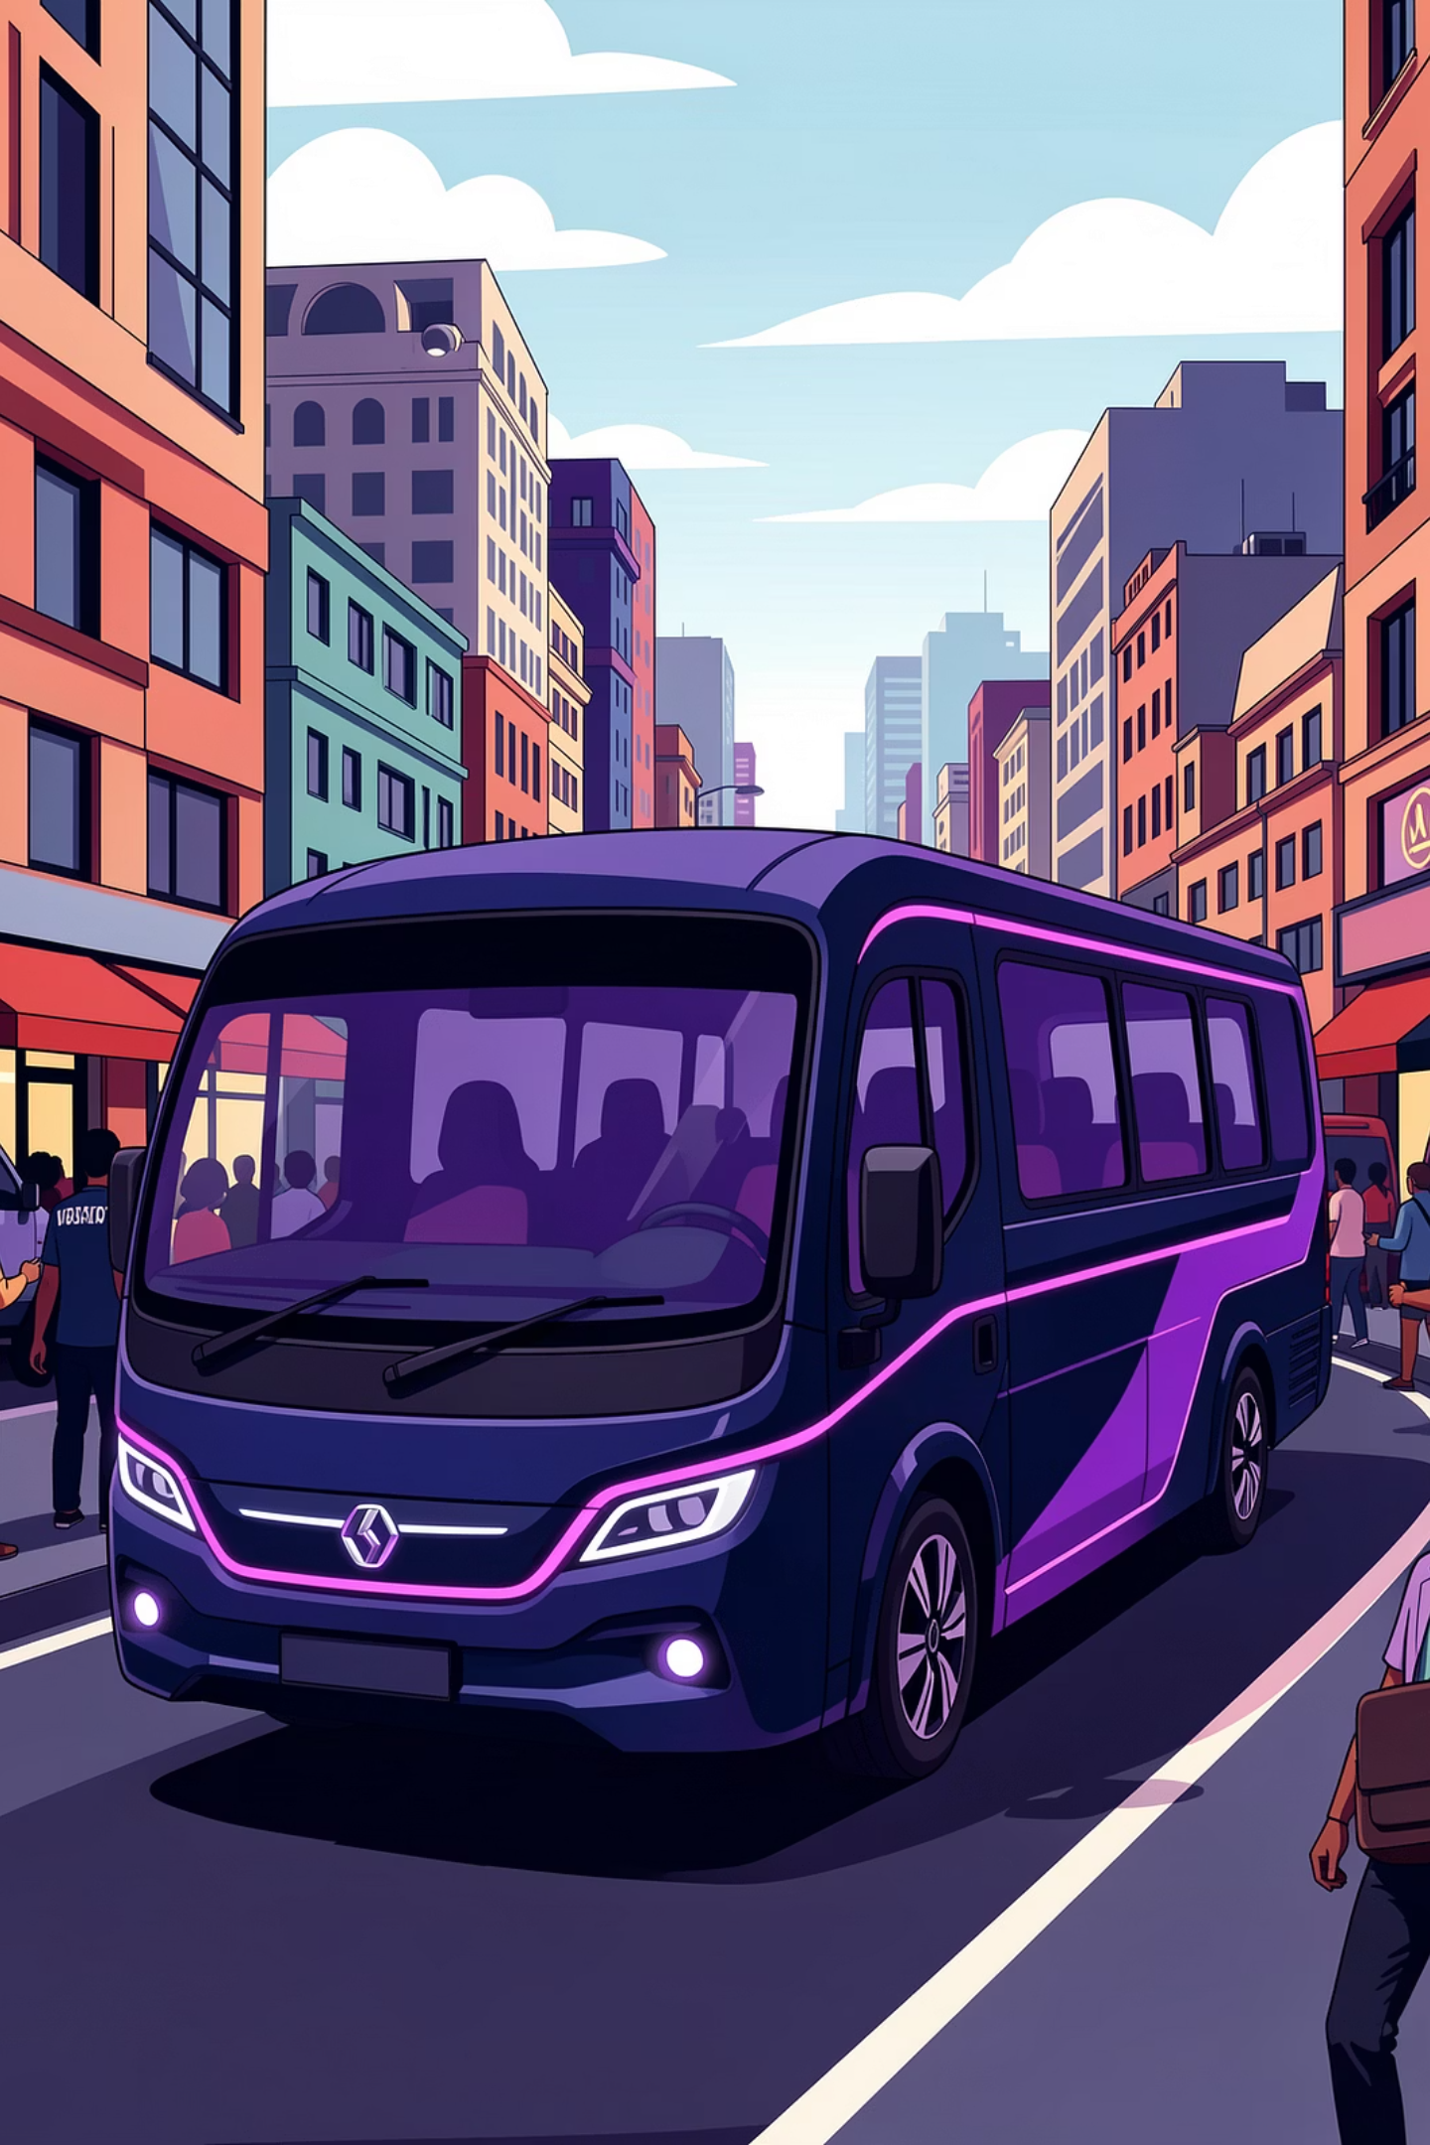
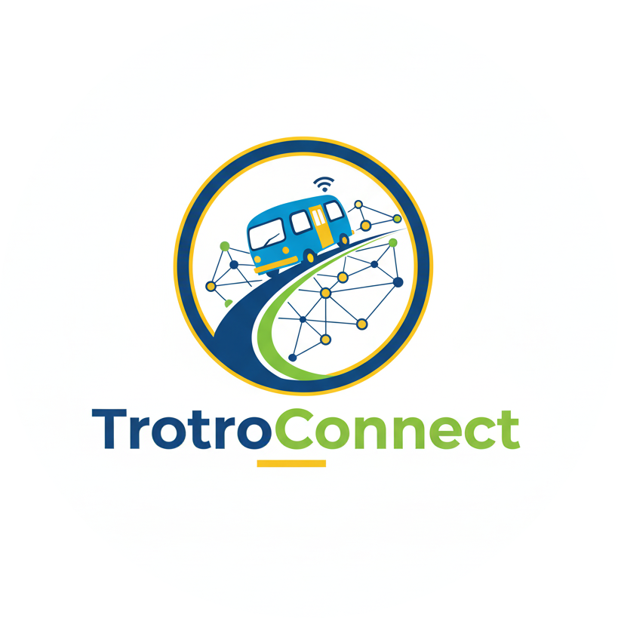
TrotroTrack Ghana
Real-Time Public Transport for Millions of Daily Commuters

Slide 2

Our Vision & Mission
VISION
"Making every commute in Africa predictable,
efficient, and respectful of people's time."
OUR CORE VALUES
LOCAL FIRST
Built by Ghanaians, for Ghanaians
SIMPLICITY
Technology that works for everyone, from students to market women
DRIVER PARTNERSHIP
Empowering existing transport,
not disrupting it
TRANSPARENCY
GPRTU-verified pricing,
real-time data
PAN-AFRICAN AMBITION
Starting in Accra,
scaling across the continent
MISSION
"Transform Ghana's ₵6.4 billion trotro network
through real-time tracking, automated capacity
updates, and fare transparency—empowering
passengers and drivers with actionable intelligence."
"3.5 million people deserve to know when their trotro is coming."

Slide 3
The Problem
THE PAINFUL REALITY OF GHANA'S TRANSPORT SYSTEM:
3.5M DAILY TROTRO TRIPS in Greater Accra
Source: MIT Atlas of Popular Transport, GUMAP 2024
❌ ZERO real-time tracking
❌ NO capacity information before arrival
❌ NO fare transparency (disputes common)
❌ 20-45 MINUTE average wait times with no ETA
70% of urban commuters depend on this system
0% have any visibility into arrival times
PASSENGERS | DRIVERS
2-3 hours wasted daily | ₵900/month wasted fuel
Stress & uncertainty | Inefficient routing
Students miss classes | Lost revenue
Workers late to jobs | Long work days

Slide 4
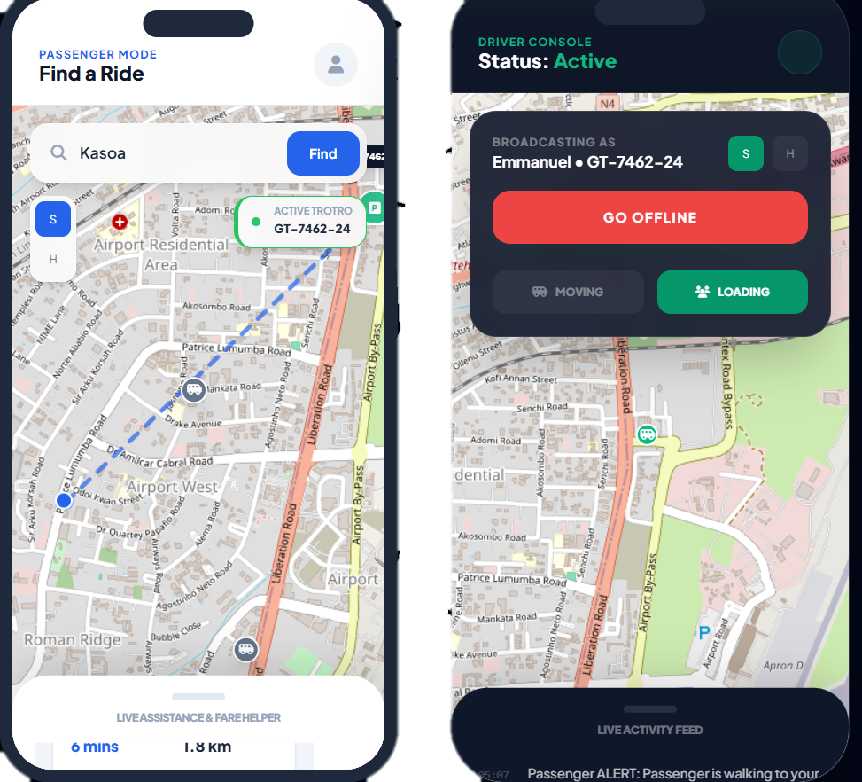
OUR SOLUTION
Real-Time Tracking
See exactly where your trotro is and when it will arrive
Fair Pricing
Pay only for the distance you travel
Maximized Efficiency
Drivers fill empty seats and maximize revenue

Slide 5
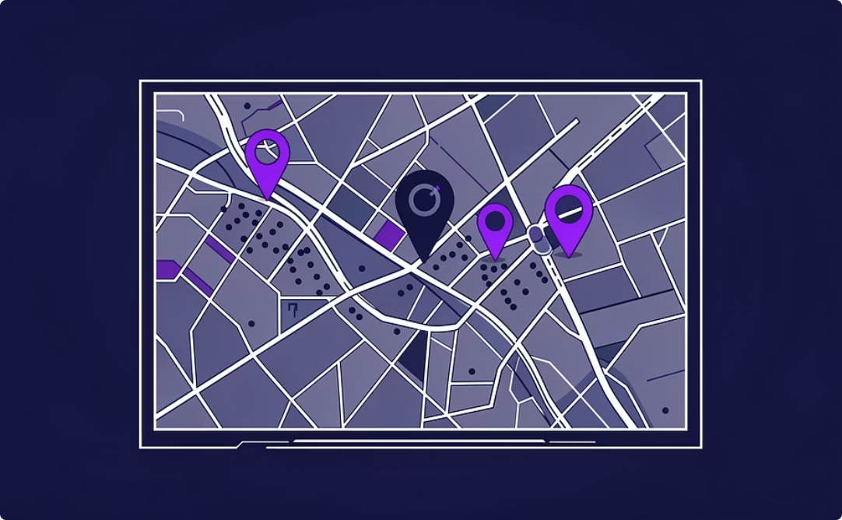
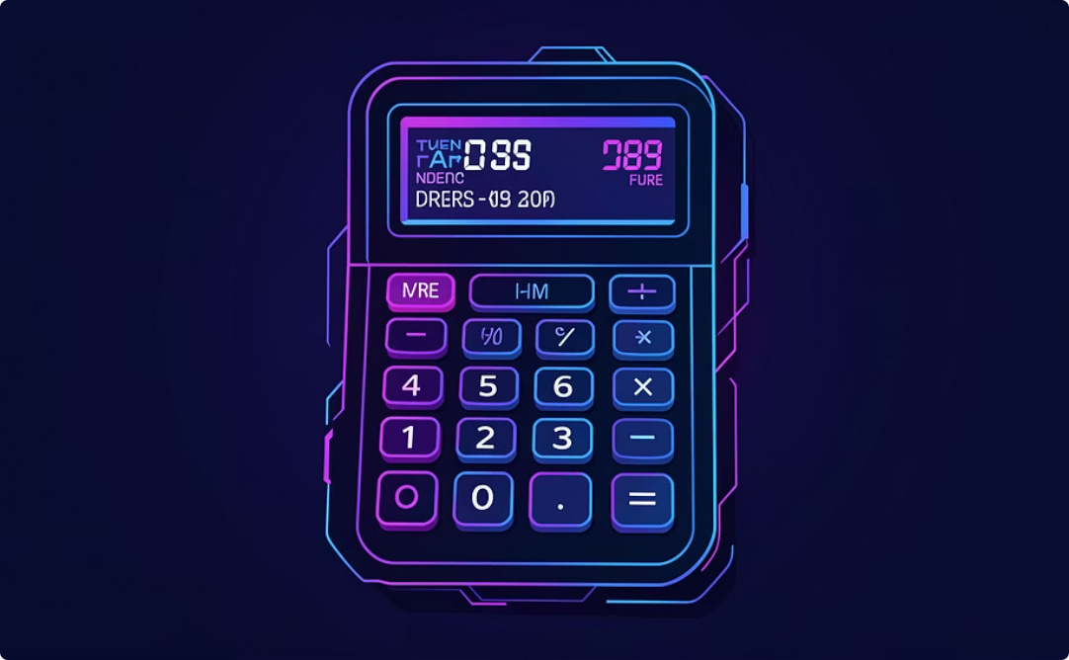
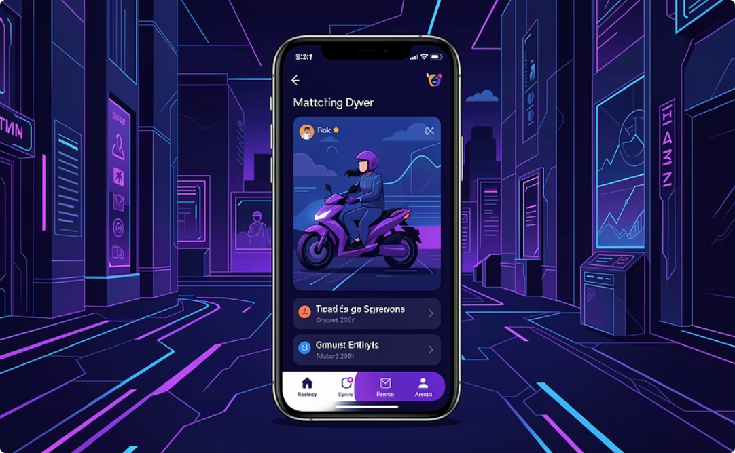
Product Features
Live Location Tracking
Distance-Based Pricing
Smart Matching
GPS-enabled tracking shows real-time trotro positions and accurate arrival predictions
Automatic fare calculation reflects actual kilometers traveled and current fuel prices
Connects drivers with waiting passengers to reduce empty seats and idle time

Slide 6



How It Works
Drivers Share GPS Location
Trotro drivers enable GPS tracking through a simple mobile app, broadcasting their location in real-time
Passengers Find Nearby Trotros
Users check the app to see available trotros, wait times, and exact fares before heading to stations
Smart Routing & Fare Calculation
System calculates optimal routes and fair fares based on distance, fuel costs, and GPRTU-approved rates

Slide 7



Impact on Passengers
Eliminate Wait Time
Pay Fair Prices
Reliable Scheduling
Plan departure around actual arrival times instead of endless waiting
Distance-based fares replace arbitrary flat rates with transparent pricing
Confidently schedule appointments and commitments based on accurate transit information

Slide 8
Impact on Drivers & Operators
Maximize Revenue
Governance & Standards
Fill empty seats efficiently and optimize routes to maximize daily earnings from every run
GPRTU gains oversight and data for better route planning, compliance monitoring, and policy decisions

Slide 9
MARKET SIZE
TAM - TOTAL ADDRESSABLE MARKET
Greater Accra Region
3.5M daily trips
Source: MIT Atlas of Popular Transport,
GUMAP Project 2024
₵5.00 average fare
Source: GPRTU Official Fares, May 2025
ANNUAL MARKET:
₵6.4 BILLION (~$425M USD)
SAM - SERVICEABLE AVAILABLE MARKET
Focus: Main corridors
(40% of total trips)
Smartphone penetration in Accra: 65%
Source: GSMA Mobile Economy SSA 2024
Digital-ready market segment:
₵1.6 BILLION/year
SOM - YEAR 1 TARGET (CONSERVATIVE)
50,000 daily active users
(1.4% of daily passengers)
500 active drivers
(Estimated 5% of Accra trotro drivers)
REVENUE POTENTIAL:
₵420,000 Year 1
₵3.2M Year 2
₵8.5M Year 3

Slide 10
BUSINESS MODEL
DRIVER SUBSCRIPTIONS (Main Revenue)
Price: ₵50/month per driver
Why drivers will pay:
They currently waste ₵900/month driving around looking for passengers
Your app helps them find passengers faster → saves ₵200+/month on fuel
Return on Investment: They pay ₵50, save ₵200 = 4x value
Revenue Growth:
Year 1: 500 drivers × ₵50 = ₵300,000
Year 2: 2,500 drivers × ₵50 = ₵1.5M
Year 3: 5,000 drivers × ₵50 = ₵3M
ADVERTISING (Starts Year 2)
Who pays: Big companies wanting to reach your users
Potential advertisers:
Telecom: MTN, Vodafone (already targeting commuters)
Retail: Shoprite, Melcom (stores near trotro routes)
FMCG: Coca-Cola, Unilever (everyday products)
Mobile Money: Payment providers
How it works:
Banner ads in the app
Sponsored stations ("This station powered by MTN")
Special promotions shown to passengers
Revenue Growth:
Year 2: ₵800,000 (when we have 50K users)
Year 3: ₵2M (when we have 150K users)
Proof it works: SafeBoda (similar app in Uganda) makes $40,000/month from ads

Slide 11
BUSINESS MODEL
PREMIUM FEATURES (Starts Year 3)
Who pays: Big companies with employees who commute
What they get:
Reserved seats for their employees
Trip planning across multiple routes
Digital receipts for expense claims
Fleet tracking for company buses
Revenue: ₵500,000+ in Year 3
WHY THIS MODEL WORKS
✅ Passengers never pay → Easy to get lots of users ✅ Drivers gladly pay → They save 4x more than they spend ✅ GPRTU partnership → Legitimacy + guaranteed revenue ✅ Multiple revenue streams → Not dependent on just one source ✅ Profitable by Year 2 → Investors get their money back fast

Slide 12
BUSINESS MODEL
COMPETITIVE ANALYSIS MATRIX
Uber Google Current Trotro
/Bolt Maps Trotros Connect
────────────────────────────────────────────────────
Real-Time ✅ ❌ ❌ ✅
Tracking
Affordable ❌ N/A ✅ ✅
(₵5 vs ₵40+)
Trotro Focus ❌ ❌ ✅ ✅
GPRTU ❌ ❌ ✅ ✅
Partnership
Fare Accuracy ✅ ❌ ❌ ✅
Works on ✅ ✅ N/A ✅
Smartphones
NETWORK EFFECTS (Winner-Take-All Dynamics)
THE FLYWHEEL:
• More drivers join → Shorter passenger wait times
• Better experience → More passengers download app • More passengers → Drivers earn more per hour
• Higher earnings → Even more drivers join
• Competitors can't catch up once we reach critical mass
MATH:
• Us (500 drivers): 5-minute average wait
• Competitor (50 drivers): 30-minute average wait
• Passengers choose us → Competitor dies
This is how Uber beat Lyft. First to scale wins.

Slide 13
Technology Stack
GPS Tracking System
Backend Infrastructure
Mobile Applications
Real-time location broadcasting
Low power consumption design
Cross-platform compatibility
Cloud-based server architecture
Scalable database systems
API integrations
Passenger-facing app (iOS/Android)
Driver portal with simplified interface
Web-based admin dashboard

