Slide 1






Emertxe Information Technologies (P) Ltd
IOT based Home Automation Solution
Submitted to : JAYALAXMI N. DHANYAL
Submitted by : PARTH K. MEHTA
3rd Year student of Dwarkadas J. Sanghvi College of Engineering, Mumbai

Slide 2
Introduction to Learning Concepts :
C-Programming
IoT (Internet of Things)
Embedded Systems (ES)
Microcontroller
Contents
Project :
Problem Statement
Tools Used
Requirements
Simulation

Slide 3





C-Programming
C is fast and resource-efficient, ideal for performance-critical systems.
C code can run on various platforms with minimal changes, making it highly versatile.
C allows direct hardware and memory manipulation, crucial for embedded systems.
C supports dividing code into functions and libraries, enhancing reusability and ease of maintenance.

Slide 4
Topics learnt in C:
1. Data type (char, int, float, double)
2. Modifier & Qualifier
3. Conditionals & loops
4. Operators
5. Arrays & Pointers
6. Strings
7. Function
8. Storage classes
9. Pre-processor

Slide 5
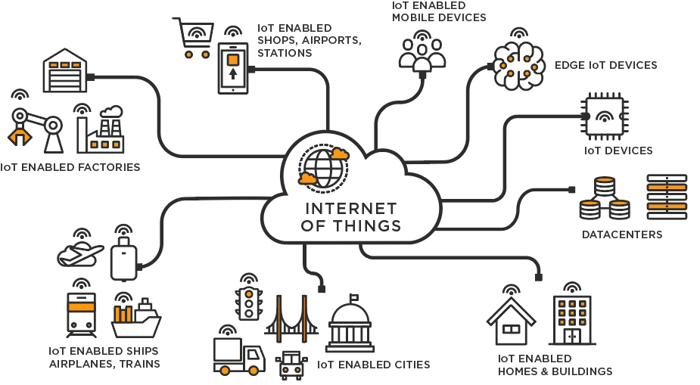
IoT (Internet of Things)
The Internet of Things (IoT) refers to a network of interconnected devices that communicate and exchange data over the internet. These devices, embedded with sensors and software, enable remote monitoring, and automation of various systems.
Connectivity: IoT connects devices for remote control.
Data Collection: IoT sensors gather real-time data.
Automation: IoT automates processes, boosting efficiency.

Slide 6
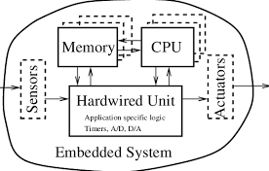
Embedded Systems (ES)
An embedded system is a specialized computing system designed to perform dedicated functions within a larger mechanical or electrical system, often with real-time computing constraints. These systems are integral to devices, providing control, monitoring, and processing capabilities.
Real-Time Operation: Embedded systems operate under strict timing constraints for real-time tasks.
Dedicated Functionality: Embedded systems are designed for specific tasks within a larger system.

Slide 7
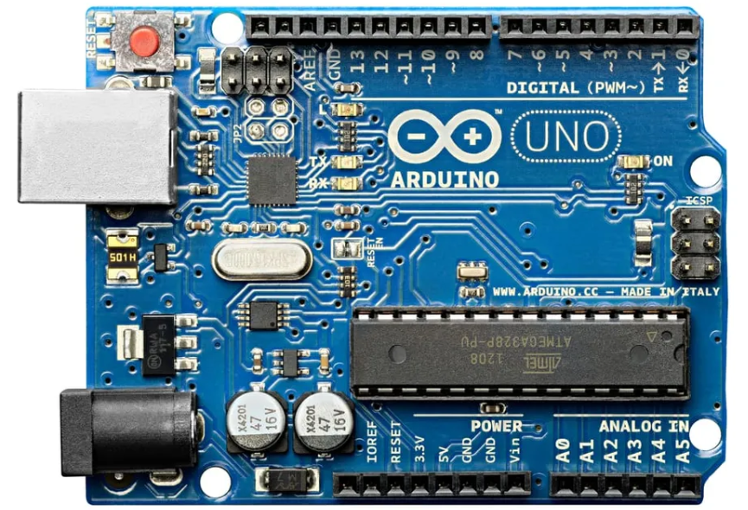
Microcontroller
A microcontroller is a compact integrated circuit designed to govern specific operations in embedded systems. It combines a processor core, memory, and programmable input/output peripherals on a single chip.
Integrated Components: Microcontrollers typically include a CPU, RAM, ROM, timers, and I/O ports, making them versatile for controlling various applications.
Programmability: Microcontrollers are programmable, allowing users to write and upload custom code to tailor their operation to specific tasks or applications.

Slide 8
Project
Overview :
Purpose of the Project: Develop a simulated home automation system that allows control over household devices (like lights, heaters, and water valves) through an IoT-based mobile application.
Scope of the Project:
Simulation Environment: Use PicSimLab to emulate real-world hardware setups.
Remote Control: Employ the Blynk IoT mobile app to manage devices such as lighting systems, temperature regulation, and water tank levels.
Real-time Monitoring: Implement live status updates and control feedback on both the CLCD display and the mobile application.

Slide 9
Project Statement:
Challenges in Home Automation:
Limited Remote Access: Traditional home automation systems lack seamless remote control, making it difficult for users to manage their home environment from a distance.
Energy Inefficiency: Without automated control, energy resources like heating, cooling, and lighting are often wasted, leading to higher utility costs.
Complexity in Implementation: Integrating various sensors, actuators, and control systems into a single, user-friendly platform presents significant technical challenges.

Slide 10
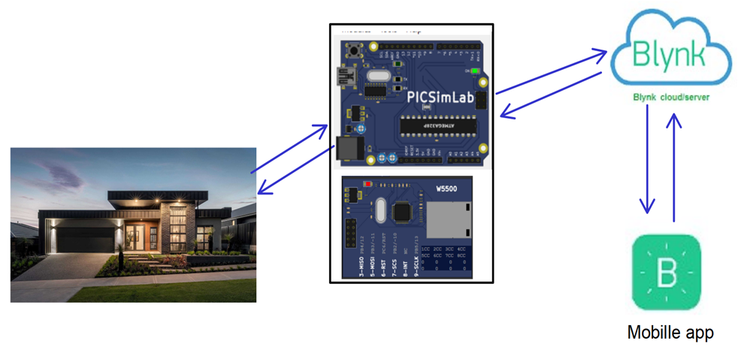
Project Statement:
Objective:
Develop a comprehensive IoT-based solution that addresses these challenges by providing efficient, remote-controlled automation of key home functions like temperature regulation, water management, and lighting.

Slide 11
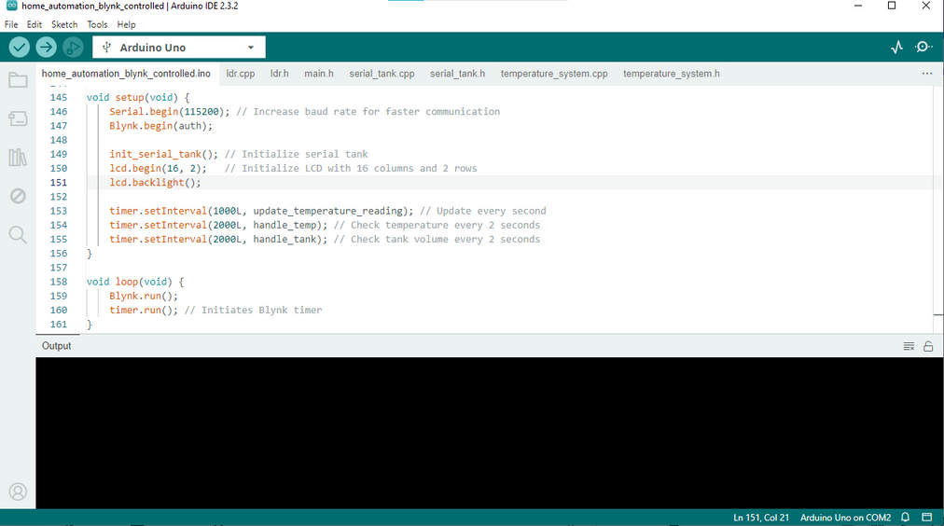
Arduino
Arduino: An open-source microcontroller platform used for building electronics projects. It provides a simple and flexible interface for controlling hardware components.
Arduino IDE: The integrated development environment for writing, compiling, and uploading code to the Arduino board. It supports multiple programming languages and simplifies hardware-software integration.

Slide 12
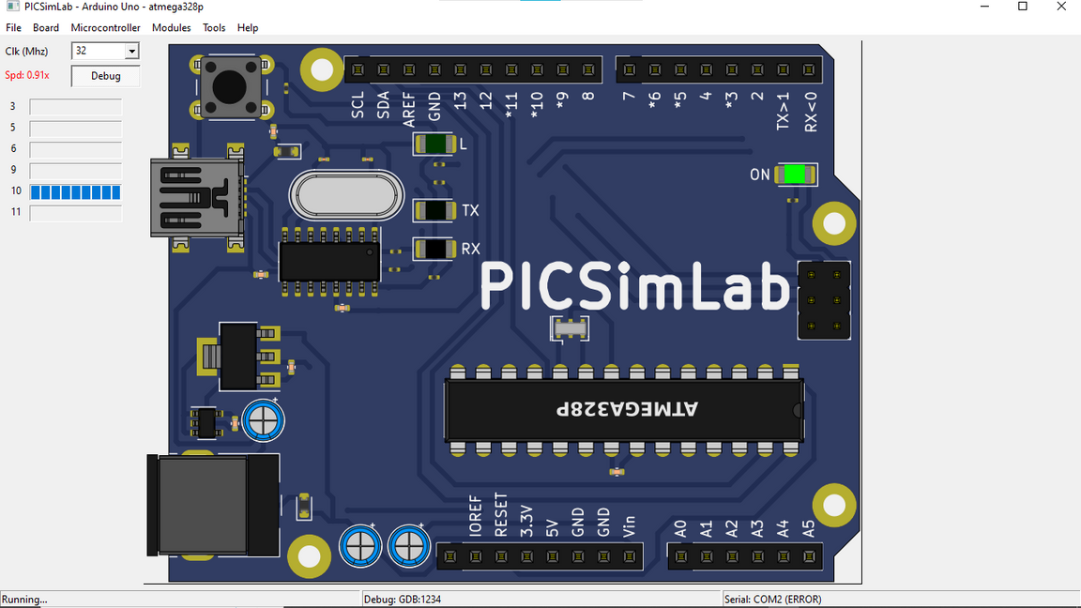
PicSimLab
PicSimLab: A virtual lab simulator that emulates various microcontroller circuits and peripherals. It allows for testing and debugging hardware setups without needing physical components, making it ideal for prototyping and educational purposes.

Slide 13
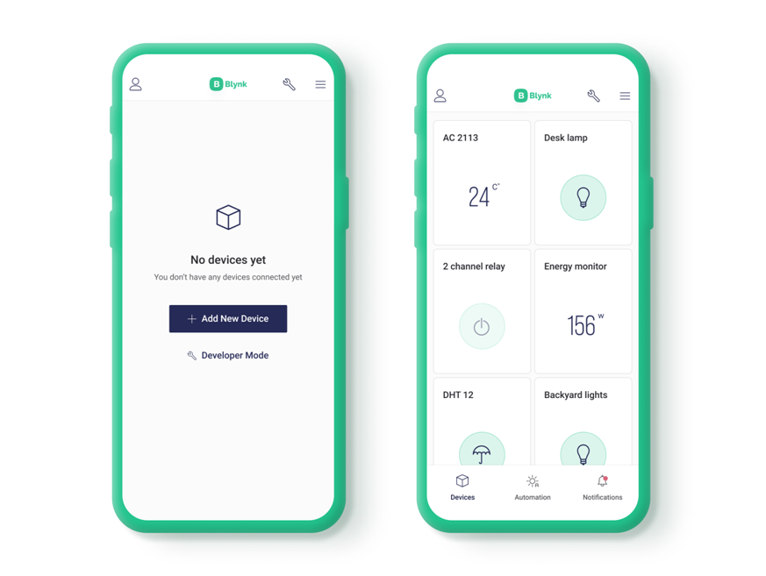
Blynk IoT Mobile Application
Blynk App:
A mobile application designed for the Internet of Things (IoT), enabling remote control and monitoring of connected devices. It features customizable widgets like buttons, gauges, and terminals to interact with sensors and actuators in real-time.

Slide 14
Garden Lights Control
Requirement Description:
Input: Light Dependent Resistor (LDR) sensor detects ambient light levels.
Process: The system reads the LDR sensor data and adjusts the brightness of garden lights accordingly, simulating the effect of natural sunlight.
Output: Automated control of LED brightness, optimizing energy use by only providing necessary lighting.
Purpose:
To ensure garden lights are automatically adjusted based on natural light availability, reducing unnecessary energy consumption.

Slide 15
Temperature Control System
Requirement Description:
Input: Temperature readings from the LM35 sensor.
Process: The system displays the temperature on a CLCD screen and controls a heater or cooler based on user input from the Blynk app.
Output: Real-time temperature display and remote control of the heating and cooling system, maintaining a comfortable indoor environment.
Purpose:
To provide a reliable method of controlling home temperature remotely, ensuring energy efficiency and user comfort.

Slide 16
Water Tank Management
Requirement Description:
Input: Serial data communication for water volume in the tank.
Process: The system reads water level data, displays it on the CLCD, and controls the inlet and outlet valves via the Blynk app.
Output: Automated and remote-controlled water management, ensuring optimal water levels in the tank.
Purpose:
To maintain efficient water usage by automating the control of water inflow and outflow, reducing waste and preventing overflow.

Slide 17
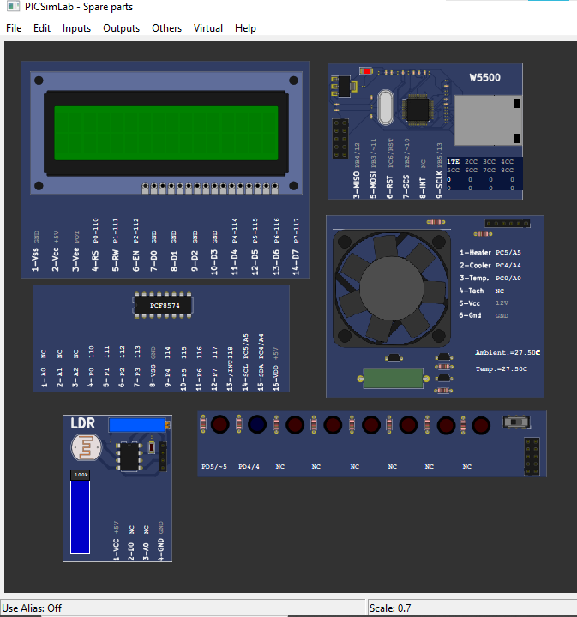
Simulation Image

Slide 18
End
Thank you
Successfully developed an IoT-based home automation system using Arduino, PicSimLab, and Blynk, offering efficient and remote control over home lighting, temperature, and water management.

