Slide 1
Cache Memories
Computer Systems
Oct. 02, 2019
Michael Kirkedal Thomsen,
Finn Schiermer Andersen
Based on slides by Randal E. Bryant and David R. O’Hallaron

Slide 2
RECAP: Memory hierarchy
Discuss 5 minutes with the person beside!
L0:
Regs
CPU registers hold words retrieved from the L1 cache.
Smaller,
faster,
and
costlier
(per byte)
storage
devices
L1:
L1 cache
(SRAM)
L1 cache holds cache lines retrieved from the L2 cache.
L2:
L2 cache
(SRAM)
L2 cache holds cache lines
retrieved from L3 cache
L3:
L3 cache
(SRAM)
L3 cache holds cache lines
retrieved from main memory.
Larger,
slower,
and
cheaper
(per byte)
storage
devices
L4:
Main memory
(DRAM)
Main memory holds disk blocks retrieved from local disks.
L5:
Local secondary storage
(local disks)
Local disks hold files retrieved from disks
on remote servers
L6:
Remote secondary storage
(e.g., Web servers)

Slide 3
General Cache Concept
Cache
Smaller, faster, more expensive
memory caches a subset of
the blocks
8
4
9
14
10
3
Data is copied in block-sized transfer units
4
10
Larger, slower, cheaper memory
viewed as partitioned into “blocks”
Memory
0
1
2
3
4
4
5
6
7
8
9
10
10
11
12
13
14
15

Slide 4
Cache Memories
Cache memories are small, fast SRAM-based memories managed automatically in hardware
  Hold frequently accessed blocks of main memory
CPU looks first for data in cache
Typical system structure:
CPU chip
Register file
ALU
Cache
memory
System bus
Memory bus
Main
memory
Bus interface
I/O
bridge

Slide 5
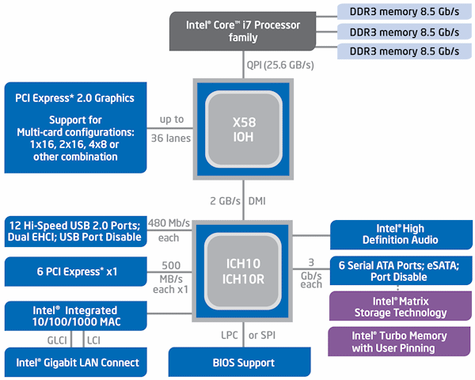
Intel Core i7 block diagram

Slide 6
Today
Cache memory organization and operation
Performance impact of caches
  The memory mountain
  Rearranging loops to improve spatial locality

Slide 7
General Cache Organization (S, E, B)
E = 2e lines per set
set
line
S = 2^{s} sets
Cache size:
C = S x E x B data bytes
v
tag
0
1
2
B-1
valid bit
B = 2^{b} bytes per cache block (the data)

Slide 8
Cache Read
Locate set
Check if any line in set
has matching tag
Yes + line valid: hit
Locate data starting
at offset
E = 2e lines per set
Address of word:
t bits
s bits
b bits
S = 2^{s} sets
tag
set
index
block
offset
data begins at this offset
v
tag
0
1
2
B-1
valid bit
B = 2^{b} bytes per cache block (the data)

Slide 9
Example: Direct Mapped Cache (E = 1)
Direct mapped: One line per set
Assume: cache block size 8 bytes
Address of int:
v
tag
0
1
2
3
4
5
6
7
t bits
0…01
100
v
tag
0
1
2
3
4
5
6
7
find set
S = 2^{s} sets
v
tag
0
1
2
3
4
5
6
7
v
tag
0
1
2
3
4
5
6
7

Slide 10
Example: Direct Mapped Cache (E = 1)
Direct mapped: One line per set
Assume: cache block size 8 bytes
Address of int:
valid? +
match: assume yes = hit
t bits
0…01
100
v
tag
0
1
2
3
4
5
6
7
tag
block offset

Slide 11
Example: Direct Mapped Cache (E = 1)
Direct mapped: One line per set
Assume: cache block size 8 bytes
Address of int:
valid? +
match: assume yes = hit
t bits
0…01
100
v
tag
0
1
2
3
4
5
6
7
block offset
int (4 Bytes) is here
If tag doesn’t match: old line is evicted and replaced

Slide 12
Direct-Mapped Cache Simulation
t=1
s=2
b=1
M=16 bytes (4-bit addresses), B=2 bytes/block,
S=4 sets, E=1 Blocks/set
Address trace (reads, one byte per read):
0 [0000₂],
1 [0001₂],
7 [0111₂],
8 [1000₂],
0 [0000₂]
x
xx
x
miss
hit
miss
miss
miss
v
Tag
Block
Set 0
0
?
?
1
1
1
0
1
0
M[0-1]
M[8-9]
M[0-1]
Set 1
Set 2
Set 3
1
0
M[6-7]

Slide 13
E-way Set Associative Cache (Here: E = 2)
E = 2: Two lines per set
Assume: cache block size 8 bytes
Address of short int:
t bits
0…01
100
v
tag
0
1
2
3
4
5
6
7
v
tag
0
1
2
3
4
5
6
7
v
tag
0
1
2
3
4
5
6
7
v
tag
0
1
2
3
4
5
6
7
find set
v
tag
0
1
2
3
4
5
6
7
v
tag
0
1
2
3
4
5
6
7
v
tag
0
1
2
3
4
5
6
7
v
tag
0
1
2
3
4
5
6
7

Slide 14
E-way Set Associative Cache (Here: E = 2)
E = 2: Two lines per set
Assume: cache block size 8 bytes
Address of short int:
compare both
t bits
0…01
100
valid? +
match: yes = hit
v
tag
0
1
2
3
4
5
6
7
tag
v
tag
0
1
2
3
4
5
6
7
block offset

Slide 15
E-way Set Associative Cache (Here: E = 2)
E = 2: Two lines per set
Assume: cache block size 8 bytes
Address of short int:
compare both
t bits
0…01
100
valid? +
match: yes = hit
v
tag
0
1
2
3
4
5
6
7
v
tag
0
1
2
3
4
5
6
7
block offset
short int (2 Bytes) is here
No match:
One line in set is selected for eviction and replacement
Replacement policies: random, least recently used (LRU), …

Slide 16
2-Way Set Associative Cache Simulation
t=2
s=1
b=1
xx
x
x
M=16 byte addresses, B=2 bytes/block,
S=2 sets, E=2 blocks/set
Address trace (reads, one byte per read):
0 [0000₂],
1 [0001₂],
7 [0111₂],
8 [1000₂],
0 [0000₂]
miss
hit
miss
miss
hit
v
Tag
Block
0
?
?
Set 0
1
00
M[0-1]
1
10
M[8-9]
0
1
01
M[6-7]
Set 1
0
0

Slide 17
What about writes?
Multiple copies of data exist:
  L1, L2, L3, Main Memory, Disk
What to do on a write-hit?
  Write-through (write immediately to memory)
  Write-back (defer write to memory until replacement of line)
    Need a dirty bit (line different from memory or not)
What to do on a write-miss?
  Write-allocate (load into cache, update line in cache)
    Good if more writes to the location follow
  No-write-allocate (writes straight to memory, does not load into cache)
Typical
  Write-through + No-write-allocate
  Write-back + Write-allocate

Slide 18
Intel Core i7 Cache Hierarchy
Processor package
Core 0
Core 3
L1 i-cache and d-cache:
32 KB, 8-way,
Access: 4 cycles
L2 unified cache:
256 KB, 8-way,
Access: 10 cycles
L3 unified cache:
8 MB, 16-way,
Access: 40-75 cycles
Block size: 64 bytes for all caches.
Regs
Regs
L1
d-cache
L1
i-cache
L1
d-cache
L1
i-cache
…
L2 unified cache
L2 unified cache
L3 unified cache
(shared by all cores)
Main memory

Slide 19
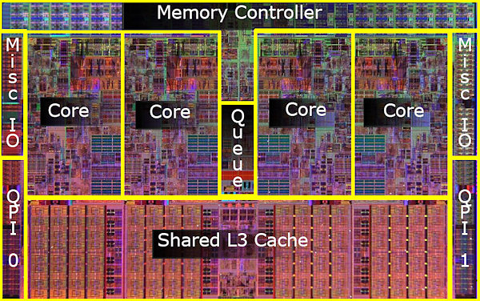
Intel Core i7 - 4-core CPU

Slide 20
Cache Performance Metrics
Miss Rate
  Fraction of memory references not found in cache (misses / accesses)
  = 1 – hit rate
  Typical numbers (in percentages):
    3-10% for L1
    can be quite small (e.g., < 1%) for L2, depending on size, etc.
Hit Time
  Time to deliver a line in the cache to the processor
    includes time to determine whether the line is in the cache
  Typical numbers:
    4 clock cycle for L1
    10 clock cycles for L2
Miss Penalty
  Additional time required because of a miss
    typically 50-200 cycles for main memory (Trend: increasing!)

Slide 21
Let’s think about those numbers
Huge difference between a hit and a miss
  Could be 100x, if just L1 and main memory
Would you believe 99% hits is twice as good as 97%?
  Consider:
  cache hit time of 1 cycle
  miss penalty of 100 cycles
  Average access time:
97% hits: 1 cycle + 0.03 * 100 cycles = 4 cycles
99% hits: 1 cycle + 0.01 * 100 cycles = 2 cycles
This is why “miss rate” is used instead of “hit rate”

Slide 22
Today
Cache organization and operation
Performance impact of caches
  The memory mountain
  Rearranging loops to improve spatial locality

Slide 23
Locality
Principle of Locality: Programs tend to use data and instructions with addresses near or equal to those they have used recently
Temporal locality:
  Recently referenced items are likely
  to be referenced again in the near future
Spatial locality:
  Items with nearby addresses tend
  to be referenced close together in time

Slide 24
Writing Cache Friendly Code
Make the common case go fast
  Focus on the inner loops of the core functions
Minimize the misses in the inner loops
  Repeated references to variables are good (temporal locality)
  Stride-1 reference patterns are good (spatial locality)
Key idea: Our qualitative notion of locality is quantified through our understanding of cache memories

Slide 25
The Memory Mountain
Read throughput (read bandwidth)
  Number of bytes read from memory per second (MB/s)
Memory mountain: Measured read throughput as a function of spatial and temporal locality.
  Compact way to characterize memory system performance.

Slide 26
Memory Mountain Test Function
long data[MAXELEMS]; /* Global array to traverse */
/* test - Iterate over first "elems" elements of
* array “data” with stride of "stride",
* using 4x4 loop unrolling.
*/
int test(int elems, int stride) {
long i, sx2=stride*2, sx3=stride*3, sx4=stride*4;
long acc0 = 0, acc1 = 0, acc2 = 0, acc3 = 0;
long length = elems, limit = length - sx4;
/* Combine 4 elements at a time */
for (i = 0; i < limit; i += sx4) {
acc0 = acc0 + data[i];
acc1 = acc1 + data[i+stride];
acc2 = acc2 + data[i+sx2];
acc3 = acc3 + data[i+sx3];
}
/* Finish any remaining elements */
for (; i < length; i++) {
acc0 = acc0 + data[i];
}
return ((acc0 + acc1) + (acc2 + acc3));
}
Call test() with many combinations of elems
and stride.
For each elems and stride:
1. Call test() once to warm up the caches.
2. Call test() again and measure the read throughput(MB/s)
mountain/mountain.c

Slide 27
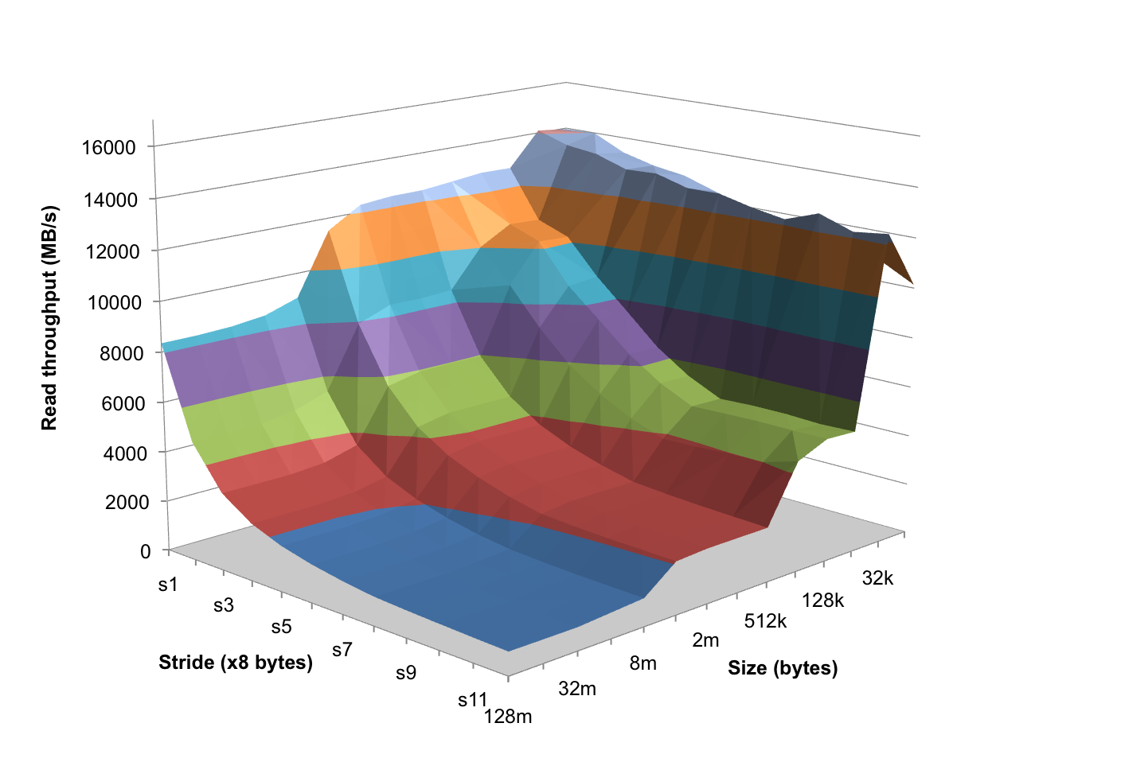
The Memory Mountain
Core i7 Haswell
2.1 GHz
32 KB L1 d-cache
256 KB L2 cache
8 MB L3 cache
64 B block size
Aggressive prefetching
L1
Ridges
of temporal locality
L2
L3
Slopes
of spatial locality
Mem

Slide 28
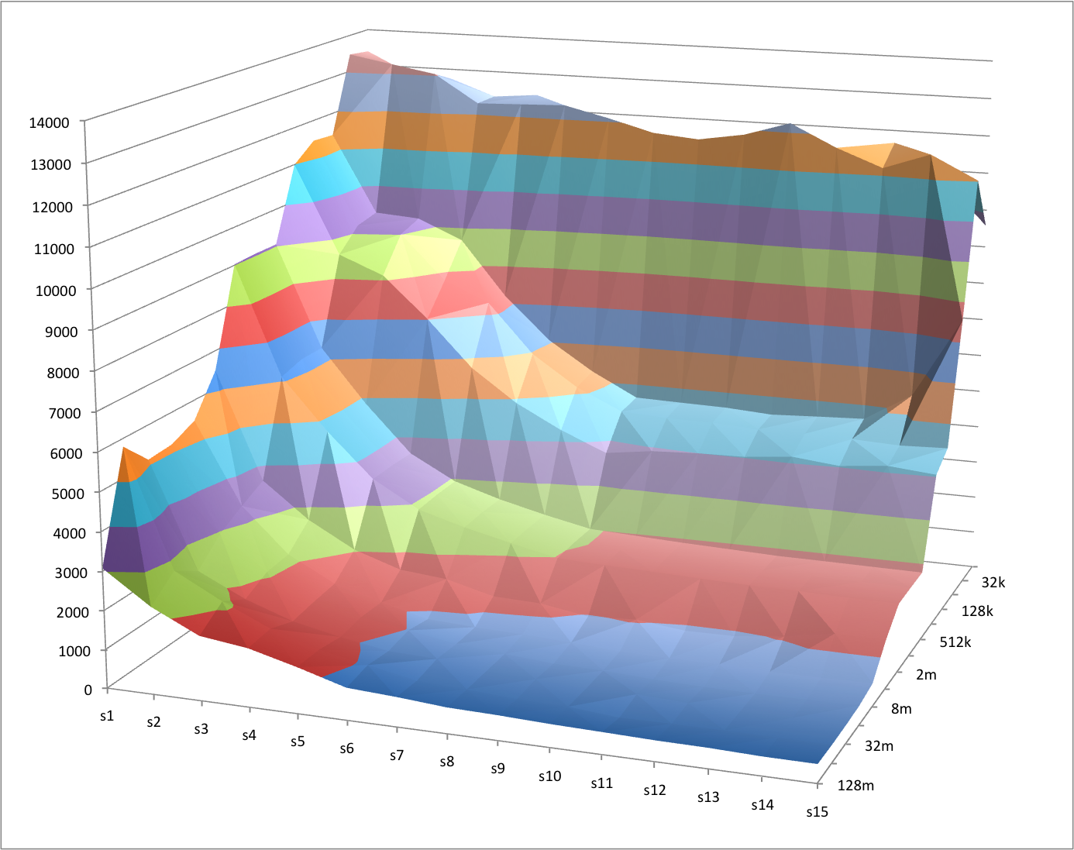
The Memory Mountain – Michaels laptop
Michaels laptop
Core i5
2.4 GHz
32 KB L1 d-cache
256 KB L2 cache
3 MB L3 cache
64 B block size

Slide 29
Today
Cache organization and operation
Performance impact of caches
  The memory mountain
  Rearranging loops to improve spatial locality

Slide 30
Matrix Multiplication Example
Description:
  Multiply N x N matrices
  Matrix elements are doubles (8 bytes)
  O(N³) total operations
  N reads per source element
  N values summed per destination
    but may be able to hold in register
Variable sum
held in register
/* ijk */
for (i=0; i<n; i++) {
for (j=0; j<n; j++) {
sum = 0.0;
for (k=0; k<n; k++)
sum += a[i][k] * b[k][j];
c[i][j] = sum;
}
}
matmult/mm.c

Slide 31
Miss Rate Analysis for Matrix Multiply
Assume:
  Block size = 32B (big enough for four doubles)
  Matrix dimension (N) is very large
    Approximate 1/N as 0.0
  Cache is not even big enough to hold multiple rows
Analysis Method:
  Look at access pattern of inner loop
j
=
k
x
j
i
i
k
C
A
B

Slide 32
Layout of C Arrays in Memory (review)
C arrays allocated in row-major order
  each row in contiguous memory locations
Stepping through columns in one row:
  for (i = 0; i < N; i++)
sum += a[0][i];
  accesses successive elements
  if block size (B) > sizeof(a_{ij}) bytes, exploit spatial locality
    miss rate = sizeof(a_{ij}) / B
Stepping through rows in one column:
  for (i = 0; i < n; i++)
sum += a[i][0];
  accesses distant elements
  no spatial locality!
    miss rate = 1 (i.e. 100%)

Slide 33
Matrix Multiplication (ijk)
/* ijk */
for (i=0; i<n; i++) {
for (j=0; j<n; j++) {
sum = 0.0;
for (k=0; k<n; k++)
sum += a[i][k] * b[k][j];
c[i][j] = sum;
}
}
Inner loop:
(*,j)
(i,j)
(i,*)
A
B
C
matmult/mm.c
Row-wise
Column-
wise
Fixed
Misses per inner loop iteration:
A B C
0.25 1.0 0.0

Slide 34
Matrix Multiplication (jik)
/* jik */
for (j=0; j<n; j++) {
for (i=0; i<n; i++) {
sum = 0.0;
for (k=0; k<n; k++)
sum += a[i][k] * b[k][j];
c[i][j] = sum
}
}
Inner loop:
(*,j)
(i,j)
(i,*)
A
B
C
matmult/mm.c
Row-wise
Column-
wise
Fixed
Misses per inner loop iteration:
A B C
0.25 1.0 0.0

Slide 35
Matrix Multiplication (jki)
Inner loop:
/* jki */
for (j=0; j<n; j++) {
for (k=0; k<n; k++) {
r = b[k][j];
for (i=0; i<n; i++)
c[i][j] += a[i][k] * r;
}
}
(*,k)
(*,j)
(k,j)
A
B
C
matmult/mm.c
Column-
wise
Fixed
Column-
wise
Misses per inner loop iteration:
A B C
1.0 0.0 1.0

Slide 36
Matrix Multiplication (kji)
/* kji */
for (k=0; k<n; k++) {
for (j=0; j<n; j++) {
r = b[k][j];
for (i=0; i<n; i++)
c[i][j] += a[i][k] * r;
}
}
Inner loop:
(*,k)
(*,j)
(k,j)
A
B
C
matmult/mm.c
Column-
wise
Fixed
Column-
wise
Misses per inner loop iteration:
A B C
1.0 0.0 1.0

Slide 37
Matrix Multiplication (kij)
/* kij */
for (k=0; k<n; k++) {
for (i=0; i<n; i++) {
r = a[i][k];
for (j=0; j<n; j++)
c[i][j] += r * b[k][j];
}
}
Inner loop:
(i,k)
(k,*)
(i,*)
A
B
C
matmult/mm.c
Fixed
Row-wise
Row-wise
Misses per inner loop iteration:
A B C
0.0 0.25 0.25

Slide 38
Matrix Multiplication (ikj)
/* ikj */
for (i=0; i<n; i++) {
for (k=0; k<n; k++) {
r = a[i][k];
for (j=0; j<n; j++)
c[i][j] += r * b[k][j];
}
}
Inner loop:
(i,k)
(k,*)
(i,*)
A
B
C
matmult/mm.c
Fixed
Row-wise
Row-wise
Misses per inner loop iteration:
A B C
0.0 0.25 0.25

Slide 39
Summary of Matrix Multiplication
for (i=0; i<n; i++) {
for (j=0; j<n; j++) {
sum = 0.0;
for (k=0; k<n; k++)
sum += a[i][k] * b[k][j];
c[i][j] = sum;
}
}
ijk (& jik):
  2 loads, 0 stores
  misses/iter = 1.25
for (k=0; k<n; k++) {
for (i=0; i<n; i++) {
r = a[i][k];
for (j=0; j<n; j++)
c[i][j] += r * b[k][j];
}
}
kij (& ikj):
  2 loads, 1 store
  misses/iter = 0.5
for (j=0; j<n; j++) {
for (k=0; k<n; k++) {
r = b[k][j];
for (i=0; i<n; i++)
c[i][j] += a[i][k] * r;
}
}
jki (& kji):
  2 loads, 1 store
  misses/iter = 2.0

Slide 40
Core i7 Matrix Multiply Performance
jki / kji
ijk / jik
kij / ikj

Slide 41
Cache Summary
Cache memories can have significant performance impact
You can write your programs to exploit this!
  Focus on the inner loops, where bulk of computations and memory accesses occur.
  Try to maximize spatial locality by reading data objects with sequentially with stride 1.
  Try to maximize temporal locality by using a data object as often as possible once it’s read from memory.

