Slide 1
Cemal Türkoğlu 150140719
ADVANCED ZERO FALSE POSITIVE AUTOMATED CROSS-SITE SCRIPTING VULNERABILITY DETECTION

Slide 2
Purpose of the Project
Detection of XSS Vulnerabilities.
Creating a tool:
Automated
Reliable (Zero-false positive)
Generic
Fast
User friendly
Comprehensive

Slide 3
What is Cross-Site Scripting (XSS)
When it comes to web application security, biggest problems always occur at user inputs.
This is the entry point for attacker. Software is designed to intrerract with user via input variables.
If this input variable is not handled correctly it causes problems and vulnerabilities.
XSS is another type of injection attack. It aims to inject malicious javascript code to user inputs.

Slide 4
Types of XSS Attacks
REFLECTED XSS
STORED XSS
DOM BASED XSS

Slide 5
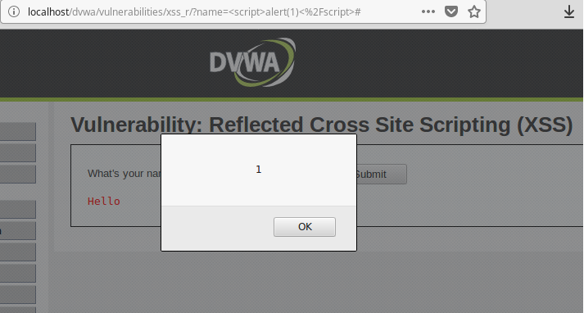
1-Reflected XSS
Reflected attacks are those where the injected script is reflected off the web server, such as in an error message, search result, or any other response

Slide 6
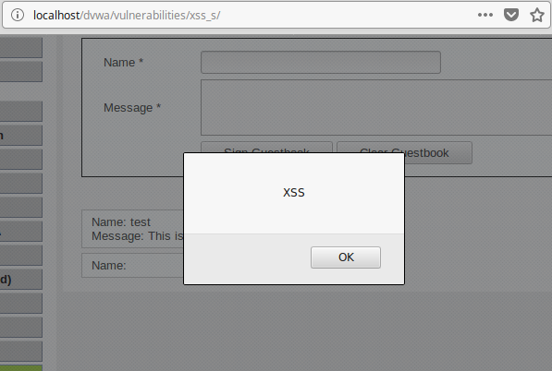
2-Stored XSS

Slide 7
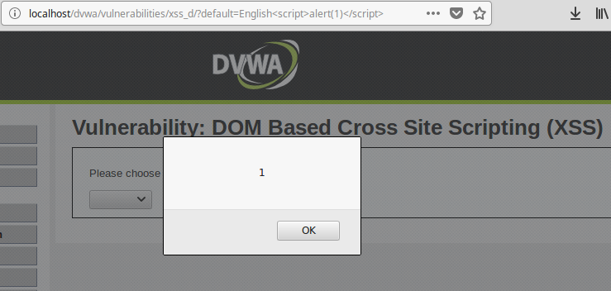
3-Dom Based XSS
Attack payload is executed as a result of modifying the DOM “environment” in the victim’s browser

Slide 8
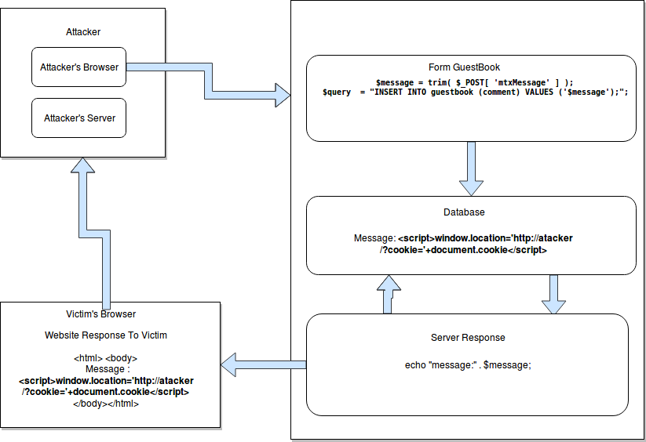
Example Attack Scenario

Slide 9
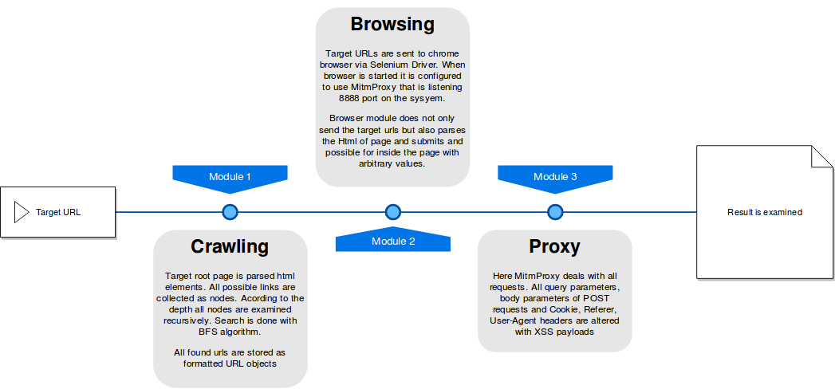
Modules of XssGo Tool

Slide 10
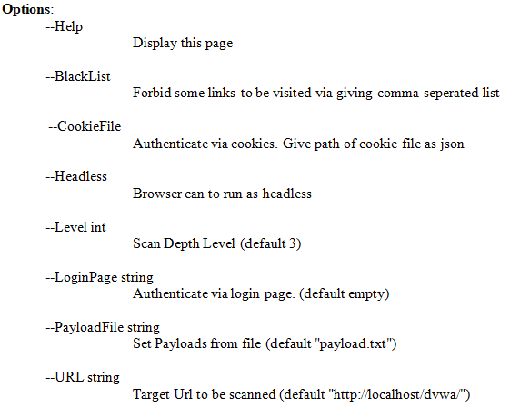
Usage of the Tool

Slide 11
1-Scanning module
Implemented by GoLang
Starts with root url, request the url
Parse the response html
Find all <a> anchor links
Continue recursively according to depth
Uses Breadth First Search (BFS) algorithm
At the moment only same domains are searched, it would be more comprehensive to search subdomains

Slide 12
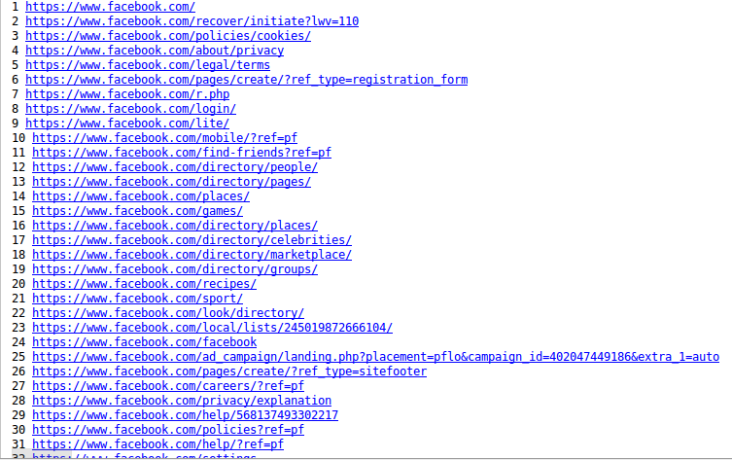
1-Scanning module: Example Output

Slide 13
1.1 Authentication Mechanism
Login Page:
./XssGo --LoginPage http://target.com/login.php

Slide 14
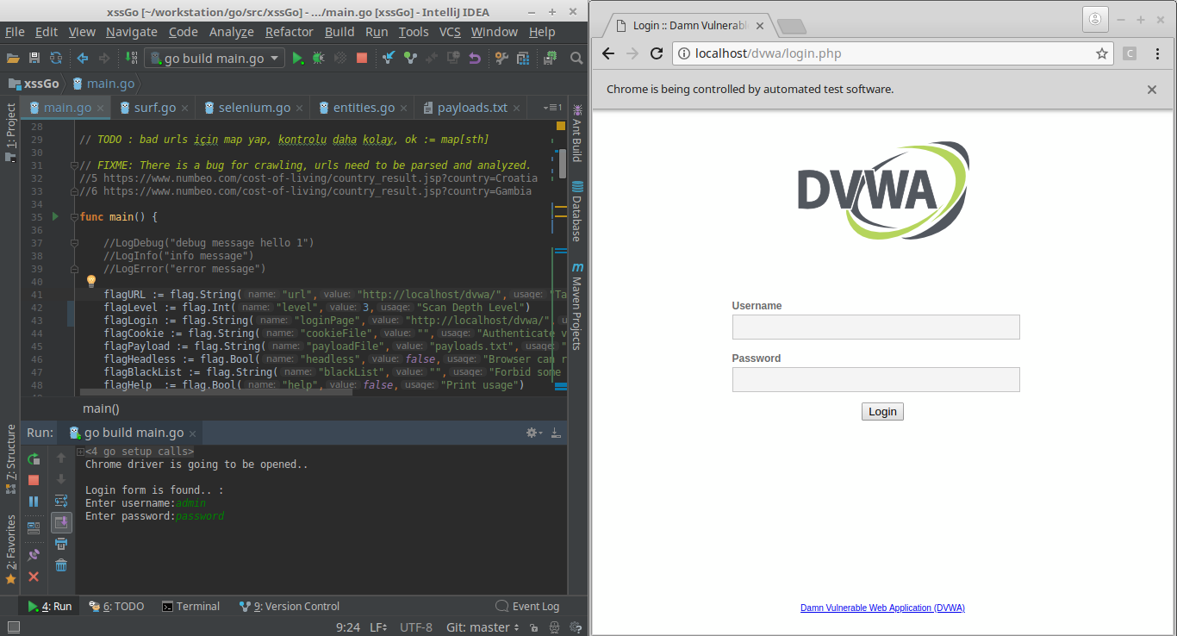
1.1 Authentication Mechanism

Slide 15
1.1 Authentication Mechanism
Cookies
./XssGo --CookieFile /path/cookies.json

Slide 16
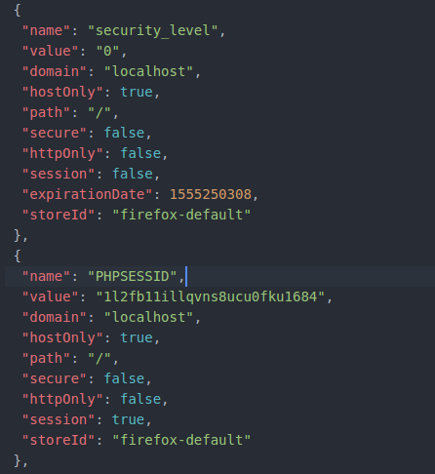
1.1 Authentication Mechanism

Slide 17
2-Browsing and Testing module
The core of browsing module consist of selenium web driver (Real Browser)
This is the solution for false-positives
To catch Javascript execution we have to observe behavior after it is loaded, rendered and run by browser

Slide 18
2-Browsing and Testing module
Demonstration

Slide 19
2-Browsing and Testing module
2 functionalities:
Setting Payload
<script> alert ( ‘ attack ‘ ) </script>
Sending Requests for:
Query Parameters
http://target.com?name=cemal
Submitting Forms
- search box
- registration form
- selection forms (language etc to filter)
- guest book
- any type of form, with any type of input variable

Slide 20
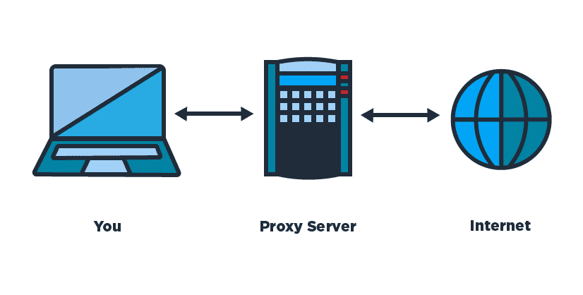
3-Proxy Module

Slide 21
3-Proxy Module
Adding the proxy module was inevitable to increase the functionality and access maximum number of attack vector
While observing a webpage on browser it is not possible to change some user inputs. These inputs can be hidden input tags, http headers so on
Another important thing is that for selection tags or radio buttons it is not possible to send arbitrary value for the input parameter
Character limitation for an input area, or expecting and integer value for a year input can be such examples

Slide 22
3-Proxy Module
Therefore not forcing the browser to inject payloads but interrupting the requests on fly and injecting payload to all necessary areas are way better solution and it increases the functionality of the test tool.
The proxy is able to support HTTPS connections via decrypting and encrypting the packets on fly via adding self signed SSL certificates
3 points to inject payload:
* referrer
* user agent
* cookie
* query parameters ( GET Method variables)
* body parameters (POST Method variables)

Slide 23
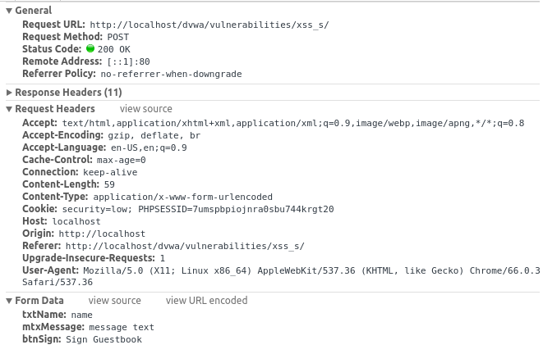
3- Proxy Module

Slide 24
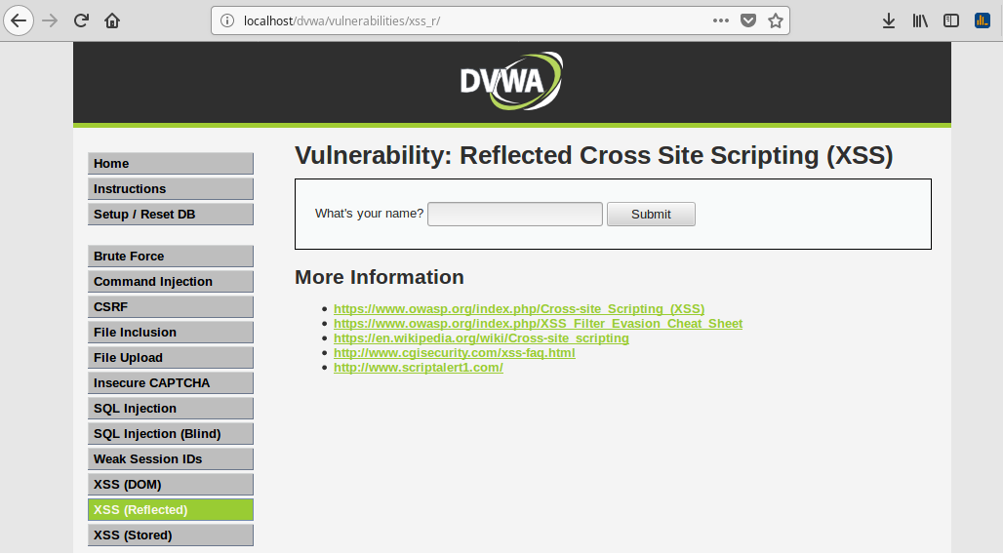
Testing-Dvwa

Slide 25
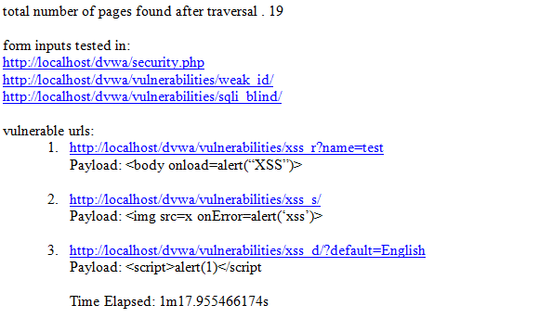
Testing-Dvwa

Slide 26
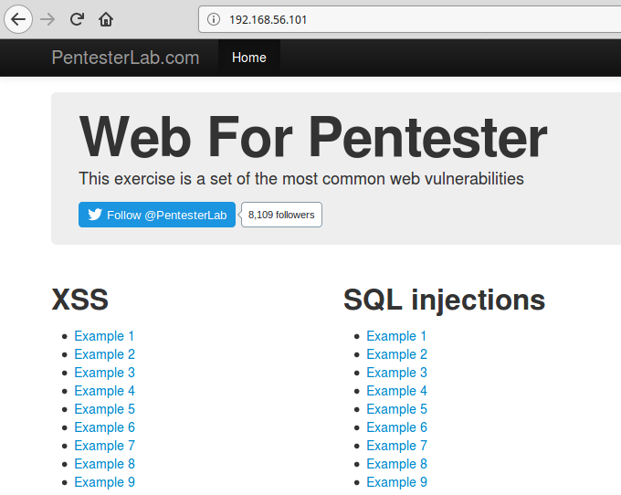
Testing-Web For Pentester

Slide 27
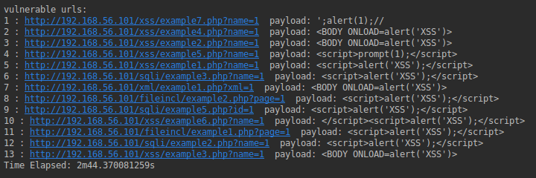
Testing-Web For Pentester

Slide 28
Conclusion
3 modules are implemented to automate XSS detection.
Scanning Module mostly focused on speed.
Browsing Module avoids false positives and wrong result via using real browser.
Proxy module gives the opportunity to test all attack vector without any limitations.

Slide 29
Cemal Türkoğlu
QUESTIONS And Demo

