Slide 1

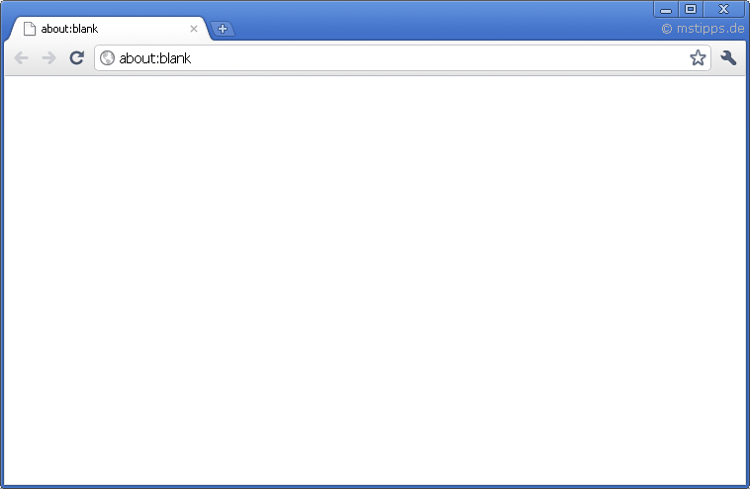
Unveiled – Android App
Unveiled - Backend
API
Java
Unveiled – Browser Client
PHP
JavaScript HTML CSS (=> Bootstrap)
mySQL FileSystem

