Slide 1

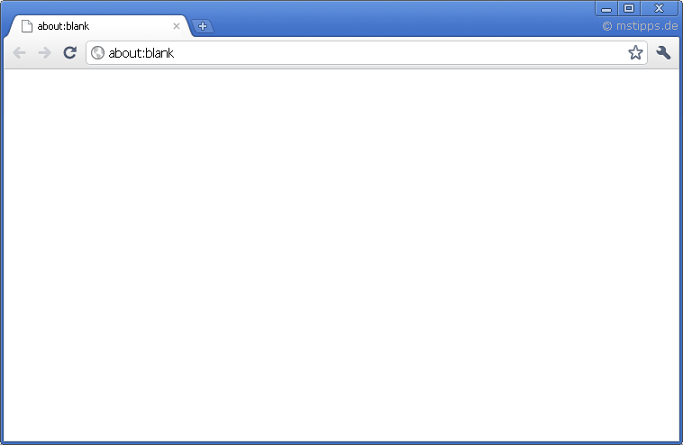
Unveiled – Android App
Unveiled - Backend
API
RTP (RTCP, RTSP)
Java
Unveiled – Browser Client
PHP
JavaScript HTML CSS (=> Bootstrap)
HTTP
mySQL FileSystem

