Slide 1

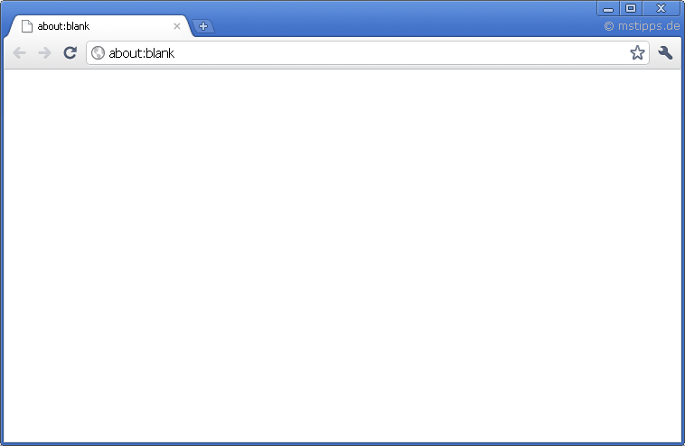
Unveiled – Android App
Unveiled - Backend
API
RTP (RTCP, RTSP)
Java
Unveiled – Browser Client
PHP
JavaScript HTML CSS (=> Bootstrap)
HTTP
mySQL FileSystem

Slide 2



Role | Description
Deployment / Configuration Manager | Oversees deployment and sets up development environment
System Analyst | Discovers all requirement use cases
Software Architect Backend | Decides on technologies and patterns for the backend
Software Architect Frontend | Decides on technologies and patterns for the frontend
Business Process Analyst | Discovers all business use cases
Designer | Details the analysis and design for use cases
Test Manager | Select tests and ensures that testing is complete
Project Manager | Plan, tracks and manages project
Implementer | Develop and implement specific functionalities
Sebastian Adams
Fabian Schäfer
Sebastian Schmidl

Slide 3
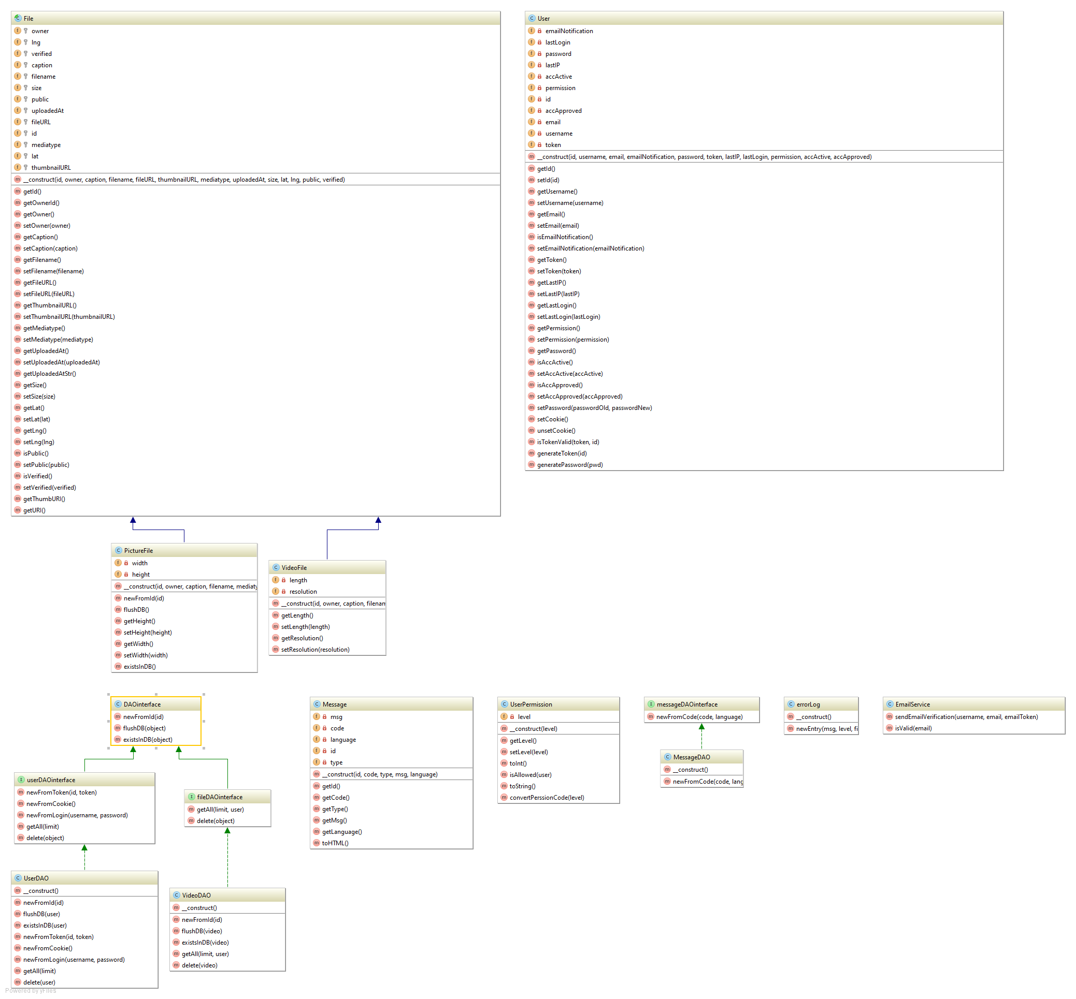
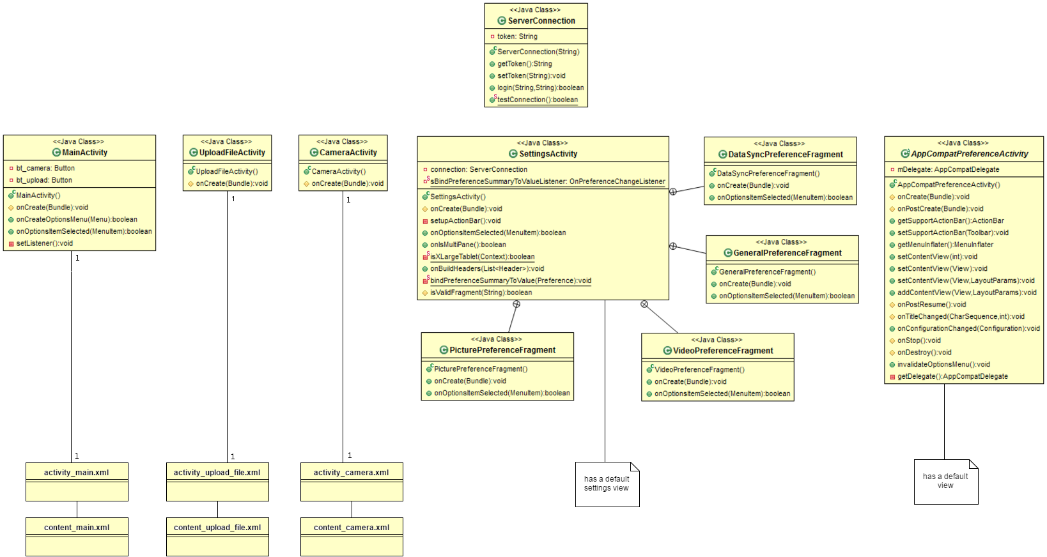

Slide 4
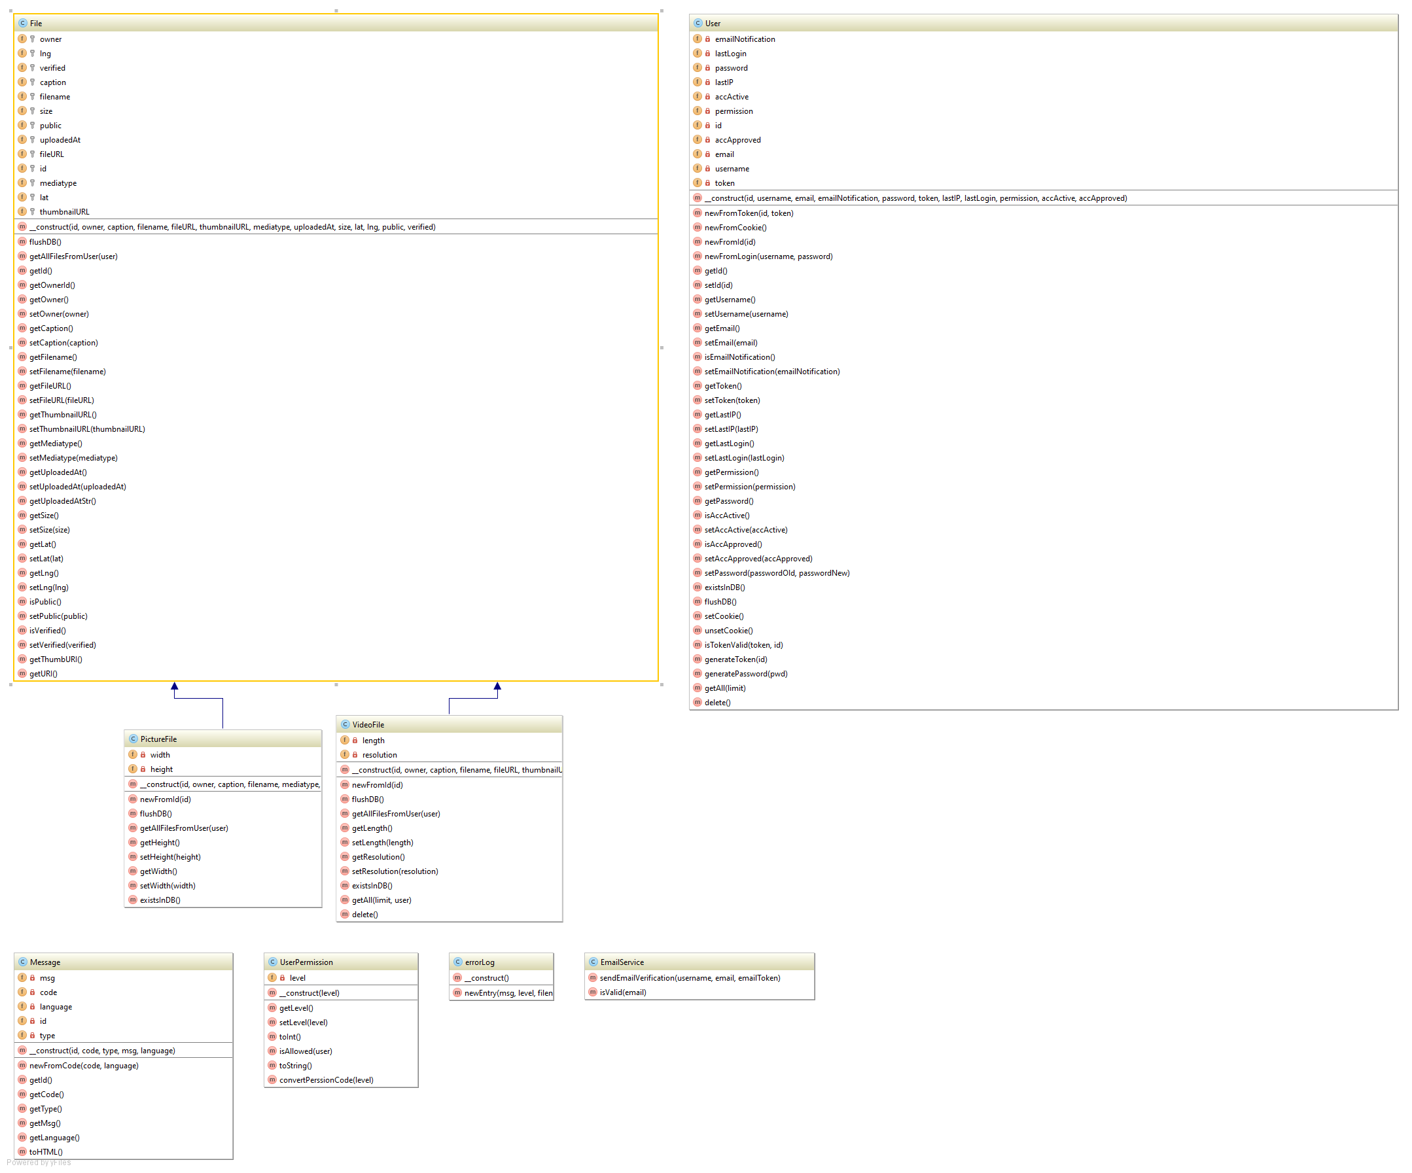
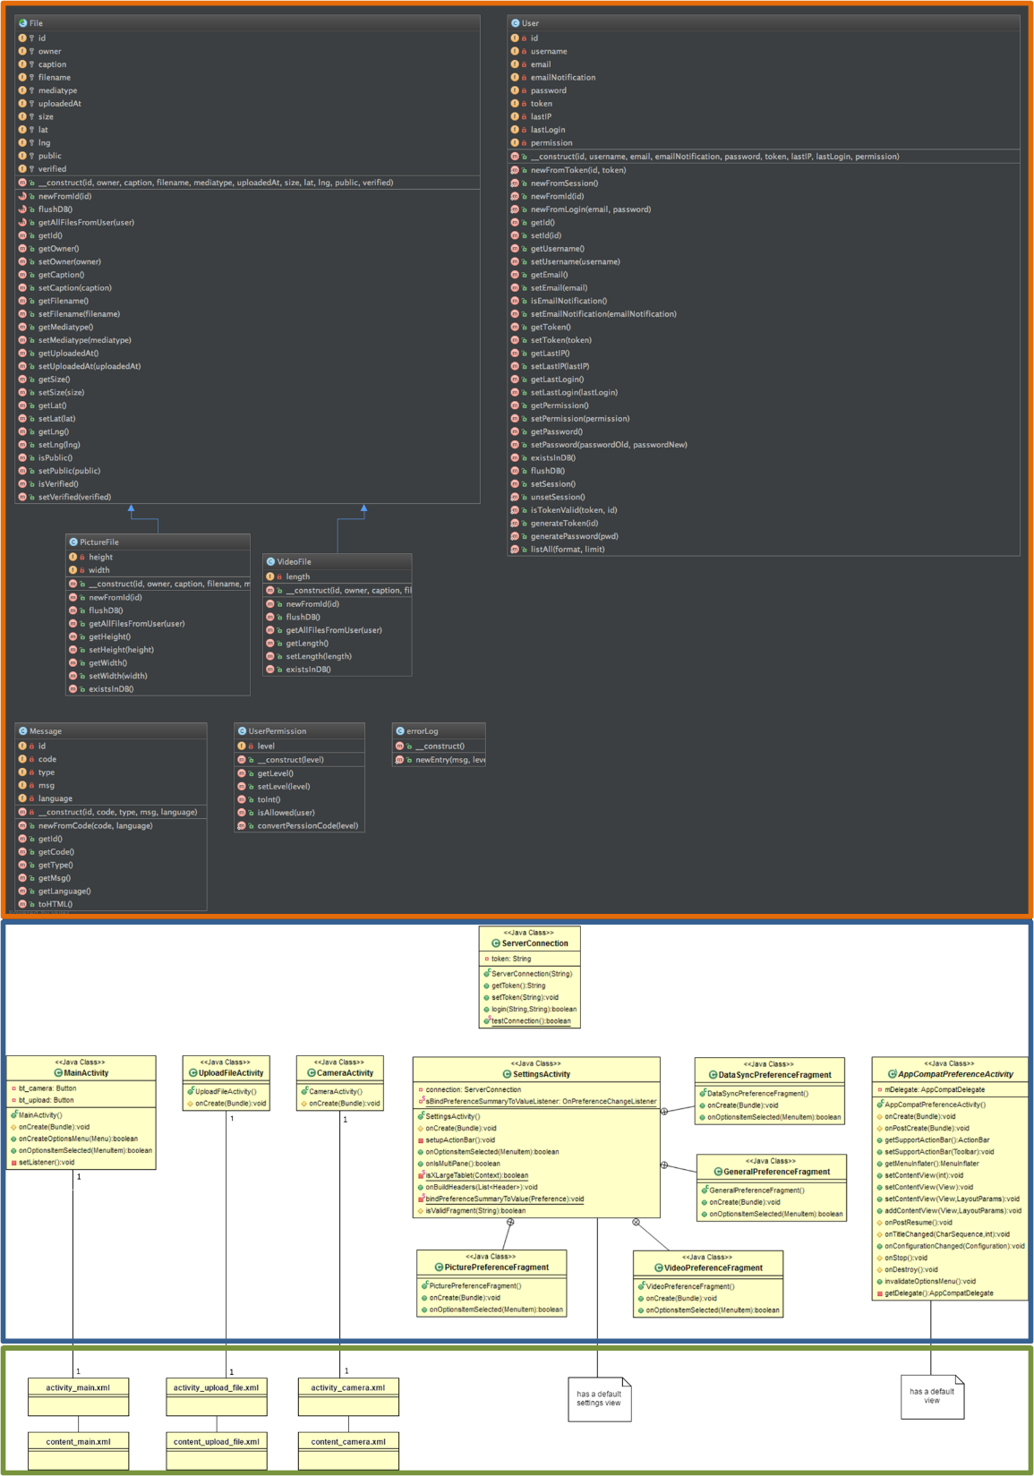

Slide 5














Push
Metrics
Build
Build Success: Deployment
Code Quality
Build Failure: Ticket Creation

