Slide 1
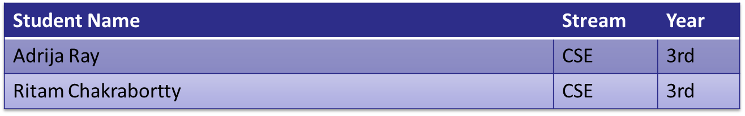
SEMI-AUTOMATED DETECTION OF SKIN CANCER USING DEEP LEARNING AND WEAKLY-SUPERVISED HUMAN VERIFICATION TECHNIQUES
Team No. 17
Institute Name: Techno International New Town
Supervisor(s) Name:Prof. Pratima Sarkar
B.Tech / B.E. Project Award in Computing
(India East & North-East) @ACM Kolkata

Slide 2
Problem Description
Skin cancer is one of the most common types of cancer globally, with early detection playing a crucial role in successful treatment outcomes.
Manual diagnosis by dermatologists can be time-consuming and subject to human error. This project aims to develop a machine learning model capable of accurately detecting skin cancer from images of skin lesions.
Our system takes into consideration the importance of involvement of human experts in the field of medical imaging so we have created a semi-supervised model so that expert can manipulate the true region of interest and can also correct the wrongly diagnosed model outputs.
Diagnosis of skin cancer often relies on the experience and expertise of dermatologists who perform visual examinations. This reliance on human judgment introduces an element of subjectivity, as different clinicians might have varying levels of expertise or may interpret lesions differently.
Factors like lighting, patient skin tone, and lesion location can influence the visual assessment, leading to misinterpretation or missed diagnoses.

Slide 3
What others have done to solve it?
There have been multiple approaches made using various deep learning techniques for the detection, prediction and classification of skin-cancer. A few examples are as follows:-
Paper[“Dermatology Image Recognition through Deep Learning ”]: A deep learning model is trained on a large dataset of skin lesion images. The model achieved performance comparable to dermatologists in classifying skin lesions into malignant and benign categories.
Paper [“Skin Lesion Analysis toward Melanoma Detection: A Challenge at the Inter_x0002_national Symposium on Biomedical Imaging (ISBI) 2016, hosted by the International Skin Imaging
Collaboration (ISIC)”] discussed the results of the ISBI 2016 Challenge on skin lesion analysis for melanoma detection. Various computer vision approaches were evaluated for tasks such as lesion segmentation, feature extraction, and classification. The challenge facilitated the benchmarking of different methods and highlighted the state-of-the-art in skin disease detection.
In paper [“Automated Melanoma Recognition in Dermoscopy Images via Very Deep Residual Networks. IEEE Transactions on Medical Imaging”], a deep learning model based on very deep residual networks for automated melanoma recognition in dermatoscopy images is introduced. The model achieved high accuracy in distinguishing between melanoma and benign lesions, surpassing previous methods.
The study in paper [“Skin Cancer Detection by Deep Learning and Integration Regions of Interest.”] proposed a deep learning approach for skin cancer detection, focusing on integration regions of interest (IROIs) to improve model performance. By aggregating predictions from multiple regions within a lesion, the model achieved higher sensitivity and specificity compared to traditional approaches.

Slide 4
What you have done? Contributions?
Our model is designed in 5 phases as follows: -
A. Collection of datasets: For the purpose of training the models, a large dataset HAM10000 ISIC is used.
B.Model 1: This a Resnet50 model used for training dataset for the classification of dermoscopic images into malignant and benign conditions.
C. Model 2: This is a CNN based model which is trained to be used for categorizing the dermoscopic images into 7 different types of cancer.
D. An elementary website will be created having HTML,CSS and Javascript as its front-end, for authenticating the user. The user interface is planned to have 2 separate sections - a) For General Users b) For medical Professionals. The medical professionals will be provided the additional flexibility to manipulate the region of interest to improve the specificity of ground truth. This will allow application of semi-automated weakly supervision facilitating to maximize accuracy and minimize error.
E. Finally, both the models along with the frontend will be integrated using a python-based back-end environment, preferably Flask.
Ultimately, the website will allow the user to upload dermatoscopic image and is expected to provide highly acurate predictions about the type and possibility of skin-cancer.

Slide 5


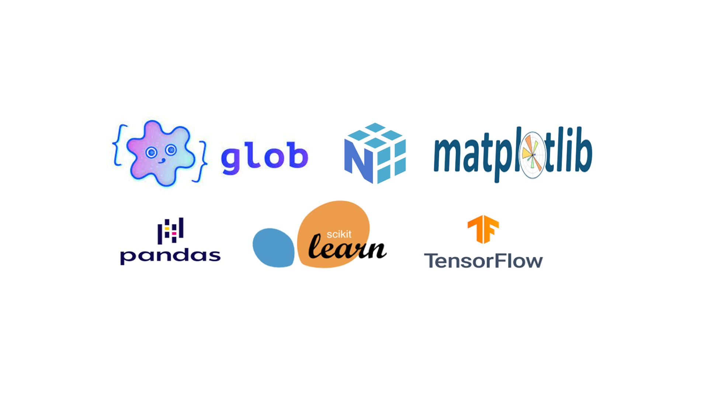
What tools / software you have (re)used?
Front End
Back End
Taking input data
Showing Result
Feeding raw image to ml model
Giving predicted result
ML model

Slide 6
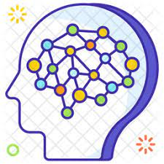
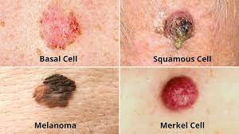
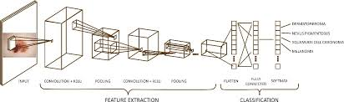
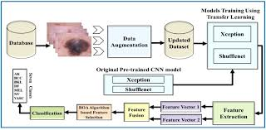
Technical Approach for Solution
Website
Web Based Application
User Authentication
Professional Verification
Output
Deep Learning Model will predict the output
Predicted Output
Upload Image
Resnet50
Convolutional Neural Network

Slide 7
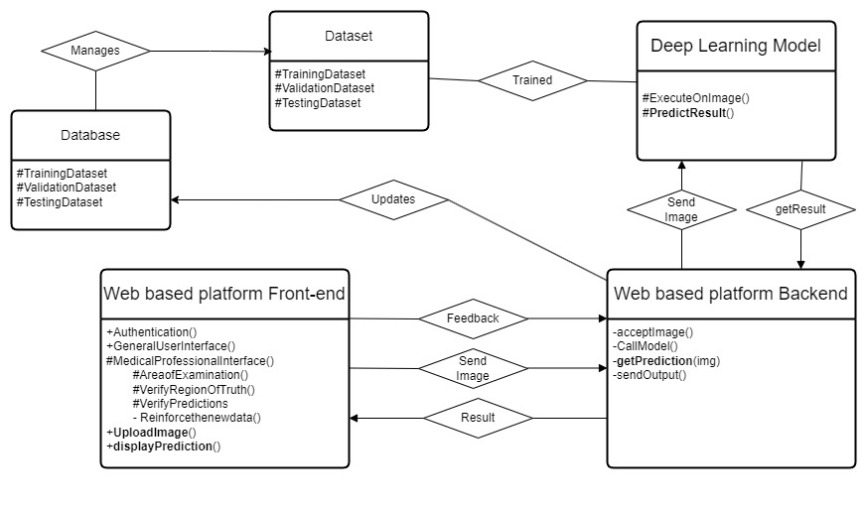

Solution Architecture / Experimental Setup

Slide 8
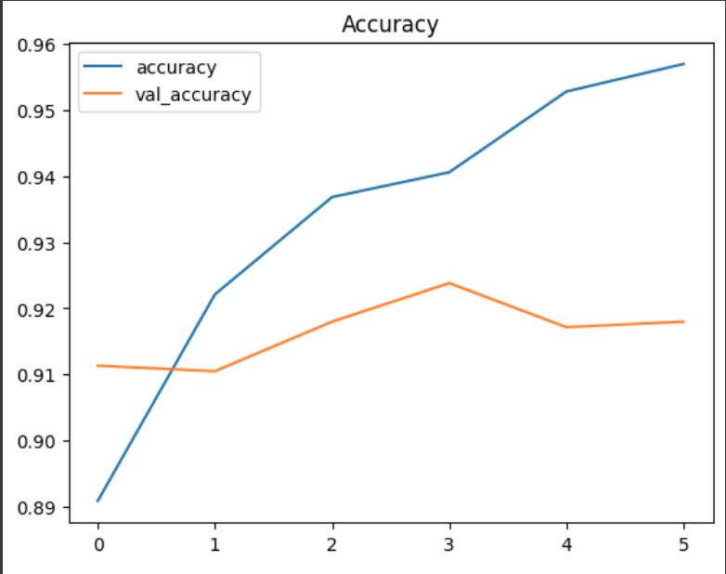
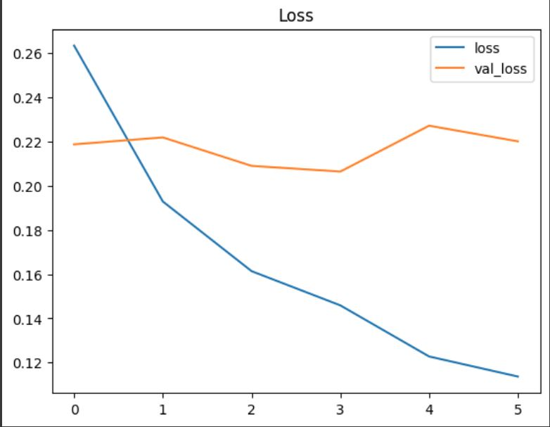
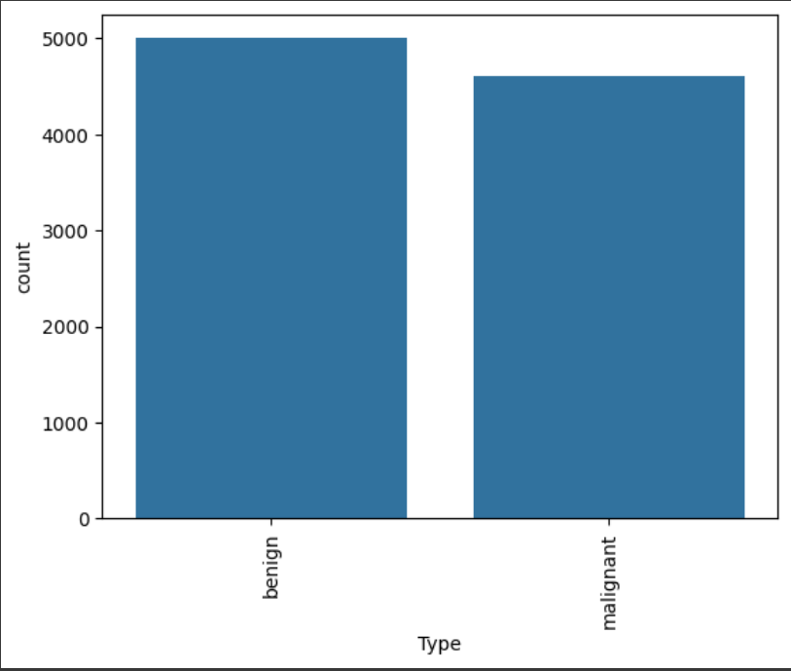
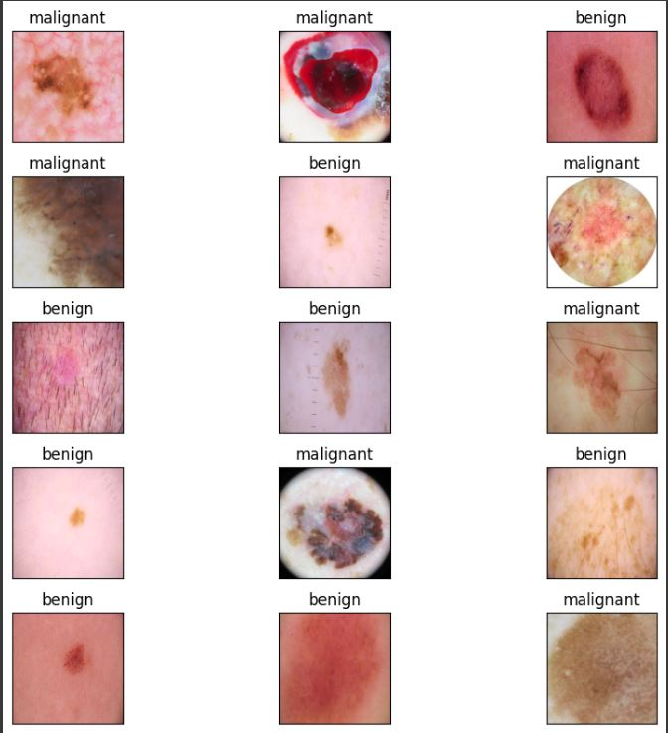
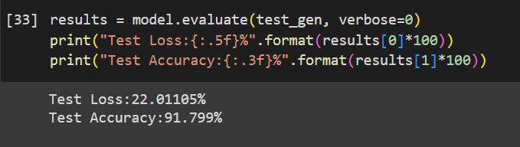
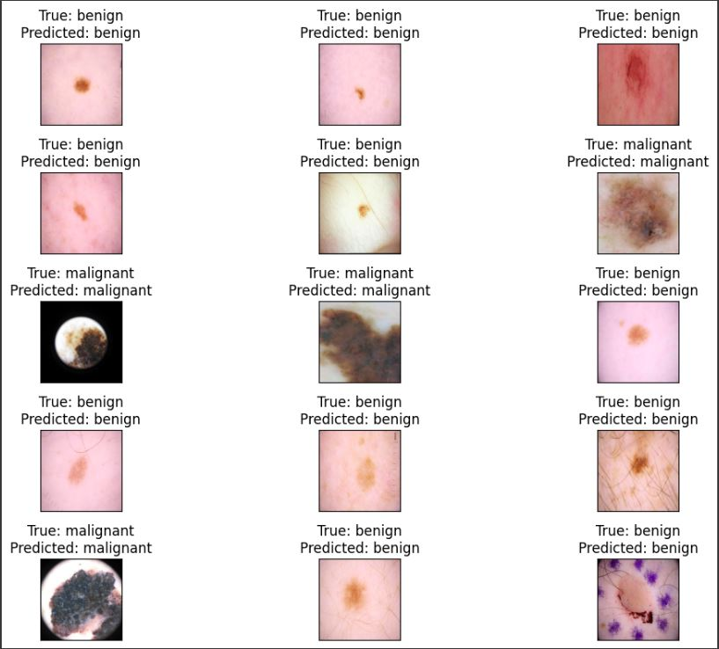
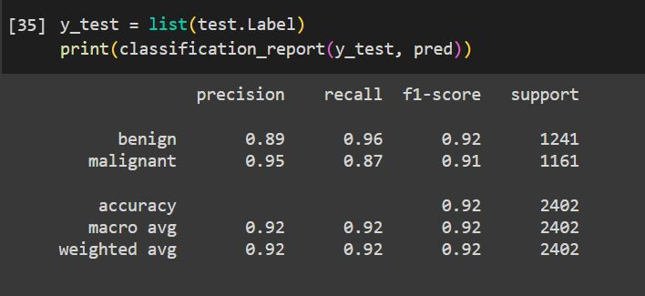
Results & Analysis

