Slide 1
SalesGenie AI Platform
Milestone 1
Lead Management and Lead Intelligence Engine
SRS Modules 1 and 2 | FastAPI · Streamlit · PostgreSQL · LangGraph
Notes:
Milestone 1 covers SRS Module 1 (Lead Management) and Module 2 (Lead Intelligence).

Slide 2


Milestone 1 at a glance
18
2
< 5 s
24 / 24
API endpoints
AI agents
analysis per lead
tests passing
Module 1: Lead Management
Module 2: Lead Intelligence
Create and bulk-import leads
Search, update and delete
Duplicate protection and validation
Company profiling and opportunities
Qualification score, 0 to 100
Personas and auto-promotion to Qualified

Slide 3
Planned work and delivery
PLANNED WORK
REPOSITORY EVIDENCE
STATUS
Kickoff, requirements, architecture, DB review
SRS, database design, agent design
DELIVERED
API contracts, tech stack, repository setup
API contract, SETUP.md, database setup
DELIVERED
ER diagram, schema, migrations, agent architecture
Data dictionary, Alembic initial migration
DELIVERED
Prospect CRUD APIs, company profile analysis
backend/main.py, lead and intelligence services
DELIVERED
Lead import, Leads UI, qualification scoring
Bulk import service, frontend, scoring routes
DELIVERED
Unit tests for import, CRUD and scoring
Lead and agent test suites
DELIVERED
Intelligence UI integration, Milestone 1 report
intelligence_view.py, test report
DELIVERED

Slide 4
System architecture
Lead Service
Create · import
De-duplicate
PostgreSQL 16
Alembic migrations
Streamlit UI
Leads · Intelligence
Scoring
FastAPI
Pydantic validation
backend/main.py
Intelligence Service
Run graph · persist
Promote
LangGraph
Research → Qualify
LLM providers (Gemini, OpenAI, Grok, Ollama) with a bounded timeout. Each agent falls back to a rule-based result on timeout or incomplete output.

Slide 5
How a lead moves through the system
1
2
3
4
5
Submit
Validate
Save
Analyze
Score
POST /api/leads
or /bulk
Email, source,
status
Case-insensitive
duplicate check
Research and
qualification agents
Insight and score
persisted
Lead status lifecycle
New Leads
Qualified
Proposal
Negotiation
Closed Won
Score of 70 or more promotes New Leads to Qualified automatically. Later stages are set by updating the lead.

Slide 6
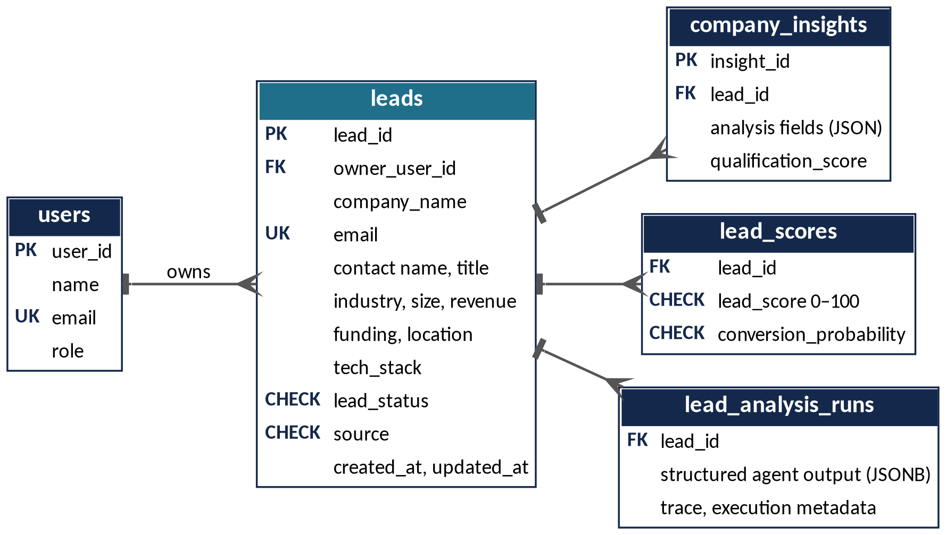



Database design
PostgreSQL 16
Schema managed by Alembic migrations
Constraints in the database
Unique email, CHECK on status, source and score ranges
Cascade deletes
Removing a lead removes its insight and score rows
Live names from the migration and models. Intelligence tables hold the latest result per lead.

Slide 7
Lead Intelligence Engine
Prospect
Stored lead or
ad-hoc payload
Research Agent
Profile · tech stack
opportunities
Qualification Agent
Score · personas
recommendation
Persist
Insight
Score
Research Agent
Qualification Agent
Industry and domain analysis
Tech stack by category: cloud, backend, frontend, data, DevOps
ERP, cloud, automation and digital transformation opportunities
Qualification score from funding and budget signals
Tech alignment and buying-committee personas
Business needs and strategic recommendation
Score ≥ 70 promotes to Qualified
< 5 s end-to-end target
Rule-based fallback if the LLM times out

Slide 8




API and lead CRUD
Create
Read
Update
Delete
POST /api/leads
POST /api/leads/bulk
GET /api/leads
GET /api/leads/stats
PUT /api/leads/{id}
DELETE /api/leads/{id}
returns 204
Lead Intelligence
Scoring
System
POST /api/leads/{id}/analyze
GET /api/leads/{id}/insights
POST /api/leads/batch-analyze
POST /api/intelligence/analyze-prospect
GET /api/intelligence/architecture
GET /api/scoring/queue
GET /api/leads/{id}/dossier
POST /api/leads/{id}/score
POST /api/leads/score-batch
GET /health
GET /api/users
GET /api/llm/providers

Slide 9
Testing and validation
24
pytest, backend/tests
24 passed
Lead and intelligence tests
13 passed
Syntax scan (compileall)
Passed
tests passed
full backend suite, 14.31 s
FastAPI import and routes
Passed
Lead management
Create, duplicate rejection, update, delete, bulk import, validation
Lead intelligence
Graph compilation, profiling, opportunities, scoring, under 5 s
Fallback paths
Provider timeout and incomplete-output handling

Slide 10
Milestone 1 delivered
Delivered
Lead create, bulk import, search, update and delete
Duplicate protection and request validation
Two-agent LangGraph analysis with scoring and personas
PostgreSQL schema through Alembic migrations
24 automated tests passing

