Slide 1
SSN College of Engineering, Kalavakkam - 603110
Department of Information Technology
UIT2739 - Full Stack Development Project
FinPilot AI
A Privacy-Focused Personal Finance Assistant
Jeya Sangavi R - 3122235002054
Rahul Akshath Rajendran - 3122235002095
Rakshitha S - 3122235002098
Project Evaluation - October 2026
Notes:
Good morning. We are presenting FinPilot AI, our UIT2739 full-stack project. It is a personal-finance assistant that builds a user's financial picture from the bank SMS and e-mails they already receive, but only after the user allows each source. This common part covers the problem, requirements, architecture, SDLC, modules, database, testing and lessons learnt; each of us then demonstrates our own features.

Slide 2
Project Overview
FinPilot AI is a personal finance app for India: an Android app and a server on the user's laptop. It reads the bank SMS and e-mails a user already receives (only from sources they allow) to track spending, predict the balance and check what they can afford.
Capture | Understand | Predict | Act
Bank SMS (on the phone) and e-mail, separate consent for each Optional: receipt photos, PDF bills, CSV/XLSX statements, manual entry | Classify, extract and de-duplicate messages Categorise payments and flag unusual ones | 90-day cash-flow forecast with an 80% range Subscription analysis and income tax for two years | Ranked insights and a finance coach Budgets, goals and a wishlist within budget
Key points
The server runs with one command (python3 run.py); the phone pairs by QR code
Data stays on the user's laptop; no cloud service
No running cost: no paid AI services and no bank login needed
Notes:
FinPilot AI is a full-stack app: a server on the user's laptop, used from a browser or from our Android app. Capture: bank SMS read on the phone and e-mail read from the user's mailbox, each behind its own consent, plus optional uploads. Understand: every message is classified, its fields extracted, duplicates reconciled and the payment categorised. Predict: a 90-day cash-flow forecast, subscription analysis and tax estimates. Act: insights, a coach, budgets, goals and a wishlist checked against what is safe to spend.

Slide 3
Problem Statement and Motivation
Problem Statement
Issues with Current Apps
Every UPI payment, card swipe, bill and salary credit already reaches the user as a bank SMS or e-mail, but this information stays scattered.
Existing apps make people type in transactions, ask for bank login details, or send personal data to paid cloud AI services. They also only show past spending.
We want to build a reliable, forward-looking view of a person's money from the messages they already receive, using only the sources they allow, running on their own computer at no cost.
Manual entry: typing every payment is tedious, so people give up; cash and paper receipts get lost
Only past data: apps show what was spent, not what the balance will be at the end of the month
Hidden leakage: price rises, unused subscriptions and duplicate charges get lost in normal spending
Privacy and cost: aggregator apps need bank credentials and AI features need paid cloud services
Motivation: make money management automatic, private and forward-looking, without extra data entry or new privacy risks.
Notes:
The data already exists: every UPI payment, card swipe and bill produces an SMS or e-mail. The problem is that it stays scattered and existing tools fall short in four ways shown on the right. Our statement: build a reliable, forward-looking picture of a person's money from the messages they already receive, only with their consent, running on their own computer at zero cost.

Slide 4
Objectives and Scope
Objectives
Scope
Capture transactions from bank SMS (read on the phone) and e-mail with the user's consent (no bank login), plus uploads
Understand spending reliably: classify, extract, de-duplicate, categorise and flag anomalies
Forecast the balance 90 days ahead and measure its accuracy against simple baselines
Find subscription leakage and estimate income tax under both regimes
Turn the data into decisions: insights, a coach, budgets, goals and an affordable wishlist
Keep users in control: consent per source and purpose, encryption, retention and deletion
In scope | Out of scope
SMS from an Android app, e-mail over IMAP, consent per source | Live bank or Account Aggregator connections
Receipt photos (on-device OCR), PDF bills, CSV/XLSX, manual entry | Real payments or money transfers
Forecast, subscriptions, tax, anomalies, insights, coach | Product recommendations or web crawling
A wishlist checked against the budget | Tax filing or financial advice (estimates only)
Laptop server; the phone pairs by QR code | iOS (Apple gives apps no SMS access)
Notes:
Six objectives, each mapped to modules we built. On the right is the scope we committed to. Out of scope, as stated in our README: no live bank or Account Aggregator connections, no payments, no product recommendations or crawling, no iOS app because iOS gives apps no SMS access, and tax figures are estimates, not advice.

Slide 5
Functional Requirements (1/2)
ID | Requirement | Description
FR1 | Accounts and sessions | Register, sign in, labelled demo login and sign out; cookies on the web, tokens in the Android app
FR2 | Consent per source | Allow SMS and e-mail separately with a purpose and a backfill window; pause, resume or revoke; delete data; consent history
FR3 | Message capture | Read SMS on the phone and e-mail over IMAP; classify 12 types, extract fields; handle duplicates, transfers and refunds
FR4 | Optional uploads | Camera receipt OCR on the device, PDF bills, CSV/XLSX statement wizard and manual entry
FR5 | Transactions and review | Search and filter, evidence drawer, recategorise with "apply to all" rules, review queue that learns
FR6 | Dashboard | Balance, safe-to-spend amount, spending, 90-day forecast band, alerts, upcoming bills and anomalies
FR7 | Cash-flow forecast | 90-day projection with an 80% band, what-if purchases, upcoming payments and a backtest against baselines
Notes:
Each requirement is implemented end to end: an API endpoint, business logic in a service, database tables and a page. FR1 to FR7 cover accounts, consent, capture, uploads, transactions, the dashboard and the forecast.

Slide 6
Functional Requirements (2/2)
ID | Requirement | Description
FR8 | Subscriptions | Detect recurring charges; flag price rises, unused plans, trials that became paid and overlaps; keep or cancel
FR9 | Tax insights | FY 2025-26 and Tax Year 2026-27 under both regimes; deductions found in transactions, headroom, advance tax; CSV/PDF export
FR10 | Insights and coach | Ranked insights that can be dismissed; a coach that answers 13 types of questions from the user's own data
FR11 | Budgets and goals | Monthly category limits with pace markers; goals with monthly targets and an "add money" option
FR12 | Wishlist | Items with a price or product link (prices read where allowed); Buy now / For your goals / Save up tiers; Can I afford…?
FR13 | Settings and data rights | Safety buffer, take-home pay, accounts and retention; phone pairing; export all data; delete account
FR14 | Model evaluation | Capability checks and measured model metrics, including a real-format SMS corpus
Notes:
Each requirement is implemented end to end: an API endpoint, business logic in a service, database tables and a page. FR8 to FR14 cover subscriptions, tax, insights and coach, budgets and goals, the wishlist, settings and data rights, and the model evaluation page.

Slide 7
Non-Functional Requirements
Requirement | How it is met
Security | Passwords hashed with bcrypt (12 rounds); JWT in httpOnly cookies (web) or Bearer tokens (app), rotated; CSRF and CORS checks; login limit
Privacy | SMS filtered on the phone; consent per source; message text encrypted, deleted after 90 days; append-only consent log; export, deletion
Reliability | Every request commits or rolls back; analytics stages and jobs are isolated; Prophet falls back to a baseline; repeat syncs are idempotent
Performance | Demo ready about 51 s after a clean start; models train in about 3 s; OCR about 0.5 s per receipt; what-if reuses the stored forecast
Usability | Android app with bottom tabs; responsive web layout; every chart also has a table view; plain-language errors and progress
Portability | One command (python3 run.py); Python 3.11+; no Docker or database server; the APK installs over USB and pairs by QR code
Maintainability | Routers -> services -> models structure; Alembic migrations; shared metrics; 82 backend, 23 browser and 17 on-device checks
Accuracy | Money stored as integer paise and handled as Decimal; held-out tests, backtests and WAPE; "estimates, not advice" disclaimers
Notes:
These qualities are visible in the code. Security: bcrypt, JWT in httpOnly cookies for the browser and Bearer tokens for the app, rotating refresh tokens, CSRF and CORS checks and a login rate limit. Privacy: personal chats, OTPs and promotions are dropped on the phone; consent per source, Fernet encryption and a 90-day retention purge. Reliability: transactions roll back, analytics stages are isolated, Prophet falls back to a baseline, and syncing the same SMS twice stores it once. Portability: one command for the server, one for the phone app.

Slide 8
System Architecture
Browser / phone
Single Python process (started by python3 run.py)
SQLite (WAL)
data/finpilot.db
29 tables
SQLAlchemy + Alembic
Next.js 16 UI (web and Android)
Same static UI in the browser and in a Capacitor 8 Android app
HTTP / JSON
FastAPI app (port 8000)
15 routers under /api/v1, CSRF guard, error handler, serves the web app
Services (business logic and ML)
Consent and capture, receipts, categories and anomalies, forecasting, subscriptions, tax, insights and coach, wishlist and price reading
ML runs in-process: scikit-learn (TF-IDF + logistic regression, IsolationForest) and Prophet
SQL
TanStack Query + api.ts
cookies + X-Requested-With (web); Bearer tokens (app)
tesseract.js · SMS plugin
OCR on the device; the app reads and filters SMS on the phone
Job runner + scheduler
Thread pool; mail every 30 min, prices daily, nightly analytics
IMAP mailboxes · product pages
Mail every 30 min; one product page a day (robots.txt)
data/ folder
Uploads, trained models and the generated secret key
The browser calls /api/v1 on the same server; the Android app calls it over Wi-Fi or a tunnel (CORS).
Notes:
The server is one Python process started by run.py on the laptop. FastAPI on port 8000 serves the JSON API under /api/v1 and the pre-built Next.js site. The same site is bundled into our Android app with Capacitor; the app calls the server over Wi-Fi, the phone's hotspot or a Cloudflare tunnel, with Bearer tokens, and its SMS plugin reads and filters the inbox on the phone. Services hold the business logic and ML; a job runner and scheduler read mailboxes every 30 minutes, re-check wishlist prices daily and run the nightly analytics. Data lives in SQLite in WAL mode.

Slide 9
Backend Layers and Request Flow
Backend layers
Example: a what-if purchase
Routers (api/v1/*.py)
HTTP, Pydantic validation, ownership checks
User enters ₹45,000 under "What if I spend..." on the Forecast page and clicks Check
api.ts sends GET /api/v1/forecast/whatif?amount=45000 with the cookie or token
FastAPI checks 0 < amount < ₹1e9 and loads the user from the JWT (otherwise 422 or 401)
The service reads the stored 90-day forecast and lowers p10, p50 and p90 from the purchase date
It compares the new lowest balance in the next 60 days with the safety buffer
TanStack Query redraws the chart and shows a green or red result
Dependencies (core/deps.py)
User from the cookie or Bearer token; one DB session
Services (services/*.py)
Business rules: forecasting, tax, wishlist, consent
Models (models/*.py)
SQLAlchemy 2 ORM; money as integer paise
Database (data/finpilot.db)
SQLite in WAL mode; Alembic migrations
Shared code: core/ (config, security, crypto, money) and jobs/ (runner, scheduler)
Notes:
The backend is layered. Routers handle HTTP and validation; dependencies give each request the signed-in user and a database session; services hold the rules; models map to SQLite. On the right is one real request: a what-if purchase on the Forecast page. It only reads the stored forecast, so it answers instantly.

Slide 10
Technologies Used
Category | Tools and versions
Frontend | Next.js 16.4 (static export), React 19.3, TypeScript 5.9, Tailwind CSS 4.3, shadcn/ui on Base UI, TanStack Query 5, Recharts 3, tesseract.js 7, Capacitor 8 (Android)
Backend | Python 3.11+ (tested on 3.14), FastAPI 0.143, Uvicorn 0.54, Pydantic 2.14, SQLAlchemy 2.1, Alembic 1.20, PyJWT 2.15, pwdlib (bcrypt), cryptography (Fernet)
Data and ML | SQLite (WAL), scikit-learn 1.9, Prophet 1.5, pandas 3.0, NumPy 2.5, RapidFuzz 3.14, dateparser 1.4
Documents and web | pdfplumber 0.11, ReportLab 5.0, openpyxl, xlrd, httpx 0.28, Protego 0.7 (robots.txt), BeautifulSoup + lxml, segno (QR)
Testing and tools | pytest 9.1, Hypothesis 6, Playwright 1.64 (browser and Android), Android SDK and emulator, Git and GitHub, Node.js / npm
All tools are free and run locally.
Notes:
All tools are free and run locally. The frontend is a Next.js static export served by FastAPI, so Node.js is only needed to rebuild the UI. The backend uses FastAPI with SQLAlchemy and SQLite. ML uses scikit-learn and Prophet. The versions shown are the ones installed in our environment.

Slide 11
Software Development Life Cycle
Model used: Iterative and incremental. Every phase ended with a working app and a check we could measure.
Requirements
Design
Implementation
Testing
Deployment
Maintenance
Phase | What we did
Requirements | Review 0 (July 2026): problem, objectives and modules. After the review, real SMS (Android app), IMAP e-mail and a wishlist replaced sample data
Design | Laptop server + Android app; 29-table schema with money in paise; Docker + PostgreSQL replaced by SQLite and run.py
Implementation | 10 build phases (0 to 9), each one a working increment with API, logic and UI
Testing | pytest + Hypothesis in every phase; Playwright in the browser and on an Android emulator; metrics on held-out data
Deployment | One command (python3 run.py); pre-built web app; Android APK installed over USB
Maintenance | Alembic migrations; demo data refreshes daily; model evaluation in Settings
Notes:
We followed an iterative and incremental model. Requirements were set at Review 0 in July; afterwards we added consent-based capture and revised the design to one process, SQLite and a one-command launcher instead of Docker and PostgreSQL. At the review, the features still ran on sample data, so we built the real-data release: an Android app that reads SMS, IMAP e-mail, file imports and a real wishlist, and removed the simulators. Each phase ended with a working app and a measurable gate.

Slide 12
Build Phases
Phase | Focus | Work done | Exit check
0 | Foundation | run.py, server, jobs, SQLite + Alembic | A clean start renders a page
1 | Data and auth | Schema, auth, demo persona, model training | Deterministic data; tests pass
2 | Capture | Consent API, pipeline, file imports | No transactions from OTP or promo messages
3 | Core UI | App shell, onboarding, dashboard, connections | E2E test: an SMS becomes a transaction
4 | Receipts | On-device OCR, receipt commit, PDF bills | A receipt photo attached to its payment
5 | Forecasting | Prophet + known schedule, backtest, what-if | Backtest against baselines; fallback tested
6 | Subscriptions, tax | Detection, both tax regimes, export | Planted findings detected; tax tests pass
7 | Insights, coach | Insights, coach, budgets, goals | Every coach intent answers from data
8 | Affordability | Safe-to-spend, wishlist, price reading | Property test passes; private links refused
9 | Real data | Android app, IMAP, XLSX import, hardening | 17/17 on-device and 23 E2E checks pass
Notes:
These are the phases as executed. Each one ended with a check we could demonstrate, for example: no transactions created from OTP or promotional messages, a receipt photo attached to its card payment, the property test showing Buy now never breaks the buffer, and the final phase: the Android app passing all 17 checks on an emulator with real-format SMS.

Slide 13
Major Features and Modules
Consent and capture: SMS read on the phone, e-mail over IMAP and file imports, with consent per source
Receipts and bills: camera OCR on the device with confidence boxes; PDF bills; matched to card payments
Transactions and review: rules, then merchant list, then ML; uncertain items go to Review and become rules
Anomaly detection: robust z-score, IsolationForest, duplicate charges and new-merchant spikes
Cash-flow forecast: known schedule + Prophet; 80% band, what-if check and a backtest against baselines
Subscriptions: price rises, unused plans, trials turned paid and overlaps, ranked by ₹ per year
Tax insights: two tax years, both regimes, deductions from transactions, CSV/PDF export
Insights, coach and budgets: ranked insights; a coach with 13 intents; budgets and goals feed affordability
Wishlist: prices from product links + affordability check with Buy now, For your goals and Save up
Notes:
Nine modules, all working end to end on the user's own data. Capture and receipts bring data in; transactions, review and anomaly detection make it trustworthy; forecasting, subscriptions and tax look ahead; insights, the coach, budgets and the wishlist turn it into decisions. Each team member will demonstrate their own modules.

Slide 14
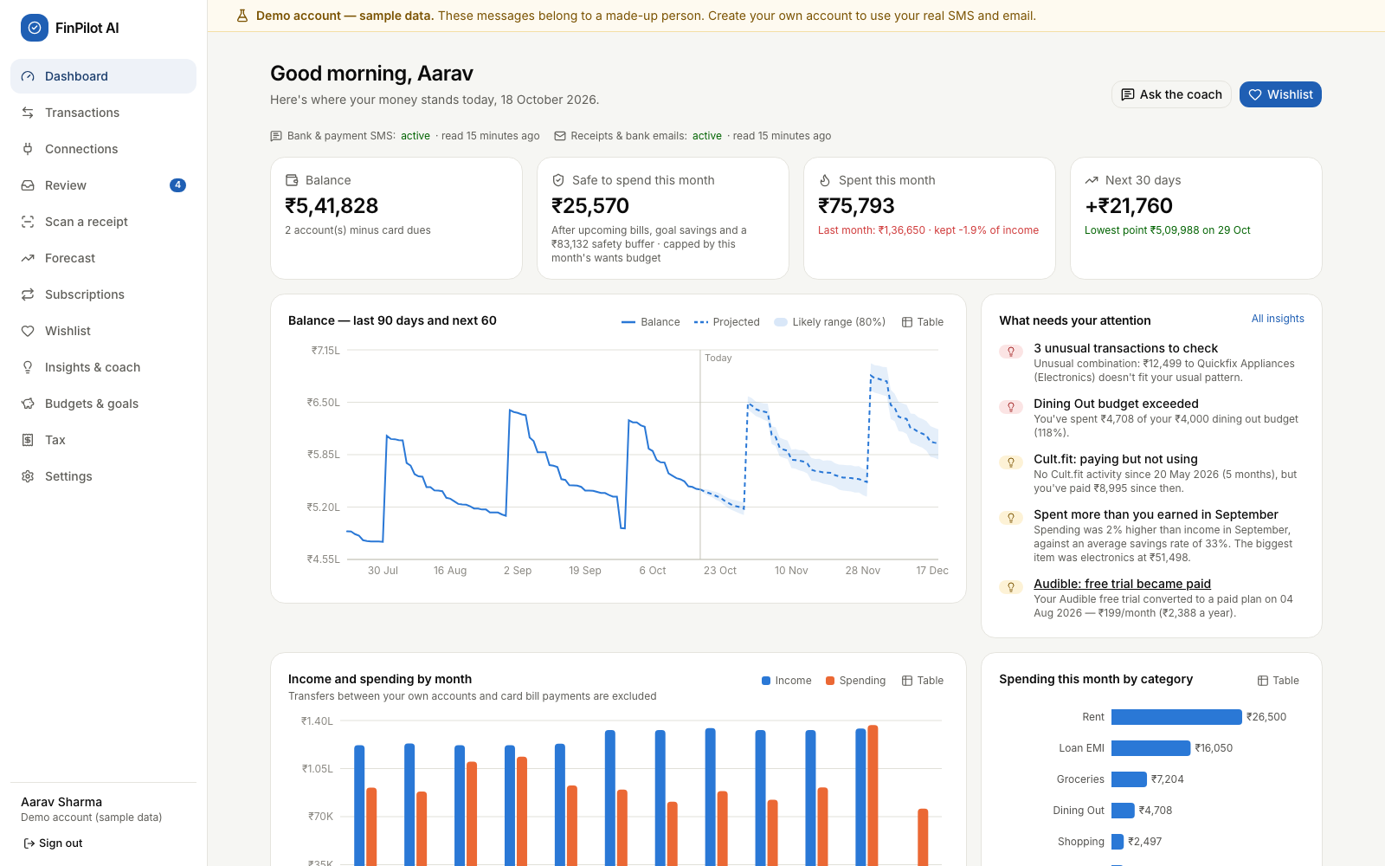
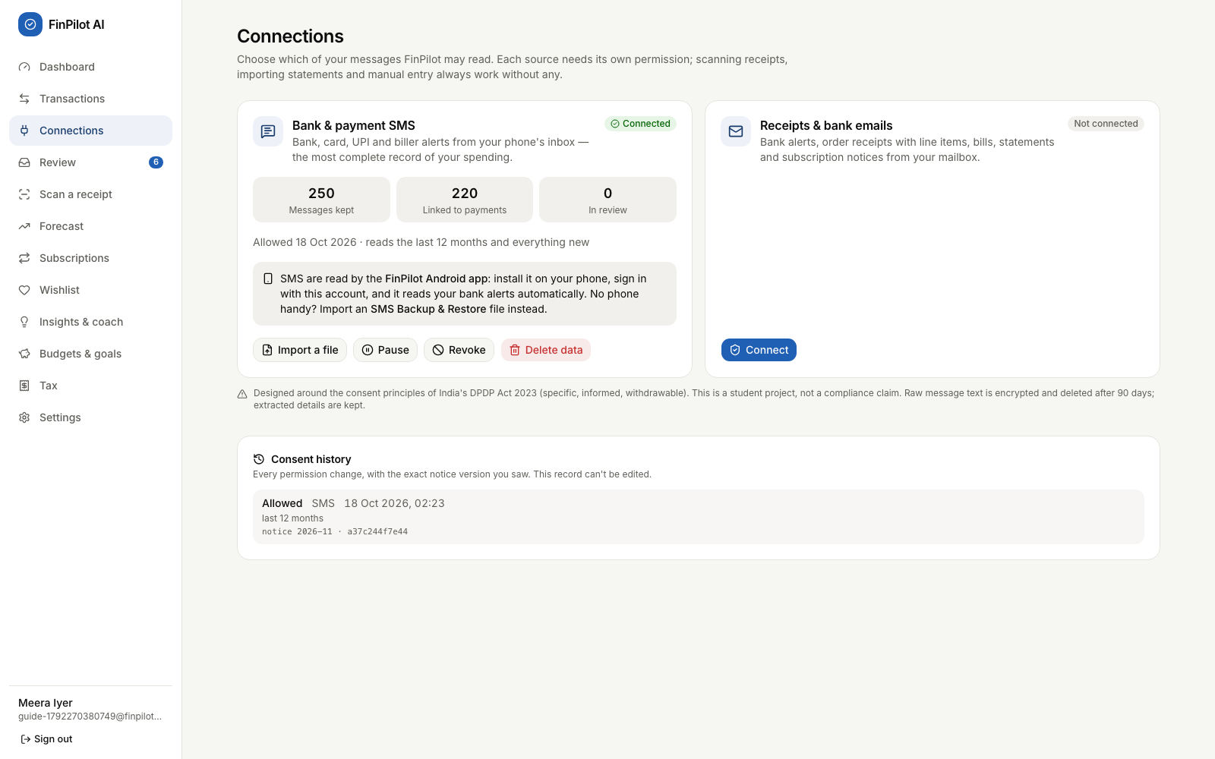
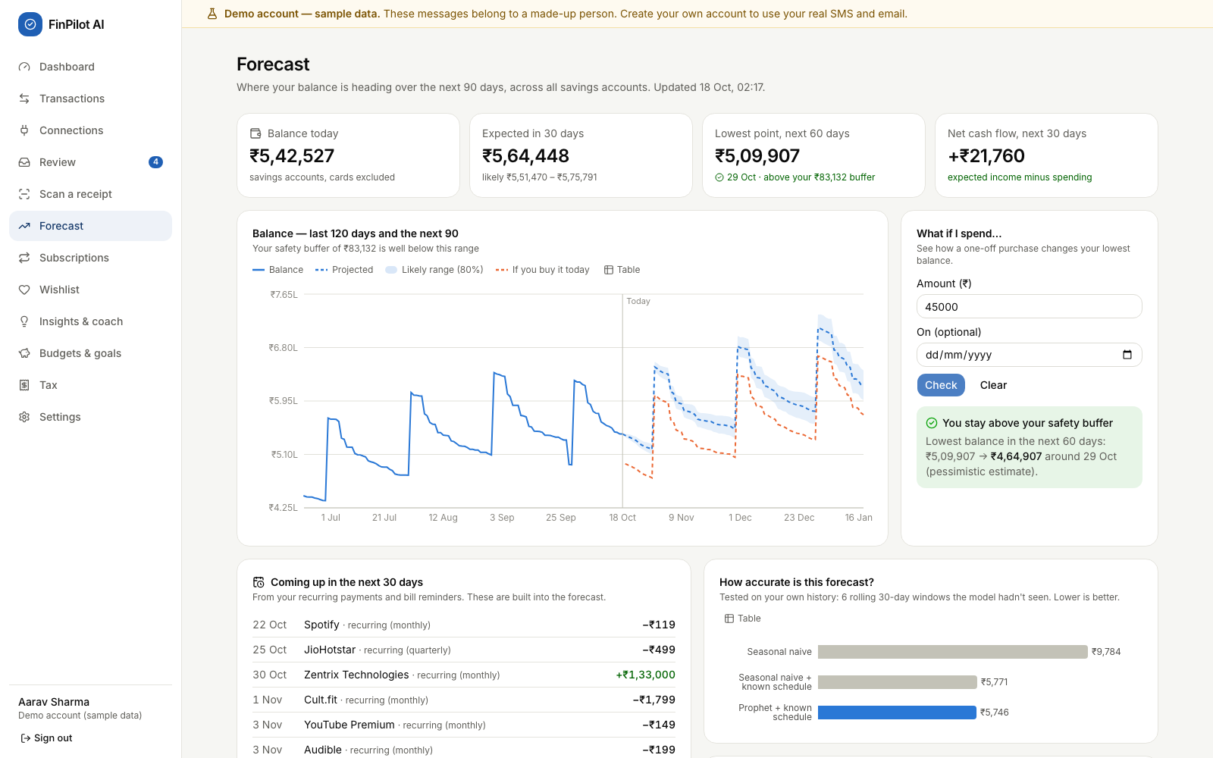
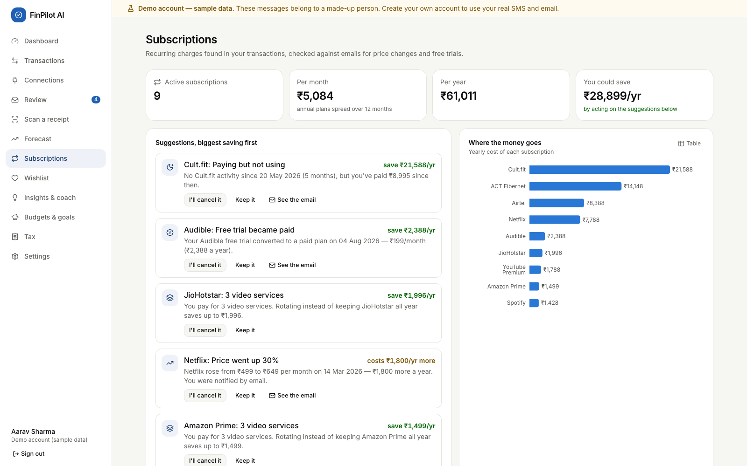
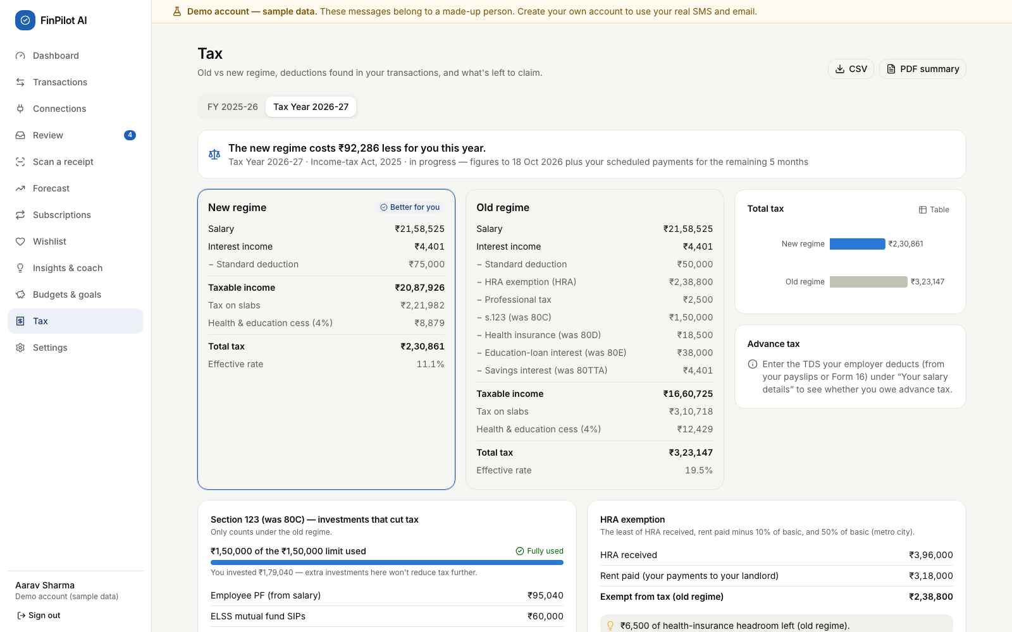
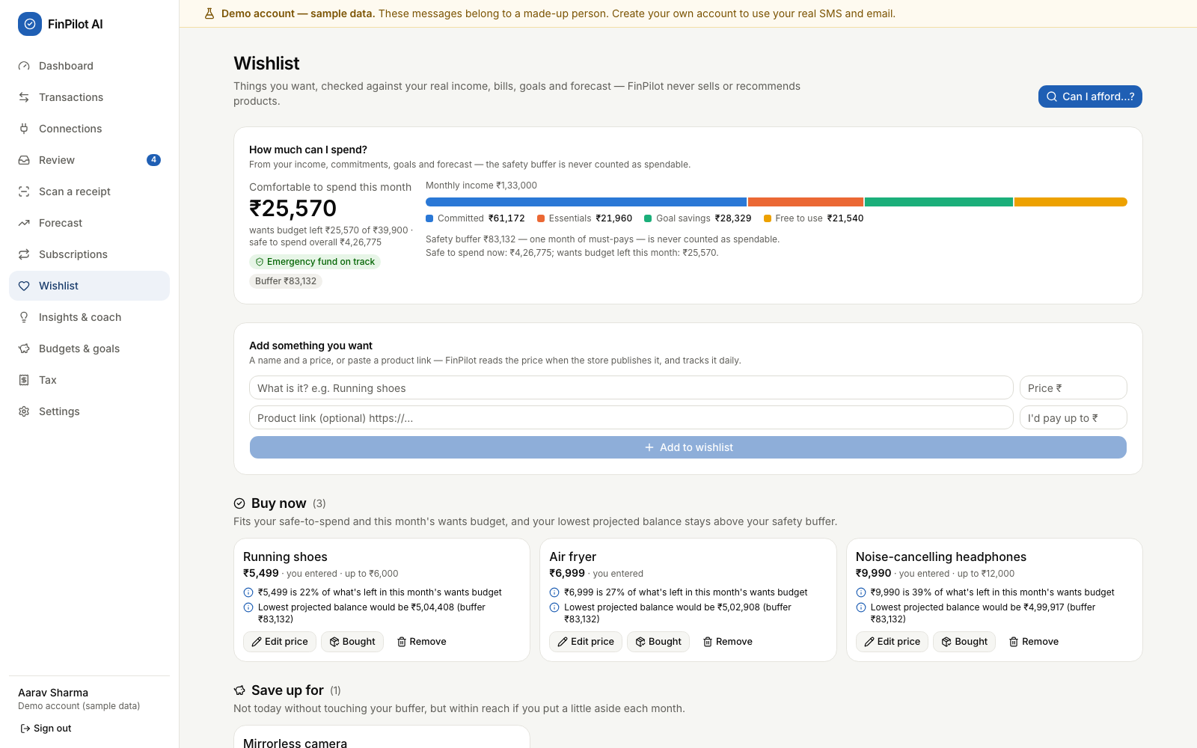
Application Screenshots
Fig. 1: Dashboard
Fig. 2: Connections (consent per source)
Fig. 3: Forecast with what-if check
Fig. 4: Subscriptions (ranked savings)
Fig. 5: Tax: old vs new regime
Fig. 6: Wishlist
Notes:
Screenshots from the running app: the dashboard, the Connections page of a new user after importing their SMS, the forecast with a what-if check, subscriptions, the tax comparison and the wishlist. The live demonstration follows after this common part, including the Android app.

Slide 15
Data Flow
Capture pipeline (same for the phone's SMS, the mailbox and file imports)
Consent gate
Pre-filter
Classify
Extract
Reconcile
Categorise
Rejected unless the source is active
Chats, OTPs and -P promos dropped on the phone; non-allowlisted e-mail
12 message types (TF-IDF + LR); OTPs are never stored
Bank templates first, then a generic reader; each field gets a confidence
One transaction per payment across SMS and e-mail; transfers, refunds
Rules, merchant list, ML, then the Review queue
Analytics after new data (user_analytics background job, also runs nightly)
Pages read the results
Dashboard, Forecast, Subscriptions, Wishlist, Insights
Anomalies
Subscriptions
Forecast
Wishlist tiers
Insights
Results are stored in SQLite (forecasts, subscriptions, anomalies, insights). Wishlist tiers and tax are calculated on each request. Each stage runs in its own try/except block, so one failure does not stop the others.
Notes:
Every message, whatever its source, goes through the same pipeline: SMS from the phone, e-mail from the mailbox, or an imported file. First the source must be active and the message inside the consent window; on the phone, chats, OTPs and promotions are dropped before anything is sent. A classifier recognises 12 kinds of message, the extractor reads the fields, and reconciliation makes sure one payment becomes one transaction even when it arrives by SMS and by e-mail. After new data, a background job refreshes the analytics that the pages read.

Slide 16
Database Design
Key design decisions
29 tables created from two Alembic migrations; SQLite in WAL mode
Money stored as integer paise and used as Decimal, never as float
Every user table has user_id with ON DELETE CASCADE
Transactions store origin, is_transfer and category_source with a confidence
Message text is Fernet-encrypted and purged after the retention period
consent_events is append-only; mailbox passwords are encrypted
Domain | Tables | Table names
Core | 4 | users, refresh_tokens, jobs, model_artifacts
Capture | 6 | data_sources, consent_events, ingested_messages, upcoming_payments, balance_snapshots, mailbox_connections
Finance | 17 | accounts, categories, merchants, merchant_aliases, category_rules, transactions, transaction_items, receipts, import_batches, budgets, goals, subscriptions, anomalies, insights, forecasts, forecast_metrics, chat_messages
Wishlist | 2 | wishlist_items, wishlist_price_points
Notes:
SQLite with 29 tables, created by two Alembic migrations and grouped into four domains. The second migration removed the Smart Picks tables and added the mailbox connection, the wishlist's price history and the phone's sync state. Key decisions: money as integer paise, every user table cascades on delete, transactions record where they came from and how they were categorised, message text and mailbox passwords are encrypted, and the consent log is append-only.

Slide 17
Results
Metric | Result
Message-type macro F1 (held-out test split) | 100%
Type accuracy on hand-written challenge set (amounts: 100%) | 98.3%
De-duplication precision / recall (SMS + e-mail) | 100% / 100%
Category accuracy on captured payments | 99.8%
Coach intent accuracy (held-out paraphrases) | 84.6%
Real-format SMS regression set: 90 messages, 25+ institutions (all fields) | 100%
Using the known payment schedule cuts forecast error by about 41%; Prophet improves it a little more.
WAPE is used instead of MAPE because the daily net flow often crosses zero.
Measured on 18 Oct 2026 (see README). Demo data is regenerated daily, so the numbers can shift slightly.
Notes:
We measured everything on data with known answers. The chart is the forecast backtest: knowing the user's schedule cuts the error by about 41 percent against the seasonal-naive baseline, and Prophet improves it only a little more; an earlier version claimed 85 percent because its backtest saw future payments, which we fixed. The tiles show message understanding, de-duplication, categorisation, the coach and our real-format SMS corpus, which we used while improving the parser, so it is a regression set rather than an unseen test.

Slide 18
Testing and Validation
Test | Count | Details
Backend tests (pytest + Hypothesis) | 82 / 82 pass | Re-run on 18 Oct 2026, took 29.3 s
End-to-end tests (Playwright) | 23 | A new user's journey, the phone layout on 12 pages, and the demo
Property-based test cases | 300 | Random cases show Buy now never breaks the safety buffer
On-device checks (Android 15 emulator) | 17 / 17 | Real-format SMS planted; only bank alerts uploaded
Backend tests cover
End-to-end and model validation
Money handling and message parsing (known, unseen and challenge formats)
Pipeline accuracy against ground truth: dedup, transfers, categories
Consent: nothing is read without it; pause, revoke, delete data
API flows: cookies and Bearer tokens, CORS, rate limit, deletion
Tax for both years; forecast backtest and fallback; wishlist
New user: register, consent, SMS backup import, onboarding
Emulator: bank SMS, OTP, promo and a chat; only alerts uploaded
Receipt photo matched; wishlist, tax PDF, coach; phone layout
Revoke and delete data; reset the demo
Models: held-out splits, unseen banks, challenge set, real formats
Notes:
Testing ran at four levels. 82 backend tests with pytest and Hypothesis, all passing on 18 October. 23 Playwright tests in a real browser: a new user's whole journey on real files, the phone layout on 12 pages, and the demo. The Android app on an Android 15 emulator: we planted real-format bank SMS, an OTP, a promotion and a personal chat, and checked that only the bank alerts reached the server, each as one transaction. Models are validated on held-out data, unseen bank formats and backtests.

Slide 19
Challenges and Possible Improvements
Challenges faced
Possible improvements
Challenge | How we solved it
Requirements changed after Review 0 | Re-planned around consent-based capture; one process instead of Docker + PostgreSQL
One payment, two messages | Reference matching and scoring; e-mail receipts add details to the SMS transaction instead of duplicating it
SQLite allows only one writer | Background jobs join the request's transaction and start after it commits (regression test added)
Judging forecast quality | Rolling backtest against two baselines; WAPE instead of MAPE; automatic fallback
Proving it on real data | An Android app reads and filters SMS on the phone; verified on an Android 15 emulator
A rotating log file and request IDs (logs only go to the terminal now)
Persistent per-account login limits, password reset and Secure cookies over HTTPS
Ask users for consent again when the notice text changes
Tax: marginal relief on surcharge above ₹50 lakh
Read new SMS in the background while the app is closed
Account Aggregator data; Gmail and Outlook through OAuth
Notes:
Left: the main challenges and how we solved them, including making every feature work on real data. Right: improvements we identified while reviewing our own code, for example there is no log file yet because logs go to the terminal, the login rate limit lives in memory, the UI does not yet ask for consent again when the notice changes, and new SMS are read only while the app is open.

Slide 20
Conclusion and Future Scope
Conclusion
Future Scope
FinPilot AI turns the messages people already receive into a private, forward-looking view of their money
Every module works end to end on the user's own SMS and e-mail
Consent, purpose limitation, encryption and deletion are built in
Results are measured; 82 backend, 23 browser and 17 on-device checks pass
Real bank data through India's Account Aggregator framework
SMS capture in the background, and a Play Store release
A local LLM for the coach, using the existing ResponseProvider interface
Hosted multi-user version with HTTPS, PostgreSQL and log files
More bank formats from users' Review queues; more languages
Thank You! Questions?
Notes:
To conclude: FinPilot AI turns messages people already receive into a private, forward-looking view of their money; every module works end to end on the user's own SMS and e-mail; privacy is built in; and our results are measured and tested, including on an Android device. In future it could read SMS in the background, connect to bank data through the Account Aggregator framework, and use a local language model behind the coach's provider interface. Thank you.

