Slide 1
SSN College of Engineering, Kalavakkam - 603110
Department of Information Technology
UIT2739 - Full Stack Development Project
FinPilot AI
A privacy-first personal finance assistant for India
Jeya Sangavi R - 3122235002054
Rahul Akshath Rajendran - 3122235002095
Rakshitha S - 3122235002098
Project evaluation · October 2026
Notes:
Good morning. We are presenting FinPilot AI, our UIT2739 full-stack project. It is a personal-finance assistant that builds a user's financial picture from the bank SMS and e-mails they already receive, but only after the user allows each source. This common part covers the problem, requirements, architecture, SDLC, modules, database, testing and lessons learnt; each of us then demonstrates our own features.

Slide 2
FinPilot AI at a glance
A personal-finance assistant for India that builds your financial picture from the bank SMS and e-mails you already receive — but only after you allow each source, one at a time, for the purposes you choose.
1
Capture
2
Understand
3
Predict
4
Act
Bank SMS on the phone and e-mail, each with its own consent
Optional: receipt OCR, PDF bills, CSV/XLSX statements, manual entry
Classify, extract and de-duplicate every message
Categorise payments and flag unusual ones
90-day cash-flow forecast with an 80% range
Subscriptions and income tax for two years
Ranked insights and a coach
Budgets, goals and a wishlist you can afford
One command: python3 run.py
Private: your laptop is the server
₹0 cost: no paid AI, no bank login
Notes:
FinPilot AI is a full-stack app: a server on the user's laptop, used from a browser or from our Android app. Capture: bank SMS read on the phone and e-mail read from the user's mailbox, each behind its own consent, plus optional uploads. Understand: every message is classified, its fields extracted, duplicates reconciled and the payment categorised. Predict: a 90-day cash-flow forecast, subscription analysis and tax estimates. Act: insights, a coach, budgets, goals and a wishlist checked against what is safe to spend.

Slide 3
Problem statement and motivation
Problem statement
Every UPI payment, card swipe, bill and salary credit already arrives as a bank SMS or e-mail, yet the information stays scattered. Existing apps make people type transactions, ask for bank credentials, or send personal data to paid cloud AI — and they only describe the past.
FinPilot AI builds a reliable, forward-looking picture of a person's money from the messages they already receive: only from sources they allow, only for purposes they choose, running on their own computer at zero cost.
1
Capture is manual
2
Insight looks backwards
Typing in every payment is tedious, so people give up; cash and paper receipts are lost.
Apps show what was spent, not what the balance will be at month end.
3
Leakage stays hidden
4
Privacy and cost
Price rises, unused subscriptions and duplicate charges hide in normal spending.
Aggregator apps want bank credentials; AI features need paid cloud services.
Motivation: make money management automatic, private and forward-looking — with no new data entry and no new risks.
Notes:
The data already exists: every UPI payment, card swipe and bill produces an SMS or e-mail. The problem is that it stays scattered and existing tools fall short in four ways shown on the right. Our statement: build a reliable, forward-looking picture of a person's money from the messages they already receive, only with their consent, running on their own computer at zero cost.

Slide 4
Objectives and scope
Objectives
In scope
1
Capture transactions from consented bank SMS (read on the phone) and e-mail — no bank login — plus uploads.
SMS from an Android app, e-mail over IMAP
Receipt photos (on-device OCR), PDF bills, CSV/XLSX
Forecast, subscriptions, tax, anomalies, insights, coach
A wishlist checked against the budget
Laptop server; the phone pairs by QR code
2
Understand spending reliably: classify, extract, de-duplicate, categorise and flag anomalies.
3
Forecast the balance 90 days ahead and report its accuracy honestly against baselines.
4
Find subscription leakage and estimate income tax under both regimes, with evidence.
Out of scope (stated limits)
Live bank or account-aggregator connections
Real payments or money transfers
Product recommendations or crawling
Tax filing or financial advice (estimates only)
iOS (Apple gives apps no SMS access)
5
Turn data into decisions: insights, a coach, budgets, goals and an affordable wishlist.
6
Keep users in control: consent per source and purpose, encryption, retention and deletion.
Notes:
Six objectives, each mapped to modules we built. On the right is the scope we committed to. Out of scope, as stated in our README: no live bank or Account Aggregator connections, no payments, no product recommendations or crawling, no iOS app because iOS gives apps no SMS access, and tax figures are estimates, not advice.

Slide 5
Functional requirements (1/2)
FR1
Accounts and sessions
Register, sign in, labelled demo, sign out; cookies on the web, tokens in the Android app.
FR2
Consent per source
Allow SMS and e-mail separately, with a purpose and a backfill window; pause, resume, revoke, delete data; consent history.
FR3
Message capture
Read SMS on the phone and e-mail over IMAP; classify 12 kinds, extract fields, reconcile duplicates, transfers and refunds.
FR4
Optional uploads
Camera receipt OCR on the device, PDF bills, a CSV/XLSX statement wizard and manual entry.
FR5
Transactions and review
Search and filter, evidence drawer, recategorise with “apply to all” rules, a review queue that learns.
FR6
Dashboard
Balance, safe to spend, spending, the 90-day forecast band, attention feed, bills due and anomalies.
FR7
Cash-flow forecast
90-day projection with an 80% band, what-if purchases, upcoming payments and a backtest against baselines.
Notes:
Each requirement is implemented end to end: an API endpoint, business logic in a service, database tables and a page. FR1 to FR7 cover accounts, consent, capture, uploads, transactions, the dashboard and the forecast.

Slide 6
Functional requirements (2/2)
FR8
Subscriptions
Detect recurring charges; flag price rises, unused plans, trials that became paid and overlaps; keep or cancel.
FR9
Tax insights
FY 2025-26 and Tax Year 2026-27, both regimes, deductions found in transactions, headroom, advance tax, CSV/PDF.
FR10
Insights and coach
Ranked, dismissible insights; a coach that answers 13 kinds of question from the user's own data.
FR11
Budgets and goals
Monthly category limits with pace markers; goals with monthly targets and “add money”.
FR12
Wishlist
Items with a price or product link, prices read where allowed, Buy now / For your goals / Save up tiers, Can I afford…?
FR13
Settings and data rights
Buffer, take-home pay, accounts and retention; pair the phone; export all data; delete account.
FR14
Model evaluation
Capability checks and measured model metrics, including a real-format SMS corpus.
Notes:
Each requirement is implemented end to end: an API endpoint, business logic in a service, database tables and a page. FR8 to FR14 cover subscriptions, tax, insights and coach, budgets and goals, the wishlist, settings and data rights, and the model evaluation page.

Slide 7
Non-functional requirements
Security
Privacy
Reliability
Performance
bcrypt passwords (12 rounds)
JWT cookies (web) or Bearer tokens (app)
CSRF and CORS checks; failed-login limit
On-phone filtering; per-source consent
Message text encrypted, deleted after 90 days
Append-only consent log; export, delete
Every request commits or rolls back
Isolated analytics stages and jobs
Prophet → baseline fallback; idempotent sync
Demo ready ≈51 s after a clean start
Models train in ≈3 s; OCR ≈0.5 s/receipt
What-if reuses the stored forecast
Usability
Portability
Maintainability
Accuracy
Android app; bottom tabs on phones
Every chart has a table view
Plain-language errors and progress
One command: python3 run.py
Python 3.11+; no Docker, no DB server
install-android over USB; QR pairing
Routers → services → models
Alembic migrations; shared metrics
82 backend, 23 browser, 17 device checks
Money as integer paise and Decimal
Held-out tests, backtests, WAPE
“Estimates, not advice” disclaimers
Notes:
These qualities are visible in the code. Security: bcrypt, JWT in httpOnly cookies for the browser and Bearer tokens for the app, rotating refresh tokens, CSRF and CORS checks and a login rate limit. Privacy: personal chats, OTPs and promotions are dropped on the phone; consent per source, Fernet encryption and a 90-day retention purge. Reliability: transactions roll back, analytics stages are isolated, Prophet falls back to a baseline, and syncing the same SMS twice stores it once. Portability: one command for the server, one for the phone app.

Slide 8
System architecture
Browser / phone
One Python process · started by python3 run.py
Next.js 16 UI (web and Android)
Same static UI in the browser and in a Capacitor 8 Android app
FastAPI app on port 8000
15 routers under /api/v1 · CSRF guard · error handler · serves the web app
SQL
SQLite (WAL)
data/finpilot.db
29 tables
SQLAlchemy + Alembic
Services (business logic and ML)
TanStack Query + api.ts
cookies + X-Requested-With (web); Bearer tokens (app)
Consent and capture
Receipts
Categories, anomalies
Forecasting
Subscriptions
Tax
Insights and coach
Wishlist, prices
ML in-process: scikit-learn (TF-IDF + logistic regression, IsolationForest) and Prophet
data/ folder
Uploads, trained models and the generated secret key
tesseract.js · SMS plugin
OCR on the device; the app reads and filters SMS on the phone
Job runner + scheduler
Thread pool; mail every 30 min, prices daily, nightly analytics
IMAP mailboxes · product pages
Mail every 30 min; one product page a day (robots.txt)
The browser calls /api/v1 on the same server; the Android app calls it over Wi-Fi or a tunnel, allowed by CORS.
Notes:
The server is one Python process started by run.py on the laptop. FastAPI on port 8000 serves the JSON API under /api/v1 and the pre-built Next.js site. The same site is bundled into our Android app with Capacitor; the app calls the server over Wi-Fi, the phone's hotspot or a Cloudflare tunnel, with Bearer tokens, and its SMS plugin reads and filters the inbox on the phone. Services hold the business logic and ML; a job runner and scheduler read mailboxes every 30 minutes, re-check wishlist prices daily and run the nightly analytics. Data lives in SQLite in WAL mode.

Slide 9
Backend layers and the life of one request
Routers api/v1/*.py
Example: a what-if purchase
HTTP, Pydantic validation, ownership checks
User types ₹45,000 under “What if I spend…” on Forecast and clicks Check.
1
Dependencies core/deps.py
User from the cookie or Bearer token; one DB session
2
api.ts sends GET /api/v1/forecast/whatif?amount=45000 with the cookie or token.
Services services/*.py
3
FastAPI checks 0 < amount < ₹1e9 and loads the user from the JWT; otherwise 422 or 401.
Business rules: forecasting, tax, wishlist, consent…
Models models/*.py
4
Service reads the stored 90-day forecast and lowers p10, p50 and p90 from the purchase date.
SQLAlchemy 2 ORM; money as integer paise
5
Rule compares the new lowest balance in the next 60 days with the safety buffer.
Database data/finpilot.db
SQLite in WAL mode; Alembic migrations
UI TanStack Query redraws the chart and shows a green or red verdict.
6
Cross-cutting: core/ (config, security, crypto, money) and jobs/ (runner, scheduler)
Notes:
The backend is layered. Routers handle HTTP and validation; dependencies give each request the signed-in user and a database session; services hold the rules; models map to SQLite. On the right is one real request: a what-if purchase on the Forecast page. It only reads the stored forecast, so it answers instantly.

Slide 10
Technologies, frameworks and tools
Frontend
Next.js 16.4 (static export)
React 19.3
TypeScript 5.9
Tailwind CSS 4.3
shadcn/ui on Base UI
TanStack Query 5
Recharts 3
tesseract.js 7
Backend
Python 3.11+ (3.14 tested)
FastAPI 0.143
Uvicorn 0.54
Pydantic 2.14
SQLAlchemy 2.1
Alembic 1.20
PyJWT 2.15
pwdlib (bcrypt)
cryptography (Fernet)
Data and ML
SQLite (WAL)
scikit-learn 1.9
Prophet 1.5
pandas 3.0
NumPy 2.5
RapidFuzz 3.14
dateparser 1.4
Documents and web
pdfplumber 0.11
ReportLab 5.0
httpx 0.28
Protego 0.7 (robots.txt)
BeautifulSoup + lxml
openpyxl
Testing and tools
pytest 9.1
Hypothesis 6
Playwright 1.64
Capacitor 8
Node.js / npm (UI and app build)
Notes:
All tools are free and run locally. The frontend is a Next.js static export served by FastAPI, so Node.js is only needed to rebuild the UI. The backend uses FastAPI with SQLAlchemy and SQLite. ML uses scikit-learn and Prophet. The versions shown are the ones installed in our environment.

Slide 11
Software development life cycle
Model: iterative and incremental, with a working app and a measurable gate at the end of every phase
Requirements
Design
Implementation
Testing
Deployment
Maintenance
Review 0 (July 2026): problem, objectives, modules
After the review: real SMS, e-mail and a wishlist
One-process architecture
29-table schema; money in paise
Docker + PostgreSQL replaced by SQLite and run.py
10 build phases (0–9)
Each phase a working increment: API, logic, UI
pytest + Hypothesis every phase
Playwright E2E + Android emulator
Metrics on held-out data
One command: python3 run.py
Web app + Android APK
Phone pairs by QR code
Alembic migrations
Demo data refreshes daily
Model evaluation in Settings
Jul 2026 Review 0
After Review 0 requirements change
Phases 0–9 built and gated
18 Oct 2026 real data, re-measured
Oct 2026 evaluation
Notes:
We followed an iterative and incremental model. Requirements were set at Review 0 in July; afterwards we added consent-based capture and revised the design to one process, SQLite and a one-command launcher instead of Docker and PostgreSQL. At the review, the features still ran on sample data, so we built the real-data release: an Android app that reads SMS, IMAP e-mail, file imports and a real wishlist, and removed the simulators. Each phase ended with a working app and a measurable gate.

Slide 12
Build phases and their gates
0
Foundation
1
Data and auth
2
Capture
3
Core UI
4
Receipts
run.py, server, jobs, SQLite + Alembic
schema, auth, demo persona, model training
consent API, pipeline, file imports
shell, onboarding, dashboard, connections
on-device OCR, receipt commit, PDF bills
Gate: a clean start renders a page
Gate: deterministic data; tests green
Gate: no transactions from OTP/promos
Gate: E2E: SMS becomes a transaction
Gate: a photo matched to its payment
5
Forecasting
6
Subscriptions, tax
7
Insights, coach
8
Affordability
9
Real data
Prophet + schedule, backtest, what-if
detection, both regimes, export
insights, coach, budgets, goals
safe-to-spend, wishlist, prices
Android app, IMAP, XLSX, hardening
Gate: honest backtest; fallback tested
Gate: planted findings; tax tests
Gate: every intent answers from data
Gate: property test; private links refused
Gate: 17/17 on-device + 23 E2E pass
Notes:
These are the phases as executed. Each one ended with a check we could demonstrate, for example: no transactions created from OTP or promotional messages, a receipt photo attached to its card payment, the property test showing Buy now never breaks the buffer, and the final phase: the Android app passing all 17 checks on an emulator with real-format SMS.

Slide 13
Major features and modules
1
Consent and capture
2
Receipts and bills
3
Transactions and review
SMS read on the phone, e-mail over IMAP, file imports; consent per source
Camera OCR with confidence boxes; PDF bills; matched to card payments
Rules → merchant list → ML; uncertain items go to Review and become rules
4
Anomaly detection
5
Cash-flow forecast
6
Subscriptions
Robust z-score, IsolationForest, duplicate charges and new-merchant spikes
Known schedule + Prophet; 80% band, what-if and a backtest against baselines
Price rises, unused plans, trials turned paid and overlaps, ranked by ₹ per year
7
Tax insights
8
Insights, coach, budgets
9
Wishlist and affordability
Two tax years, both regimes, deductions from transactions, CSV/PDF export
Ranked insights; a 13-intent coach; budgets and goals feed affordability
Prices from product links + affordability: Buy now, For your goals, Save up
Notes:
Nine modules, all working end to end on the user's own data. Capture and receipts bring data in; transactions, review and anomaly detection make it trustworthy; forecasting, subscriptions and tax look ahead; insights, the coach, budgets and the wishlist turn it into decisions. Each team member will demonstrate their own modules.

Slide 14
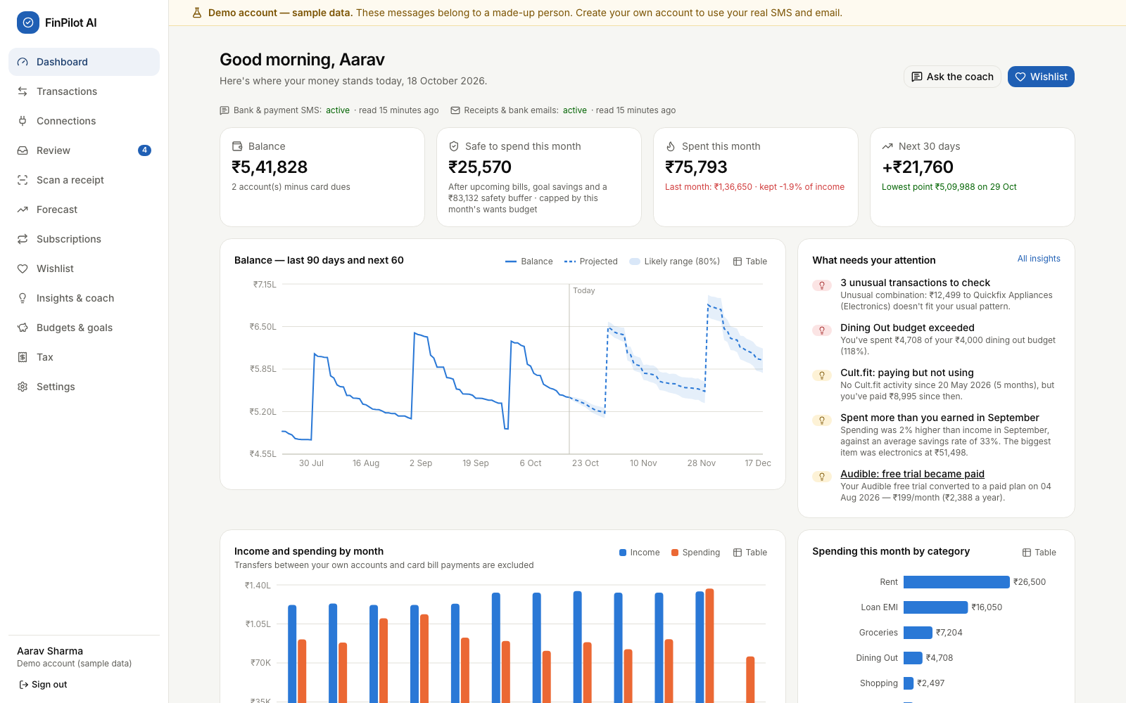
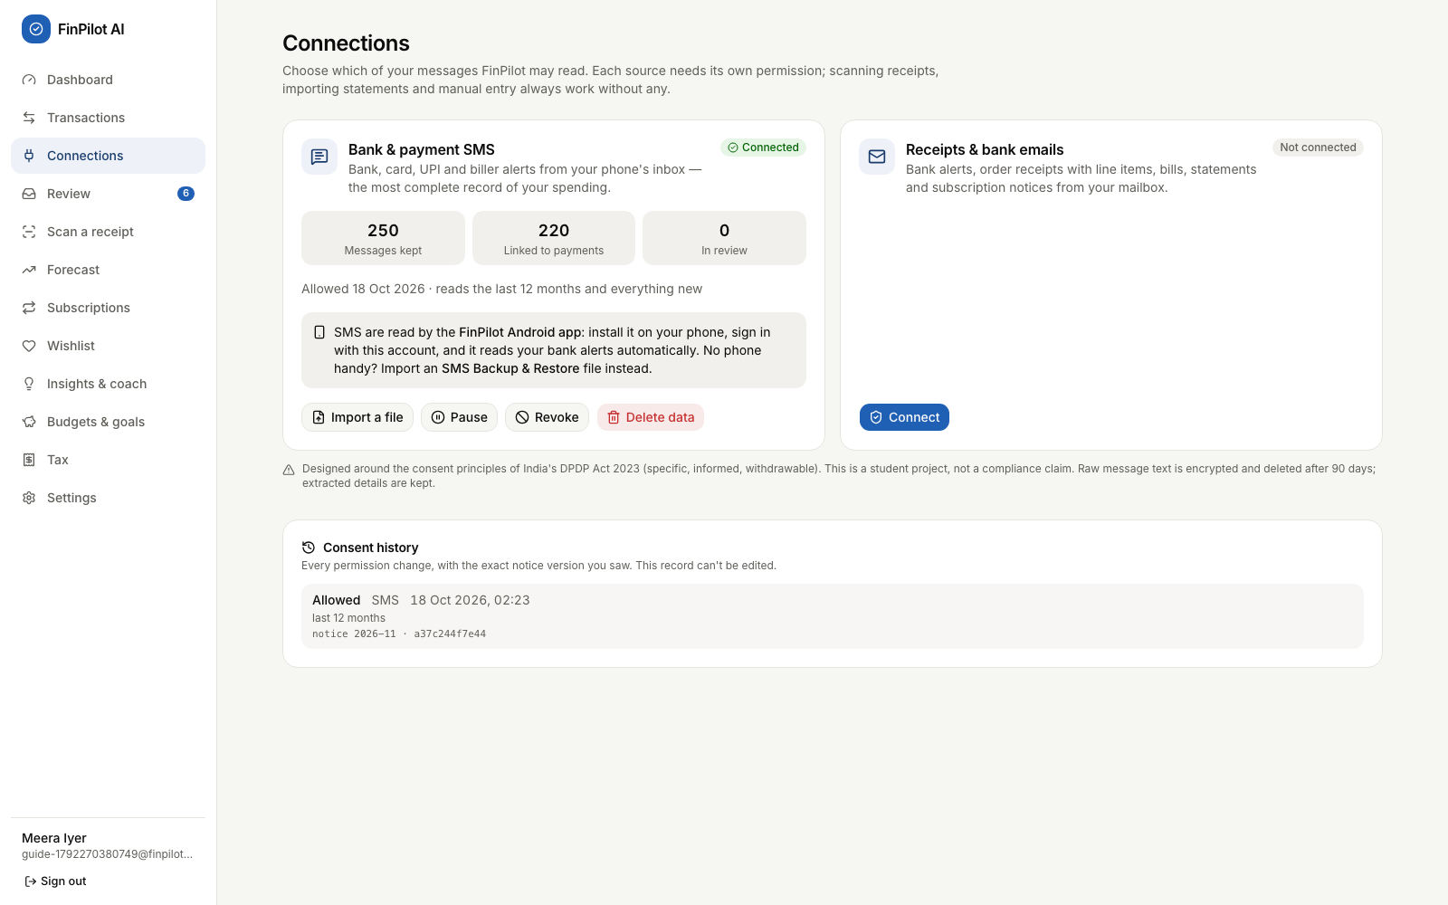
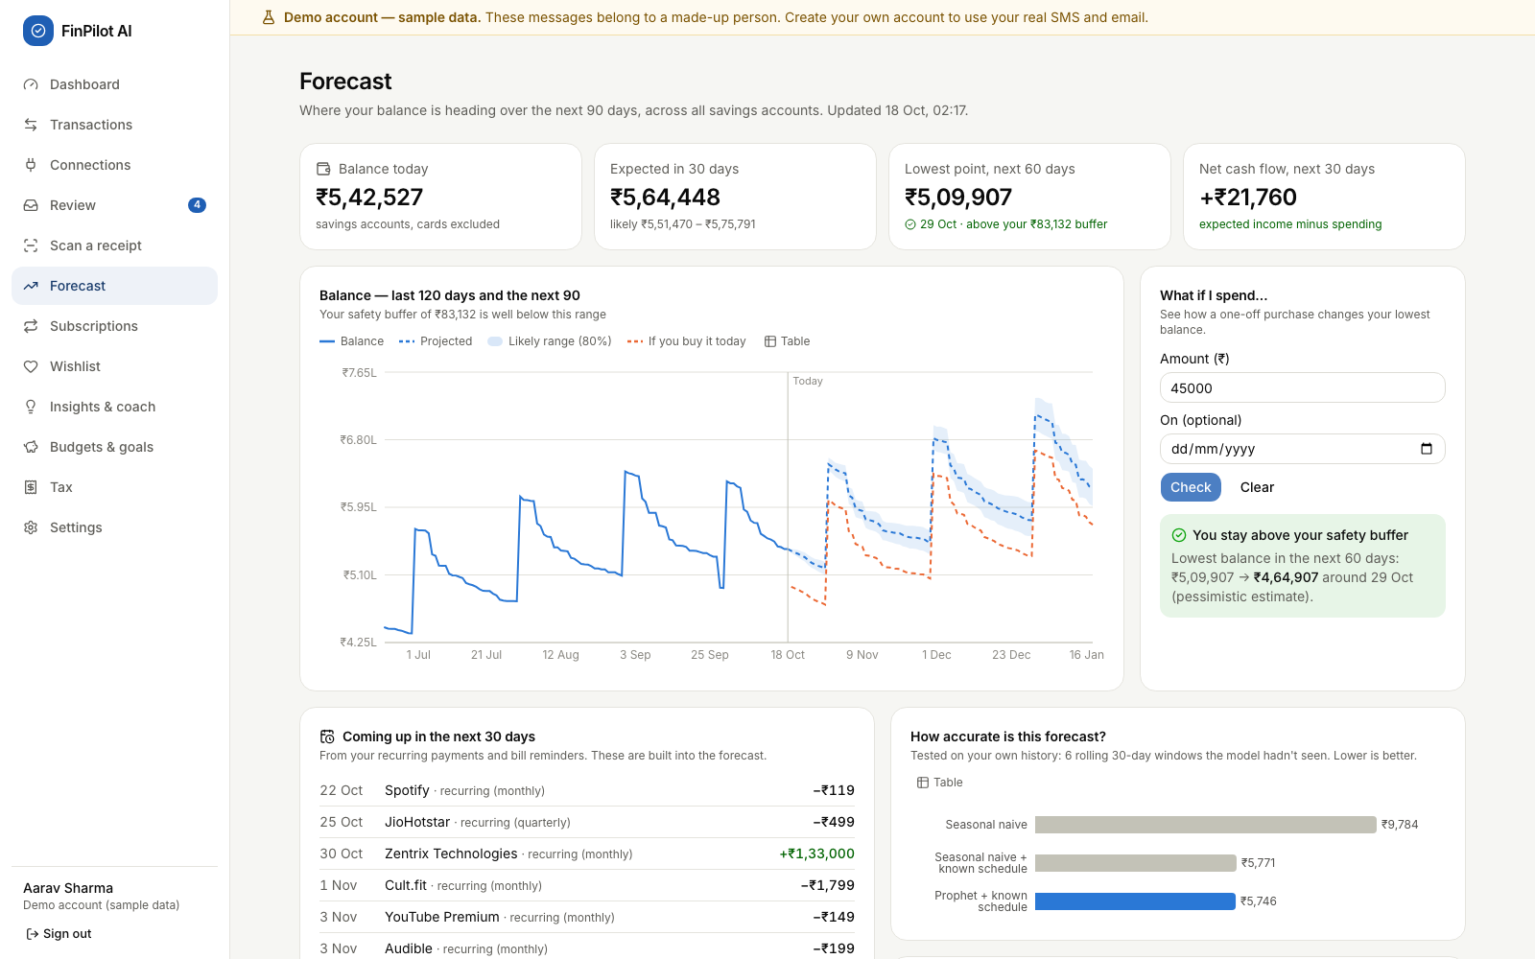
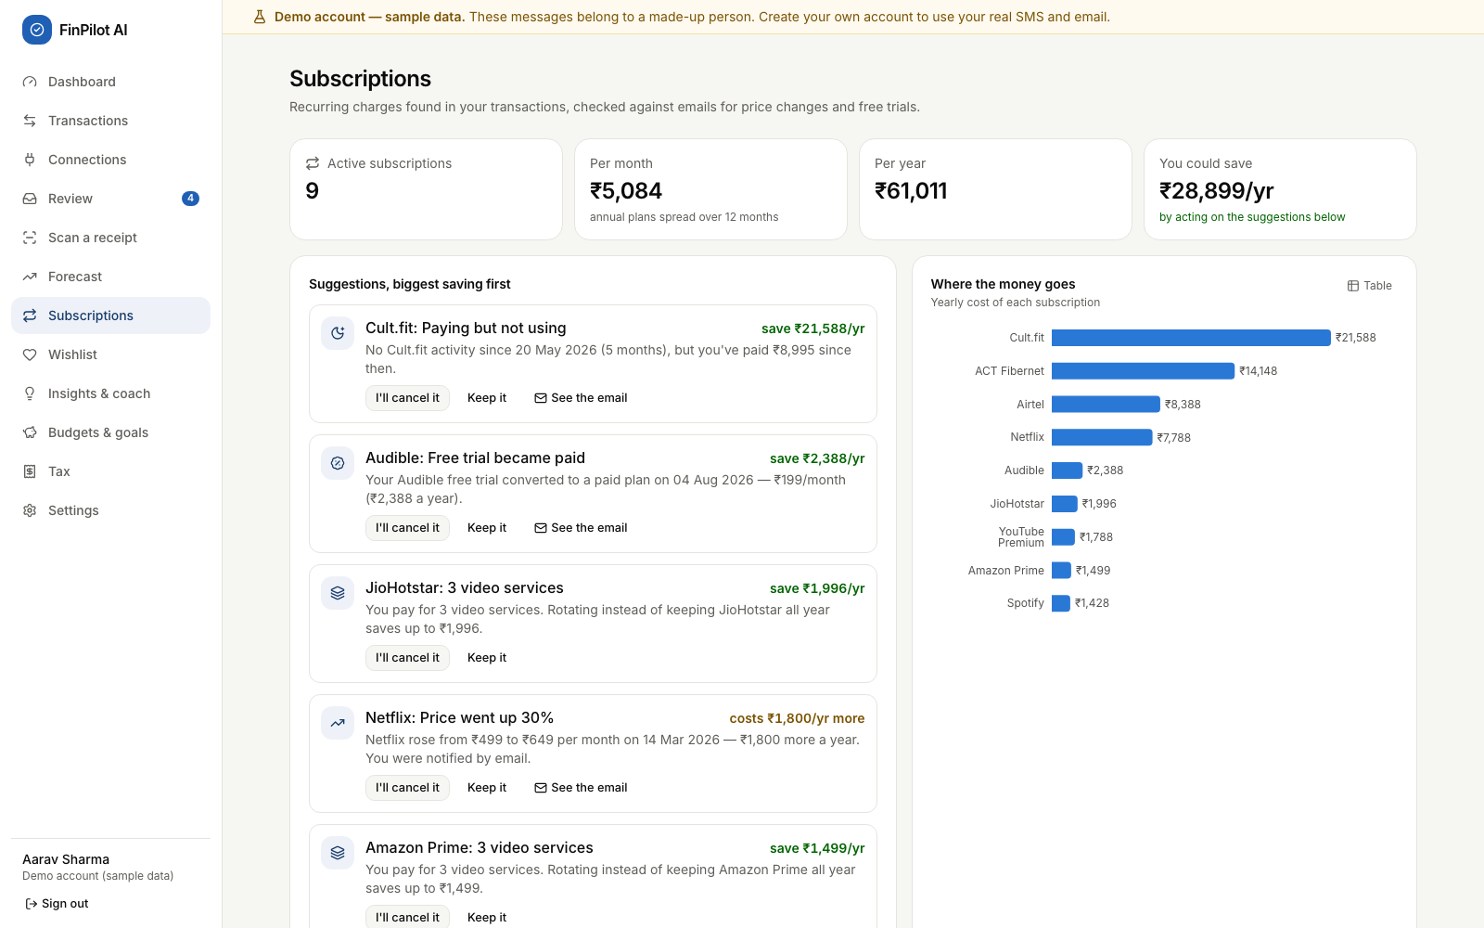
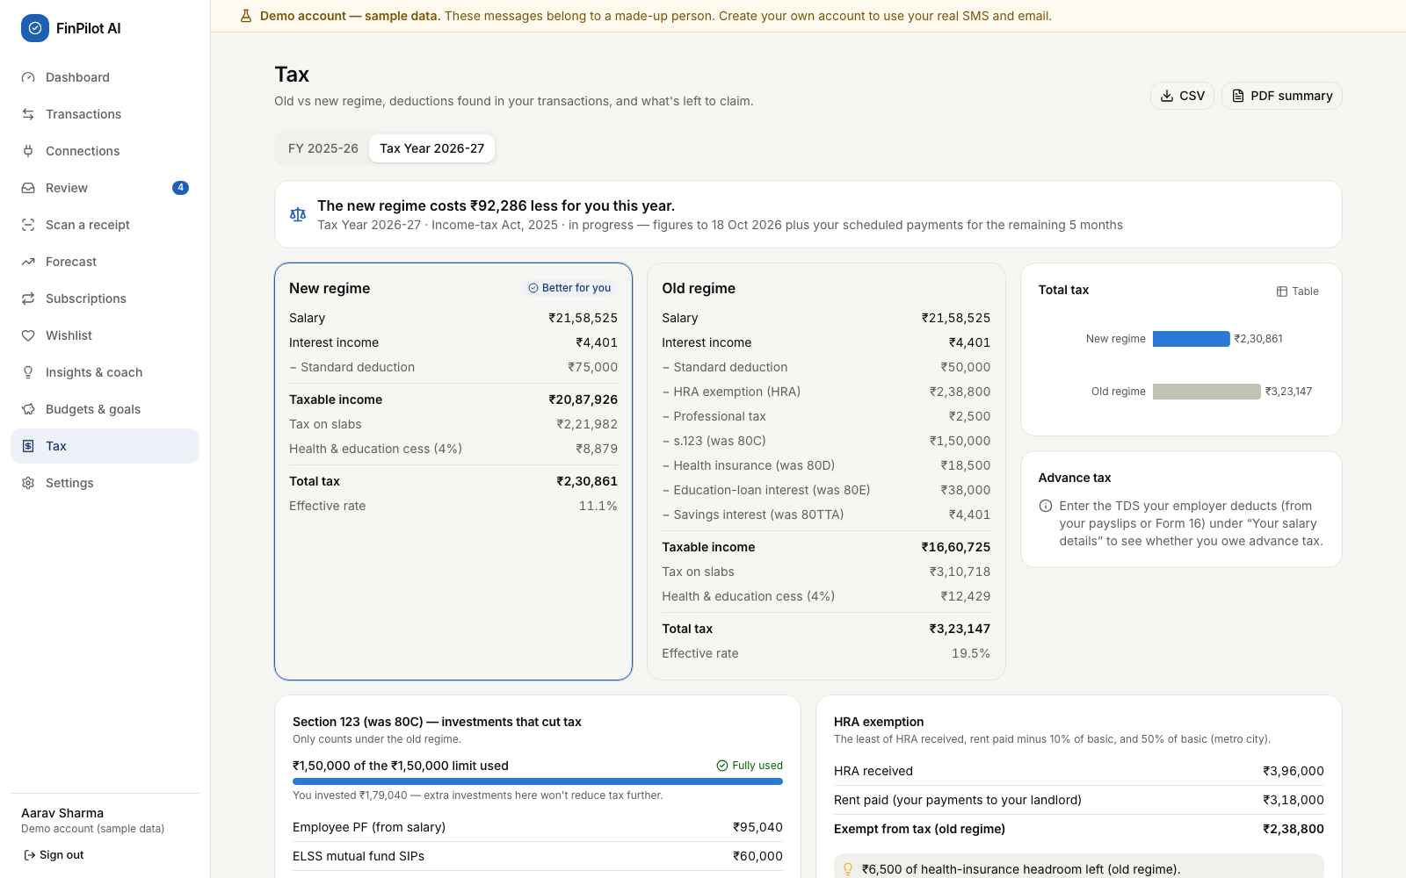
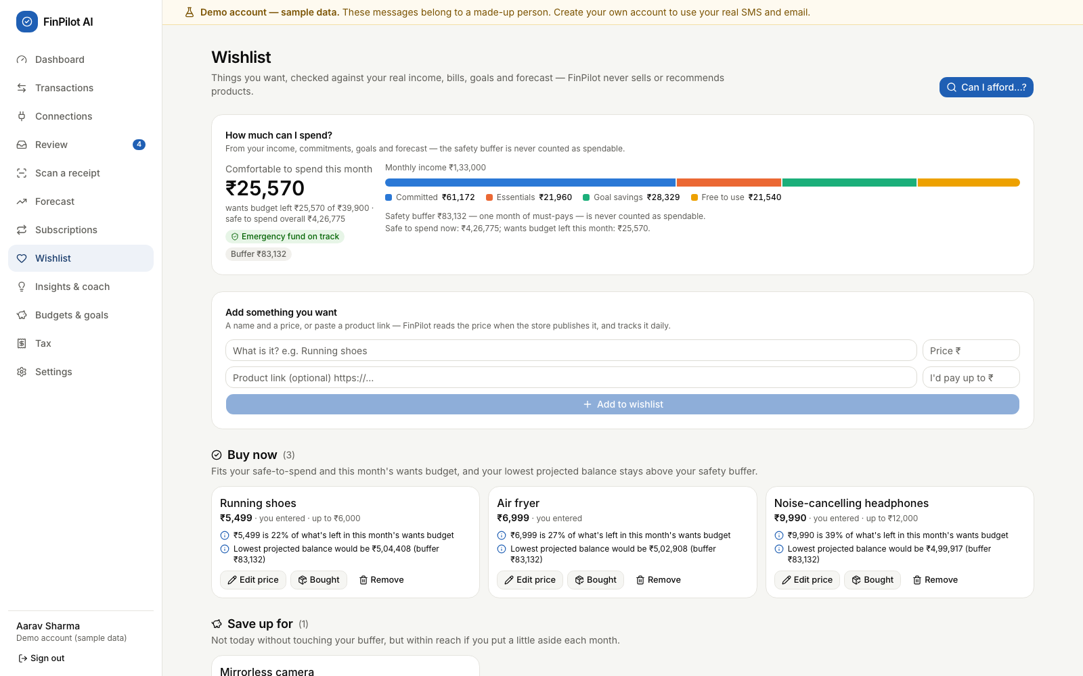
The application in action
Dashboard
Connections: consent per source
Forecast with a what-if check
Subscriptions: ranked savings
Tax: old vs new regime
Wishlist: affordability first
Notes:
Screenshots from the running app: the dashboard, the Connections page of a new user after importing their SMS, the forecast with a what-if check, subscriptions, the tax comparison and the wishlist. The live demonstration follows after this common part, including the Android app.

Slide 15
Data flow: from a message to a decision
Capture pipeline — the same for the phone's SMS, the mailbox and file imports
Consent gate
Pre-filter
Classify
Extract
Reconcile
Categorise
Refused unless the source is active
Chats, OTPs and -P promos dropped on the phone; non-allowlisted e-mail
12 message kinds (TF-IDF + LR); OTPs never stored
Bank templates, then a generic reader; each field has a confidence
One transaction per payment across SMS + e-mail; transfers, refunds
Rules → merchant list → ML → Review queue
Analytics after new data — the user_analytics background job (also nightly)
Pages read the results
Dashboard · Forecast · Subscriptions · Wishlist · Insights
Anomalies
Subscriptions
Forecast
Wishlist tiers
Insights
Results are stored in SQLite (forecasts, subscriptions, anomalies, insights). Wishlist tiers and tax are computed on each request. Each stage runs in its own try/except, so one failure never blocks the others.
Notes:
Every message, whatever its source, goes through the same pipeline: SMS from the phone, e-mail from the mailbox, or an imported file. First the source must be active and the message inside the consent window; on the phone, chats, OTPs and promotions are dropped before anything is sent. A classifier recognises 12 kinds of message, the extractor reads the fields, and reconciliation makes sure one payment becomes one transaction even when it arrives by SMS and by e-mail. After new data, a background job refreshes the analytics that the pages read.

Slide 16
Database design
Key design decisions
Core
4 tables
Capture
6 tables
users, refresh_tokens, jobs, model_artifacts
data_sources, consent_events, ingested_messages, upcoming_payments, balance_snapshots, mailbox_connections
29 tables from two Alembic migrations; SQLite in WAL mode
Money stored as integer paise and used as Decimal, never as floats
Every user table has user_id … ON DELETE CASCADE
transactions record origin, is_transfer and category_source with a confidence
Message text Fernet-encrypted and purged after the retention period
consent_events is append-only; mailbox passwords are encrypted
Finance
17 tables
Wishlist
2 tables
accounts, categories, merchants, merchant_aliases, category_rules, transactions, transaction_items, receipts, import_batches, budgets, goals, subscriptions, anomalies, insights, forecasts, forecast_metrics, chat_messages
wishlist_items, wishlist_price_points
Notes:
SQLite with 29 tables, created by two Alembic migrations and grouped into four domains. The second migration removed the Smart Picks tables and added the mailbox connection, the wishlist's price history and the phone's sync state. Key decisions: money as integer paise, every user table cascades on delete, transactions record where they came from and how they were categorised, message text and mailbox passwords are encrypted, and the consent log is append-only.

Slide 17
Measured results
100%
98.3%
message-type macro F1 on the held-out test split
type accuracy on a hand-written challenge set; amounts 100%
100% / 100%
99.8%
de-duplication precision / recall across SMS and e-mail
category accuracy on captured payments
84.6%
100%
coach intent accuracy on held-out paraphrases
on a real-format SMS regression set (90 messages, 25+ institutions)
The known schedule cuts the error by ≈41%; Prophet adds a little on top. WAPE is reported instead of MAPE because daily net flow often crosses zero.
Measured 18 Oct 2026 (README). The demo regenerates daily, so figures shift slightly.
Notes:
We measured everything on data with known answers. The chart is the forecast backtest: knowing the user's schedule cuts the error by about 41 percent against the seasonal-naive baseline, and Prophet improves it only a little more; an earlier version claimed 85 percent because its backtest saw future payments, which we fixed. The tiles show message understanding, de-duplication, categorisation, the coach and our real-format SMS corpus, which we used while improving the parser, so it is a regression set rather than an unseen test.

Slide 18
Testing and validation
82 / 82
23
300
17 / 17
backend tests pass (pytest + Hypothesis), re-run 18 Oct 2026 in 29.3 s
browser tests (Playwright): a new user, the phone layout, the demo
random cases prove Buy now never breaks the safety buffer
on-device checks on an Android 15 emulator
What the backend tests cover
End-to-end and model validation
Money handling and message parsing (known, unseen and challenge formats)
Pipeline accuracy against ground truth: dedup, transfers, categories
Consent: nothing read without it; pause, revoke, delete data
API flows: cookies and Bearer tokens, CORS, rate limit, deletion
Tax for both years; forecast backtest and fallback; wishlist
New user: register, consent, SMS backup import, onboarding
Emulator: bank SMS, OTP, promo and a chat; only alerts uploaded
Receipt photo matched; wishlist, tax PDF, coach; phone layout
Revoke and delete data; reset the demo
Held-out splits, unseen banks, challenge set, real formats
Notes:
Testing ran at four levels. 82 backend tests with pytest and Hypothesis, all passing on 18 October. 23 Playwright tests in a real browser: a new user's whole journey on real files, the phone layout on 12 pages, and the demo. The Android app on an Android 15 emulator: we planted real-format bank SMS, an OTP, a promotion and a personal chat, and checked that only the bank alerts reached the server, each as one transaction. Models are validated on held-out data, unseen bank formats and backtests.

Slide 19
Challenges and possible improvements
Challenges and how we solved them
Possible improvements
Requirements changed after Review 0
Re-planned around consented capture; one process instead of Docker + PostgreSQL.
A rotating log file and request IDs (logs go to the terminal today)
Persistent, per-account login limits; password reset; Secure cookies over HTTPS
Ask users to consent again when the notice text changes
Tax: marginal relief on surcharge above ₹50 lakh
Read new SMS in the background while the app is closed
Account Aggregator data; Gmail and Outlook through OAuth
One payment, two messages
Reference matching and scoring; e-mail receipts enrich the SMS transaction instead of duplicating it.
SQLite allows one writer
Background jobs join the request's transaction and start after it commits (regression test).
Judging forecast quality
Rolling backtest against two baselines; WAPE instead of MAPE; automatic fallback.
Proving it on real data
Android app reads and filters SMS on the phone; verified on an Android 15 emulator.
Notes:
Left: the main challenges and how we solved them, including making every feature work on real data. Right: improvements we identified while reviewing our own code, for example there is no log file yet because logs go to the terminal, the login rate limit lives in memory, the UI does not yet ask for consent again when the notice changes, and new SMS are read only while the app is open.

Slide 20
Conclusion and future scope
Conclusion
Future scope
Turns messages people already receive into a private, forward-looking view of their money
Every module works end to end on the user's own SMS and e-mail
Consent, purpose limitation, encryption and deletion are built in
Measured honestly; 82 backend, 23 browser and 17 on-device checks pass
Real bank data through India's Account Aggregator framework
SMS capture in the background, and a Play Store release
A local LLM behind the coach's ResponseProvider interface
Hosted multi-user deployment with HTTPS, PostgreSQL and log files
More bank formats from users' Review queues; more languages
Thank you · Questions?
Notes:
To conclude: FinPilot AI turns messages people already receive into a private, forward-looking view of their money; every module works end to end on the user's own SMS and e-mail; privacy is built in; and our results are measured and tested, including on an Android device. In future it could read SMS in the background, connect to bank data through the Account Aggregator framework, and use a local language model behind the coach's provider interface. Thank you.

