Slide 1
SSN College of Engineering, Kalavakkam - 603110
Department of Information Technology
UIT2739 - Full Stack Development Project
FinPilot AI
A privacy-first personal finance assistant for India
Jeya Sangavi R - 3122235002054
Rahul Akshath Rajendran - 3122235002095
Rakshitha S - 3122235002098
Project evaluation · October 2026
Notes:
Good morning. We are presenting FinPilot AI, our UIT2739 full-stack project. It is a personal-finance assistant that builds a user's financial picture from the bank SMS and e-mails they already receive, but only after the user allows each source. This common part covers the problem, requirements, architecture, SDLC, modules, database, testing and lessons learnt; each of us then demonstrates our own features.

Slide 2
FinPilot AI at a glance
A personal-finance assistant for India that builds your financial picture from the bank SMS and e-mails you already receive — but only after you allow each source, one at a time, for the purposes you choose.
1
Capture
2
Understand
3
Predict
4
Act
Bank SMS and e-mail, each with its own consent
Optional: receipt OCR, PDF bills, statement CSV, manual entry
Classify, extract and de-duplicate every message
Categorise payments and flag unusual ones
90-day cash-flow forecast with an 80% range
Subscriptions and income tax for two years
Ranked insights and a coach
Budgets, goals and Smart Picks you can afford
One command: python3 run.py
Offline: after the first run
₹0 cost: no paid AI, no bank login
Notes:
FinPilot AI is a full-stack web app. Capture: bank SMS and e-mails, each behind its own consent, plus optional uploads. Understand: every message is classified, its fields extracted, duplicates reconciled and the payment categorised. Predict: a 90-day cash-flow forecast, subscription analysis and tax estimates. Act: insights, a coach, budgets, goals and Smart Picks that never touch the safety buffer. It runs with one command, works offline after the first run and costs nothing to operate.

Slide 3
Problem statement and motivation
Problem statement
Every UPI payment, card swipe, bill and salary credit already arrives as a bank SMS or e-mail, yet the information stays scattered. Existing apps make people type transactions, ask for bank credentials, or send personal data to paid cloud AI — and they only describe the past.
FinPilot AI builds a reliable, forward-looking picture of a person's money from the messages they already receive: only from sources they allow, only for purposes they choose, running on their own computer at zero cost.
1
Capture is manual
2
Insight looks backwards
Typing in every payment is tedious, so people give up; cash and paper receipts are lost.
Apps show what was spent, not what the balance will be at month end.
3
Leakage stays hidden
4
Privacy and cost
Price rises, unused subscriptions and duplicate charges hide in normal spending.
Aggregator apps want bank credentials; AI features need paid cloud services.
Motivation: make money management automatic, private and forward-looking — with no new data entry and no new risks.
Notes:
The data already exists: every UPI payment, card swipe and bill produces an SMS or e-mail. The problem is that it stays scattered and existing tools fall short in four ways shown on the right. Our statement: build a reliable, forward-looking picture of a person's money from the messages they already receive, only with their consent, running on their own computer at zero cost.

Slide 4
Objectives and scope
Objectives
In scope
1
Capture transactions from consented bank SMS and e-mail — no bank login — plus optional uploads.
SMS and e-mail capture with per-source consent
Receipts (in-browser OCR), PDF bills, CSV, manual entry
Forecast, subscriptions, tax, anomalies, insights, coach
Smart Picks over the bundled demo stores
One-command local install that works offline
2
Understand spending reliably: classify, extract, de-duplicate, categorise and flag anomalies.
3
Forecast the balance 90 days ahead and report its accuracy honestly against baselines.
4
Find subscription leakage and estimate income tax under both regimes, with evidence.
Out of scope (stated limits)
Live bank, account-aggregator or Gmail connections
Real payments or money transfers
Crawling the live internet
Tax filing or financial advice (estimates only)
A native mobile app (responsive web instead)
5
Turn data into decisions: insights, a coach, budgets, goals and affordable Smart Picks.
6
Keep users in control: consent per source and purpose, encryption, retention and deletion.
Notes:
Six objectives, each mapped to modules we built. On the right is the scope we committed to. The out-of-scope items are the limits stated in our README: no live bank or Gmail connections, no payments, only the bundled demo stores for crawling, and tax figures are estimates, not advice.

Slide 5
Functional requirements (1/2)
FR1
Accounts and sessions
Register, sign in, one-click demo, sign out; sessions refresh silently in the background.
FR2
Consent per source
Allow SMS and e-mail separately, with purposes and a backfill window; pause, resume, revoke, delete data; consent history.
FR3
Message capture
Pre-filter, classify 12 message kinds, extract fields with confidence, reconcile duplicates, transfers, reversals and refunds.
FR4
Optional uploads
Receipt OCR in the browser, digital PDF bills, a statement CSV wizard and manual entry.
FR5
Transactions and review
Search and filter, evidence drawer, recategorise with “apply to all” rules, a review queue that learns.
FR6
Dashboard
Balance, safe to spend, spending, the 90-day forecast band, attention feed, bills due and anomalies.
FR7
Cash-flow forecast
90-day projection with an 80% band, what-if purchases, upcoming payments and a backtest against baselines.
Notes:
Each requirement is implemented end to end: an API endpoint, business logic in a service, database tables and a page. FR1 to FR7 cover accounts, consent, capture, uploads, transactions, the dashboard and the forecast.

Slide 6
Functional requirements (2/2)
FR8
Subscriptions
Detect recurring charges; flag price rises, unused plans, trials that became paid and overlaps; keep or cancel.
FR9
Tax insights
FY 2025-26 and Tax Year 2026-27, both regimes, deductions found in transactions, headroom, advance tax, CSV/PDF.
FR10
Insights and coach
Ranked, dismissible insights; a coach that answers 13 kinds of question from the user's own data.
FR11
Budgets and goals
Monthly category limits with pace markers; goals with monthly targets and “add money”.
FR12
Smart Picks
Polite crawler over demo stores, affordability snapshot, Buy now / For your goals / Save up tiers, wishlist, price check.
FR13
Settings and data rights
Buffer, emergency months, picks per week and retention; export all data; delete account; reset demo.
FR14
System and model quality
Capability checks, measured model metrics and an in-browser OCR benchmark.
Notes:
Each requirement is implemented end to end: an API endpoint, business logic in a service, database tables and a page. FR8 to FR14 cover subscriptions, tax, insights and coach, budgets and goals, Smart Picks, settings and data rights, and the system quality page.

Slide 7
Non-functional requirements
Security
Privacy
Reliability
Performance
bcrypt passwords (12 rounds)
JWT in httpOnly cookies; rotating refresh tokens
CSRF header check; failed-login limit
Consent per source and purpose
Message text encrypted, deleted after 90 days
Append-only consent log; export, delete
Every request commits or rolls back
Isolated analytics stages and jobs
Prophet → baseline fallback; crawler retries
Demo ready ≈51 s after a clean start
Models train in ≈3 s; OCR ≈0.5 s/receipt
What-if reuses the stored forecast
Usability
Portability
Maintainability
Accuracy
Responsive, with a mobile drawer
Every chart has a table view
Plain-language errors and progress
One command: python3 run.py
Python 3.11+; no Docker, no DB server
Works offline after the first run
Routers → services → models
Alembic migrations; shared metrics
59 backend + 14 end-to-end tests
Money as integer paise and Decimal
Held-out tests, backtests, WAPE
“Estimates, not advice” disclaimers
Notes:
These qualities are visible in the code. Security: bcrypt, JWT in httpOnly cookies, rotating refresh tokens, a CSRF header and a login rate limit. Privacy: consent per source and purpose, Fernet encryption and a 90-day retention purge. Reliability: transactions roll back, analytics stages are isolated, and Prophet falls back to a baseline. Performance figures come from our measured cold start. Portability: one command, no Docker.

Slide 8
System architecture
Browser
One Python process · started by python3 run.py
Next.js 16 web app
React 19 · TypeScript · Tailwind CSS 4 · shadcn/ui · static export
FastAPI app on port 8000
15 routers under /api/v1 · CSRF guard · error handler · serves the web app
SQL
SQLite (WAL)
data/finpilot.db
33 tables
SQLAlchemy + Alembic
Services (business logic and ML)
TanStack Query + api.ts
fetch with session cookies and the X-Requested-With header
Consent and capture
Receipts
Categories, anomalies
Forecasting
Subscriptions
Tax
Insights and coach
Smart Picks, crawler
ML in-process: scikit-learn (TF-IDF + logistic regression, IsolationForest) and Prophet
data/ folder
Uploads, trained models and the generated secret key
tesseract.js
Receipt OCR runs in the browser; images never need a server
Job runner + scheduler
Thread pool; crawl every 6 h, nightly analytics, retention purge
Demo stores on port 8090
robots.txt, sitemaps and JSON-LD, read by the crawler
The browser loads the site and calls /api/v1 (JSON with session cookies) on the same server, so no CORS is needed.
Notes:
Everything runs in one Python process started by run.py. FastAPI on port 8000 serves both the JSON API under /api/v1 and the pre-built Next.js site, so the browser talks to one origin and no CORS is needed. Services hold the business logic and ML; a job runner and scheduler do background work; a second Uvicorn server on port 8090 hosts the demo stores that the Smart Picks crawler visits. Data lives in SQLite in WAL mode.

Slide 9
Backend layers and the life of one request
Routers api/v1/*.py
Example: a what-if purchase
HTTP, Pydantic validation, ownership checks
User types ₹45,000 under “What if I spend…” on Forecast and clicks Check.
1
Dependencies core/deps.py
Signed-in user from the JWT cookie; one DB session
2
api.ts sends GET /api/v1/forecast/whatif?amount=45000 with the session cookie.
Services services/*.py
3
FastAPI checks 0 < amount < ₹1e9 and loads the user from the JWT; otherwise 422 or 401.
Business rules: forecasting, tax, picks, consent…
Models models/*.py
4
Service reads the stored 90-day forecast and lowers p10, p50 and p90 from the purchase date.
SQLAlchemy 2 ORM; money as integer paise
5
Rule compares the new lowest balance in the next 60 days with the safety buffer.
Database data/finpilot.db
SQLite in WAL mode; Alembic migrations
UI TanStack Query redraws the chart and shows a green or red verdict.
6
Cross-cutting: core/ (config, security, crypto, money) and jobs/ (runner, scheduler)
Notes:
The backend is layered. Routers handle HTTP and validation; dependencies give each request the signed-in user and a database session; services hold the rules; models map to SQLite. On the right is one real request: a what-if purchase on the Forecast page. It only reads the stored forecast, so it answers instantly.

Slide 10
Technologies, frameworks and tools
Frontend
Next.js 16.4 (static export)
React 19.3
TypeScript 5.9
Tailwind CSS 4.3
shadcn/ui on Base UI
TanStack Query 5
Recharts 3
tesseract.js 7
Backend
Python 3.11+ (3.14 tested)
FastAPI 0.143
Uvicorn 0.54
Pydantic 2.14
SQLAlchemy 2.1
Alembic 1.20
PyJWT 2.15
pwdlib (bcrypt)
cryptography (Fernet)
Data and ML
SQLite (WAL)
scikit-learn 1.9
Prophet 1.5
pandas 3.0
NumPy 2.5
RapidFuzz 3.14
dateparser 1.4
Documents and crawling
pdfplumber 0.11
ReportLab 5.0
httpx 0.28
Protego 0.7 (robots.txt)
BeautifulSoup + lxml
defusedxml
Testing and tools
pytest 9.1
Hypothesis 6
Playwright 1.64
Git + GitHub
Node.js / npm (UI build only)
Notes:
All tools are free and run locally. The frontend is a Next.js static export served by FastAPI, so Node.js is only needed to rebuild the UI. The backend uses FastAPI with SQLAlchemy and SQLite. ML uses scikit-learn and Prophet. The versions shown are the ones installed in our environment.

Slide 11
Software development life cycle
Model: iterative and incremental, with a working app and a measurable gate at the end of every phase
Requirements
Design
Implementation
Testing
Deployment
Maintenance
Review 0 (July 2026): problem, objectives, modules
After Review 0: consent-based capture and Smart Picks added
One-process architecture
33-table schema; money in paise
Docker + PostgreSQL replaced by SQLite and run.py
10 build phases (0–9)
Each phase a working increment: API, logic, UI
pytest + Hypothesis every phase
Playwright E2E demo script
Metrics on held-out data
One command: python3 run.py
Pre-built web app
Offline after the first run
Alembic migrations
Demo data refreshes daily
Quality report in Settings
Jul 2026 Review 0
After Review 0 requirements change
Phases 0–9 built and gated
10 Oct 2026 measured results
Oct 2026 evaluation
Notes:
We followed an iterative and incremental model. Requirements were set at Review 0 in July; afterwards they changed to add consent-based SMS and e-mail capture and Smart Picks, so we revised the design: one process, SQLite and a one-command launcher instead of Docker and PostgreSQL. Implementation ran in ten phases, each ending with a working app and a measurable gate, followed by testing, packaging and maintenance.

Slide 12
Build phases and their gates
0
Foundation
1
Data and auth
2
Capture
3
Core UI
4
Receipts
run.py, two servers, jobs, SQLite + Alembic
schema, auth, demo persona, model training
consent API, pipeline, imports, simulators
shell, onboarding, dashboard, connections
in-browser OCR, receipt commit, PDF bills
Gate: a clean start renders a page
Gate: deterministic data; tests green
Gate: no transactions from OTP/promos
Gate: E2E: SMS becomes a transaction
Gate: 9/9 sample fields read
5
Forecasting
6
Subscriptions, tax
7
Insights, coach
8
Smart Picks
9
Hardening
Prophet + schedule, backtest, what-if
detection, both regimes, export
insights, coach, budgets, goals
demo stores, crawler, affordability
README, E2E suite, screenshots
Gate: honest backtest; fallback tested
Gate: planted findings; tax tests
Gate: every intent answers from data
Gate: BlockedMart skipped; property test
Gate: clean start + full E2E pass
Notes:
These are the ten phases as executed, taken from our project plan. Each one ended with a check we could demonstrate, for example: no transactions created from OTP or promotional messages, the BlockedMart store skipped because robots.txt forbids it, and the property test showing Buy now never breaks the buffer.

Slide 13
Major features and modules
1
Consent and capture
2
Receipts and bills
3
Transactions and review
SMS and e-mail per source; sample inbox, file import and live simulators
In-browser OCR with confidence boxes; PDF bills; matched to card payments
Rules → merchant list → ML; uncertain items go to Review and become rules
4
Anomaly detection
5
Cash-flow forecast
6
Subscriptions
Robust z-score, IsolationForest, duplicate charges and new-merchant spikes
Known schedule + Prophet; 80% band, what-if and a backtest against baselines
Price rises, unused plans, trials turned paid and overlaps, ranked by ₹ per year
7
Tax insights
8
Insights, coach, budgets
9
Smart Picks
Two tax years, both regimes, deductions from transactions, CSV/PDF export
Ranked insights; a 13-intent coach; budgets and goals feed affordability
Polite crawler + affordability: Buy now, For your goals, Save up
Notes:
Nine modules, all working end to end. Capture and receipts bring data in; transactions, review and anomaly detection make it trustworthy; forecasting, subscriptions and tax look ahead; insights, the coach, budgets and Smart Picks turn it into decisions. Each team member will demonstrate their own modules.

Slide 14
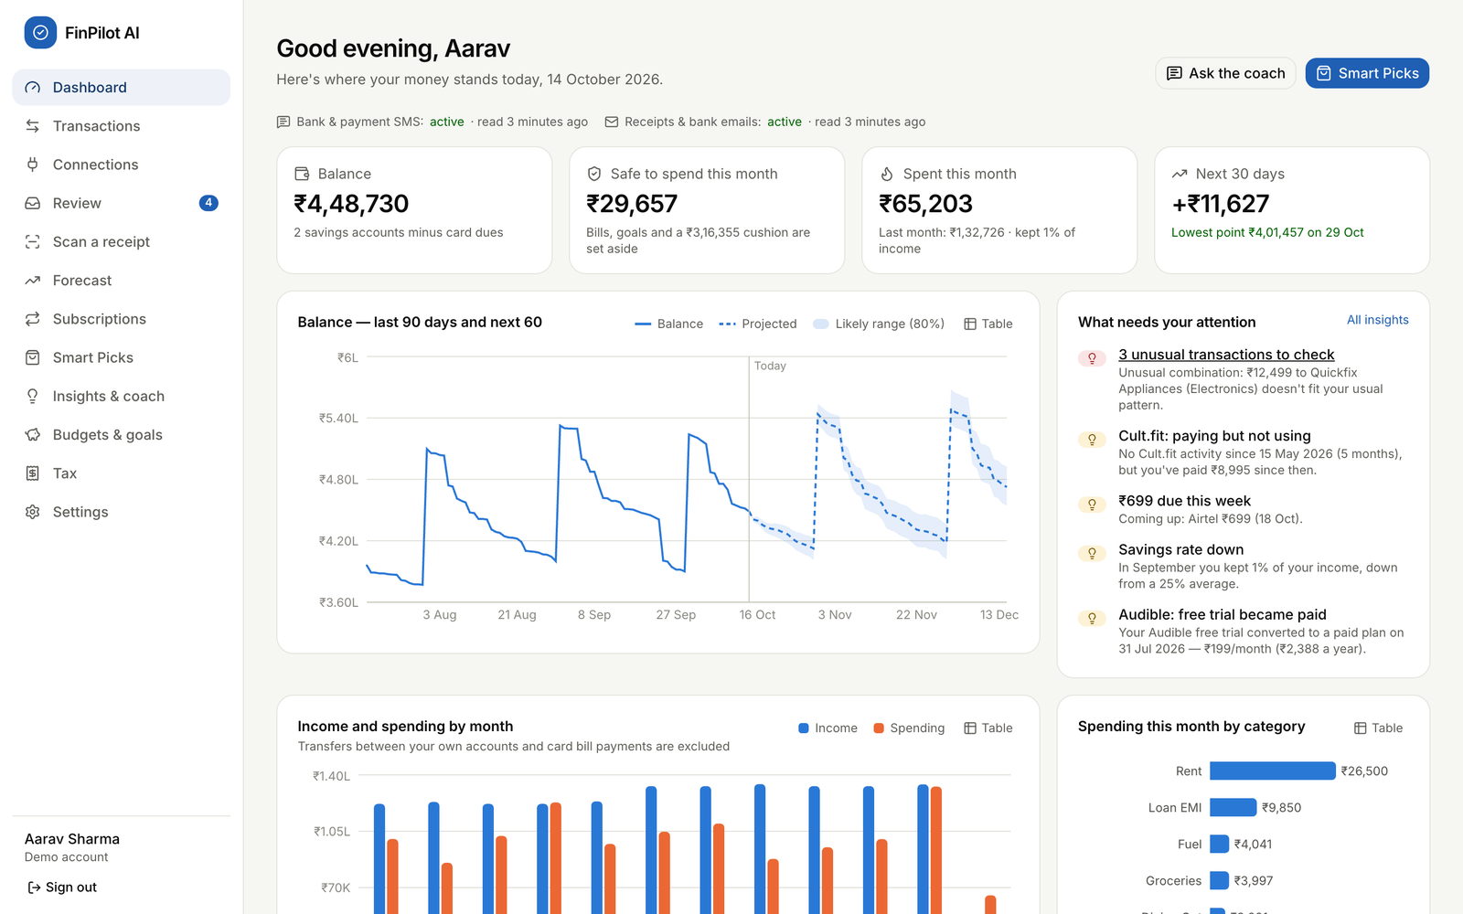
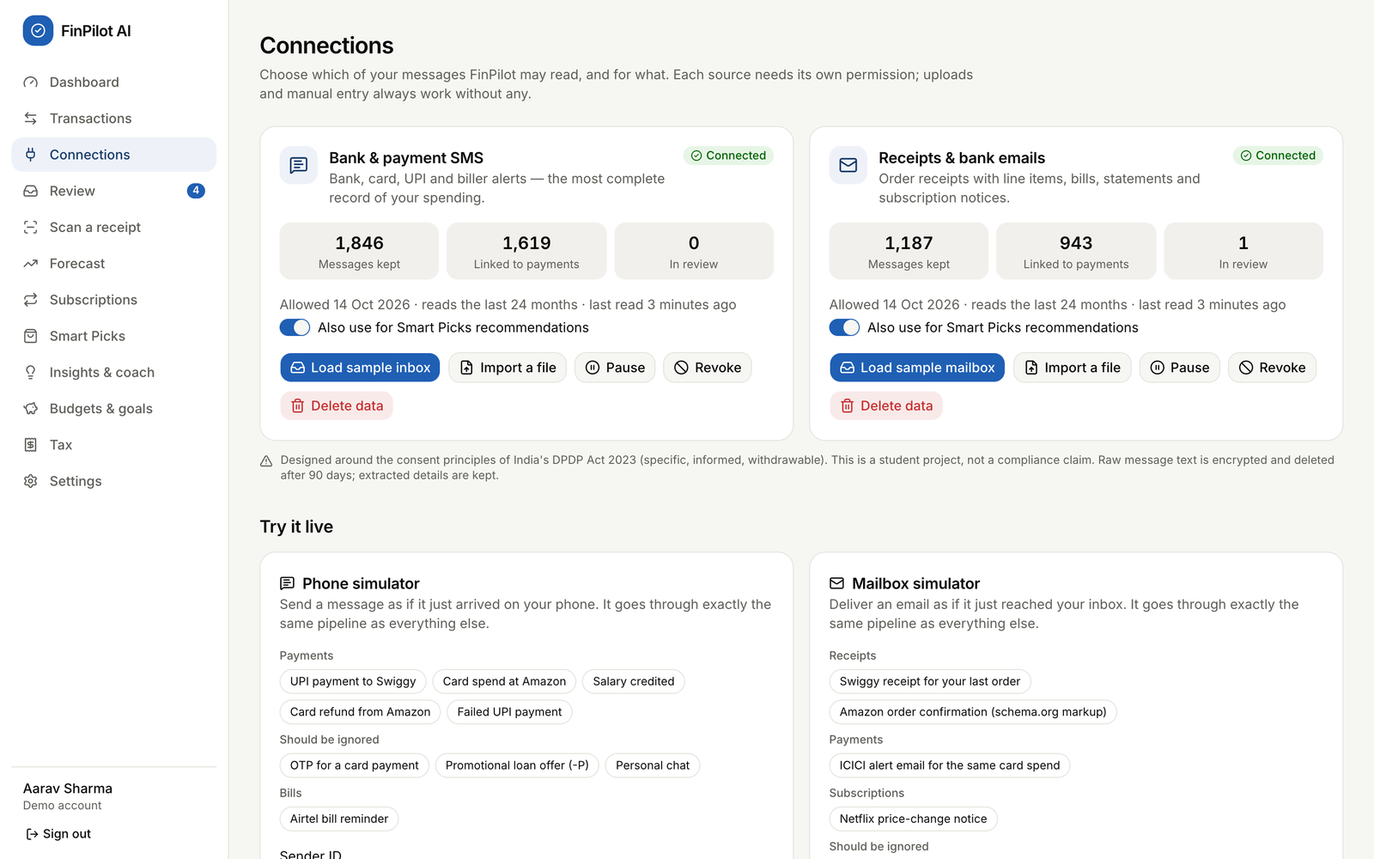
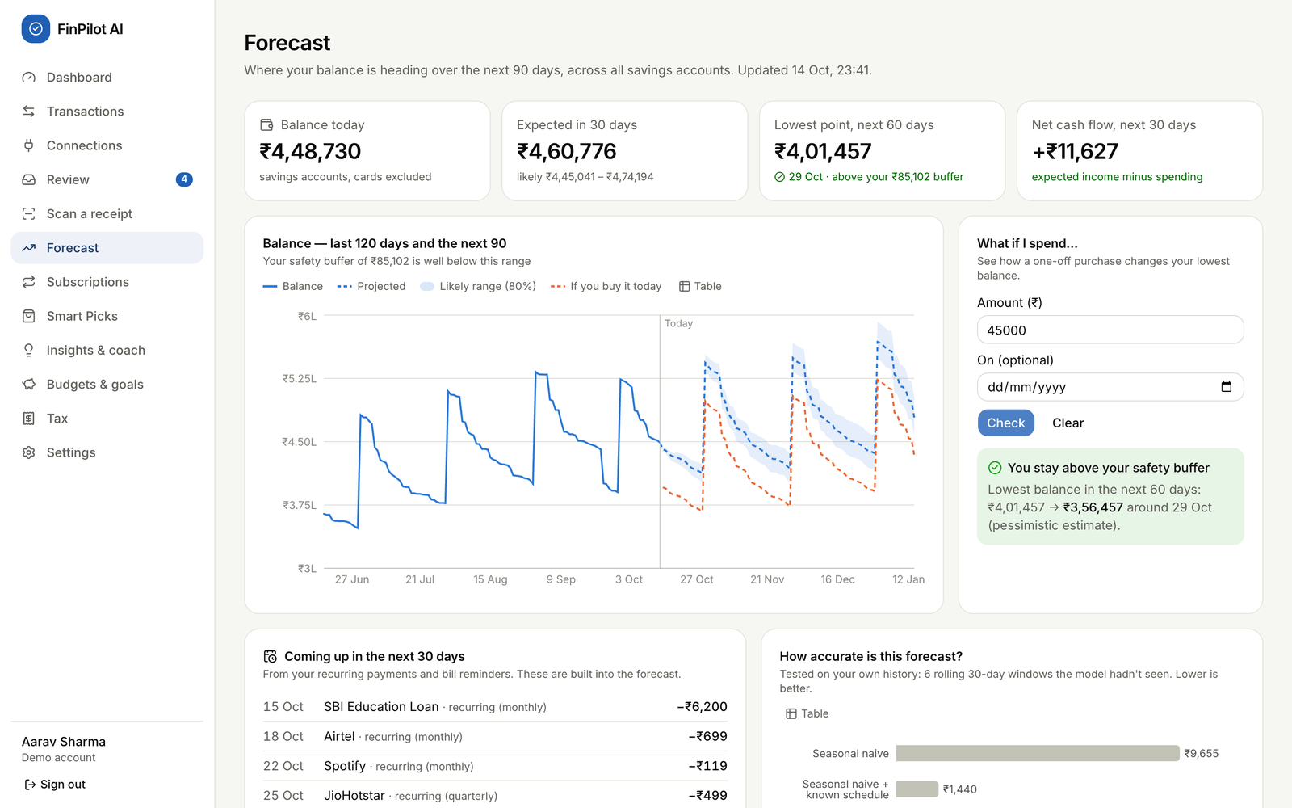
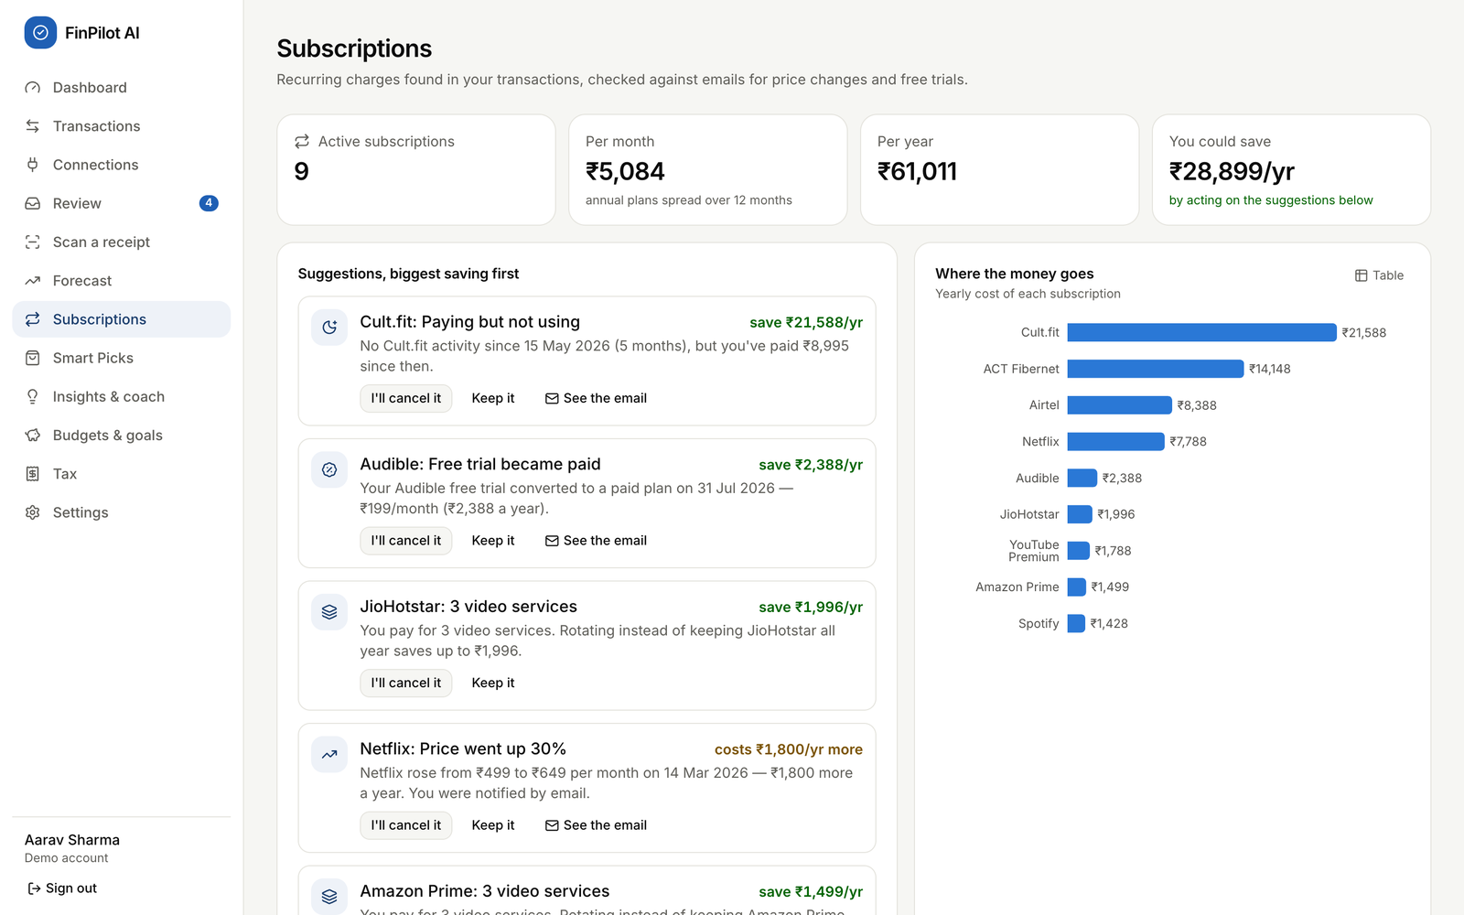
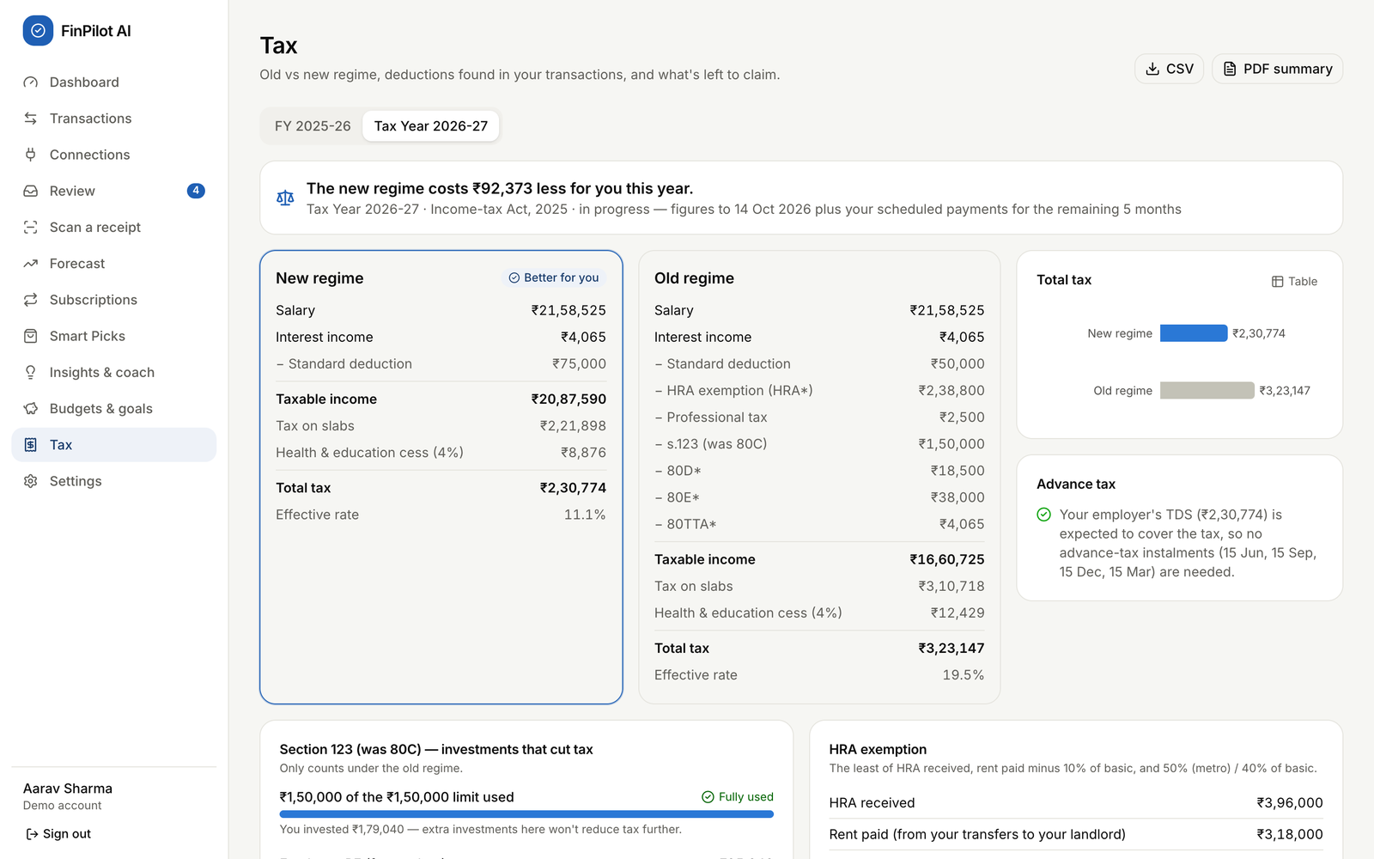
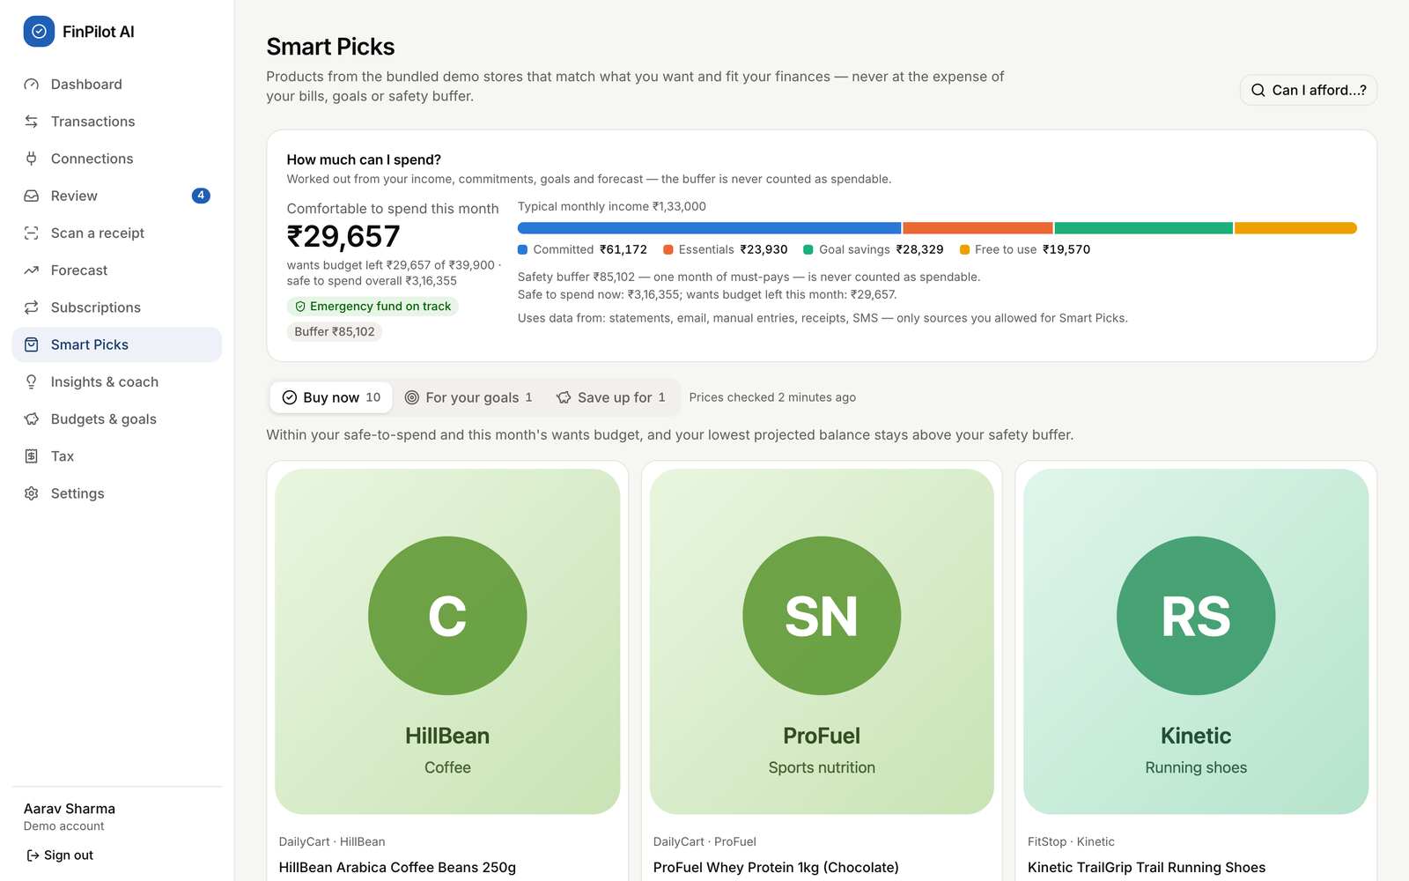
The application in action
Dashboard
Connections: consent per source
Forecast with a what-if check
Subscriptions: ranked savings
Tax: old vs new regime
Smart Picks: affordability first
Notes:
Real screenshots from the running app with the demo persona, Aarav Sharma: the dashboard, the consent centre, the forecast with a what-if check, subscriptions, the tax comparison and Smart Picks. The live demonstration follows after this common part.

Slide 15
Data flow: from a message to a decision
Capture pipeline — the same for the sample inbox, file imports and the live simulators
Consent gate
Pre-filter
Classify
Extract
Reconcile
Categorise
Refused unless the source is active
Drops promo (-P) senders, personal numbers, non-allowlisted e-mail
12 message kinds (TF-IDF + LR); OTPs never stored
Bank templates, then a generic reader; each field has a confidence
One transaction per payment across SMS + e-mail; transfers, refunds
Rules → merchant list → ML → Review queue
Analytics after new data — the user_analytics background job (also nightly)
Pages read the results
Dashboard · Forecast · Subscriptions · Picks · Insights
Anomalies
Subscriptions
Forecast
Smart Picks
Insights
Results are stored in SQLite (forecasts, subscriptions, product_recommendations, insights). Tax is computed on each request. Each stage runs in its own try/except, so one failure never blocks the others.
Notes:
Every message, whatever its source, goes through the same pipeline. First the source must be active; then the pre-filter drops promotions and personal messages before anything is stored. A classifier recognises 12 kinds of message, the extractor reads the fields, and reconciliation makes sure one payment becomes one transaction even when it arrives by SMS and by e-mail. After new data, a background job refreshes the analytics that the pages read.

Slide 16
Database design
Key design decisions
Core
4 tables
Capture
5 tables
users, refresh_tokens, jobs, model_artifacts
data_sources, consent_events, ingested_messages, upcoming_payments, balance_snapshots
33 tables from one Alembic migration; SQLite in WAL mode
Money stored as integer paise and used as Decimal, never as floats
Every user table has user_id … ON DELETE CASCADE
transactions record origin, is_transfer and category_source with a confidence
Message text Fernet-encrypted and purged after the retention period
consent_events is append-only; the product catalogue is shared
Finance
17 tables
Smart Picks
7 tables
accounts, categories, merchants, merchant_aliases, category_rules, transactions, transaction_items, receipts, import_batches, budgets, goals, subscriptions, anomalies, insights, forecasts, forecast_metrics, chat_messages
product_sources, crawl_runs, products, product_price_history, wishlist_items, affordability_snapshots, product_recommendations
Notes:
SQLite with 33 tables, created by one Alembic migration and grouped into four domains. Key decisions: money as integer paise, every user table cascades on delete so removing an account removes everything, transactions record where they came from and how they were categorised, message text is encrypted and purged, and the consent log is append-only.

Slide 17
Measured results
100%
96.6%
message-type macro F1 on the held-out test split
type accuracy on a hand-written challenge set; amounts 100%
100% / 100%
99.8%
de-duplication precision / recall across SMS and e-mail
category accuracy on captured payments
84.6%
100% vs 80%
coach intent accuracy on held-out paraphrases
Smart Picks precision@10 vs a most-reviewed baseline
The known schedule cuts the error by 85%; Prophet adds ≈3% on top. WAPE is reported instead of MAPE because daily net flow often crosses zero.
Measured 10 Oct 2026 (README). The demo regenerates daily, so figures shift slightly.
Notes:
We measured everything on data with known answers. The chart is the forecast backtest: knowing the user's schedule cuts the error by 85 percent against the seasonal-naive baseline, and Prophet improves it by about 3 percent more, which we report honestly. The tiles show message understanding, de-duplication, categorisation, the coach and Smart Picks.

Slide 18
Testing and validation
59 / 59
14
300
6 × 30 days
backend tests pass (pytest + Hypothesis), re-run 14 Oct 2026 in 29.8 s
end-to-end tests (Playwright) walk the full demo script
random cases prove Buy now never breaks the safety buffer
rolling-origin backtest windows for the forecast
What the backend tests cover
End-to-end and model validation
Money handling and message parsing (known, unseen and challenge formats)
Pipeline accuracy against ground truth: dedup, transfers, categories
Consent: nothing read without it; pause, revoke, delete data
API flows: auth, rules, preferences, rate limit, account deletion
Tax for both years; forecast backtest and fallback; picks
New user: register, consent, sample inbox, onboarding
Simulated SMS, OTP and promo; receipt e-mail enrichment; OCR
Forecast what-if, subscriptions, tax PDF, coach, picks, crawl
Revoke and delete data; reset the demo
Held-out splits, unseen banks, challenge set, precision@10
Notes:
Testing ran at three levels. 59 backend tests with pytest and Hypothesis; we re-ran them on 14 October and all 59 passed in about 30 seconds. 14 Playwright end-to-end tests walk the whole demo script in a real browser. Models are validated on held-out data, unseen bank formats, a hand-written challenge set and rolling backtests. Settings shows a live quality report and an in-browser OCR benchmark.

Slide 19
Challenges and possible improvements
Challenges and how we solved them
Possible improvements
Requirements changed after Review 0
Re-planned around consented capture and Smart Picks; one process instead of Docker + PostgreSQL.
A rotating log file and request IDs (logs go to the terminal today)
Persistent, per-account login limits; password reset; Secure cookies over HTTPS
Ask users to consent again when the notice text changes
Tax: marginal relief on surcharge; let users clear profile fields
UI: fix the subscription status filter; explain an empty backtest
Real data sources through Account Aggregator or Gmail with OAuth
One payment, two messages
Reference matching and scoring; e-mail receipts enrich the SMS transaction instead of duplicating it.
SQLite allows one writer
Background jobs join the request's transaction and start after it commits (regression test).
Judging forecast quality
Rolling backtest against two baselines; WAPE instead of MAPE; automatic fallback.
Crawling responsibly
robots.txt and Crawl-delay obeyed; demo stores only; no affiliate links or urgency.
Notes:
Left: the main challenges and how we solved them. Right: improvements we identified while reviewing our own code, for example there is no log file yet because logs go to the terminal, the login rate limit lives in memory, and the UI does not yet ask for consent again when the notice changes.

Slide 20
Conclusion and future scope
Conclusion
Future scope
Turns messages people already receive into a private, forward-looking view of their money
Nine modules work end to end, offline, from one command
Consent, purpose limitation, encryption and deletion are built in
Results are measured honestly; 59 backend and 14 end-to-end tests pass
Real bank data through India's Account Aggregator framework
An Android companion app that reads SMS with permission
A local LLM behind the coach's ResponseProvider interface
Hosted multi-user deployment with HTTPS, PostgreSQL and log files
Partnerships with real stores for Smart Picks; more languages
Thank you · Questions?
Notes:
To conclude: FinPilot AI turns messages people already receive into a private, forward-looking view of their money; every module works end to end from one command; privacy is built in; and our results are measured and tested. In future it could connect to real bank data through the Account Aggregator framework, gain an Android companion app, and use a local language model behind the coach's provider interface. Thank you.

