Slide 1
SSN College of Engineering, Kalavakkam - 603110
Department of Information Technology
UIT2739 - Full Stack Development Project
FinPilot AI
A Privacy-Focused Personal Finance Assistant
Jeya Sangavi R - 3122235002054
Rahul Akshath Rajendran - 3122235002095
Rakshitha S - 3122235002098
Project Evaluation - October 2026
Notes:
Good morning. We are presenting FinPilot AI, our UIT2739 full-stack project. It is a personal-finance assistant that builds a user's financial picture from the bank SMS and e-mails they already receive, but only after the user allows each source. This common part covers the problem, requirements, architecture, SDLC, modules, database, testing and lessons learnt; each of us then demonstrates our own features.

Slide 2
Project Overview
FinPilot AI is a personal finance web app for users in India. It reads the bank SMS and e-mails that a user already receives (only from the sources they allow) and uses them to track spending, predict the balance and suggest what they can afford.
Capture | Understand | Predict | Act
Bank SMS and e-mail, with separate consent for each Optional: receipt OCR, PDF bills, statement CSV, manual entry | Classify, extract and de-duplicate messages Categorise payments and flag unusual ones | 90-day cash-flow forecast with an 80% range Subscription analysis and income tax for two years | Ranked insights and a finance coach Budgets, goals and Smart Picks within budget
Key points
Runs with a single command: python3 run.py
Works offline after the first run
No running cost: no paid AI services and no bank login needed
Notes:
FinPilot AI is a full-stack web app. Capture: bank SMS and e-mails, each behind its own consent, plus optional uploads. Understand: every message is classified, its fields extracted, duplicates reconciled and the payment categorised. Predict: a 90-day cash-flow forecast, subscription analysis and tax estimates. Act: insights, a coach, budgets, goals and Smart Picks that never touch the safety buffer. It runs with one command, works offline after the first run and costs nothing to operate.

Slide 3
Problem Statement and Motivation
Problem Statement
Issues with Current Apps
Every UPI payment, card swipe, bill and salary credit already reaches the user as a bank SMS or e-mail, but this information stays scattered.
Existing apps make people type in transactions, ask for bank login details, or send personal data to paid cloud AI services. They also only show past spending.
We want to build a reliable, forward-looking view of a person's money from the messages they already receive, using only the sources they allow, running on their own computer at no cost.
Manual entry: typing every payment is tedious, so people give up; cash and paper receipts get lost
Only past data: apps show what was spent, not what the balance will be at the end of the month
Hidden leakage: price rises, unused subscriptions and duplicate charges get lost in normal spending
Privacy and cost: aggregator apps need bank credentials and AI features need paid cloud services
Motivation: make money management automatic, private and forward-looking, without extra data entry or new privacy risks.
Notes:
The data already exists: every UPI payment, card swipe and bill produces an SMS or e-mail. The problem is that it stays scattered and existing tools fall short in four ways shown on the right. Our statement: build a reliable, forward-looking picture of a person's money from the messages they already receive, only with their consent, running on their own computer at zero cost.

Slide 4
Objectives and Scope
Objectives
Scope
Capture transactions from bank SMS and e-mail with the user's consent (no bank login), plus optional uploads
Understand spending reliably: classify, extract, de-duplicate, categorise and flag anomalies
Forecast the balance 90 days ahead and measure its accuracy against simple baselines
Find subscription leakage and estimate income tax under both regimes
Turn the data into decisions: insights, a coach, budgets, goals and affordable Smart Picks
Keep users in control: consent per source and purpose, encryption, retention and deletion
In scope | Out of scope
SMS and e-mail capture with consent per source | Live bank, Account Aggregator or Gmail connections
Receipt OCR in the browser, PDF bills, CSV import, manual entry | Real payments or money transfers
Forecast, subscriptions, tax, anomalies, insights, coach | Crawling the live internet
Smart Picks over the bundled demo stores | Tax filing or financial advice (estimates only)
One-command local install that works offline | Native mobile app (responsive web app instead)
Notes:
Six objectives, each mapped to modules we built. On the right is the scope we committed to. The out-of-scope items are the limits stated in our README: no live bank or Gmail connections, no payments, only the bundled demo stores for crawling, and tax figures are estimates, not advice.

Slide 5
Functional Requirements (1/2)
ID | Requirement | Description
FR1 | Accounts and sessions | Register, sign in, one-click demo login and sign out; sessions are refreshed in the background
FR2 | Consent per source | Allow SMS and e-mail separately with purposes and a backfill window; pause, resume or revoke; delete data; consent history
FR3 | Message capture | Pre-filter, classify 12 message types, extract fields with confidence; handle duplicates, transfers, reversals and refunds
FR4 | Optional uploads | Receipt OCR in the browser, digital PDF bills, statement CSV import wizard and manual entry
FR5 | Transactions and review | Search and filter, evidence drawer, recategorise with "apply to all" rules, review queue that learns
FR6 | Dashboard | Balance, safe-to-spend amount, spending, 90-day forecast band, alerts, upcoming bills and anomalies
FR7 | Cash-flow forecast | 90-day projection with an 80% band, what-if purchases, upcoming payments and a backtest against baselines
Notes:
Each requirement is implemented end to end: an API endpoint, business logic in a service, database tables and a page. FR1 to FR7 cover accounts, consent, capture, uploads, transactions, the dashboard and the forecast.

Slide 6
Functional Requirements (2/2)
ID | Requirement | Description
FR8 | Subscriptions | Detect recurring charges; flag price rises, unused plans, trials that became paid and overlaps; keep or cancel
FR9 | Tax insights | FY 2025-26 and Tax Year 2026-27 under both regimes; deductions found in transactions, headroom, advance tax; CSV/PDF export
FR10 | Insights and coach | Ranked insights that can be dismissed; a coach that answers 13 types of questions from the user's own data
FR11 | Budgets and goals | Monthly category limits with pace markers; goals with monthly targets and an "add money" option
FR12 | Smart Picks | Polite crawler over demo stores, affordability check, Buy now / For your goals / Save up tiers, wishlist, price check
FR13 | Settings and data rights | Safety buffer, emergency months, picks per week and retention; export all data; delete account; reset demo
FR14 | System and model quality | Capability checks, measured model metrics and an in-browser OCR benchmark
Notes:
Each requirement is implemented end to end: an API endpoint, business logic in a service, database tables and a page. FR8 to FR14 cover subscriptions, tax, insights and coach, budgets and goals, Smart Picks, settings and data rights, and the system quality page.

Slide 7
Non-Functional Requirements
Requirement | How it is met
Security | Passwords hashed with bcrypt (12 rounds); JWT in httpOnly cookies with rotating refresh tokens; CSRF header check; failed-login limit
Privacy | Consent per source and purpose; message text encrypted and deleted after 90 days; append-only consent log; data export and deletion
Reliability | Every request commits or rolls back; analytics stages and jobs are isolated; Prophet falls back to a baseline; crawler retries
Performance | Demo ready about 51 s after a clean start; models train in about 3 s; OCR about 0.5 s per receipt; what-if reuses the stored forecast
Usability | Responsive layout with a mobile menu; every chart also has a table view; plain-language errors and progress messages
Portability | One command (python3 run.py); Python 3.11+; no Docker and no database server; works offline after the first run
Maintainability | Routers -> services -> models structure; Alembic migrations; shared metrics; 59 backend and 14 end-to-end tests
Accuracy | Money stored as integer paise and handled as Decimal; held-out tests, backtests and WAPE; "estimates, not advice" disclaimers
Notes:
These qualities are visible in the code. Security: bcrypt, JWT in httpOnly cookies, rotating refresh tokens, a CSRF header and a login rate limit. Privacy: consent per source and purpose, Fernet encryption and a 90-day retention purge. Reliability: transactions roll back, analytics stages are isolated, and Prophet falls back to a baseline. Performance figures come from our measured cold start. Portability: one command, no Docker.

Slide 8
System Architecture
Browser
Single Python process (started by python3 run.py)
SQLite (WAL)
data/finpilot.db
33 tables
SQLAlchemy + Alembic
Next.js 16 web app
React 19, TypeScript, Tailwind CSS 4, shadcn/ui (static export)
HTTP / JSON
FastAPI app (port 8000)
15 routers under /api/v1, CSRF guard, error handler, serves the web app
Services (business logic and ML)
Consent and capture, receipts, categories and anomalies, forecasting, subscriptions, tax, insights and coach, Smart Picks and crawler
ML runs in-process: scikit-learn (TF-IDF + logistic regression, IsolationForest) and Prophet
SQL
TanStack Query + api.ts
fetch with session cookies and X-Requested-With header
tesseract.js
Receipt OCR runs in the browser, so images never go to the server
Job runner + scheduler
Thread pool; crawl every 6 h, nightly analytics, retention purge
Demo stores (port 8090)
robots.txt, sitemaps and JSON-LD read by the crawler
data/ folder
Uploads, trained models and the generated secret key
The browser loads the site and calls /api/v1 on the same server, so no CORS setup is needed.
Notes:
Everything runs in one Python process started by run.py. FastAPI on port 8000 serves both the JSON API under /api/v1 and the pre-built Next.js site, so the browser talks to one origin and no CORS is needed. Services hold the business logic and ML; a job runner and scheduler do background work; a second Uvicorn server on port 8090 hosts the demo stores that the Smart Picks crawler visits. Data lives in SQLite in WAL mode.

Slide 9
Backend Layers and Request Flow
Backend layers
Example: a what-if purchase
Routers (api/v1/*.py)
HTTP, Pydantic validation, ownership checks
User enters ₹45,000 under "What if I spend..." on the Forecast page and clicks Check
api.ts sends GET /api/v1/forecast/whatif?amount=45000 with the session cookie
FastAPI checks 0 < amount < ₹1e9 and loads the user from the JWT (otherwise 422 or 401)
The service reads the stored 90-day forecast and lowers p10, p50 and p90 from the purchase date
It compares the new lowest balance in the next 60 days with the safety buffer
TanStack Query redraws the chart and shows a green or red result
Dependencies (core/deps.py)
Signed-in user from the JWT cookie; one DB session
Services (services/*.py)
Business rules: forecasting, tax, picks, consent
Models (models/*.py)
SQLAlchemy 2 ORM; money as integer paise
Database (data/finpilot.db)
SQLite in WAL mode; Alembic migrations
Shared code: core/ (config, security, crypto, money) and jobs/ (runner, scheduler)
Notes:
The backend is layered. Routers handle HTTP and validation; dependencies give each request the signed-in user and a database session; services hold the rules; models map to SQLite. On the right is one real request: a what-if purchase on the Forecast page. It only reads the stored forecast, so it answers instantly.

Slide 10
Technologies Used
Category | Tools and versions
Frontend | Next.js 16.4 (static export), React 19.3, TypeScript 5.9, Tailwind CSS 4.3, shadcn/ui on Base UI, TanStack Query 5, Recharts 3, tesseract.js 7
Backend | Python 3.11+ (tested on 3.14), FastAPI 0.143, Uvicorn 0.54, Pydantic 2.14, SQLAlchemy 2.1, Alembic 1.20, PyJWT 2.15, pwdlib (bcrypt), cryptography (Fernet)
Data and ML | SQLite (WAL), scikit-learn 1.9, Prophet 1.5, pandas 3.0, NumPy 2.5, RapidFuzz 3.14, dateparser 1.4
Documents and crawling | pdfplumber 0.11, ReportLab 5.0, httpx 0.28, Protego 0.7 (robots.txt), BeautifulSoup + lxml, defusedxml
Testing and tools | pytest 9.1, Hypothesis 6, Playwright 1.64, Git and GitHub, Node.js / npm (only to build the UI)
All tools are free and run locally.
Notes:
All tools are free and run locally. The frontend is a Next.js static export served by FastAPI, so Node.js is only needed to rebuild the UI. The backend uses FastAPI with SQLAlchemy and SQLite. ML uses scikit-learn and Prophet. The versions shown are the ones installed in our environment.

Slide 11
Software Development Life Cycle
Model used: Iterative and incremental. Every phase ended with a working app and a check we could measure.
Requirements
Design
Implementation
Testing
Deployment
Maintenance
Phase | What we did
Requirements | Review 0 (July 2026): problem, objectives and modules. Consent-based capture and Smart Picks were added after Review 0
Design | Single-process architecture; 33-table schema with money in paise; Docker + PostgreSQL replaced by SQLite and run.py
Implementation | 10 build phases (0 to 9), each one a working increment with API, logic and UI
Testing | pytest + Hypothesis in every phase; Playwright end-to-end demo script; metrics on held-out data
Deployment | One command (python3 run.py); pre-built web app; works offline after the first run
Maintenance | Alembic migrations; demo data refreshes daily; quality report in Settings
Notes:
We followed an iterative and incremental model. Requirements were set at Review 0 in July; afterwards they changed to add consent-based SMS and e-mail capture and Smart Picks, so we revised the design: one process, SQLite and a one-command launcher instead of Docker and PostgreSQL. Implementation ran in ten phases, each ending with a working app and a measurable gate, followed by testing, packaging and maintenance.

Slide 12
Build Phases
Phase | Focus | Work done | Exit check
0 | Foundation | run.py, two servers, jobs, SQLite + Alembic | A clean start renders a page
1 | Data and auth | Schema, auth, demo persona, model training | Deterministic data; tests pass
2 | Capture | Consent API, pipeline, imports, simulators | No transactions from OTP or promo messages
3 | Core UI | App shell, onboarding, dashboard, connections | E2E test: an SMS becomes a transaction
4 | Receipts | In-browser OCR, receipt commit, PDF bills | 9/9 sample fields read correctly
5 | Forecasting | Prophet + known schedule, backtest, what-if | Backtest against baselines; fallback tested
6 | Subscriptions, tax | Detection, both tax regimes, export | Planted findings detected; tax tests pass
7 | Insights, coach | Insights, coach, budgets, goals | Every coach intent answers from data
8 | Smart Picks | Demo stores, crawler, affordability | BlockedMart skipped; property test passes
9 | Hardening | README, E2E suite, screenshots | Clean start + full E2E suite passes
Notes:
These are the ten phases as executed, taken from our project plan. Each one ended with a check we could demonstrate, for example: no transactions created from OTP or promotional messages, the BlockedMart store skipped because robots.txt forbids it, and the property test showing Buy now never breaks the buffer.

Slide 13
Major Features and Modules
Consent and capture: SMS and e-mail with consent per source; sample inbox, file import and live simulators
Receipts and bills: in-browser OCR with confidence boxes; PDF bills; matched to card payments
Transactions and review: rules, then merchant list, then ML; uncertain items go to Review and become rules
Anomaly detection: robust z-score, IsolationForest, duplicate charges and new-merchant spikes
Cash-flow forecast: known schedule + Prophet; 80% band, what-if check and a backtest against baselines
Subscriptions: price rises, unused plans, trials turned paid and overlaps, ranked by ₹ per year
Tax insights: two tax years, both regimes, deductions from transactions, CSV/PDF export
Insights, coach and budgets: ranked insights; a coach with 13 intents; budgets and goals feed affordability
Smart Picks: polite crawler + affordability check with Buy now, For your goals and Save up
Notes:
Nine modules, all working end to end. Capture and receipts bring data in; transactions, review and anomaly detection make it trustworthy; forecasting, subscriptions and tax look ahead; insights, the coach, budgets and Smart Picks turn it into decisions. Each team member will demonstrate their own modules.

Slide 14
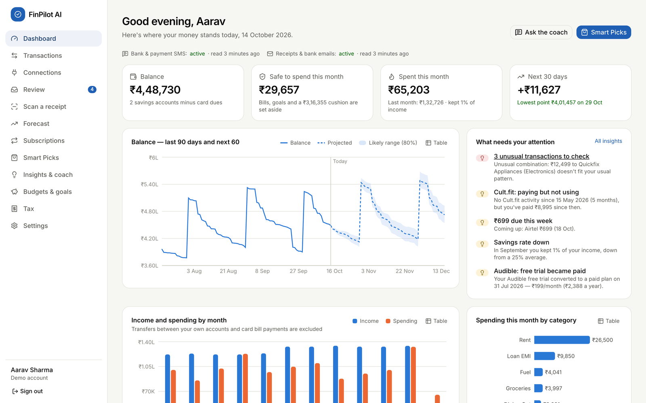
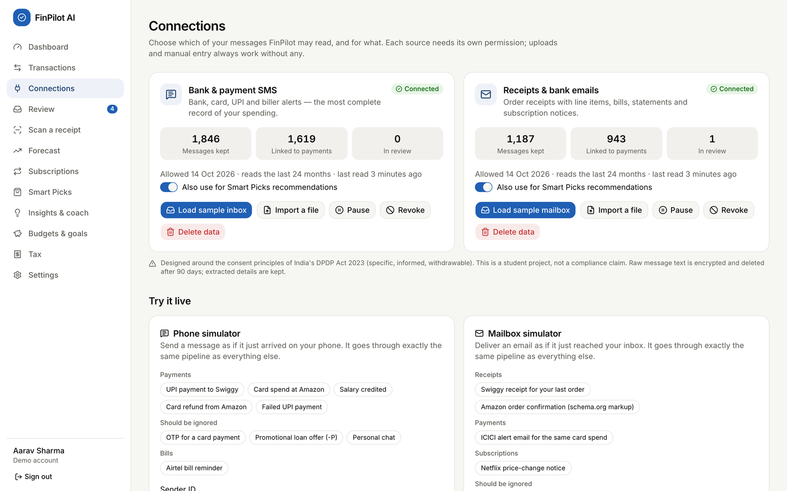
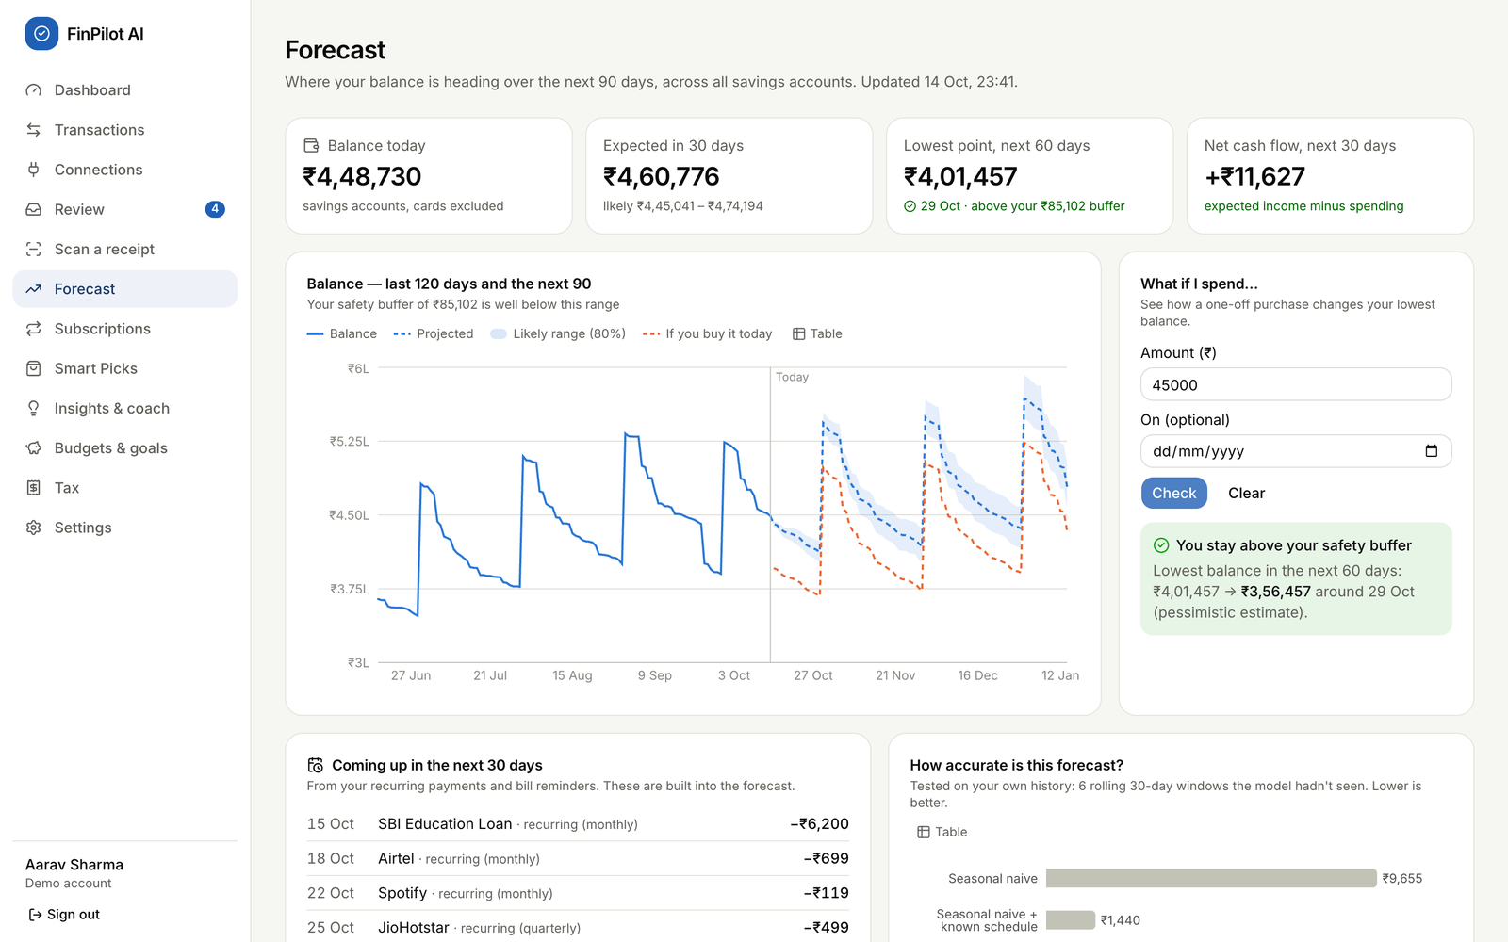
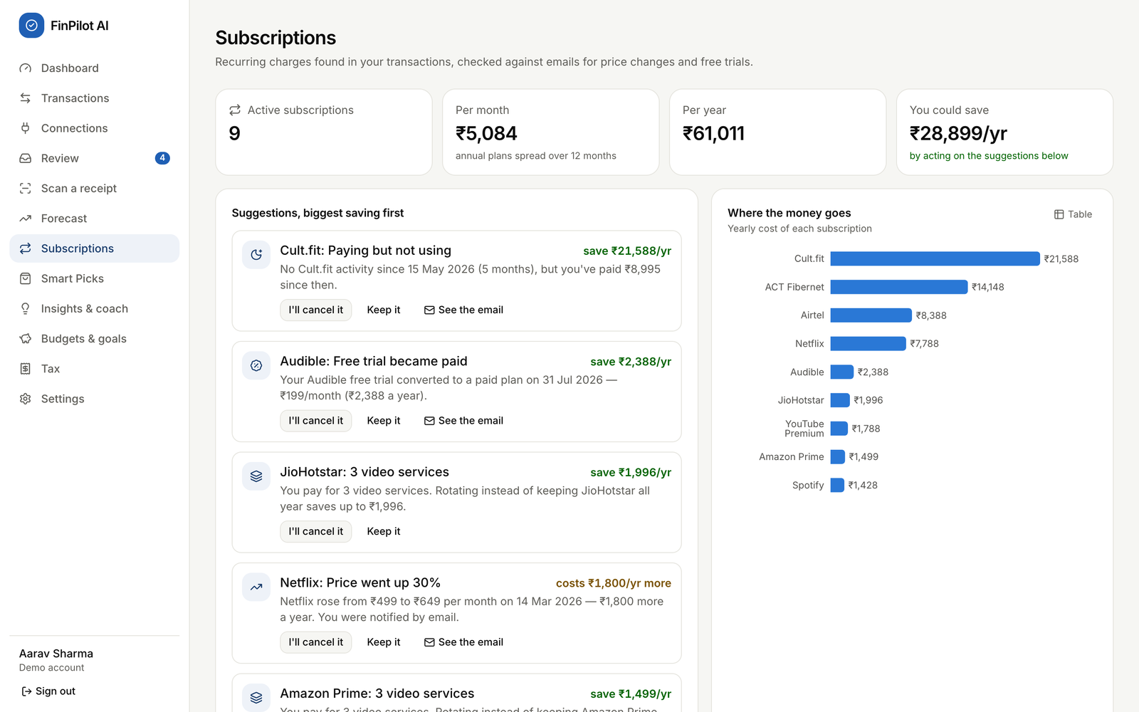
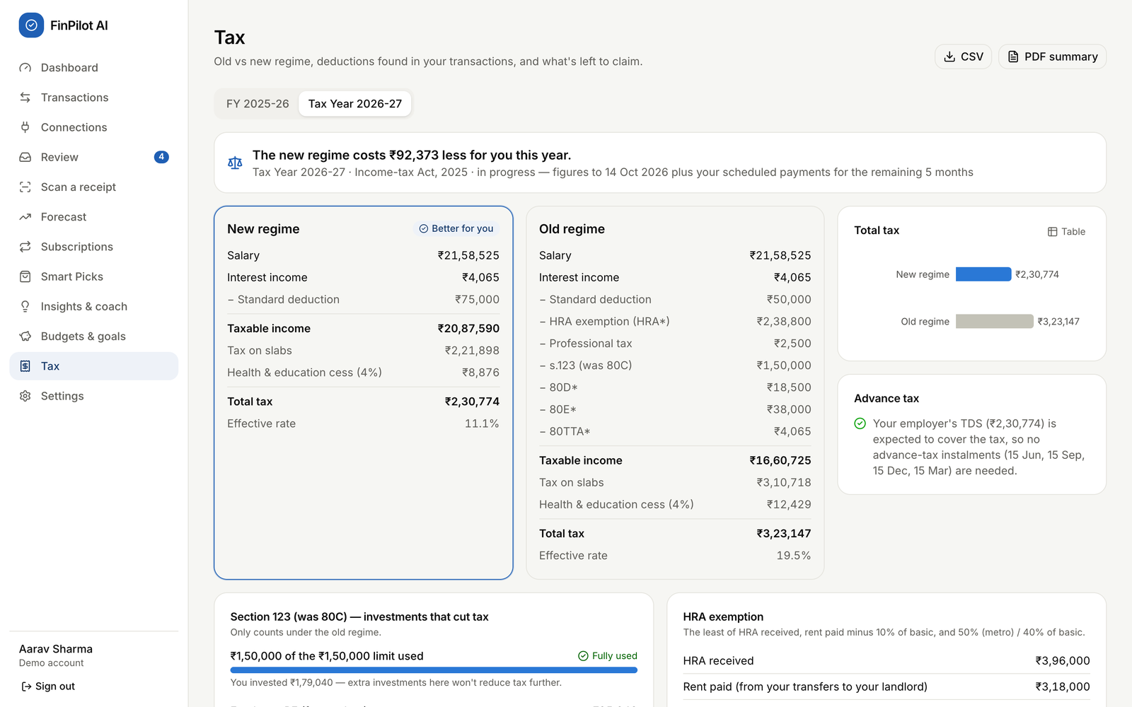
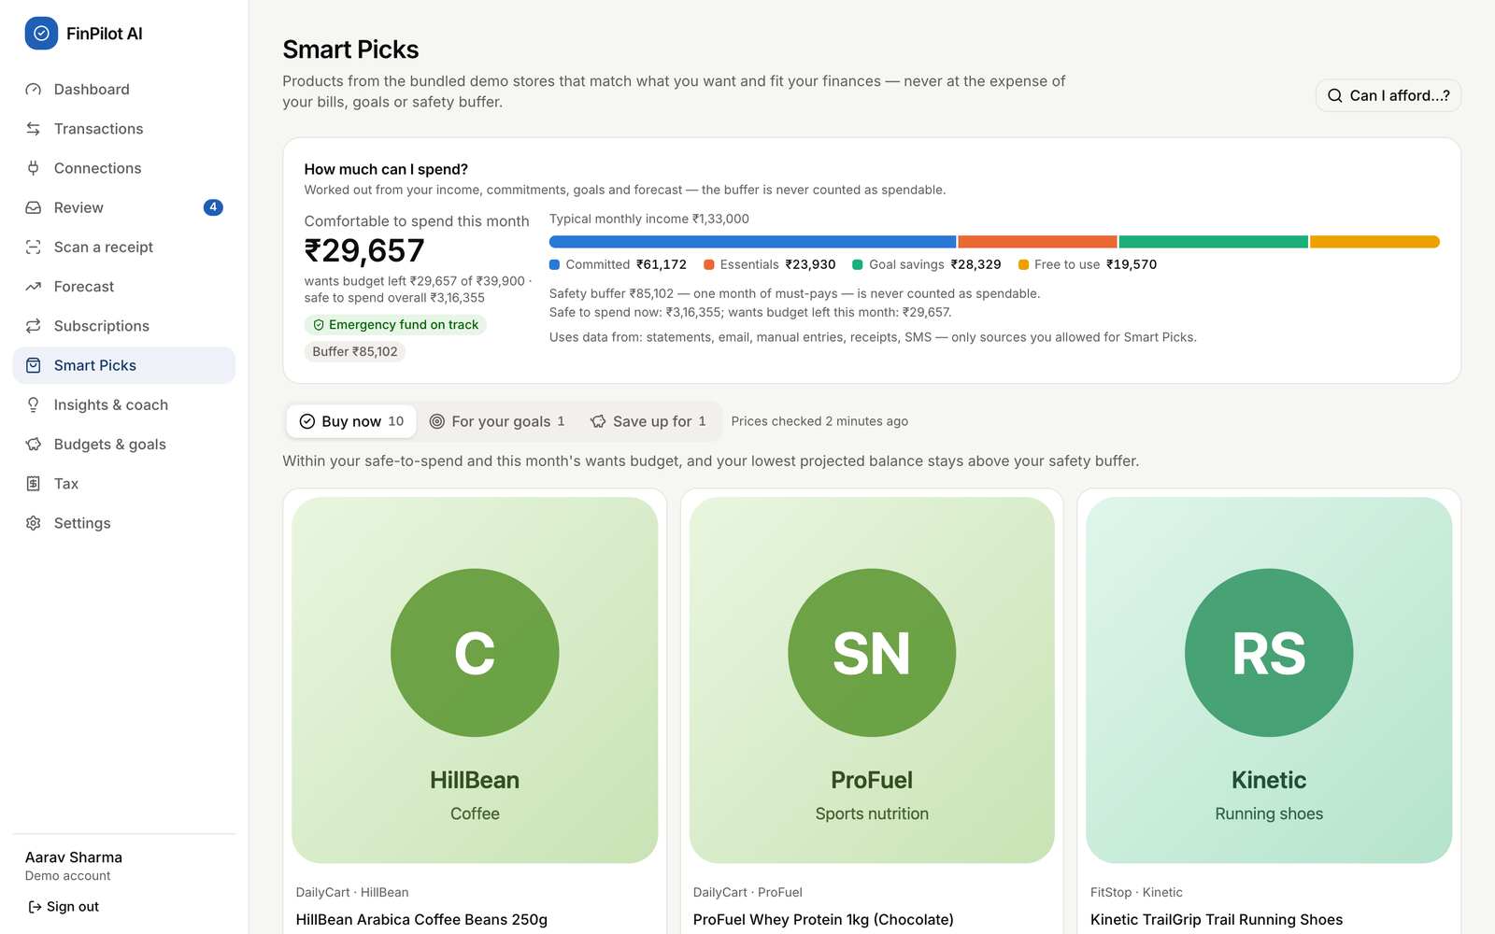
Application Screenshots
Fig. 1: Dashboard
Fig. 2: Connections (consent per source)
Fig. 3: Forecast with what-if check
Fig. 4: Subscriptions (ranked savings)
Fig. 5: Tax: old vs new regime
Fig. 6: Smart Picks
Notes:
Real screenshots from the running app with the demo persona, Aarav Sharma: the dashboard, the consent centre, the forecast with a what-if check, subscriptions, the tax comparison and Smart Picks. The live demonstration follows after this common part.

Slide 15
Data Flow
Capture pipeline (same for the sample inbox, file imports and live simulators)
Consent gate
Pre-filter
Classify
Extract
Reconcile
Categorise
Rejected unless the source is active
Drops promo (-P) senders, personal numbers and non-allowlisted e-mail
12 message types (TF-IDF + LR); OTPs are never stored
Bank templates first, then a generic reader; each field gets a confidence
One transaction per payment across SMS and e-mail; transfers, refunds
Rules, merchant list, ML, then the Review queue
Analytics after new data (user_analytics background job, also runs nightly)
Pages read the results
Dashboard, Forecast, Subscriptions, Picks, Insights
Anomalies
Subscriptions
Forecast
Smart Picks
Insights
Results are stored in SQLite (forecasts, subscriptions, product_recommendations, insights). Tax is calculated on each request. Each stage runs in its own try/except block, so one failure does not stop the others.
Notes:
Every message, whatever its source, goes through the same pipeline. First the source must be active; then the pre-filter drops promotions and personal messages before anything is stored. A classifier recognises 12 kinds of message, the extractor reads the fields, and reconciliation makes sure one payment becomes one transaction even when it arrives by SMS and by e-mail. After new data, a background job refreshes the analytics that the pages read.

Slide 16
Database Design
Key design decisions
33 tables created from one Alembic migration; SQLite in WAL mode
Money stored as integer paise and used as Decimal, never as float
Every user table has user_id with ON DELETE CASCADE
Transactions store origin, is_transfer and category_source with a confidence
Message text is Fernet-encrypted and purged after the retention period
consent_events is append-only; the product catalogue is shared
Domain | Tables | Table names
Core | 4 | users, refresh_tokens, jobs, model_artifacts
Capture | 5 | data_sources, consent_events, ingested_messages, upcoming_payments, balance_snapshots
Finance | 17 | accounts, categories, merchants, merchant_aliases, category_rules, transactions, transaction_items, receipts, import_batches, budgets, goals, subscriptions, anomalies, insights, forecasts, forecast_metrics, chat_messages
Smart Picks | 7 | product_sources, crawl_runs, products, product_price_history, wishlist_items, affordability_snapshots, product_recommendations
Notes:
SQLite with 33 tables, created by one Alembic migration and grouped into four domains. Key decisions: money as integer paise, every user table cascades on delete so removing an account removes everything, transactions record where they came from and how they were categorised, message text is encrypted and purged, and the consent log is append-only.

Slide 17
Results
Metric | Result
Message-type macro F1 (held-out test split) | 100%
Type accuracy on hand-written challenge set (amounts: 100%) | 96.6%
De-duplication precision / recall (SMS + e-mail) | 100% / 100%
Category accuracy on captured payments | 99.8%
Coach intent accuracy (held-out paraphrases) | 84.6%
Smart Picks precision@10 vs most-reviewed baseline | 100% vs 80%
Using the known payment schedule cuts forecast error by 85%; Prophet improves it by about 3% more.
WAPE is used instead of MAPE because the daily net flow often crosses zero.
Measured on 10 Oct 2026 (see README). Demo data is regenerated daily, so the numbers can shift slightly.
Notes:
We measured everything on data with known answers. The chart is the forecast backtest: knowing the user's schedule cuts the error by 85 percent against the seasonal-naive baseline, and Prophet improves it by about 3 percent more, which we report honestly. The tiles show message understanding, de-duplication, categorisation, the coach and Smart Picks.

Slide 18
Testing and Validation
Test | Count | Details
Backend tests (pytest + Hypothesis) | 59 / 59 pass | Re-run on 14 Oct 2026, took 29.8 s
End-to-end tests (Playwright) | 14 | Walk through the full demo script in a real browser
Property-based test cases | 300 | Random cases show Buy now never breaks the safety buffer
Forecast backtest | 6 x 30 days | Rolling-origin backtest windows
Backend tests cover
End-to-end and model validation
Money handling and message parsing (known, unseen and challenge formats)
Pipeline accuracy against ground truth: dedup, transfers, categories
Consent: nothing is read without it; pause, revoke, delete data
API flows: auth, rules, preferences, rate limit, account deletion
Tax for both years; forecast backtest and fallback; picks
New user: register, consent, sample inbox, onboarding
Simulated SMS, OTP and promo; receipt e-mail enrichment; OCR
Forecast what-if, subscriptions, tax PDF, coach, picks, crawl
Revoke and delete data; reset the demo
Models: held-out splits, unseen banks, challenge set, precision@10
Notes:
Testing ran at three levels. 59 backend tests with pytest and Hypothesis; we re-ran them on 14 October and all 59 passed in about 30 seconds. 14 Playwright end-to-end tests walk the whole demo script in a real browser. Models are validated on held-out data, unseen bank formats, a hand-written challenge set and rolling backtests. Settings shows a live quality report and an in-browser OCR benchmark.

Slide 19
Challenges and Possible Improvements
Challenges faced
Possible improvements
Challenge | How we solved it
Requirements changed after Review 0 | Re-planned around consent-based capture and Smart Picks; one process instead of Docker + PostgreSQL
One payment, two messages | Reference matching and scoring; e-mail receipts add details to the SMS transaction instead of duplicating it
SQLite allows only one writer | Background jobs join the request's transaction and start after it commits (regression test added)
Judging forecast quality | Rolling backtest against two baselines; WAPE instead of MAPE; automatic fallback
Crawling responsibly | robots.txt and Crawl-delay are followed; demo stores only; no affiliate links
A rotating log file and request IDs (logs only go to the terminal now)
Persistent per-account login limits, password reset and Secure cookies over HTTPS
Ask users for consent again when the notice text changes
Tax: marginal relief on surcharge; allow clearing profile fields
UI: fix the subscription status filter; explain an empty backtest
Real data sources through Account Aggregator or Gmail with OAuth
Notes:
Left: the main challenges and how we solved them. Right: improvements we identified while reviewing our own code, for example there is no log file yet because logs go to the terminal, the login rate limit lives in memory, and the UI does not yet ask for consent again when the notice changes.

Slide 20
Conclusion and Future Scope
Conclusion
Future Scope
FinPilot AI turns the messages people already receive into a private, forward-looking view of their money
All nine modules work end to end, offline, from a single command
Consent, purpose limitation, encryption and deletion are built in
Results are measured on test data; 59 backend and 14 end-to-end tests pass
Real bank data through India's Account Aggregator framework
An Android companion app that reads SMS with permission
A local LLM for the coach, using the existing ResponseProvider interface
Hosted multi-user version with HTTPS, PostgreSQL and log files
Tie-ups with real stores for Smart Picks; more languages
Thank You! Questions?
Notes:
To conclude: FinPilot AI turns messages people already receive into a private, forward-looking view of their money; every module works end to end from one command; privacy is built in; and our results are measured and tested. In future it could connect to real bank data through the Account Aggregator framework, gain an Android companion app, and use a local language model behind the coach's provider interface. Thank you.

