Slide 1
ANALOG TO DIGITAL CONVERTOR
ADC
Electronics Club, IIT Bombay

Slide 2
ADC
An ADC converts an input voltage into a number and has a resolution.
A 10 Bit ADC has a range of 0-1023. (2^10=1024)
The ADC also has a Reference voltage(ARef).
When input voltage is GND the output is 0
When input voltage is equal to ARef the output is 1023
So the input range is 0-ARef and digital output is 0-1023.

Slide 3
ADC REGISTERS
To configure the working of the ADC we have different registers :
ADC Multiplexer Selection Register – ADMUX : For selecting the reference voltage and the input channel.
ADC Control and Status Register A – ADCSRA : As the name says it has the status of ADC and is also use for controlling it.
The ADC Data Register – ADCL and ADCH : The final result of conversion is here.

Slide 4
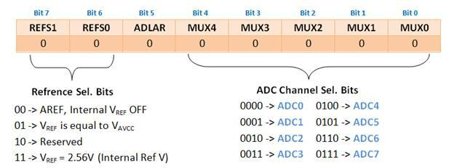
ADMUX

Slide 5
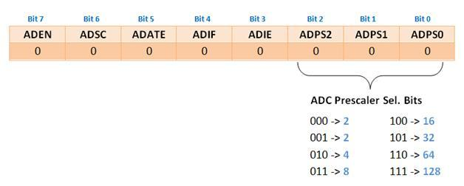
ADSCRA

Slide 6

ADCL and ADCH

Slide 7
READING ADC INPUT
uint16_t ReadADC(uint8_t ch) {
//Select ADC Channel ch must be 0-7
ch=ch&0b00000111;
ADMUX|=ch;
//Start Single conversion
ADCSRA|=(1<<ADSC);
//Wait for conversion to complete
while(!(ADCSRA & (1<<ADIF))); //Clear ADIF by writing one to it
ADCSRA|=(1<<ADIF);
return(ADC); }

Slide 8
THANK YOU

