Slide 1

Android Introduction
Graphical User Interface
@2011 Mihail L. Sichitiu

Slide 2
Goal
Familiarize with the main types of GUI components
Concepts:
  Layouts
  Widgets
  Menus
@2011 Mihail L. Sichitiu

Slide 3
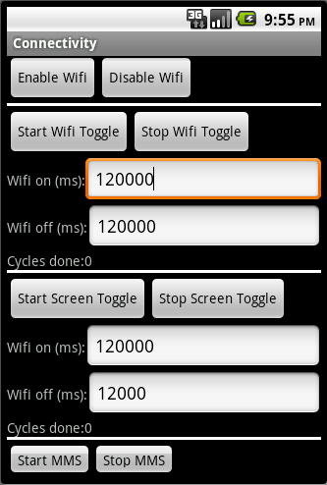
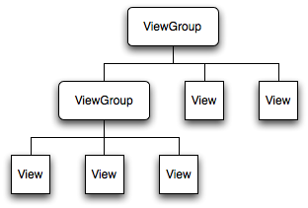
View Hierarchy
All the views in a window are arranged in a tree
You show the tree by calling setContentView(rootNode) in the activity
@2011 Mihail L. Sichitiu

Slide 4
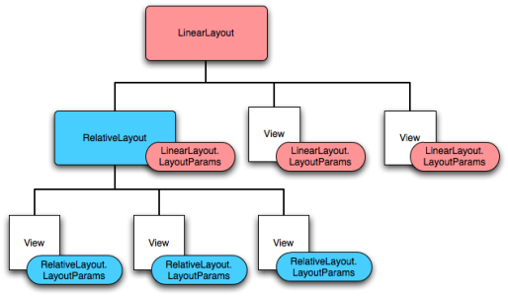
Layout
Defines how elements are positioned relative to each other (next to each other, under each other, in a table, grid, etc.)
Can have a different layouts for each ViewGroup
@2011 Mihail L. Sichitiu

Slide 5
Widgets
All are View objects
Examples:
  TextFields
  EditFields
  Buttons
  Checkboxes
  RadioButtons
  etc.
@2011 Mihail L. Sichitiu

Slide 6
UI Events
Usually handled by defining a Listener of the form On<something>Listener and register it with the View
For example:
  OnClickListener() for handling clicks on Buttons or Lists
  OnTouchListener() for handling touches
  OnKeyListerner() for handling key presses
Alternatively, Override an existing callback if we implemented our own class extending View
@2011 Mihail L. Sichitiu

Slide 7
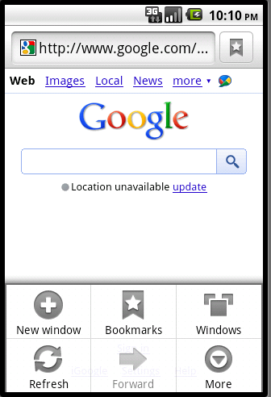
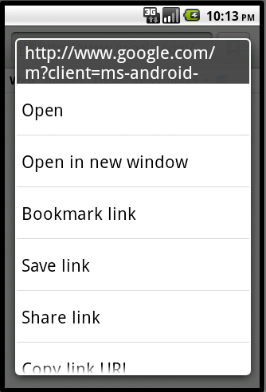
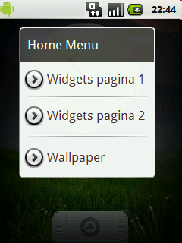
Menus
Options Menu
Context Menu
Sub-menu
@2011 Mihail L. Sichitiu

Slide 8
Menus (continued)
MenuItem
Has 0 or more
MenuItem
Has 0 or more
Has 0 or more
SubMenu
@2011 Mihail L. Sichitiu

