Slide 1

Android Introduction
Hello Views
Part 1
@2011 Mihail L. Sichitiu

Slide 2
Goal
Familiarize with the main types of GUI components
Concepts:
  Layouts
  Widgets
  Menus
@2011 Mihail L. Sichitiu

Slide 3
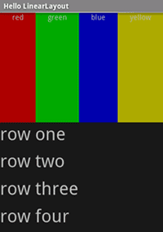
Linear Layout
<?xml version="1.0" encoding="utf-8"?>
<LinearLayout xmlns:android="http://schemas.android.com/apk/res/android"
android:orientation="vertical"
android:layout_width="fill_parent"
android:layout_height="fill_parent">
<LinearLayout
android:orientation="horizontal"
android:layout_width="fill_parent"
android:layout_height="fill_parent"
android:layout_weight="1">
<TextView
android:text="red"
android:gravity="center_horizontal"
[…………………….]
</LinearLayout>
<LinearLayout
android:orientation="vertical"
android:layout_width="fill_parent"
android:layout_height="fill_parent"
android:layout_weight="1">
<TextView
android:text="row one"
android:textSize="15pt"
android:layout_width="fill_parent"
android:layout_height="wrap_content"
android:layout_weight="1"/>
<TextView
android:text="row two"
android:textSize="15pt"
android:layout_width="fill_parent"
android:layout_height="wrap_content"
android:layout_weight="1"/>
[…………………………………..]
</LinearLayout>
</LinearLayout>
http://developer.android.com/resources/tutorials/views/hello-linearlayout.html
@2011 Mihail L. Sichitiu

Slide 4
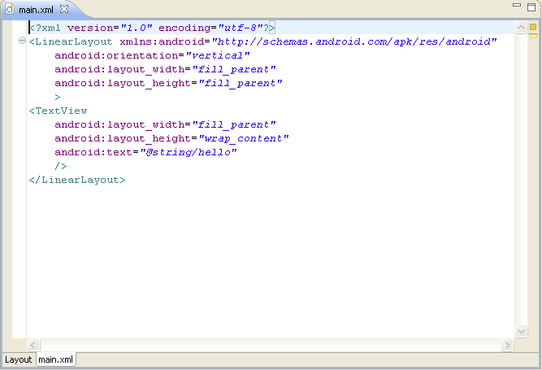
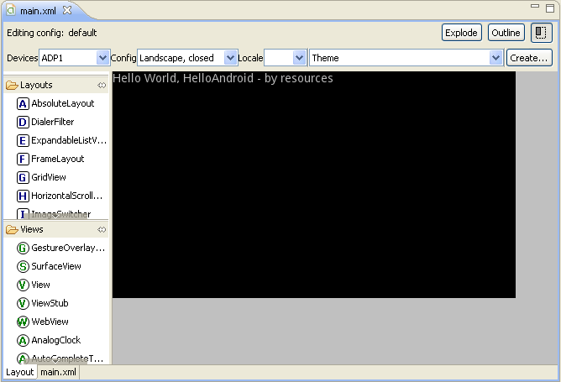
One Layout, two views
XML File vs Layout Preview
@2011 Mihail L. Sichitiu

Slide 5
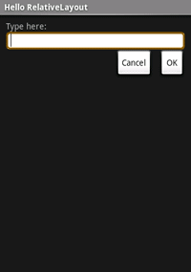
Relative Layout
<?xml version="1.0" encoding="utf-8"?>
<RelativeLayout xmlns:android="http://schemas.android.com/apk/res/android"
android:layout_width="fill_parent"
android:layout_height="fill_parent">
<TextView
android:id="@+id/label"
android:layout_width="fill_parent"
android:layout_height="wrap_content"
android:text="Type here:"/>
<EditText
android:id="@+id/entry"
android:layout_width="fill_parent"
android:layout_height="wrap_content"
android:background="@android:drawable/editbox_background"
android:layout_below="@id/label"/>
<Button
android:id="@+id/ok"
android:layout_width="wrap_content"
android:layout_height="wrap_content"
android:layout_below="@id/entry"
android:layout_alignParentRight="true"
android:layout_marginLeft="10dip"
android:text="OK" />
<Button
android:layout_width="wrap_content"
android:layout_height="wrap_content"
android:layout_toLeftOf="@id/ok"
android:layout_alignTop="@id/ok"
android:text="Cancel" />
</RelativeLayout>
@2011 Mihail L. Sichitiu

Slide 6
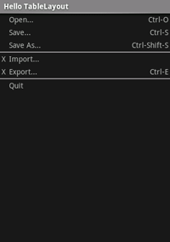
Table Layout
<?xml version="1.0" encoding="utf-8"?>
<TableLayout xmlns:android="http://schemas.android.com/apk/res/android"
android:layout_width="fill_parent"
android:layout_height="fill_parent"
android:stretchColumns="1">
<TableRow>
<TextView
android:layout_column="1"
android:text="Open..."
android:padding="3dip" />
<TextView
android:text="Ctrl-O"
android:gravity="right"
android:padding="3dip" />
</TableRow>
<TableRow>
<TextView
android:layout_column="1"
android:text="Save..."
android:padding="3dip" />
<TextView
android:text="Ctrl-S"
android:gravity="right"
android:padding="3dip" />
</TableRow>
<TableRow>
<TextView
android:layout_column="1"
android:text="Save As..."
android:padding="3dip" />
<TextView
android:text="Ctrl-Shift-S"
android:gravity="right"
android:padding="3dip" />
</TableRow>
<View
android:layout_height="2dip"
android:background="#FF909090" />
[………………………]
</TableLayout>
@2011 Mihail L. Sichitiu

Slide 7
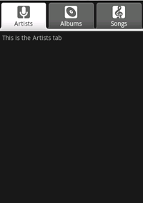
TabLayout
One activity per tab
Create new Project HelloTabs
@2011 Mihail L. Sichitiu

Slide 8
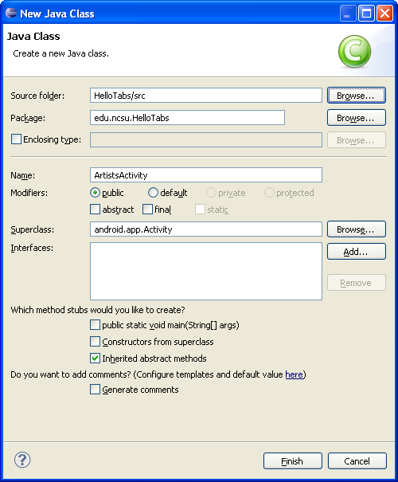
Create three new activities
Right click on HelloTabs Package Name -> New -> Class
Right click on the new class, Source -> Override/Implement Methods -> Check OnCreate();
@2011 Mihail L. Sichitiu

Slide 9
Fill in the OnCreate() method
public class ArtistsActivity extends Activity {
public void onCreate(Bundle savedInstanceState) {
super.onCreate(savedInstanceState);
TextView textview = new TextView(this);
textview.setText("This is the Artists tab");
setContentView(textview);
}
}
Quick and dirty
“by hand”
like in
HelloWorld
Copy and Paste ArtistsActivity into two more activities:
AlbumsActivity and
SongsActivity
@2011 Mihail L. Sichitiu

Slide 10
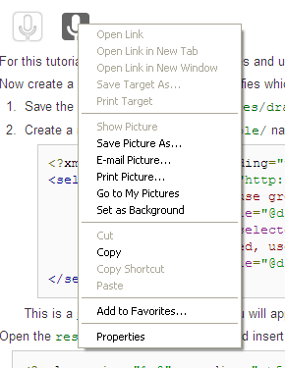
Copy the icons
Right click -> Save As,
Make ./res/drawable
move the icons into ./res/drawable
@2011 Mihail L. Sichitiu

Slide 11
Create ./res/drawable/ic_tab_artists.xml
<?xml version="1.0" encoding="utf-8"?>
<selector xmlns:android="http://schemas.android.com/apk/res/android">
<!-- When selected, use grey -->
<item android:drawable="@drawable/ic_tab_artists_grey"
android:state_selected="true" />
<!-- When not selected, use white-->
<item android:drawable="@drawable/ic_tab_artists_white" />
</selector>
StateListDrawable object that displays different images for different states of a View
@2011 Mihail L. Sichitiu

Slide 12
Make copies or the xml files for the other two tabs:
Copy the xml file:
  ic_tab_artists.xml ->
    ic_tab_albums.xlm ->
    ic_tab_songs.xml
@2011 Mihail L. Sichitiu

Slide 13
Main Layout
<?xml version="1.0" encoding="utf-8"?>
<TabHost xmlns:android="http://schemas.android.com/apk/res/android"
android:id="@android:id/tabhost"
android:layout_width="fill_parent"
android:layout_height="fill_parent">
<LinearLayout
android:orientation="vertical"
android:layout_width="fill_parent"
android:layout_height="fill_parent"
android:padding="5dp">
<TabWidget
android:id="@android:id/tabs"
android:layout_width="fill_parent"
android:layout_height="wrap_content" />
<FrameLayout
android:id="@android:id/tabcontent"
android:layout_width="fill_parent"
android:layout_height="fill_parent"
android:padding="5dp" />
</LinearLayout>
</TabHost>
@2011 Mihail L. Sichitiu

Slide 14
OnCreate() for HelloTabs
(main activity)
public void onCreate(Bundle savedInstanceState)
super.onCreate(savedInstanceState);
setContentView(R.layout.main);
Resources res = getResources(); // Resource object to get Drawables
TabHost tabHost = getTabHost(); // The activity TabHost
TabHost.TabSpec spec; // Resusable TabSpec for each tab
Intent intent; // Reusable Intent for each tab
// Create an Intent to launch an Activity for the tab (to be reused)
intent = new Intent().setClass(this, ArtistsActivity.class);
// Initialize a TabSpec for each tab and add it to the TabHost
spec = tabHost.newTabSpec("artists").setIndicator("Artists",
res.getDrawable(R.drawable.ic_tab_artists))
.setContent(intent);
tabHost.addTab(spec);
// Do the same for the other tabs
[………………………]
tabHost.setCurrentTab(2);
}
Main Activity is a TabActivity – has a TabHost
Builder mapping the resources to the tab
Select Tab 2
@2011 Mihail L. Sichitiu

Slide 15
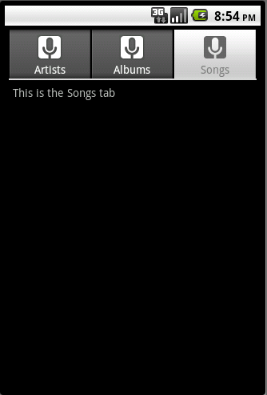
Run it!
@2011 Mihail L. Sichitiu

Slide 16
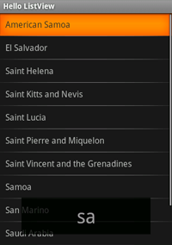
List View
List of scrollable items
Application will inherit from ListActivity rather than Activity
Create ./res/layout/list_item.xml
  Layout for each item
@2011 Mihail L. Sichitiu

Slide 17
Override the OnCreate method
Setup the list for this application, with this layout and this content
public class HelloListView extends ListActivity {
/** Called when the activity is first created. */
@Override
public void onCreate(Bundle savedInstanceState) {
super.onCreate(savedInstanceState);
setListAdapter(new ArrayAdapter<String>(this, R.layout.list_item, COUNTRIES));
ListView lv = getListView();
lv.setTextFilterEnabled(true);
lv.setOnItemClickListener(new OnItemClickListener() {
public void onItemClick(AdapterView<?> parent, View view,
int position, long id) {
// When clicked, show a toast with the TextView text
Toast.makeText(getApplicationContext(), ((TextView) view).getText(),
Toast.LENGTH_SHORT).show();
}
});
}
}
Enables filtering by keyboard
Small Toast showing the text in the clicked item for a short time
@2011 Mihail L. Sichitiu

Slide 18
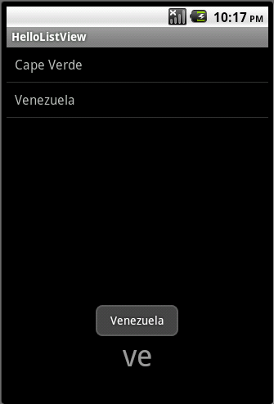
Run it!
@2011 Mihail L. Sichitiu

Slide 19
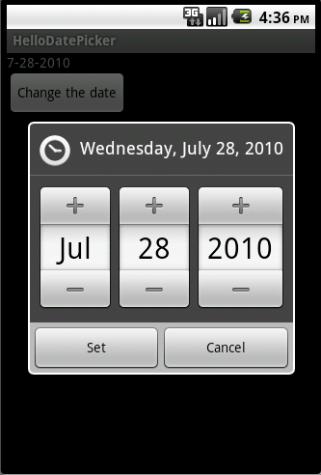
Date Picker
Will display a dialogbox allowing to change the date
@2011 Mihail L. Sichitiu

Slide 20
Layout
<?xml version="1.0" encoding="utf-8"?>
<LinearLayout xmlns:android="http://schemas.android.com/apk/res/android"
android:layout_width="wrap_content"
android:layout_height="wrap_content"
android:orientation="vertical">
<TextView android:id="@+id/dateDisplay"
android:layout_width="wrap_content"
android:layout_height="wrap_content"
android:text=""/>
<Button android:id="@+id/pickDate"
android:layout_width="wrap_content"
android:layout_height="wrap_content"
android:text="Change the date"/>
</LinearLayout>
@2011 Mihail L. Sichitiu

Slide 21
OnCreate( )
protected void onCreate(Bundle savedInstanceState) {
super.onCreate(savedInstanceState);
setContentView(R.layout.main);
// capture our View elements
mDateDisplay = (TextView) findViewById(R.id.dateDisplay);
mPickDate = (Button) findViewById(R.id.pickDate);
// add a click listener to the button
mPickDate.setOnClickListener(new View.OnClickListener() {
public void onClick(View v) {
showDialog(DATE_DIALOG_ID);
}
});
// get the current date
final Calendar c = Calendar.getInstance();
mYear = c.get(Calendar.YEAR);
mMonth = c.get(Calendar.MONTH);
mDay = c.get(Calendar.DAY_OF_MONTH);
// display the current date (this method is below)
updateDisplay();
}
@2011 Mihail L. Sichitiu

Slide 22
updateDisplay( )
// updates the date in the TextView
private void updateDisplay() {
mDateDisplay.setText(
new StringBuilder()
// Month is 0 based so add 1
.append(mMonth + 1).append("-")
.append(mDay).append("-")
.append(mYear).append(" "));
}
@2011 Mihail L. Sichitiu

Slide 23
DatePickerDialog.OnDateSetListener( )
// the callback received when the user "sets" the date in the dialog
private DatePickerDialog.OnDateSetListener mDateSetListener =
new DatePickerDialog.OnDateSetListener() {
public void onDateSet(DatePicker view, int year,
int monthOfYear, int dayOfMonth) {
mYear = year;
mMonth = monthOfYear;
mDay = dayOfMonth;
updateDisplay();
}
};
@2011 Mihail L. Sichitiu

Slide 24
onCreateDialog( )
@Override
protected Dialog onCreateDialog(int id) {
switch (id) {
case DATE_DIALOG_ID:
return new DatePickerDialog(this,
mDateSetListener,
mYear, mMonth, mDay);
}
return null;
}
@2011 Mihail L. Sichitiu

Slide 25
Run it!
@2011 Mihail L. Sichitiu

