Slide 1

Android Introduction
Hello Views
Part 2

Slide 2
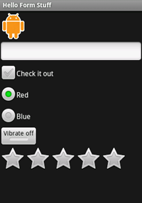
Hello Form Stuff
Custom Buttons
Edit Text
Check Boxes
Radio Boxes
Toggle Button
Rating Bar

Slide 3



Custom Button
<?xml version="1.0" encoding="utf-8"?>
<selector xmlns:android="http://schemas.android.com/apk/res/android">
<item android:drawable="@drawable/android_pressed"
android:state_pressed="true" />
<item android:drawable="@drawable/android_focused"
android:state_focused="true" />
<item android:drawable="@drawable/android_normal" />
</selector>
<Button
android:id="@+id/button"
android:layout_width="wrap_content"
android:layout_height="wrap_content"
android:padding="10dp"
android:background="@drawable/android_button" />
final Button button = (Button) findViewById(R.id.button);
button.setOnClickListener(new OnClickListener() {
public void onClick(View v) {
// Perform action on clicks
Toast.makeText(HelloFormStuff.this, "Beep Bop", Toast.LENGTH_SHORT).show();
}
});

Slide 4
Edit Text
<EditText
android:id="@+id/edittext"
android:layout_width="fill_parent"
android:layout_height="wrap_content"/>
final EditText edittext = (EditText) findViewById(R.id.edittext);
edittext.setOnKeyListener(new OnKeyListener() {
public boolean onKey(View v, int keyCode, KeyEvent event) {
// If the event is a key-down event on the "enter" button
if ((event.getAction() == KeyEvent.ACTION_DOWN) &&
(KeyEvent.KEYCODE_ENTER)) {
// Perform action keyCode == on key press
Toast.makeText(HelloFormStuff.this, edittext.getText(), Toast.LENGTH_SHORT).show();
return true;
}
return false;
}
});

Slide 5
Check Box
<CheckBox android:id="@+id/checkbox"
android:layout_width="wrap_content"
android:layout_height="wrap_content"
android:text="check it out" />
final CheckBox checkbox = (CheckBox) findViewById(R.id.checkbox);
checkbox.setOnClickListener(new OnClickListener() {
public void onClick(View v) {
// Perform action on clicks, depending on whether it's now checked
if (((CheckBox) v).isChecked()) {
Toast.makeText(HelloFormStuff.this, "Selected", Toast.LENGTH_SHORT).show();
} else {
Toast.makeText(HelloFormStuff.this, "Not selected", Toast.LENGTH_SHORT).show();
}
}
});

Slide 6
Radio Button
<RadioGroup
android:layout_width="fill_parent"
android:layout_height="wrap_content"
android:orientation="vertical">
<RadioButton android:id="@+id/radio_red"
android:layout_width="wrap_content"
android:layout_height="wrap_content"
android:text="Red" />
<RadioButton android:id="@+id/radio_blue"
android:layout_width="wrap_content"
android:layout_height="wrap_content"
android:text="Blue" />
</RadioGroup>
private OnClickListener radio_listener = new OnClickListener() {
public void onClick(View v) {
// Perform action on clicks
RadioButton rb = (RadioButton) v;
Toast.makeText(HelloFormStuff.this, rb.getText(), Toast.LENGTH_SHORT).show();
}
};
final RadioButton radio_red = (RadioButton) findViewById(R.id.radio_red);
final RadioButton radio_blue = (RadioButton) findViewById(R.id.radio_blue);
radio_red.setOnClickListener(radio_listener);
radio_blue.setOnClickListener(radio_listener);

Slide 7
Toggle Button
<ToggleButton android:id="@+id/togglebutton"
android:layout_width="wrap_content"
android:layout_height="wrap_content"
android:textOn="Vibrate on"
android:textOff="Vibrate off"/>
final ToggleButton togglebutton = (ToggleButton) findViewById(R.id.togglebutton);
togglebutton.setOnClickListener(new OnClickListener() {
public void onClick(View v) {
// Perform action on clicks
if (togglebutton.isChecked()) {
Toast.makeText(HelloFormStuff.this, "Checked", Toast.LENGTH_SHORT).show();
} else {
Toast.makeText(HelloFormStuff.this, "Not checked", Toast.LENGTH_SHORT).show();
}
}
});

Slide 8
Rating Bar
<RatingBar android:id="@+id/ratingbar"
android:layout_width="wrap_content"
android:layout_height="wrap_content"
android:numStars="5"
android:stepSize="1.0"/>
final RatingBar ratingbar = (RatingBar) findViewById(R.id.ratingbar);
ratingbar.setOnRatingBarChangeListener(new OnRatingBarChangeListener() {
public void onRatingChanged(RatingBar ratingBar, float rating, boolean fromUser) {
Toast.makeText(HelloFormStuff.this, "New Rating: " + rating, Toast.LENGTH_SHORT).show();
}
});

Slide 9
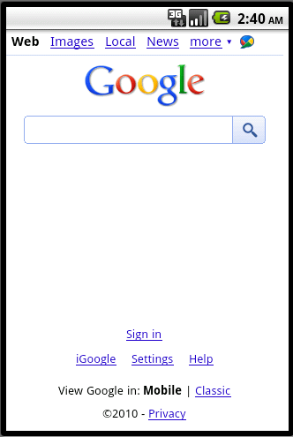
Hello WebView
Making a window for viewing web pages

Slide 10
/res/layout/main.xml
<?xml version="1.0" encoding="utf-8"?>
<WebView xmlns:android="http://schemas.android.com/apk/res/android"
android:id="@+id/webview"
android:layout_width="fill_parent"
android:layout_height="fill_parent"
/>

Slide 11
OnCreate( )
WebView mWebView;
public void onCreate(Bundle savedInstanceState) {
super.onCreate(savedInstanceState);
setContentView(R.layout.main);
mWebView = (WebView) findViewById(R.id.webview);
mWebView.getSettings().setJavaScriptEnabled(true);
mWebView.loadUrl("http://www.google.com");
}

Slide 12
AndroidManifest
<uses-permission android:name="android.permission.INTERNET" />
<activity android:name=".HelloWebView" android:label="@string/app_name"
android:theme="@android:style/Theme.NoTitleBar">

Slide 13
Run it!

Slide 14
For the MapView
Generate an API Key
Thank you for signing up for an Android Maps API key!
Your key is:
0sfwSFw1BU4WGRreaBYtss4jGuPccZhhq7WDOCg
This key is good for all apps signed with your certificate whose fingerprint is:
D6:0A:9A:E8:24:D1:D7:8C:F5:68:20:7D:67:40:3A:01
Here is an example xml layout to get you started: <com.google.android.maps.MapView android:layout_width="fill_parent" android:layout_height="fill_parent" android:apiKey="0sfwSFw1BU4WGRreaBYtss4jGuPccZhhq7WDOCg" />

