Slide 1

Android Introduction
Hello World
@2011 Mihail L. Sichitiu

Slide 2
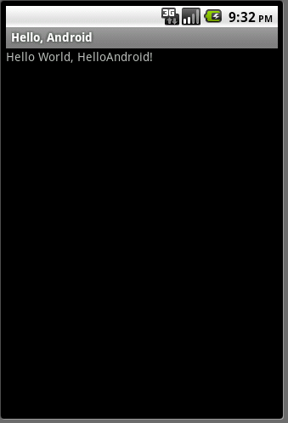
Goal
Create a very simple application
Run it on a real device
Run it on the emulator
Examine its structure
@2011 Mihail L. Sichitiu

Slide 3
Google Tutorial
We will follow the tutorial at:
http://developer.android.com/resources/tutorials/hello-world.html
Start Eclipse (Start -> All Programs -> Eclipse)
Create an Android Virtual Device (AVD)
Create a New Android Project
@2011 Mihail L. Sichitiu

Slide 4
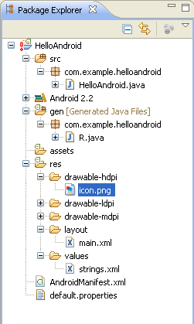
Package Content
All source code here
Java code for our activity
All non-code
resources
Generated Java code
Helps link resources to
Java code
Images
Layout of the activity
Strings used in the
program
Android Manifest
@2011 Mihail L. Sichitiu

Slide 5
Android Manifest
<?xml version="1.0" encoding="utf-8"?>
<manifest xmlns:android="http://schemas.android.com/apk/res/android"
package="com.example.helloandroid"
android:versionCode="1"
android:versionName="1.0">
<application android:icon="@drawable/icon" android:label="@string/app_name">
<activity android:name=".HelloAndroid"
android:label="@string/app_name">
<intent-filter>
<action android:name="android.intent.action.MAIN" />
<category android:name="android.intent.category.LAUNCHER" />
</intent-filter>
</activity>
</application>
</manifest>
@2011 Mihail L. Sichitiu

Slide 6
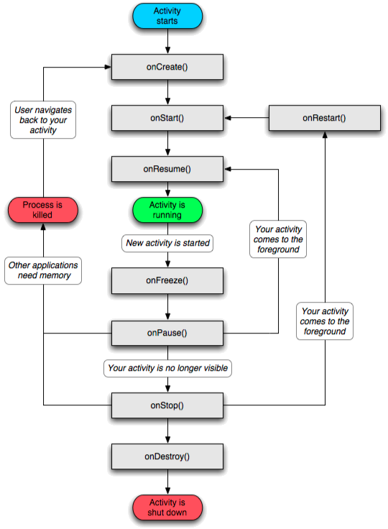
Activity
An Android activity is focused on a single thing a user can do.
Most applications have multiple activities
@2011 Mihail L. Sichitiu

Slide 7
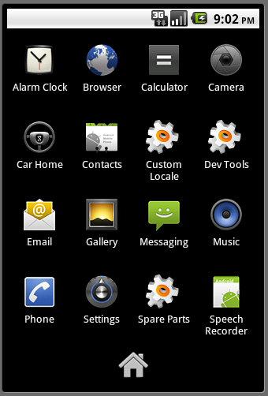
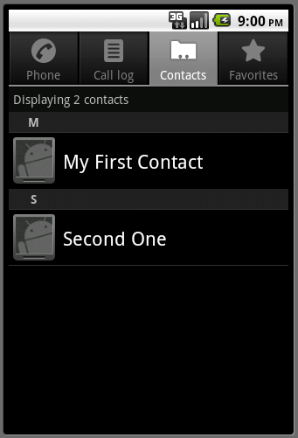
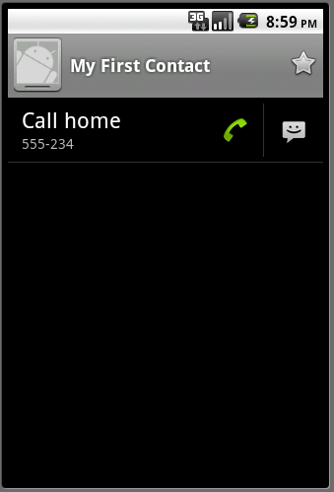
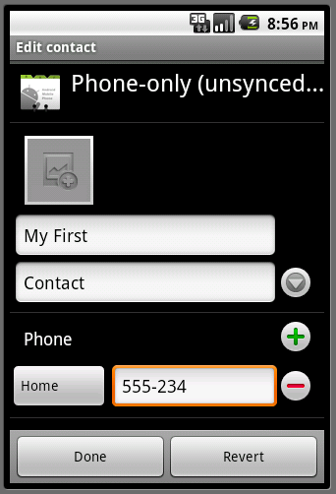
Activities start each other
@2011 Mihail L. Sichitiu

Slide 8
Revised HelloAndroid.java
Inherit from the Activity Class
package com.example.helloandroid;
import android.app.Activity;
import android.os.Bundle;
import android.widget.TextView;
public class HelloAndroid extends Activity {
/** Called when the activity is first created. */
@Override
public void onCreate(Bundle savedInstanceState) {
super.onCreate(savedInstanceState);
TextView tv = new TextView(this);
tv.setText("Hello, Android – by hand");
setContentView(tv);
}
}
Set the view “by hand” – from the program
@2011 Mihail L. Sichitiu

Slide 9
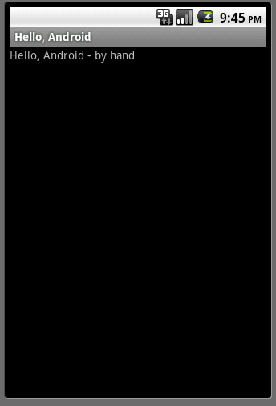
Run it!
@2011 Mihail L. Sichitiu

Slide 10
/res/layout/main.xml
<?xml version="1.0" encoding="utf-8"?>
<LinearLayout xmlns:android="http://schemas.android.com/apk/res/android"
android:orientation="vertical"
android:layout_width="fill_parent"
android:layout_height="fill_parent"
>
<TextView
android:layout_width="fill_parent"
android:layout_height="wrap_content"
android:text="@string/hello"
/>
</LinearLayout>
Further redirection to /res/values/strings.xml
@2011 Mihail L. Sichitiu

Slide 11
/res/values/strings.xml
<?xml version="1.0" encoding="utf-8"?>
<resources>
<string name="hello">Hello World, HelloAndroid – by resources!</string>
<string name="app_name">Hello, Android</string>
</resources>
@2011 Mihail L. Sichitiu

Slide 12
HelloAndroid.java
package com.example.helloandroid;
import android.app.Activity;
import android.os.Bundle;
public class HelloAndroid extends Activity {
/** Called when the activity is first created. */
@Override
public void onCreate(Bundle savedInstanceState) {
super.onCreate(savedInstanceState); setContentView(R.layout.main);
}
}
Set the layout of the view as described in the main.xml layout
@2011 Mihail L. Sichitiu

Slide 13
/gen/R.java
package com.example.helloandroid;
public final class R {
public static final class attr {
}
public static final class drawable {
public static final int icon=0x7f020000;
}
public static final class id {
public static final int textview=0x7f050000;
}
public static final class layout {
public static final int main=0x7f030000;
}
public static final class string {
public static final int app_name=0x7f040001;
public static final int hello=0x7f040000;
}
}
@2011 Mihail L. Sichitiu

Slide 14
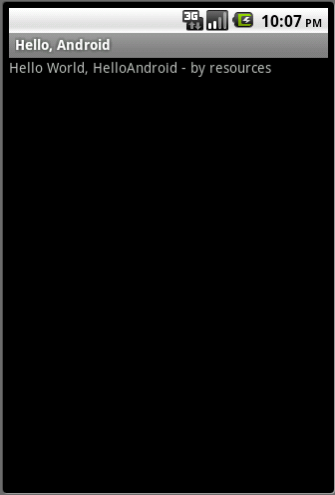
Run it!
@2011 Mihail L. Sichitiu

Slide 15
Introduce a bug
package com.example.helloandroid;
import android.app.Activity;
import android.os.Bundle;
public class HelloAndroid extends Activity {
/** Called when the activity is first created. */
@Override
public void onCreate(Bundle savedInstanceState) {
super.onCreate(savedInstanceState);
Object o = null;
o.toString();
setContentView(R.layout.main);
}
}
@2011 Mihail L. Sichitiu

Slide 16
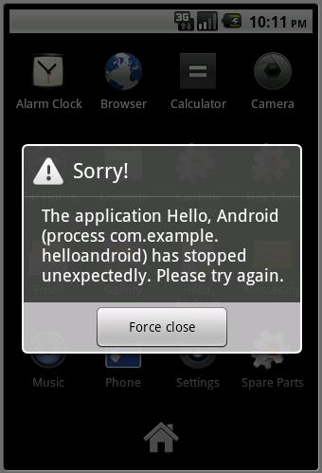
Run it!
@2011 Mihail L. Sichitiu

