Slide 1

Android Introduction
Platform Overview
@2011 Mihail L. Sichitiu

Slide 2

What is Android?
Android is a software stack for mobile devices that includes an operating system, middleware and key applications.
@2011 Mihail L. Sichitiu

Slide 3
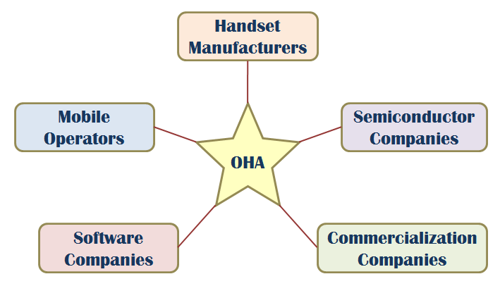
OHA (Open Handset Alliance)
A business alliance consisting of 47 companies to develop open standards for mobile devices
@2011 Mihail L. Sichitiu

Slide 4
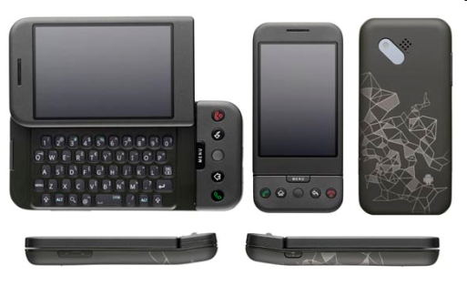
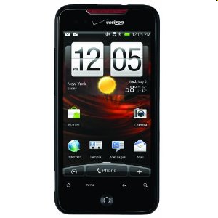

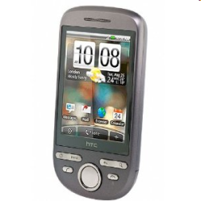
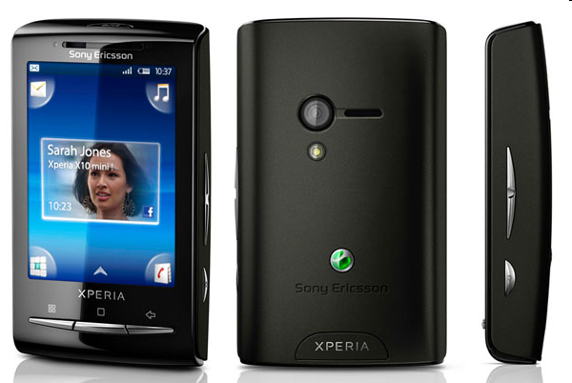
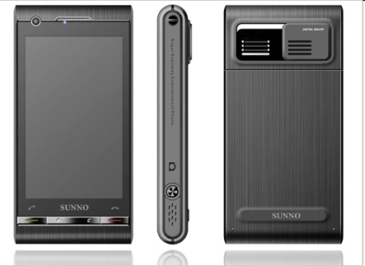
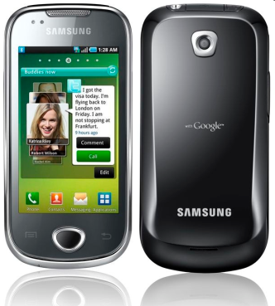
Phones
HTC G1,
Droid,
Tattoo
Motorola Droid (X)
Suno S880
Samsung Galaxy
Sony Ericsson
@2011 Mihail L. Sichitiu

Slide 5
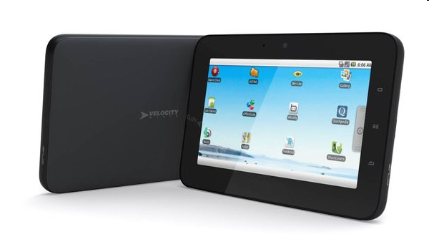
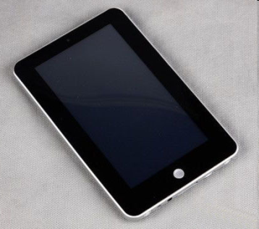
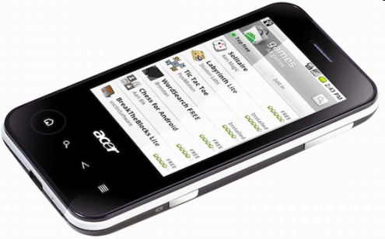
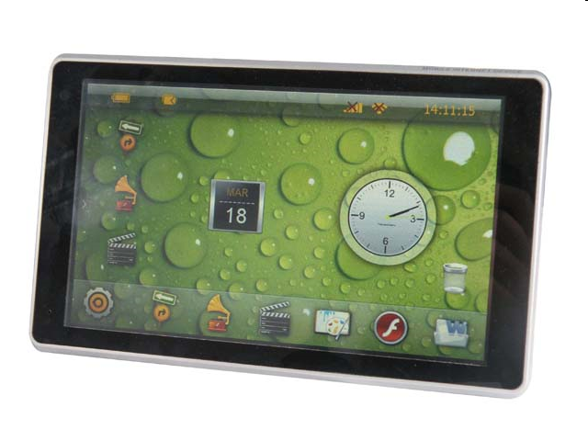
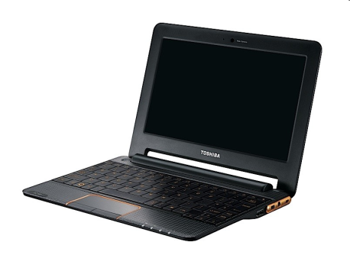
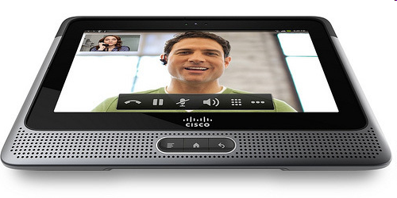
Tablets
Velocity Micro Cruz
Gome FlyTouch
Acer beTouch
Toshiba Android
SmartBook
Cisco Android Tablet
Dawa D7
@2011 Mihail L. Sichitiu

Slide 6
MarketShare
 | Feb’10 | May’10 | Apr’11
RIM | 42.1% | 41.7% | 29%
Apple | 25.4% | 24.4% | 25%
Google | 9% | 13% | 33%
Microsoft | 15.1% | 13.2% | 7.7%
Palm | 5.4% | 4.8% | 2.9%
@2011 Mihail L. Sichitiu

Slide 7
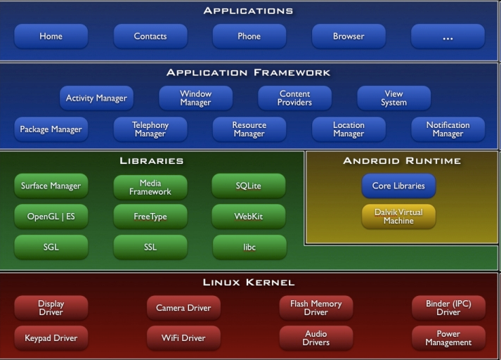
Architecture
@2011 Mihail L. Sichitiu

Slide 8
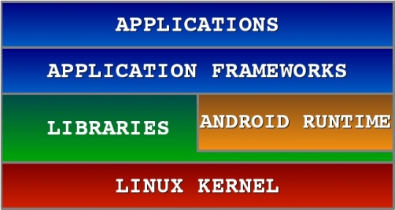

Android S/W Stack - Application
Android provides a set of core applications:
  Email Client
  SMS Program
  Calendar
  Maps
  Browser
  Contacts
  Etc
All applications are written using the Java language.
@2011 Mihail L. Sichitiu

Slide 9
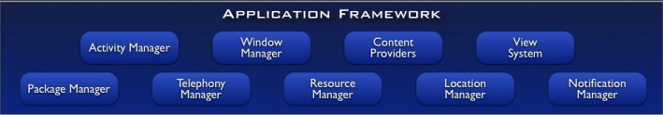
Android S/W Stack –
App Framework
Enabling and simplifying the reuse of components
  Developers have full access to the same framework APIs used by the core applications.
  Users are allowed to replace components.
@2011 Mihail L. Sichitiu

Slide 10
Android S/W Stack –
App Framework (Cont)
Features
Feature | Role
View System | Used to build an application, including lists, grids, text boxes, buttons, and embedded web browser
Content Provider | Enabling applications to access data from other applications or to share their own data
Resource Manager | Providing access to non-code resources (localized strings, graphics, and layout files)
Notification Manager | Enabling all applications to display customer alerts in the status bar
Activity Manager | Managing the lifecycle of applications and providing a common navigation backstack
@2011 Mihail L. Sichitiu

Slide 11
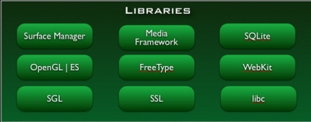
Android S/W Stack - Libraries
Including a set of C/C++ libraries used by components of the Android system
Exposed to developers through the Android application framework
@2011 Mihail L. Sichitiu

Slide 12
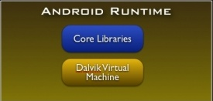
Android S/W Stack - Runtime
Core Libraries
  Providing most of the functionality available in the core libraries of the Java language
  APIs
    Data Structures
    Utilities
    File Access
    Network Access
    Graphics
    Etc
@2011 Mihail L. Sichitiu

Slide 13
Android S/W Stack – Runtime (Cont)
Dalvik Virtual Machine
  Providing environment on which every Android application runs
    Each Android application runs in its own process, with its own instance of the Dalvik VM.
    Dalvik has been written such that a device can run multiple VMs efficiently.
  Register-based virtual machine
@2011 Mihail L. Sichitiu

Slide 14
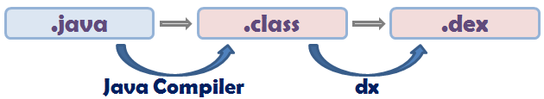
Android S/W Stack – Runtime (Cont)
Dalvik Virtual Machine (Cont)
  Executing the Dalvik Executable (.dex) format
    .dex format is optimized for minimal memory footprint.
    Compilation
  Relying on the Linux Kernel for:
    Threading
    Low-level memory management
@2011 Mihail L. Sichitiu

Slide 15
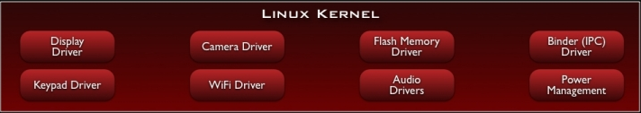
Android S/W Stack – Linux Kernel
Relying on Linux Kernel 2.6 for core system services
  Memory and Process Management
  Network Stack
  Driver Model
  Security
Providing an abstraction layer between the H/W and the rest of the S/W stack
@2011 Mihail L. Sichitiu

