Slide 1
Track A | HealthTech | Problem Statement 1
Nidan
Diabetes
Hypertension
Clinical Decision Support System
AI-powered lifestyle disease risk prediction &
early referral assistant for primary care
CKD
CVD
5
Conditions covered
4
Scoring engines
0
External medical APIs called
Stroke
Team — Tetrathon 2026 | August 1, 2026 | github.com/CodeMeAbhishek/TETRA010

Slide 2
Problem & Approach
2
Problem
Our Approach
Late diagnosis
No external medical APIs
77% of lifestyle disease cases in India are only
caught when they have already worsened.
We read the original published research papers and WHO/KDIGO guidelines,
extracted every formula and threshold, then coded them directly in Python.
No decision support
Deterministic scoring engines
Primary health workers lack tools to screen
systematically — screening is inconsistent.
4 independent engines run the math. Each engine cites its source. The AI layer
only explains results — it never calculates a score.
Incomplete records
Graceful degradation
Rural PHCs often have NO lab results.
System must still give useful output.
If lab data is missing, the system automatically uses the non-lab fallback chart
and tells the doctor exactly which test to order — never guesses.
Notes:
KEY MESSAGE: We didn't call any medical API or let an AI estimate a risk number. We went to the source papers, pulled the validated formulas, and hard-coded them. That is what makes this auditable.

Slide 3
System Architecture
3
Frontend — Patient Assessment Form (HTML/JS)
FastAPI Backend — /analyze endpoint (Python)
Input Checker — identifies which fields are present vs. missing
Diabetes
IDRS formula
Blood Pressure
ACC/AHA 2017
Heart Risk
WHO CVD charts
Kidney Risk
KDIGO 2024
Missing Investigations — de-duplicates what each engine needs
Referral Engine — REFER / MONITOR / ROUTINE + reason
Structured JSON only passed to AI — AI never calculates a score
AI Layer (NVIDIA NIM / Claude) — explain | translate | draft referral note
Notes:
Walk top to bottom. Emphasize:
1) All 4 engines run in parallel — no blocking.
2) The GOLD arrow: engines produce JSON, AI receives JSON. AI is an explainer, not a calculator.
3) Missing investigations aggregator means the doctor gets ONE list, not four.

Slide 4
How We Built the Scoring Engines — No Medical API
4
Every formula in this system came from reading the original published research papers, not from calling any third-party medical API.
Diabetes Risk (IDRS)
Heart Risk (WHO CVD Charts)
Source: ICMR-INDIAB study | 113,043 patients across India
Source: WHO South Asia CVD Risk Charts — digitised into JSON grid
We read the research paper and extracted a 4-factor scoring formula:
Age + Waist size + Physical activity + Family history = score 0 to 100
We photographed and manually digitised the WHO colour risk table
(800+ cells). System looks up the right cell for each patient.
if waist_cm >= 90: score += 30 # male threshold
if age >= 50: score += 20
if sedentary: score += 20
if family_history: score += 10
# No API — we digitised the chart ourselves
risk = who_cvd_grid[age_band][sex][sbp_band][cholesterol_band]
Kidney Risk (KDIGO)
Blood Pressure (ACC/AHA 2017)
Source: KDIGO 2024 Clinical Practice Guidelines + CKD-EPI 2021 formula
Source: 2017 ACC/AHA Hypertension Guideline + Stroke protocols
We extracted the eGFR formula from the guideline and coded the
colour risk grid (G1-G5 x A1-A3 = 15 cells) directly in Python.
We read the guideline document and coded every BP threshold,
cross-module rule (e.g. CKD+HTN = stricter target), and stroke protocol.
eGFR = 142 * min(cr/kappa,1)**alpha * max(cr/kappa,1)**-1.200
risk_color = kdigo_grid[g_stage][a_stage]
if sbp >= 180 or dbp >= 110: category = 'Stage 2 Hypertension'
elif sbp >= 130: category = 'Stage 1 Hypertension'
Notes:
Key talking point: We did the hard manual work of reading these papers and coding their formulas ourselves. That is WHY the system is accurate and auditable — there is no black box API that we're hoping is correct.
The code snippets shown are simplified but accurate excerpts from the actual engine files.

Slide 5
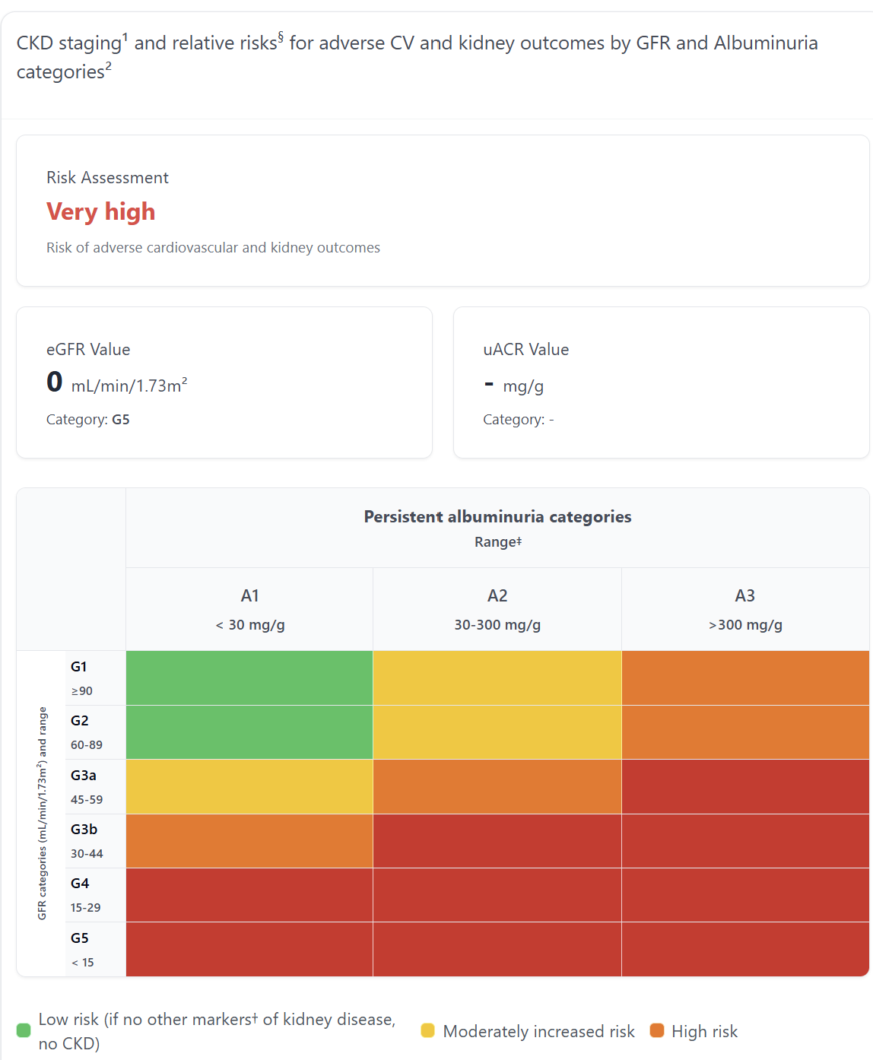
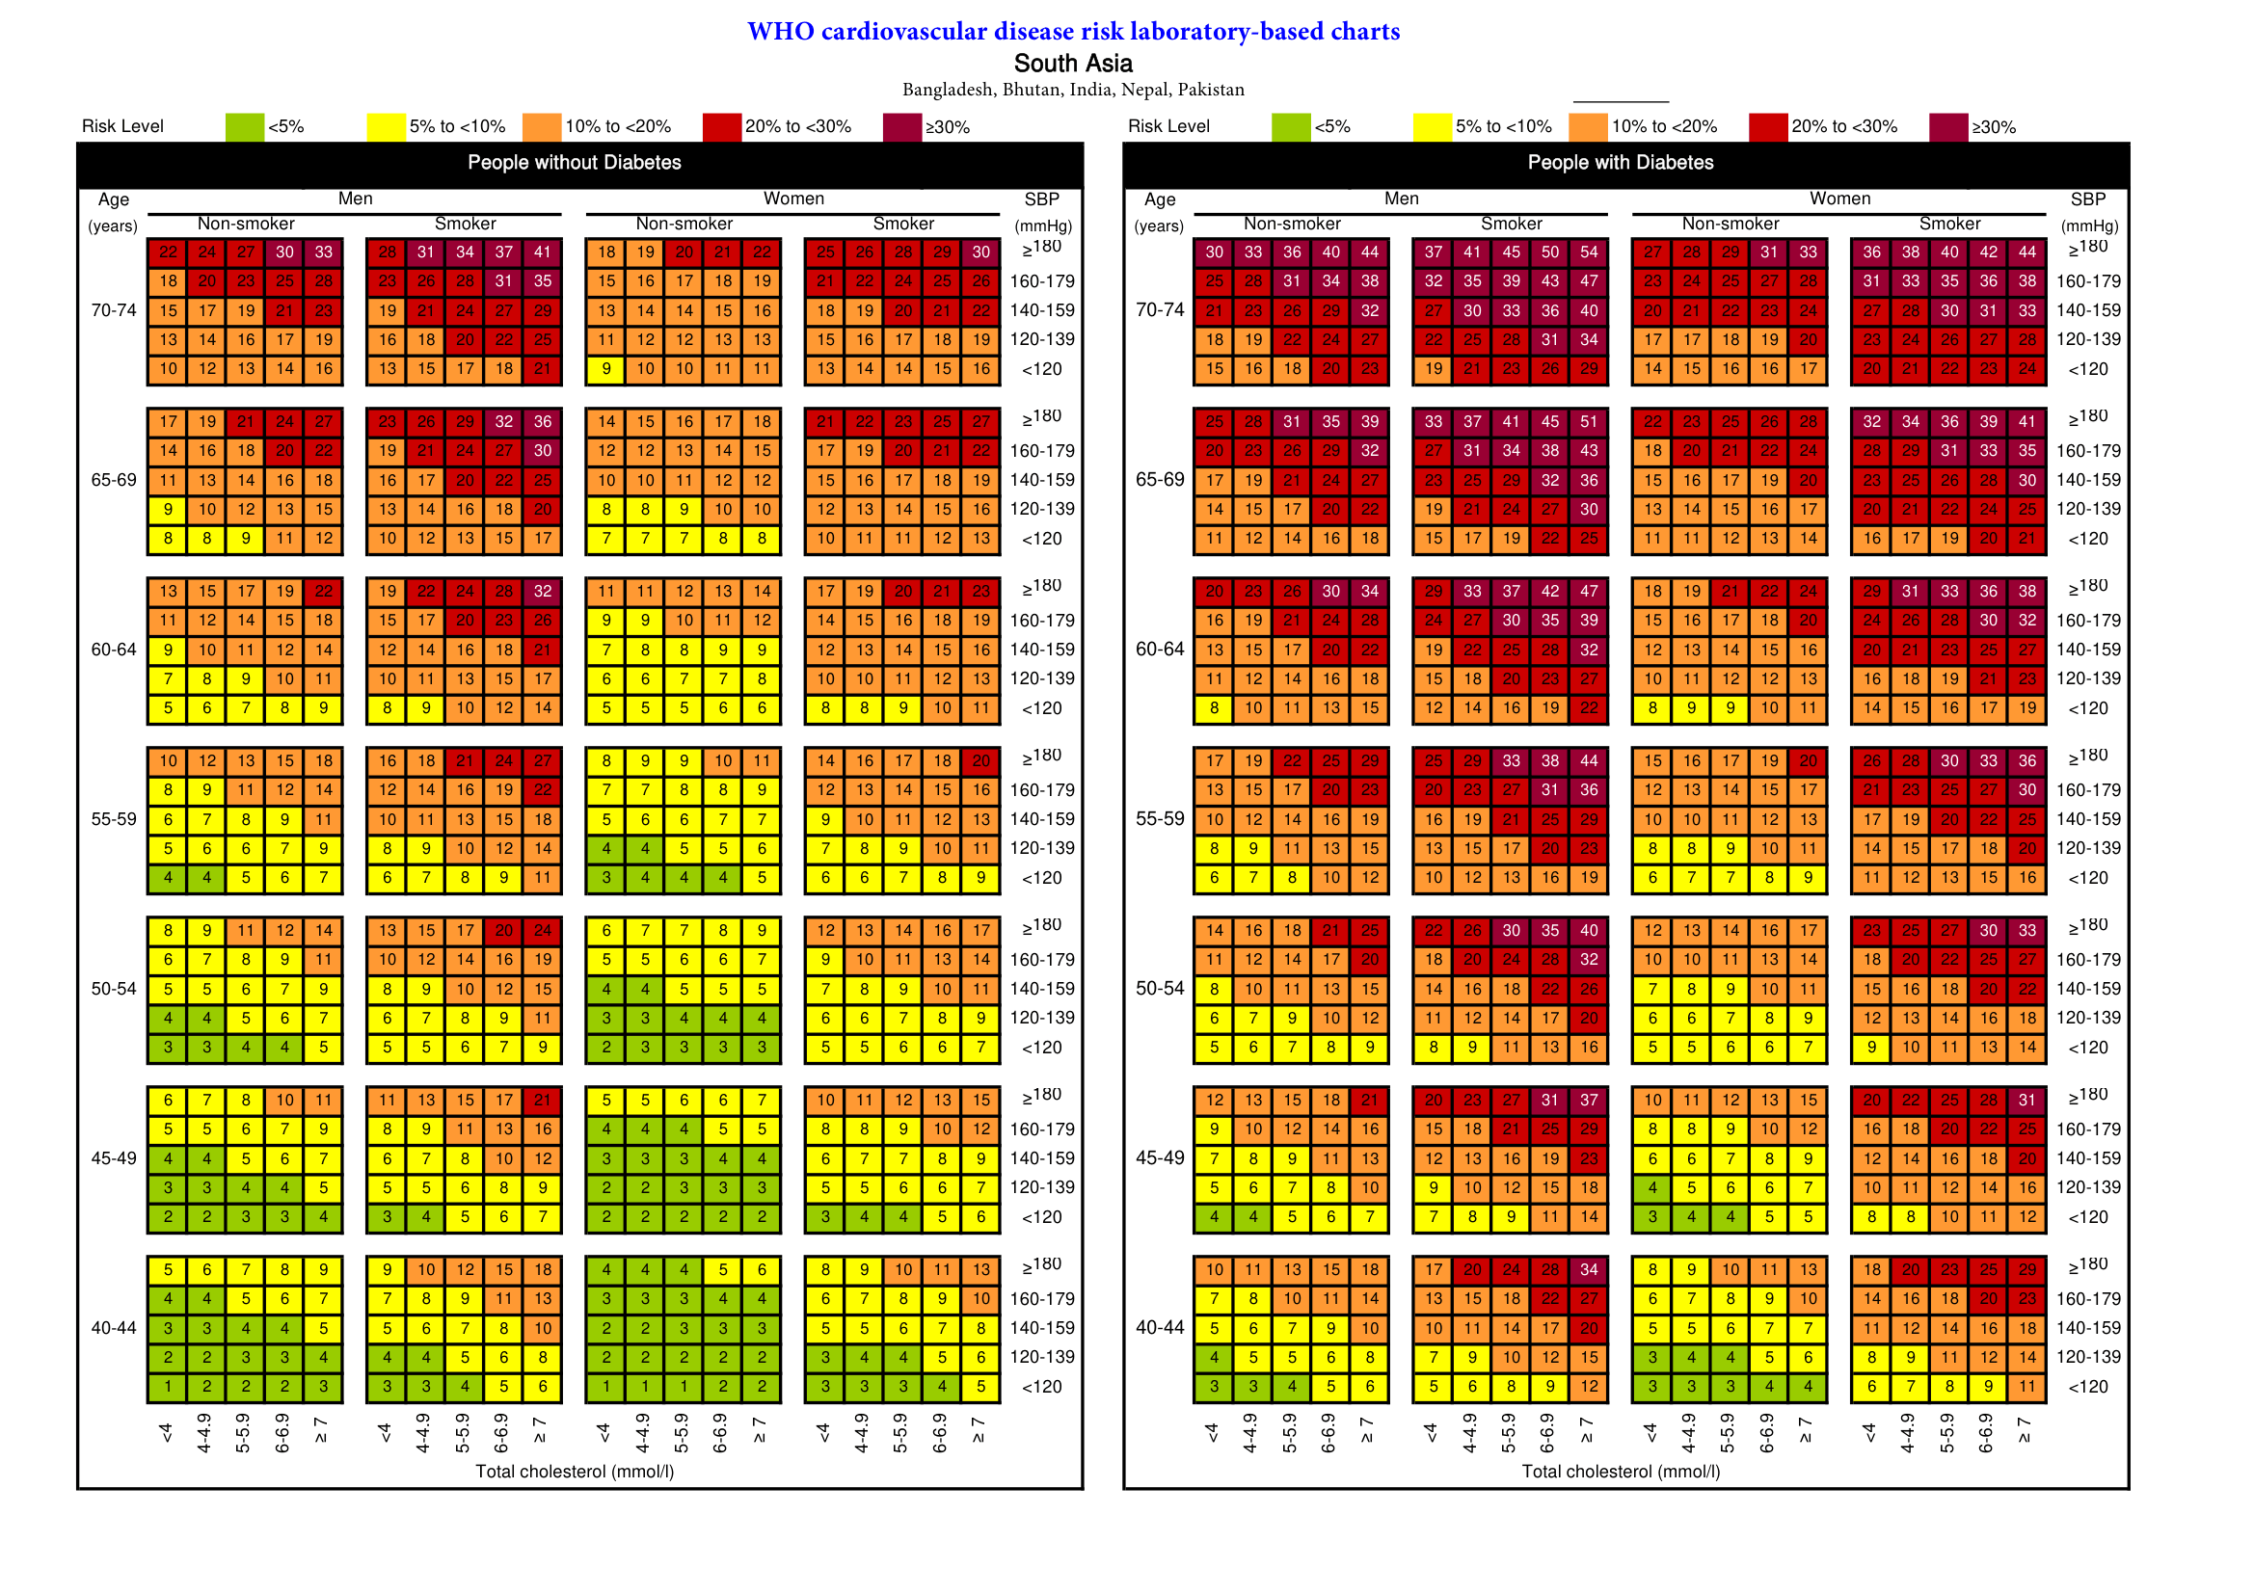
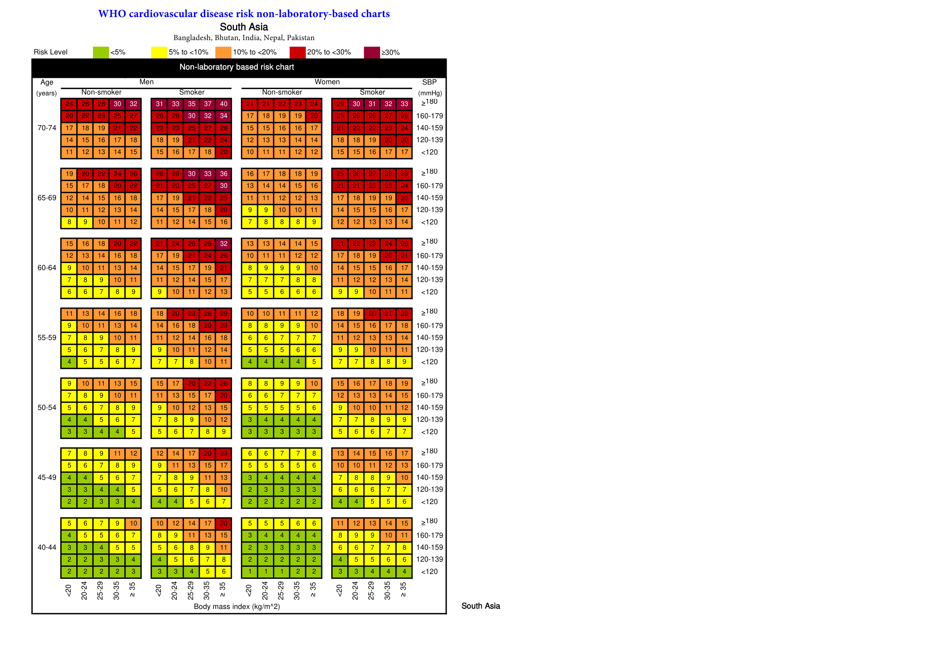
The Source Charts We Digitised Into Code
5
KDIGO Kidney Risk Grid
WHO CVD Chart — Lab Version (with Cholesterol)
G1-G5 (kidney function) x A1-A3 (protein in urine) = risk colour
Rows: age | Columns: cholesterol + BP | Colour: 10-year risk %
WHO CVD Chart — Non-Lab Version (uses BMI instead)
Auto-used when cholesterol lab result is unavailable
We coded all 15 cells of this grid into Python dict — no API
These are the ACTUAL source images. We manually digitised them — every number in our JSON data files came from these charts.
Notes:
This slide is the visual proof of the manual work.
Point to the KDIGO grid: 'We coded every one of these 15 coloured cells into a Python dict.'
Point to WHO lab chart: 'Each of these coloured numbers is a JSON value that our engine looks up.'
Point to WHO non-lab: 'This is the fallback chart — uses BMI instead of cholesterol. Our system automatically switches to this when cholesterol is missing.'

Slide 6
Handling Missing Data — Graceful Degradation
6
The problem statement explicitly calls out incomplete patient records in rural settings. Here is exactly how we handle it:
PATIENT ARRIVES
Are lab results available?
YES — Cholesterol available
NO — Cholesterol missing
Use lab-based WHO-CVD chart
Auto-switch to BMI-based chart
High-precision 10-year risk %
Risk calculated via BMI instead
Flag raised for doctor:
"Lipid panel recommended — Source: WHO CVD Guidelines"
Same logic for kidney tests: if Serum Creatinine is missing -> engine returns partial result + flags "Serum Creatinine required for kidney risk calculation"
Notes:
Emphasize: we never silently substitute a default value for missing data. The system tells the doctor exactly what is missing AND why it matters. The missing investigations list is de-duplicated — if two engines need creatinine, the doctor only sees one 'order creatinine' recommendation.

Slide 7
Tech Stack & Progress
7
Backend REST API — /analyze endpoint with Pydantic input validation
FastAPI (Python)
4 scoring engines — zero ML/AI dependencies for the math. 86% unit test coverage
Pure Python engines
AI layer: generates the plain-English explanation and referral note only.
Receives structured JSON — never computes a risk score
NVIDIA NIM / Claude AI
Frontend — no framework. Runs in any browser, works on a tablet.
10-patient demo dropdown built in for live evaluation
Vanilla HTML / CSS / JS
10 clinical edge-case patients (missing labs, elderly, stroke, healthy baseline)
Caught 3 real bugs before demo
Synthetic test suite
Notes:
Be honest about test coverage: 86%. Stroke edge cases are the thinnest area.
AI layer is a graceful enhancement: if the API key is absent, all 4 scoring engines still run and return full structured data — the AI explanation is additive, not required.

Slide 8
What We Caught & Fixed — Validation Approach
8
Honest reporting of real bugs found during development builds more credibility than claiming a perfect build.
Bug 1
WHO CVD Chart — BMI boundary gap
Our digitised grid had 30–34 where the source chart shows 30–35. A patient with BMI exactly 34.8 was reading the wrong risk band.
Found by: manually comparing our JSON grid cell-by-cell against the source chart image
Bug 2
Kidney Risk Grid — wrong cell colour
One specific cell (G4 + low protein) was coded as Yellow but the official KDIGO grid shows Orange.
Found by: comparing our hardcoded grid against the actual KDIGO heatmap screenshot we had saved
Bug 3
Kidney eGFR — float vs integer boundary
eGFR of 44.2 was falling through our G-stage conditions written as integers (30 <= eGFR <= 44), giving wrong G5 instead of G3b.
Found by: synthetic test Patient 10 (elderly boundary case) in our automated test suite
10-patient synthetic test suite — covering missing data, boundary values, elderly patients, acute stroke — caught all 3 bugs before demo.
Notes:
Don't be defensive about these bugs — they show the validation process is working.
Bug 2 was only catchable because we HAD the source image saved locally and could compare.
Bug 3 was caught by the test suite, not manually — shows the test suite was worth building.

Slide 9
Likely Questions
Q: Why not just ask an AI for the risk score?
AI can hallucinate numbers. Our engines use the actual validated formulas — every score is traceable to a specific guideline.
Live Demo
Q: Is this validated on real patients?
The formulas we coded ARE validated — IDRS on 113k patients, WHO/KDIGO by global health bodies. Our implementation tested on 10 synthetic edge-case patients.
localhost:8081
Q: What if two conditions give conflicting advice?
P03
High Risk case — full lab data
The ACC/AHA guideline has cross-condition rules (e.g. CKD + HTN = stricter BP target). We coded these combined rules into the referral engine.
P04
Missing labs — graceful fallback
Q: What would you build next?
P06
Healthy patient — all green
Offline mode (PS2 scope), more regional language support, expanded synthetic test coverage to 100+ cases.
github.com/CodeMeAbhishek/TETRA010
Notes:
Demo order:
1. P03 — walk through all 4 gauges + referral banner
2. P04 — show WHO chart fallback + missing investigations panel
3. P06 — show calm low-risk state (system doesn't just alarm on everyone)
After demo, offer to open GitHub and show /backend/scoring/ folder.

Slide 10
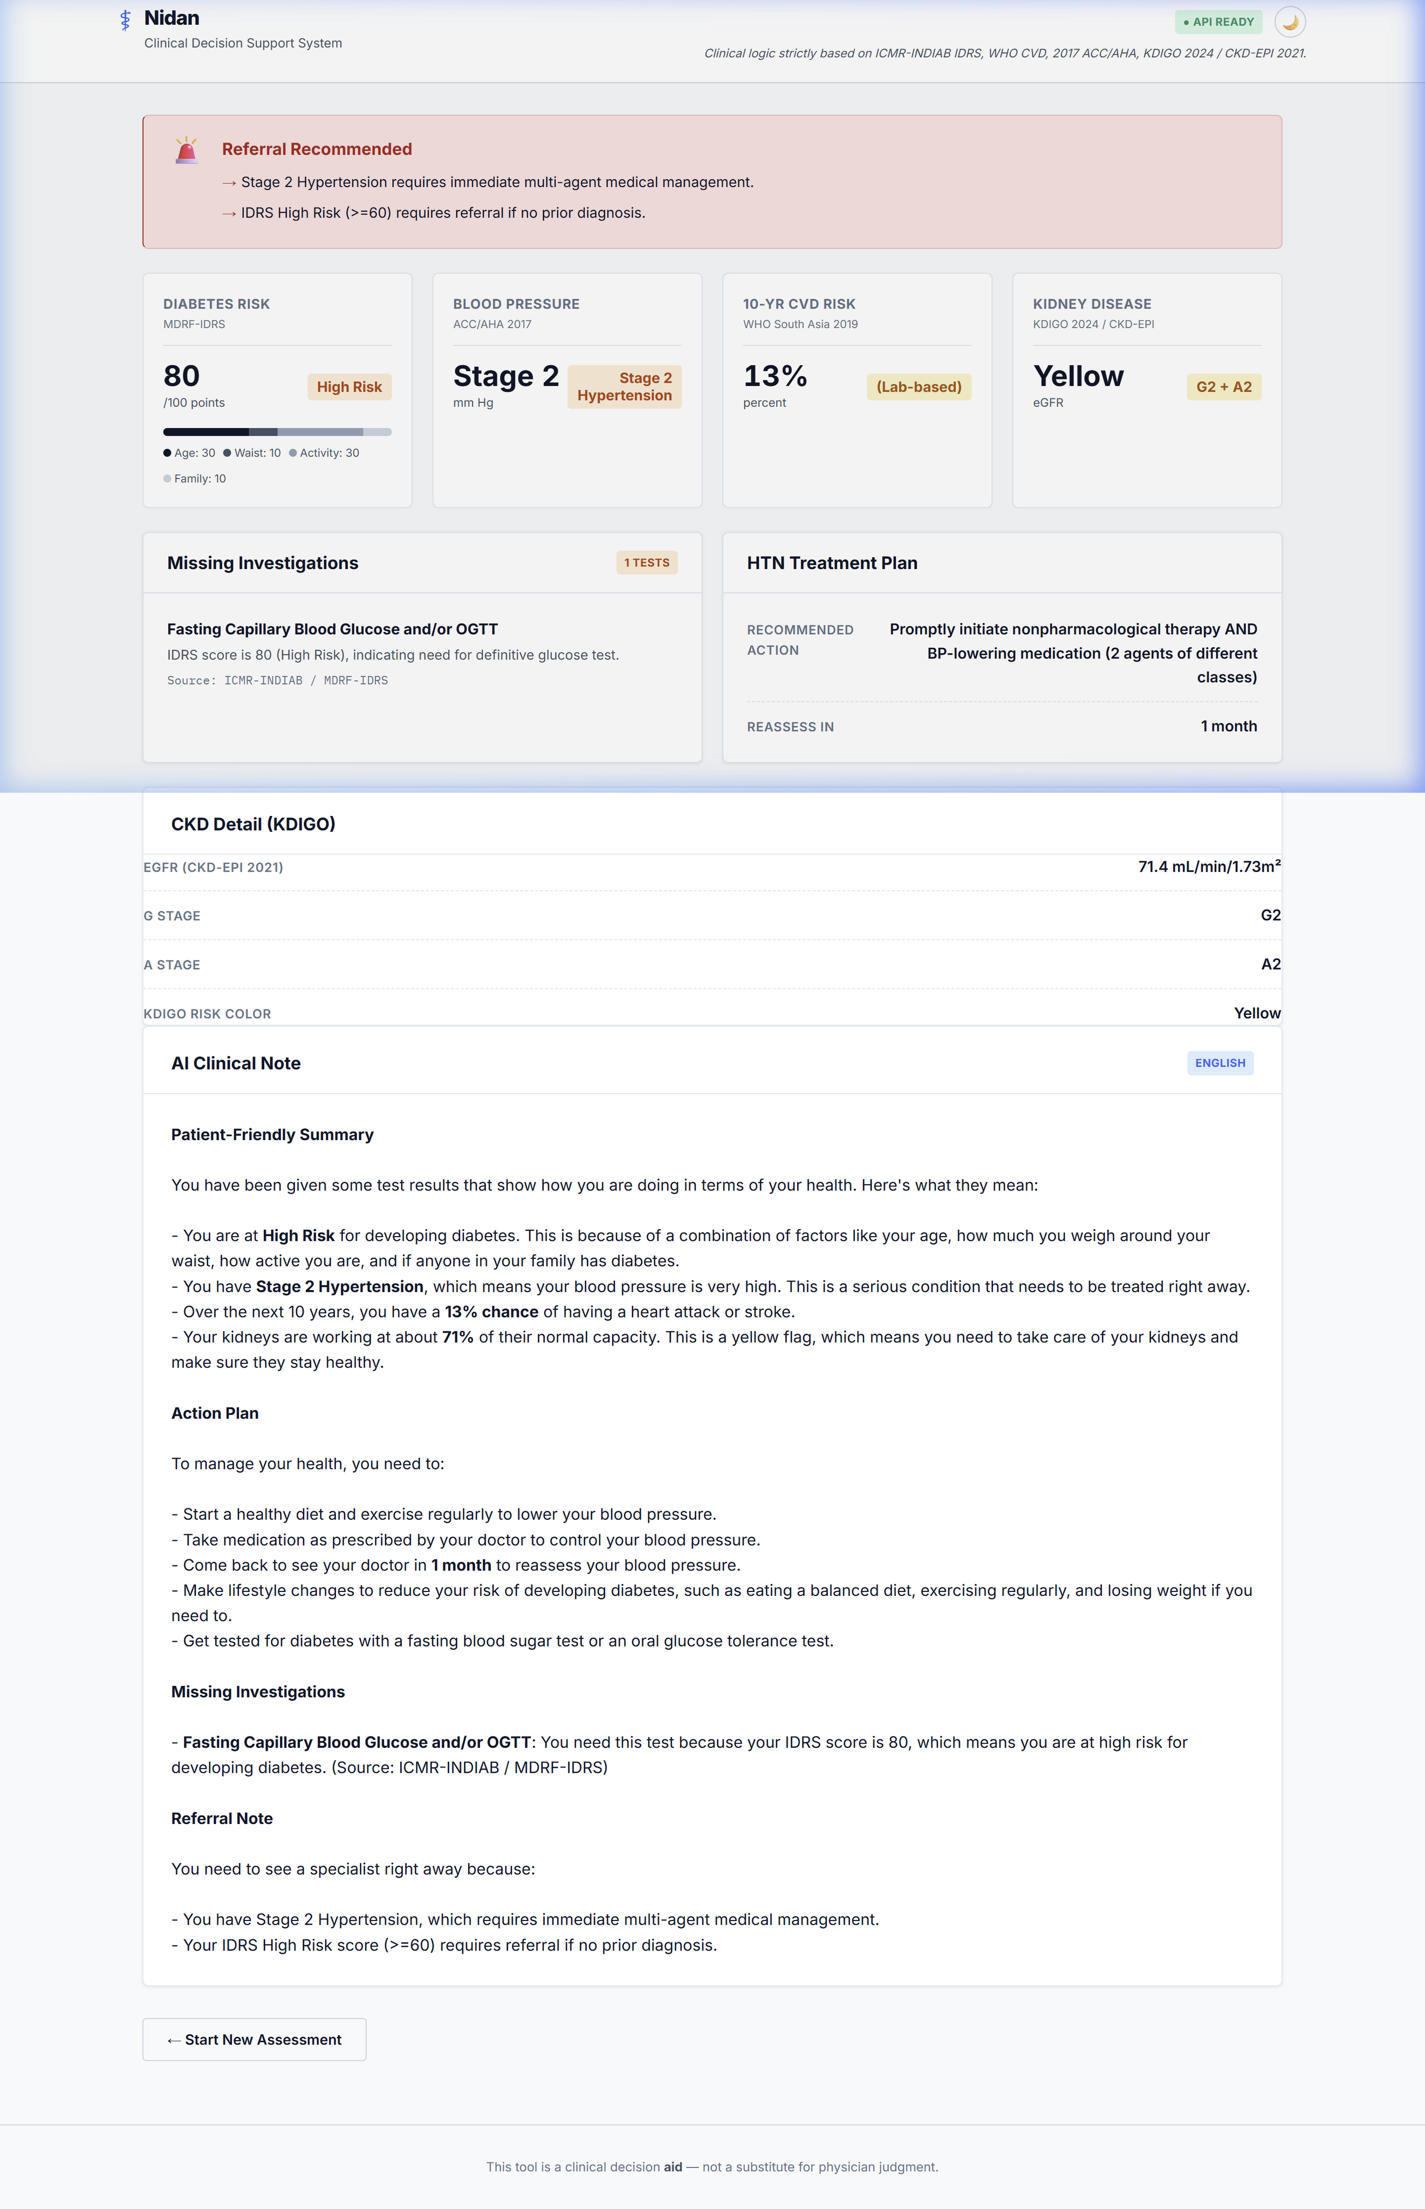
Test Case P03: Multi-Condition High Risk
10
High Risk Scenario Profile
• Patient features:
- Age: 65, Male
- Waist: 102cm (IDRS high)
- SBP: 165 mmHg (HTN Stage 2)
- Lipids: Total Chol 6.2 mmol/L
- Creatinine: 1.8 mg/dL
- Urine ACR: 45 mg/g (CKD G3b-A2)
• Assessment Outcomes:
- CVD risk: 36% (Very High)
- IDRS: 80 (High Risk)
- HTN: Stage 2 Hypertension
- CKD: Orange (High Risk)
• Referral Engine:
- Action: REFER (Urgent)
- Note drafts complete clinical justifications for the PCP.

Slide 11
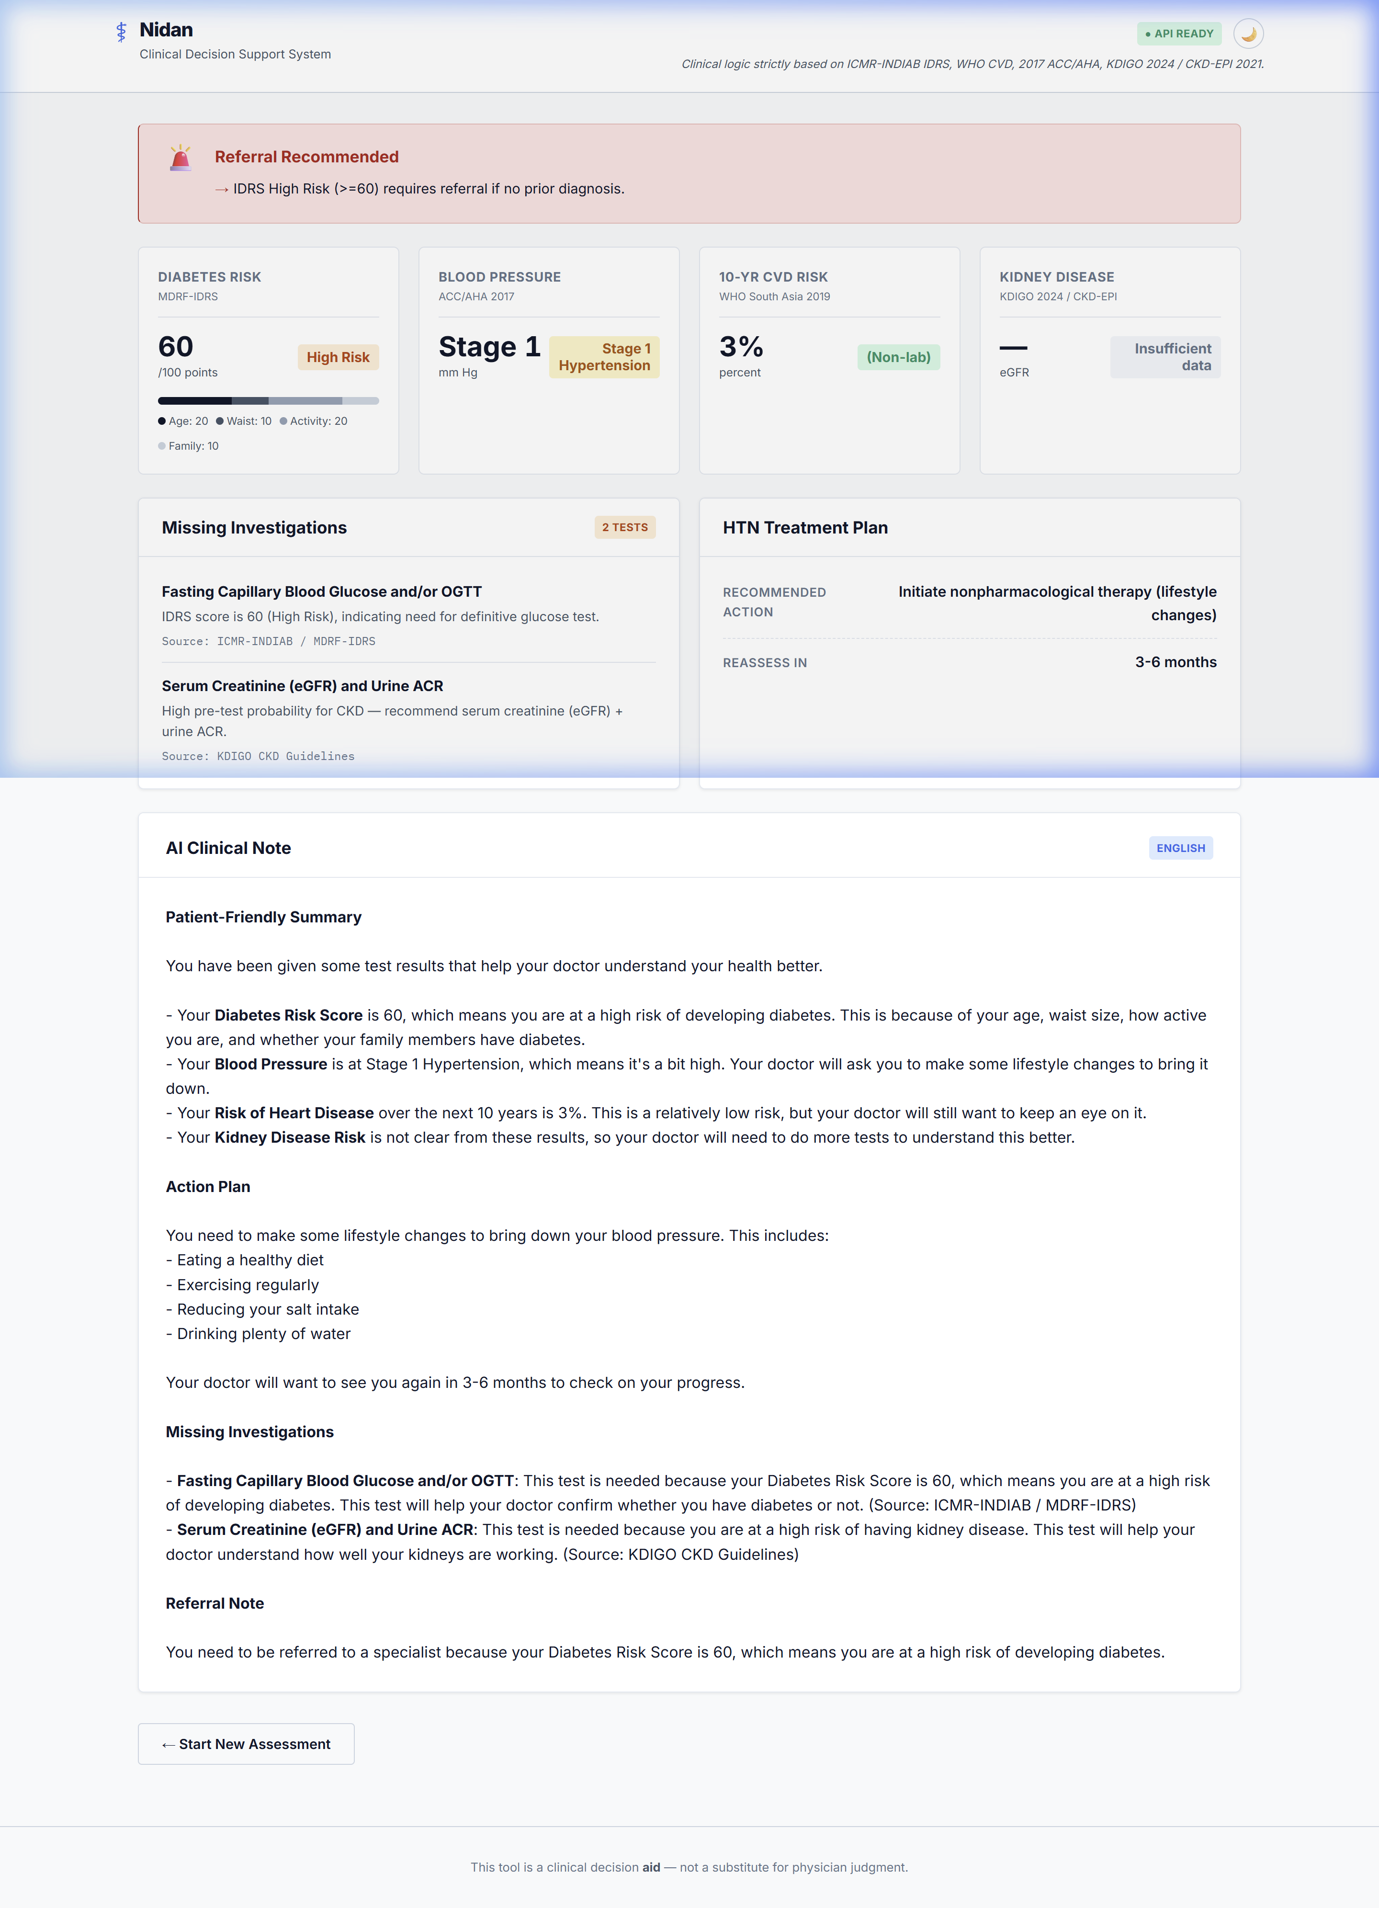
Test Case P04: Missing Labs Fallback
11
Graceful Degradation Profile
• Patient features:
- Age: 55, Female
- Waist: 95cm
- SBP: 135 mmHg
- Lipids: MISSING (No labs)
- BMI: 28.5 (Fallback input)
• Assessment Outcomes:
- CVD: Automatically uses BMI non-lab chart. Calculated risk: 8%.
- HTN: Stage 1 Hypertension
• Required Investigations:
- Aggregator flags Lipid Panel and Serum Creatinine as missing.
- Cites exact medical source.

Slide 12
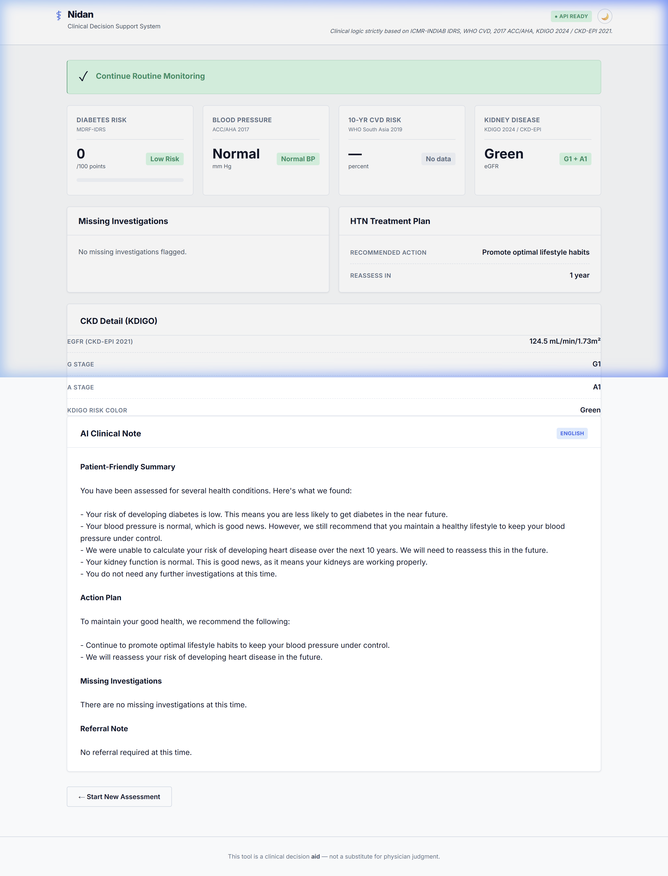
Test Case P06: Healthy Baseline
12
Healthy Patient Profile
• Patient features:
- Age: 35, Female
- Waist: 70cm
- Physical activity: Active
- SBP: 110, DBP: 75 mmHg
- No prior history
• Assessment Outcomes:
- CVD risk: <1% (Low)
- IDRS: 0 (Low)
- HTN: Normal BP
- CKD: G1/A1 Green (Normal)
• Referral Engine:
- Action: ROUTINE MONITORING
- Reassuring clinical communication in summary.

