Slide 1

Class - 02
Hasan Mahmud Rhidoy
Software Development Engineer, BRAC IT

Slide 2
Class Topics
1. Python Variables
2. Python Data Types
3. Python Keywords
4. Python Comments
5. Data Input and Output

Slide 3
Python Variables : Introduction
Variable is a name that is used to refer to memory location. Python variable is also known as an identifier and used to hold value.
In Python, we don't need to specify the type of variable because Python smart enough to get variable type.
Variable names can be a group of both the letters and digits, but they have to begin with a letter or an underscore.

Slide 4
Python Variables : identifier naming rules and conventions
Valid identifiers must follow these rules:
The first character of the variable must be an alphabet or underscore ( _ ).
All the characters except the first character may be an alphabet of lower-case(a-z), upper-case (A-Z), underscore, or digit (0-9).
Identifier name must not contain any white-space, or special character (!, @, #, %, ^, &, *).
Identifier name must not be similar to any keyword defined in the language.
Identifier names are case sensitive; for example, myname, and MyName is not the same.
Examples of valid identifiers: num123, _num, num_9, etc.
Examples of invalid identifiers: 1num, num%4, num 9, etc.

Slide 5
Python Variables :Declare Variable and Assigning values
Python does not bind us to declare a variable before using it in the application. It allows us to create a variable at the required time.
The equal (=) operator is used to assign value to a variable.
Variable Names
Camel Case - In the camel case, each word or abbreviation in the middle of begins with a capital letter. There is no intervention of whitespace. For example - nameOfStudent, valueOfVaraible, etc.
Pascal Case - It is the same as the Camel Case, but here the first word is also capital. For example - NameOfStudent, etc.
Snake Case - In the snake case, Words are separated by the underscore. For example - name_of_student, etc.
>>>>>> Code On the Screen <<<<<<

Slide 6
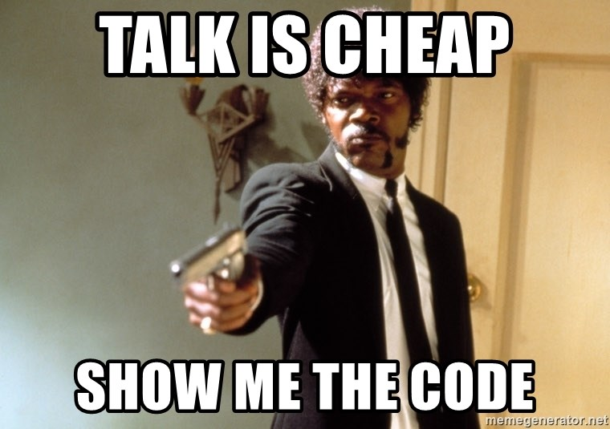
Python Variables : Variable Type
There are two types of variables in Python –
Local variable : Local variables are the variables that declared inside the function and have scope within the function.
Global variable : Global variables can be used throughout the program, and its scope is in the entire program.

Slide 7
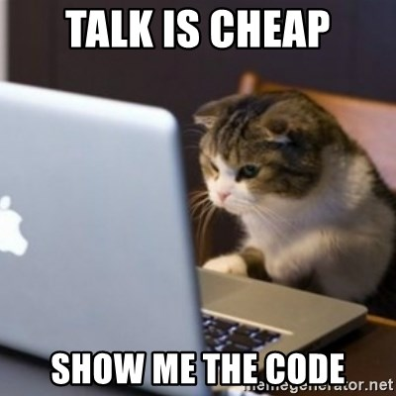
Python Variables : Multiple Assignment

Slide 8
Python Variables : Object Identity

Slide 9
Python Variables : Delete Variable

Slide 10
Python Variables : Print Single and Multiple Variable

Slide 11
Python Variables : [Clean Code] 5 tips for better variable names
Revealing Intent: Variable names should express their purpose
Search-ability: Variable name should be easy to find in your codebase.
Consistent vocabulary: Names of variables of the same entity should be the same across your codebase.
Avoid Mental Mapping: Be explicit rather than implicit in your names, don’t leave any room for assumptions.
Avoid Excess Context: Don’t provide more context in the variable name than already provided by its surrounding structure.

Slide 12
Python Data Type : Introduction
Variables can hold values, and every value has a data-type.
Python is a dynamically typed language; hence we do not need to define the type of the variable while declaring it.
The interpreter implicitly binds the value with its type.

Slide 13
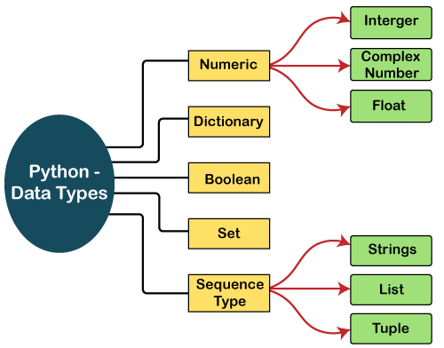
Standard data types

Slide 14
Python Data Type : Standard Data type
Numbers: Number stores numeric values. The integer, float, and complex values belong to a Python Numbers data-type.
Python supports three types of numeric data.
Int - Integer value can be any length such as integers 10, 2, 29, -20, -150 etc.
Float - Float is used to store floating-point numbers like 1.9, 9.902, 15.2, etc.
Complex - A complex number contains an ordered pair, i.e., x + iy where x and y denote the real and imaginary parts, respectively.

Slide 15
Python Data Type : Standard Data type
Sequence Type
String : The string can be defined as the sequence of characters represented in the quotation marks. In Python, we can use single, double, or triple quotes to define a string.
List: Python Lists are similar to arrays. However, the list can contain data of different types. The items stored in the list are separated with a comma (,) and enclosed within square brackets [].
Tuple: A tuple is similar to the list in many ways. The items of the tuple are separated with a comma (,) and enclosed in parentheses (). A tuple is a read-only data structure as we can't modify the size and value of the items of a tuple.

Slide 16
Python Data Type : Standard Data type
Dictionary
Dictionary is an unordered set of a key-value pair of items.
Key can hold any primitive data type, whereas value is an arbitrary Python object.
The items in the dictionary are separated with the comma (,) and enclosed in the curly braces {}.
Boolean
Boolean type provides two built-in values, True and False.
These values are used to determine the given statement true or false.
Set
Python Set is the unordered collection of the data type.
It is iterable, mutable(can modify after creation), and has unique elements.
The set is created by using a built-in function set(), or a sequence of elements is passed in the curly braces and separated by the comma.

Slide 17
Python Data Type : Type Check
Python enables us to check the type of the variable used in the program.
Python provides us the type() function, which returns the type of the variable passed.

Slide 18
Python Keywords : Introduction
Python keywords are unique words reserved with defined meanings.
False | await | else | import | pass
None | break | except | in | raise
True | class | finally | is | return
and | continue | for | lambda | try
as | def | from | nonlocal | while
assert | del | global | not | with
async | elif | if | or | yield

Slide 19
Python Comments : Introduction
We might wish to take notes of why a section of script functions, for instance.
Formulas, procedures, and sophisticated business logic are typically explained with comments.
Two types of comments in Python:
Single-line comments
multi-line comments

Slide 20
Python Data Input and Output

Slide 21
Python TypeCasting

Slide 22
