Slide 1
Online RESTAURANT Service
What is a cell ?
What is a
ll ?
Presented by :
UAP_DEBUGGERS
Saturday, 5 August, 2017

Slide 2
Unique Ideas
Location Track
Time Intelligence
Seasonal Intelligence
Table Reservation
Custom Order
Mobile PayMent

Slide 3
Architecture Design
Location
Client
Start
Restaurant
Suggest
Restaurant
Time
Menu
Cash
Credit
Instant
Seasonal
Order
Payment
Pre
Custom

Slide 4
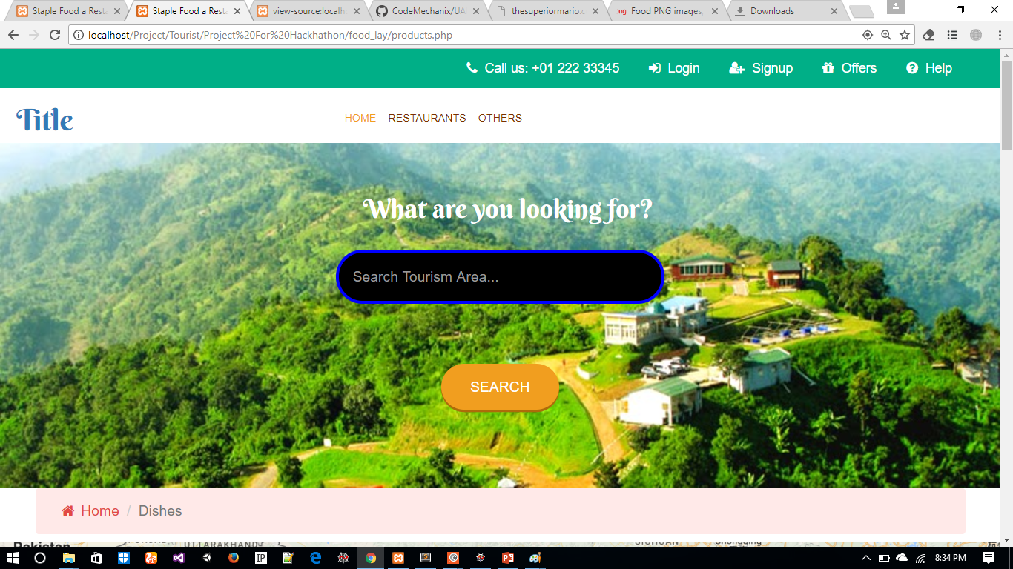
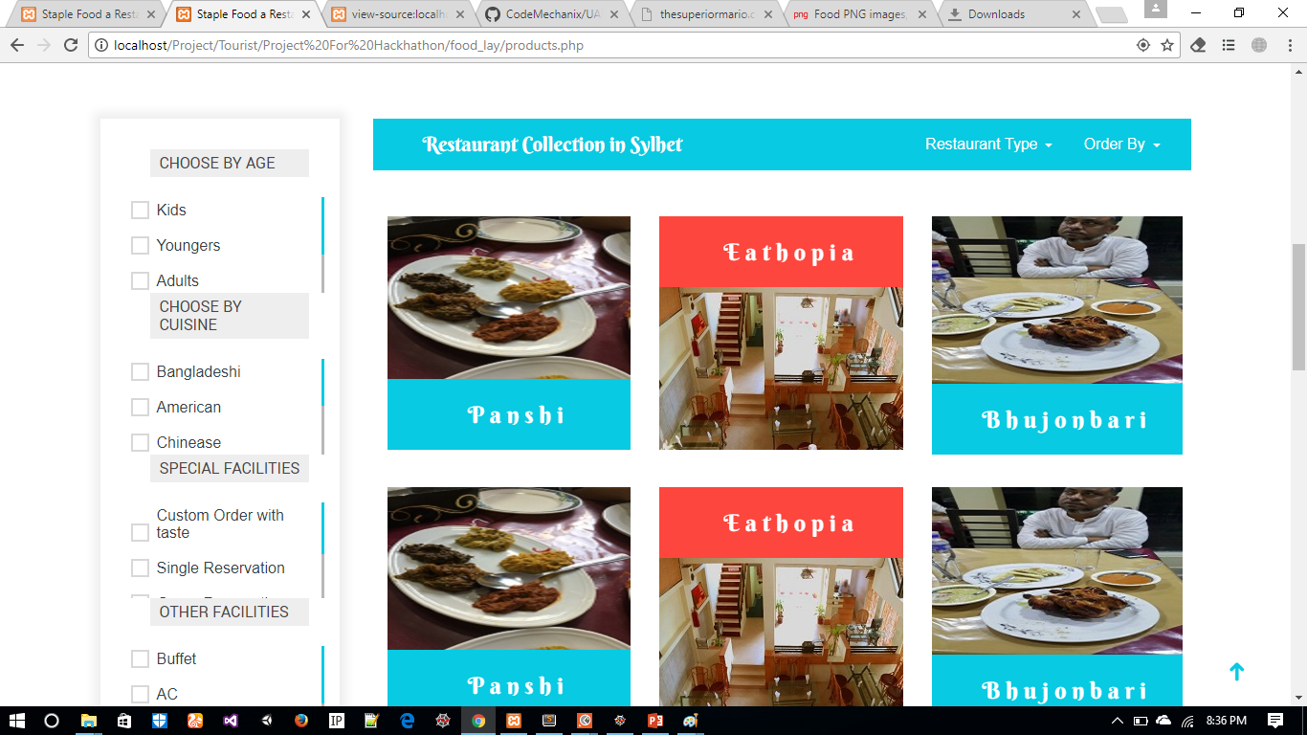
Screen Shots

Slide 5
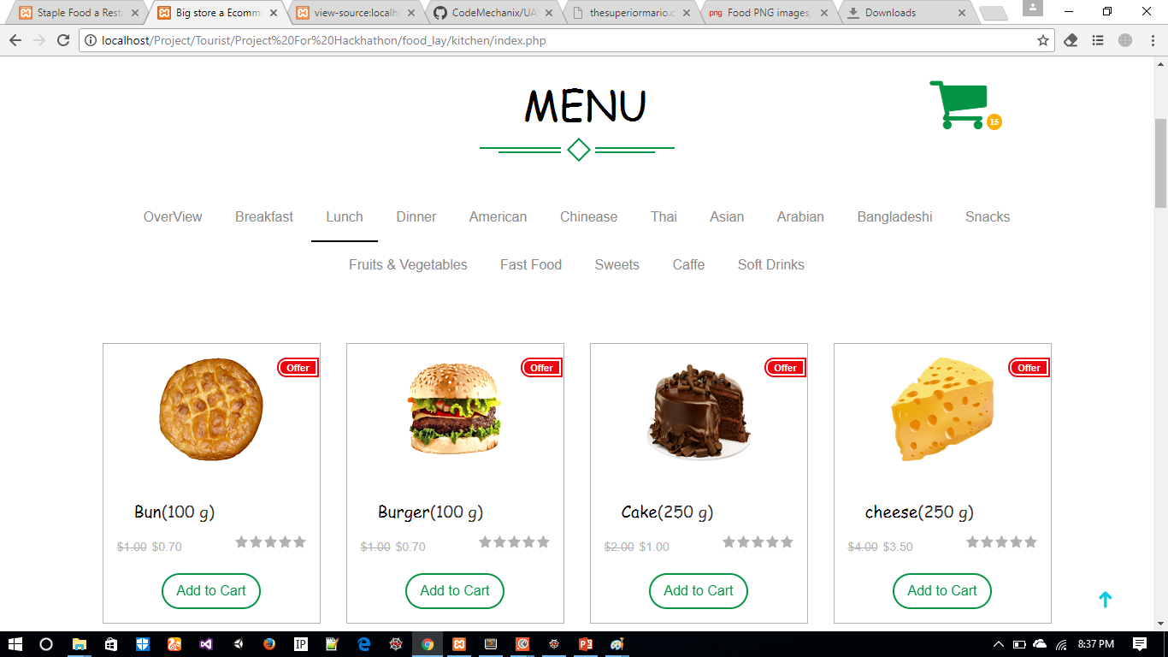
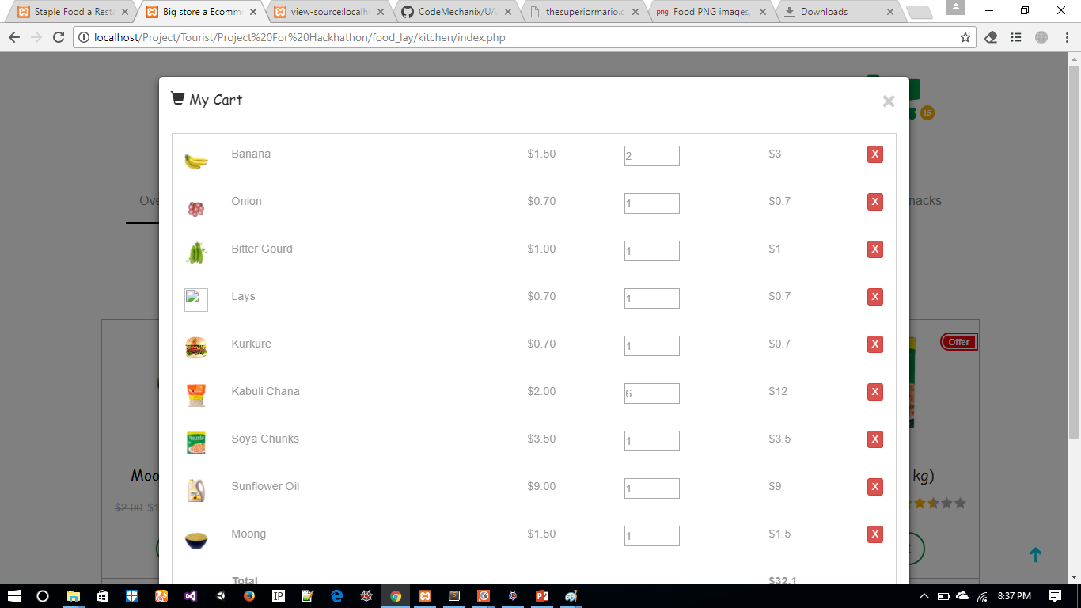
Screen Shot

