Slide 1
Nachos中模拟的硬件设备

Slide 2
Nachos simulates a real CPU and harware devices

Slide 3
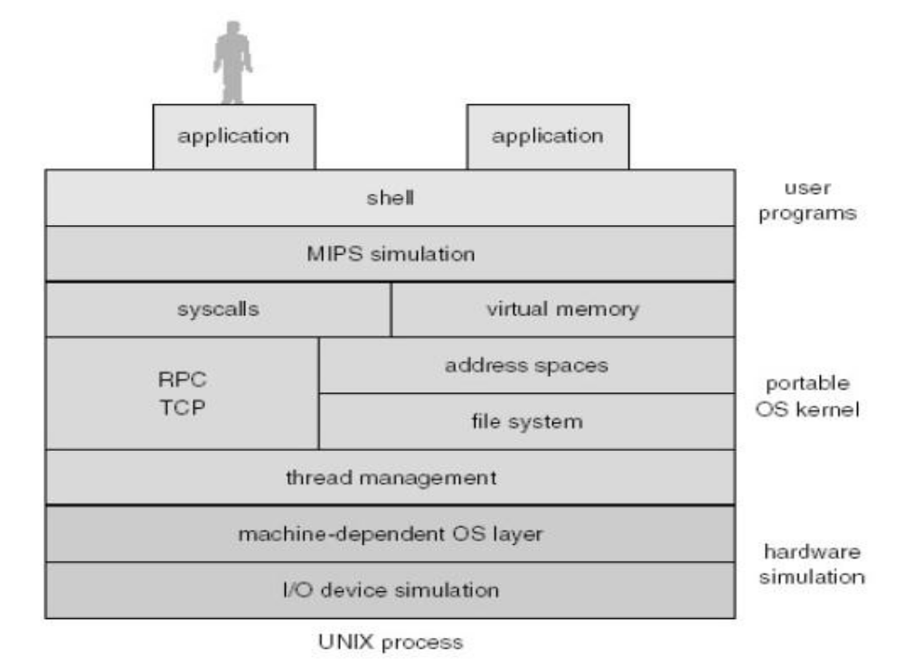
Nachos系统的层次关系

Slide 4
Configuring Nachos
When Nachos starts, it reads in nachos.conf from the current directory.
It contains a bunch of keys and values, in the simple format "key = value" with one key/value pair per line.
To change the default scheduler, default shell program, to change the amount of memory the simulator provides, or to reduce network reliability, modify this file.

Slide 5
Configuring Nachos
The nachos simulation is configured for the various projects using the nachos.conf file
It specifies which hardware devices to include in the simulation as well as which Nachos kernel to use.
This file is equivelant to the BIOS
AutoGrader is equivelant to the bootstrap code at the boot sector of the disk.

Slide 6
nachos.conf（for Proj1）
Machine.stubFileSystem = false
Machine.processor = false
Machine.console = false
Machine.disk = false
Machine.bank = false
Machine.networkLink = false
ElevatorBank.allowElevatorGUI = true
NachosSecurityManager.fullySecure = false
ThreadedKernel.scheduler = nachos.threads.RoundRobinScheduler #nachos.threads.PriorityScheduler
Kernel.kernel = nachos.threads.ThreadedKernel

Slide 7
nachos.conf（for Proj2）
Machine.stubFileSystem = true
Machine.processor = true
Machine.console = true
Machine.disk = false
Machine.bank = false
Machine.networkLink = false
Processor.usingTLB = false
Processor.numPhysPages = 64

Slide 8
nachos.conf（for Proj2）(cont.)
ElevatorBank.allowElevatorGUI = false
NachosSecurityManager.fullySecure = false
ThreadedKernel.scheduler =nachos.threads.RoundRobinScheduler #nachos.threads.LotteryScheduler
Kernel.shellProgram = halt.coff #sh.coff
Kernel.processClassName = nachos.userprog.UserProcess
Kernel.kernel = nachos.userprog.UserKernel

Slide 9
nachos.conf（for Proj3）
Machine.stubFileSystem = true
Machine.processor = true
Machine.console = true
Machine.disk = false
Machine.bank = false
Machine.networkLink = false
Processor.usingTLB = true
Processor.numPhysPages = 16

Slide 10
nachos.conf（for Proj3）(cont.)
ElevatorBank.allowElevatorGUI = false
NachosSecurityManager.fullySecure = false
ThreadedKernel.scheduler = nachos.threads.RoundRobinScheduler
Kernel.shellProgram = sh.coff
Kernel.processClassName = nachos.vm.VMProcess
Kernel.kernel = nachos.vm.VMKernel

Slide 11
nachos.conf（for Proj4）
Machine.stubFileSystem = true
Machine.processor = true
Machine.console = true
Machine.disk = false
Machine.bank = false
Machine.networkLink = true
Processor.usingTLB = true
Processor.variableTLB = true
Processor.numPhysPages = 16

Slide 12
nachos.conf（for Proj4）(cont.)
ElevatorBank.allowElevatorGUI = false
NetworkLink.reliability = 1.0 # use 0.9 when you're ready
    Specifies the reliability of the network. The reliability, between 0 and 1, is the probability that any particular packet will not get dropped by the network.
NachosSecurityManager.fullySecure = false
ThreadedKernel.scheduler = nachos.threads.RoundRobinScheduler
Kernel.shellProgram = sh.coff
Kernel.processClassName = nachos.network.NetProcess
Kernel.kernel = nachos.network.NetKernel

Slide 13
nachos.conf中一些常用的设置
Machine.stubFileSystem
    Specifies whether the machine should provide a stub file system.
    A stub file system just provides direct access to the test directory.
    Since we’re not doing the file system project, this should always be true
Machine.processor
    Specifies whether the machine should provide a MIPS processor.
    In the first project, we only run kernel code, so this is false.
    In the other projects it should be true.

Slide 14
nachos.conf中一些常用的设置(续)
Machine.console:
    Specifies whether the machine should provide a console.
    The first project doesn’t need it, but the rest of them do
Machine.disk:
    Specifies whether the machine should provide a simulated disk.
    No file system project, so this should always be false.
ElevatorBank.allowElevatorGUI:
    Normally true. When we grade, this will be false, to prevent malicious students from running a GUI during grading.

Slide 15
nachos.conf中一些常用的设置(续)
NachosSecurityManager.fullySecure:
    Normally false. When we grade, this will be true, to enable additional security checks.
Kernel.kernel:
    Specifies what kernel class to dynmically load.
    For proj1, this is nachos.threads.ThreadedKernel.
    For proj2, this should be nachos.userprog.UserKernel.
    For proj3, nachos.vm.VMKernel.
    For proj4, nachos.network.NetKernel.
Processor.usingTLB:
    Specifies whether the MIPS processor provides a page table
    Interface or a TLB interface. (Translation Lookaside Buffer)
    In page table mode (proj2), the processor accesses an arbitrarily large kernel data structure to do address translation.
    In TLB mode (proj3 and proj4), the processor maintains a small TLB (4 entries).

Slide 16
nachos.conf中一些常用的设置(续)
Processor.numPhysPages:
    The number of pages of physical memory.
    Each page is 1K.
    This is normally 64, but we can lower it in proj3 to see whether projects thrash or crash.

Slide 17
Boot Process
The nachos boot process is similar to that of a real machine
    An instance of the nachos.machine.Machine class is created to begin booting.
    The hardware (Machine object) first initializes the devices including the interrupt controller, timer, elevator controller, MIPS processor, console, and file system.
    The Machine object then hands control to the particular AutoGrader in use
      An action equivelant to loading the bootstrap code from the boot sector of the disk.
    It is the AutoGrader that creates a Nachoskernel, starting the operating system, don't worry about this step

Slide 18
Machine类 is the master class of the simulated machine. Processes command line arguments, constructs all simulated hardware devices, and starts the grader.
Processor类模拟MIPS处理器及其指令系统
Translate类模拟MMU设备
Interrupt类模拟中断处理设备
Timer类模拟时钟设备
Console类模拟控制台设备
Disk类模拟硬磁盘设备
Filesystem类模拟文件系统
Network类模拟网络接口设备

