Slide 1

Introduction to Finite State Machines
Frank E. Hernandez

Slide 2
Finite State Machine
A deterministic finite state machine is a quintuple (5-tuple) (Σ,S,s₀,δ,F) where:
Σ is the input alphabet.
S is the set of state.
s₀ is the initial state.
δ is the state-transition function: δ: S x Σ -> S
F is the set of final state.

Slide 3
Example
Σ = {a,b}
S = {I, M}
s₀ = I
F ={}
δ : (I , a) -> M
δ : (M, b) -> I
I
a
M
b

Slide 4
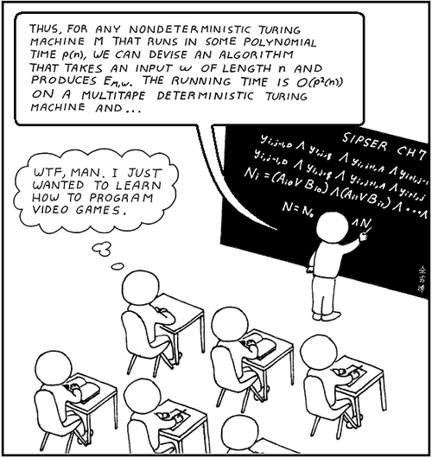
Say What???

Slide 5


Game Example
Σ = {“move”, “done”}
S = { , }
s₀ =
F ={}
δ : ( , “move”) ->
δ : ( , “done”) ->
I
“move”
M
“done”

Slide 6
Code Link
Start Project

