Slide 1
Chapter Three
Cellular Networks and Satellite Communication

Slide 2
Outline
Basics of Cellular Networks
Generation of Cellular Networks
Basics of Satellite Communication

Slide 3
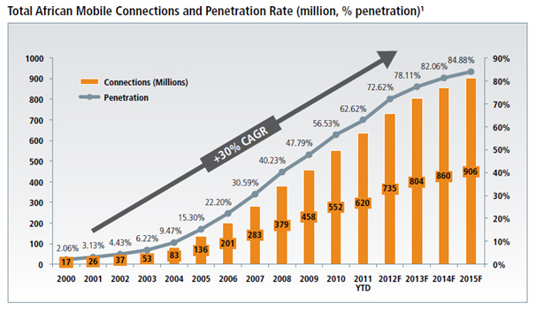
Ethiopia - 2012 Main Lines In Use: 797,500 Mobile Cellular: 20.524 million http://www.economywatch.com/economic-statistics/Ethiopia/Telephone_Statistics/

Slide 4
Basics of Cellular Networks
Cellular radio is a technique that was developed to increase the capacity available for mobile radio telephone service.
Prior to the introduction of cellular radio, mobile radio telephone service was only provided by a high-power transmitter/receiver.
Cellular Network Organization
a cellular network is the use of multiple low-power transmitters, on the order of 100W or less
Because the range of such a transmitter is small, an area can be divided into cells, each one served by its own antenna.
Each cell is allocated a band of frequencies and
Each cell is served by a base station, consisting of transmitter, receiver, and control unit.
Adjacent cells are assigned different frequencies to avoid interference or crosstalk

Slide 5
Basics of Cellular Networks
The first design decision to make is the shape of cells to cover an area.
A matrix of square cells would be the simplest layout to define
However, this geometry is not ideal.
If the width of a square cell is d, then a cell has four neighbors at a distance d and four neighbors at a distance √2d.
As a mobile user within a cell moves toward the cell's boundaries, it is best if all of the adjacent antennas are equidistant.
This simplifies the task of determining when to switch the user to an adjacent antenna and which antenna to choose.

Slide 6
Basics of Cellular Networks
A hexagonal pattern provides for equidistant antennas
A precise hexagonal pattern is not used.
Variations from the ideal are due to
Topographical limitations,
Local signal propagation conditions, and
Practical limitation on sitting antennas

Slide 7
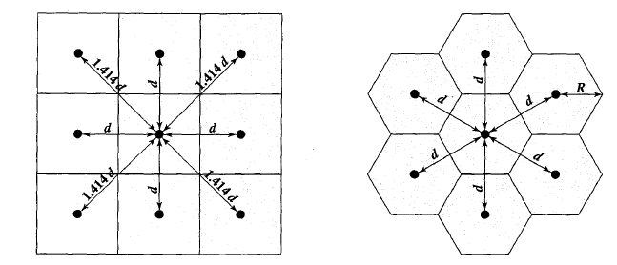
Basics of Cellular Networks

Slide 8
Basics of Cellular Networks
Frequency Reuse
Each cell has a base transceiver.
The transmission power is carefully controlled to allow communication within the cell using a given frequency band while limiting the power at that frequency
Within a given cell, multiple frequency bands are assigned, the number of bands depending on the traffic expected.
A key design issue is to determine the minimum separation between two cells using the same frequency band, so that the two cells do not interfere with each other.
Objective is to reuse frequency in nearby cells
10 to 50 frequencies assigned to each cell
Transmission power controlled to limit power at that frequency escaping to adjacent cells
The issue is to determine how many cells must intervene between two cells using the same frequency

Slide 9
In characterizing frequency reuse, the following parameters are commonly used:
D = minimum distance between centers of cells that use the same frequency band (called co-channels )
R = radius of a cell
d = distance between centers of adjacent cells
N = number of cells in a repetitious pattern (each cell in the pattern uses a unique set of frequency bands - reuse factor.
In a hexagonal cell pattern, only the following values of N are possible:
N = I² + J² + (I X J), I,J = 0, 1,2,3, ...
Can have the value 1,3,4,7,9,12,13,16,19,21,…

Slide 10
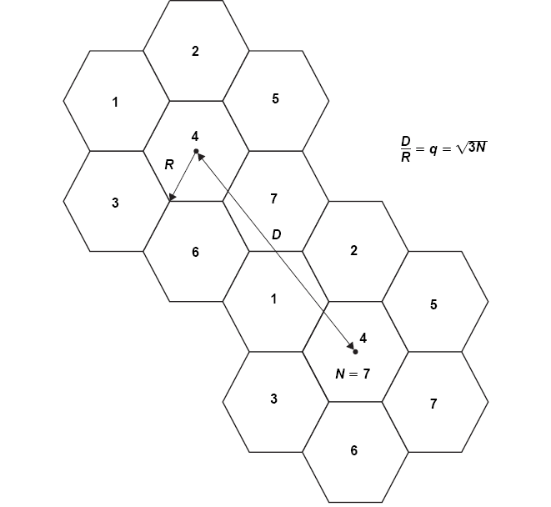

Slide 11
Basics of Cellular Networks
Increasing Capacity
as more customers use the system, traffic may build up so that there are not enough frequency bands assigned to a cell to handle its calls.
A number of approaches have been used to cope with this situation, including the following:
Adding new channels - growth and expansion can be managed in an orderly fashion by adding new channels.
Frequency borrowing - frequencies are taken from adjacent cells by congested cells.
The frequencies can also be assigned to cells dynamically.

Slide 12
Basics of Cellular Networks
Cell splitting - Cells in areas of high usage can be split into smaller cells.
Generally, the original cells are about 6.5 to 13 km in size.
The smaller cells can themselves be split; however, 1.5-km cells are close to the practical minimum size as a general solution
Handoff – transferring of the call from one base transceiver to another
As the cells get smaller, these handoffs become much more frequent.
Cell sectoring - a cell is divided into a number of wedge-shaped sectors, each with its own set of channels, typically 3 or 6 sectors per cell.
Microcells – antennas move to buildings, hills, and lamp posts
Microcells are useful in city streets in congested areas, along highways, and inside large public buildings.

Slide 13
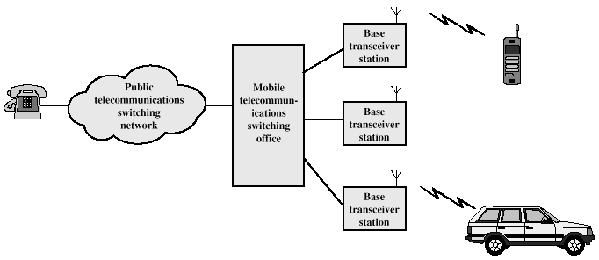
Cellular System Overview

Slide 14
Operation of Cellular Systems
Base Station (BS) – includes an antenna, a controller, and a number of transceivers
The controller is used to handle the call process between the mobile unit and the rest of the network.
Each BS is connected to a mobile telecommunications switching office (MTSO), with one MTSO serving multiple BSs.
The MTSO
connects calls between mobile units.
is also connected to the public telephone or telecommunications network
can make a connection between a fixed subscriber to the public network and a mobile subscriber to the cellular network.

Slide 15
Operation of Cellular Systems
The MTSO
assigns the voice channel to each call,
performs handoffs and
monitors the call for billing information.
Two types of channels available between mobile unit and BS
Control channels – used to exchange information having to do with setting up and maintaining calls and
with establishing a relationship between a mobile unit and the nearest BS
Traffic channels – carry voice or data connection between users
Forward channel – from BS to the mobile unit
Reverse channel – from the mobile unit to the BS

Slide 16
Operation of Cellular Systems
The steps in a typical call between two mobile users within an area controlled by a single MTSO:
Mobile unit initialization
When the mobile unit is turned on, it scans and selects the strongest setup control channel used for this system
Cells with different frequency bands repetitively broadcast on different setup channels
The receiver selects the strongest setup channel and monitors that channel.
the mobile unit has automatically selected the BS antenna of the cell within which it will operate.
Then a handshake takes place between the mobile unit and the MTSO controlling this cell, through the BS in this cell.
The handshake is used to identify the user and register its location.

Slide 17
Operation of Cellular Systems
Mobile-originated call
A mobile unit originates a call by sending the number of the called unit on the preselected setup channel
The receiver at the mobile unit first checks that the setup channel is idle by examining information in the forward (from the BS) channel.
When an idle is detected, the mobile unit may transmit on the corresponding reverse (to BS) channel.
The BS sends the request to the MTSO.
Paging
The MTSO then attempts to complete the connection to the called unit.
The MTSO sends a paging message to certain BSs depending on the called mobile unit number
Each BS transmits the paging signal on its own assigned setup channel.

Slide 18
Operation of Cellular Systems
Call accepted
The called mobile unit recognizes its number on the setup channel being monitored and responds to that BS, which sends the response to the MTSO.
The MTSO sets up a circuit between the calling and called BSs.
the MTSO selects an available traffic channel within each BS's cell and notifies each BS, which in turn notifies its mobile unit
The two mobile units tune to their respective assigned channels.
Ongoing call
While the connection is maintained, the two mobile units exchange voice or data signals, going through their respective BSs and the MTSO

Slide 19
Operation of Cellular Systems
Handoff
If a mobile unit moves out of range of one cell and into the range of another during a connection, the traffic channel has to change to one assigned to the BS in the new cell
The system makes this change without either interrupting the call or alerting the user.

Slide 20
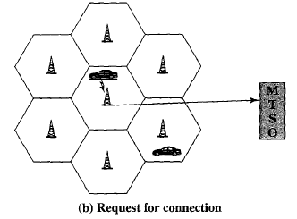
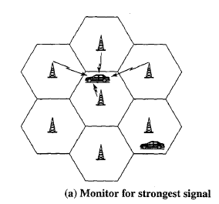
Operation of Cellular Systems
Initialization
Request for Connection

Slide 21
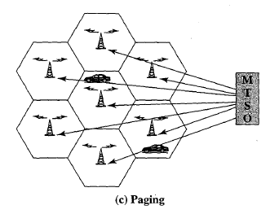
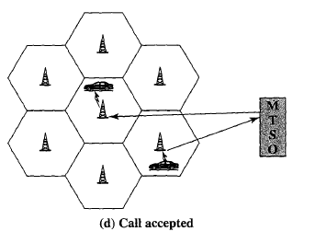
Operation of Cellular Systems
Paging
Call accepted

Slide 22
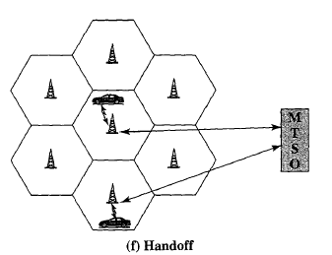
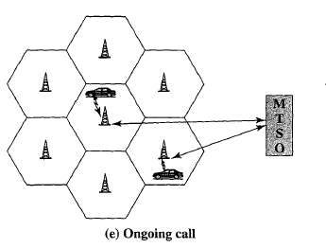
Operation of Cellular Systems
Ongoing call
Handoff

Slide 23
Operation of Cellular Systems
Issues Vital to cellular networks
Frequency allocation
Licensed- are reliable and offer better performance than unlicensed frequency bands which are low cost and easy to deploy but interference is common
Many providers
Multiple Access
Many users
Wide area of coverage
Traffic management
Location management
High mobility (in cars, trains)
Multiple suppliers
Handoff management, roaming

Slide 24
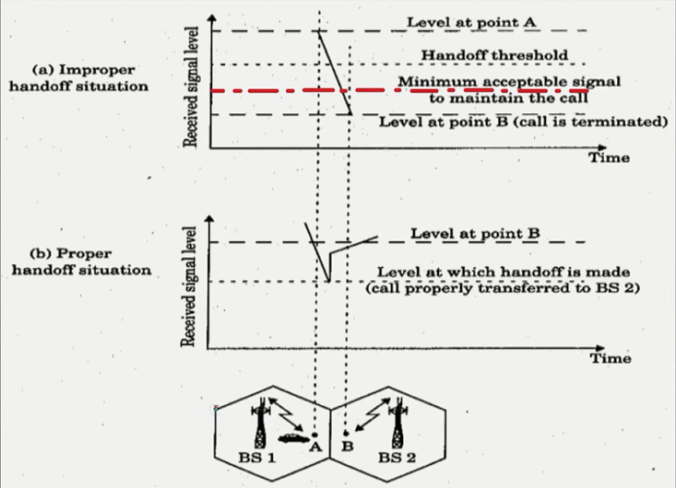
Handoff - Is the procedure for changing the assignment of a mobile unit from one BS to another as the mobile unit moves from one cell to another.
Guard channel – offers a means of improving the probability of a successful handoff by reserving a certain number of channels allocated exclusively for hand off request
Usually given higher priority than initial call
Selecting the threshold signal level is vital
Too small – lost connection
Too large - unnecessary handoffs

Slide 25
performance metrics used to make the handoff decision.
Cell blocking –
The probability of a new call being blocked, due to heavy load on the BS traffic capacity.
the mobile unit is handed off to a neighboring cell based not on signal quality but on traffic capacity.
Call dropping - The probability that, due to a handoff, a call is terminated.
Call completion - The probability that an admitted call is not dropped before it terminates.
Probability of unsuccessful handoff - The probability that a handoff is executed while the reception conditions are inadequate.
Handoff blocking - The probability that a handoff cannot be successfully completed.

Slide 26
Handoff probability - The probability that a handoff occurs before call termination.
Rate of handoff - The number of handoffs per unit time.
Interruption duration: The duration of time during a handoff in which a mobile unit is not connected to either base station.
Handoff delay: The distance the mobile unit moves from the point at which the handoff should occur to the point at which it does occur.

Slide 27
Multiple Access Methods
Is the technique that lets multiple mobile users to share the allotted spectrum in the most effective manner
Since spectrum is limited , the sharing is necessary to improve the overall capacity of the geographical area
This is carried out by permitting the available bandwidth to be used simultaneously by different users
In computer networks, the multiple access method permits various terminals to connect to the same multipoint transmission medium to transmit over it and share its capacity
Depending the channel type, specific multiple access techniques can be used for communication
FDMA, TDMA and CDMA are the most common

Slide 28
Multiple Access Methods
FDMA – Frequency Division Multiple Access
The total bandwidth available to the system is divided into frequencies
Is used mainly for analog transmission
All users share the satellite simultaneously but each user transmits at single frequency.
Used 30 KHz for each user.

Slide 29
Multiple Access Methods
Pros
Very Simple to design
Narrowband (no ISI)
ISI - is a form of distortion of a signal in which one symbol interferes with subsequent symbols)
Synchronization is easy
No interference among users in a cell
Cons
Narrowband interference
Static spectrum allocation
Freq. reuse is a problem
High Q analog filters or large guard band required

Slide 30
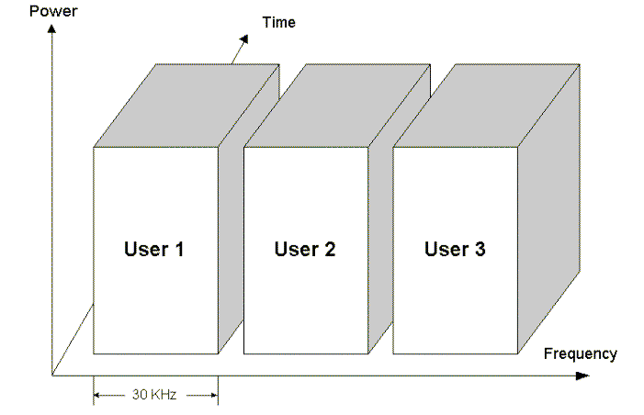
Multiple Access Methods
Example FM Radios

Slide 31
Multiple Access Methods
TDMA – Time Division Multiple Access
A time slot is assigned to each call during the conversation, a regular space in a digital stream
This technology enables three different users to use one frequency at the same time.
Used same 30 KHz channels, but with three users sharing them (3 slots)
Pros
Better suited for digital
Often gets higher capacity (3 times higher here)
Relaxes need for high Q filters

Slide 32
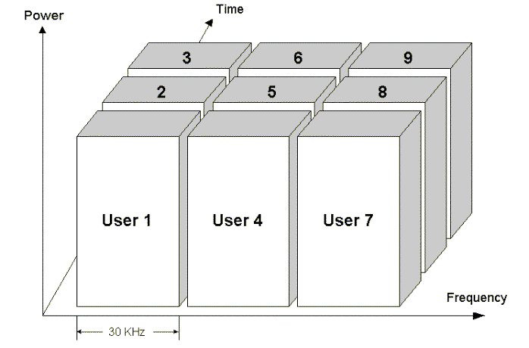
Multiple Access Methods
Cons
Strict synchronization and guard time needed
Still susceptible to jamming, other-cell interference
Often requires equalizer

Slide 33
Multiple Access Methods
CDMA – Code Division Multiple Access
Employs spread-spectrum technology
Each bit time is subdivided into m short intervals called chips
Each station has its own unique chip sequence
To transmit a 1 bit, a station sends its chip sequence
To transmit a 0 bit, it sends the one's complement of its chip sequence
All chip sequences are pair wise orthogonal
Generated using a method known as Walsh codes

Slide 34
Example
We have four senders A, B, C, D with the following chip sequence:
A: 00011011
B: 00101110
C: 01011100
D: 01000010
Assume we represent binary 0 with -1 and binary 1 with +1
A: {-1-1-1+1+1-1+1+1}
B: {-1-1+1-1+1+1+1-1}
C: {-1+1-1+1+1+1-1-1}
D: {-1+1-1-1-1-1+1-1}
Data Transmitters Data at the receiver
- - 1 - C S₁= {-1+1-1+1+1+1-1-1}
- 1 1 - B+C S₂ ={-2 0 0 0+2+2 0-2}
1 0 1 - A+B’+C S₃={-1+1-3+3+1-1-1+1}
1 1 0 1 A+B+C’+D S₄={-2-2 0-2 0-2+4 0}

Slide 35
To recover the data sent by transmitter C , the receiver calculate the dot product of the chip sequence of C with the data received
S₁.C = (1+1+1+1+1+1+1+1)/8 = 1 which is 1
S₂.C = (2+0+0+0+2+2+0+2)/8 =1 which is 1
S₃.C = (1+1+3+3+1-1+1-1)/8=1 which is 1
S₄.C = (2-2+0-2+0-2-4+0)/8=-1 which is 0

Slide 36
Outline
Basics of Cellular Networks
Generation of Cellular Networks (1G/2G/3G/4G)
Basics of Satellite Communication

Slide 37
1G - First-Generation Analog
Analog and circuit switched
The most advanced 1G system in North America is Advanced Mobile Phone Service (AMPS)
In North America, Two 25-MHz bands are allocated to AMPS
One for transmission from base to mobile unit
One for transmission from mobile unit to base
Each band split in two to encourage competition
The control channels are data channels operating at 10 kbps.
The conversation channels carry the conversations in analog using frequency modulation.
The number of channels is inadequate for most major markets, so some way must be found
either to use less bandwidth per conversation or
to reuse frequencies.
For AMPS, Frequency reuse exploited
Uses FDMA

Slide 38
2G - Second Generation- Digital
Based on digital transmission
provide higher quality signals, higher data rates for support of digital services, and greater capacity.
Uses TDMA and CDMA
E.g. IS-95 (CDMA), GSM(TDMA)
Different approaches in US and Europe
US: divergence(difference or disparity)
Only one player (AMPS) in 1G
Became several players in 2G due to competition
Europe: Convergence(coming together)
5 incompatible 1G systems (no clear winner)
European PTT development of GSM (uses new frequency and completely digital communication)
Notes:
IS- Interim Standard
PTT – Push to Talk

Slide 39
Advantages of Digital Communications for Wireless
Voice, data and fax can be integrated into a single system
Better compression can lead to better channel utilization
Error correction codes can be used for better quality
Sophisticated encryption can be used

Slide 40
Differences Between First and Second Generation Systems
Digital traffic channels – first-generation systems are almost purely analog; second-generation systems are digital
Encryption – all second generation systems provide encryption to prevent eavesdropping
Error detection and correction – second-generation digital traffic allows for detection and correction, giving clear voice reception
Channel access – second-generation systems allow channels to be dynamically shared by a number of users

Slide 41
GSM - Global System for Mobile Communication
European standard introduced in 1990
Was developed to provide a common second-generation technology for Europe
Several flavors based on frequency:
GSM (900 MHz)
GSM 1800 (called DCS 1800)
GSM 1900 (called DCS 1900) - used in North America
Uses combination of FDMA and TDMA
Notes:
DCS – Digital Cellular System

Slide 42
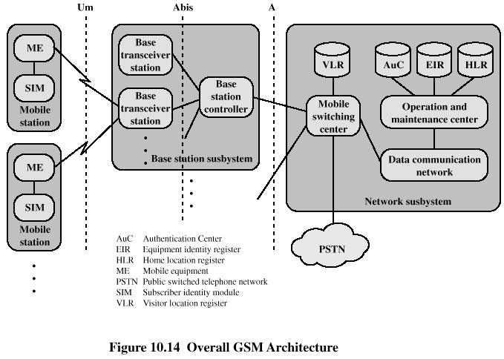
GSM Network Architecture

Slide 43
GSM Network Architecture
The boundaries at Um, Abis, and A refer to interfaces between functional elements that are standardized in the GSM documents.
Mobile Station
communicates across the Um interface, also known as the air interface, with a base station transceiver in the same cell in which the mobile unit is located.
Mobile Equipment (ME) - refers to the physical terminal, such as a telephone or PCS (personal communications service) device.
ME includes
the radio transceiver,
digital signal processors, and
the subscriber identity module (SIM).

Slide 44
GSM Network Architecture
The SIM is a portable device in the form of a smart card or plug-in module that stores
the subscriber's identification number,
the networks the subscriber is authorized to use,
encryption keys, and
other information specific to the subscriber.
The GSM subscriber units are totally generic until an SIM is inserted.
Except for certain emergency communications, the subscriber units will not work without a SIM inserted.
the SIMs roam, not necessarily the subscriber devices.

Slide 45
GSM Network Architecture
Base Station Subsystem (BSS)
consists of a base station controller and one or more base transceiver stations.
Each base transceiver station (BTS) defines a single cell;
BTS includes a radio antenna, a radio transceiver, and a link to a base station controller.
A GSM cell can have a radius of between 100 m and 35 km, depending on the environment.
A base station controller (BSC) may be collocated with a BTS or may control multiple BTS units and hence multiple cells.
The BSC reserves radio frequencies, manages the handoff of a mobile unit from one cell to another within the BSS, and controls paging.

Slide 46
GSM Network Architecture
Network Subsystem (NS)
Provides the link between the cellular network and the public switched telecommunications networks.
Controls handoffs between cells in different BSSs,
Authenticates users and validates their accounts, and
Includes functions for enabling worldwide roaming of mobile users.
The central element of the NS is the mobile switching center (MSC).

Slide 47
GSM Network Architecture
MSC is supported by four databases that it controls:
Home location register (HLR) database: stores information, both permanent and temporary, about each of the subscribers that "belongs" to it.
Visitor location register (VLR) database: Determines the location into which the subscriber is entered.
Maintains information about subscribers that are currently physically in the region covered by the switching center.
Records whether or not the subscriber is active and other parameters associated with the subscriber.
Authentication center database (AuC): is used for authentication activities of the system;
holds the authentication and encryption keys for all the subscribers in both the home and visitor location registers.

Slide 48
GSM Network Architecture
Equipment identity register database (EIR): keeps track of the type of equipment that exists at the mobile station.
also plays a role in security
e.g., blocking calls from stolen mobile stations and preventing use of the network by stations that have not been approved.

Slide 49
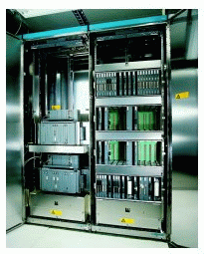
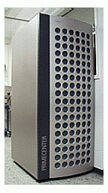
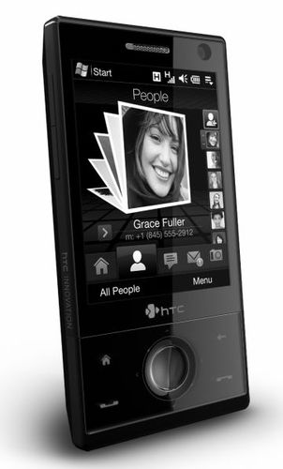
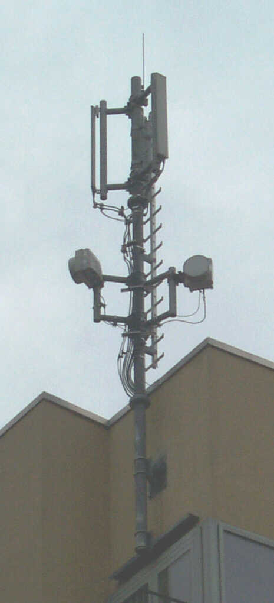
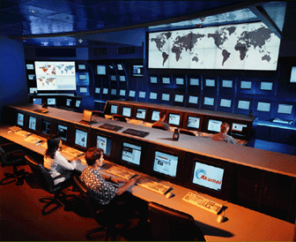
Components
Mobile Station
Switching center
Database
Base Transceiver Station
Management

Slide 50
2.5G
Circuit switching and Packet switching
GPRS (General Packet Radio Service)
40 kbps data
2.75G
EDGE (Enhanced Data Rate for GSM Evolution)
100 kbps

Slide 51
3G - Third Generation
Voice quality comparable to the public switched telephone network
144 kbps data rate available to users in high-speed motor vehicles over large areas
384 kbps available to pedestrians standing or moving slowly over small areas
Support for 2. 048 Mbps for office use
Symmetrical and asymmetrical data transmission rates
Support for both packet switched and circuit switched data services
Supports multimedia services (data, voice, video, image)
Support for a wide variety of mobile equipment
Flexibility to allow the introduction of new services and technologies

Slide 52
3G Technologies
CDMA2000 1x EV-DO
The first 3G wireless system to be deployed commercially
Offer near-broadband packet data speeds for wireless access to the Internet
EV signifies that it is an evolutionary technology built on the 15-95 standard.
Data only (DO)
With voice over IP (VoIP) technology, it can support voice traffic.
Data rates 150 kbps – 1.2Mbps

Slide 53
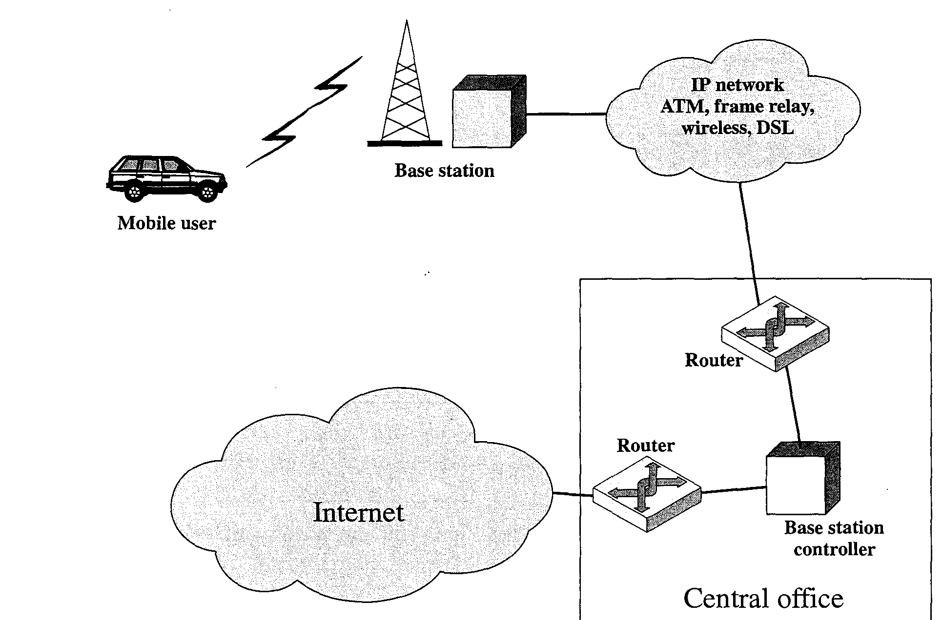

Slide 54
UMTS
Stands for Universal Mobile Telecommunication System
Europe's 3G wireless standard.
includes two standards.
Wideband CDMA, or W-CDMA - provide high data rates with efficient use of bandwidth
IMT-TC, or TD-CDMA - is a combination of WCDMA and TDMA technology
Based on GSM
Uses W-CDMA

Slide 55
4G – Fourth Generation
Provides mobile ultra-broadband Internet access
Maximum 100 Mbps for high mobility communication
1 Gbps for low mobility communication (such as pedestrians and stationary users)
Be based on an all-IP packet switched network.
Does not support traditional Circuit-switched telephony service, but all IP based communication
Predecessors - Mobile WiMAX (802.16e) and LTE (Long Term Evolution)
WiMAX 2.0 and LTE Advanced

Slide 56
5G – Fifth Generation?
2020?
What is different?

Slide 57
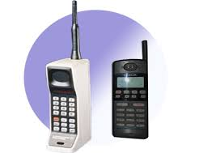
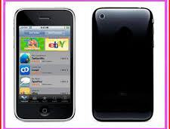
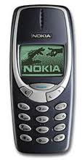
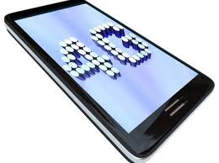
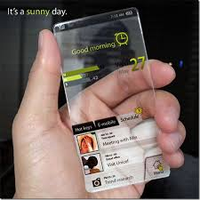
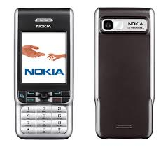
1G
2G
2.5/2.75G
3G
4G
5G

Slide 58
References
William Stallings, Wireless Communication and Networks , 2nd Edition.
Ch 7, 10
T. S. Rappaport, Wireless Communications: Principles & Practice, 2nd Edition
Ch 2, 8
Wikipedia

Slide 59
Outline
Basics of Cellular Networks
Generation of Cellular Networks
Basics of Satellite Communication

Slide 60
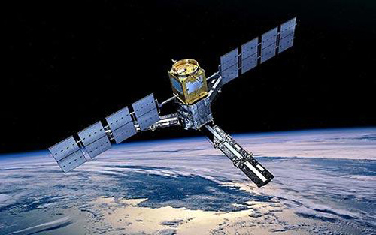
Basics of Satellite Communication
Satellite Communication
Communication that involves the use of an active or passive satellite to extend the range of a communications, radio, television, or other transmitter by returning signals to earth from an orbiting satellite

Slide 61
Basics of Satellite Communication
The heart of a satellite communications system is a satellite-based antenna in a stable orbit above the earth.
In a satellite communications system, two or more stations on or near the earth communicate via one or more satellites that serve as relay stations in space.
The antenna systems on or near the earth are referred to as earth stations.
A transmission from an earth station to the satellite is referred to as uplink,
Whereas transmissions from the satellite to the earth station are downlink.
The component in the satellite that takes an uplink signal and converts it to a downlink signal is called a transponder.

Slide 62
Basics of Satellite Communication
There are a number of different ways of categorizing communications satellites:
Coverage area: Global, regional, or national.
The larger the area of coverage, the more satellites must be involved in a single networked system.
Service type: Fixed service satellite (FSS), broadcast service satellite (BSS), and mobile service satellite (MSS).
General usage: Commercial, military, amateur, experimental.

Slide 63
Basics: Advantages of Satellites
The advantages of satellite communication over terrestrial communication are:
The coverage area of a satellite greatly exceeds that of a terrestrial system
Transmission cost of a satellite is independent of the distance from the center of the coverage area
Satellite to Satellite communication is very precise
Higher Bandwidths are available for use

Slide 64
Basics: Disadvantages of Satellites
The disadvantages of satellite communication:
Launching satellites into orbit is costly
Satellite bandwidth is gradually becoming used up
There is a larger propagation delay in satellite communication than in terrestrial communication

Slide 65
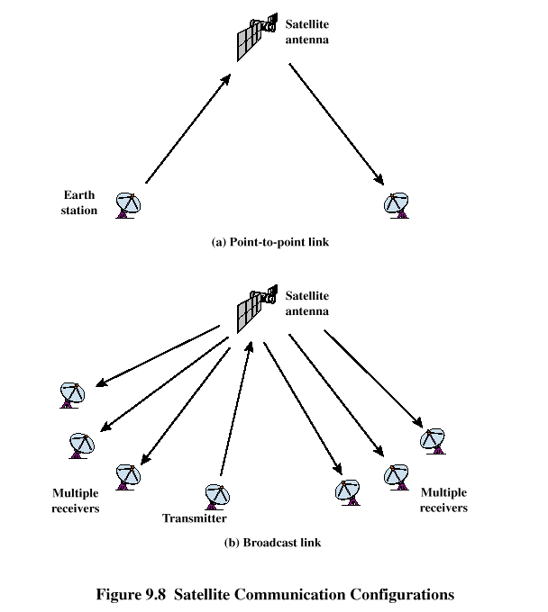

Slide 66
Classification of Satellite Orbits
Circular or elliptical orbit
Circular - with center at earth’s center
Elliptical - with one of the two foci at earth’s center
Orbit around earth in different planes
Equatorial orbit - above earth’s equator
Polar orbit - passes over both poles
Other orbits referred to as inclined orbits
Altitude of communications satellites is classified as:
Geostationary orbit (GEO)
Medium earth orbit (MEO)
Low earth orbit (LEO)

Slide 67
GEO Orbit
Orbit 35,863 km above the earth’s surface along the equator
The most common type of communications satellite
Revolve around the earth at the same speed as the earth rotates. This means GEO satellites remain in the same position relative to the surface of earth
The coverage region of a satellite is called its footprint. This is the region from which the satellite is visible.
Advantages of the GEO orbit
No problem with frequency changes
Tracking of the satellite is simplified
High coverage area
Disadvantages of the GEO orbit
Weak signal after traveling over 35,000 km
Polar regions are poorly served
Signal sending delay is substantial

Slide 68
LEO Satellite Characteristics
Circular/slightly elliptical orbit under 2000 km
Orbit period ranges from 1.5 to 2 hours
Diameter of coverage is about 8000 km
Round-trip signal propagation delay less than 20 ms
Maximum satellite visible time up to 20 min
Atmospheric drag results in gradual orbital deterioration
Handoffs are required between satellites
requires the multiple orbital planes be used, each with multiple satellites in orbit.

Slide 69
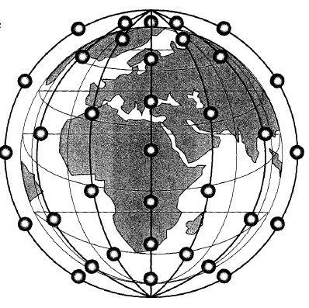

Slide 70
Advantages
A LEO satellite’s proximity to earth compared to a GEO satellite gives it
a better signal strength and
less of a time delay, which makes it better for point to point communication
A LEO satellite’s smaller area of coverage is less of a waste of bandwidth
For this reason, it is currently being proposed for communicating with mobile terminals and with personal terminals that need stronger signals to function.
Disadvantages
A network of LEO satellites is needed, which can be costly
Atmospheric drag effects LEO satellites, causing gradual orbital deterioration

Slide 71
MEO Satellite Characteristics
Circular orbit at an altitude in the range of 5000 to 12,000 km
Orbit period of 6 hours
Diameter of coverage is 10,000 to 15,000 km
Round trip signal propagation delay less than 50 ms
Maximum satellite visible time is a few hours
Require much fewer handoffs than LEO satellites.
The satellites will be divided equally between two planes tilted 45° to the equator.
Proposed applications are digital voice, data, facsimile, high-penetration notification, and messaging services.

Slide 72
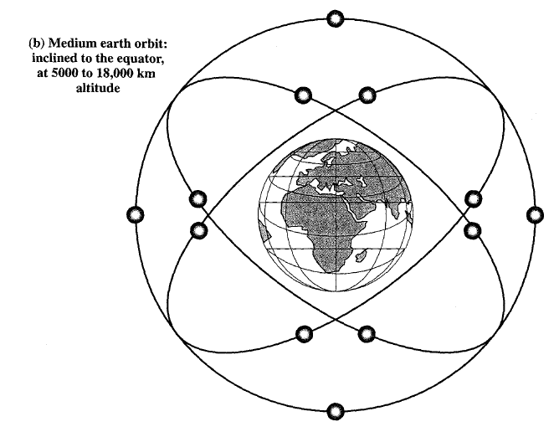

Slide 73
Advantage
A MEO satellite’s longer duration of visibility and wider footprint means fewer satellites are needed in a MEO network than a LEO network.
Disadvantage
A MEO satellite’s distance gives it
A longer time delay and
Weaker signal than a LEO satellite, though not as bad as a GEO satellite.
The power required are greater than LEO

Slide 75
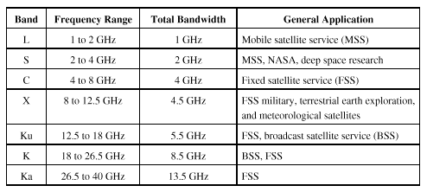
Frequency Bands Available for Satellite Communications

Slide 76
Frequency Bands
Increasing bandwidth is available in the higher-frequency bands.
The higher the frequency, the greater the effect of transmission impairments
The mobile satellite service (MSS) is allocated frequencies in the Land S bands.
In these bands, compared to higher frequencies, there is
a greater degree of refraction and
greater penetration of physical obstacles, such as foliage (plants) and non-metallic structures.
These characteristics are desirable for mobile service.
However, the Land S bands are also heavily used for terrestrial applications.
Thus, there is intense competition among the various microwave services for Land S band capacity.

Slide 77
For any given frequency allocation for a service, there is an allocation of an uplink band and a downlink band, with the uplink band always of higher frequency.
The higher frequency suffers greater spreading, or free space loss
The earth station is capable of higher power, which helps to compensate for the poorer performance at higher frequency.

Slide 78
Transmission Impairments
Transmission impairments to satellite communication:
The distance between an earth station and a satellite (free space loss).
Satellite Footprint:
The center point of that area will receive the highest radiated power, and the power drops off as you move away from the center point in any direction.
The satellite transmission’s strength is strongest in the center of the transmission, and decreases farther from the center as free space loss increases.
Atmospheric Attenuation caused by air and water can impair the transmission.
It is particularly bad during rain and fog.

Slide 79
References
William Stallings, Wireless Communication and Networks , 2nd Edition.
Ch 10
Andrew S. Tanenbaum, Computer Networks, 4th Edition.
Ch 2
http://www.cs.wustl.edu/~jain/cis788-97/ftp/satellite_nets.pdf
http://learnabouttelecom.blogspot.com/2012/06/difference-between-fdma-cdma-and-tdma.html

