Slide 1
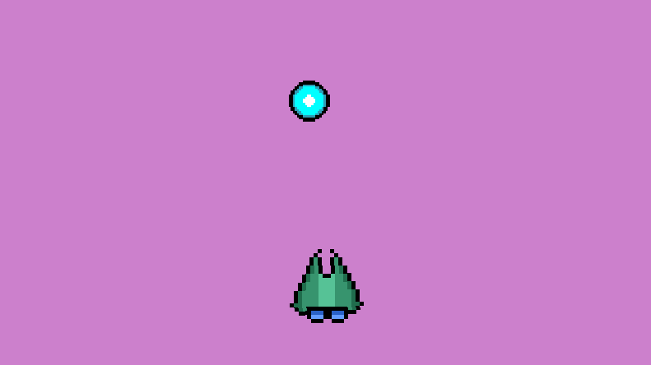
Space Shooter
Part 1 - Player

Slide 2
Quick things
You’re using a small game engine I wrote + PixiJS, a professional JavaScript rendering framework
aka, looks good on your resume
You’ll be using ‘let’ instead of ‘var’. ‘let’ is better
You can access the entire engine at https://github.com/CodeNinjas-Rocklin/JS_Engine

Slide 3
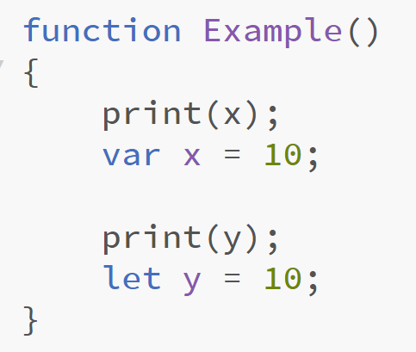
Why ‘let’ instead?
What’s wrong with this code?
What do you think would happen if this function was called?

Slide 4
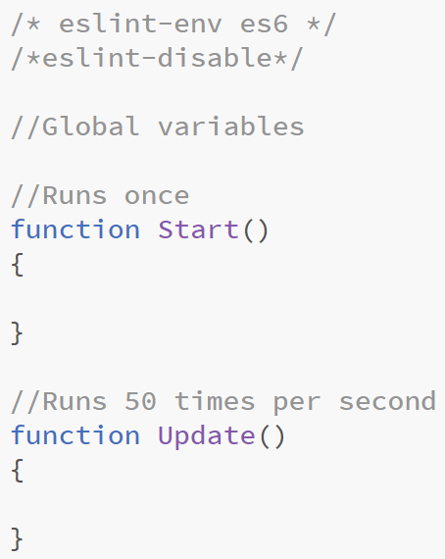
Starting point
This is the starting code for the engine
Start() is the same thing as ‘Initialize When Scene Starts’
Update() is the same thing as ‘Update Every Frame’

Slide 5
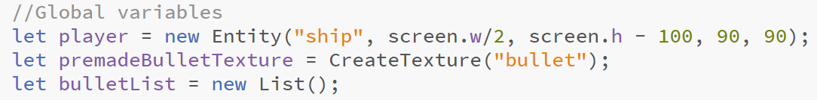
Creating the first variables
Entity is how we make objects. They’re basically fancy sprites
Textures are generated images that save memory and are faster to copy (good for making a lot of copies very fast)
Lists are arrays but easier to use

Slide 6
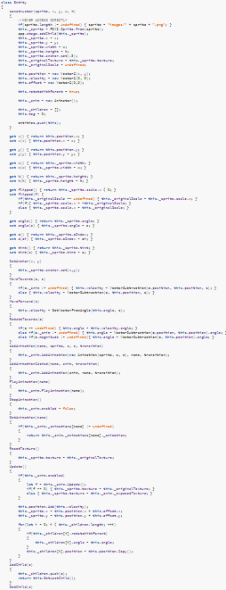
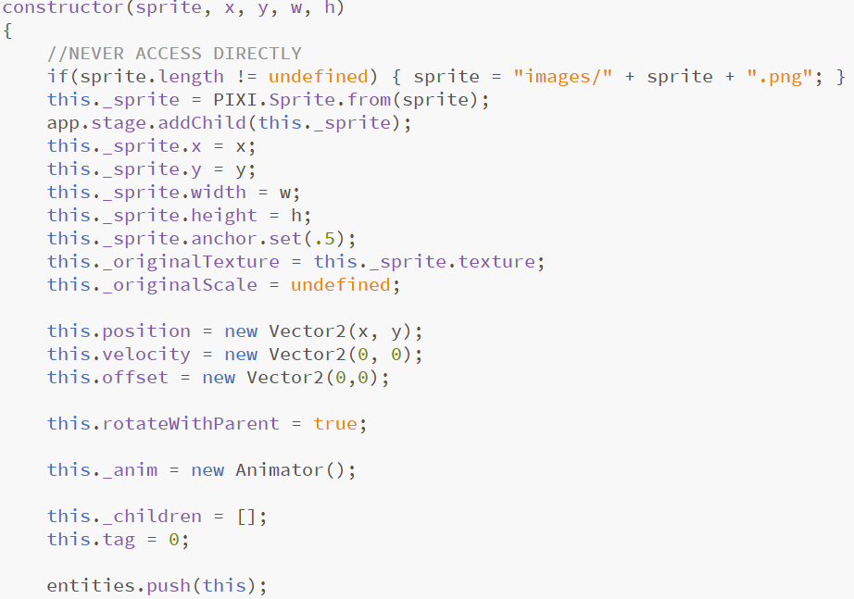
Not so easy

Slide 7
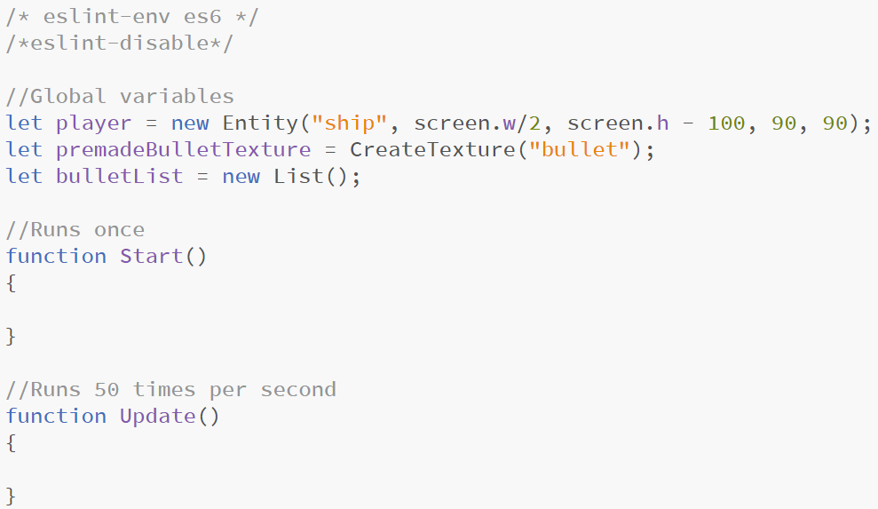
Checkpoint

Slide 8
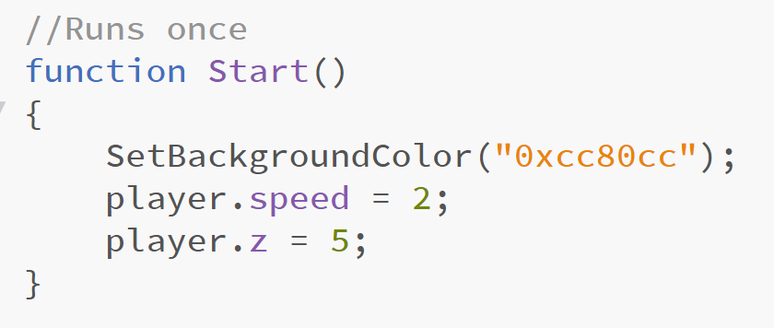
Start()

Slide 9
Start() explained
What do you think ‘SetBackgroundColor()’ does?
you can use any hex color code you want
We’re giving ‘player’ a speed variable to use later
We’re setting the ‘z’ property of ‘player’ to 5
What do you think the ‘z’ property is/does?

Slide 10
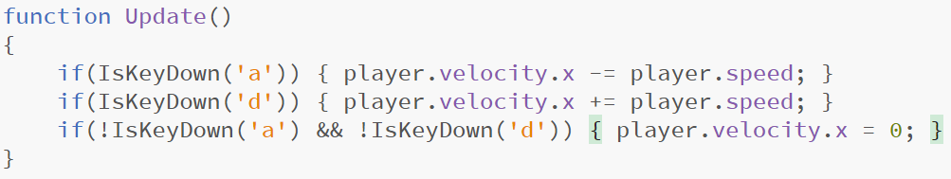
Update() part 1
IsKeyDown(char) returns true or false, depending if the key is down or not
Remember, !true = false, so !IsKeyDown(‘a’) is only true if the key is NOT down
Remember, && means ‘and’
What’s velocity?

Slide 11
Velocity/Vectors
x: -.5
y: -15
Vectors are directions, and magnitudes
Magnitude is a fancy word for the length of a vector
Velocity is a vector
x: 10
y: 0

Slide 12
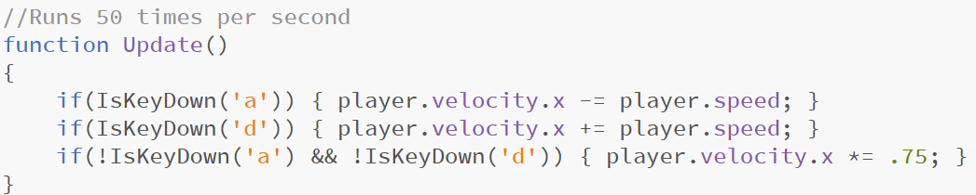
Update() part 1.5
What’s the change?
Why did we make that change?

Slide 13
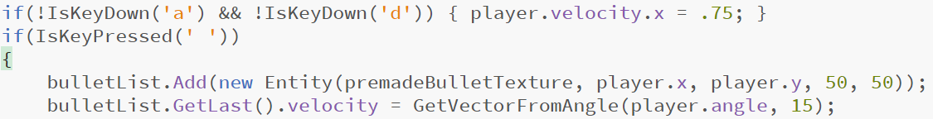
Update() part 2
What’s the difference between IsKeyPressed(‘a’) and IsKeyDown(‘a’)?
bulletList.Add(x) adds something to a list. We’re adding a new bullet
bulletList.GetLast() returns the last added item
GetVectorFromAngle(a, s) gets the direction something is facing and scales it

Slide 14
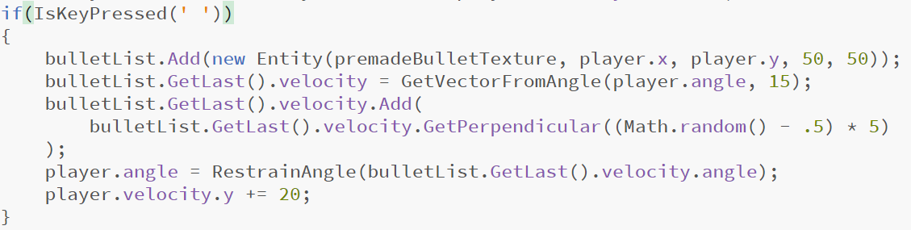
Update() part 2 but with more juice
GetPerpendicular(s) returns a vector that is perpendicular to the parent, with a specific scale
RestrainAngle(a) keeps the angle positive, so -90 would get turned into 270

Slide 15
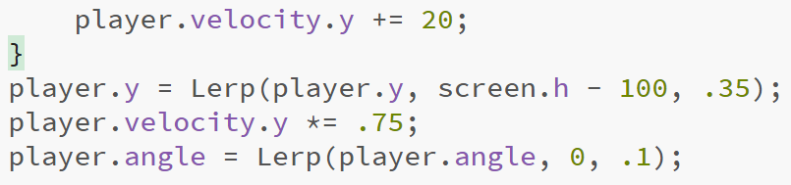
Update() part 3

Slide 16
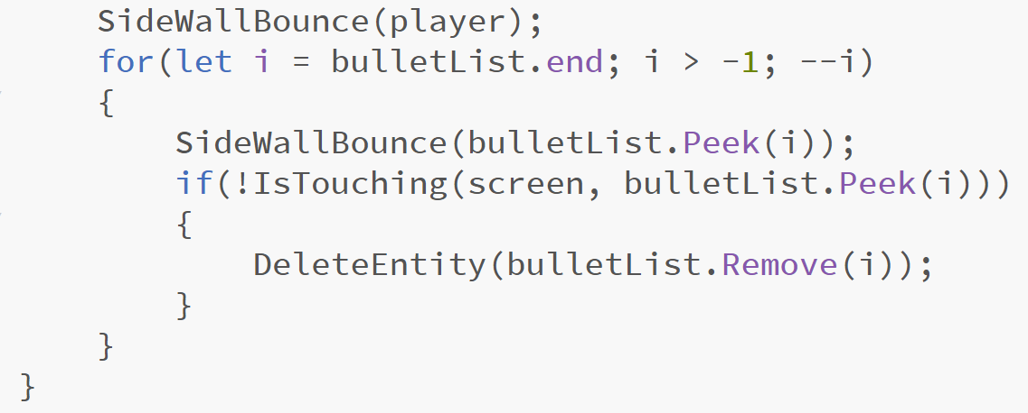
Update() part 4

Slide 17
Update() part 4 explained
SideWallBounce(e) bounces the entity off the side walls (we still need to write the function for it)
IsTouching(a, b) checks if two entities are touching
list.Peek(i) returns the i-th item in the list. 0 would be the first, 1 the second, and so on
DeleteEntity(e) deletes an entity
list.Remove() removes and returns the i-th item

Slide 18
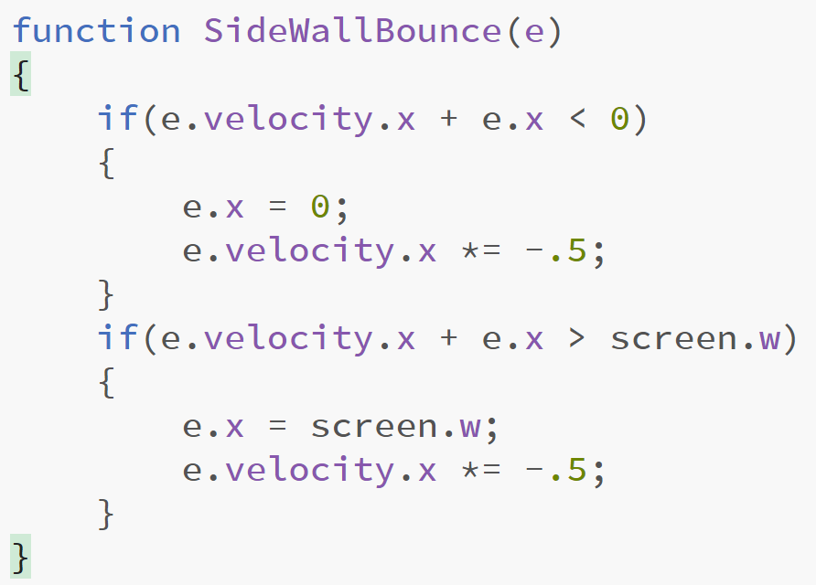
SideWallBounce()
If the entity is too far to the left, or too far to the right (also known as being off the screen), then we flip the x velocity so it bounces

Slide 19
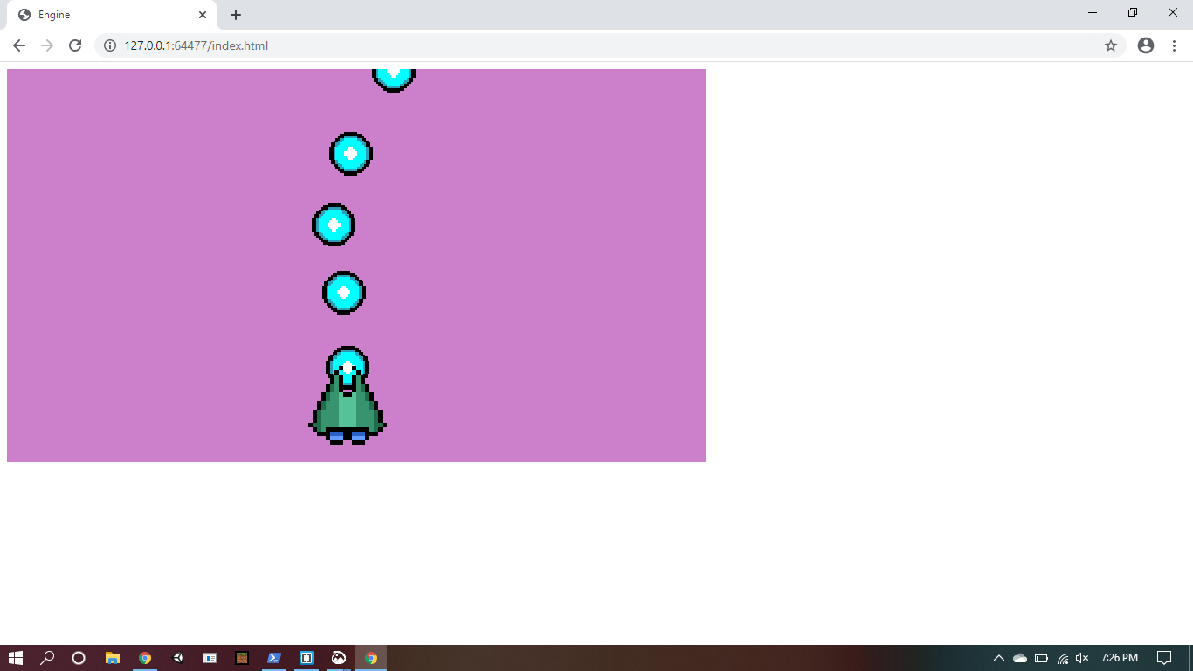
All done

