Slide 1
Heroes of CSS

Slide 2
Admin Work

Slide 3
Homework #1 - Assignment
Also, at this point everyone should have access to the class content and homework repository (Gitlab)
https://columbia.bootcampcontent.com/columbia-bootcamp/COLNYC201904FSF2/blob/master/Homeworks/Week-1-HTML-CSS-Git/Instructions/
Homework Assignment #1 is due next week
Due Saturday, April 20, 2019 11:59 PM (Next Saturday)

Slide 4
Homework Assignment
Really, work hard on this assignment! This assignment introduces you to fundamental concepts that we’ll be building the entire course-long.
Review In Class Material, especially Exercises: https://columbia.bootcampcontent.com/columbia-bootcamp/COLNYC201904FSF2/tree/master/Activities/Week-1-HTML-CSS-Git
Work with your peers! It’s much better than screaming at your computer alone.
Ask Questions on Slack! Your peers, TAs, and Instructors are all here to help when they can.

Slide 5
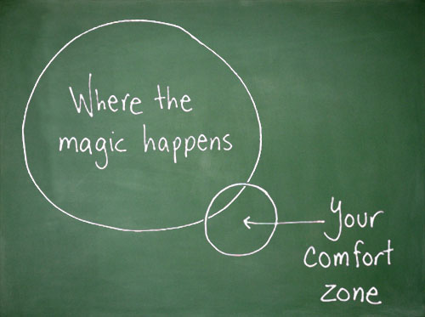
Most Important of All….
Just Submit SOMETHING (even if it seems pretty crummy)!

Slide 6
Warning!

Slide 7
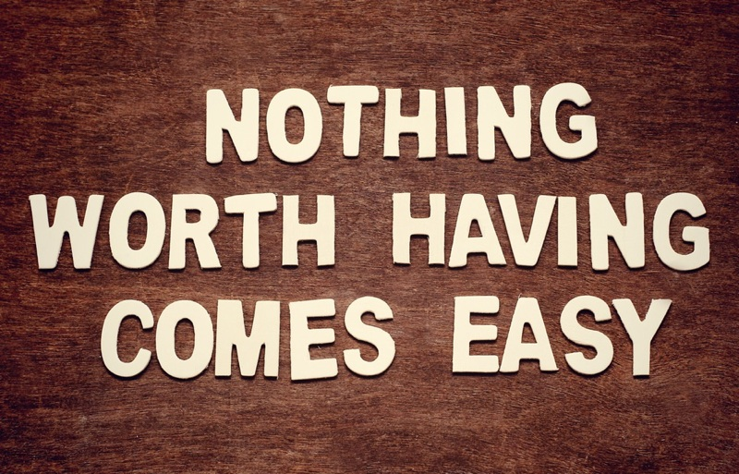
Brace Yourselves
Today is going to be a bit tough.
But trust us!
It will all look easy a few weeks from now.

Slide 8
Brace Yourselves
Don’t expect to understand EVERYTHING at once.
Today is all about getting immersed.

Slide 9
Git Workflow

Slide 10

The .git Folder
• When you cloned your repo, you might have noticed a hidden .git folder was created.
• This folder stores information about your repository, including a history of all changes, along with who made them.
This is what makes your local directory a repo, as opposed to a regular folder.

Slide 11
Git Workflow
In Git, there are four conceptual areas your code can be in.
Local
Repository
(HEAD)
Remote
Repository
Staging Area
(index)
Workspace
git add
git commit
git push

Slide 12


Workspace
The workspace is where you’re used to dealing with your files.
Any time you save a file, you’re replacing the old version of a file with a new one.
This step is referred to as Untracked since Git has no knowledge of your workspace.

Slide 13

Setting the Stage
• git add - Adds a file to the Staging Area.
This command takes an argument, which means we must provide the name of the file we want to add. Ex: git add myFile.md
Since we want to add all the files in our directory, we’ll give it the option -A. Ex: git add -A

Slide 14
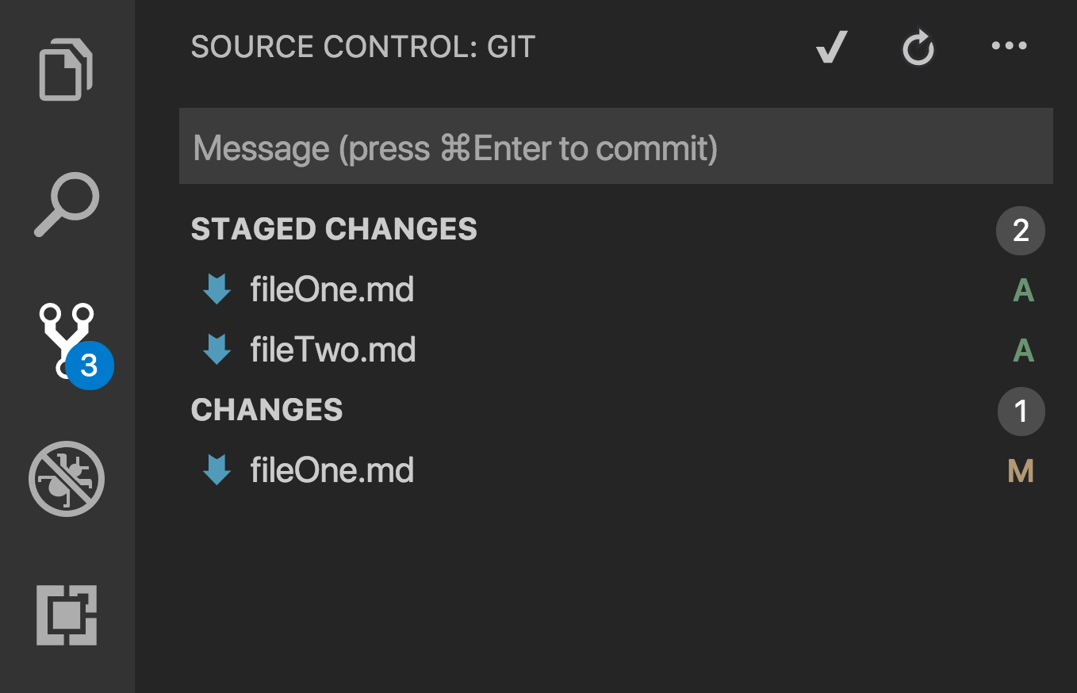
Setting the Stage Continued
These files have been staged with git add, but not committed.
This file has been changed (and saved) since it was staged.
We should probably run git add -A again.

Slide 15

Keeping It Local
To add files to the local repository, run git commit
This command takes the files from your staging area and adds them to the history kept in the .git folder.
git commit -m “Fixed a bug that caused a 403 error”

Slide 16


The Remote Repository
Lastly, we add our local repo to our remote repo with git push.
• Once things are pushed up to GitHub, GitHub will have a history of every change you’ve committed, along with any changes your teammates have pushed to the repo.
Remote Repo
Leia’s Local Repo
Luke’s New Repo
git push
git clone
Translate Branch
Translate Copy

Slide 17
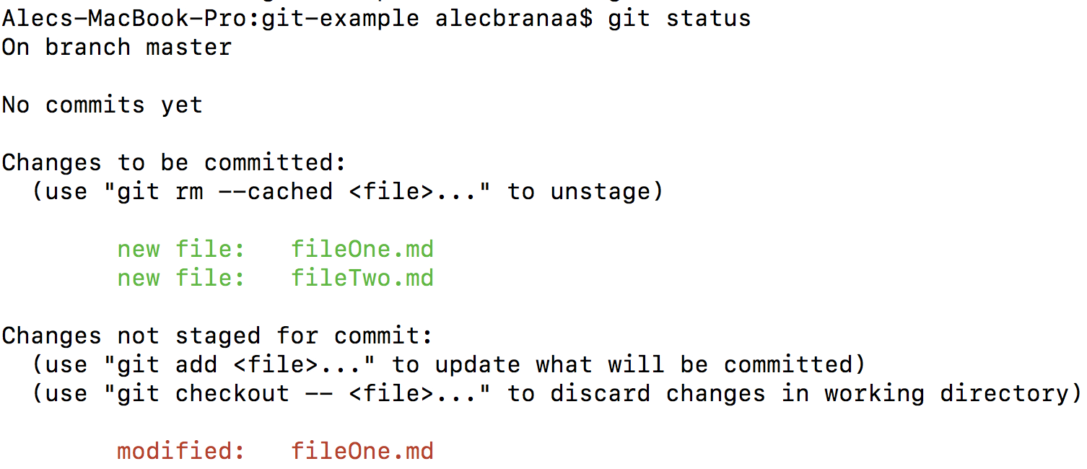
Still a Bit Lost? Never Worry!
• Remember that you will use these concepts every day.
It’s most important that you familiarize yourself with the 5 basic git commands.
• If you’re ever in the middle of making changes and want to see what step you’re at, run git status.

Slide 18
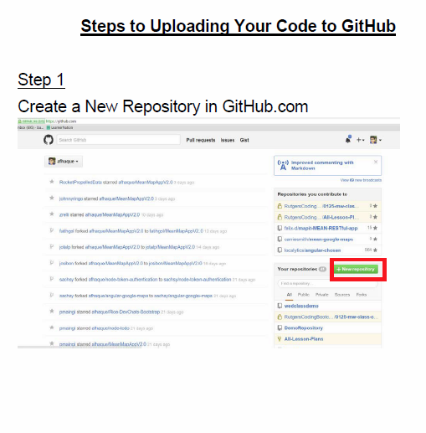
Still a Bit Lost? Never Worry!
Follow the handy pdf guide provided to you!
Practice a few times on your own before our next class.

Slide 19
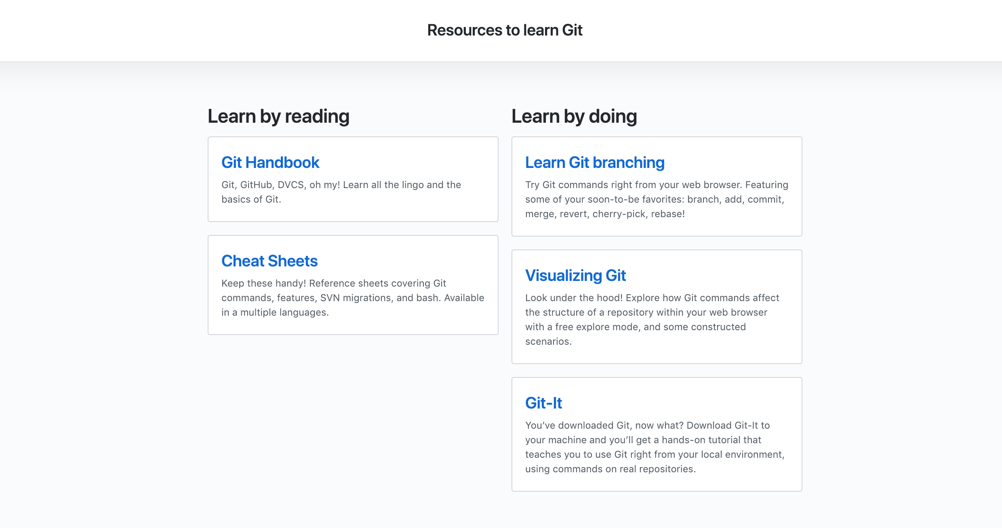
If You’re Still Lost… Here’s Some (Free) Resources
https://try.github.io/

Slide 20
HTML Round 2

Slide 21
HTML Syntax (Basic)
Content
<h1>
This is Mah House
</h1>
Opening Tag
Closing Tag

Slide 22
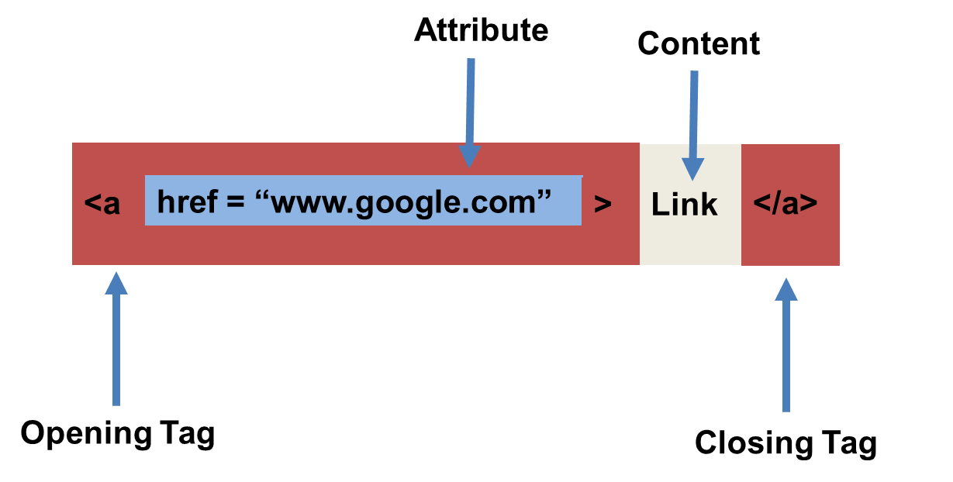
HTML Syntax (with Attribute)

Slide 23
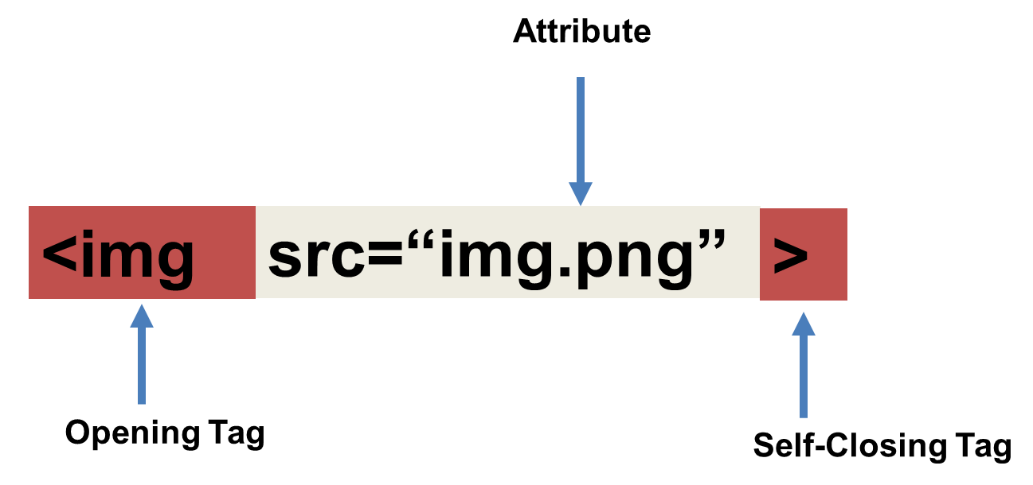
Tricky Tags (Self-Closing)

Slide 24
Important Common Tags
Headings:
<h1> </h1> - Heading 1 (Largest Heading)
<h2> </h2> - Heading 2 (Next Largest Heading)
<h3> </h3> - Heading 3
…
Containers:
<html> </html> - Wraps the entire page
<head> </head> - Wraps the header of the page
<body> </body> - Wraps the main content
<div> </div> - Logical Container ***
<p> </p> - Wraps individual Paragraphs
Others:
<strong> (bold), <em> (emphasis)
<img> (images), <a href> (links), <li> (list items) , <title> (title), <br> (line break), <table> (tables), <!-- --> (comments)

Slide 25
Less Common Tags
All HTML Tags are listed here: http://www.w3schools.com/tags/
Don’t try to memorize them! Simply refer back to documentation as needed.
Other tags:
<video> for Videos
<audio> for Audio files
<embed> for Embedded files
<code> for including computer code
<header> for headers
<nav> for navigation bars
<footer> for footers

Slide 26
HTML for Forms
Common UI (User Interface) Form Elements:
<form> - Creates a form section in HTML
<input> - Input boxes
<label> - Labels for boxes
<button> - Button
<textarea> - Large textbox

Slide 27
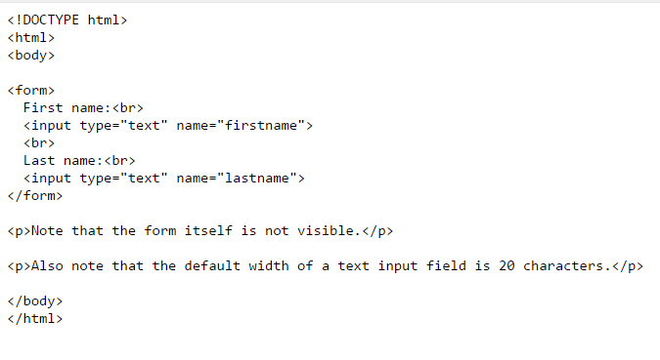
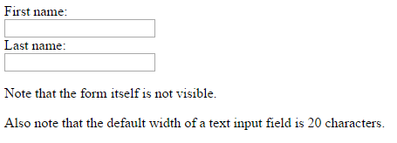
HTML for Forms

Slide 28
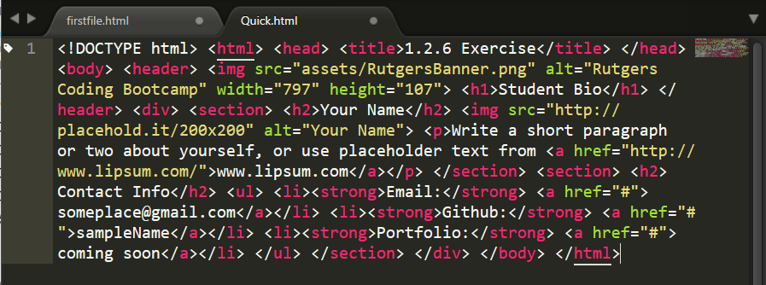
On Ugly HTML
Don’t do this… Use proper indentation and sectioning.
Readable code is easier to maintain.
Invest time to get better about this now. It will pay dividends!

Slide 29
> YOUR TURN!
Activity: 1-HTML_Git | Suggested Time: 20 min
Assignment
In this activity, you’ll create a student bio using HTML. You will then add, commit, and push your completed HTML to GitHub for the world to see.
Additional instructions, sent via Slack.

Slide 30
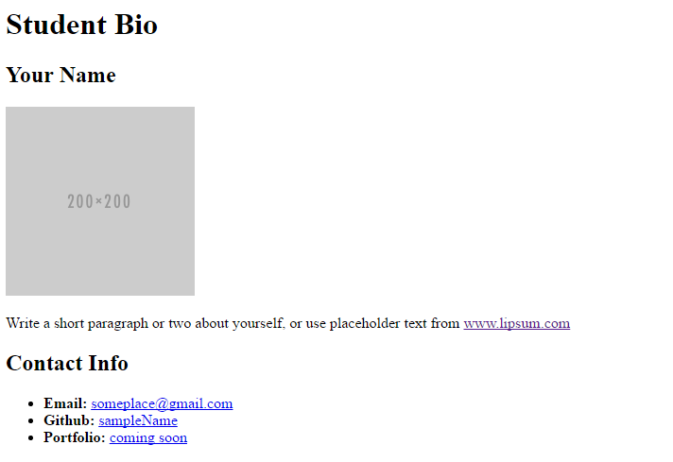
> YOUR TURN!

Slide 31
CSS Stylin’

Slide 32
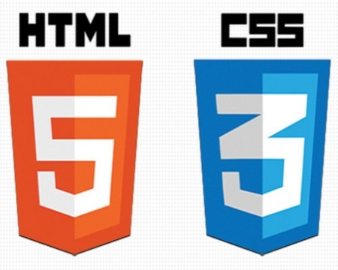

HTML / CSS Definitions (*yawn* unimportant)
HTML: Hypertext Markup Language – (Content)
CSS: Cascading Style Sheets – (Appearance)
HTML/CSS are the “languages of the web.” Together they define both the content and the aesthetics of a webpage – handling everything from the layouts, colors, fonts and content placement. (JavaScript is the third – handling logic, animation, etc.)

Slide 33


HTML / CSS Analogy
HTML Alone
Like writing papers in “Notepad.”
Can only write unformatted text.
HTML / CSS
Like writing papers in Microsoft Word.
Can format text, page settings, alignment, etc. based on “highlighting” and menu options.

Slide 34
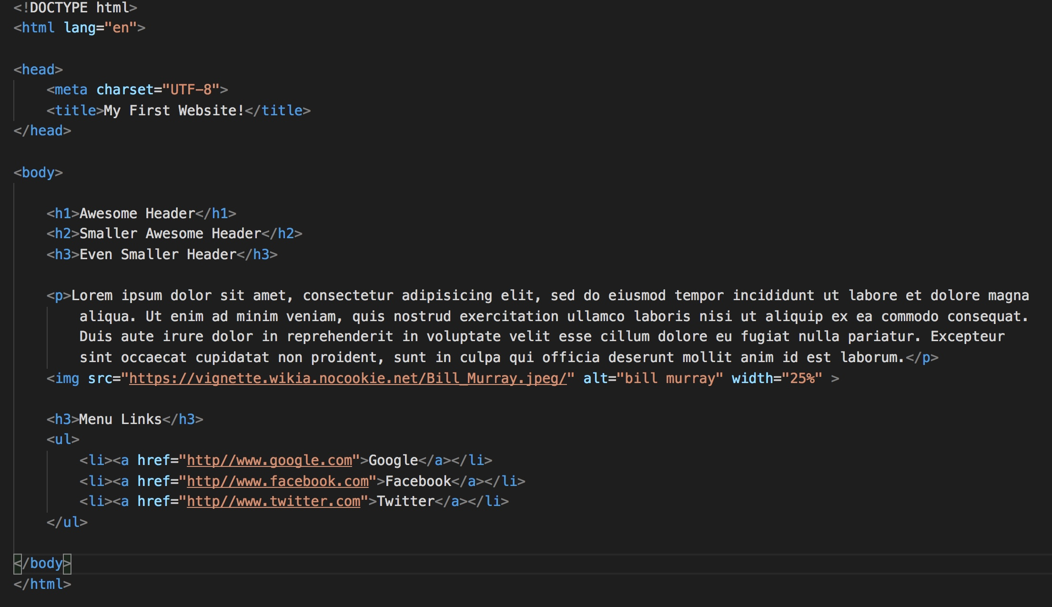
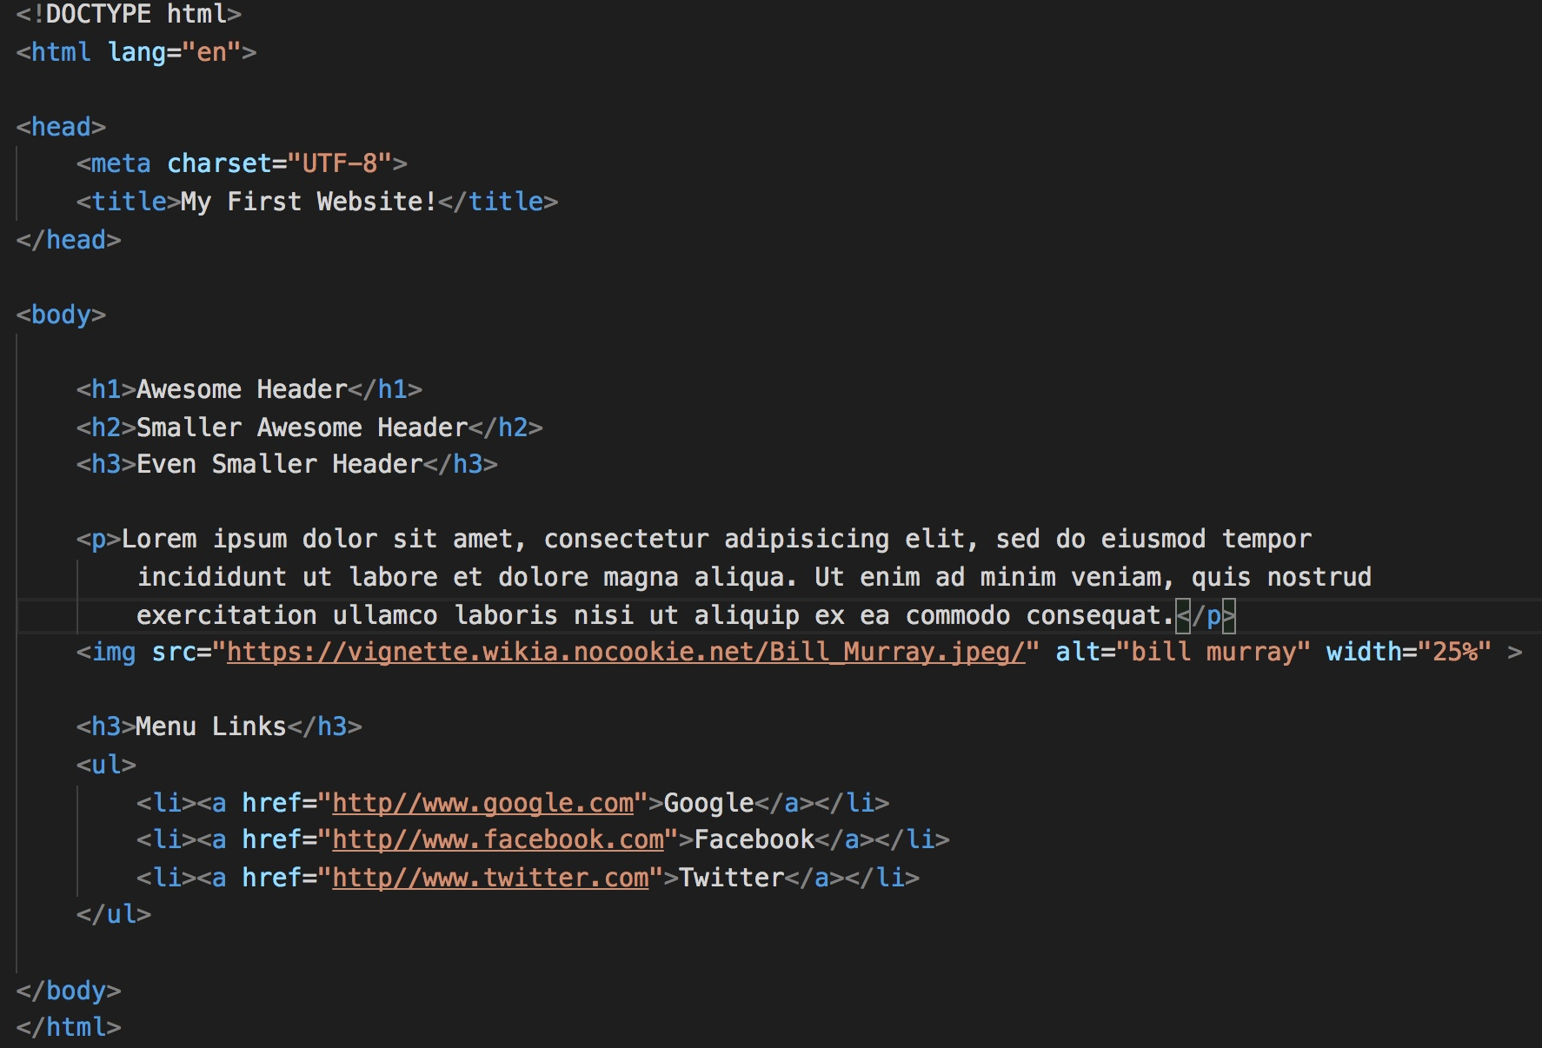
Basic HTML Page

Slide 35
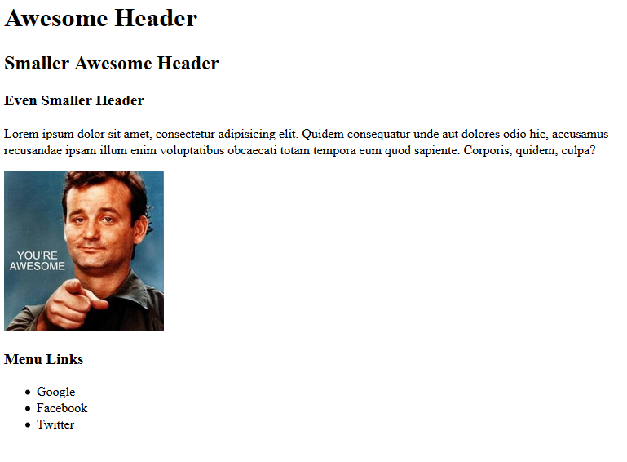
Basic HTML Page - Result

Slide 36
Basic HTML Page - Result
Super Boring…

Slide 37
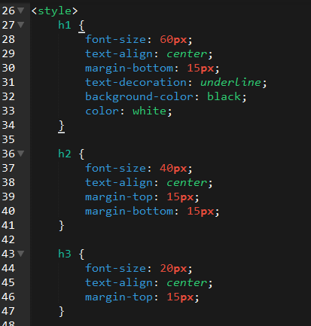
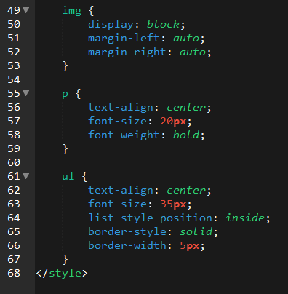
Enter CSS

Slide 38
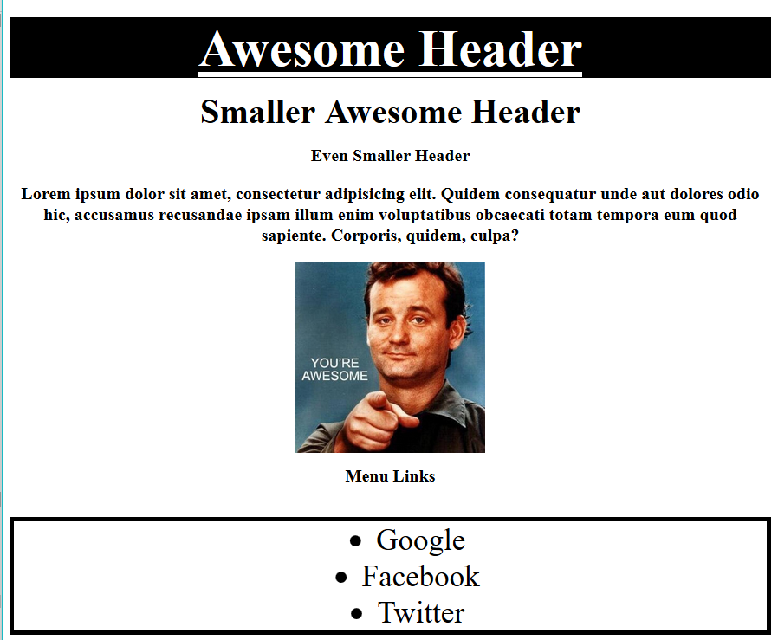
Enter CSS - Result

Slide 39
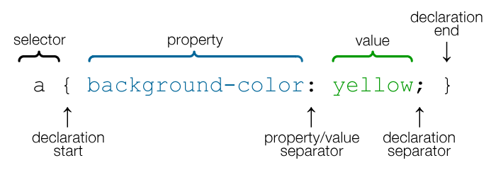
CSS Syntax
CSS works by hooking onto selectors added into HTML using classes and identifiers.
Once hooked, we apply styles to those HTML elements using CSS.

Slide 40
CSS Example
In the below example the “Header” would be turned blue and MUCH larger because of the CSS.
We can incorporate an element’s class or ID to apply a CSS style to a particular part of the document.
Just remember to include the necessary symbol before the CSS: “.” for class, “#” for ID.
Example (HTML):
<p class=“bigBlue”>Header</p>
Example (CSS):
.bigBlue
{
font-size: 100px;
color: blue;
}

Slide 41
Key CSS Attributes
Font / Color:
color: Sets color of text.
font-size: Sets size of the font.
font-style: Sets italics.
font-weight: Sets bold.
Alignment / Spacing:
padding (top/right/bottom/left): Adds space between element and its own border.
margin (top/right/bottom/left): Adds space between element and surrounding elements.
float: Forces elements to the sides, centers, or tops.
Background:
background-color: sets background color.
background-image: sets background image.

Slide 42
Powerful Duo
Believe it or not, HTML / CSS is all you need
to develop a vivid, full-blown website.

Slide 43
INSTRUCTOR DEMO
Instructor: Demo
(quickexample_internalcss.html | 2-BasicCSS)

Slide 44
> YOUR TURN!
Activity: 3-HTML_CSS_Layout | Suggested Time: 20 min
Assignment
In this activity, you’ll upgrade your previous HTML bio-page using CSS style rules. Once you’re done, commit and push up your changes to GitHub.
We’ll send you additional instructions via Slack.

Slide 45
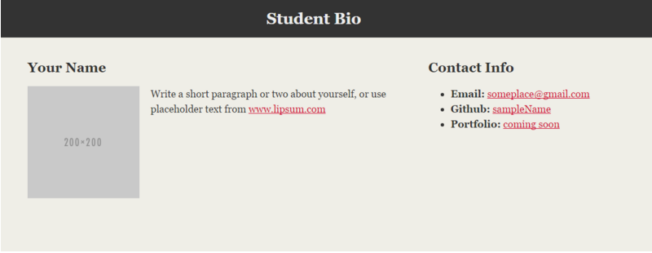
> YOUR TURN!

Slide 46
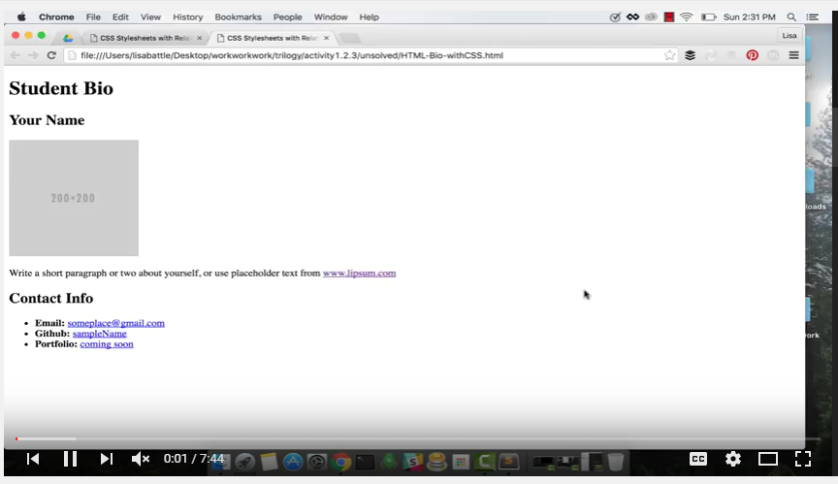
Video Walkthrough!!
https://www.youtube.com/watch?v=kMBinXTCrXI&list=PLgJ8UgkiorCnMLsUevoQRxH8t9bt7ne14&index=2

Slide 47

Still a Bit Confused?
Remember! We’ve got video guides for key activities like that last one.
If you feel like you are EVER falling behind, use those online walkthroughs to help catch back up. They are made to be easy to understand.
Still having trouble? Shoot your instructor or one of your TAs a message!
We are here to help you out in whatever way we can!

Slide 48
CSS Recap

Slide 49
Critical Question
What is “CSS?”

Slide 50
HTML / CSS Definitions (*yawn* unimportant)
HTML: Hypertext Markup Language – (Content)
CSS: Cascading Style Sheets – (Appearance)
HTML/CSS are the “languages of the web.” Together they define both the content and the aesthetics of a webpage – handling everything from the layouts, colors, fonts, and content placement. (JavaScript is the third – handling logic, animation, etc.)

Slide 51
HTML / CSS Analogy
HTML Alone
Like writing papers in “Notepad.”
Can only write unformatted text.
HTML / CSS
Like writing papers in Microsoft Word.
Can format text, page settings, alignment, etc. based on “highlighting” and menu options.

Slide 52
Basic HTML Page - Result

Slide 53
Enter CSS - Result

Slide 54
Critical Question
How do we style HTML…
Elements?
Classes?
IDs?

Slide 55
CSS Syntax
CSS works by hooking onto selectors added into HTML using classes and identifiers.
Classes use .classname, IDs use #idname, and elements use just their name.
Once hooked, we apply styles to those HTML elements using CSS.

Slide 56
Selectors
Element selector
Applies to all <p> elements
p {
background-color: blue;
}
Applies to all elements with class=“classItem"
.classItem {
background-color: orange;
}
Applies to all elements with id=“idItem"
#idItem {
background-color: green;
}
Element name
(p, a, div, span, etc)
Class Selector
Period (.) + variable name
(.myDiv, .phoneNumber, etc.)
ID Selector
Hash (#) + variable name
(#myDiv, #phoneNumber)

Slide 57
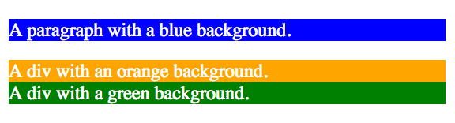
CSS Selectors
p {
background-color: blue;
}
.classItem {
background-color: orange;
}
#idItem {
background-color: green;
}
<p>
A paragraph with a blue background.
</p>
<div class=“classItem">
A div with an orange background.
</div>
<div id=“idItem">
A div with a green background.
</div>
+

Slide 58
Lingering Questions
Questions so far?

Slide 59
Relative File Paths

Slide 60
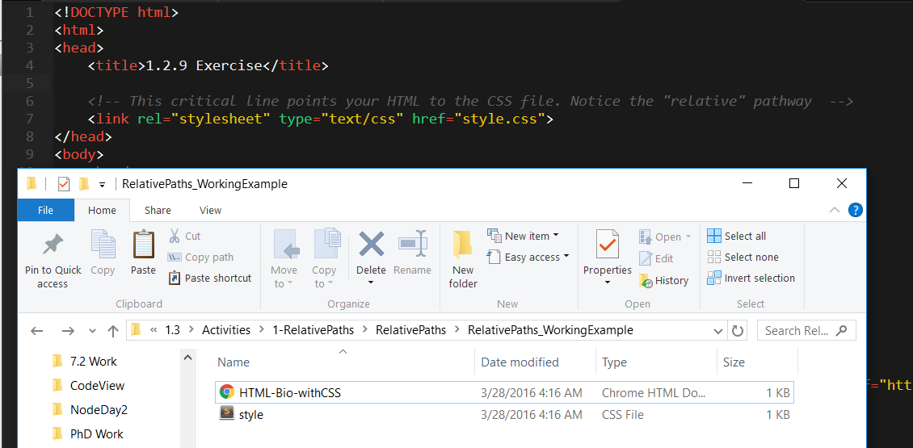
Relative File Paths
Relative file paths connect us with other files in our working directory. In this case, style.css is in the same folder as our html document.

Slide 61
Quick Demo
Instructor: Demo
(RelativePaths_DEMO | 1-RelativePaths)

Slide 62
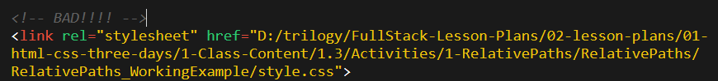

Absolutely No Absolute Paths
VERY VERY BAD
ALWAYS USE RELATIVE FILE PATHS.
If you deploy your sites without them, all of your links will fail.
The same will happen if you move your project from one folder to another.
Remember, there is no such thing as a “C:” drive on the internet.

Slide 63
> YOUR TURN!!
Activity: 1-RelativePaths| Suggested Time: 10 min
Assignment
1. Unzip the folder sent to you via Slack.
2. Edit the HTML files in all of the “RelativePaths” folders. You need to write relative paths that link the HTML documents with CSS stylesheets.
Tip: Check out the “RelativePaths_WorkingExample” folder.

