Slide 1
Going Live, Down and Dirty CSS

Slide 2
A Few Admin Items…

Slide 3

Homework is Due!
Don’t forget to submit both the GitHub and GitHub Pages links!

Slide 4

Feedback #1 – Pace is Fast!!!

Slide 5
Feedback #1 – Pace is Fast!!!
Here’s the reality, the pace of this program is FAST.
We could slow down and make it easier – but that wouldn’t prepare you to be developers right out of the program.
Take up the challenge. Try to retain as much as you can.
Then on your own time (after the program), go back and review the concepts you felt you needed a refresher on.
Don’t try to master every little detail.
Focus on the big picture and how to find what you need, when you need it.

Slide 6

Feedback #1 – Pace is Fast!!!
That said, as instructors and TAs, we are here to help.
Share your GitHub code as you run into issues. We can let you know if you’re going in the right (or wrong) direction.
Come to office hours! We can help go over old code, offer tips on homework, or just generally give you a pep talk.
Reach out to Student Success if you’d ever like to schedule a 1-on-1 meeting.

Slide 7

Feedback #2 – Books Please?

Slide 8
Feedback #2 – Books Please?
Advice: While in this program, concentrate all your efforts on what we’re covering in class.
Books can be helpful when you are learning on your own. But in a Bootcamp like this, they can also be distracting—especially when our class is moving so quickly.
When you’re at home, focus your efforts on completing your homework, re-completing in-class exercises, and going over slides.
Invest in books and outside tutorials after you finish the program.

Slide 9
Feedback #2 – Books Please?
That said,
if you truly feel the need for outside resources…

Slide 10

Feedback #2 – Books Please?
PluralSight offers some of the best online courses for HTML, CSS, JavaScript, Node, Express and Angular.

Slide 11
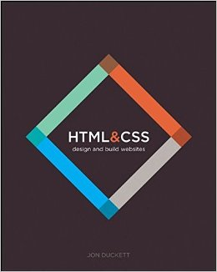
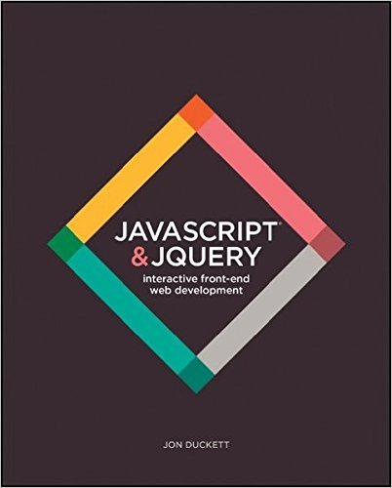
Feedback #2 – Books Please?
Jon Duckett’s books HTML & CSS and JavaScript & jQuery.
These are two of the clearest primers on their respective subjects. If you’re a “book-person,” these may be helpful texts.

Slide 12
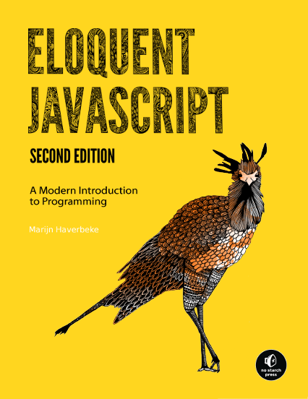
Feedback #2 – Books Please?
Eloquent JavaScript: a terrific, free book that goes through the fundamentals of JavaScript.
You can find it here: http://eloquentjavascript.net/

Slide 13

Feedback #3 – Homework is Hard

Slide 14
Feedback #3 – Homework is Hard
Check your homework due dates in Bootcamp Spot.
Generally speaking, expect homework to be semi-challenging.
Make sure you’re leaving a solid block of time to put in.
If you find yourself working on assignment for over 2 hours without even a small amount of progress, let us know!
You don’t win points in life staring at a blank screen.

Slide 15
Today’s Class

Slide 16
Objectives
In today’s class, we’ll be introducing:
Chrome Developer Tools
Deploying with GitHub
CSS Typography and Google Fonts
Pseudo-Classes
The Basics of Twitter Bootstrap

Slide 17
Double Take

Slide 18
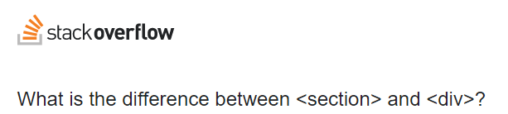
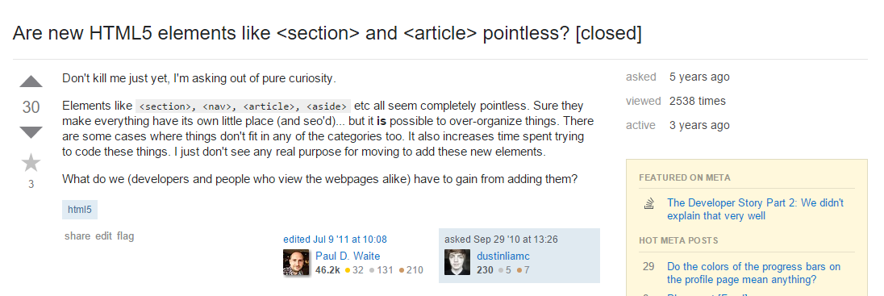
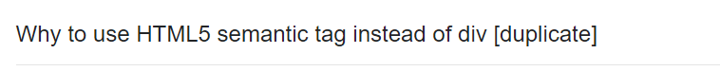

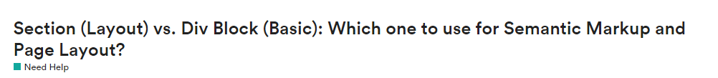
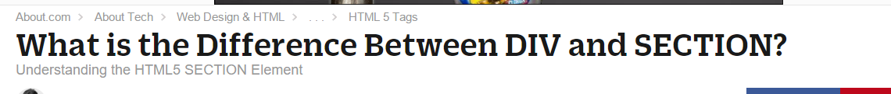
Divs, Sections, Navs, Etc….

Slide 19
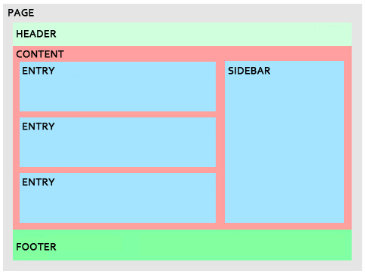
Divs, Sections, Navs, Etc….
All web layouts are inherently composed of containers, traditionally called “divs.”

Slide 20
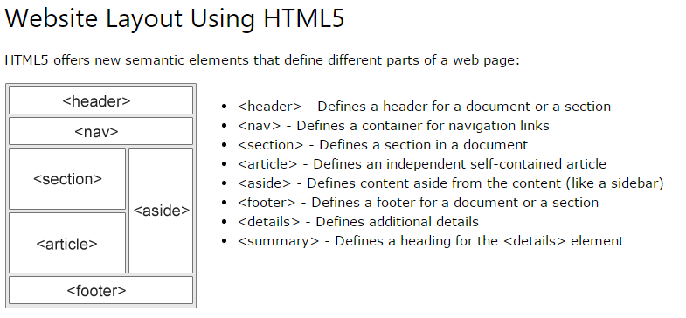
Divs, Sections, Navs, Etc….
HTML5 introduced the concept of “semantic layouts,” meaning “divs” could be given more meaningful names.
In theory, this helps with organization and search engine optimization.

Slide 21
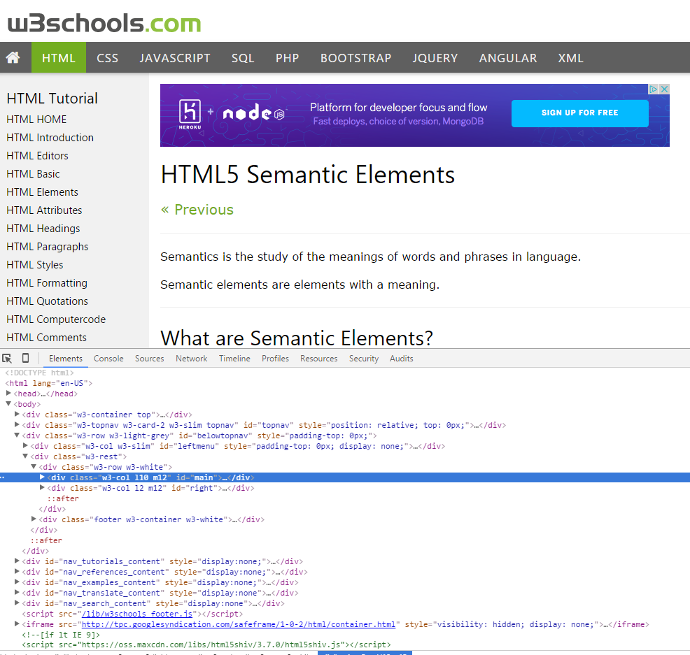
Divs, Sections, Navs, Etc….
That said… many (if not most) websites, seem to still be using basic divs.
There are reasons for this that we’ll showcase in later sections.
Additionally, it’s possible to include “semantics” by using id names and classes.

Slide 22
Divs, Sections, Navs, Etc….
div?
Section?
Bottom line: Follow your homework’s instructions. But when you get out in the “real world,” follow the convention of where you work!

Slide 23

Classes vs. IDs
Classes = Barcode (all iPod)
IDs = Serial Number (unique iPod)
When choosing between a CSS ID and a CSS Class follow the convention:
Classes (.classname) are to be used if the same style will be used on multiple HTML elements.
IDs (#idname) are to be used if a style is unique to that HTML element.

Slide 24
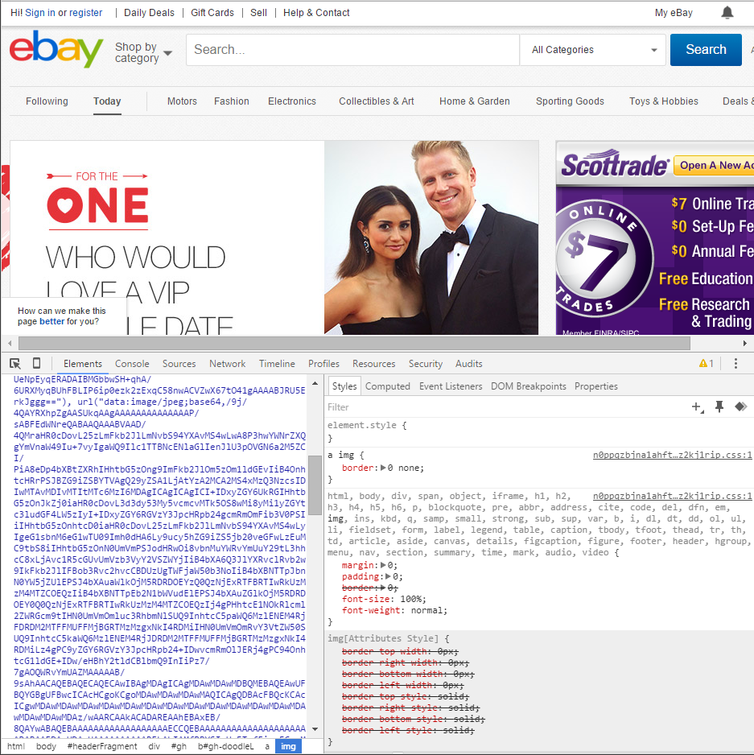
Chrome Developer Tools (Inspector)
This is one of the most frequent tools you will use in web development.
It allows you to truly debug your web designs.
Start using it!

Slide 25
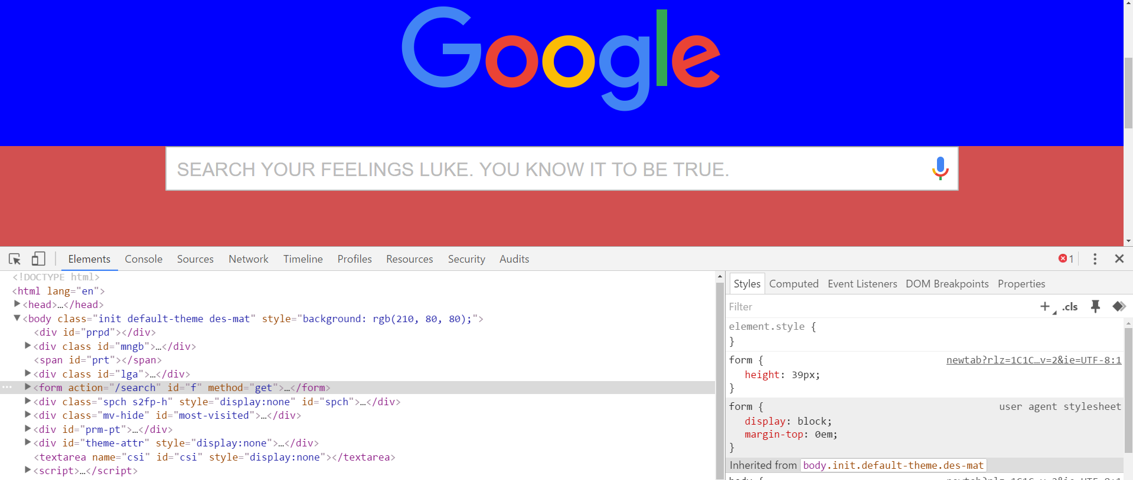
Modifying Sites
You can edit any page’s HTML and CSS with Chrome Developer Tools.
Plus, you’ll see your results instantly.

Slide 26
INSTRUCTOR DEMO!
Instructor: Demo
(Chrome Developer Tools)
Notes:
26

Slide 27
> YOUR TURN!!
Suggested Time: 15 min
Assignment
For the next 15 minutes, take a website you commonly use (Amazon, Google, Huff Po, etc.) and heavily modify it using the Chrome Developer Tools.
Be sure to at least modify:
Content (Change words)
Colors
Spacing
Send a screenshot to the class’s slack profile when you’re done.

Slide 28
> YOUR TURN!!
Suggested Time: 10 min
Assignment
For the next 10 minutes, edit any site that you’ve been working on in-class or for homework with Chrome Developer Tools.
Be sure to at least modify:
Content (Change words)
Colors
Spacing

Slide 29
CSS Resets

Slide 30
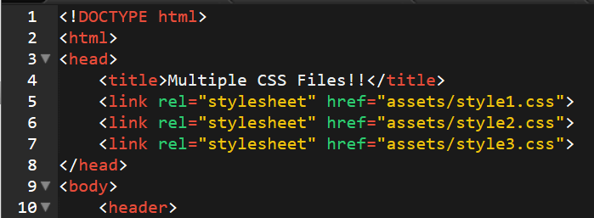
Loading Multiple CSS Files ***(Very Important!!!)***
An incredibly powerful technique: deploying multiple CSS files simultaneously.
This lets developers to create complex designs made up of abounding design elements.
Just remember: the loading order matters!!!

Slide 31
INSTRUCTOR DEMO!
Instructor: Demo
(1-3_CSSFiles.html | 3-MultipleCSS)
Notes:
31

Slide 32
What Browser?
By a show of hands…
Which browser do you use?

Slide 33
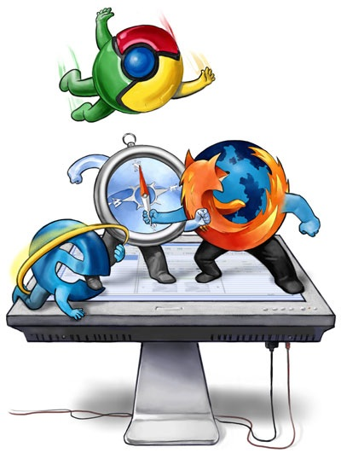
Battle of the Browsers
Under the hood, web browsers often render web pages differently than their competition.
These disparities could mean HTML/CSS displaying differently in each web client.
Because of these potential divergences, web developers need to make their websites cross-browser compatible.

Slide 34
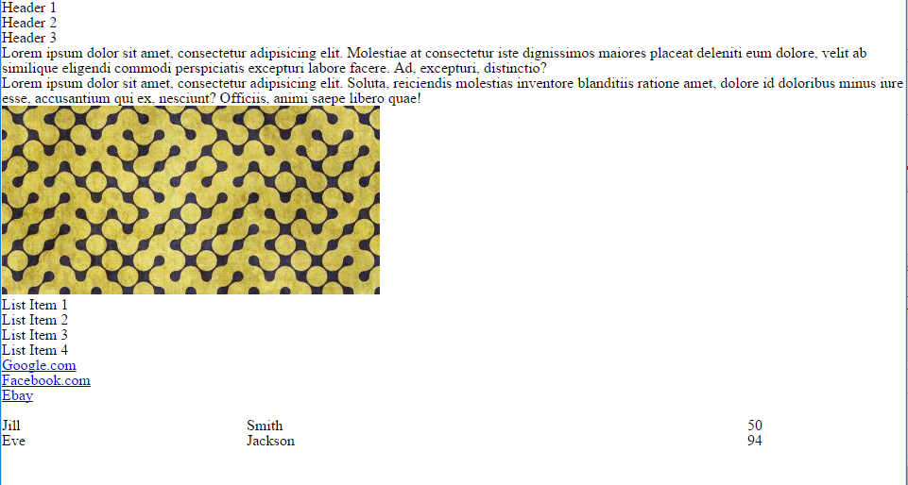
Reset.css (or Normalize.css)
Reset.css will “reset” all browser-specific CSS. This means your site will appear the same in all browsers.
However, you will have to re-style everything yourself.

Slide 35
INSTRUCTOR DEMO!
Instructor: Demo
(Example.html | 4-ResetCSS)
Notes:
35

Slide 36
Why CSS Resets Matter
It’s important for creating browser-compatible websites
It’s an example of using someone else’s CSS in your website!!!
It’s a common Front-End Developer Interview question.

Slide 37
> YOUR TURN!!
Suggested Time: 10 min
Assignment
Follow the instructions given via Slack to incorporate a reset.css file into a basic HTML file.
Note the impact the reset file makes after its inclusion.

Slide 38
To the Web with GitHub!

Slide 39
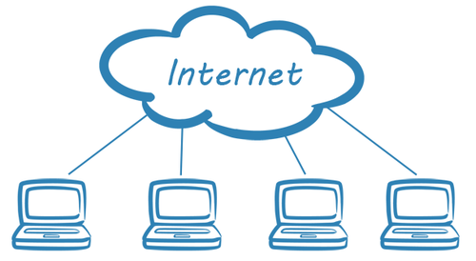
The Internet
A deep and complex diagram above on how the internet works.

Slide 40
The World Will See Our Greatness!
GitHub provides hosting for static websites – which means we can deploy our websites and applications onto their servers for the world to see.

Slide 41
Together Now…
Let’s all login to GitHub

Slide 42
INSTRUCTOR DEMO!
Instructor: Demo
(GitHub Pages Deployment - Personal)
Notes:
42

Slide 43
Deploying Static Personal Site – GitHub Pages
Basic Steps:
Create a new repo that is named `_username_.github.io`
Navigate into a folder and clone the repo into it
Build your files
Add, commit, and push your changes into the repository

Slide 44
> YOUR TURN!!
Suggested Time: 15 min
Assignment
Time to take your newfangled website and deploy it to the cloud (in this case, GitHub Pages).
Additional instructions to be sent via Slack.

Slide 45
INSTRUCTOR DEMO!
Instructor: Demo
(GitHub Pages Deployment - Project)
Notes:
45

Slide 46
Deploying a Static Project Site – GitHub Pages
Basic Steps:
1. Create a new repository on your GitHub account. You can name this repository whatever you would like.
2. Once inside of the repository, create a new file and name it `index.html`
3. Add some very basic HTML into this file, save it, and then navigate into your repository's Settings tab.
4. Scroll down to the GitHub Pages section and then, in the section labeled "Source", select that you would like to use the master branch as your source.
5. Navigate to `<username>.github.io/<repositoryname>` and you will find that your new web page has gone live!

Slide 47
> YOUR TURN!!
Suggested Time: 15 min
Assignment
Build a newfangled website, and deploy it to GitHub Pages as a project instead of a personal site.
Additional instructions to be sent via Slack.

Slide 48
Practice Through Frustration
Keep Practicing!
It gets better.

Slide 49
Questions?

