Slide 1
Week 2: Classes, __init__ and Inheritance
One interface for every sensor on the vehicle
AI for Aerospace & Mechanical Engineering (PhD)
New content. OOP concepts rewritten from W3Schools (Classes, __init__, Class Properties, Inheritance, Polymorphism) and GeeksforGeeks (class vs instance variables, super(), property(), Abstract Classes, dataclasses, Getting Started with Pytest); ISA model adapted from Anderson, Introduction to Flight, Ch. 3; flat-Earth frame adapted from Groves, Principles of GNSS, Ch. 2.

Slide 2
Three sensors, one robot
• IMU: 6 numbers at 50 Hz, biased, can saturate
• LiDAR: 16 ranges at 10 Hz, 0.0 or inf when no echo
• GPS: lat, lon, alt, HDOP at 5 Hz, some fixes are garbage
• Every later module (lanes, obstacles, control) consumes them
• Q: how do we add a 4th sensor without editing everything?
Visual: Top view of a small ground robot with three labelled sensors (IMU in the body, LiDAR on the roof with a ring of beams, GPS antenna), each with an arrow to a different raw-data format.
Week 02 | OOP: the sensor hierarchy | 1
Notes:
Open with the vehicle, not with Python. Ask the room how they would organise code for three different sensors. Write the final question on the board and keep it there.

Slide 3
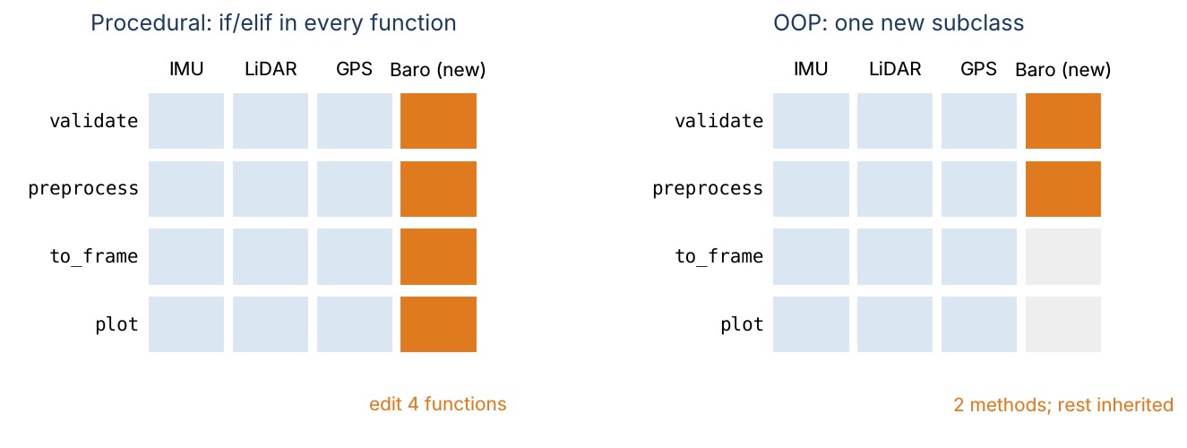
Why the procedural version breaks
• One function per job, an if/elif chain on the sensor type inside each
• Adding a barometer = edit validate, preprocess, to_frame, plot
• Configuration (biases) ends up in globals
• Typos fall through the chain silently
Week 02 | OOP: the sensor hierarchy | 2
Notes:
Left grid: the new column touches every function. Right grid: the new sensor only writes the two methods that are really different; the rest is inherited.

Slide 4
Example 1: the silent typo
• preprocess("imu", raw) removes the bias
• preprocess("IMU", raw) returns raw data: no error
• preprocess("imu", [0.35, -0.05]) accepts 2 values: zip stops early
• Biased data flows into the model unnoticed
Visual: Code block: def preprocess(sensor_type, data): if sensor_type == "imu": ... elif "lidar": ... return data with the three calls and their outputs below; the two wrong outputs highlighted in orange.
Week 02 | OOP: the sensor hierarchy | 3
Notes:
Run Section 0 of the lab live. The point: errors that do not raise are the expensive ones.

Slide 5
Class, object, __init__, self
• Class = blueprint; object = one thing built from it
• __init__ runs at creation and stores attributes on self
• Method = function in the class; Python passes the object as self
• Two objects, one class, different state (two QNH settings)
Visual: Code: class SimpleBarometer: def __init__(self, sensor_id, reference_pressure_pa=101325.0): ... def altitude_m(self, p): ... next to two object boxes "baro0 (101 325 Pa)" and "baro_qnh (100 500 Pa)".
Week 02 | OOP: the sensor hierarchy | 4
Notes:
Rewritten from W3Schools "Python Classes" and "__init__() Method". Stress that self is just the first parameter; the name is a convention.

Slide 6
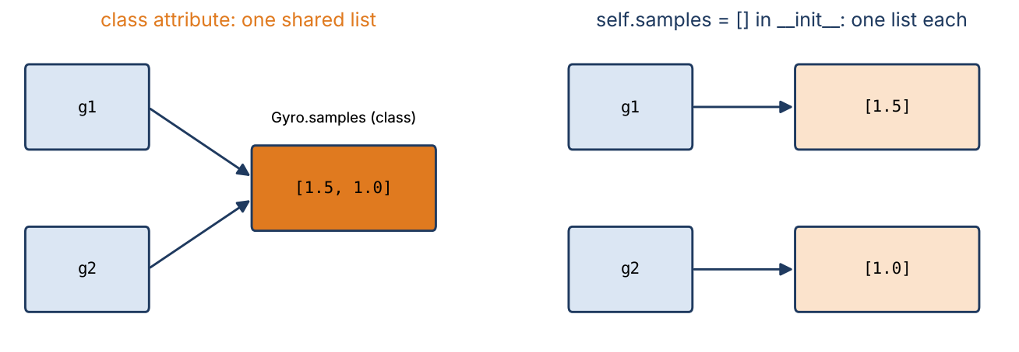
Class attributes vs instance attributes
• Class body: shared by all objects (good for constants)
• self.x in __init__: one per object (state)
• Mutating a shared list leaks data between sensors
• Assignment on an instance shadows; mutation does not
Week 02 | OOP: the sensor hierarchy | 5
Notes:
GeeksforGeeks "Class (static) and instance variables". In-class Problem 1 drills this. Rule: mutable state goes in __init__.

Slide 7
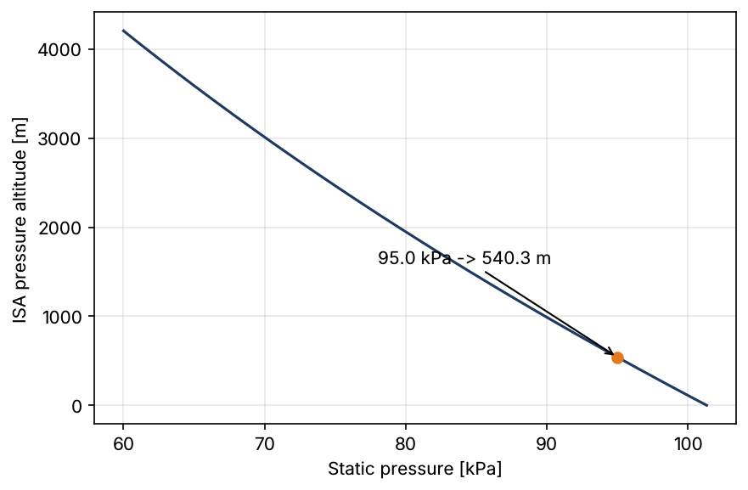
Example 2: ISA altitude by hand
• h = (T0/L) [1 − (p/p_ref)^(RL/g0)], T0/L = 44 330.8 m, RL/g0 = 0.190263
• p = 95 000 Pa: ratio 0.937577, ln = −0.064457
• power = e^(−0.012264) = 0.987811
• h = 44 330.8 × 0.012189 = 540.3 m
• QNH 100 500 Pa instead: 472.2 m (same class, other object)
Week 02 | OOP: the sensor hierarchy | 6
Notes:
Do the arithmetic on the board first, then run SimpleBarometer. Exercise 1.1 is the QNH case.

Slide 8
Properties: attributes that check themselves
• @property: looks like an attribute, runs a method
• Setter validates: rate_hz = 0 raises ValueError
• No setter = read-only (sensor_id)
• Derived values stay consistent: period_s = 1 / rate_hz
• _name: "internal, do not touch" convention
Visual: Code: @property def rate_hz(self) / @rate_hz.setter def rate_hz(self, value): if not value > 0: raise ValueError; arrow from imu.rate_hz = 0 to a red "ValueError".
Week 02 | OOP: the sensor hierarchy | 7
Notes:
GeeksforGeeks "Python property() function". Ask: why not store period_s in __init__? Because it would go stale when the rate changes.

Slide 9
Inheritance and super()
• class Barometer(Sensor): gets every method of Sensor
• Override: same method name, sensor-specific body
• super().__init__(...) lets the parent set up its part
• isinstance(baro, Sensor) is True
• MRO: the order Python searches for a method
Visual: Two stacked boxes Sensor (sensor_id, rate_hz, readings, add_reading, preprocess) and Barometer (reference_pressure_pa, preprocess override) joined by an inheritance arrow.
Week 02 | OOP: the sensor hierarchy | 8
Notes:
W3Schools "Python Inheritance" and GeeksforGeeks "super()". Live: print Barometer.__mro__.

Slide 10
Example 3: follow super() through three classes
• IMU → InertialSensor → Sensor → object
• Each __init__ prints, then calls super().__init__
• Printed: IMU init, Inertial init, Sensor init
• describe() returns "IMU/inertial imu0 @ 200 Hz"
• Forget one super().__init__: AttributeError much later
Visual: Vertical chain of four boxes (IMU, InertialSensor, Sensor, object); down arrows labelled "super().__init__", up arrows labelled "return value of describe()".
Week 02 | OOP: the sensor hierarchy | 9
Notes:
In-class Problem 2. Students predict before running. The late AttributeError is the key lesson.

Slide 11
Abstract base classes: the interface as a contract
• class BaseSensor(ABC) with @abstractmethod validate, preprocess
• BaseSensor(...) raises TypeError: cannot instantiate
• Subclass missing a method (or with a typo) also raises TypeError
• Error at construction, not mid-flight
Visual: Code: class ForgetfulBarometer(AbstractSensor): def pre_process(...) and the resulting TypeError: Can't instantiate abstract class ... with abstract method preprocess.
Week 02 | OOP: the sensor hierarchy | 10
Notes:
GeeksforGeeks "Abstract Classes in Python". Week 3 goes deeper (abstract properties, typing).

Slide 12
Dataclasses: SensorReading
• @dataclass writes __init__, __repr__, __eq__ from the fields
• frozen=True: a logged measurement cannot change (and is hashable)
• slots=True: no per-object __dict__, less memory
• values is a tuple: arrays break == and hash
Visual: Side by side: 15-line ManualReading class vs 6-line @dataclass(frozen=True, slots=True) class SensorReading: timestamp: float; values: tuple[float, ...]; sensor_id: str; is_valid: bool = True.
Week 02 | OOP: the sensor hierarchy | 11
Notes:
GeeksforGeeks "Understanding Python Dataclasses". Show FrozenInstanceError live.

Slide 13
Example 4: IMU bias and saturation by hand
• ±4 g IMU: full scale 39.23 m/s²; bias a = (0.10, −0.05, 0.20), g = (0.8, −0.3, 0.1)
• (0.35, −0.05, 10.05 | 0.8, −0.3, 2.1) → (0.25, 0, 9.85 | 0, 0, 2.0), n = 1.005
• NaN in a_y → invalid, stored raw
• a_z = 39.50 ≥ 39.23 → saturated, invalid: true value unknown
• (1.30, −0.45, 19.80 | ...) → (1.2, −0.4, 19.6), n = 2.003
Visual: Four-row table: raw sample, valid?, preprocessed values, load factor; invalid rows shaded orange.
Week 02 | OOP: the sensor hierarchy | 12
Notes:
Same numbers as Lab Section 7 and tests. The last sample is Week 1's worked example; continuity matters for weak programmers.

Slide 14
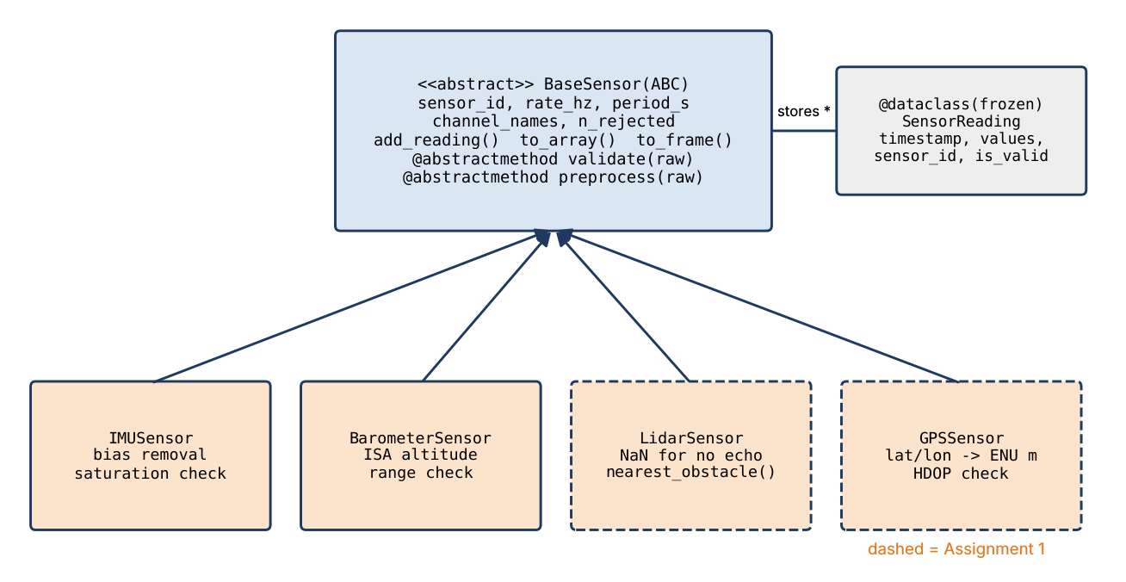
The course sensor hierarchy
• BaseSensor owns buffering, time checks, arrays, DataFrames
• Subclasses own only validate() and preprocess()
• IMUSensor, BarometerSensor: in src/aerospace_ai/sensors.py
• LidarSensor, GPSSensor: Assignment 1
Week 02 | OOP: the sensor hierarchy | 13
Notes:
Instructor: read sensors.py before class; it also uses __slots__, __init_subclass__ and a deque buffer, which we discuss in Weeks 3 and 4.

Slide 15
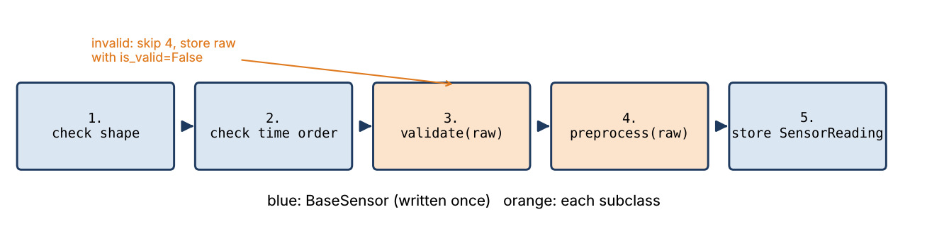
Template method: add_reading
• Algorithm fixed once in the base class
• Steps 3 and 4 delegated to the subclass
• Invalid samples kept raw with is_valid=False
• to_array() returns valid samples only
Week 02 | OOP: the sensor hierarchy | 14
Notes:
Name the pattern now; Week 4 covers Strategy, Observer and Factory.

Slide 16
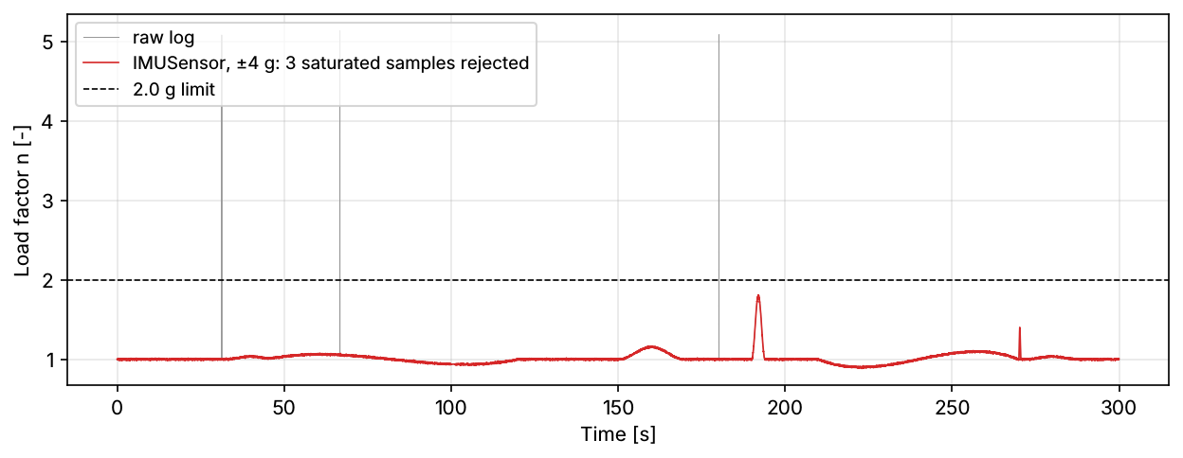
Example 5: the Week 1 log through IMUSensor
• Calibrate biases from t < 25 s (parked, level)
• Feed 14 940 samples; ±4 g full scale
• 3 spikes (≈ 50 m/s²) rejected as saturated
• Peak load factor 1.81 g: below the 2.0 g limit
• Week 1 needed a rolling median; here the object knows its limits
Week 02 | OOP: the sensor hierarchy | 15
Notes:
Lab Section 9. Caveat: rejection works here because the spikes exceed full scale; spikes inside the range still need filtering.

Slide 17
Polymorphism: one loop, many sensors
• for sensor in suite: sensor.add_reading(t, raw)
• No if/elif on types anywhere
• A new ThermometerSensor joins with zero changes to the loop
• Same call, type-specific behaviour
Visual: Code loop over [IMUSensor, BarometerSensor, ThermometerSensor] printing id, class, channels, readings, rejected.
Week 02 | OOP: the sensor hierarchy | 16
Notes:
W3Schools "Python Polymorphism". Exercise 8.1 builds the thermometer (kelvin in, Celsius out).

Slide 18
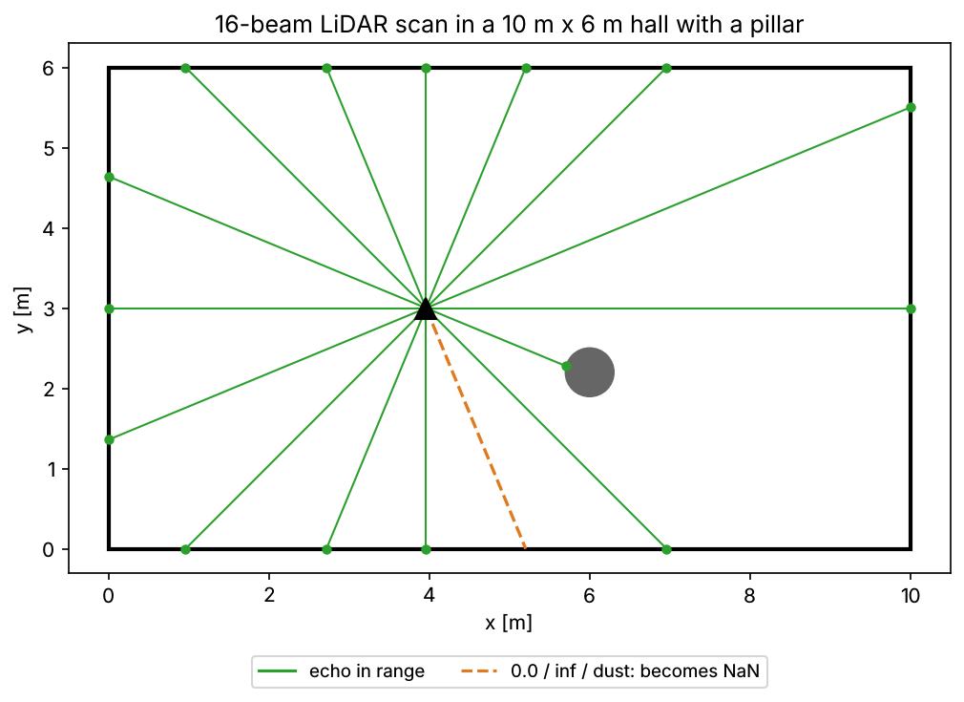
LiDAR: beams, angles and missing echoes
• Beam i at −180° + i × 22.5° (16 beams, 360°)
• No echo: 0.0 or inf; dust: 0.05 m < min range
• Unusable beams become NaN, not zero
• Scan valid if ≥ 50 % of beams usable (fog rejects 4 of 50)
• nearest_obstacle(): np.nanargmin on the latest valid scan
Week 02 | OOP: the sensor hierarchy | 17
Notes:
Why NaN and not 0: a zero range would be read as an obstacle touching the robot. Assignment 1, Tasks 4 to 6.

Slide 19
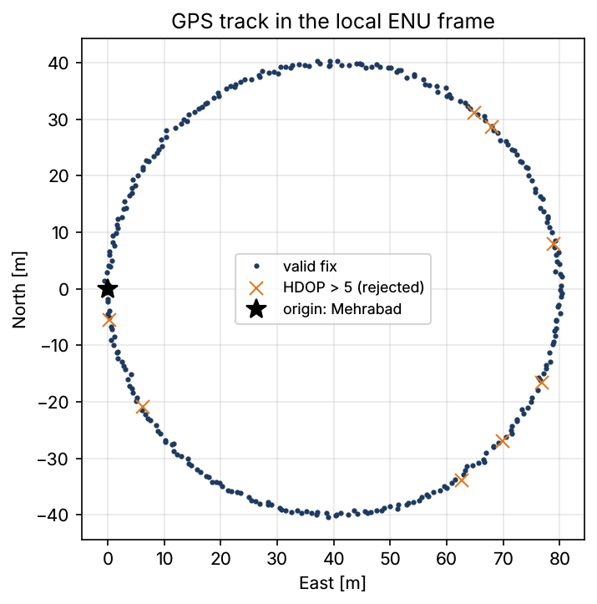
Example 6: GPS to local metres by hand
• 1° latitude = Rπ/180 = 111 195 m (R = 6 371 km)
• 1° longitude = 111 195 × cos φ0; at Mehrabad (35.69°): 90 314 m
• 0.001° N and E of origin → (east, north) = (90.3, 111.2) m
• Reject: HDOP > 5, NaN, |lat| > 90°
Week 02 | OOP: the sensor hierarchy | 18
Notes:
Flat-Earth approximation adapted from Groves, Ch. 2; error below 1 cm over 80 m. Forgetting cos φ0 is one of the grader's mutants.

Slide 20
Testing classes with pytest
• test_*.py files, test_* functions, plain assert
• pytest.raises: the error must happen
• @pytest.mark.parametrize: one test, many inputs
• @pytest.fixture: a fresh object per test
• Good tests check numbers, not just types
Visual: Code: fixture imu(), test_imu_removes_bias, parametrized test_rate_must_be_positive; terminal line "41 passed".
Week 02 | OOP: the sensor hierarchy | 19
Notes:
GeeksforGeeks "Getting Started with Pytest". Assignment 1 grades students' tests by running them against three subtly broken implementations.

Slide 21
This week's work
• Lab: notebooks/week02/week02_oop_sensors.ipynb (5 TODO exercises)
• In class: 4 warm-ups (shared list, super chain, IMU by hand, climb rate)
• Assignment 1: LiDAR + GPS sensors + your pytest suite, about 4 h, due Week 3
• python -m pytest assignments/assignment01 before you push
Visual: Three icons: notebook, pencil, Git branch.
Week 02 | OOP: the sensor hierarchy | 20
Notes:
Assignment 1 hidden tests check numbers from the provided CSVs; the expected-output table in the notebook lets students self-check.

Slide 22
What We Now Know How To Do
• Bundle data and behaviour in classes; use __init__ and self correctly
• Guard state with properties; keep mutable state per object
• Reuse with inheritance and super(); enforce interfaces with ABCs
• Write records with frozen dataclasses; process sensors polymorphically
• Test a class hierarchy with pytest
Visual: The opener's robot with its three sensors now all pointing into one box "BaseSensor interface", green check marks on each.
Week 02 | OOP: the sensor hierarchy | 21
Notes:
Return to the opener question: a fourth sensor is one new subclass with two methods.

