Slide 1
Week 1: Python and Environment Review
From a raw flight log to engineering answers
AI for Aerospace & Mechanical Engineering (PhD)
New content. Python tooling rewritten from W3Schools (Python, NumPy, Pandas, Matplotlib, Git tutorials) and GeeksforGeeks (virtual environments, Anaconda, Jupyter, describe()); load factor adapted from Anderson, Introduction to Flight, Ch. 6.

Slide 2
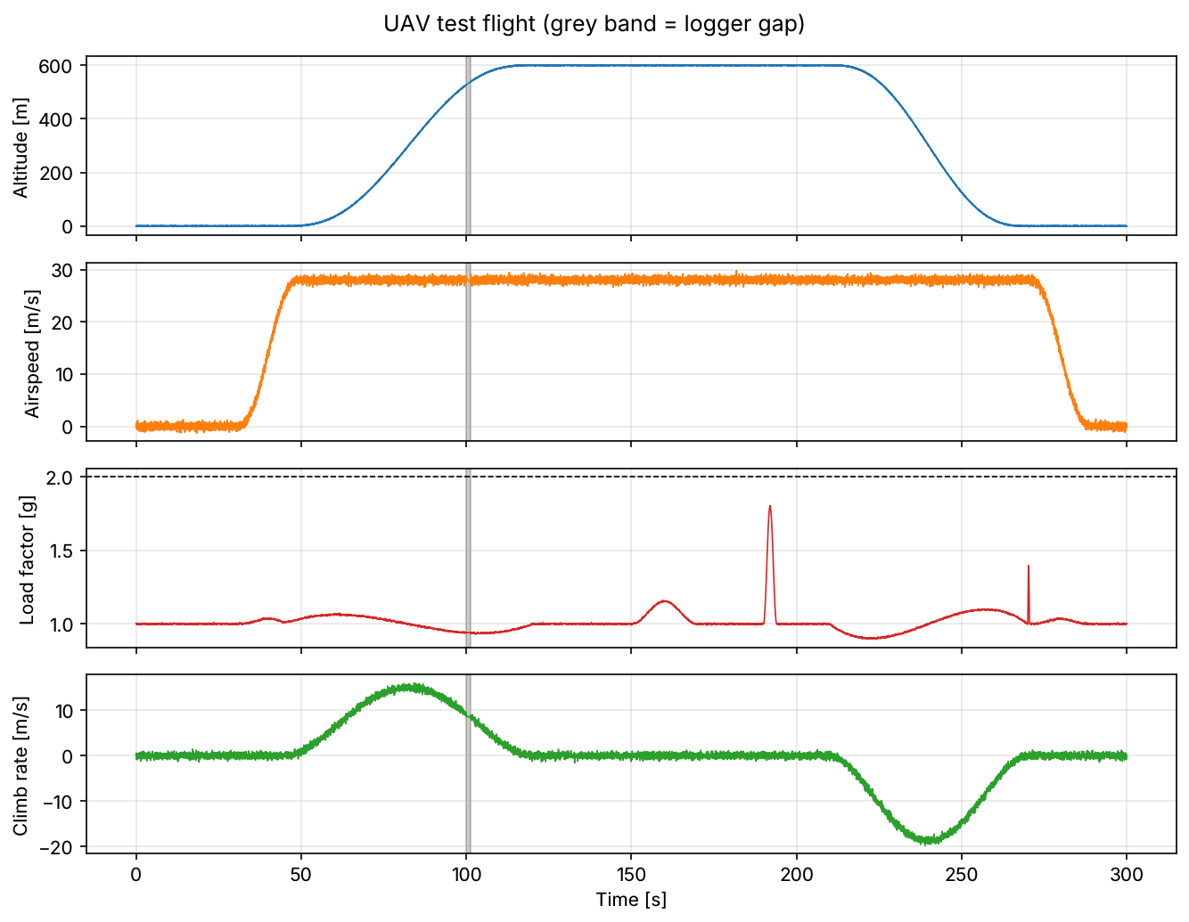
A flight log lands on your desk
• 5-minute UAV test flight, IMU at 50 Hz + baro, pitot, temperature
• Q1: What was the sample rate? Did the logger lose data?
• Q2: Peak load factor? Was the 2.0 g limit exceeded?
• Q3: How noisy are the gyros while parked?
• Q4: What was the peak climb rate?
Week 01 | Python & environment review | 1
Notes:
Open with the file, not with Python. Ask the room how they would answer Q2 with Excel. Keep the four questions on the board all session; every tool we introduce answers one of them.

Slide 3
Today: problem → tools → answers
• Reproducible environment: conda / venv, Jupyter, Git
• NumPy: vectorised maths on arrays
• Pandas: labelled tables, read_csv, describe
• Matplotlib: figures that answer questions
• Preview: the same logic as a reusable class
Visual: Left-to-right chain of five boxes: "CSV file" → "Environment" → "NumPy" → "Pandas" → "Matplotlib" → "Answers Q1–Q4".
Week 01 | Python & environment review | 2
Notes:
Students with weak programming backgrounds need to see that each tool exists for a reason.

Slide 4
Example 0: what the raw file looks like
• time_s, accel_x/y/z [m/s²], gyro_x/y/z [deg/s]
• baro_alt_m, airspeed_mps, temp_c
• 14 940 rows × 10 columns, ~1 MB
• Units live in the column names: a convention, not luck
Visual: Code block of the first three CSV lines: time_s,accel_x_mps2,...,temp_c / 0.0,-0.052,0.0375,9.8537,... / 0.02,0.0389,0.0033,9.863,...
Week 01 | Python & environment review | 3
Notes:
Point out accel_z ≈ 9.81 on the ground: the accelerometer measures specific force, so it reads +1 g when parked.

Slide 5
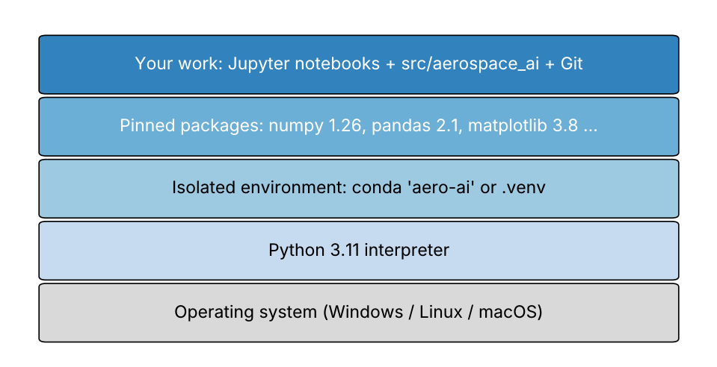
Why an isolated environment?
• "Works on my machine" is not a result
• One environment per project, pinned versions
• conda: Python + compiled libraries (PyTorch later)
• venv + pip: built-in, lightweight
• environment.yml / requirements.txt = the recipe
Week 01 | Python & environment review | 4
Notes:
Source: GeeksforGeeks "Python Virtual Environment" and "Set up virtual environment for Python using Anaconda" (rewritten).

Slide 6
The commands you need this week
• conda create -n aero-ai python=3.11 → conda activate aero-ai
• python -m venv .venv → activate → pip install -r requirements.txt
• jupyter lab (run cells: Shift+Enter; restart & run all)
• git clone / switch -c / add / commit / push
• git status before every commit
Visual: Two-column cheat sheet: left "conda / venv / jupyter", right "git". Highlight git status.
Week 01 | Python & environment review | 5
Notes:
Demo live; have students type along. Git basics follow W3Schools "Git Introduction" (repository, staging, commit, branch, push/pull).

Slide 7
Example: first environment and first commit
• conda env create -f environment.yml
• jupyter lab → open notebooks/week01/week01_python_env.ipynb
• Run the version-check cell: all "ok"?
• git switch -c week01-yourname
• git add, commit -m "Week 1: environment ok", push
Visual: Screenshot placeholder of the version-check cell output with four "ok" lines.
Week 01 | Python & environment review | 6
Notes:
10-minute hands-on. Anyone who fails here gets help now, not in Week 9.

Slide 8
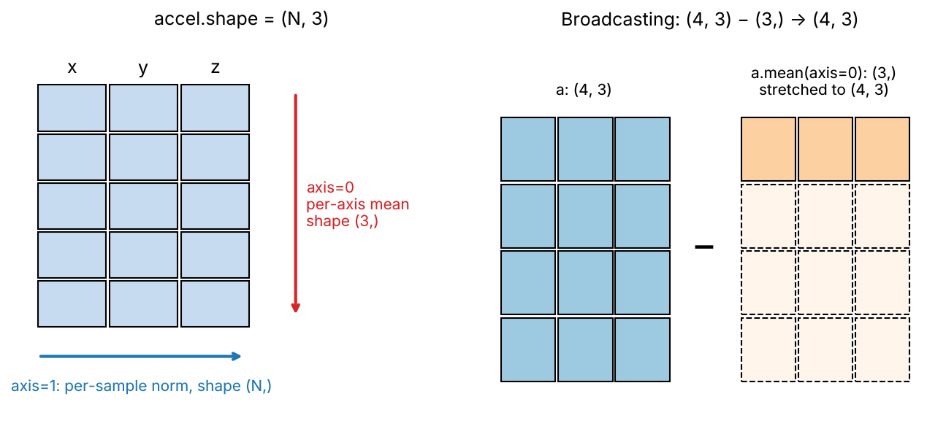
NumPy: arrays, shape, axis
• ndarray: one block of numbers, one dtype
• accel.shape = (N, 3): rows = samples, columns = x, y, z
• axis=0 collapses samples; axis=1 collapses components
• Vectorised: np.sqrt(np.sum(a**2, axis=1)) → ~10× faster than a loop
Week 01 | Python & environment review | 7
Notes:
Rewritten from W3Schools "Introduction to NumPy". The timing cell in the notebook shows the speed-up on 200 000 vectors.

Slide 9
Broadcasting and boolean masks
• (4, 3) − (3,) → (4, 3): trailing dimensions align
• Remove per-axis IMU bias: a − a.mean(axis=0)
• Mask: on_ground = t < 25 → df.loc[on_ground]
• Masks replace if-statements inside loops
Week 01 | Python & environment review | 8
Notes:
In-class Problem 4 drills this.

Slide 10
Example 1: noise statistics by hand (ddof)
• x = [0.2, −0.4, 0.1, 0.5, −0.4] deg/s → mean = 0
• Σ(x − x̄)² = 0.62
• Population σ = √(0.62/5) = 0.352 (np.std default)
• Sample s = √(0.62/4) = 0.394 (pandas .std default)
• Always write ddof explicitly
Visual: Two-row table: "divide by N → 0.352 (NumPy)", "divide by N−1 → 0.394 (Pandas)", with the 12 % difference highlighted.
Week 01 | Python & environment review | 9
Notes:
Do it on the board first, then run the cell. This is a classic silent bug.

Slide 11
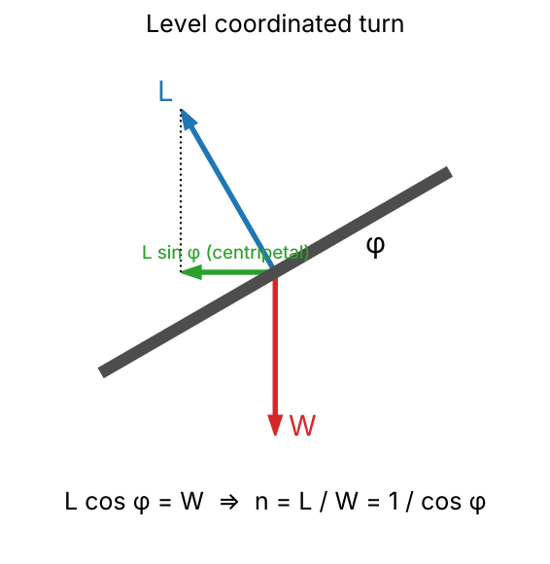
Load factor from an accelerometer
• Accelerometer measures specific force f (not gravity)
• n = ‖f‖ / g₀, with g₀ = 9.80665 m/s²
• Level coordinated turn: n = 1 / cos φ
• 30° bank → 1.155 g; 60° bank → 2.0 g
Week 01 | Python & environment review | 10
Notes:
Adapted from Anderson, Introduction to Flight, Ch. 6 (turning flight).

Slide 12
Pandas: first look at any dataset
• df = pd.read_csv(path)
• df.head(): does it look right?
• df.info(): dtypes and non-null counts
• df.describe().T: count, mean, std, min, quartiles, max
• Read count and max like an engineer
Visual: describe() table with two cells circled: count = 14 865 for baro_alt_m (missing data) and max = 50.3 m/s² for accel_z (≈ 5 g?).
Week 01 | Python & environment review | 11
Notes:
Rewritten from W3Schools "Pandas Read CSV" / "Analyzing DataFrames" and GeeksforGeeks "DataFrame describe()".

Slide 13
Example 2: load factor by hand
• f = (1.2, −0.4, 19.6) m/s²
• ‖f‖² = 1.44 + 0.16 + 384.16 = 385.76
• ‖f‖ = 19.641 m/s² → n = 19.641 / 9.80665 = 2.003
• One sample above 2.0 g. Real exceedance or not?
Visual: 3-D vector arrow with its three components and the norm labelled.
Week 01 | Python & environment review | 12
Notes:
Then the vectorised version: np.linalg.norm(samples, axis=1) / G0.

Slide 14
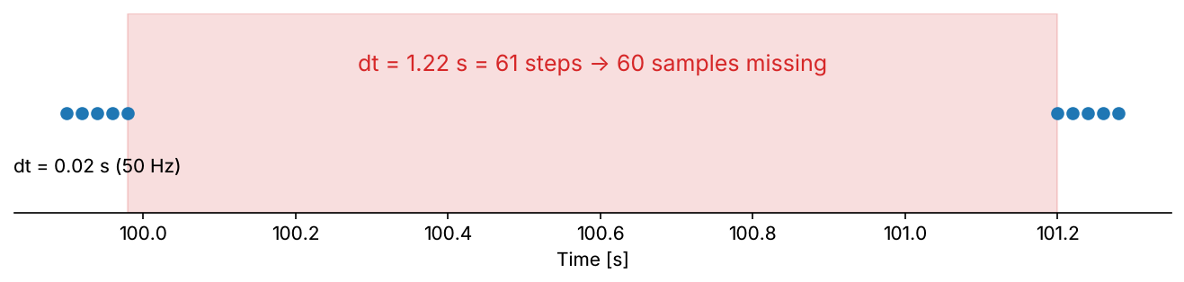
Q1: sample rate and gaps
• dt = t.diff(); fs = 1 / median(dt) = 50 Hz
• Median, not mean: one gap ruins the mean
• Nyquist = fs / 2 = 25 Hz
• Gap: dt > 1.5 × nominal → 1.22 s step = 60 missing samples
• 0.5 % NaN in baro and airspeed
Week 01 | Python & environment review | 13
Notes:
Answer to Q1 goes on the board.

Slide 15
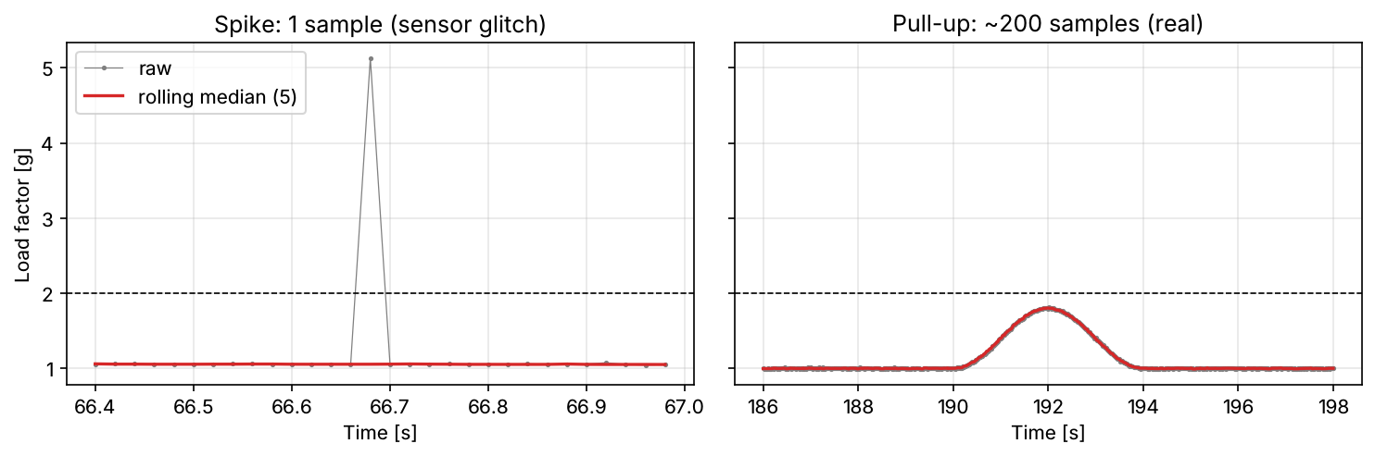
Q2: spike or manoeuvre?
• Raw peak: 5.13 g at t = 66.68 s
• Neighbours: 1.06, 1.06, 5.13, 1.06, 1.06 → one sample
• Real manoeuvres last seconds (hundreds of samples)
• Rolling median (5 samples) removes spikes, keeps manoeuvres
• Filtered peak 1.80 g at 192 s → limit not exceeded
Week 01 | Python & environment review | 14
Notes:
This is the first data-cleaning decision of the course; Week 5 generalises it.

Slide 16
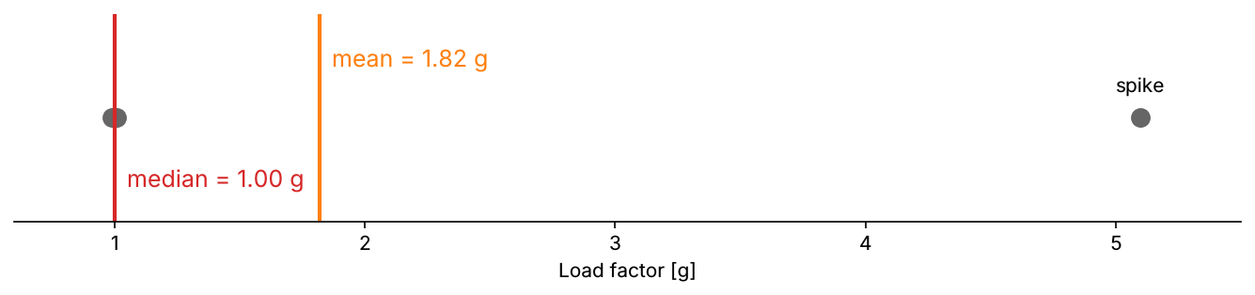
Example 3: mean vs median, and a gap by hand
• Window [1.00, 1.01, 5.10, 0.99, 1.00]
• Mean = 9.10 / 5 = 1.82 g (spike leaks in)
• Median = sort → [0.99, 1.00, 1.00, 1.01, 5.10] → 1.00 g
• Timestamps 99.94, 99.96, 99.98, 101.20 → 1.22 / 0.02 − 1 = 60 lost
Week 01 | Python & environment review | 15
Notes:
Students compute both on paper before you reveal them.

Slide 17
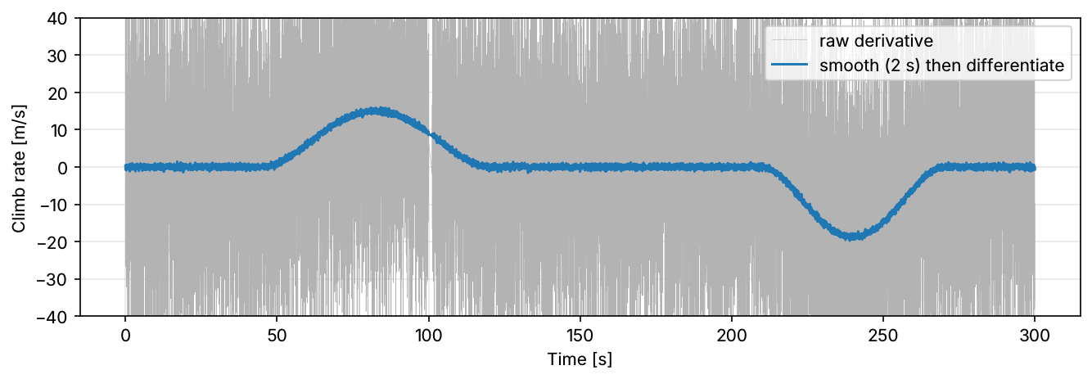
Q3 and Q4: noise and derivatives
• Parked (t < 25 s): gyro s ≈ 0.30 deg/s, bias ≈ 0
• Histogram ≈ Gaussian → white noise
• Differentiating noise amplifies it: ±28 m/s raw
• Smooth (2 s) first, then differentiate
• Peak climb ≈ 16 m/s at 84 s (design 15 m/s)
Week 01 | Python & environment review | 16
Notes:
Show fig_gyro_noise.png as a backup if time allows.

Slide 18
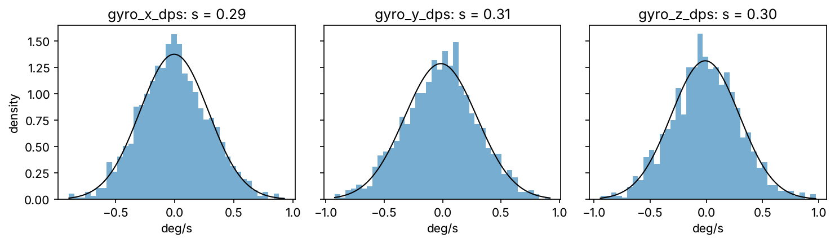
Matplotlib: figures that answer questions
• fig, axes = plt.subplots(4, 1, sharex=True)
• One question per panel; units on every axis
• Reference lines: ax.axhline(2.0, ls="--")
• Shade gaps: ax.axvspan(start, end)
• Return the Figure from functions; show it outside
Week 01 | Python & environment review | 17
Notes:
Rewritten from W3Schools "Matplotlib Pyplot".

Slide 19
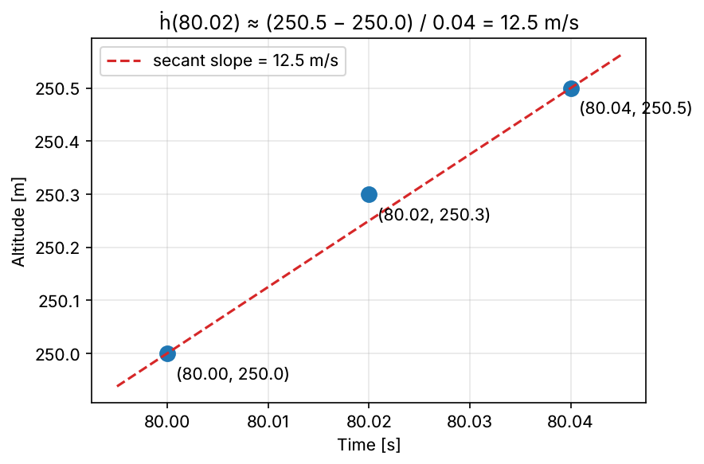
Example 4: a derivative by hand
• h = [250.0, 250.3, 250.5] m at t = [80.00, 80.02, 80.04] s
• Central difference: (250.5 − 250.0) / 0.04 = 12.5 m/s
• Baro noise σ = 0.8 m → difference noise √2 · 0.8 = 1.13 m
• 1.13 m / 0.04 s ≈ ±28 m/s noise on a 15 m/s signal
Week 01 | Python & environment review | 18
Notes:
Motivates smoothing; the same reasoning returns in Week 12 (trajectory velocity).

Slide 20
From notebook to class: FlightLog (preview)
• FlightLog.from_csv(path): @classmethod constructor
• log.sample_rate_hz: @property, computed on access
• __slots__, __repr__, type hints, docstrings
• Same answers as the notebook in five lines
• Week 2: Sensor hierarchy (IMU / LiDAR / GPS)
Visual: UML box "FlightLog" with attributes (source) and methods (time_gaps, load_factor, robust_load_factor, climb_rate, segment, plot_overview).
Week 01 | Python & environment review | 19
Notes:
Code: src/aerospace_ai/utils.py. Instructor: read it before Week 2; it previews several OOP features.

Slide 21
This week's work
• Lab: notebooks/week01/week01_python_env.ipynb (7 TODO exercises)
• In class: 4 warm-ups (ddof, bank angle, gaps, NumPy shapes)
• Assignment 0: flight-log quality check, 3–4 h, due Week 2
• Push your branch; Restart & Run All before submitting
Visual: Three icons: notebook, pencil, Git branch.
Week 01 | Python & environment review | 20
Notes:
Assignment 0 has hidden tests; the public tests show the expected format.

Slide 22
What We Now Know How To Do
• Build and activate a pinned environment; version-control a notebook
• Load a sensor CSV and read describe() like an engineer
• Find the true sample rate, gaps and missing values
• Separate sensor spikes from real manoeuvres
• Estimate noise and derivatives from noisy data, and plot the answers
Visual: The four questions Q1–Q4 from slide 1, each with a green check mark and its answer.
Week 01 | Python & environment review | 21
Notes:
Close by returning to the opener: every question now has a number.

